Slide 1
COP 4331 Recitation #2

Slide 2
COP 4331 Recitation #2
Kia Manoochehri
kiam@knights.ucf.edu
Office Hours: 1:30-3:30 Tuesday / Thursday
HEC 308 (The Cave)

Slide 3
Unified Modeling Language
Class & Sequence Diagrams

Slide 4
Class Diagram
Each class is divided into three components:

Slide 5
Class Diagram
Each class is divided into three components:
Class Name

Slide 6
Class Diagram
Each class is divided into three components:
Class Name
Attributes

Slide 7
Class Diagram
Each class is divided into three components:
Class Name
Attributes
Attributes can be:
+ Public
- Private
# Protected

Slide 8
Class Diagram
Each class is divided into three components:
Class Name
Attributes
Operations

Slide 9
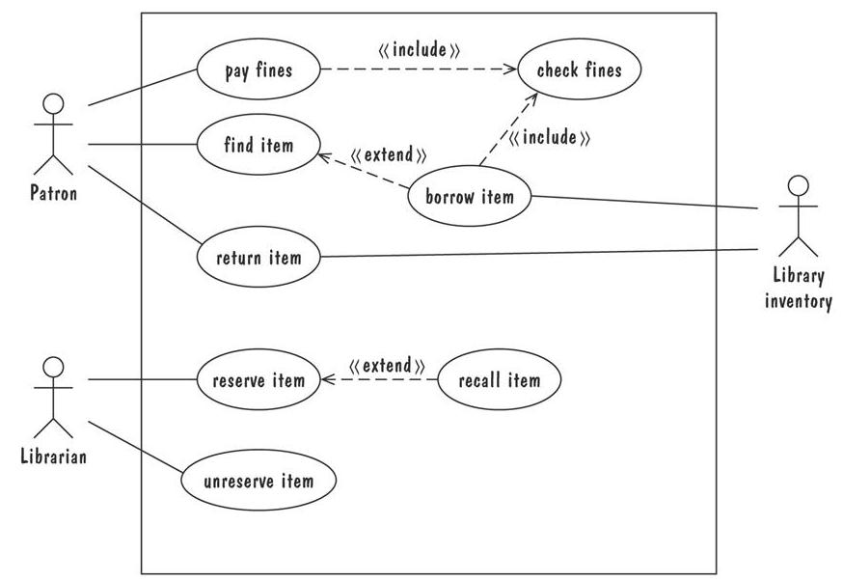
Class Diagram example:

Slide 10
Class Diagram example:
Patron

Slide 11
Class Diagram example:
Patron
# ID_Number : integer
+Name : String
- Fines : double

Slide 12
Class Diagram example:
Patron
# ID_Number : integer
+Name : String
- Fines : double
checkFines()
payFines()

Slide 13
Class Diagram
Class diagrams also contain information regarding the relationship between them
Association
Dependency
Generalization

Slide 14
Class Diagram
Association: A link indicating that two classes need to communicate with one another
Student
Professor

Slide 15
Class Diagram
Association: A link indicating that two classes need to communicate with one another
Multiplicity: Every professor has 1 or more students
Student
Professor
[1…*]

Slide 16
Class Diagram
Association: A link indicating that two classes need to communicate with one another
Multiplicity: Every professor has 1 or more students
Role Names: Students learn from Professors
Student
teaches
learns from
Professor

Slide 17
Class Diagram
Aggregation: “has a” association. Each part exists outside of the whole
Shown by using an empty diamond
Wheel
Car
Engine

Slide 18
Class Diagram
Composition: demonstrates strong ownership, the part cannot exist without the whole and vice versa
Shown by using a filled diamond
Arm
Person
Leg

Slide 19
Class Diagram
Dependency relationship:
Is a semantic relationship between classes because the functionality of one depends on the other
Calendar
addEvent(p: Party)
Party

Slide 20
Class Diagram
Generalization: connection between a subclass and a superclass
People
Student
Professor

Slide 21
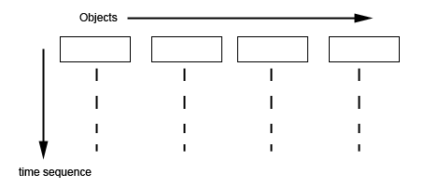
Sequence Diagram
Sequence diagrams emphasis the time ordering of messages

Slide 22
Sequence Diagram
Sequence diagrams emphasis the time ordering of messages
Objects create the “object life line”

Slide 23
Sequence Diagram
Messages are shown by a horizontal line between life lines
May include a condition
Customer
Bank
withdraw money

Slide 24
Sequence Diagram
A return message is a response from the object
Customer
Bank
withdraw money
money

Slide 25
Sequence Diagram
The end of an object life line is demonstrated by an X
Bank

