Slide 1
Modular Performance Reasoning of Data-Intensive Programs
Yu David Liu
State University of New York (SUNY)
at Binghamton
FOAL 2015

Slide 2
Modular Performance Reasoning of Data-Intensive Programs
Yu David Liu
State University of New York (SUNY)
at Binghamton
FOAL 2015

Slide 3
Modular Performance Reasoning of Data-Intensive Programs
Yu David Liu
State University of New York (SUNY)
at Binghamton
FOAL 2015

Slide 4
Modular Performance Reasoning of Data-Intensive Programs
Yu David Liu
State University of New York (SUNY)
at Binghamton
FOAL 2015

Slide 5
Modular Performance Reasoning of Data-Intensive Programs
Yu David Liu
State University of New York (SUNY)
at Binghamton
FOAL 2015

Slide 6
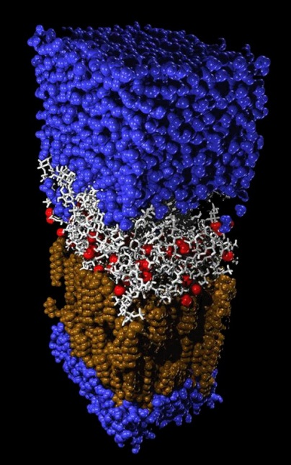
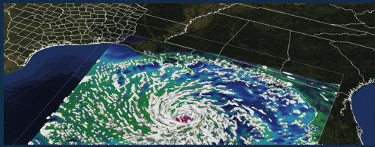
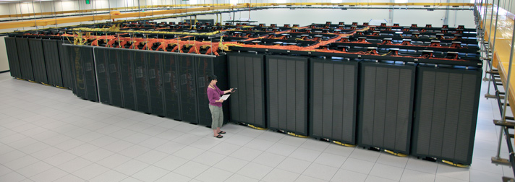
Data Intensive Applications
On the rise
High-performance requirement

Slide 7
Motivating Question I
Can programming language techniques help understand and optimize performance of data-intensive software?

Slide 8
Performance Question 1
Is this data rate achievable and sustainable?
?

Slide 9
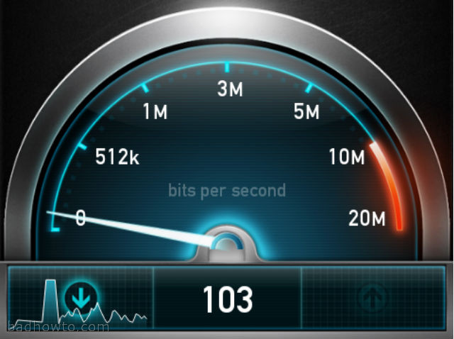
Performance Question 2
Given an Input data rate, what will the output rate be?
?

Slide 10
Performance Question 3
Given a desired output rate, what input rate is required?
?

Slide 11
Performance Question 4
Given unlimited Input data, how fast can the output rate be?
?

Slide 12
Motivating Question II
Can program structures help reason about performance of data-intensive software modularly?

Slide 13
This Talk: Rate Types
A type system to reason about data rates
in data intensive applications
Bartenstein, Liu, “Rate Types for Stream Programs” (OOPSLA’14)

Slide 14
Motivating Question Revisited
Can program structures help reason about performance of data-intensive software modularly?
What programming models?
(an open question in the long term)

Slide 15
Stream Programming
A well-known paradigm
  classic data-flow model (e.g. Lucid) +
  high-throughput data processing
Many recent examples from both PL and database communities
  StreamIt, Streamflex, Aurora, Borealis, Pig Latin, Bamboo, FlumeJava….
  The latest Java has stream support

Slide 16
Stream Programming: Filters and Streams
Streams:
Sequence of Data
x=Pop()
x=x+3
Push(x)
…, 28, 21, 14, 7
…, 31, 24, 17, 10
Filters:
Consume data from an input stream
Process Data
Produce data on an output stream

Slide 17
Stream Programming: Combinators
chain
fork-join
feedback

Slide 18
Stream Programming Benefits
Friendliness to Big Data applications
High parallel efficiency
  Task Parallelism
  Data Parallelism
  Pipelining
Programming abstractions friendly for performance reasoning (as we shall see)

Slide 19
Rate Types
A type system to reason about data rates of stream programs

Slide 20
Stream Rate Insight
Output Data rate depends on input data rate…

Slide 21
Stream Rate Insight
… until …

Slide 22
Stream Rate Insight
… processing time becomes the bottleneck;
Output rate is proportional to processing time.

Slide 23
Input / Output Rate Graph
Where does it plateau?
What’s the slope?

Slide 24
Rate Types
Slope is the “throughput ratio” -
  ratio between the output rate and input rate
Plateau is the “natural bound” -
  output rate given unlimited input rate
Rate type is the tuple –

Slide 25
Input / Output Rate Graph
ν = 3
θ = 1

Slide 26
Stream Programming: Combinators
chain
diamond
circle

Slide 27
Chain Combinator Type Checking
P_{A}
P_{B}

Slide 28
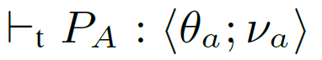

Chain Combinator Type Checking
P_{a}
P_{b}

Slide 29
Diamond Combinator Type Checking
5
2
3
P_{A}
P_{B}
1
2
3

Slide 30
Circle Combinator Type Checking
Complex because of feedback
Intuitively
  inverted diamond
  fix point
1
1
2
P_{B}
P_{A}
2
1
1

Slide 31
Base Case: Filter Type Checking
2
3
filter
time

Slide 32
Subtyping

Slide 33
Why Types? A Unified Solution
Type Checking:
Type Inference:
Principal Typing:
?
?
?
?

Slide 34
Why Types? Modularity
Thanks to its type system formulation, a distinctive trait of Rate Types for performance reasoning is it promotes modular reasoning
  Partial stream graph reasoning: no need to have all filters implemented to reason about the data rate of the entire program.
  “Plug-in” stream subgraphs as long as they conform to the throughput ratio and natural bound specified on the signature

Slide 35
(Rate Types) Operational Semantics
Data-aware: correct “bean counting” on input/output data items in the stream
Time-aware: tracking filter/graph processing times
Parallel-aware: supporting parallel execution among filters
An abstract machine with minimal assumptions:
  No (requirement on) synchronizing clocks
  Working with arbitrary schedules

Slide 36
Why Types? Provable Correctness
Soundness:
if the type system says rate x can be achieved,
a reduction sequence exists
Completeness:
if the type system says rate x cannot be achieved,
no reduction sequence with rate x exists

Slide 37
Why Types? Provable Correctness
Type inference is sound relative to type checking
Type inference is complete relative to type checking
Principal typing always exists

Slide 38
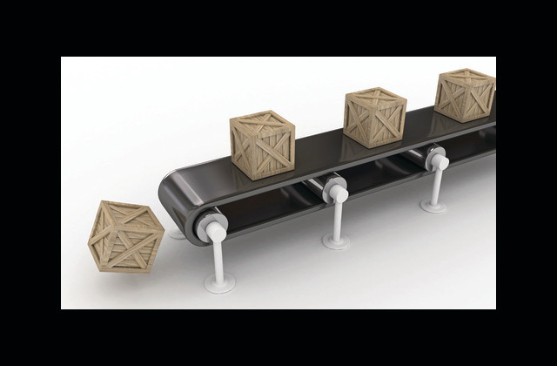
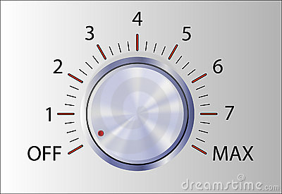
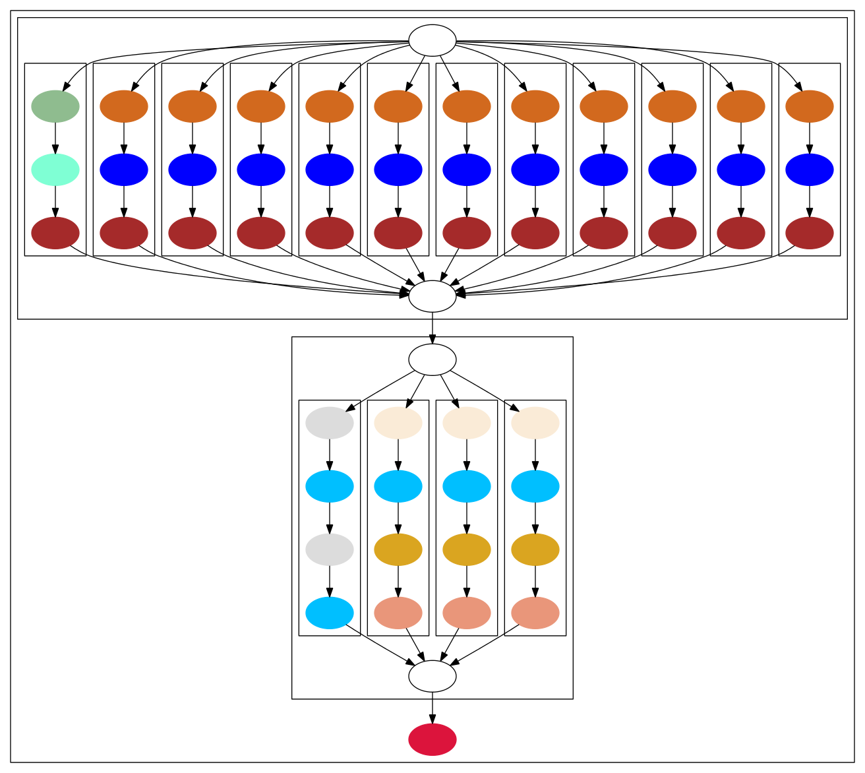
Implementation
StreamIt base
Calculate principal rate types
Control Input rate
Measure Output rate
Run benchmarks
  4 Micro-benchmarks
  6 StreamIt benchmarks
  200 input data rates
Graph Expected vs. Measured

Slide 39
Rate Types Generality
Potential generalizations to systems such as Aurora, Bamboo, StreamFlex, and may further have applications in FRP-like languages where signal sampling rates matter
Limitations include…
  Assumes declarative push and pop counts for filters
  Assumes stable filter level profiling
Current/Future work includes hybrid typing
  handle dynamic fluctuations
  improve adaptiveness
  A Java-based framework

Slide 40
Rate Types in Retrospective
Can program structures help understand performance of data-intensive software?
Rate Types provides a unified and modular reasoning framework for performance of data-intensive software
surprising how much we can statically answer questions that appear to be inherently dynamic

Slide 41
Bigger Picture
Non-functional properties such as performance and energy are critical and well-studied in experimental research (OSDI/SOSP, ASPLOS, ISCA, SIGMOD, SC, etc)
reasoning about non-functional properties

Slide 42
Thank You

