Slide 1
Sources of Information
Gary T. Leavens
COP 4910
Notes:
This is about where to find IT related information, specifically about innovations (and problems). This helps with lifelong learning.

Slide 2

Problem
Technology changes quickly
How to keep up?
Photo by Jeremy Thomas on Unsplash
Notes:
Want to find innovations early, before the competition, and you want to be the one to bring these to your enterprise…

Slide 3

Advice from UCF’s former CIO: Joel Hartman
Define what is meant by “IT”
  What areas are of interest?
Find reliable sources that are:
  Timely
  Relevant
Subscribe or bookmark
Good sources:
  Gartner Campus Access
  educause.edu
  Selected organizations and publications
Attend conferences
Leverage the Library
Photo source: https://www.itr.ucf.edu/cio.asp
Notes:
See the course resources page for more. Conferences include CES

Slide 4

Categories of Sources
cs.ucf.edu/~leavens/COP4910/resources.shtml
Library
Social Media
Professional Societies
Journals
Online
Photo by v2osk on Unsplash

Slide 5

What do you think?
Could citing Wikipedia be embarrassing?
Photo by Nathan Dumlao on Unsplash
Notes:
May be okay for ideas and a topic introduction, but for credibility about solutions and consequences, should have more trustworthy sources.

Slide 6
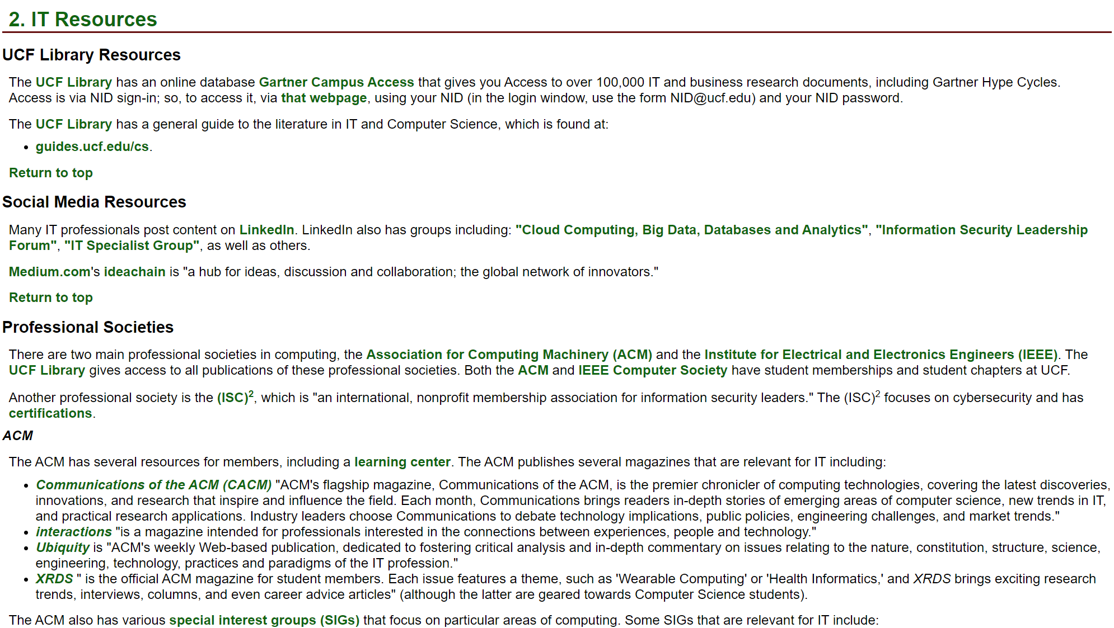
www.cs.ucf.edu/~leavens/COP4910/resources.shtml#IT

Slide 7


Professional Societies
ACM:
Special Interest Groups (SIGs)
Journals:
  Communications of the ACM (CACM)
  interactions
  Ubiquity
IEEE Computer Society:
EITBOK
Tech News
IT Professional magazine.
Notes:
Interactions "is a magazine intended for professionals interested in the connections between experiences, people and technology.“
Ubiquity is "ACM's weekly Web-based publication, dedicated to fostering critical analysis and in-depth commentary on issues relating to the nature, constitution, structure, science, engineering, technology, practices and paradigms of the IT profession.“
Browse these
Tech News features "Relevant news, analysis, and blogs to keep you best informed, based on world-class research and thought leadership." You can subscribe to the Computing Edge newsletter there.

Slide 8


Online Resources
Enterprisers Project
TechGenix.com's Tech News
IBM's IT Biz Advisor
TechImpact
Forbes Technology Council posts
EDUCAUSE
Source: enterprisersproject.com
Source: techgenix.com
Notes:
These are miscellaneous resources. The Enterprisers Project is from Harvard Business Review; it offers resources for CIOs. TechImpact aims to help "nonprofits and communities thrive" by improving their IT infrastructure and knowledge.”

Slide 9
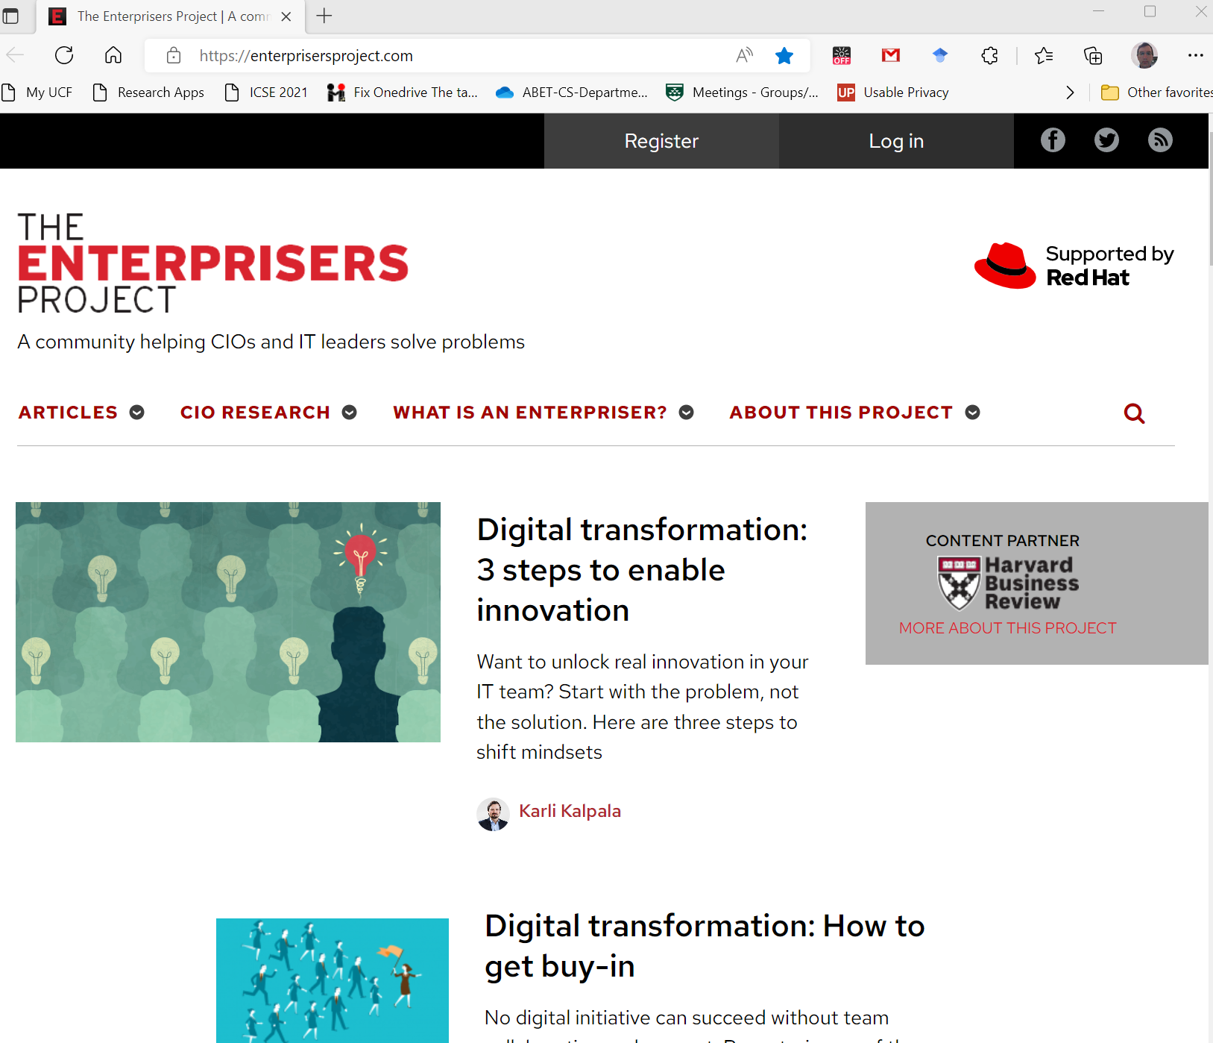
The Enterprisers Project website
enterprisersproject.com

Slide 10
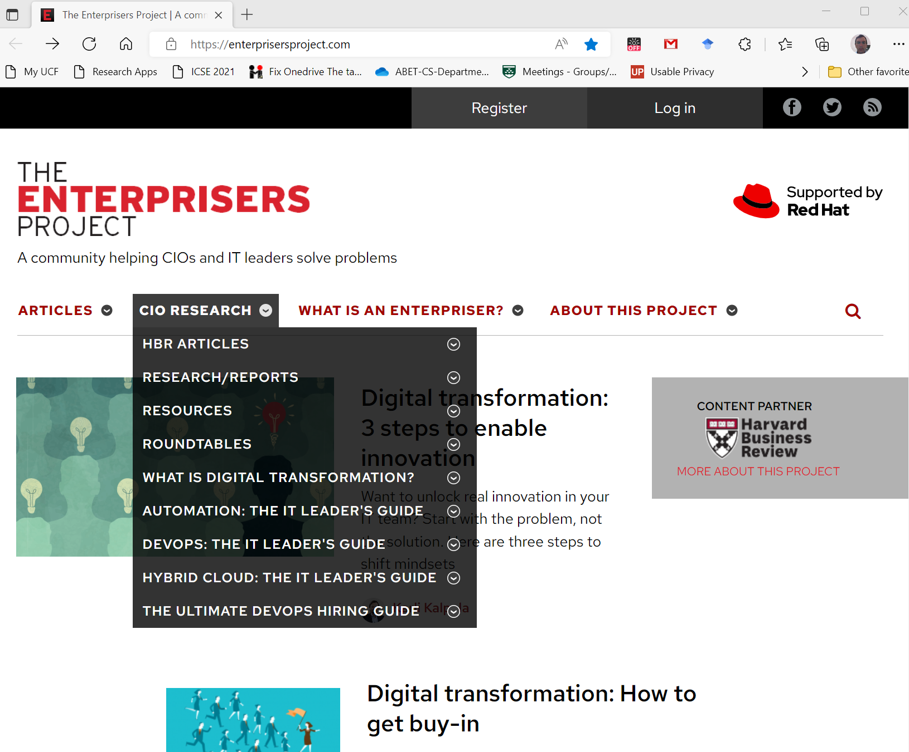
The Enterprisers Project website: Resources
enterprisersproject.com

Slide 11
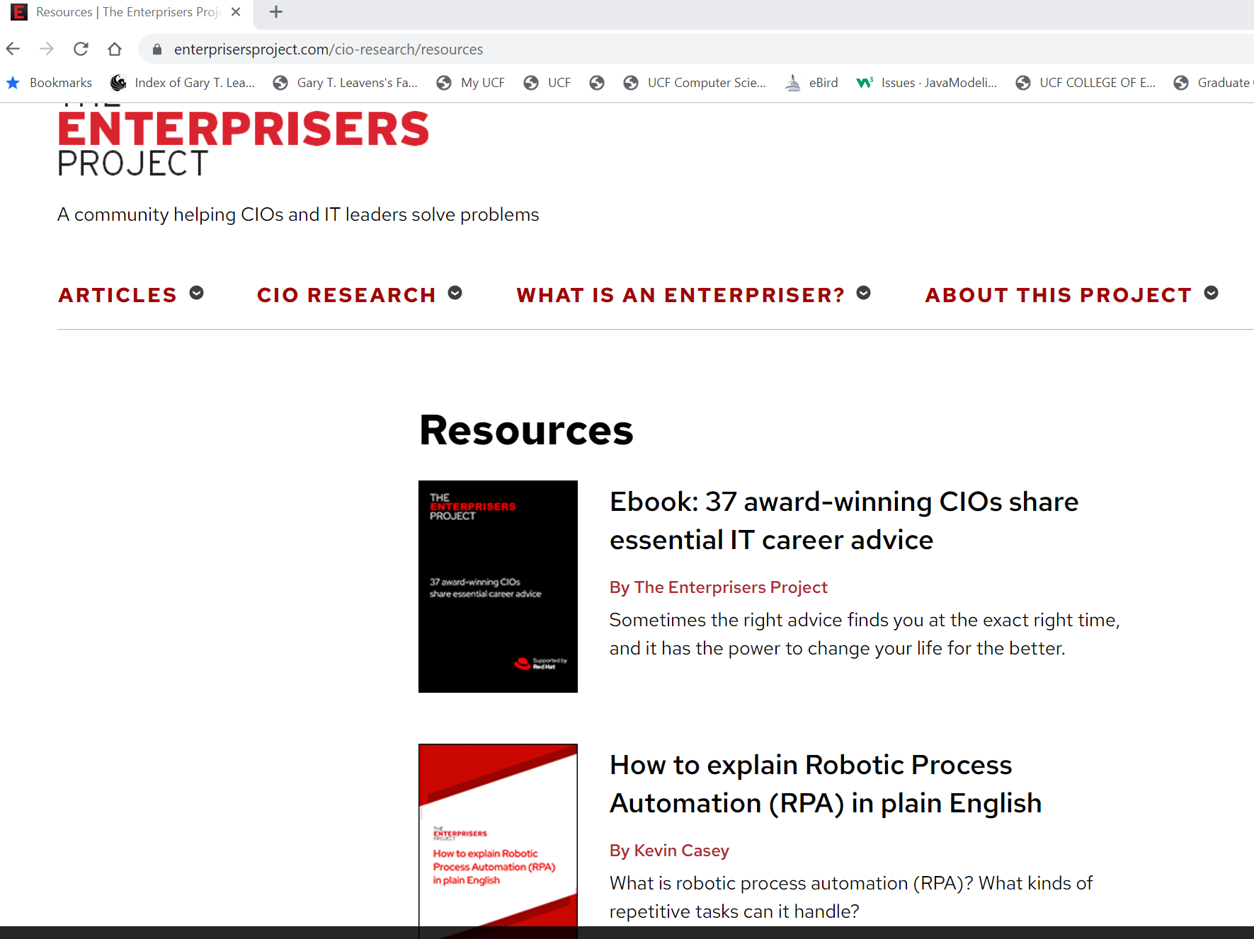
The Enterprisers Project website: Resources
Requires registration
enterprisersproject.com/resources

Slide 12
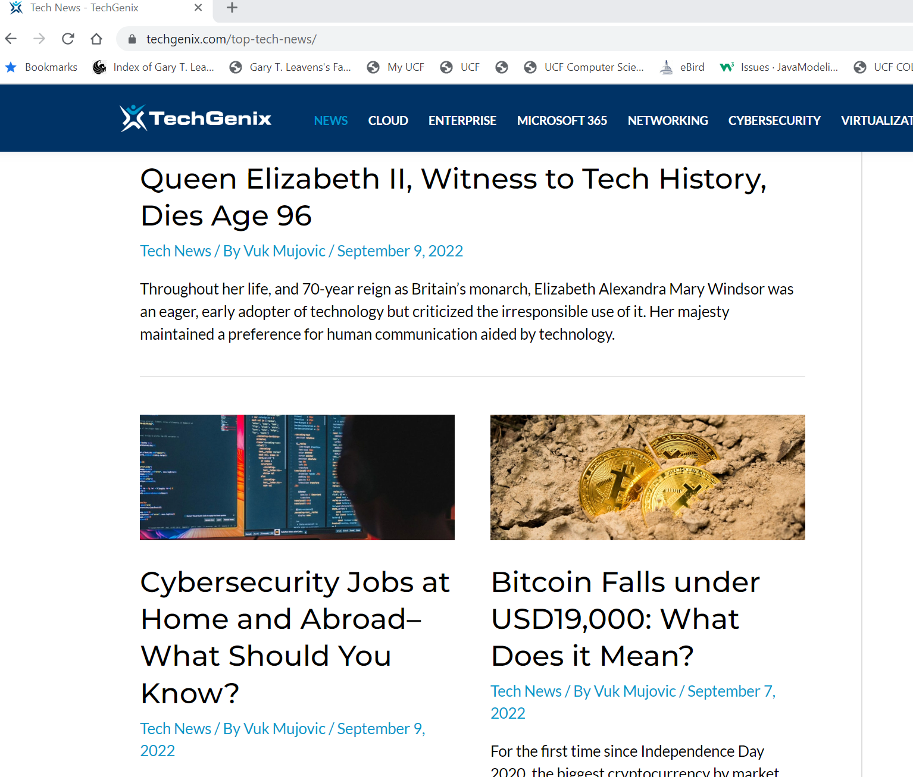
TechGenix’s Tech News
techgenix.com/top-tech-news

Slide 13

Up to the Second: Twitter
@UCFComSci – Our department at UCF
@TheOfficialACM
@acmTechNews
@ACMEducation
@ACMQueue
@XRDS_ACM
@ComputerSociety – IEEE Computer Society
@SiliconOrange
@InfoSec_World
@OWASPOrlando
Photo by Gary Leavens

Slide 14

Library Resources
Can access from off campus
library.ucf.edu
Journals:
  Journal of Information Technology
  Journal of Cases on Information Technology
Photo by Shawn Ang on Unsplash
Notes:
The advantage of journals is that their content is peer-reviewed, so more trustworthy.

Slide 15
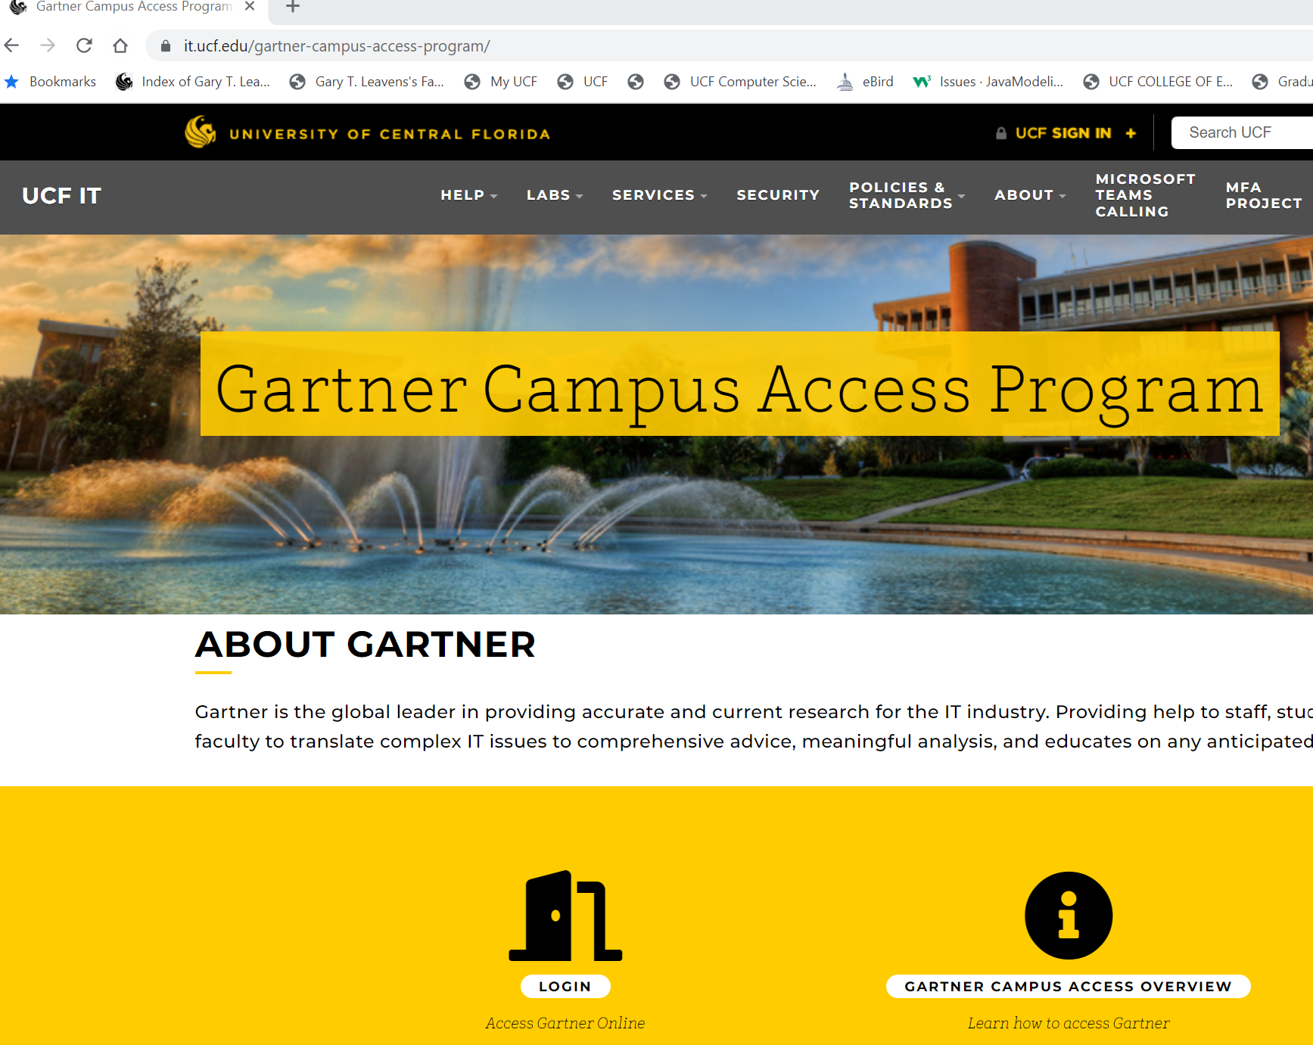
Gartner Campus Access
Notes:
There is a link on the course resources webpage, login using your NID and NID password…

Slide 16
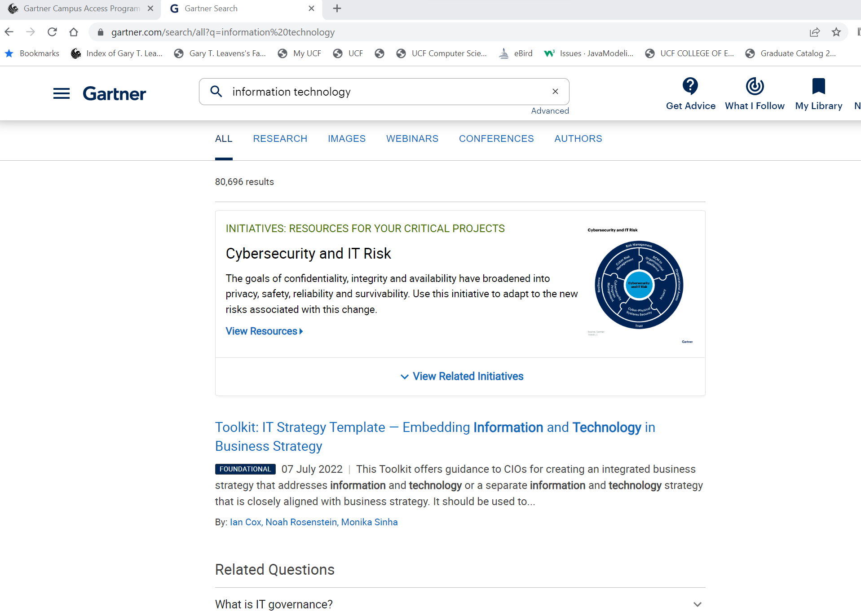
Search function: Finding information related to a topic
Search for “information technology”

Slide 17
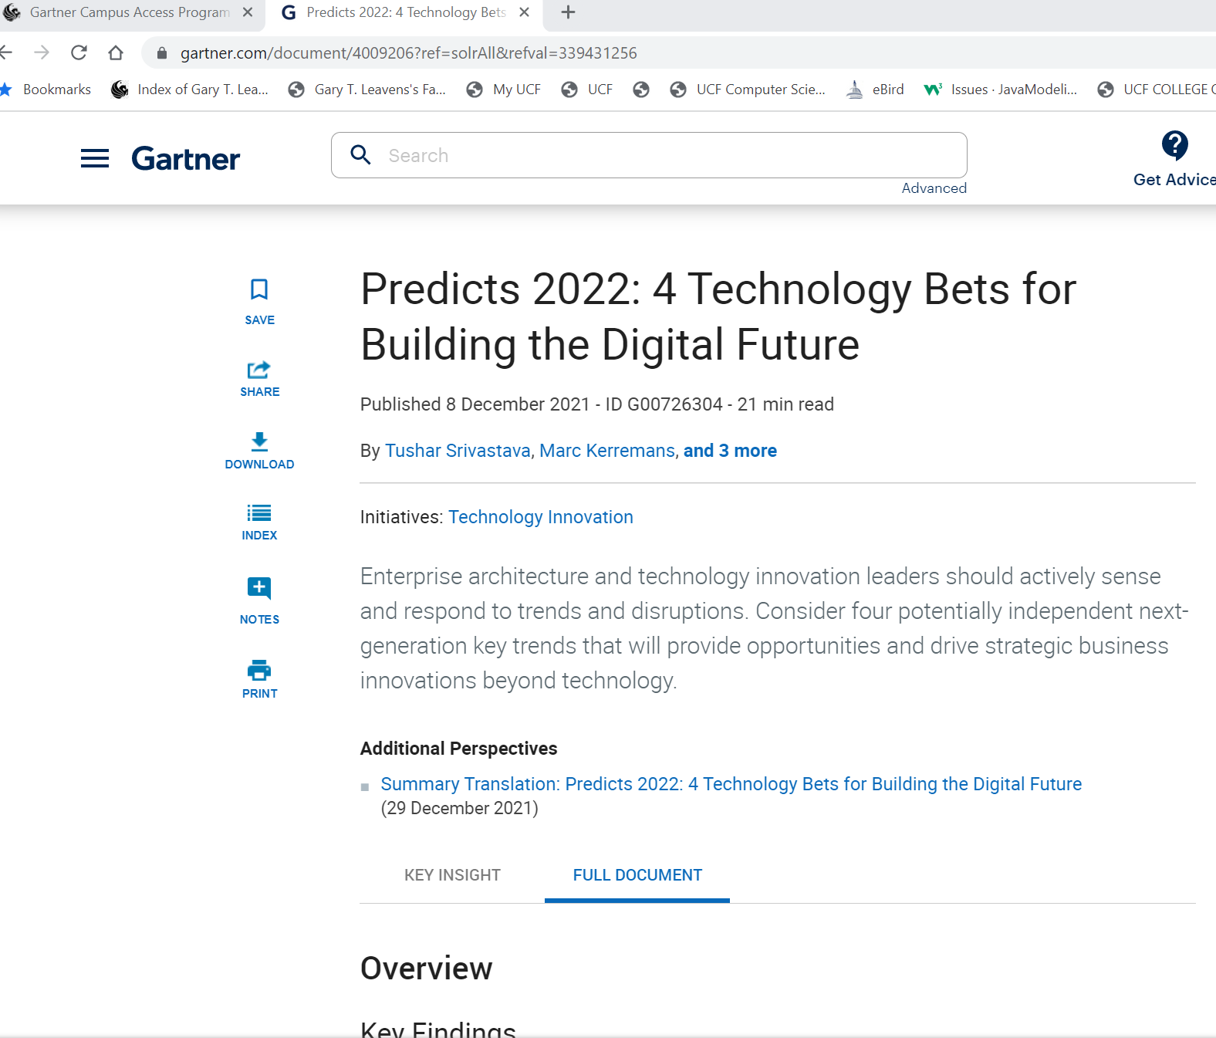
Example of predictions from information technology search

Slide 18
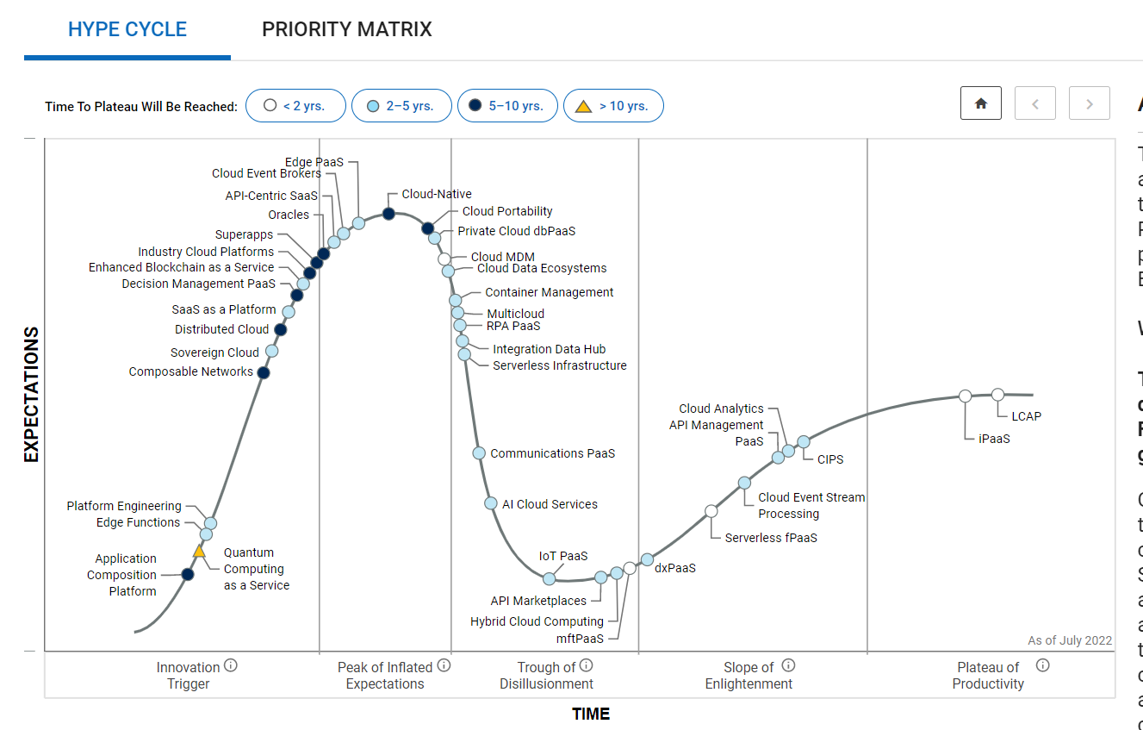
Hype Cycle Overview
Notes:
This is the one for Cloud Platform Services, 2022.

Slide 19
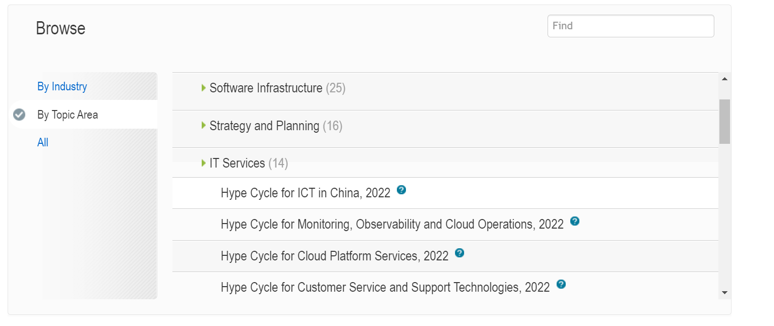
Many hype cycles available
Notes:
This can be reached from the “hype cycles” button/tab on the home page.

Slide 20

Conclusion
Keeping up is a lifelong project
Make it a habit
Photo by Sopan Shewale on Unsplash

Slide 21
Bibliography
Robin K. Hill. “First-Year Research Sources.” blog@CACM, Communications of the ACM, January 27, 2021. https://cacm.acm.org/blogs/blog-cacm/250164-first-year-research-sources

