Slide 1
Verification Technology for Our Aircraft
Gary T. Leavens
Boeing Corp.
August 25, 2022
Notes:
Of course I don’t really work for Boeing, but I’m pretending that I do.

Slide 2
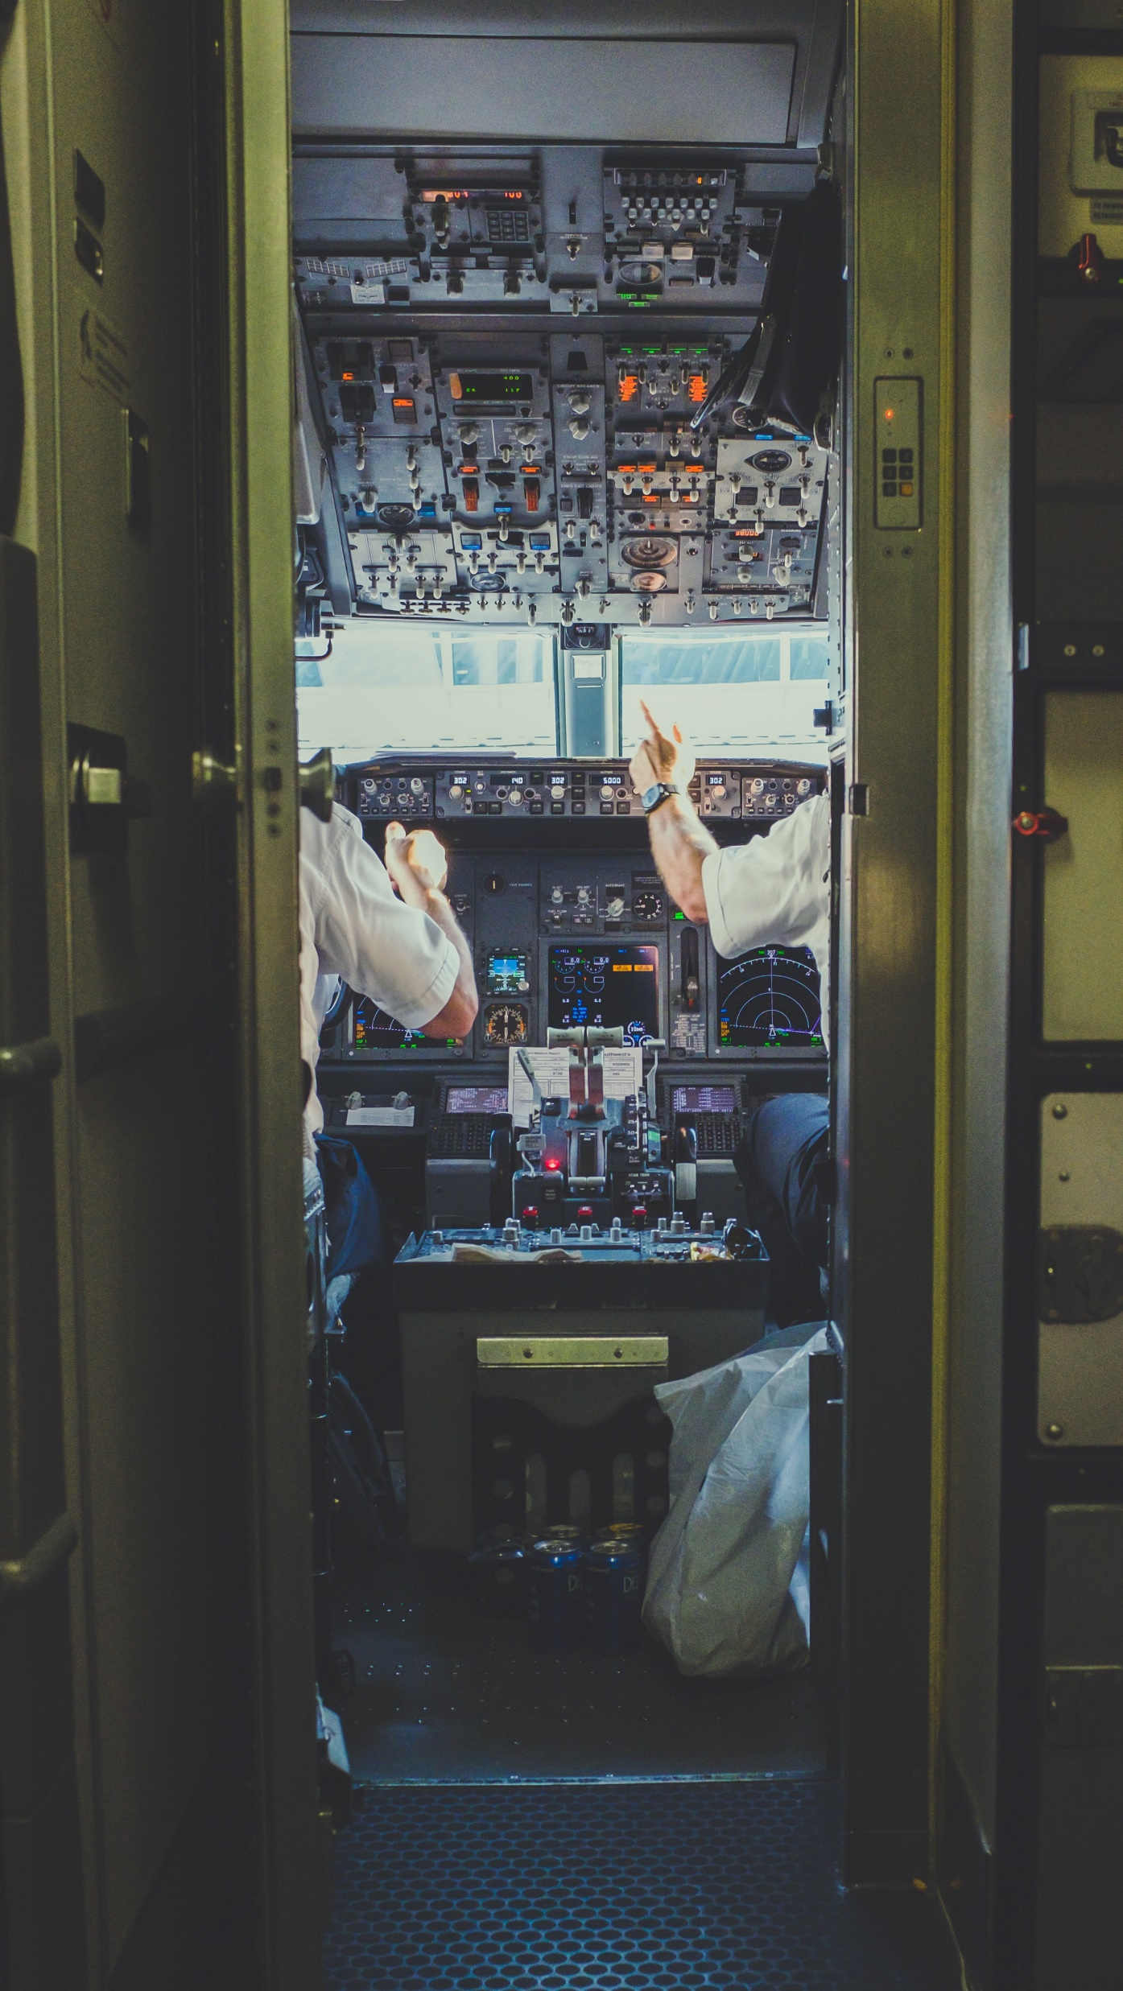
The Problem
We need software to fly our planes
Software has bugs
Photo by NeONBRAND on Unsplash
Notes:
346 people have been killed by the Boeing 737 Max jet, because the software took control of the plane away from pilots. The MCAS, which was intended to make the plane handle more predictably, activated repeatedly after a sensor on the plane’s fuselage malfunctioned, causing the airplane to crash.

Slide 3
Current Approach
Coding Standards
Code Reviews
Testing
Photo by Christina @ wocintechchat.com on Unsplash
Notes:
The problem is that all of these are fallible, they didn’t detect the problem, and people died. This is both an ethical problem and a problem of business.

Slide 4
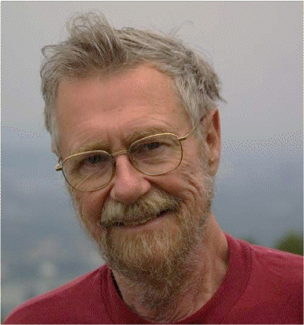
Limits of Testing
“Program testing can best show the presence of errors but never their absence.”
Photo of Edsger Dijkstra
from wiki.c2.com/
Notes:
The problem is that programs have an infinite number of possible inputs and don’t have to behave in a continuous fashion (like a bridge).

Slide 5
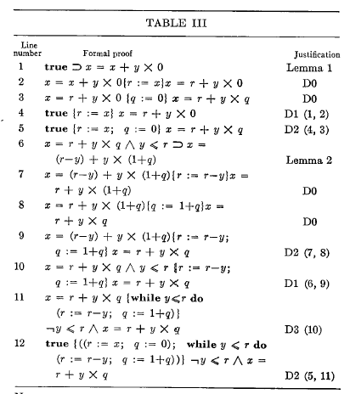
A Possible Solution: Formal Verification
Verification steps:
Specify program with logic
Convert program into logical statement
Prove that the program is correct
From “An Axiomatic Basis for Computer Programming” by C.A.R. Hoare
CACM, 12(10):576-583, Oct. 1969
Notes:
In essence, we convert both the specification and program to logical formulas, and then prove an implication (that the behavior of the program implies the specified behavior).

Slide 6
State of the Art
Specification requires experts
“Main bottleneck”
First-order reasoning automated
Success with finite-state systems
“Verification of complex systems is never automatic”
Testing still needed
Photo by Steve Halama on Unsplash
Notes:
Quotes from B. Beckert and R. Hähnle, "Reasoning and Verification: State of the Art and Current Trends," in IEEE Intelligent Systems, vol. 29, no. 1, pp. 20-29, Jan.-Feb. 2014. doi: 10.1109/MIS.2014.3

Slide 7
Commercial Success
System | Usage
Astrée | Airbus Absence of run-time errors
Static Driver Verifier | Microsoft, Compliance of Windows driver software
ACL2 | US Government, Correctness of microprocessor systems
HOL Light | Intel, Floating point algorithms in hardware
Pex | Microsoft, Glassbox test generation for C#
Photo by Steve Halama on Unsplash
Notes:
From B. Beckert and R. Hähnle, "Reasoning and Verification: State of the Art and Current Trends," in IEEE Intelligent Systems, vol. 29, no. 1, pp. 20-29, Jan.-Feb. 2014. doi: 10.1109/MIS.2014.3. The Microsoft tools are both in Visual Studio.

Slide 8
Other Considerations
Safety can be improved
Experts expensive
Tradeoff with ethics, reputation
Technology improving
Math won’t give guarantees:
Specification wrong
Specification incomplete
Photo by Etty Fidele on Unsplash
Notes:
The cost is probably less than what Boeing is losing now. And the cost will keep declining. Will still need some manual effort

Slide 9
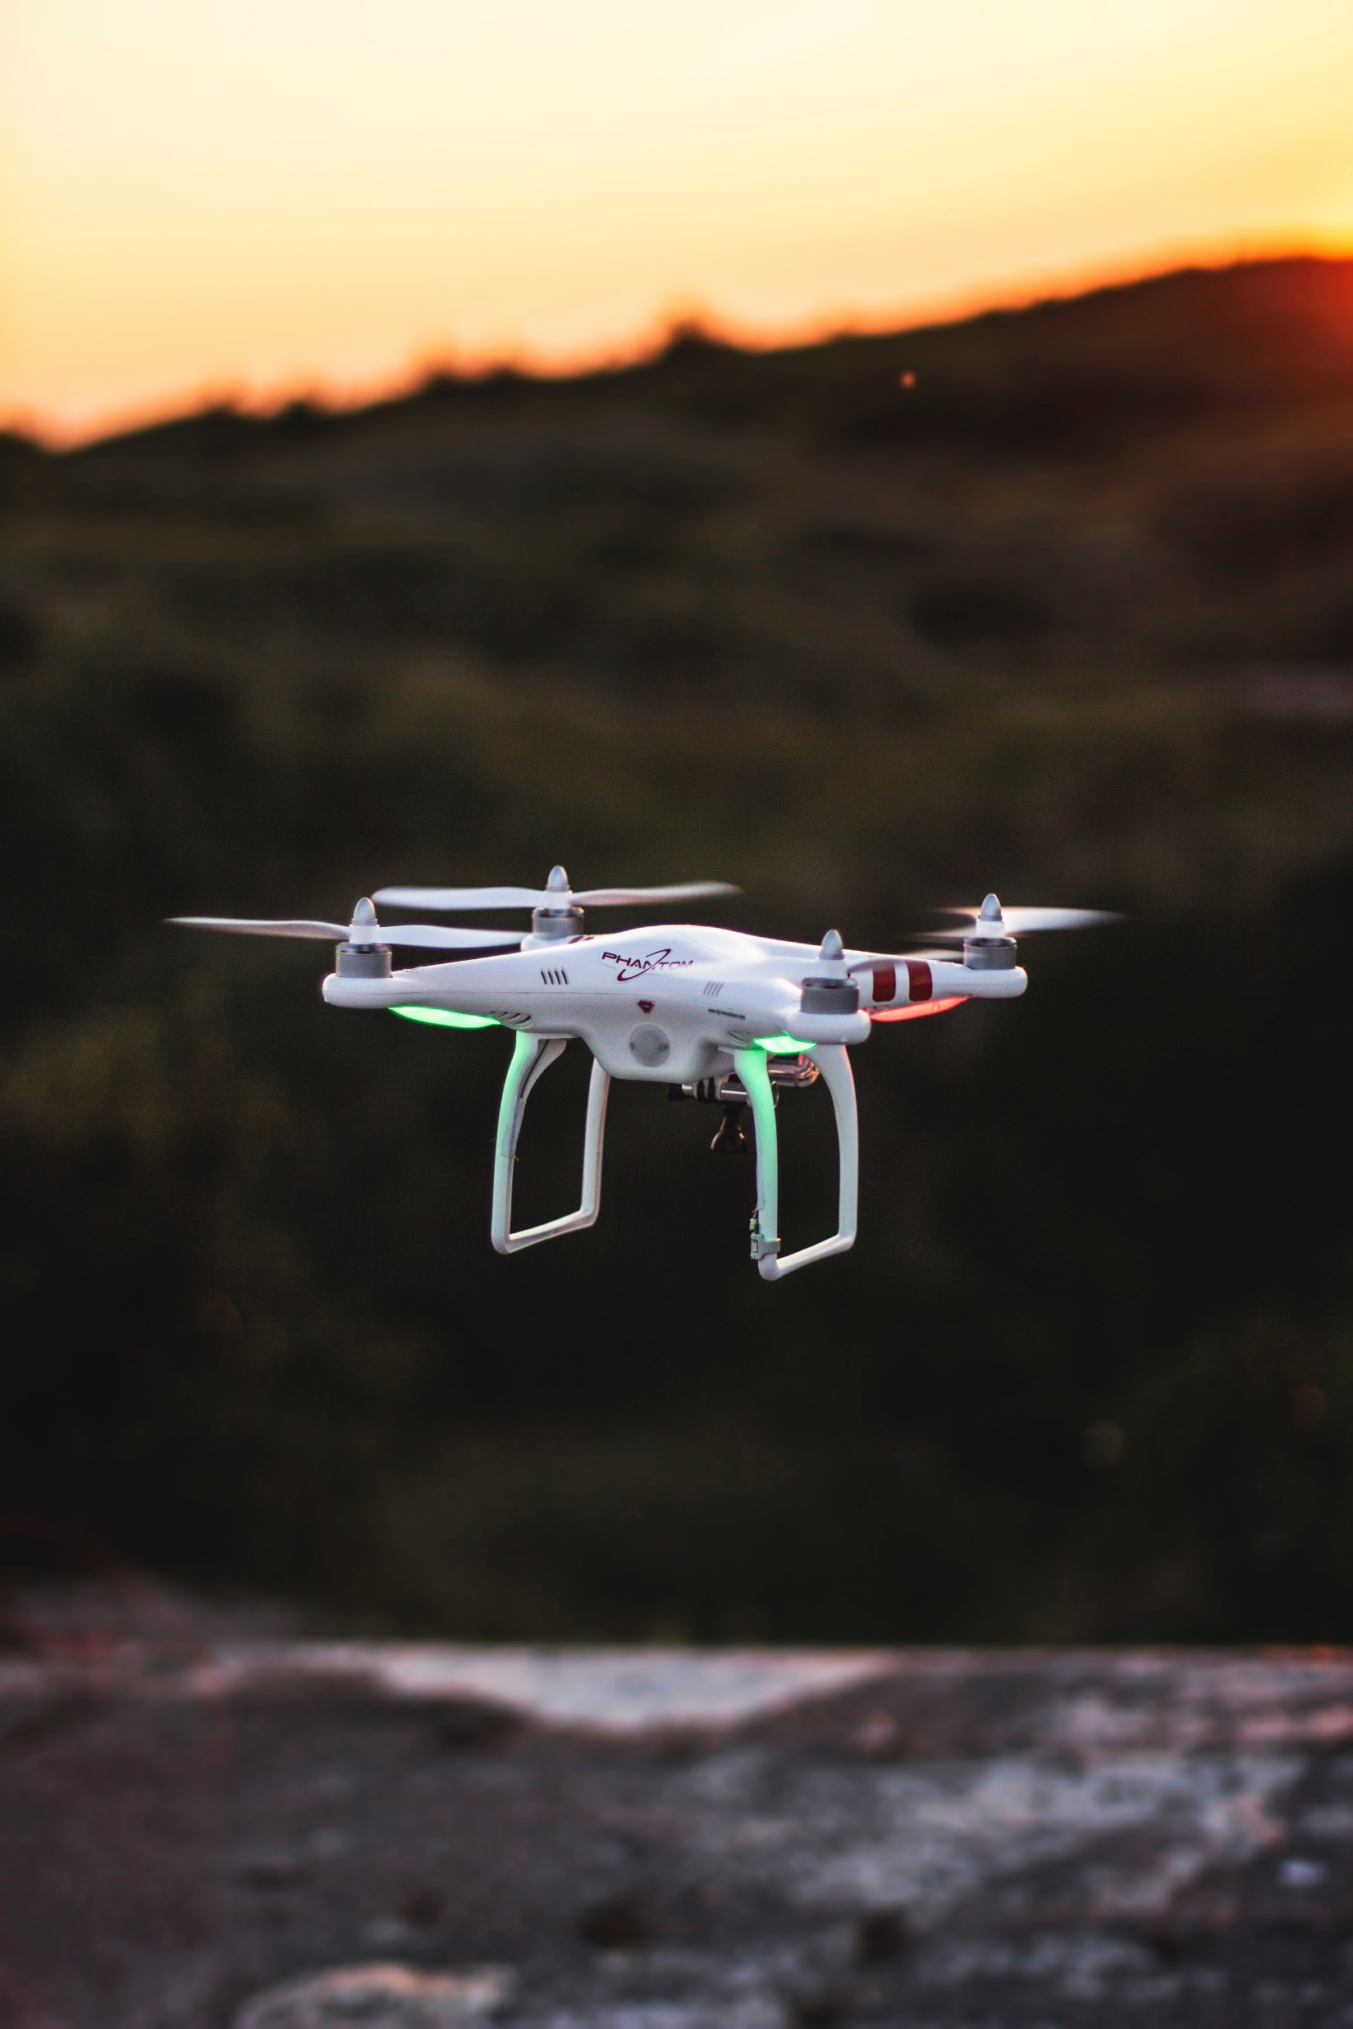
Future Possibilities
Automated flight control
FAA certification?
Safety-critical systems a new market?
Photo by Mathias Arlund on Unsplash
Notes:
Automated flight control means more software, more critical possibilities for failure. If we become expert at this, we could sell verification as a service to other companies! Maybe the FAA will allow us to do less testing? That might cut costs.

Slide 10
Conclusion
Start investing in verification
Challenge hires with our problems
Photo by Taha Mazandarani on Unsplash
Notes:
Advocate an incremental approach.

Slide 11
Bibliography
B. Beckert and R. Hähnle. “Reasoning and Verification: State of the Art and Current Trends,” IEEE Intelligent Systems, 29(1):20-29, Jan.-Feb. 2014. https://doi.org/10.1109/MIS.2014.3
C.A.R. Hoare. “An Axiomatic Basis for Computer Programming” CACM, 12(10):576-583, Oct. 1969.

