Slide 1
Verification Technology for Our Aircraft
Gary T. Leavens
Boeing Corp.
August 25, 2022

Slide 2
OUTLINE
WHAT IS VERIFICATION TECHNOLOGY?
WHY USE VERIFICATION TECHNOLOGY?
SUCCESSES OF VERIFICATION TECHNOLOGY
OTHER CONSIDERATIONS in the use of verification technology
CONCLUSIONs
Notes:
Read this, facing the screen!

Slide 3
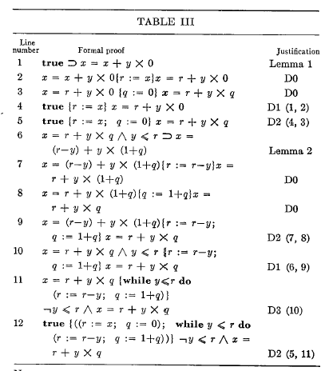
WHAT IS Verification TECHNOLOGY?
The basic IDEA of Formal program verification is as follows:
An expert specifies the FUNCTIONAL behavioUr of the desired program
in LOGIC
  Predicate logic (Floyd-HOARE)
  TEMPORAL LOGIC (PNUELLI)
A FORMAL VERIFCATION SYSTEM Converts THE program into logical FORMULAS
(See example at right)
USE THEOREM PROVING TO SHOW THAT THE PROGRAM IS CORRECT (OR NOT)
  SMT solvers for predicate logic have improved much in recent years
  MODEL CHECKERS FOR TEMPORAL LOGIC have achieved great success (ESPECIALLY for protocols)
From “An Axiomatic Basis
for Computer Programming” by C.A.R. Hoare
CACM, 12(10):576-583, Oct. 1969
Notes:
Note the spelling errors and the awful, unnecessary animation.

Slide 4
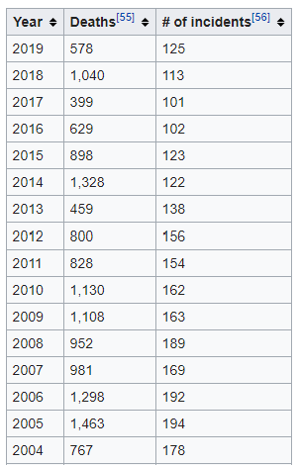
WHY USE VERIFICATION TECHNOLOGY?
346 people have been killed by the Boeing 737 Max jet,
because the software took control of the plane away from pilots.
The MCAS, which was intended to make the plane handle more predictably,
activated repeatedly after a sensor on the plane’s fuselage malfunctioned,
causing the airplane to crash.
SOFTWARE IS INCREASINGLY USED TO CONTROL AIRPLANES, ALTHOUGH IT IS not often visible
The MCAS system is software
MCAS itself is not buggy, but its interaction with other control software
has human-computer interface problems
Source: https://en.wikipedia.org/wiki/Aviation_accidents_and_incidents
Notes:
346 people have been killed by the Boeing 737 Max jet, because the software took control of the plane away from pilots. The MCAS, which was intended to make the plane handle more predictably, activated repeatedly after a sensor on the plane’s fuselage malfunctioned, causing the airplane to crash.

Slide 5

STANDARD PRACTICE HERE
WE HAVE RIGOROUS Coding Standards that emphasize safety
and security. These are always followed by our software
engineers, and help prevent problems. This has been
successful in achieving FAA CERTIFICATION FOR OUR AIRCRAFT
We use expert Code Reviews (at great cost) with teams of
4-5 software engineers reviewing every line of code
We have rigorous independent Testing, that ensures code
COVERAGE AS MANDATED BY FAA standards
Notes:
Note the clip art…

Slide 6
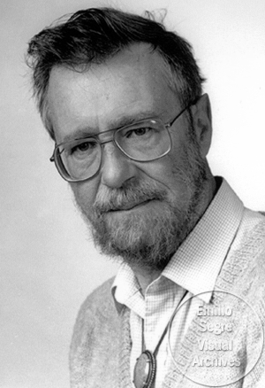
TESTING HAS LIMITATIONS, HOWEVER
Edsger DijKSTRA (A FAMOUS COMPUTER SCIENTIST and the Association for Computing machinery’s TURING AWARD WINNER) was a proponent of program verification. He famously said SOMETHING LIKE: testing can show the presence of BUGS but never their absence.
So:
Testing isn’t good enough for proving the safety of our airplanes
Notes:
Too much text, the quote is not exact, and the picture is unattributed.

Slide 7
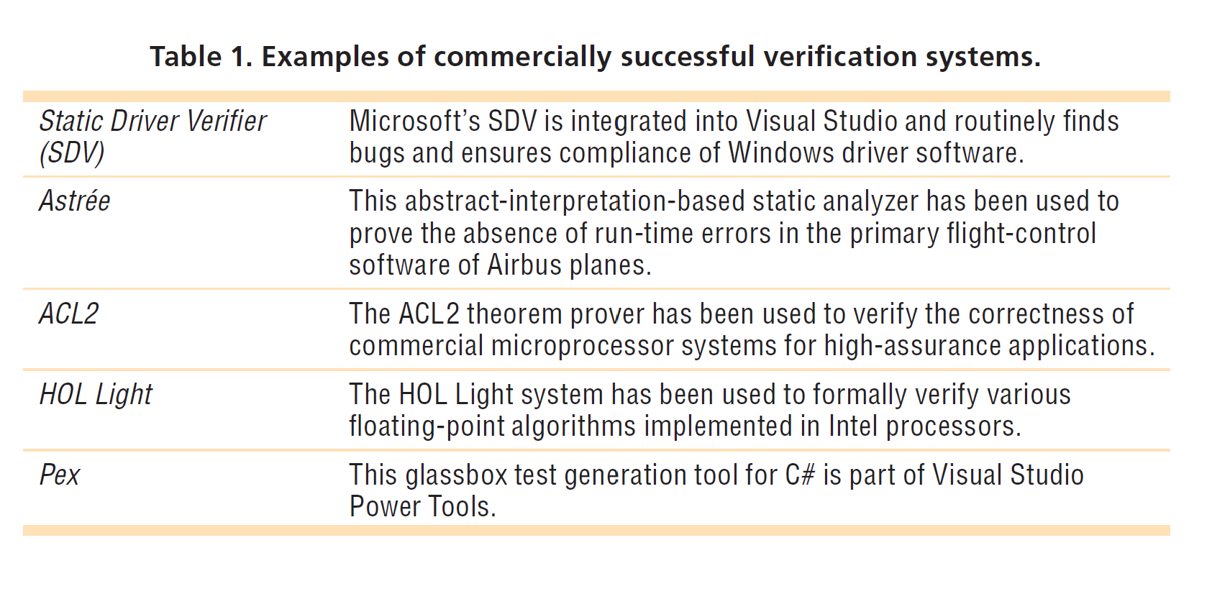
Commercial Success
From B. Beckert and R. Hähnle, "Reasoning and Verification: State of the Art and Current Trends,"
in IEEE Intelligent Systems, vol. 29, no. 1, pp. 20-29, Jan.-Feb. 2014. doi: 10.1109/MIS.2014.3
Notes:
From B. Beckert and R. Hähnle, "Reasoning and Verification: State of the Art and Current Trends," in IEEE Intelligent Systems, vol. 29, no. 1, pp. 20-29, Jan.-Feb. 2014.
doi: 10.1109/MIS.2014.3. The Microsoft tools are both in Visual Studio.

Slide 8


Other Considerations
The Safety of the systems involved can be improved to the extent to which they can be verified
However, the Mathematics won’t give us absolute guarantees, for several possible reasons:
  The Specification might be just plain wrong, so that a correct implementation doesn’t do what is really needed, OR
  The Specification might be incomplete, in the sense that it doesn’t say what should happen in some cases, so that a correct implementation could do the wrong thing and still be considered two bee correct in those cases, even though the airplane is not doing what it really should do (what should be the requirements) in those cases. These can often be hard to test and this in fact a fairly common problem.
The Experts who can understand both airplanes (i.e., aerospace engineering) and formal specification and verification (i.e., formal methods) can be expensive, because there are few of them, and so they can command a high salary. However, eventually it may be possible, with advances in technology, to have fewer such experts or perhaps even none at all, in the distant future.
Notes:
Too much text! And what does that picture have to do with anything?

Slide 9
Future applications of this technology
WE may want to automate our planes further, allowing our customers to use cheaper pilots. Of course, this is what our main competitor (airbus) is doing already, but we may have to keep up with them. So we may need to further automate the control of our airplanes. And that will require more software. More software means more possible bugs, and hence more testing.
The following graph indicates the increasing number of bugs that will result from more automation…
Number of
bugs
Complexity of the flight control software
Notes:
No scale on this graph. Automated flight control means more software, more critical possibilities for failure. If we become expert at this, we could sell verification as a service to other companies! Maybe the FAA will allow us to do less testing? That might cut costs.

Slide 10
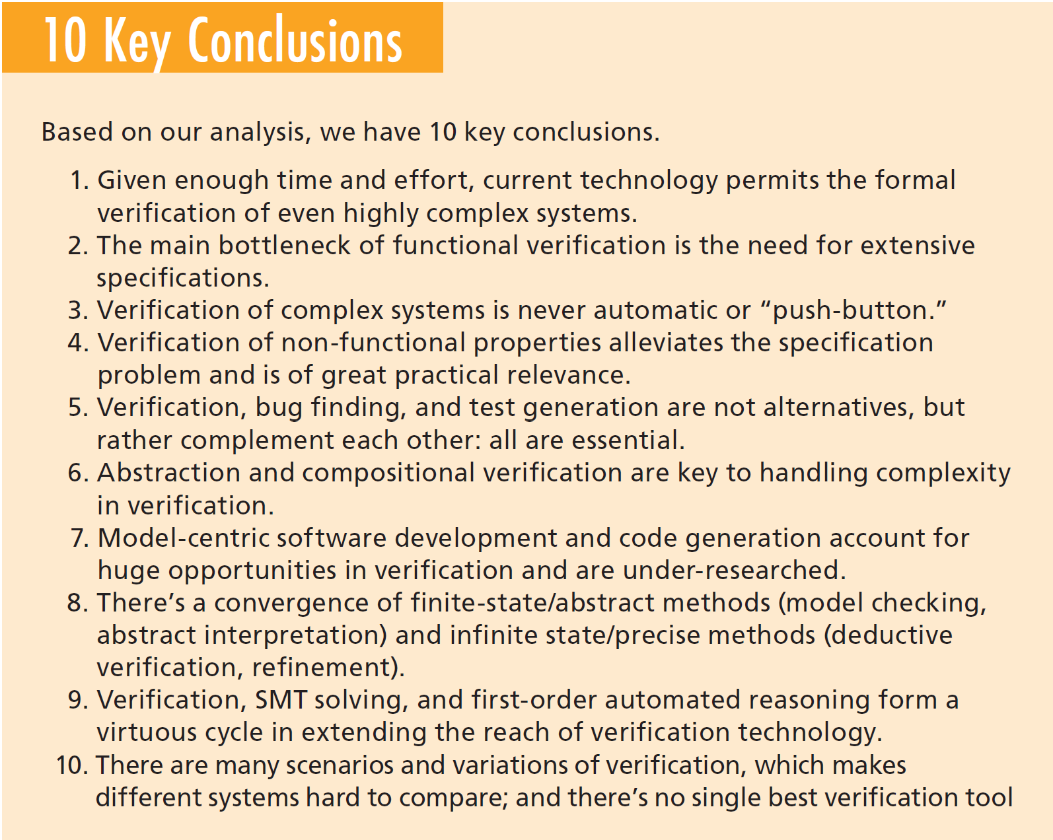
State of the Art for verification
from B. Beckert and R. Hähnle, "Reasoning and Verification: State of the Art and Current Trends," in IEEE Intelligent Systems, vol. 29, no. 1, pp. 20-29, Jan.-Feb. 2014.
Notes:
Quotes from B. Beckert and R. Hähnle, "Reasoning and Verification: State of the Art and Current Trends," in IEEE Intelligent Systems, vol. 29, no. 1, pp. 20-29, Jan.-Feb. 2014.
doi: 10.1109/MIS.2014.3

Slide 11
Conclusions
The technology of software verification holds the promise of completely correct and safe systems. That is important to us as a major manufacturer of aircraft, because public trust in our products is important for sales.
Therefore, As a company, we should Start investing in verification technology now, before it is too late, and we have major problems.
Software
bugs
Use of software verification technology

Slide 12
QUESTIONS?

