Slide 1
Other Considerations: Business, Ethics, Environment, etc.
Gary T. Leavens
COP 4910
Notes:
We tend to focus on technology, but we need to keep these considerations in mind…

Slide 2
It’s not just Technology
Other Considerations:
Business
Ethics
Environment
Work
Photo by John Schnobrich on Unsplash
Notes:
These are the issues we’ll talk about today.

Slide 3
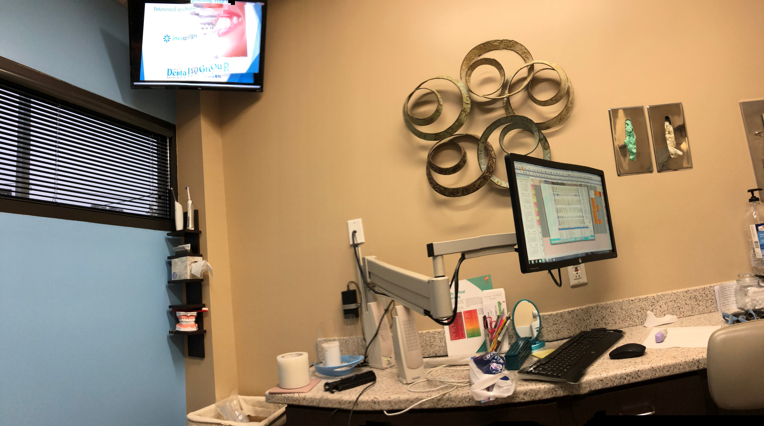
Business Considerations
From What the CEO Wants you to Know
By Ram Charan
See the business as a whole
Source: Gary Leavens
Notes:
Book recommended to me by Jeff Jacoby on our IAB. These are things you can also ask on an interview…

Slide 4
My visit to the dentist
Source: Gary Leavens
Notes:
Tell story about my dentist visit (in December 2019), which started with a text message and phone call, and the new screens in each office to sell dental procedures, etc.

Slide 5
Moneymaking in business
Satisfying customer needs
Generating cash
Producing return on investment
Growing profitably
Photo by Blake Wisz on Unsplash
Notes:
A business must satisfy customer needs better than the competition. Not just these 4 things, but also the relationship between them is important.

Slide 6
Customers
Must fill a need or fix a problem
Should be simple
May be different from consumers
Photo by Hush Naidoo on Unsplash
Notes:
Johnson & Johnson sells toothpaste to (wholesale distribution companies who sell to) supermarkets, who sell to consumers. An IT division of a large company (or a consulting firm) may “sell” a service to other divisions, who may ultimately sell to consumers.

Slide 7
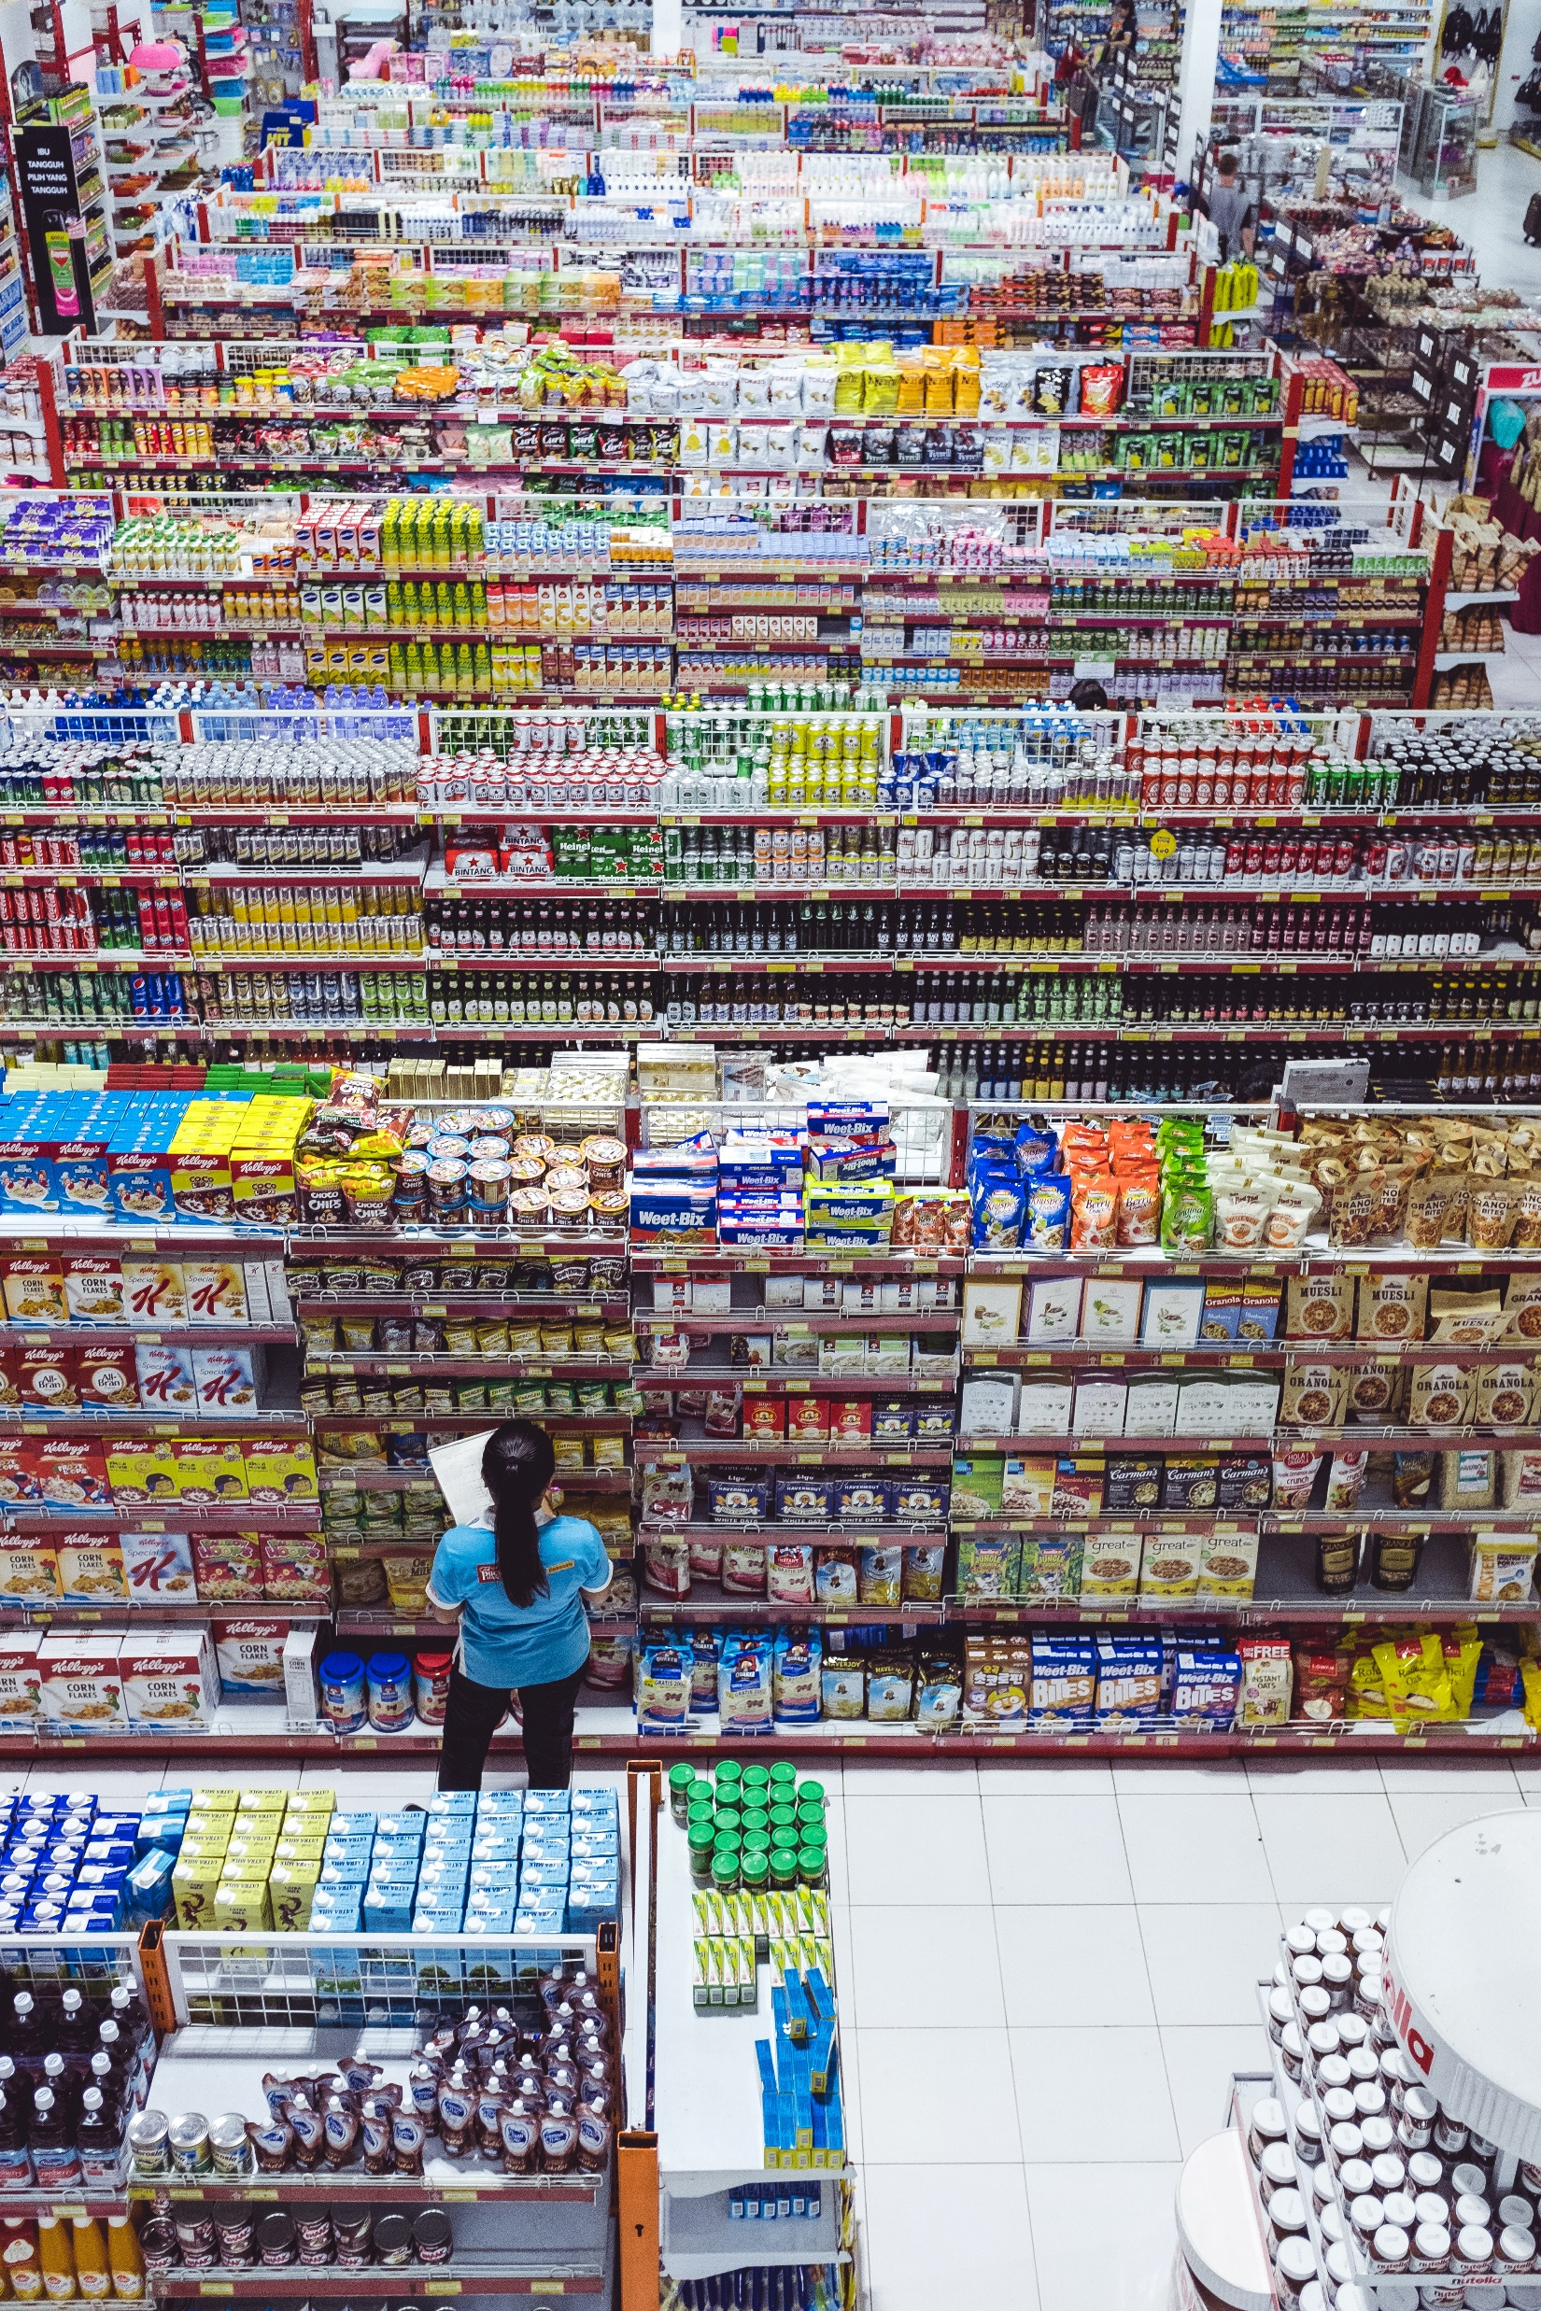
Consumers vs. Customers
Consumers: ______________
Ask: What are they buying?
Customers: _______________
Ask: What am I selling?
Photo by Bernard Hermant on Unsplash
Notes:
What does Disney sell?

Slide 8
Consumers vs. Customers
Consumers: buy things
Ask: What are they buying?
Customers: buy from your business
Ask: What am I selling?
Photo by Bernard Hermant on Unsplash
Notes:
Consumers might be buying more than a product, perhaps reliability, trustworthiness, convenience, service, an experience… “Customers need a simple reason to buy from you,” e.g., “something they really need”

Slide 9
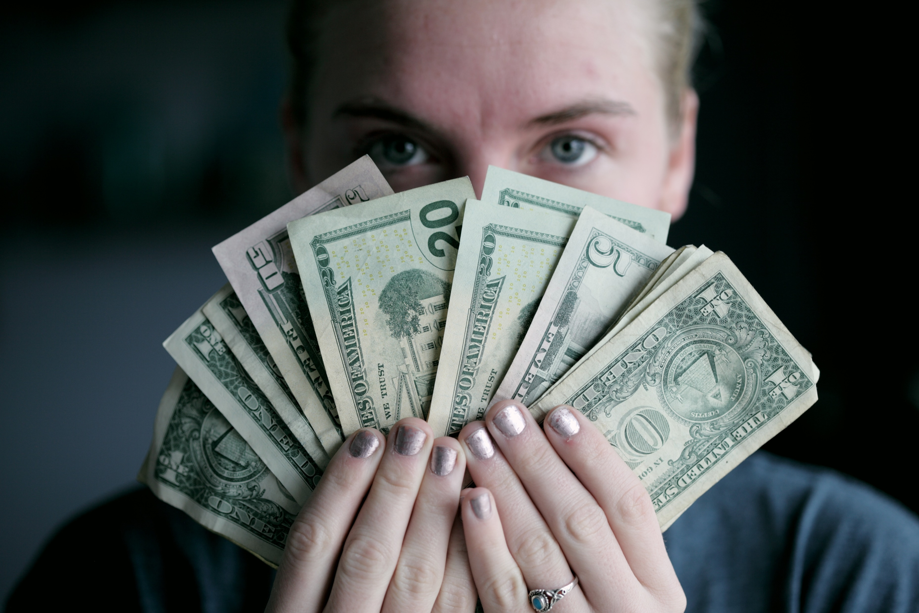
Cash Generation
Needed to stay in business
Cash ≠ Income
Credit given will be income, but not cash
Time needed to collect on credit
Know:
Sources of cash
How is cash used?
Photo by Sharon McCutcheon on Unsplash
Notes:
Cash generation is the difference between money coming in and going out. Like breathing, needed in every time period (e.g., to pay employees).
What role does IT have to play? Getting cash processed quickly is one thing

Slide 10
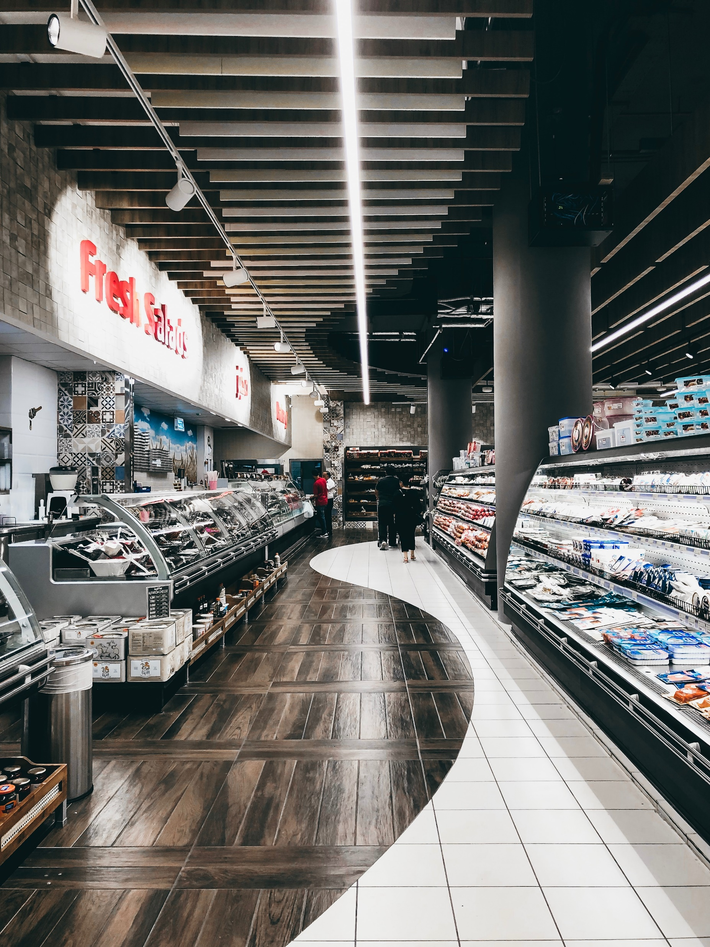
A Cautionary Tale
Webvan
Customers order online
Groceries delivered
Marketing:
High quality
Supermarket prices
How does that impact cash generation?
Solution: Automation
Warehouses expensive
Photo by Benziad on Unsplash
Notes:
They would have lower margins than the already small margins of supermarkets. The warehouses cost $35M each, so company paid out about $125M a quarter, so ran out of cash

Slide 11
Gross Margin
$$GrossMargin=\frac{Revenue −CostOfGoodsSold}{Revenue}$$
Dentist has:
sales of $700k
Costs of $400k
What’s the gross margin?
Notes:
Margin is 42.8%, Data is an approximate average, from the ADA 2018 survey of dental practice https://www.ada.org/en/science-research/health-policy-institute/dental-statistics/income-billing-and-other-dentistry-statistics. How can this be improved?

Slide 12
Components of Gross Margin
Products
Customers
Pricing
Distribution channels
Cost structure
Photo by LORA on Unsplash
Notes:
Understanding these helps you understand why gross margin is what it is or increases or decreases.

Slide 13
How to Improve Revenue?
When should the dentist invest?
$$ReturnOnInvestedCapital=\frac{Revenue}{TotalInvestedCapital}$$
Source: Gary Leavens
Notes:
The dentist can take out a loan to buy things (e.g., video screens), but will that make money or lose it? What would be a good rate? Should be better than the stock market or a bank! Has to be greater than the cost of the capital (about 8%) at least!

Slide 14
How to Increase Return on Invested Capital?
How to increase Return?
$$Return=Margin × Velocity$$
$$Velocity=\frac{Sales}{TotalInventory}$$
Gary Leavens
Notes:
McDonalds or Walmart have high velocity. Sales are amount for some time period (a year) and total inventory is the amount of money invested in inventory for the same time.

Slide 15
Growth
Growth energizes a business
Attracts talent
New opportunities
Constraints still apply
Good Growth:
Profitable
Organic
Differentiated
Sustainable
Photo by Taha Mazandarani on Unsplash
Notes:
Constraints include cash generation, ROIC. Profitable means a good ROIC; must be greater than ultra-safe investments (e.g., Treasury Bills). Differentiated because don’t want to make a commodity (as small money there). Sustainable means it can continue in the long term. Overall: how can we make money and be profitable giving customers what they want?

Slide 16
The Growth Box
 | Existing Customers | New Customers
New Needs | B Existing Customers New Needs | C New Customers New Needs
Existing Needs | A Existing Customers Existing Needs | D New Customers Existing Needs
Notes:
How does that apply to the dentist? A. Sell other dental products (toothpaste, etc.); B. Sell different services (teeth whitening); C. A new business, e.g., treating snoring; D. marketing to get new customers (e.g., senior citizens, young people, …)

Slide 17
Review and Application to other Enterprises
Keys to Business Acumen:
Satisfying customer needs
Generating cash
Producing return on investment
Growing profitably
How does this apply to:
Non-profits?
Government agencies?
Photo by Mustapha Muhammed on Unsplash
Notes:
Say the Red Cross, or the transportation security agency (TSA)? What about UCF?

Slide 18
What can IT do to help?
How can IT help your enterprise:
Satisfy customer needs?
Generate cash?
Produce return on investment?
Grow profitably?
Source: Gary Leavens

Slide 19
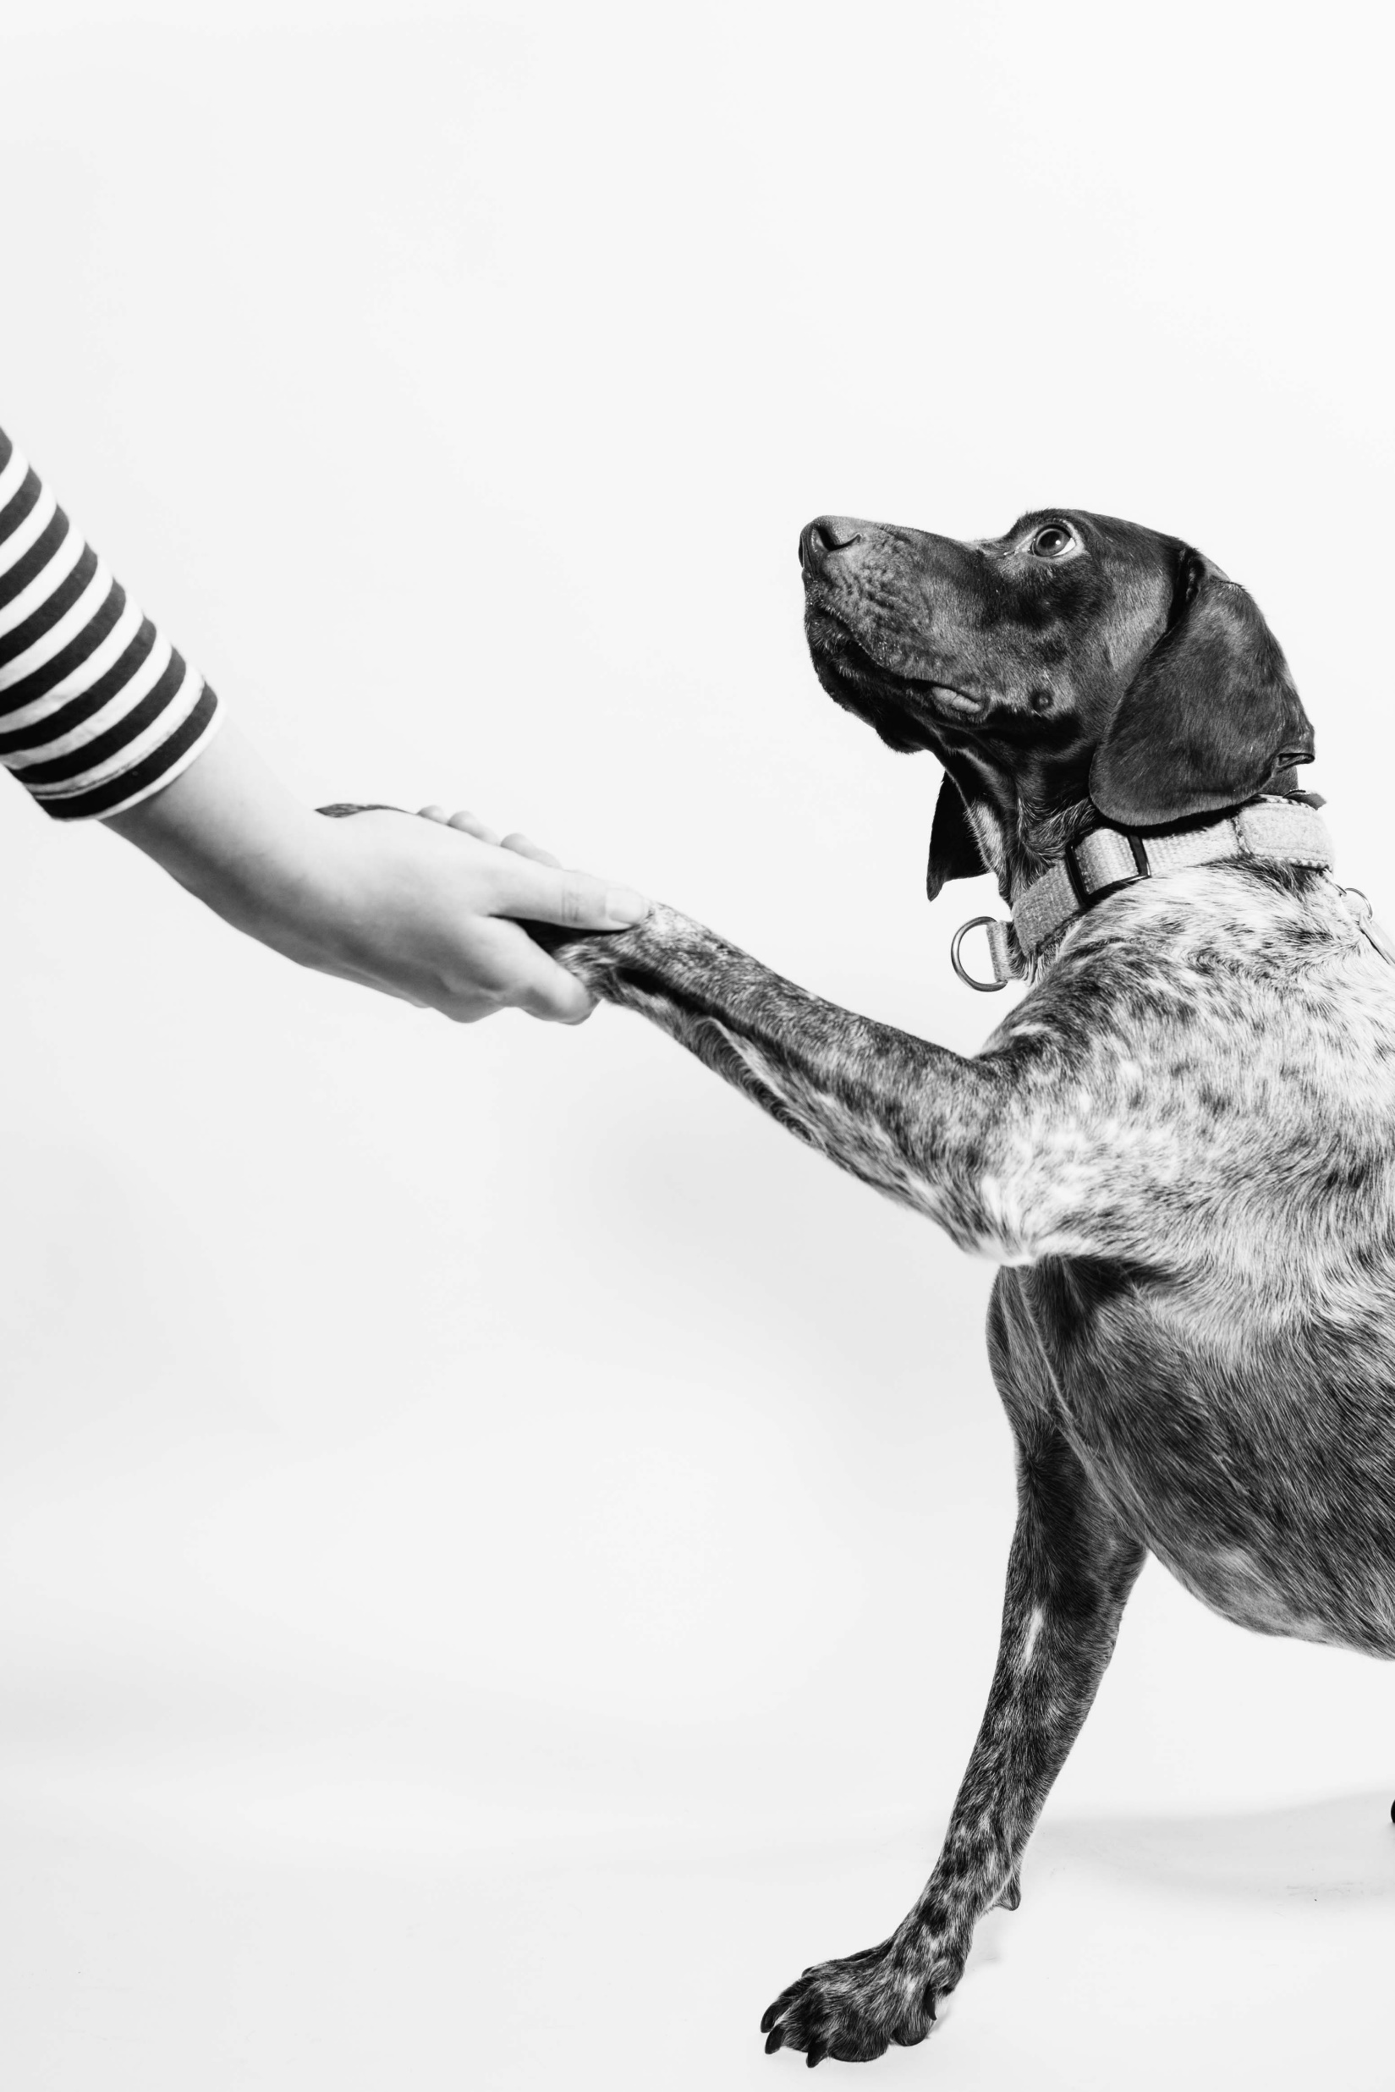
Ethics
For people to trust you in business, need:
Credibility
Capacity
Character
Photo by Fabian Gieske on Unsplash
Notes:
Would you buy from someone you don’t trust? From someone who couldn’t deliver? Who was a criminal?

Slide 20
IT Can Change the World
From ACM talk on Ethics by
Don Gotterbarn & Marty J. Wolf:
Computing can change the World, so:
Think about wider impacts
Consistently support the public good
Photo by Arif Riyanto on Unsplash
Notes:
Consider: Facebook, iPhones, the human genome project, …

Slide 21
Pitfalls in Ethical Thinking
Competition, get solution to market fast!
More is better!
Ignoring ethics: it doesn’t matter!
Equating Law and Ethics
Ethics theater
Ethics is a matter of opinion!
The fatal premise: “I’m a good person, but evil is done by evil people. QED”
Photo by Vincent Foret on Unsplash
Notes:
Quoted and adapted From ACM talk on Ethics by Don Gotterbarn & Marty J. Wolf.

Slide 22
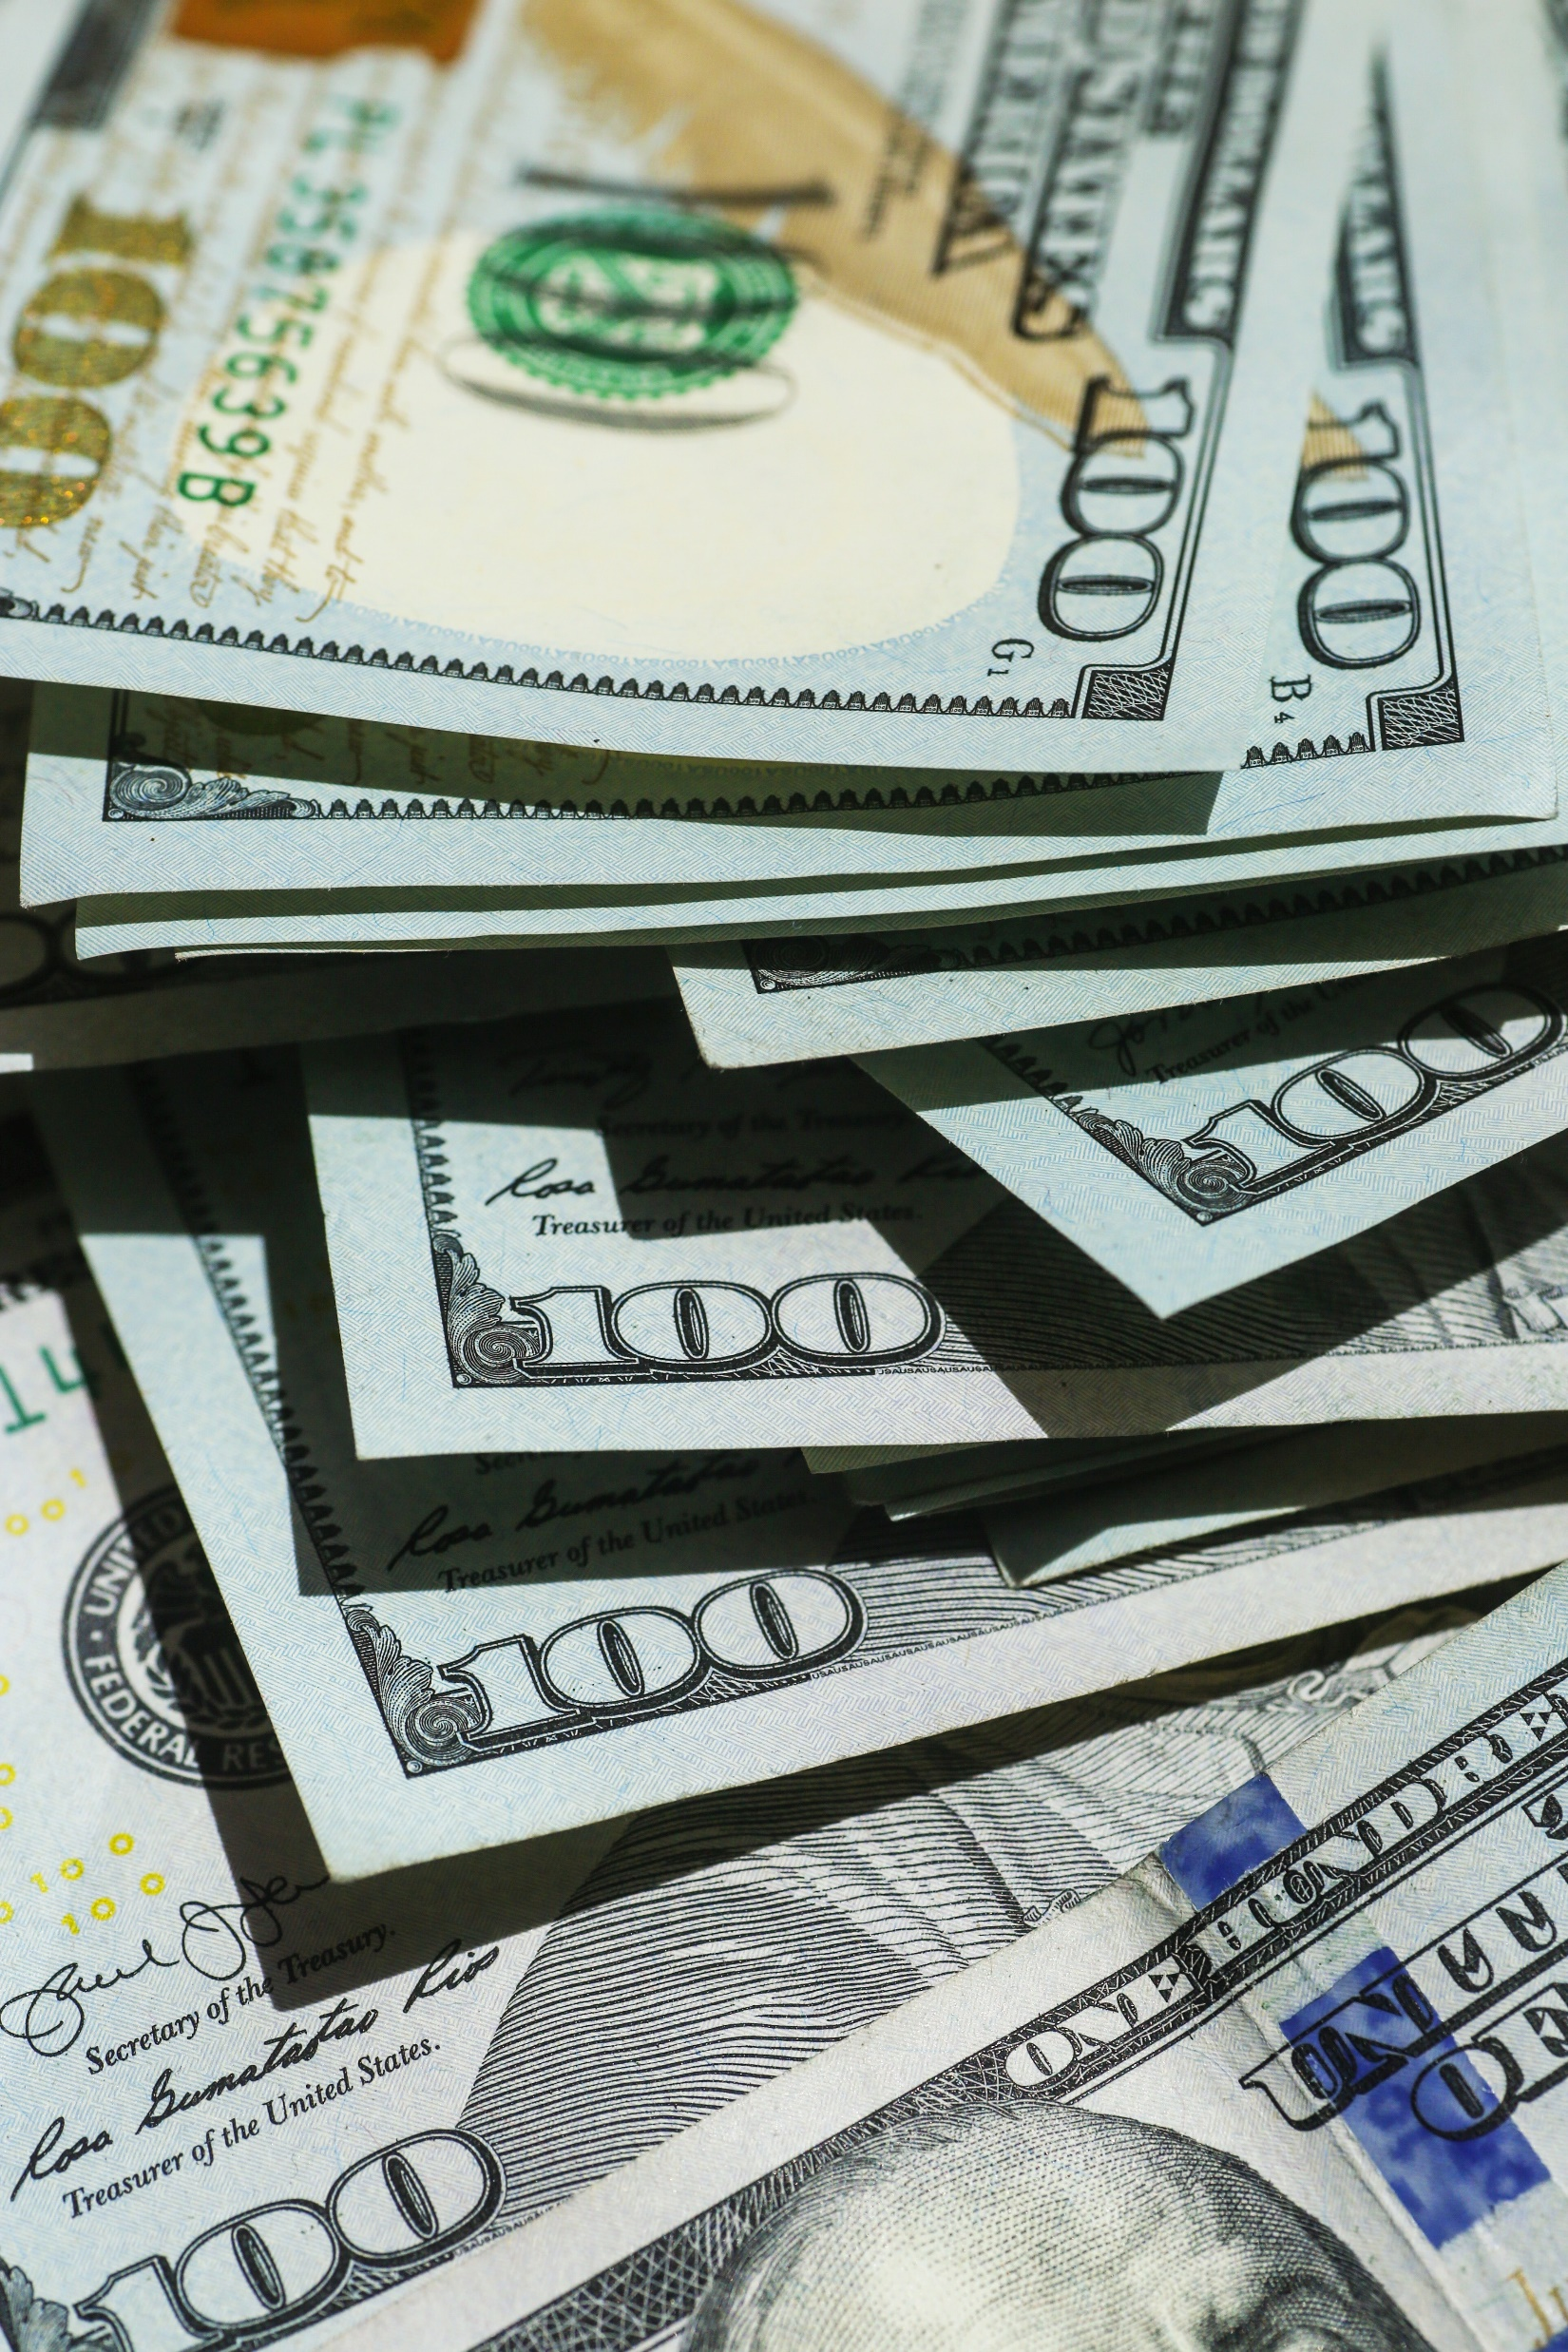
Benefits to Ethical Work/Decisions
For employees:
Pride in work, loyalty
Better retention, less turnover
Reduced conflict and tension
For customers:
Increased trust and loyalty
Photo by Giorgio Trovato on Unsplash
Notes:
Quoted and adapted From ACM talk on Ethics by Don Gotterbarn & Marty J. Wolf.

Slide 23
“Ethicking:” Making Ethical Decisions
First: an intuitive reaction
Second: slower, think and take time to:
Consider stakeholders and ethical elements.
Analyze the impact.
Review responsibilities and alternative approaches.
Evaluate the trade-offs.
Photo by Jonathan Borba on Unsplash
Notes:
Quoted and adapted From ACM talk on Ethics by Don Gotterbarn & Marty J. Wolf.

Slide 24
ACM Code of Ethics and Professional Conduct
General Principles:
Contribute to Society and Human well-being
Avoid harm
Be honest and trustworthy
Be fair; don’t discriminate
Respect work creative products
Respect privacy
Honor confidentiality
Photo by Matthew Henry on Unsplash
Notes:
1. All humans are stakeholders in computing. Are we all affected by Facebook, Google, and Twitter? Do our systems contribute to global warming? 2. Esp. important to avoid negative consequences when they are significant and unjust. Have computers killed people? Caused loss of money? 3. Fully disclose system capabilities, limits, and potential problems. Is it okay to say you know the R programming language if you can learn it on the job? 4. Foster fair participation by all people including underrepresented groups. Is it okay to not think about this when designing a loan approval system for a bank? 5. Credit originators of ideas and respect patents and copyright. 6. Tech can collect lots of data, use info only for legitimate ends, have transparent policies. 7. You will learn about aspects of a business in confidence, need to keep that.

Slide 25
ACM Code of Ethics and Professional Conduct
Professional Responsibilities:
Strive for high quality
Maintain high standards of competence, conduct, ethics
Know and respect rules of professional work
Accept and provide professional review
Photo by JC Gellidon on Unsplash
Notes:
1. Insist on and support high quality work. Your dignity and the dignity of your colleagues depends on it. 2. Technical knowledge and awareness of social context. Life-long learning. 3. Rules include laws and regulations. Abide by rules unless ethics dictates otherwise; then challenge the rule before violating it. Rule breaking will have consequences. 4. Seek and participate in peer and stakeholder review.

Slide 26
ACM Code of Ethics and Professional Conduct
Professional Responsibilities:
Give thorough evaluations
Only work in area of competence
Forster public awareness and understanding
Use resources only when authorized
Design/implement systems that are robust and secure
Photo by Christina @ wocintechchat.com on Unsplash
Notes:
5. We’re in a position of trust, must be perceptive, thorough and objective in evaluation. 6. Must evaluate potential work assignments; disclose lack of expertise. 7. Foster understanding of computing and tech. 8. Individuals and organizations have a right to restrict access to their systems and data.

Slide 27
ACM Code of Ethics and Professional Conduct
Leadership Principles:
Ensure public good
Encourage social responsibility
Manage personnel and resources to enhance quality of life
Support these principles
Help others grow as professionals
Careful modifying or retiring systems
Special care for systems society depends on
Photo by Artyom PJ on Unsplash
Notes:
Especially when acting as a leader: 1. Always make the public good a central concern. 2. Articulate, encourage, and evaluate fulfillment of social responsibilities to reduce harm to public and raise awareness of associated responsibilities. 3. Enhance and not degrade the quality of working life. 4. Communicate and uphold these principles. 5. support and encourage further education and enhancement of knowledge/skills. 6. Interface changes can affect productivity. 7. Society comes to depend on certain computing systems, even if business ones (such as Windows) but also government systems (healthcare.gov).

Slide 28
A case study
You work for a software firm
Request: simple changes to UI
In testing you note:
Left arrow accepts company’s product
Right arrow upgrades user & silently upgrades protection plan
What do you do?
Photo by michael podger on Unsplash
Notes:
This is the “Dark UX Pattern” case study from http://ethics.acm.org/code-of-ethics/using-the-code/case-dark-ux-patterns/.
Violates several principles (1-4). The design doesn’t respect the public good. But fighting back could lose the client and even get one fired!

Slide 29
Environment, Society
Can computing systems:
Harm the natural environment?
Harm society?
Photo by Studio Dekorasyon on Unsplash
Notes:
1. Climate change is one way. Paper waste could lead to cutting down more trees, and waste computers themselves could leach toxic chemicals … 2. Making us disconnected from each other. Throwing people out of work.

Slide 30
Conclusion
Pay attention to:
Business aspects
Satisfying customer needs
Generating cash
Producing return on investment
Growing profitably
Ethical aspects
Help Society
Do no harm
Photo by Bernard Hermant on Unsplash
Notes:
The main thing is to think about these considerations in the future.

Slide 31
Bibliography
Don Gotterbarn and Marty Wolf. “Leveraging the ACM Code of Ethics Against Ethical Snake Oil and Dodgy Development. June 2020. https://learning.acm.org/techtalks/acmethics

