Slide 1
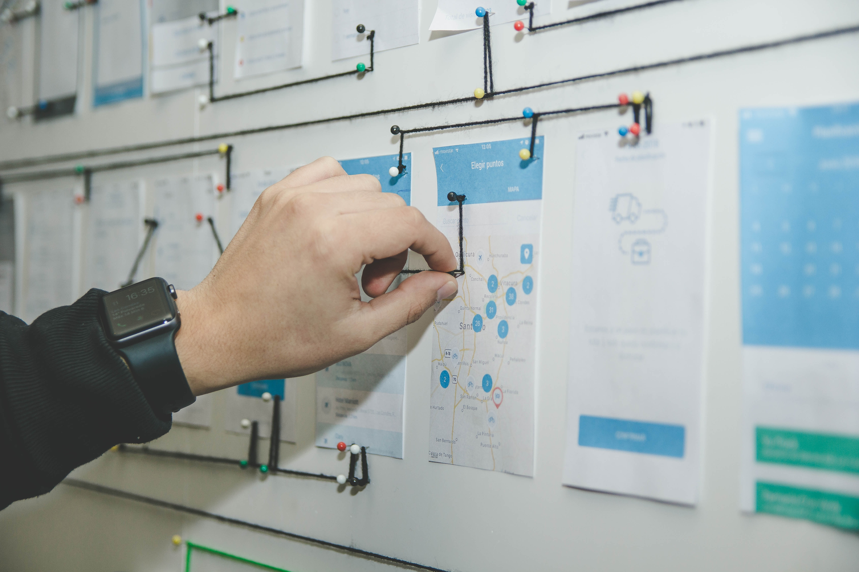
Today’s Plan
Final HW1 presentations
Overview of HW2
  Topics
  Group formation
Photo by Alvaro Reyes on Unsplash

Slide 2

Homework 2 Overview
Done in groups of two
  Groups same for further HW
  Specific to an enterprise
Email by Sept. 10:
  Group membership
  Enterprise
  Problem
  Kind of solution
  Preferred dates
Photo by Priscilla Du Preez on Unsplash

Slide 3

Topic selection
Focus on the problem
Both problem and solution
must be specific
Use resources from the
course resources page
Photo by Sebastian Herrmann on Unsplash

Slide 4

Advice on group formation
Interested in same kinds of enterprise:
  Large business
  Medium or small business
  Non-profit
  Government
Can meet
Photo by Tiomothy Swope on Unsplash

Slide 5
Zoom Breakout Rooms
Join a Breakout Room
based on your interests:
Large Businesses
Small to Medium Businesses
Non-profit Corps
Government Agencies
Photo by Priscilla Du Preez on Unsplash

Slide 6
How to Join a Breakout Room
To Join a Breakout Room
Click the JOIN button (at lower Right)
Turn on your microphone (and camera)
Click the “ASK FOR HELP” button to ask host for help
You will see a 60 second countdown when the breakouts are ending
Photo by Priscilla Du Preez on Unsplash
Notes:
On a phone, tell the host what room you want to be in.

