Slide 1
Welcome to COP 4910 Frontiers of IT
http://www.cs.ucf.edu/~leavens/COP4910
Prof. Gary T. Leavens Leavens@ucf.edu (407)823-4758
Office: HEC 329,
Office hours: TR 10:30-11:30 AM and 4:30-5:00 PM
Notes:
Welcome, Please ask questions at any time.

Slide 2
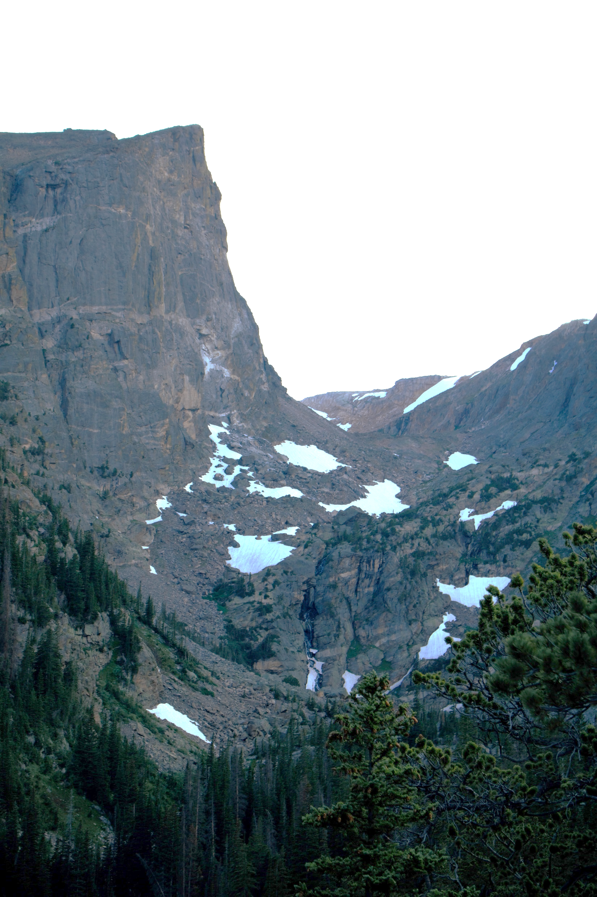
Outline
Course Objectives
Course Outcomes
Nuts and Bolts
Grading System
Photo by James Lee on Unsplash
Notes:
Today I’m going to explain the journey we are taking in this course…

Slide 3
High-level Summary of Course Objectives
Professionalism
Photo by Damir Kopezhanov on Unsplash
Notes:
We want to instill professional ideas, behaviors in you and given you practice with them.

Slide 4
Course Learning Objectives
You will be able to learn and teach others about innovations.
You will be able to:
[Discover] Discover innovations in IT,
[Evaluate] Evaluate their importance,
[Communicate] Effectively communicate them.
See www.cs.ucf.edu/~leavens/COP4910/about.shtml#objectives
Photo by Steve Halama on Unsplash
Notes:
Why is this useful for your career?

Slide 5
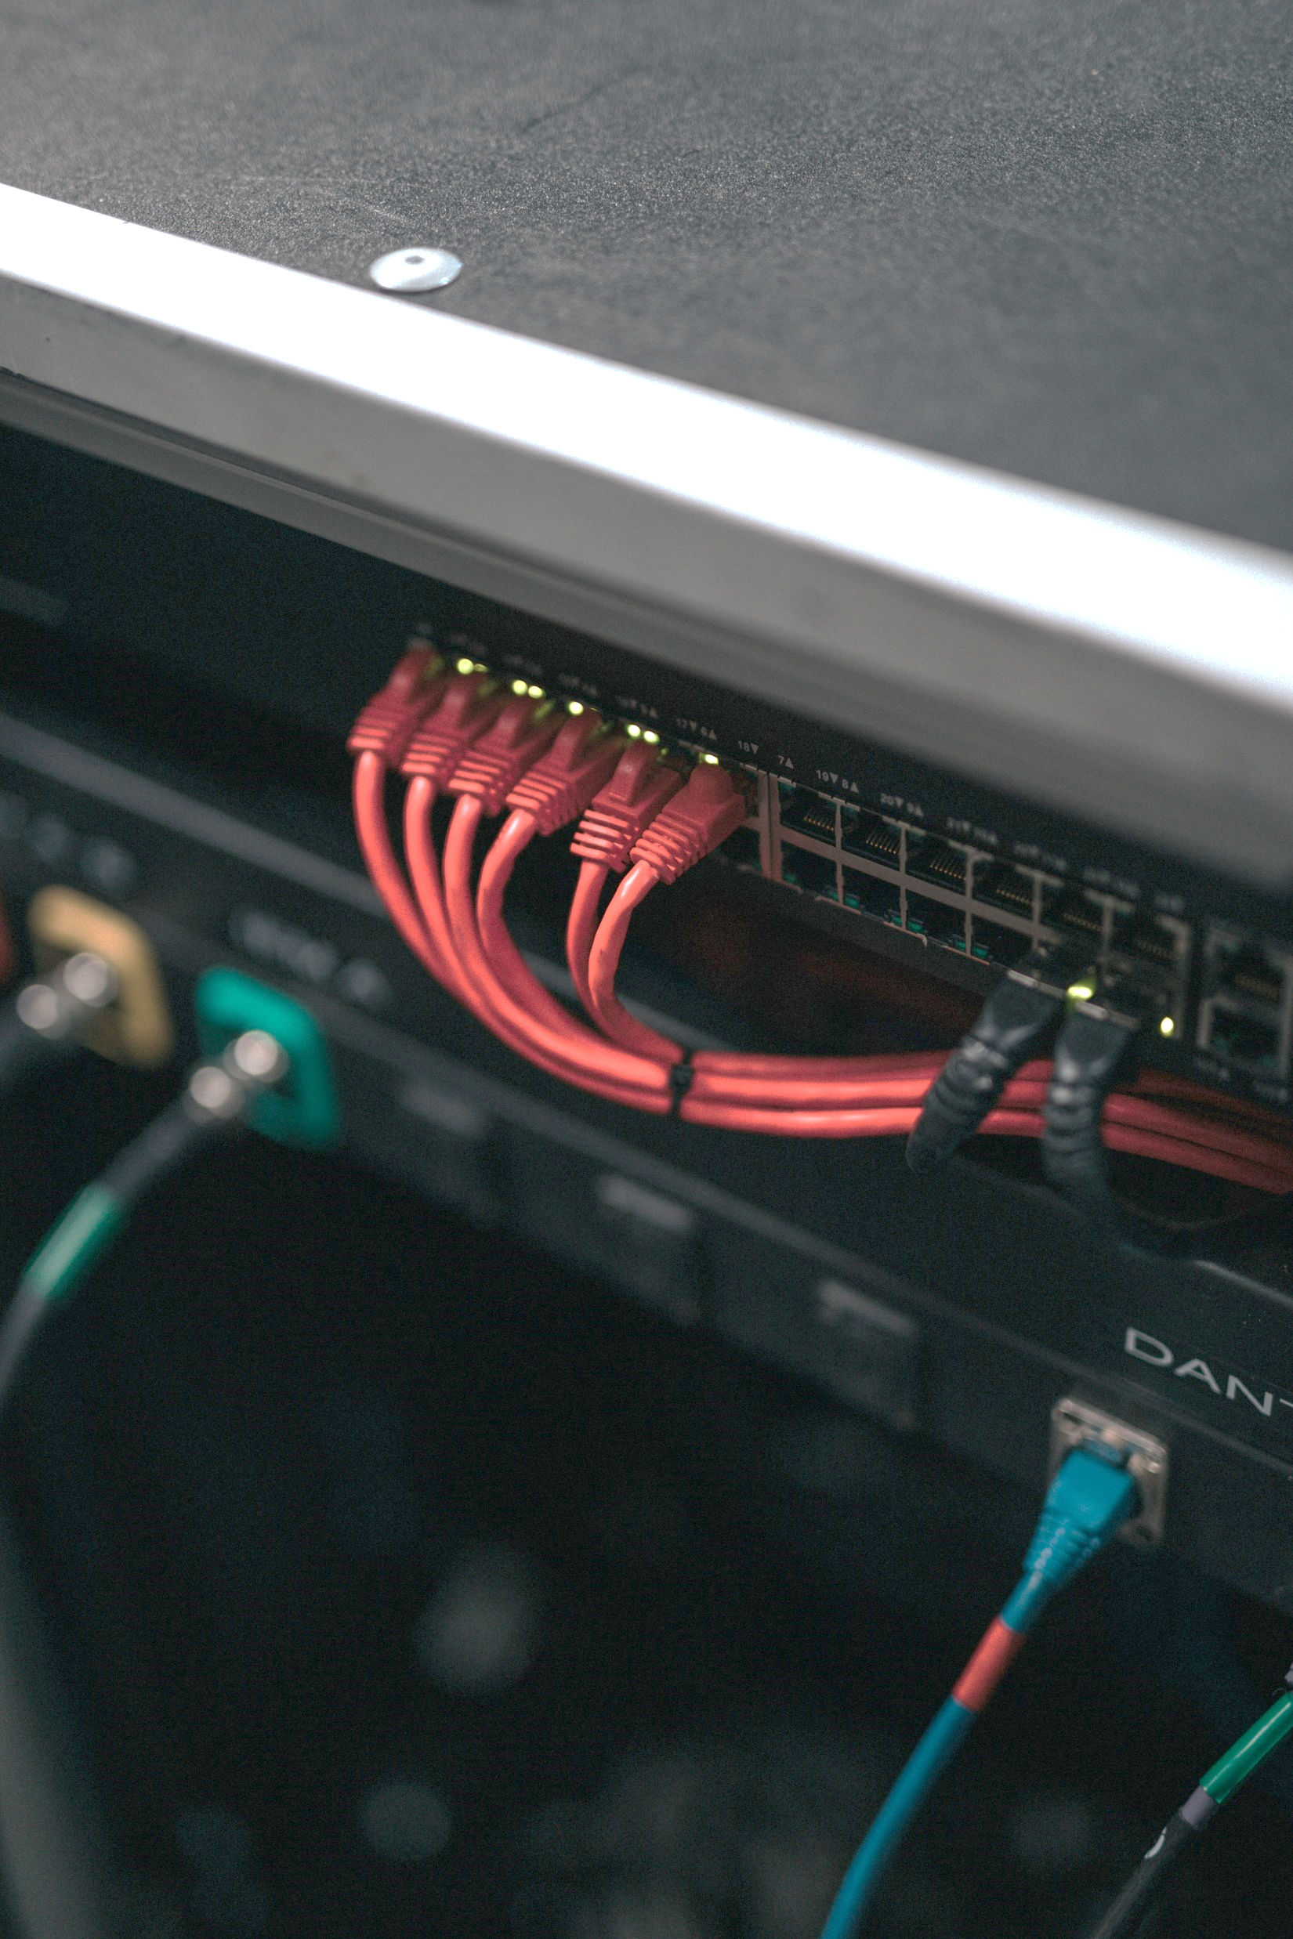
Course Learning Outcomes
Effectively communicate the importance and implications of innovations.
You will be able to:
[Present] Clearly and effectively present ideas, importance, and implications of innovations,
[Write] Clearly and effectively communicate in writing,
[Judge] Give a well-reasoned judgment about the importance and implications, and
[Find] Find new innovations.
See: www.cs.ucf.edu/~leavens/COP4910/about.shtml#outcomes
Photo by Nathan Dumlao on Unsplash
Notes:
Finding them comes first in time, but presentation will be what we do…

Slide 6
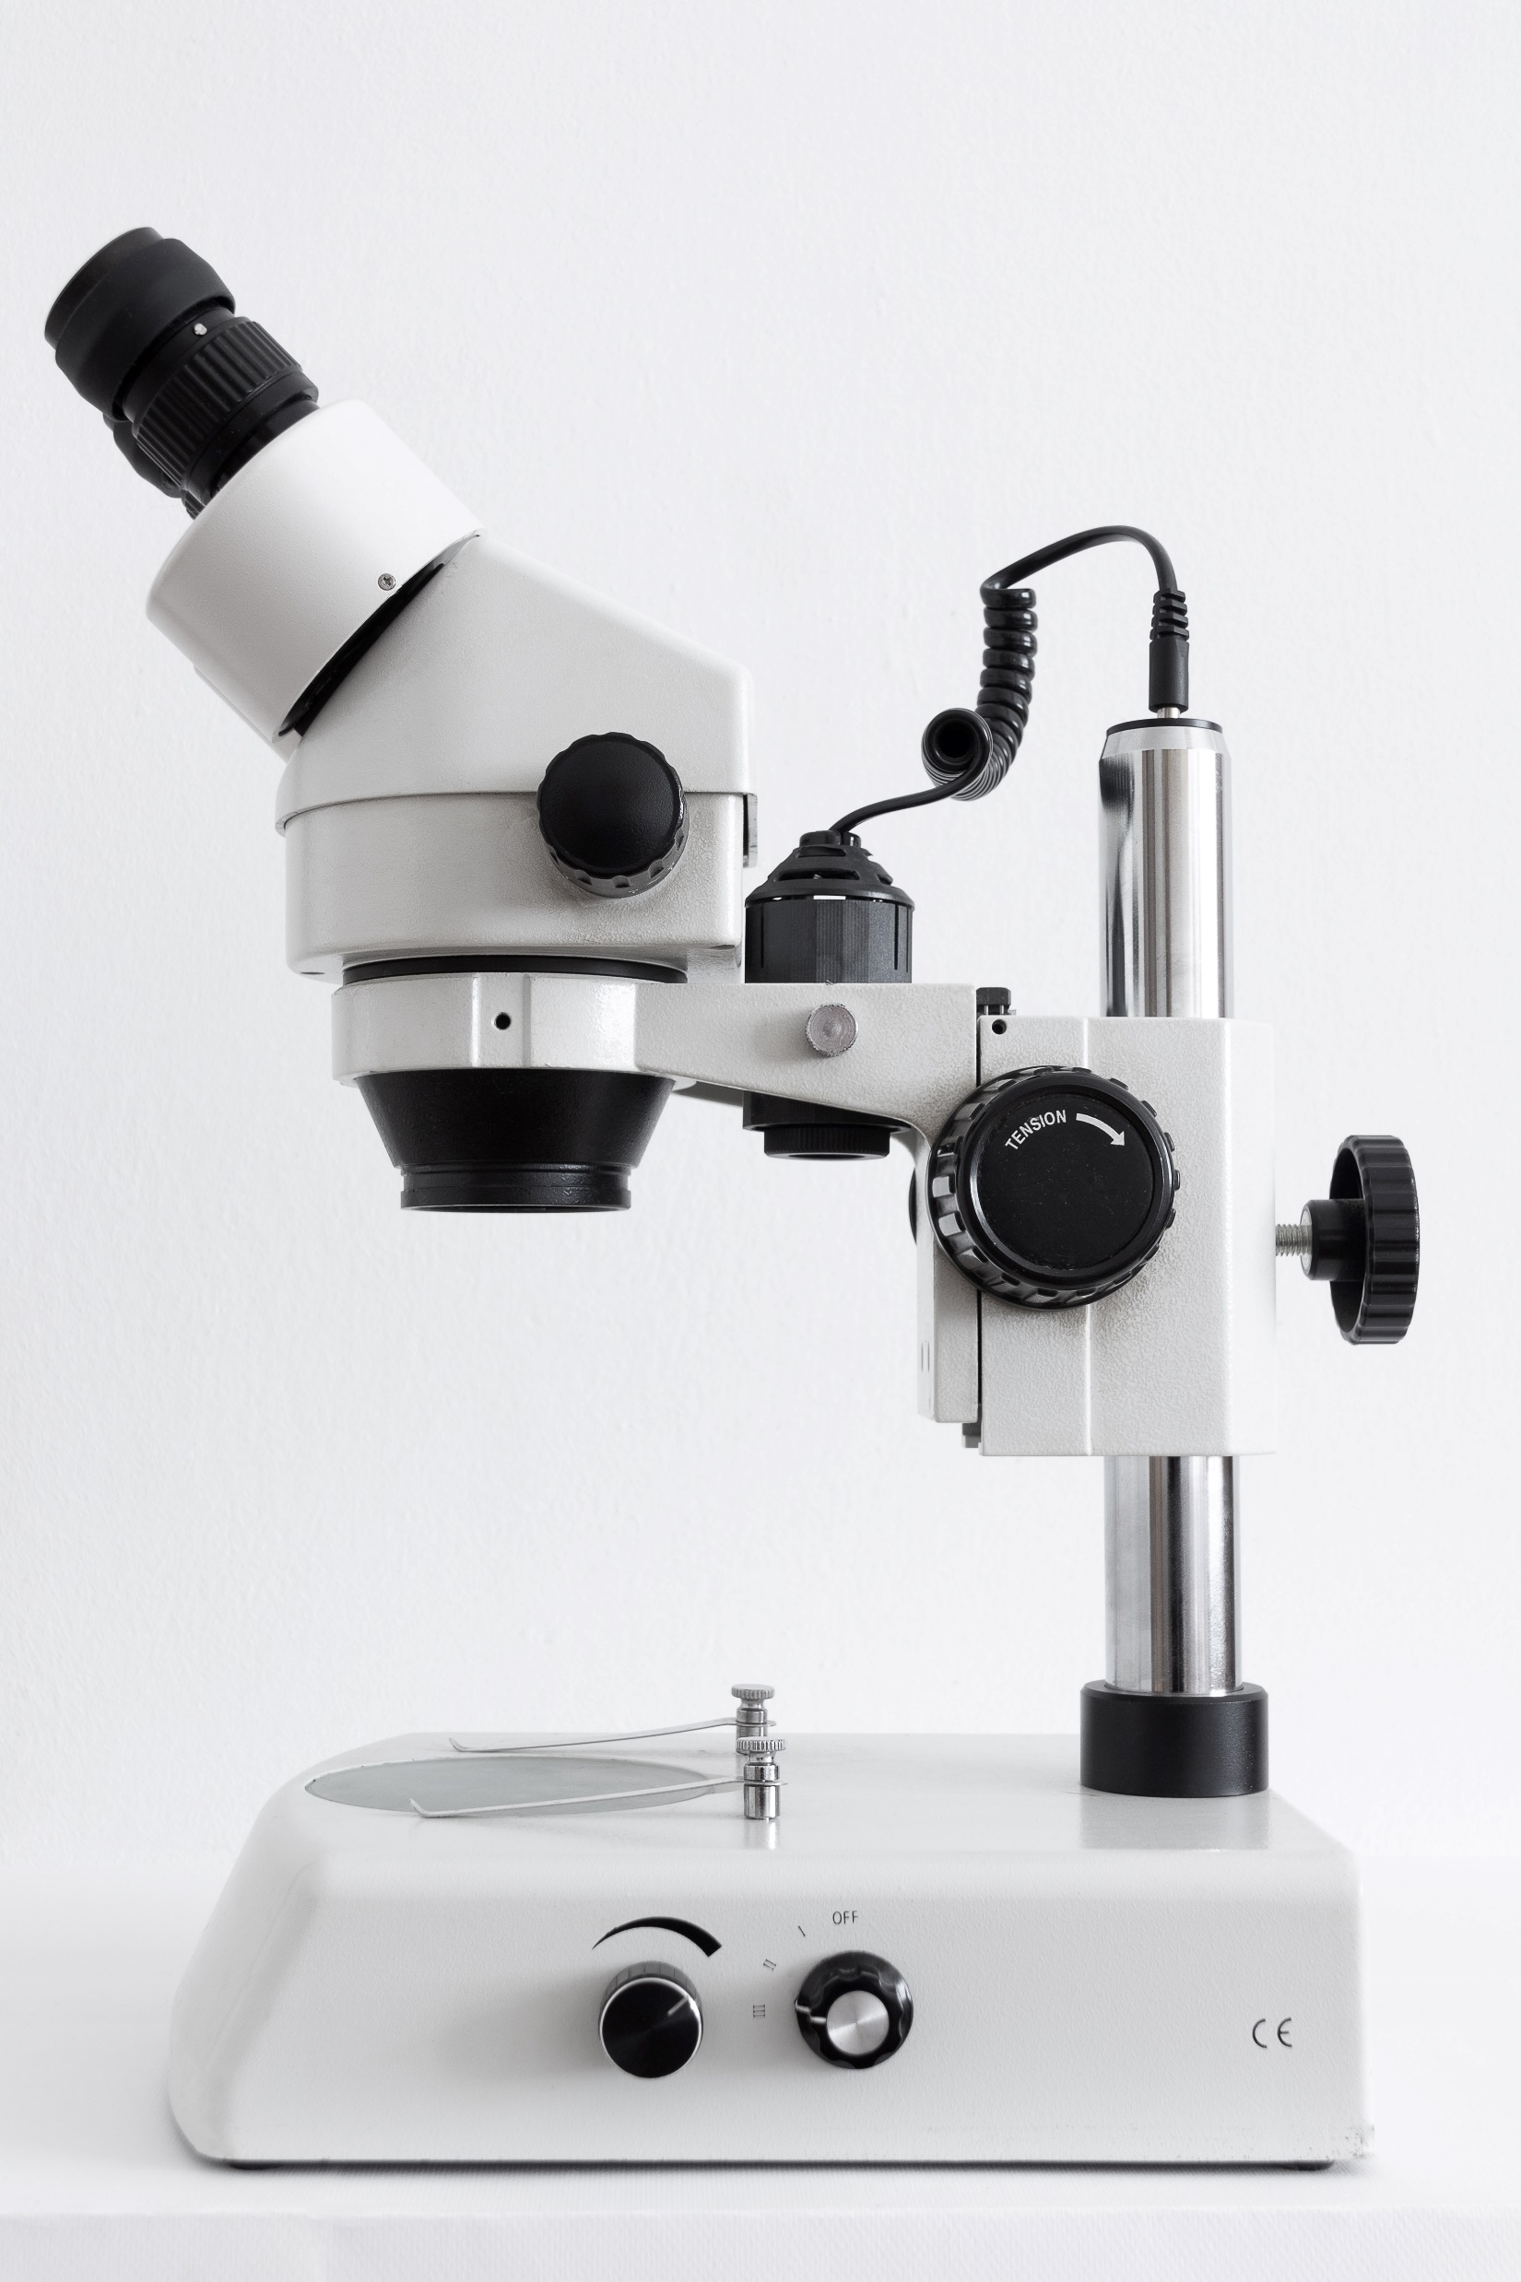
Details
No textbook
web: www.cs.ucf.edu/~leavens/COP4910/
Grading: ABCDF
no +/- grades,
no curve grading
Final grades:
50% presentations
10% participation
40% report
Details about assignments on web
Photo by Paweł Czerwiński on Unsplash

Slide 7
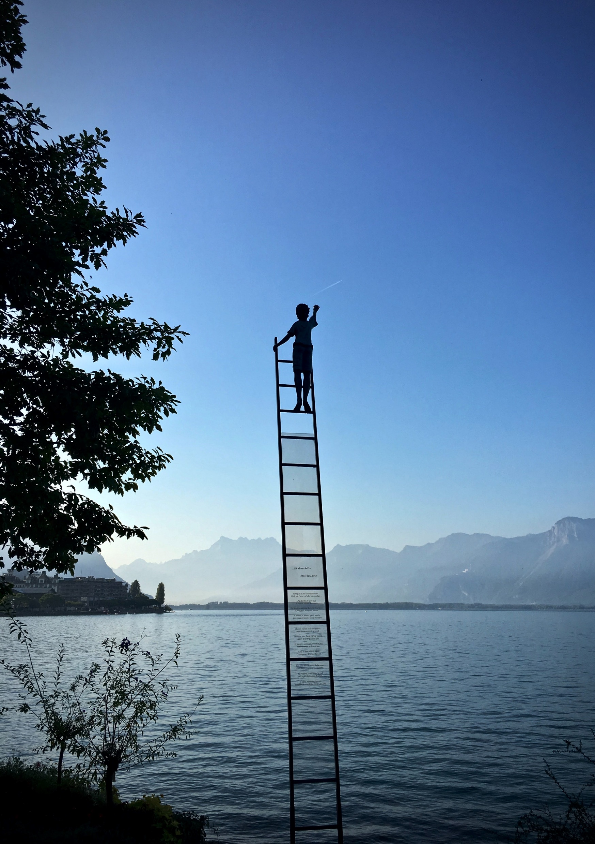
Grading Scale
Final grade based on weighted percentage
Percentage | Grade
90% | A
80% | B
70% | C
55% | D
less | F
Photo by Armand Khoury on Unsplash

Slide 8
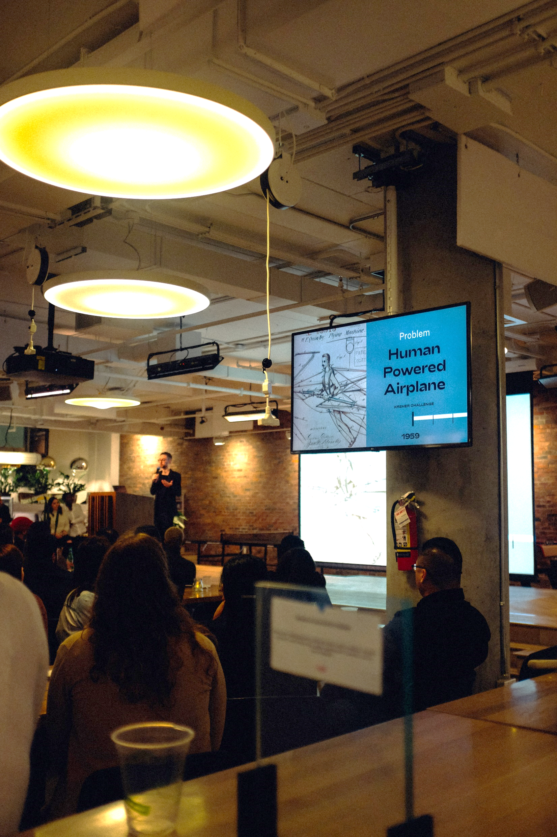
Participation Grade
10% of your final grade
Attendance
+ Asking Good Questions (starting with HW2)
Asking good questions
Ask one professional question per class meeting
Max of 2 points per class meeting
Critical Reviews
Can do 2 per homework
Max of 10 points per critical review
Photo by Charles Deluvio on Unsplash

Slide 9
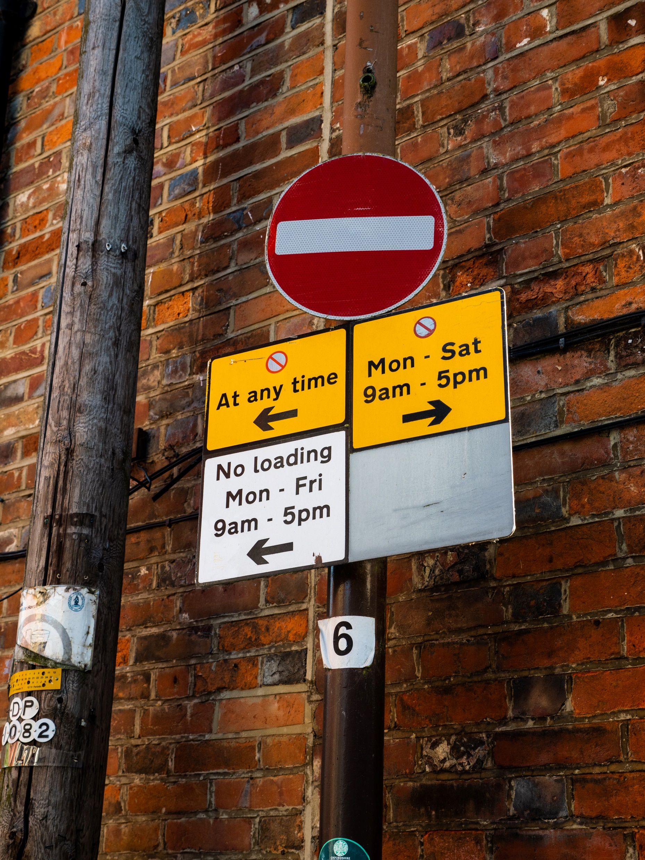
Penalties and Bonus
Penalties for:
Not attending
Not being ready to present (unless you swap)
Bonus:
Presenting on first or second day of a topic
Photo by Matt Seymour on Unsplash

Slide 10
Motivating Story
I’m the CEO of our enterprise
You are being mentored to be a CIO
Photo by Damir Kopezhanov on Unsplash
Notes:
So, I want you to succeed in your IT career and become a CIO. For that you must understand a lot of skills, not just technical ideas, but also about the business and how you can help make it grow and prosper, as that is how you can advance your career.

Slide 11
“Soft Skills” You Need
Listening
Critical Thinking
Communicating
Professionalism
Photo by Charles Deluvio on Unsplash

Slide 12
Questions and Critical Reviews
Questions
To help the enterprise
Critical Review
To summarize for the CEO
Photo by Damir Kopezhanov on Unsplash

Slide 13
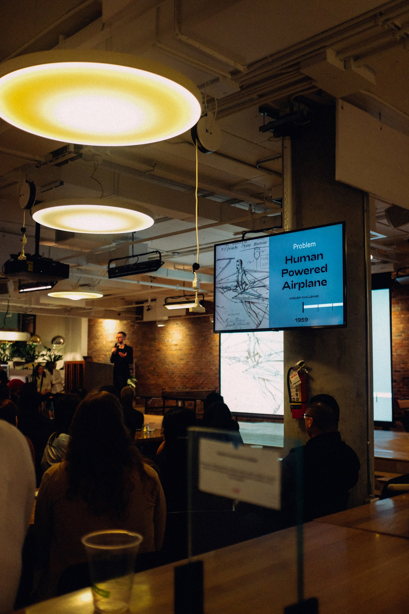
Homework 1: What IT Means to You
4 slide presentation file due Friday 11:59 PM
2-4 min presentation on Tues (or Thurs) in class:
Title Slide with your name
Slides that answer these questions:
(a) What can IT do to help?
(b) What is and is not IT?
(c) What kind of enterprise am I interested in?
See https://www.cs.ucf.edu/~leavens/COP4910/homeworks/hw1.pdf
Photo by Charles Deluvio on Unsplash
Notes:
By “I” here I mean you (the student), not Gary the teacher…

Slide 14
What is an “Enterprise”?
Business
Large
Small
Photo by Zane Lee on Unsplash
Notes:
What are examples of each of these?

Slide 15
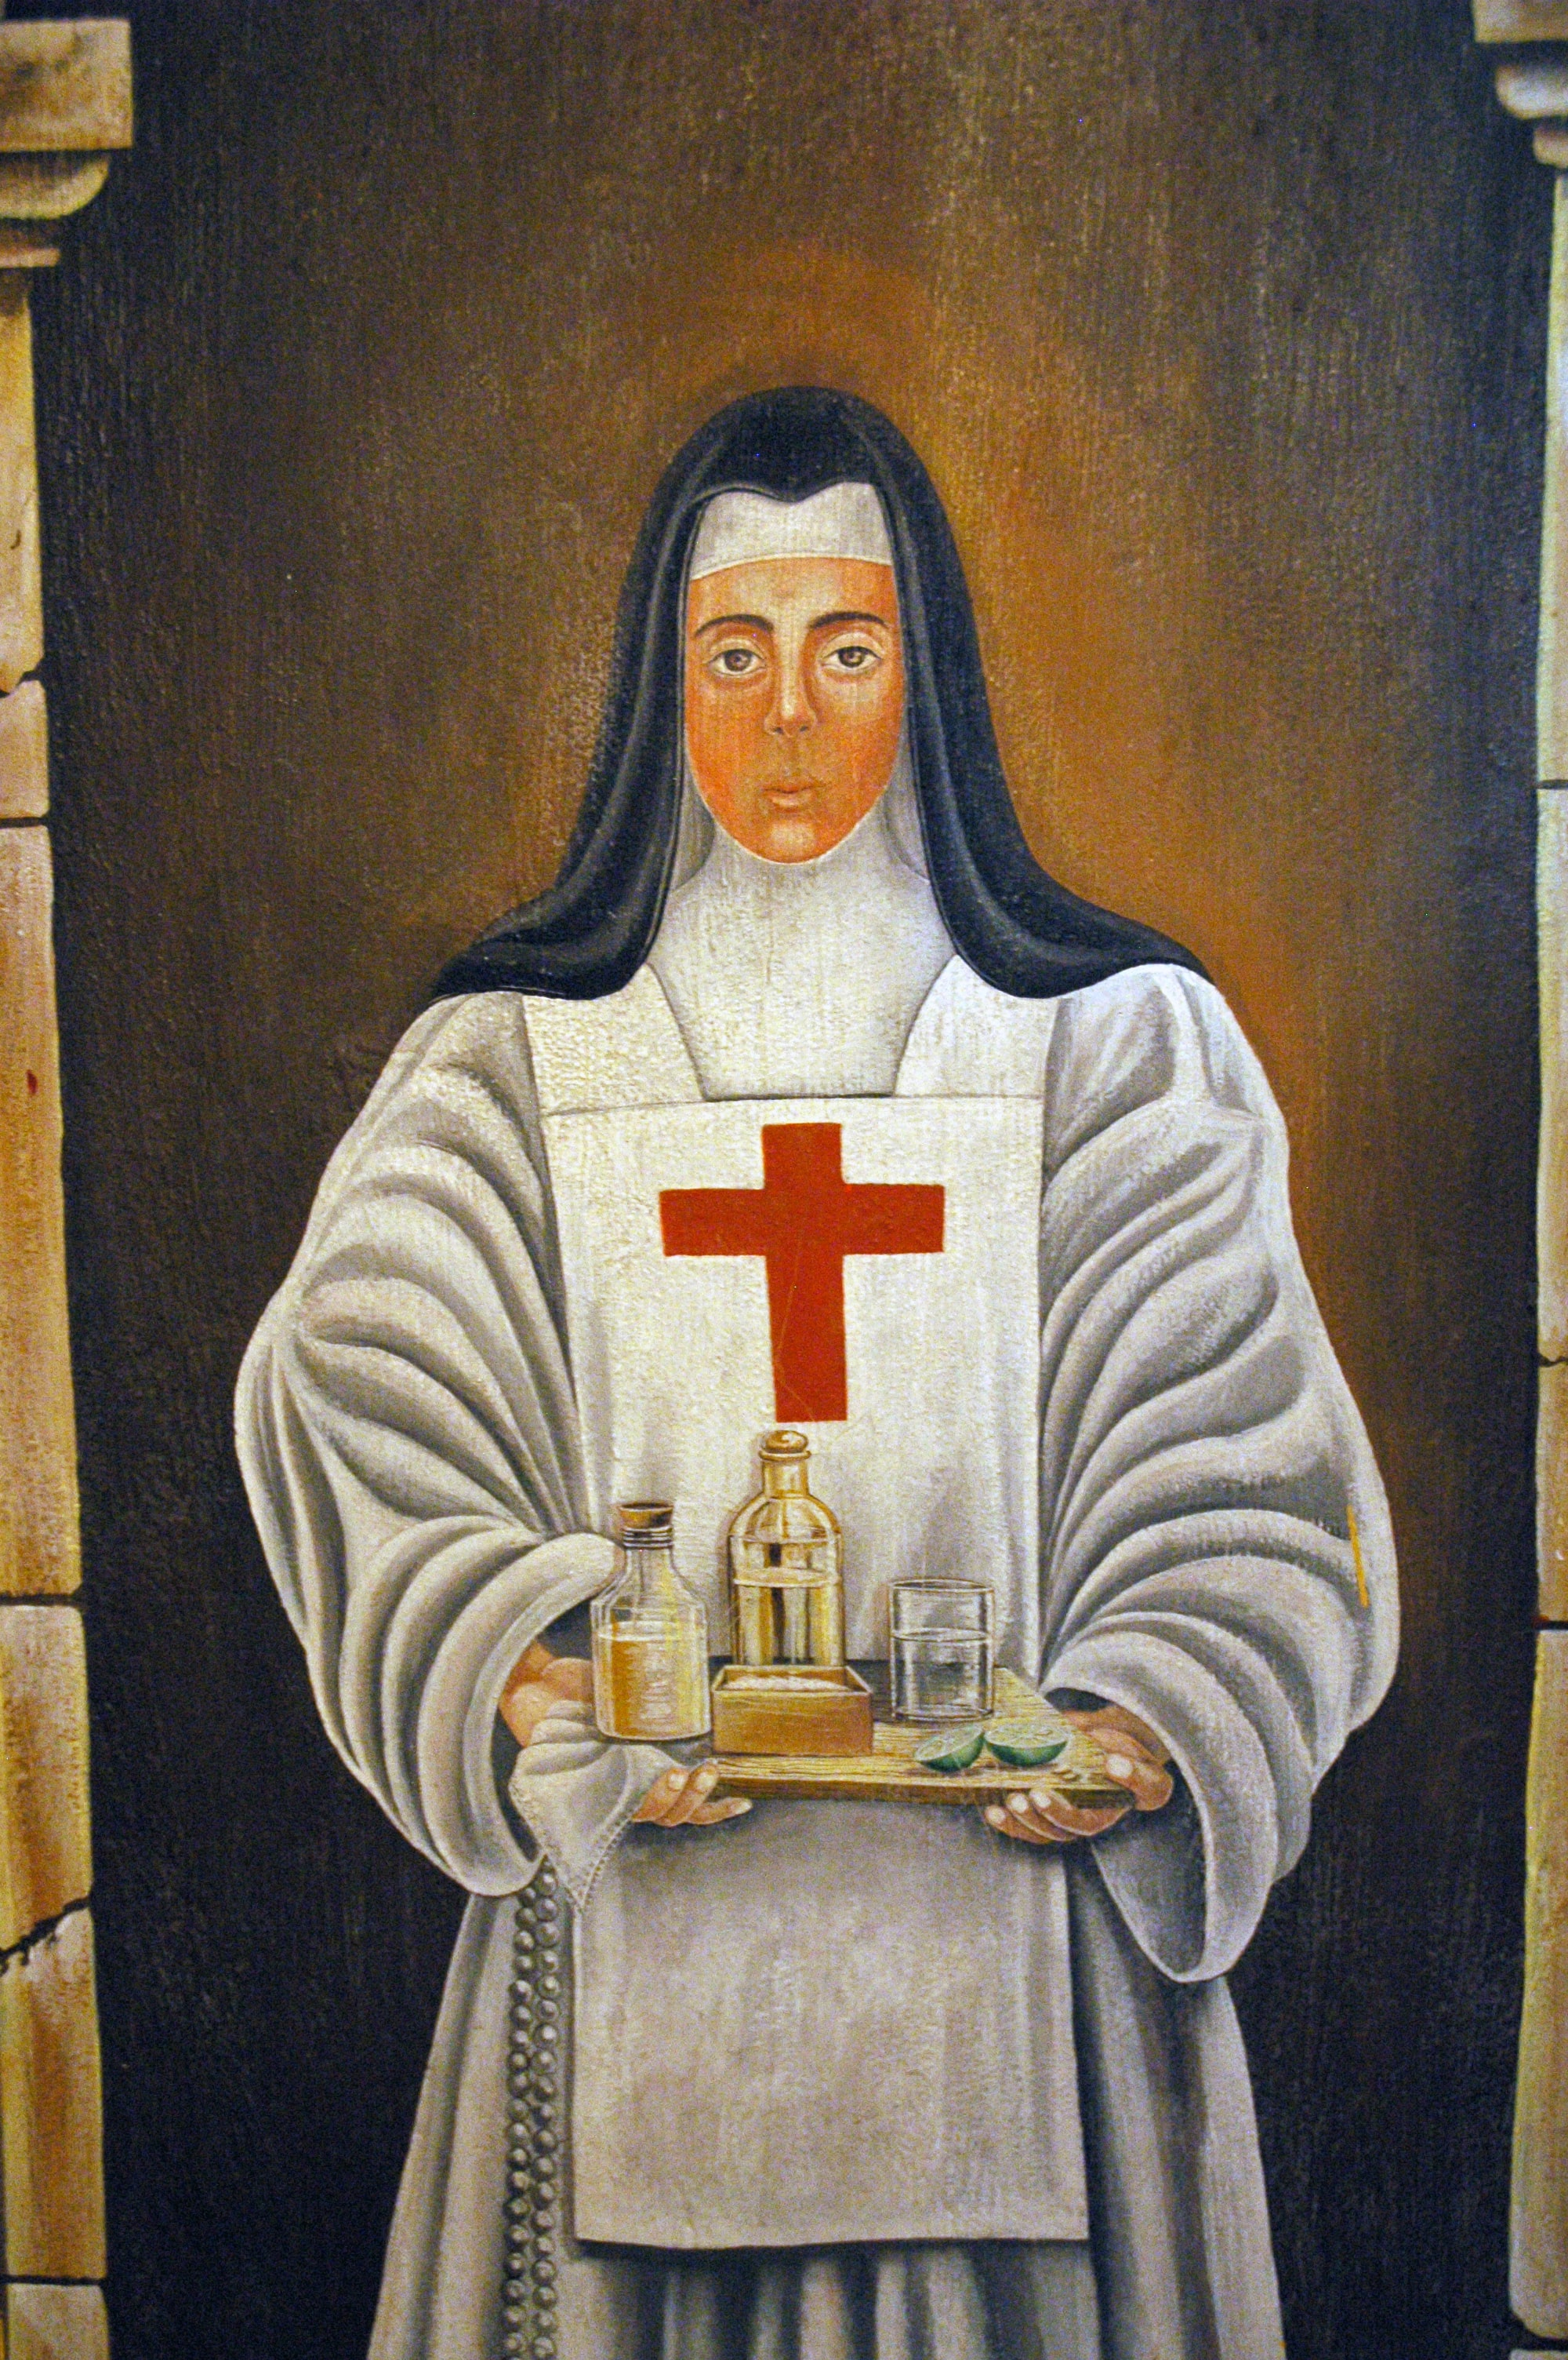
What is an “Enterprise”?
Business
Large
Small
Non-profit organization
Photo by Wonderlane on Unsplash
Notes:
What are examples of each of these?

Slide 16
What is an “Enterprise”?
Business
Large
Small
Non-profit organization
Government Agency
Photo by Fas Khan on Unsplash
Notes:
What are examples of each of these?

Slide 17
What is Information Technology (IT)?
What is it not?
How is IT different from:
Computer Science,
Computer Engineering,
Information Science (IS), and
Management Information Systems (MIS)?
Photo by Nathan Dumlao on Unsplash
Notes:
Have a discussion about this, there’s no one right answer.

