Slide 1
Chapter 9: Virtual Memory

Slide 2
Background
Virtual memory – separation of user logical memory from physical memory.
  Only part of the program needs to be in memory for execution
  Logical address space can therefore be much larger than physical address space
  Allows address spaces to be shared by several processes
  Allows for more efficient process creation
Virtual memory can be implemented via:
  Demand paging
  Demand segmentation

Slide 3
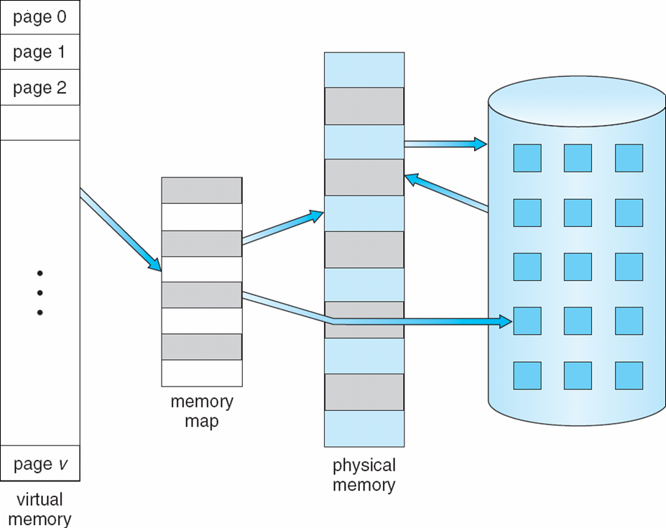
Virtual Memory That is Larger Than Physical Memory
⇒

Slide 4
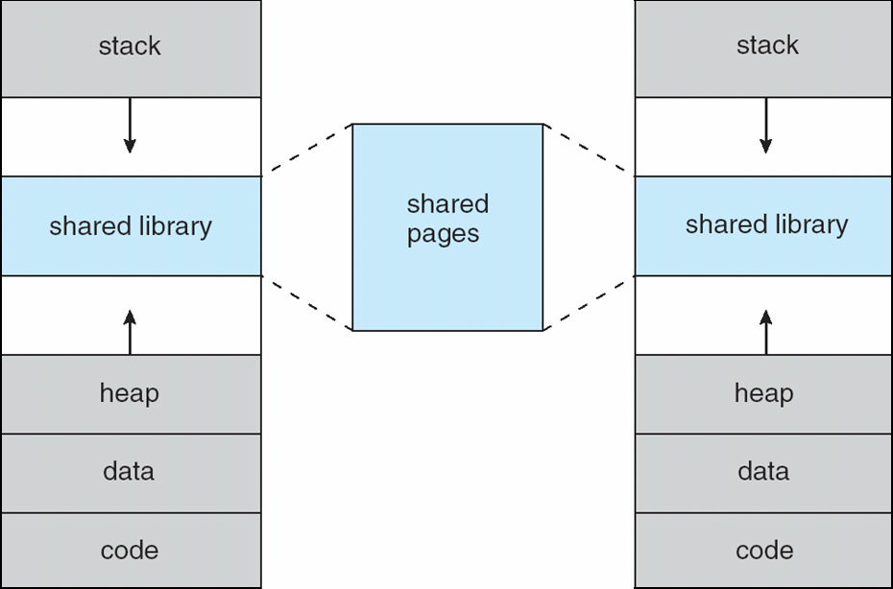
Shared Library Using Virtual Memory

Slide 5
Demand Paging
Bring a page into memory only when it is needed
  Less I/O needed
  Less memory needed
  Faster response
  More users
Page is needed ⇒ reference to it
  invalid reference ⇒ abort
  not-in-memory ⇒ bring to memory
Lazy swapper – never swaps a page into memory unless page will be needed
  Swapper that deals with pages is a pager

Slide 6
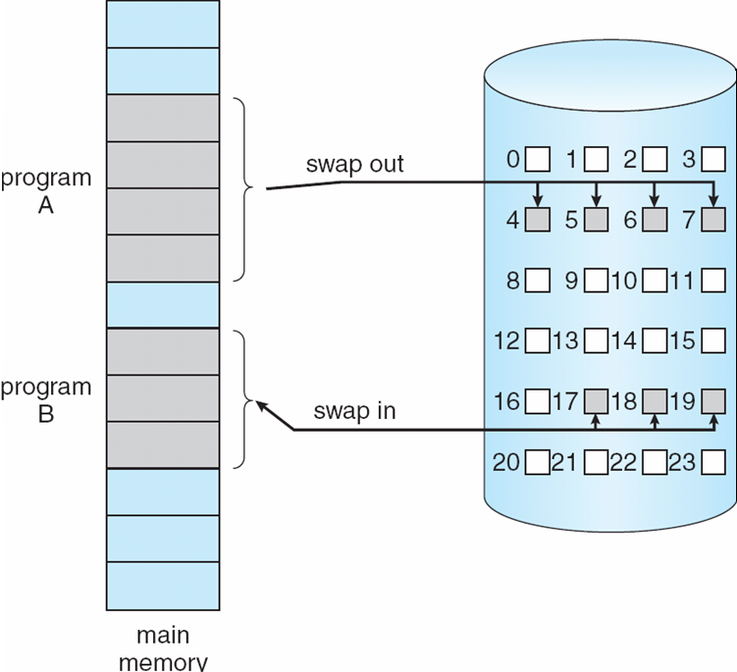
Transfer of a Paged Memory to Contiguous Disk Space

Slide 7
Valid-Invalid Bit
With each page table entry a valid–invalid bit is associated
(v ⇒ in-memory, i ⇒ not-in-memory)
Initially valid–invalid bit is set to i on all entries
Example of a page table snapshot:
During address translation, if valid–invalid bit in page table entry
is I ⇒ page fault
Frame #
valid-invalid bit
v
v
v
v
i
….
i
i
page table

Slide 8
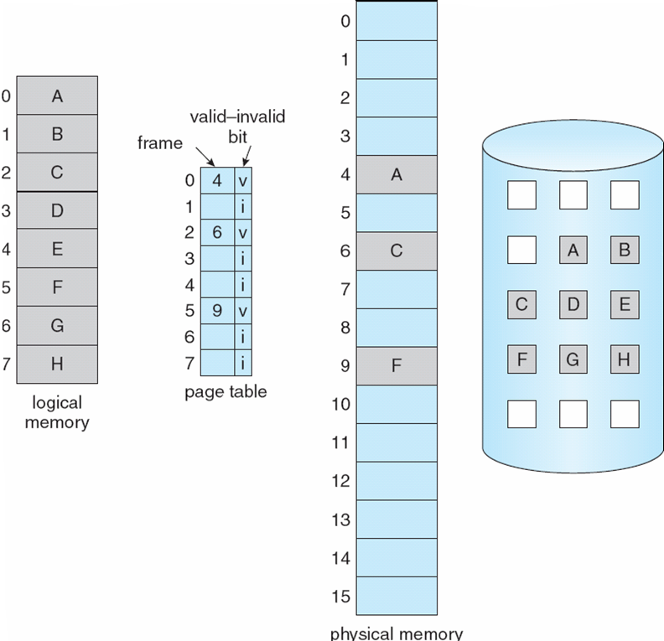
Page Table When Some Pages Are Not in Main Memory

Slide 9
Page Fault
If there is a reference to a page, first reference to that page will trap to operating system:
page fault
Operating system looks at another table to decide:
  Invalid reference ⇒ abort
  Just not in memory
Get empty frame
Swap page into frame
Reset tables
Set validation bit = v
Restart the instruction that caused the page fault

Slide 10
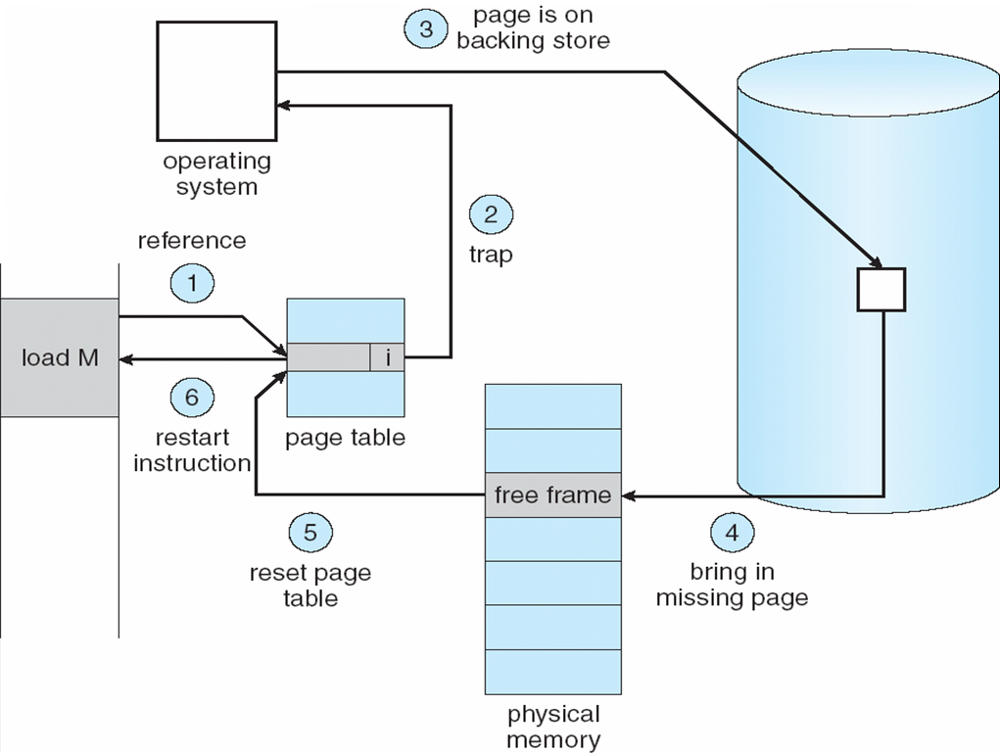
Steps in Handling a Page Fault

Slide 11
Performance of Demand Paging
Page Fault Rate 0 ≤ p ≤ 1.0
  if p = 0 no page faults
  if p = 1, every reference is a fault
Effective Access Time (EAT)
EAT = (1 – p) x memory access
+ p (page fault overhead
+ swap page out
+ swap page in
+ restart overhead
)

Slide 12
Demand Paging Example
Memory access time = 200 nanoseconds
Average page-fault service time = 8 milliseconds
EAT = (1 – p) x 200 + p (8 milliseconds)
= (1 – p x 200 + p x 8,000,000
= 200 + p x 7,999,800
If one access out of 1,000 causes a page fault, then
EAT = 8.2 microseconds.
This is a slowdown by a factor of 40!!

Slide 13
Process Creation
Virtual memory allows other benefits during process creation:
- Copy-on-Write
- Memory-Mapped Files (later)

Slide 14
Copy-on-Write
Copy-on-Write (COW) allows both parent and child processes to initially share the same pages in memory
If either process modifies a shared page, only then is the page copied
COW allows more efficient process creation as only modified pages are copied
Free pages are allocated from a pool of zeroed-out pages

Slide 15
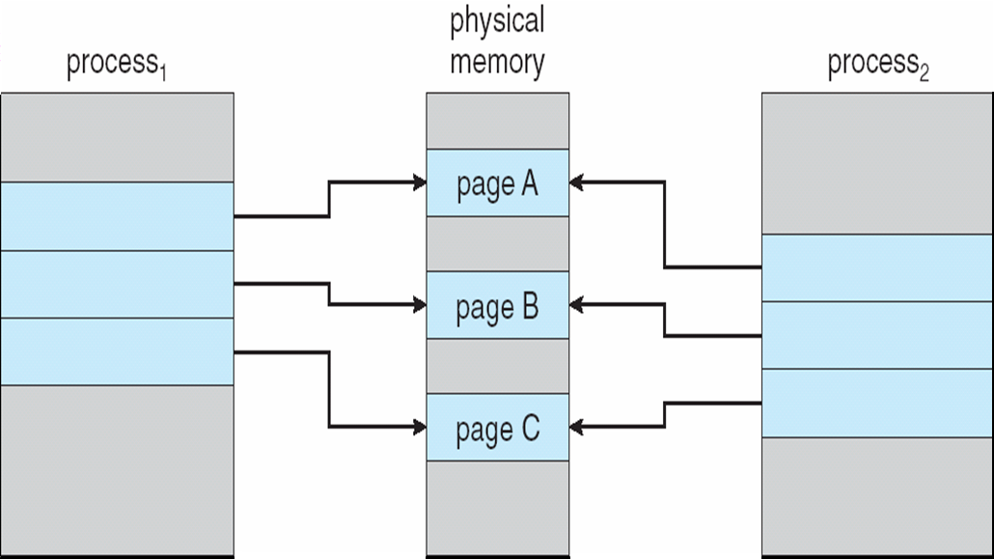
Before Process 1 Modifies Page C

Slide 16
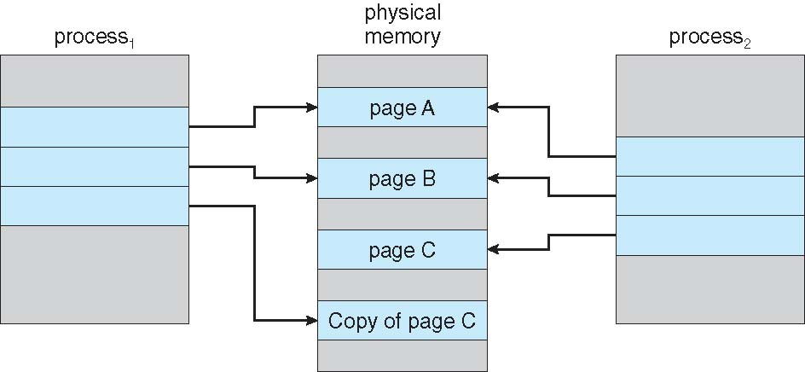
After Process 1 Modifies Page C

Slide 17
What happens if there is no free frame?
Page replacement – find some page in memory, but not really in use, swap it out
  algorithm
  performance – want an algorithm which will result in minimum number of page faults
Same page may be brought into memory several times

Slide 18
Page Replacement
Prevent over-allocation of memory by modifying page-fault service routine to include page replacement
Use modify (dirty) bit to reduce overhead of page transfers – only modified pages are written to disk
Page replacement completes separation between logical memory and physical memory – large virtual memory can be provided on a smaller physical memory

Slide 19
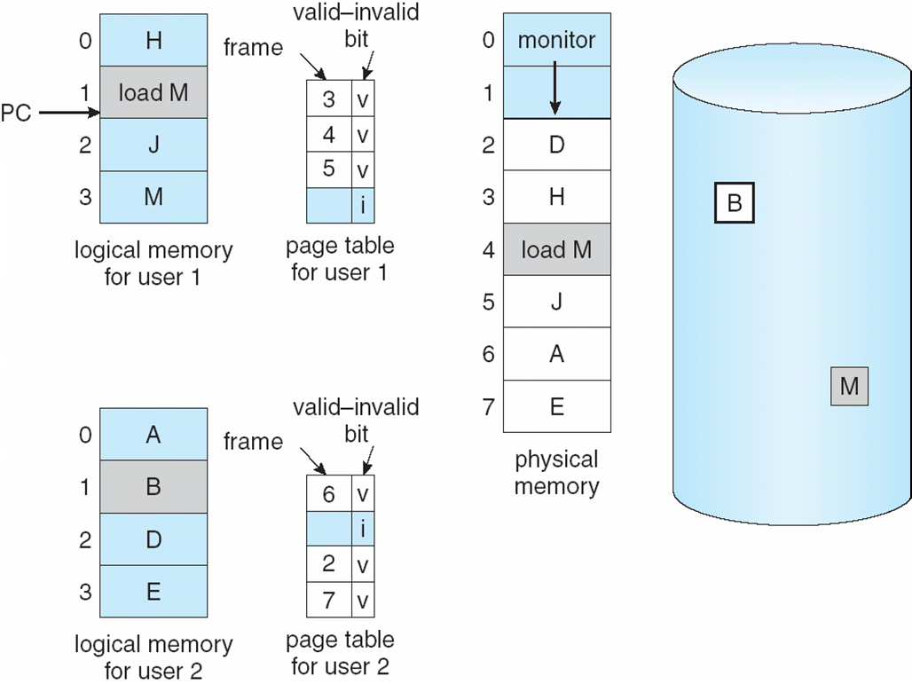
Need For Page Replacement

Slide 20
Basic Page Replacement
Find the location of the desired page on disk
Find a free frame:
- If there is a free frame, use it
- If there is no free frame, use a page replacement algorithm to select a victim frame
Bring the desired page into the (newly) free frame; update the page and frame tables
Restart the process

Slide 21
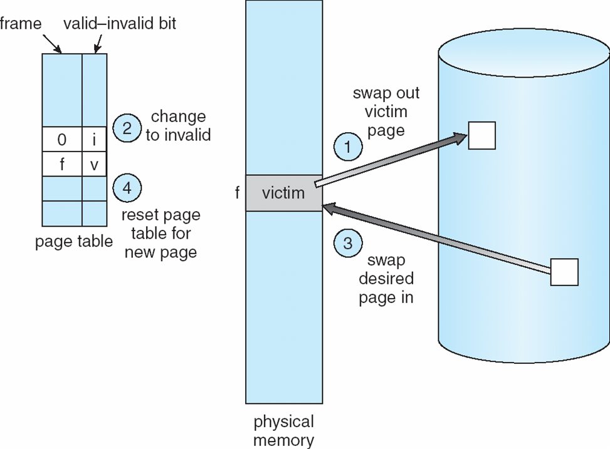
Page Replacement

Slide 22
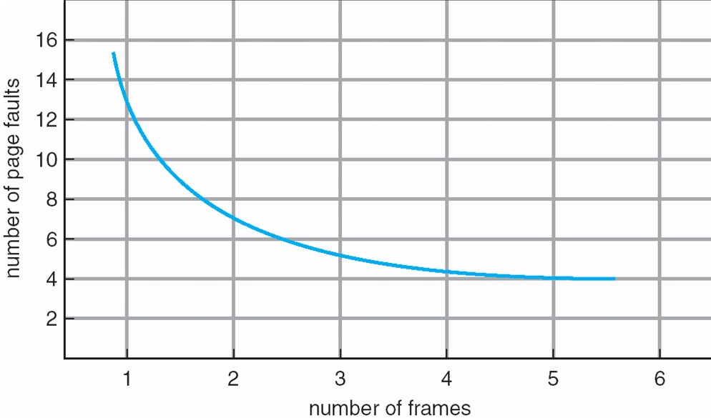
Graph of Page Faults Versus The Number of Frames
Under normal circumstances, the more frames you have allocated to the process, the lower the number of page faults.
If the number of pages == number of frames, no page fault will happen.
But weird things can happen… see below.

Slide 23
Page Replacement Algorithms
Want lowest page-fault rate
Evaluate algorithm by running it on a particular string of memory references (reference string) and computing the number of page faults on that string

Slide 24
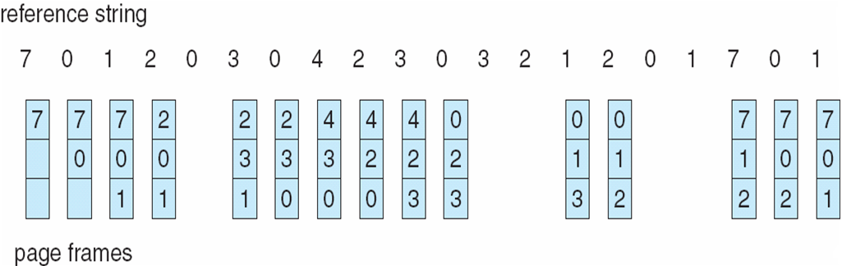
FIFO Page Replacement
Replace the page which had been in the memory the longest.
Easy to implement, because you don’t need to look at accesses!!!

Slide 25
Problems with FIFO
Reference string: 1, 2, 3, 4, 1, 2, 5, 1, 2, 3, 4, 5
3 frames (3 pages can be in memory at a time per process)
4 frames
Belady’s Anomaly: more frames ⇒ more page faults
1
1
4
5
2
2
1
3
9 page faults
3
3
2
4
1
1
5
4
2
2
1
5
10 page faults
3
3
2
4
4
3

Slide 26
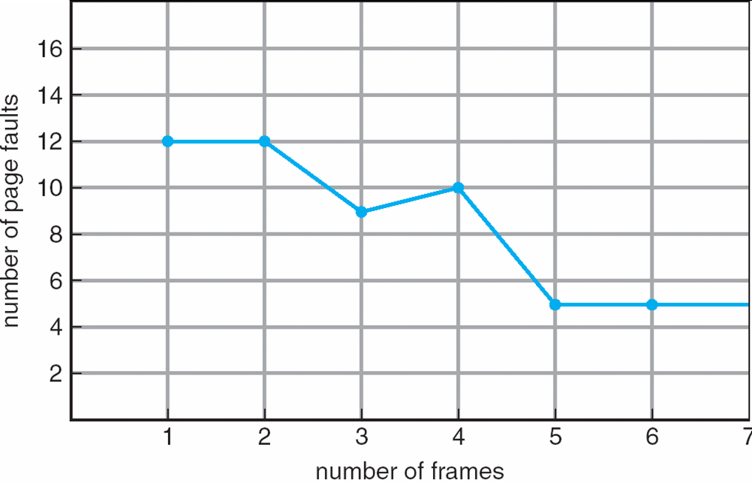
Belady’s Anomaly
Named after László Bélády, Hungarian computer scientist working at IBM research.
For certain types of loads, with a FIFO replacement, the number of page faults increases when more frames are allocated!

Slide 27
Optimal Algorithm
Replace page that will not be used for longest period of time
4 frames example
1, 2, 3, 4, 1, 2, 5, 1, 2, 3, 4, 5
How do you know this?
  This is not a practical algorithm, it requires you to look into the future!
  Only useful for measuring how well your algorithm performs, as a base of comparison.
1
4
2
6 page faults
3
4
5

Slide 28
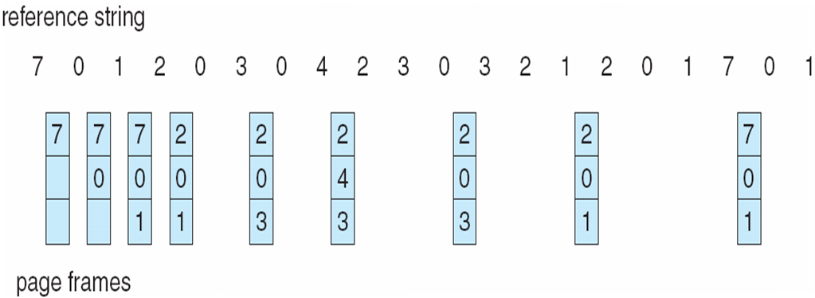
Optimal Page Replacement

Slide 29
Least Recently Used (LRU) Algorithm
Reference string: 1, 2, 3, 4, 1, 2, 5, 1, 2, 3, 4, 5
Counter implementation
  Every page entry has a counter; every time page is referenced through this entry, copy the clock into the counter
  When a page needs to be replaced, look at the counters to determine which one to replace – it will be the one with the lowest counter.
1
1
1
1
5
2
2
2
2
2
3
5
5
4
4
4
4
3
3
3

Slide 30
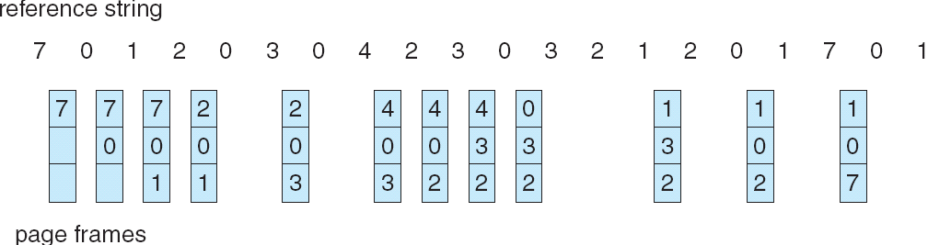
LRU Page Replacement
Is it possible to implement it?
  Yes, we are looking into the past, not into the future.
But it is expensive:
  We need to keep track of all the accesses, and update the counters!

Slide 31
LRU Approximation Algorithms
Reference bit
  With each page associate a bit, initially = 0
  When page is referenced bit set to 1
  Replace the one which is 0 (if one exists)
    We do not know the order, however
Second chance
  Need reference bit
  Clock replacement
  If page to be replaced (in clock order) has reference bit = 1 then:
    set reference bit 0
    leave page in memory
    replace next page (in clock order), subject to same rules

Slide 32
Allocation of Frames
Each process needs minimum number of pages
Example: IBM 370 – 6 pages to handle SS MOVE instruction:
  instruction is 6 bytes, might span 2 pages
  2 pages to handle from
  2 pages to handle to
Two major allocation schemes
  fixed allocation
  priority allocation

Slide 33
Fixed Allocation
Equal allocation – For example, if there are 100 frames and 5 processes, give each process 20 frames.
Proportional allocation – Allocate according to the size of process

Slide 34
Priority Allocation
Use a proportional allocation scheme using priorities rather than size
If process P_{i} generates a page fault,
  select for replacement one of its frames
  select for replacement a frame from a process with lower priority number

Slide 35
Global vs. Local Allocation
Global replacement – process selects a replacement frame from the set of all frames; one process can take a frame from another
Local replacement – each process selects from only its own set of allocated frames

Slide 36
Thrashing
If a process does not have “enough” pages, the page-fault rate is very high. This leads to:
  low CPU utilization
  operating system thinks that it needs to increase the degree of multiprogramming
  another process added to the system
Thrashing ≡ a process is busy swapping pages in and out

Slide 37
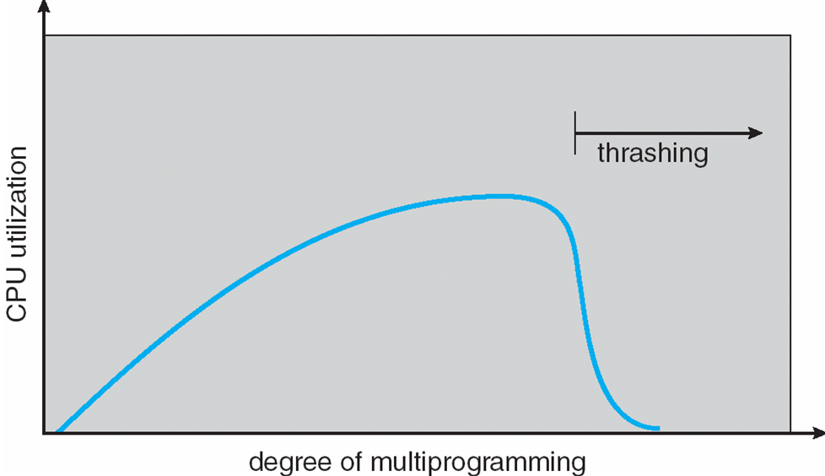
Thrashing (Cont.)
Beyond the performance penalty due for the process, there will also be a lower CPU utilization.
Small number of processes: low CPU utilization, as processes wait for I/O
More processes, better CPU utilization, as I/O is overlapped.
Too many processes: thrashing – the computer spends its time doing page I/O.

Slide 38
Demand Paging and Thrashing
Demand paging:
  Allocate a new page only when the process makes an access to it
  Example of lazy evaluation
Why does demand paging work?
Locality model
  The process access some part of memory within a certain interval
  Process migrates from one locality to another
  Localities may overlap
Why does thrashing occur?
Σ size of locality > total memory size
It is important to estimate the size of locality!

Slide 39
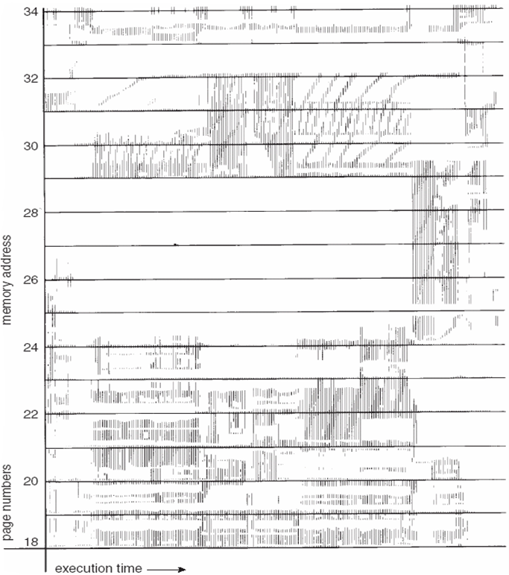
Locality In A Memory-Reference Pattern

Slide 40
Working-Set Model
Δ ≡ working-set window ≡ a fixed number of page references
Example: 10,000 instructions
WSS_{i} (working set of Process P_{i}) =
total number of pages referenced in the most recent Δ (varies in time)
  if Δ too small will not encompass entire locality
  if Δ too large will encompass several localities
  if Δ = ∞ ⇒ will encompass entire program
D = Σ WSS_{i} ≡ total demand frames
  The sum of the working sets of currently running processes
if D > m ⇒ Thrashing
  … because we cannot allocate the processes the amount of memory they need
A policy to prevent thrashing: if D > m, then suspend one of the processes
  It is better to suspend one process and let the other ones proceed.

Slide 41
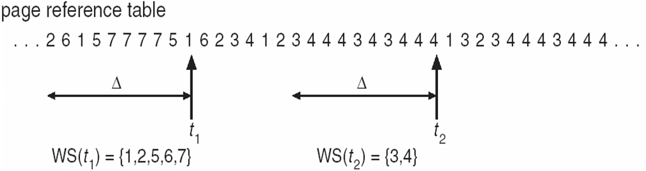
Working-set model

Slide 42
Keeping Track of the Working Set
Approximate with interval timer + a reference bit
Example: Δ = 10,000
  Timer interrupts after every 5000 time units
  Keep in memory 2 bits for each page
  Whenever a timer interrupts copy and sets the values of all reference bits to 0
  If one of the bits in memory = 1 ⇒ page in working set
Why is this not completely accurate?
  You can have a window that is overlapping in a different way, and have more (or less) processes.
Improvement = 10 bits and interrupt every 1000 time units

Slide 43
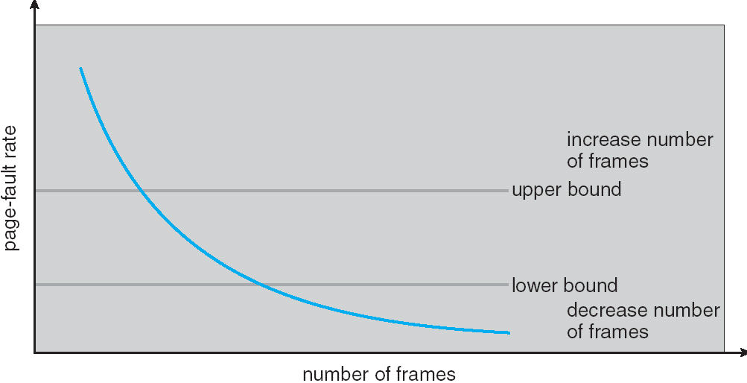
Page-Fault Frequency Scheme
Establish “acceptable” page-fault rate
  If actual rate too low, process loses frame
  If actual rate too high, process gains frame

Slide 44
Other Issues – TLB Reach
TLB Reach - The amount of memory accessible from the TLB
TLB Reach = (TLB Size) X (Page Size)
Ideally, the working set of each process is stored in the TLB
  Otherwise there is a high degree of page faults
Increase the Page Size
  This may lead to an increase in fragmentation as not all applications require a large page size
Provide Multiple Page Sizes
  This allows applications that require larger page sizes the opportunity to use them without an increase in fragmentation

Slide 45
Other Issues – Program Structure
Program structure
  Int[128,128] data;
  Each row is stored in one page
  Program 1
for (j = 0; j <128; j++)
for (i = 0; i < 128; i++)
data[i,j] = 0;
  128 x 128 = 16,384 page faults
  Program 2
  for (i = 0; i < 128; i++)
  for (j = 0; j < 128; j++)
  data[i,j] = 0;
  128 page faults

Slide 46
Other Issues – I/O interlock
I/O Interlock – Pages must sometimes be locked into memory
Consider I/O - Pages that are used for copying a file from a device must be locked from being selected for eviction by a page replacement algorithm

Slide 47
End of Slide Deck
-remaining slides are backup-

Slide 48
Memory-Mapped Files
Memory-mapped file I/O allows file I/O to be treated as routine memory access by mapping a disk block to a page in memory
A file is initially read using demand paging. A page-sized portion of the file is read from the file system into a physical page. Subsequent reads/writes to/from the file are treated as ordinary memory accesses.
Simplifies file access by treating file I/O through memory rather than read() write() system calls
Also allows several processes to map the same file allowing the pages in memory to be shared

Slide 49
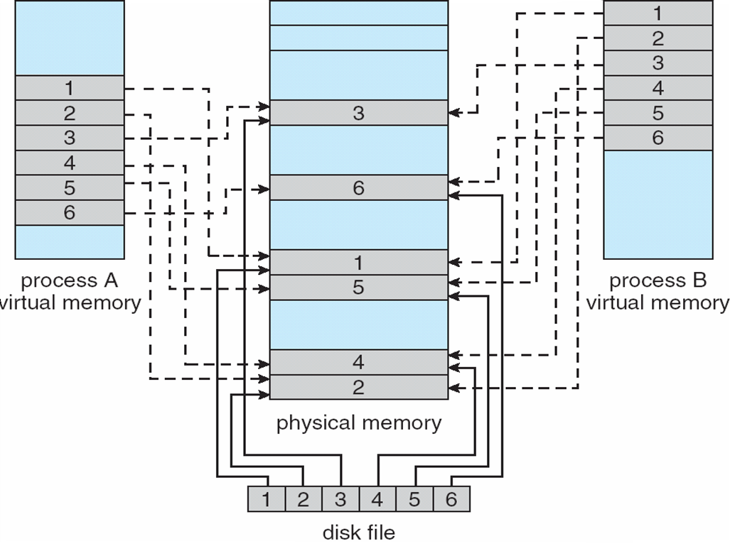
Memory Mapped Files

Slide 50
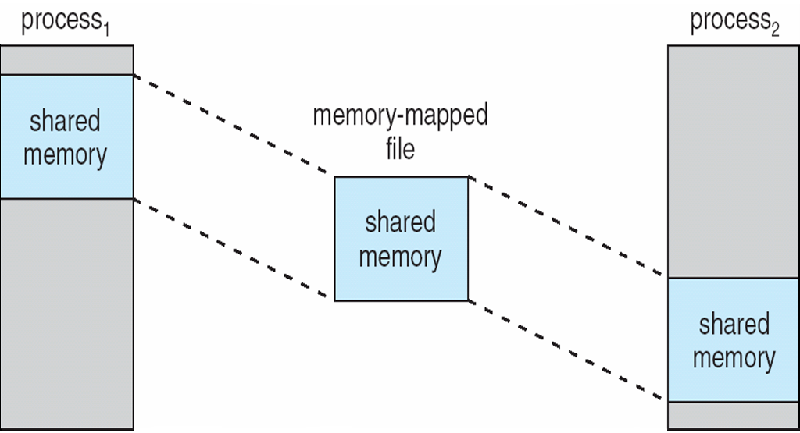
Memory-Mapped Shared Memory in Windows

Slide 51
Allocating Kernel Memory
Treated differently from user memory
Often allocated from a free-memory pool
  Kernel requests memory for structures of varying sizes
  Some kernel memory needs to be contiguous

Slide 52
Buddy System
Allocates memory from fixed-size segment consisting of physically-contiguous pages
Memory allocated using power-of-2 allocator
  Satisfies requests in units sized as power of 2
  Request rounded up to next highest power of 2
  When smaller allocation needed than is available, current chunk split into two buddies of next-lower power of 2
    Continue until appropriate sized chunk available

Slide 53
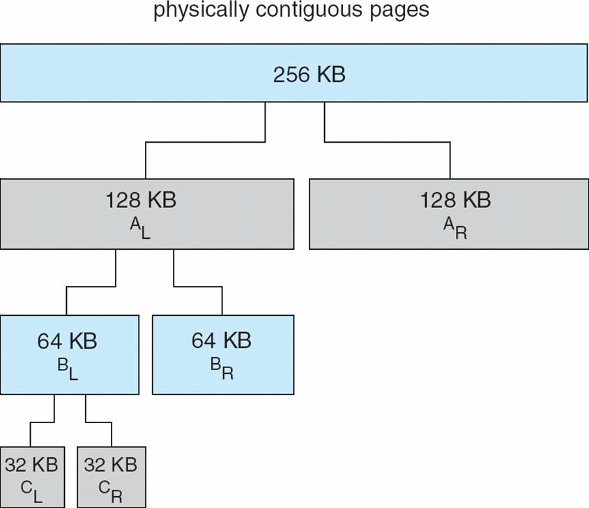
Buddy System Allocator

Slide 54
Slab Allocator
Alternate strategy
Slab is one or more physically contiguous pages
Cache consists of one or more slabs
Single cache for each unique kernel data structure
  Each cache filled with objects – instantiations of the data structure
When cache created, filled with objects marked as free
When structures stored, objects marked as used
If slab is full of used objects, next object allocated from empty slab
  If no empty slabs, new slab allocated
Benefits include no fragmentation, fast memory request satisfaction

Slide 55
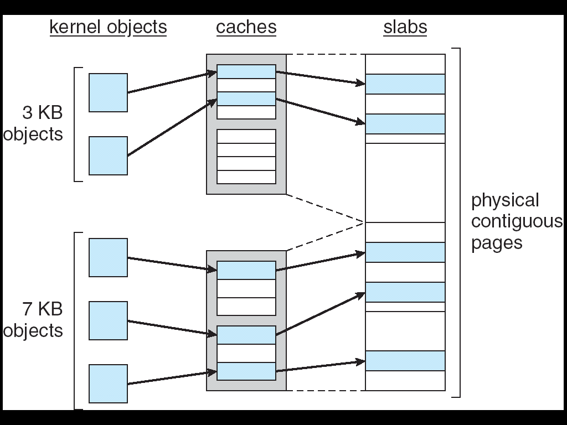
Slab Allocation

Slide 56
Other Issues -- Prepaging
Prepaging
  To reduce the large number of page faults that occurs at process startup
  Prepage all or some of the pages a process will need, before they are referenced
  But if prepaged pages are unused, I/O and memory was wasted
  Assume s pages are prepaged and α of the pages is used
    Is cost of s * α save pages faults > or < than the cost of prepaging
    s * (1- α) unnecessary pages?
    α near zero ⇒ prepaging loses

Slide 57
Other Issues – Page Size
Page size selection must take into consideration:
  fragmentation
  table size
  I/O overhead
  locality

Slide 58
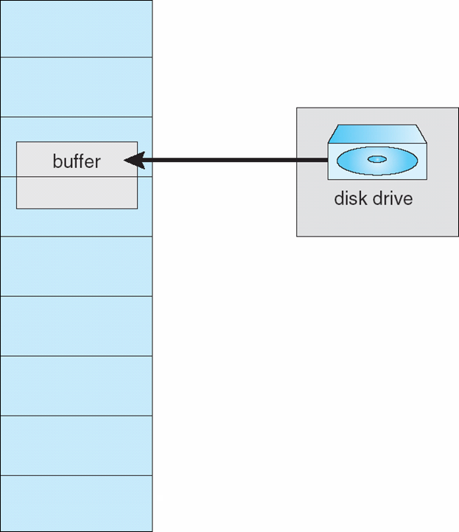
Reason Why Frames Used For I/O Must Be In Memory

Slide 59
Operating System Examples
Windows XP
Solaris

Slide 60
Windows XP
Uses demand paging with clustering. Clustering brings in pages surrounding the faulting page
Processes are assigned working set minimum and working set maximum
Working set minimum is the minimum number of pages the process is guaranteed to have in memory
A process may be assigned as many pages up to its working set maximum
When the amount of free memory in the system falls below a threshold, automatic working set trimming is performed to restore the amount of free memory
Working set trimming removes pages from processes that have pages in excess of their working set minimum

Slide 61
Solaris
Maintains a list of free pages to assign faulting processes
Lotsfree – threshold parameter (amount of free memory) to begin paging
Desfree – threshold parameter to increasing paging
Minfree – threshold parameter to being swapping
Paging is performed by pageout process
Pageout scans pages using modified clock algorithm
Scanrate is the rate at which pages are scanned. This ranges from slowscan to fastscan
Pageout is called more frequently depending upon the amount of free memory available

Slide 62
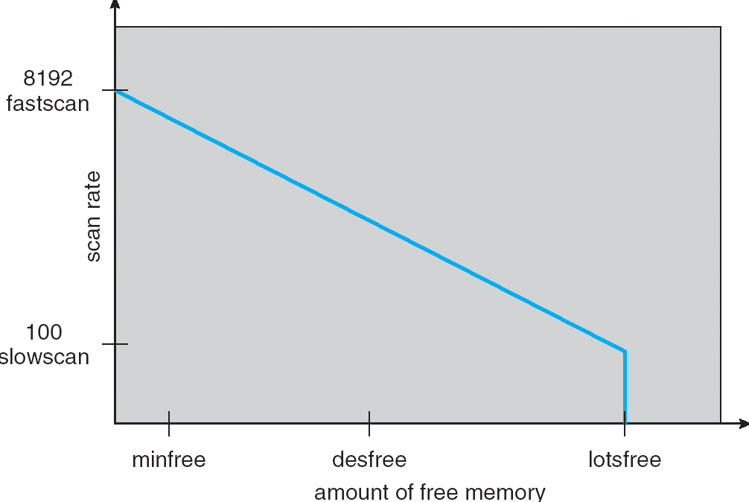
Solaris 2 Page Scanner

