Slide 1
Neural networks and deep learning

Slide 2
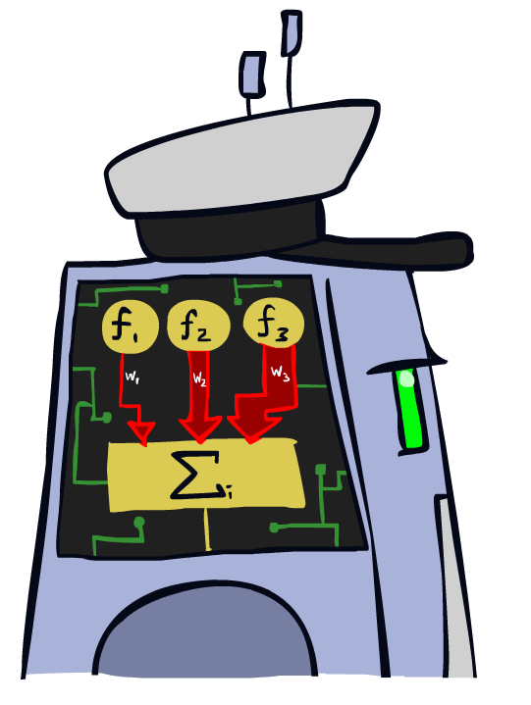
Linear Classifiers

Slide 3
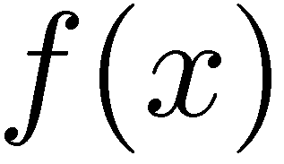



Feature Vectors
Hello,
Do you want free printr cartriges? Why pay more when you can get them ABSOLUTELY FREE! Just
# free : 2
YOUR_NAME : 0
MISSPELLED : 2
FROM_FRIEND : 0
...
SPAM
or
+
PIXEL-7,12 : 1
PIXEL-7,13 : 0
...
NUM_LOOPS : 1
...
“2”

Slide 4

Some (Simplified) Biology
Very loose inspiration: human neurons

Slide 5
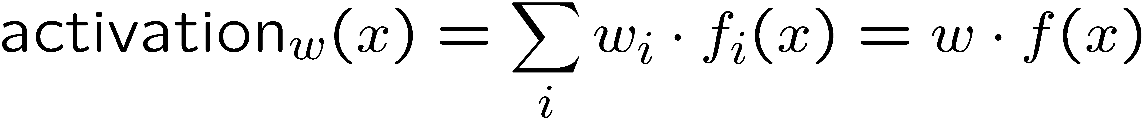
Linear Classifiers
Inputs are feature values
Each feature has a weight
Sum is the activation
If the activation is:
  Positive, output +1
  Negative, output -1
w₁
f₁
Σ
w₂
>0?
f₂
w₃
f₃

Slide 6

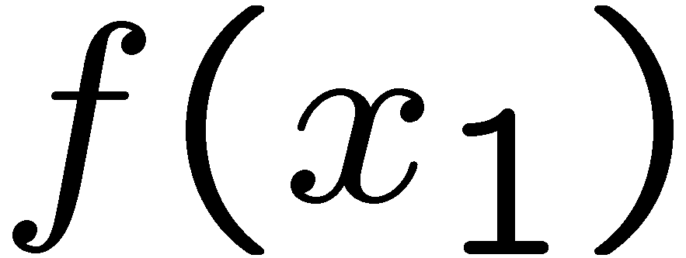
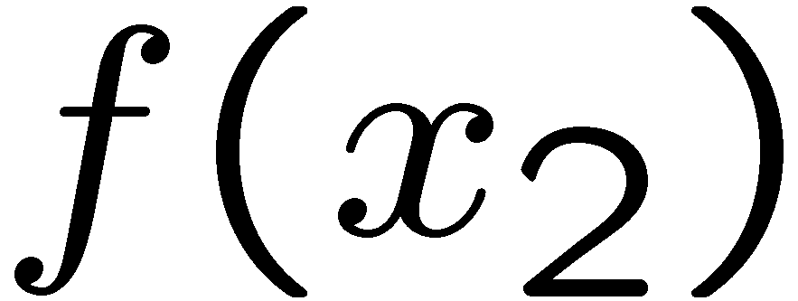
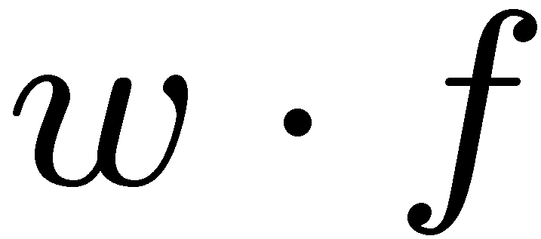
Weights
Binary case: compare features to a weight vector
Learning: figure out the weight vector from examples
# free : 4
YOUR_NAME :-1
MISSPELLED : 1
FROM_FRIEND :-3
...
# free : 2
YOUR_NAME : 0
MISSPELLED : 2
FROM_FRIEND : 0
...
# free : 0
YOUR_NAME : 1
MISSPELLED : 1
FROM_FRIEND : 1
...
Dot product positive means the positive class

Slide 7
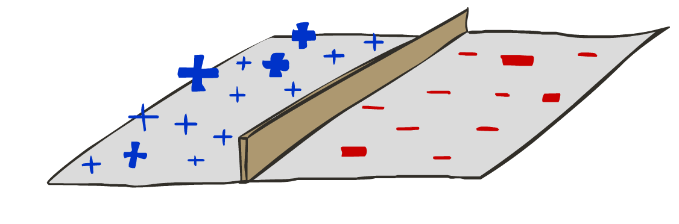
Decision Rules

Slide 8

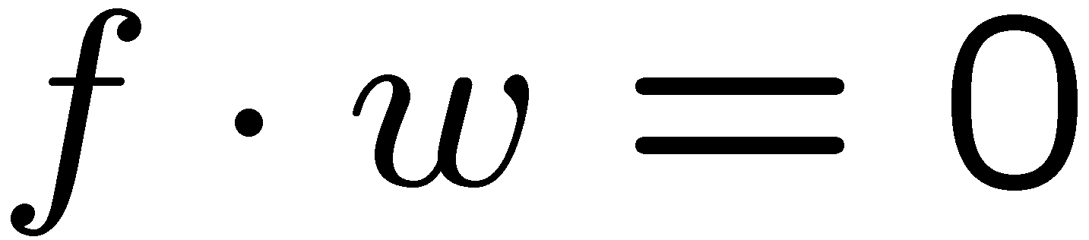
Binary Decision Rule
In the space of feature vectors
  Examples are points
  Any weight vector is a hyperplane
  One side corresponds to Y=+1
  Other corresponds to Y=-1
money
2
+1 = SPAM
1
BIAS : -3
free : 4
money : 2
...
0
-1 = HAM
0
1
free

Slide 9
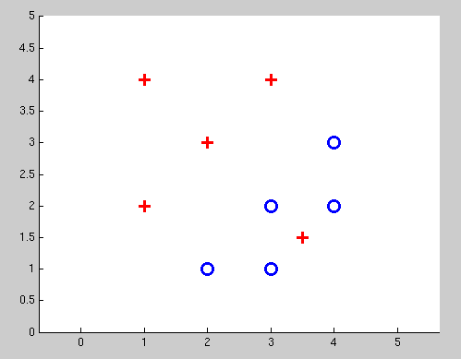
Non-Separable Case: Deterministic Decision
Even the best linear boundary makes at least one mistake

Slide 10
Non-Separable Case: Probabilistic Decision
0.9 | 0.1
0.7 | 0.3
0.5 | 0.5
0.3 | 0.7
0.1 | 0.9

Slide 11
How to get probabilistic decisions?
Perceptron scoring:
If very positive → want probability going to 1
If very negative → want probability going to 0
Sigmoid function

Slide 12



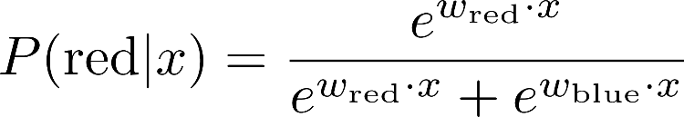
A 1D Example
definitely blue
not sure
definitely red
probability increases exponentially as we move away from boundary
normalizer

Slide 13
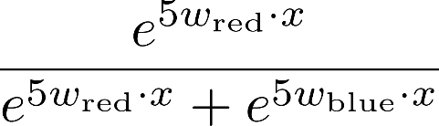
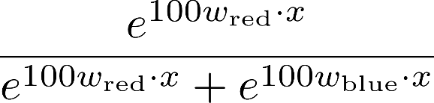

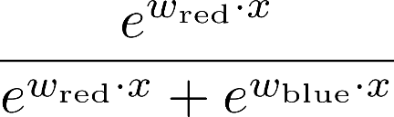
The Soft Max

Slide 14
Best w?
Maximum likelihood estimation:
with:
= Logistic Regression

Slide 15
Separable Case: Deterministic Decision – Many Options

Slide 16
Separable Case: Probabilistic Decision – Clear Preference
0.7 | 0.3
0.5 | 0.5
0.7 | 0.3
0.3 | 0.7
0.5 | 0.5
0.3 | 0.7

Slide 17



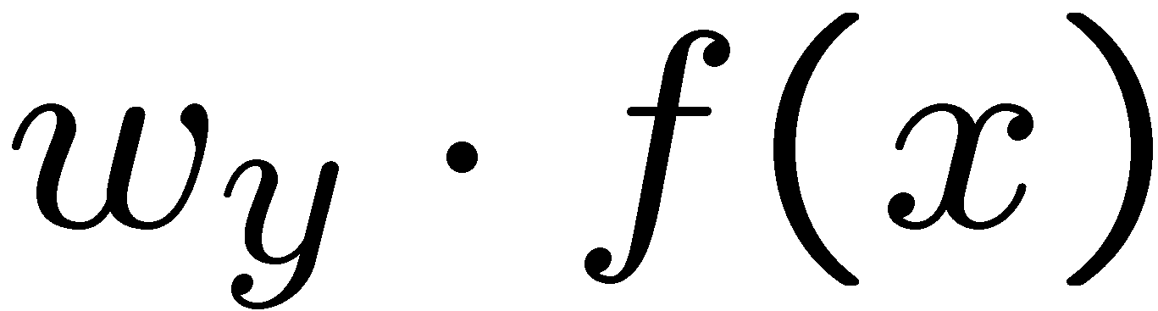


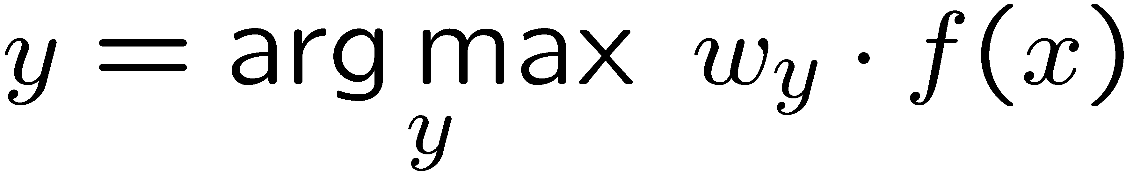
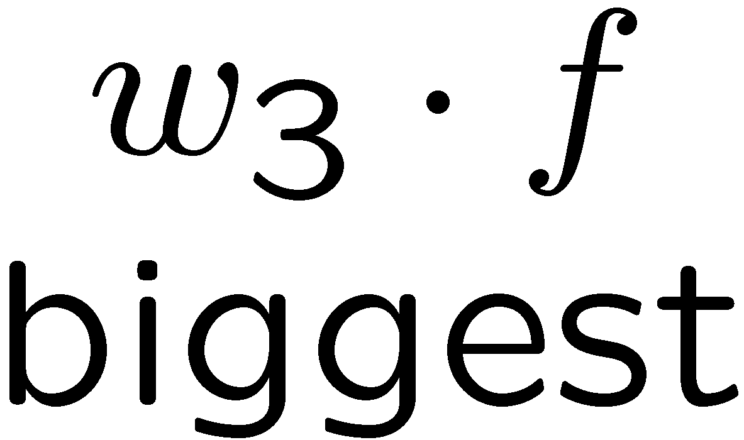
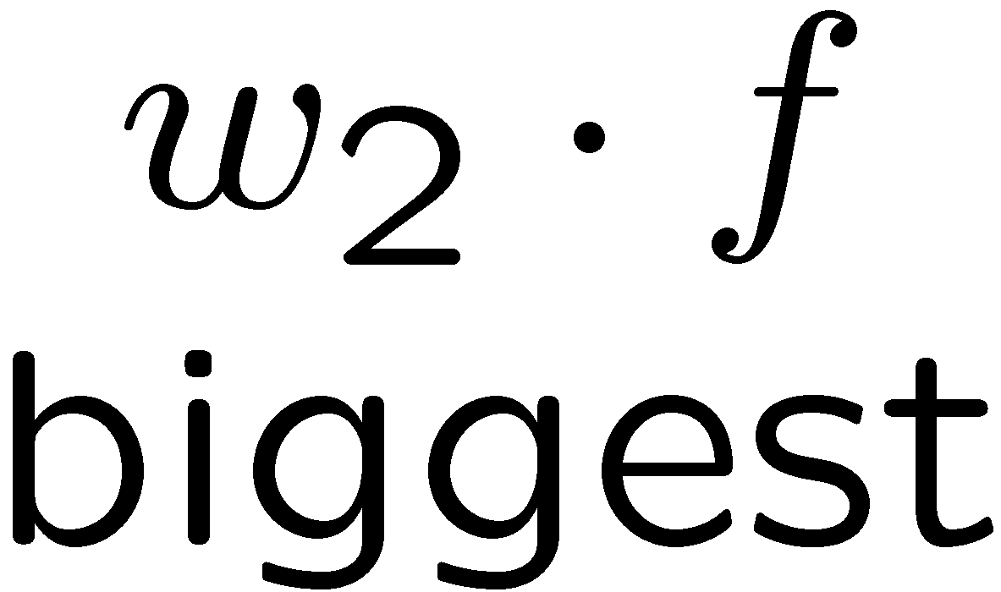
Multiclass Logistic Regression
Recall Perceptron:
  A weight vector for each class:
  Score (activation) of a class y:
  Prediction highest score wins
How to make the scores into probabilities?
original activations
softmax activations

Slide 18
Best w?
Maximum likelihood estimation:
with:
= Multi-Class Logistic Regression

Slide 19
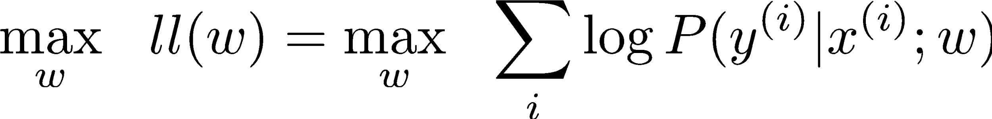
Optimization
Optimization
  i.e., how do we solve:

Slide 20

Hill Climbing
Recall from CSPs lecture: simple, general idea
  Start wherever
  Repeat: move to the best neighboring state
  If no neighbors better than current, quit
What’s particularly tricky when hill-climbing for multiclass logistic regression?
  Optimization over a continuous space
    Infinitely many neighbors!
    How to do this efficiently?

Slide 21
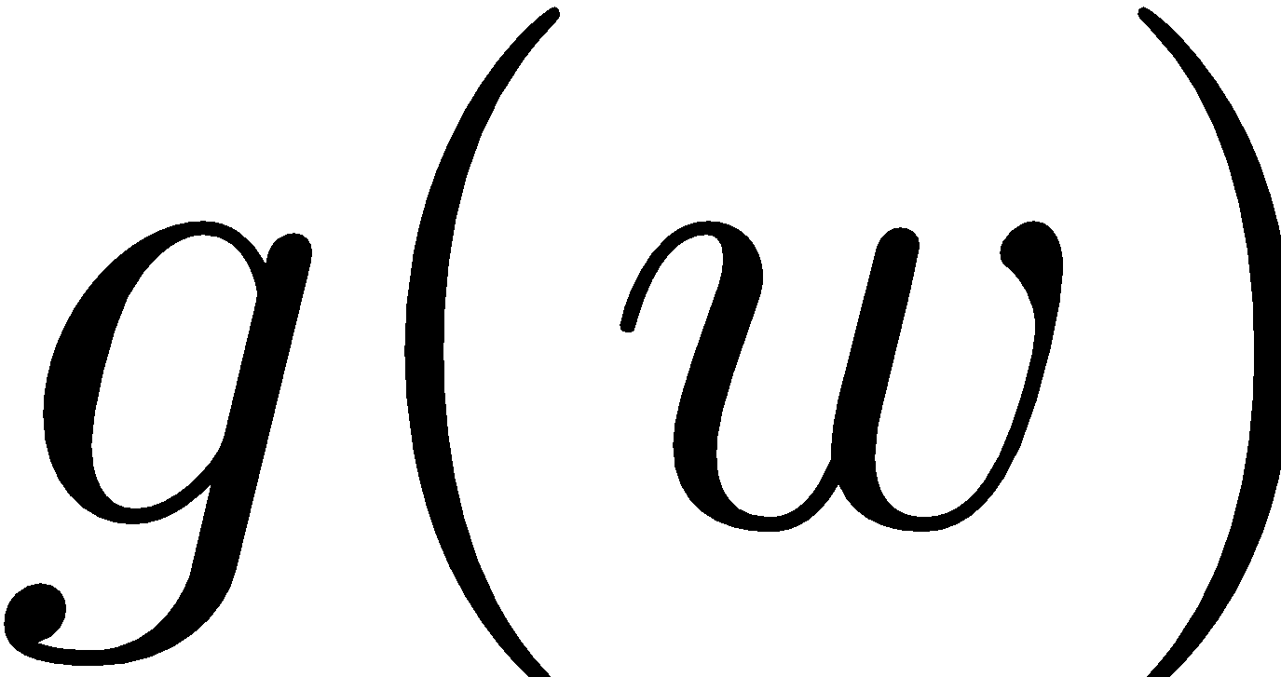
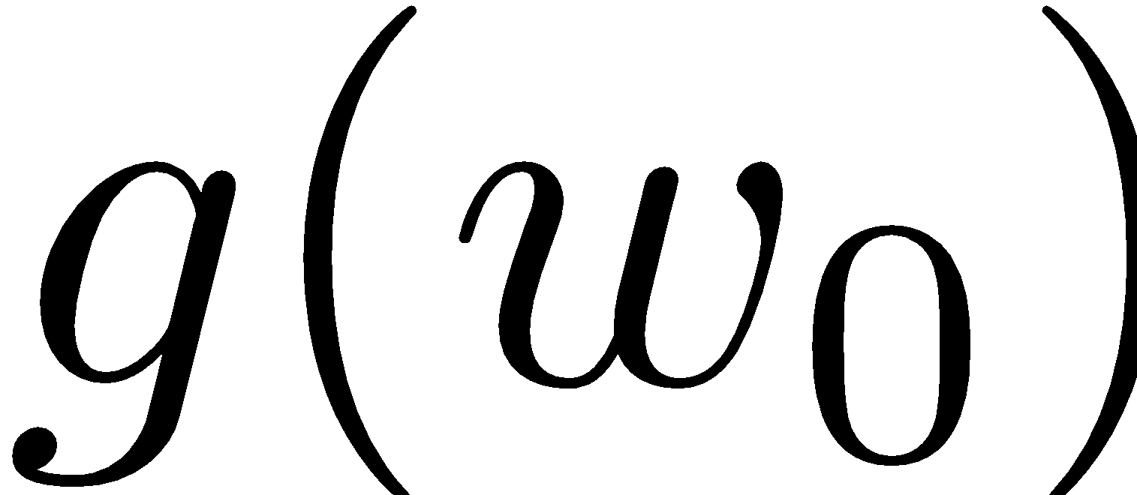


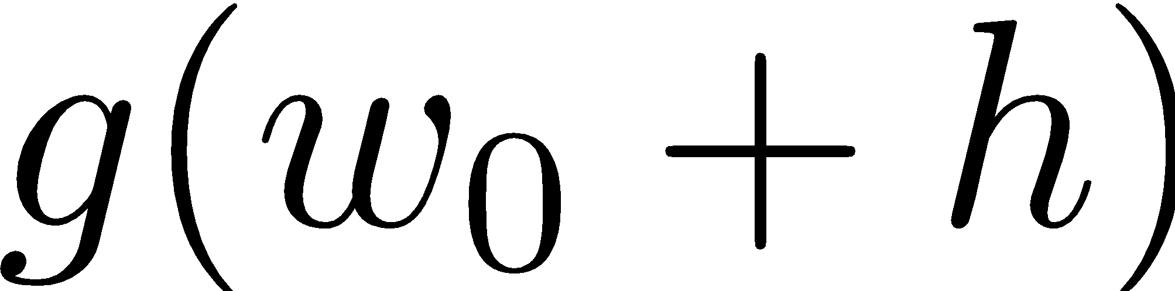
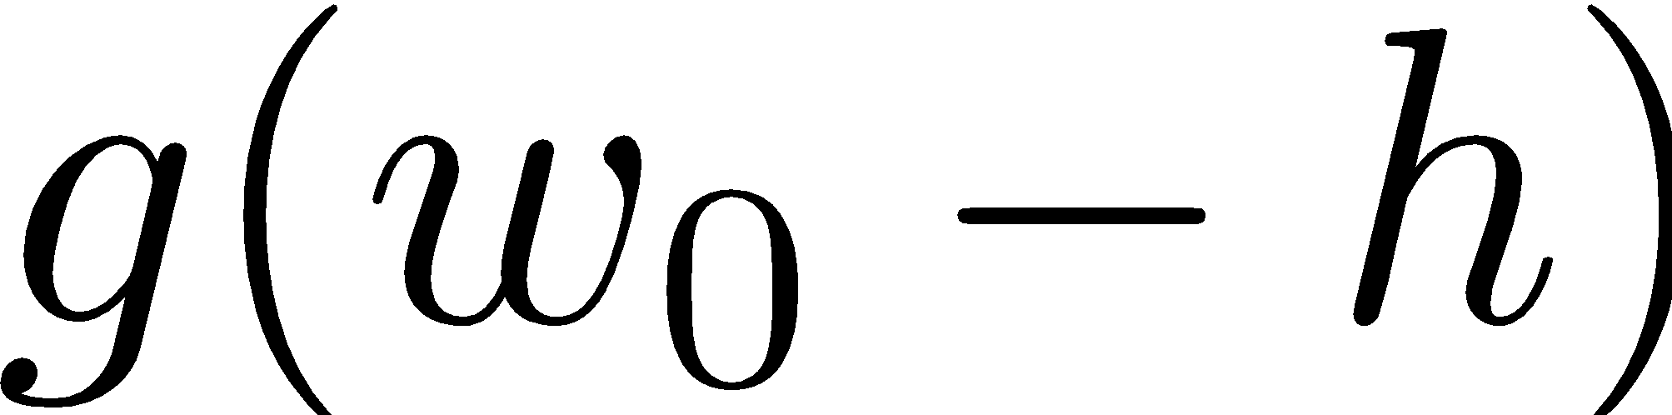
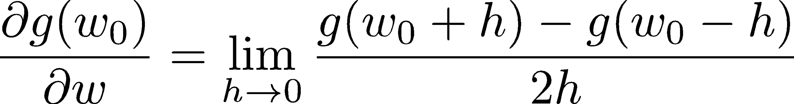
1-D Optimization
Could evaluate and
  Then step in best direction
Or, evaluate derivative:
  Tells which direction to step into

Slide 22
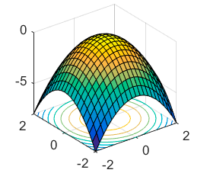
2-D Optimization
Source: offconvex.org

Slide 23
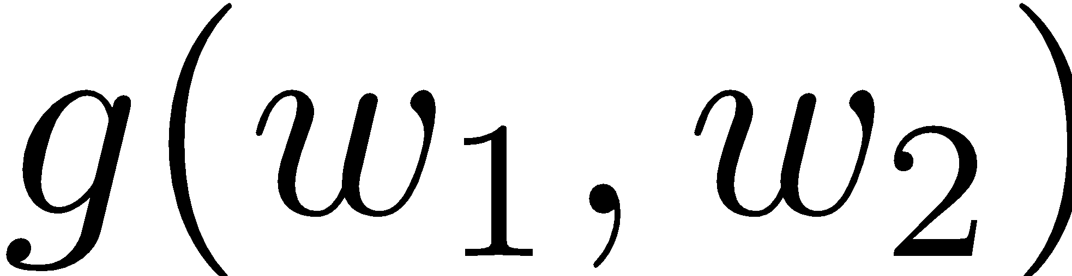
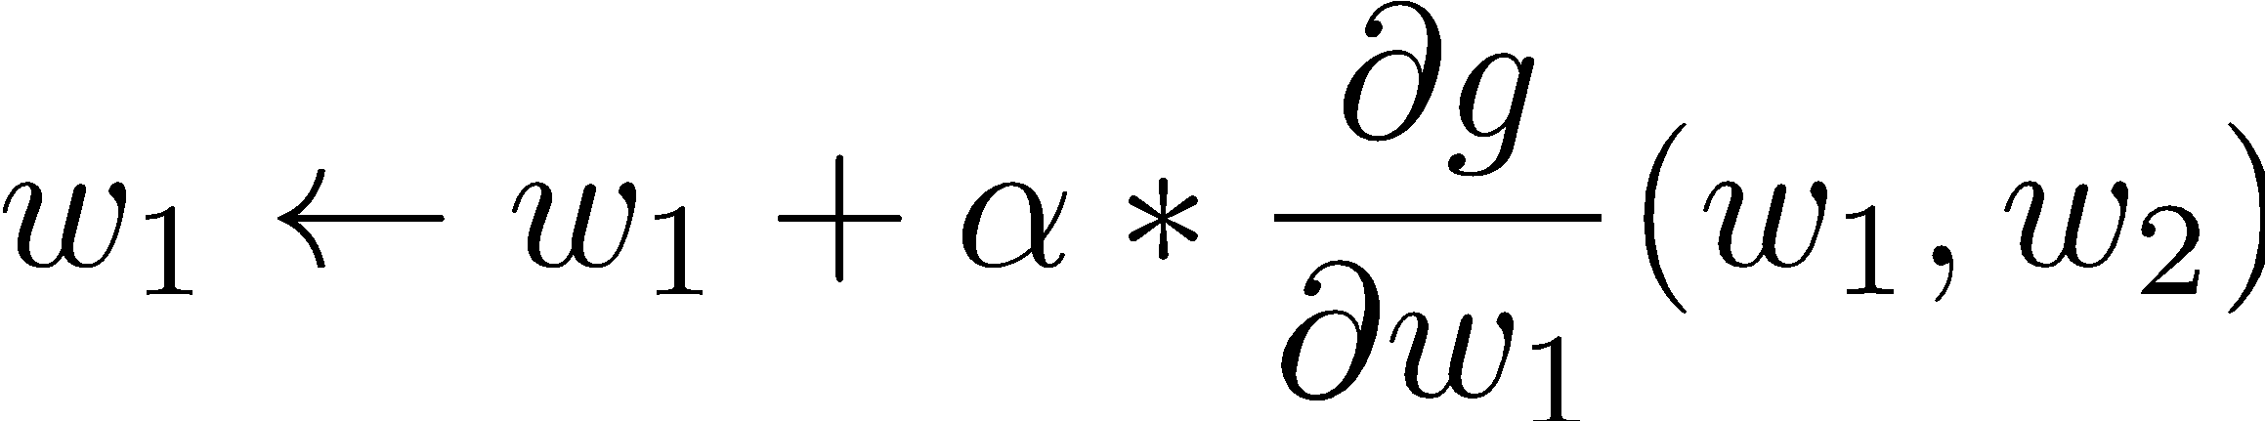
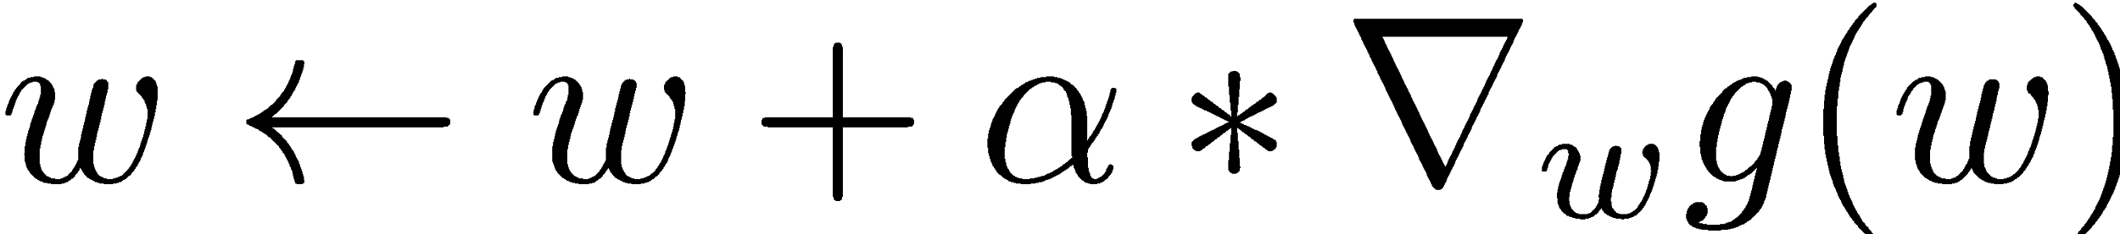
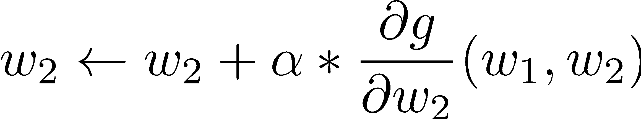
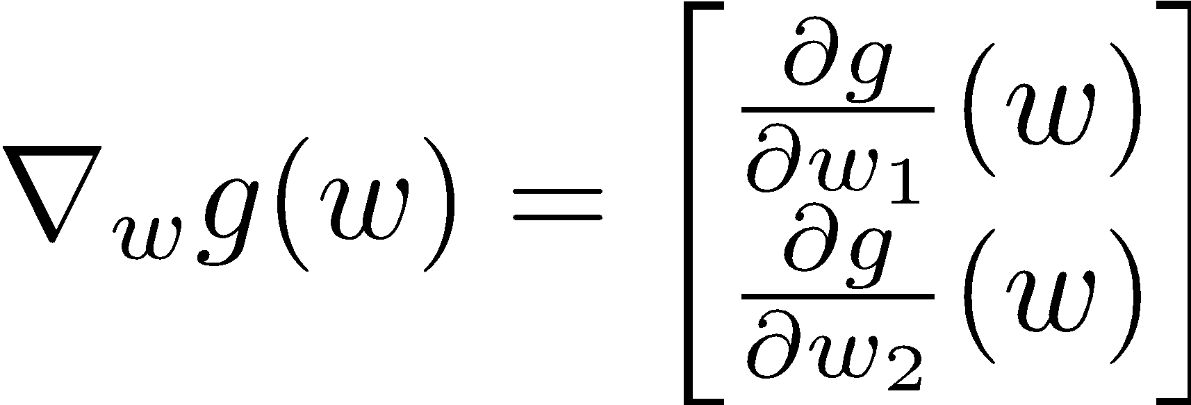
Gradient Ascent
Perform update in uphill direction for each coordinate
The steeper the slope (i.e. the higher the derivative) the bigger the step for that coordinate
E.g., consider:
    Updates:
  Updates in vector notation:
  with:
= gradient

Slide 24
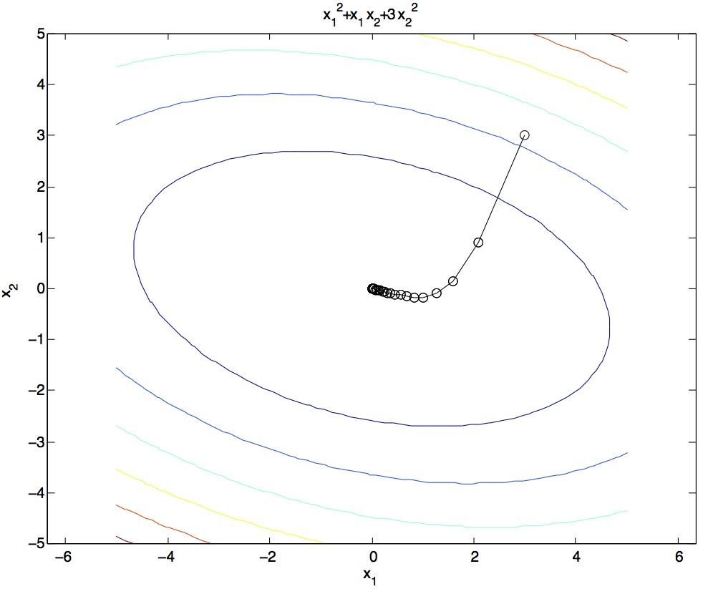
Gradient Ascent
Idea:
  Start somewhere
  Repeat: Take a step in the gradient direction
Figure source: Mathworks

Slide 25
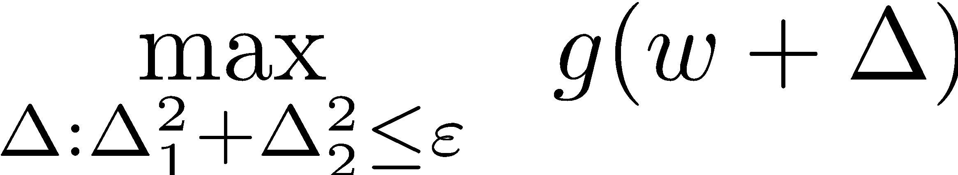
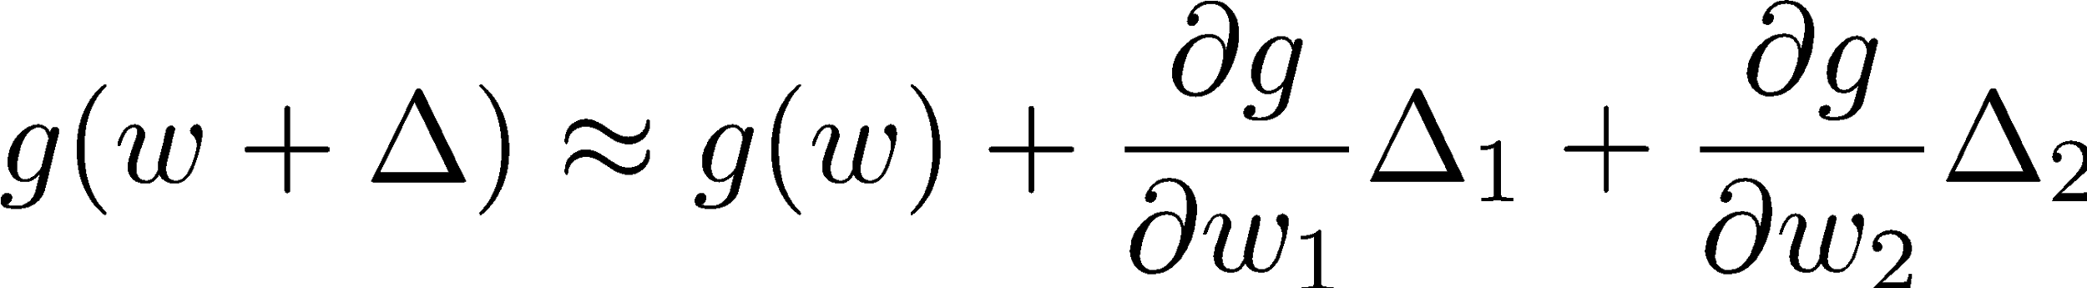
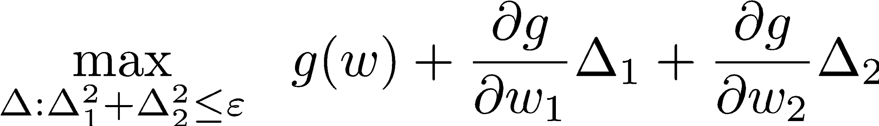
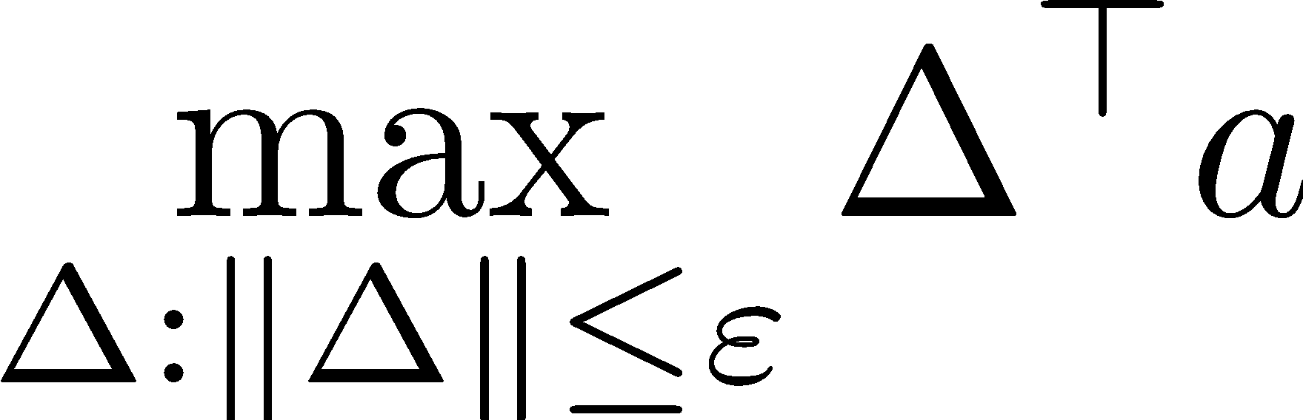
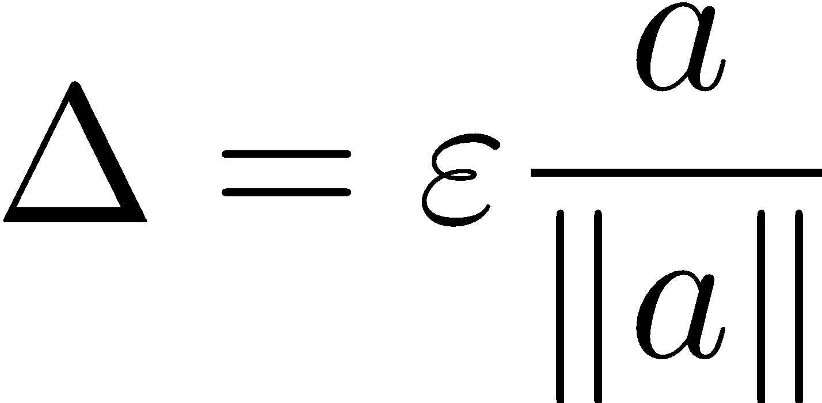
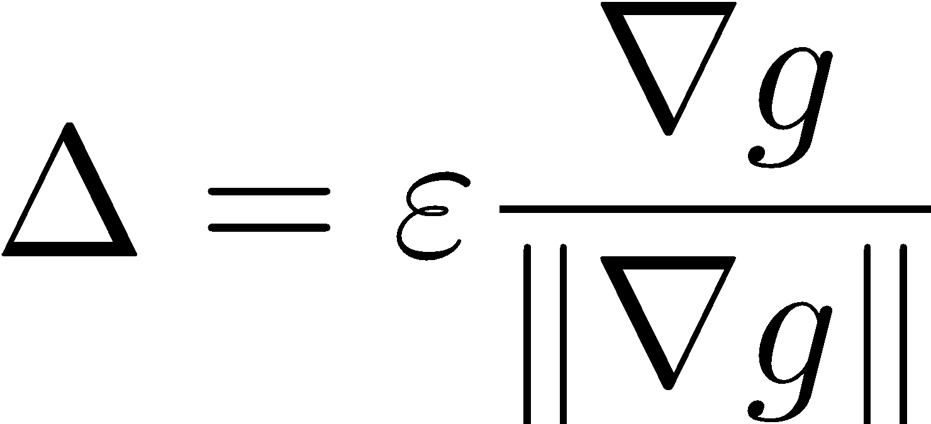
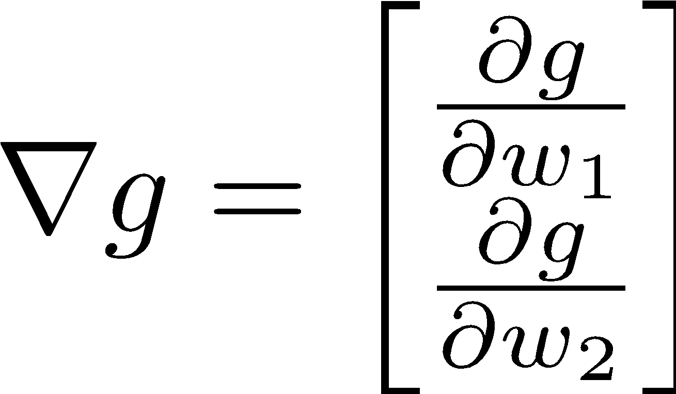
What is the Steepest Direction?*
First-Order Taylor Expansion:
Steepest Ascent Direction:
Recall: 🡪
Hence, solution:
Gradient direction = steepest direction!

Slide 26
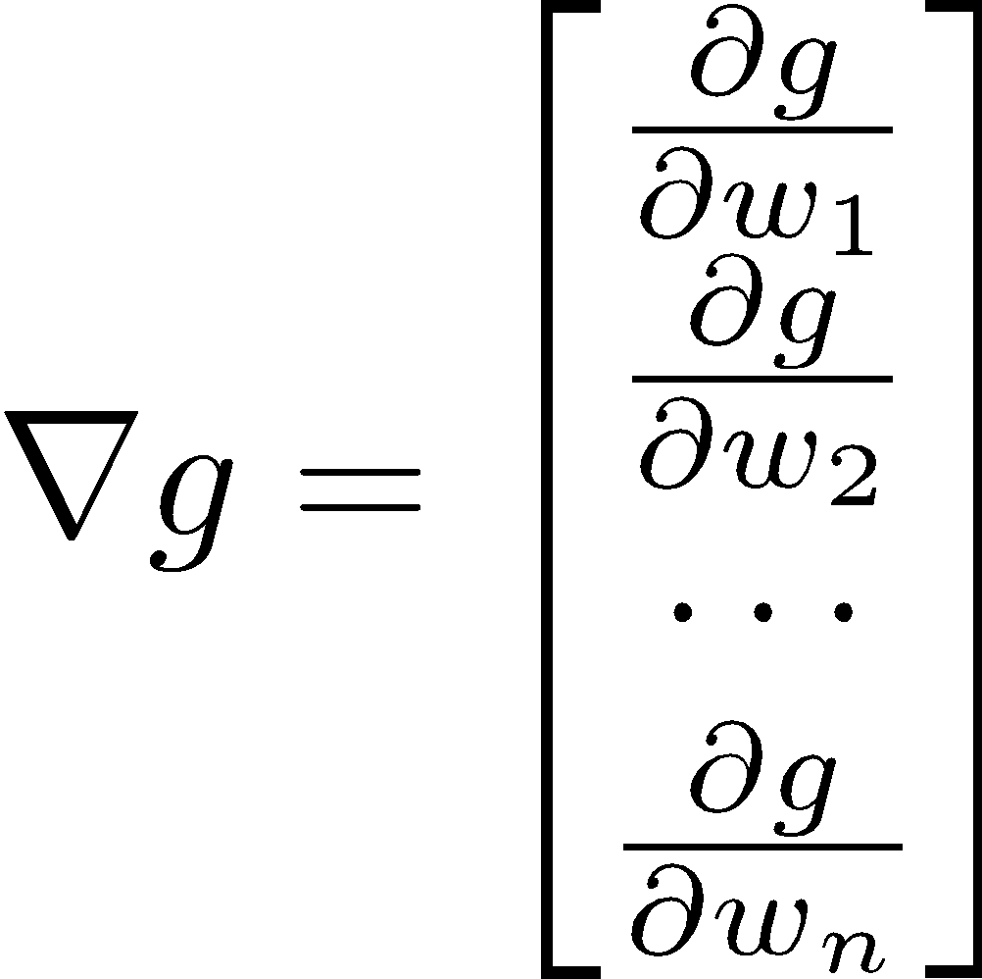
Gradient in n dimensions

Slide 27
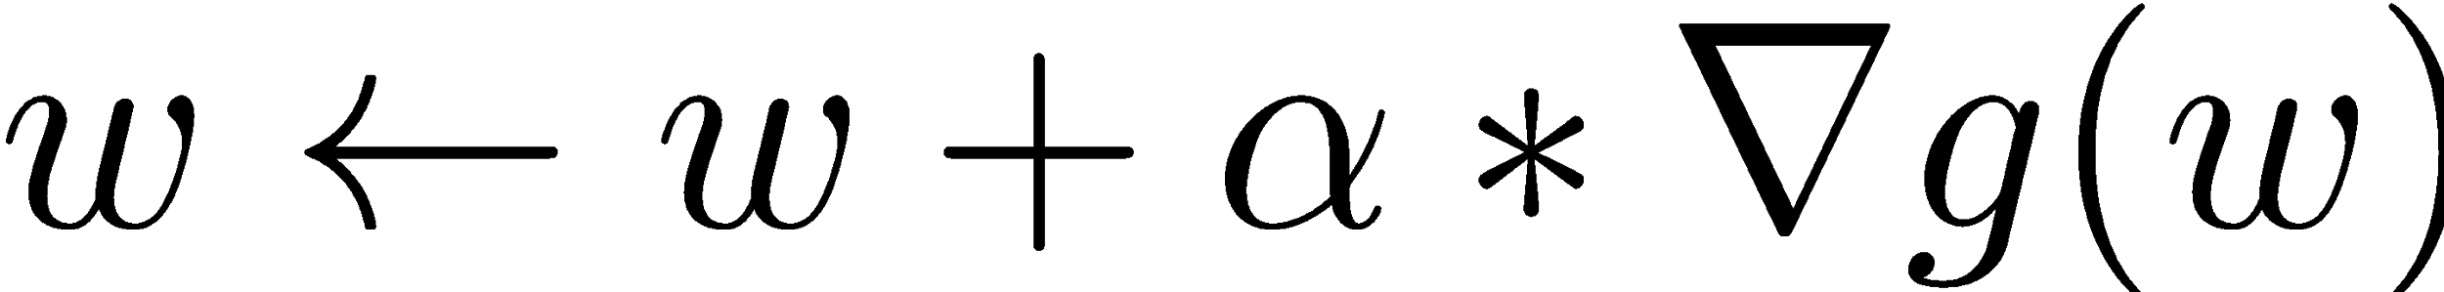

Optimization Procedure: Gradient Ascent
init
for iter = 1, 2, …
: learning rate --- tweaking parameter that needs to be chosen carefully
How? Try multiple choices
  Crude rule of thumb: update changes about 0.1 – 1 %

Slide 28
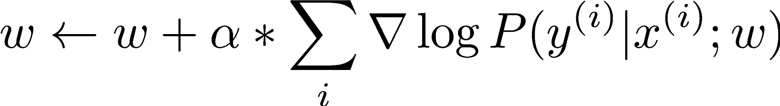
Batch Gradient Ascent on the Log Likelihood Objective
init
for iter = 1, 2, …

Slide 29
Stochastic Gradient Ascent on the Log Likelihood Objective
Observation: once gradient on one training example has been computed, might as well incorporate before computing next one
init
for iter = 1, 2, …
  pick random j

Slide 30
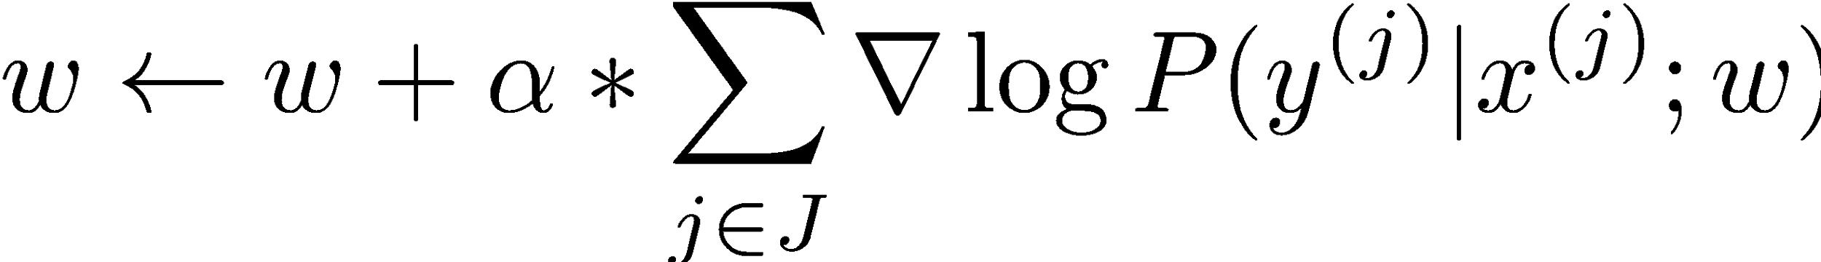
Mini-Batch Gradient Ascent on the Log Likelihood Objective
Observation: gradient over small set of training examples (=mini-batch) can be computed in parallel, might as well do that instead of a single one
init
for iter = 1, 2, …
  pick random subset of training examples J

Slide 31
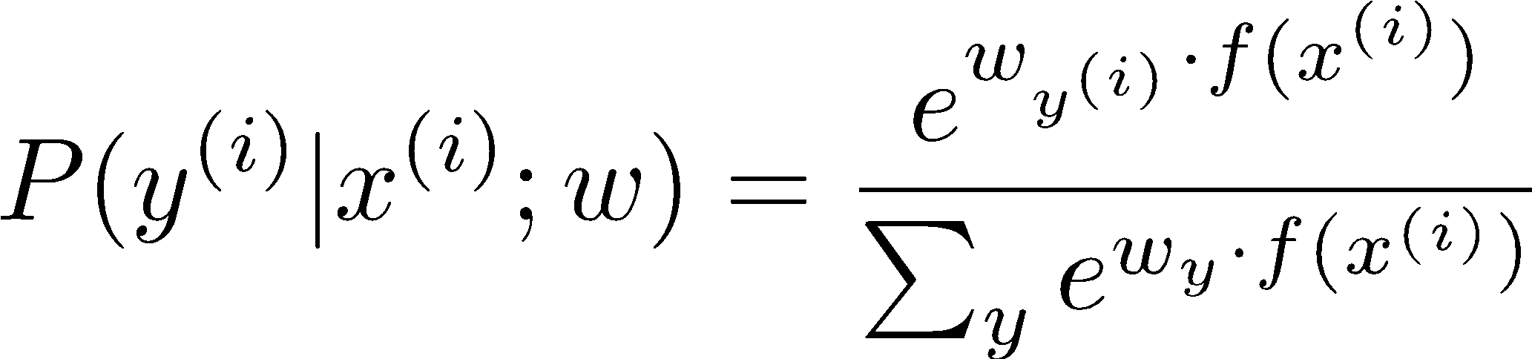
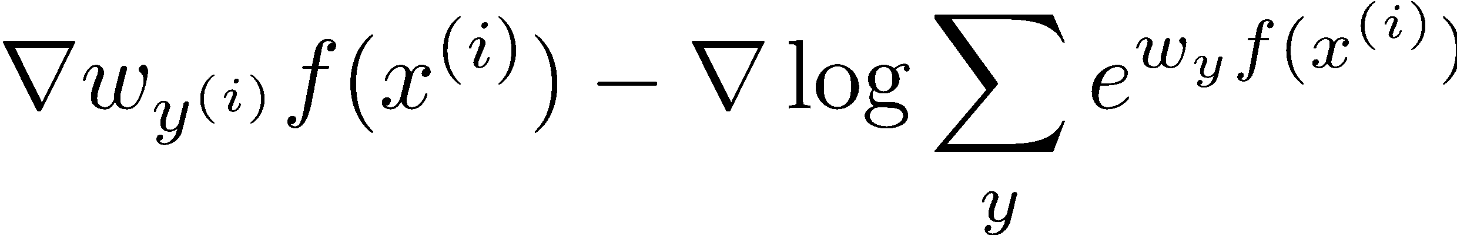
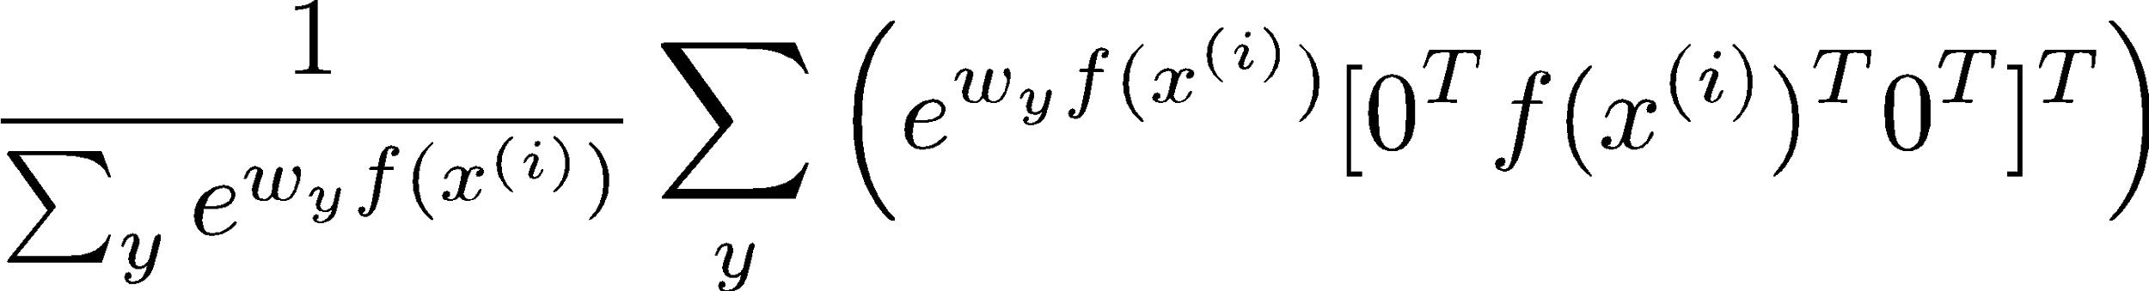
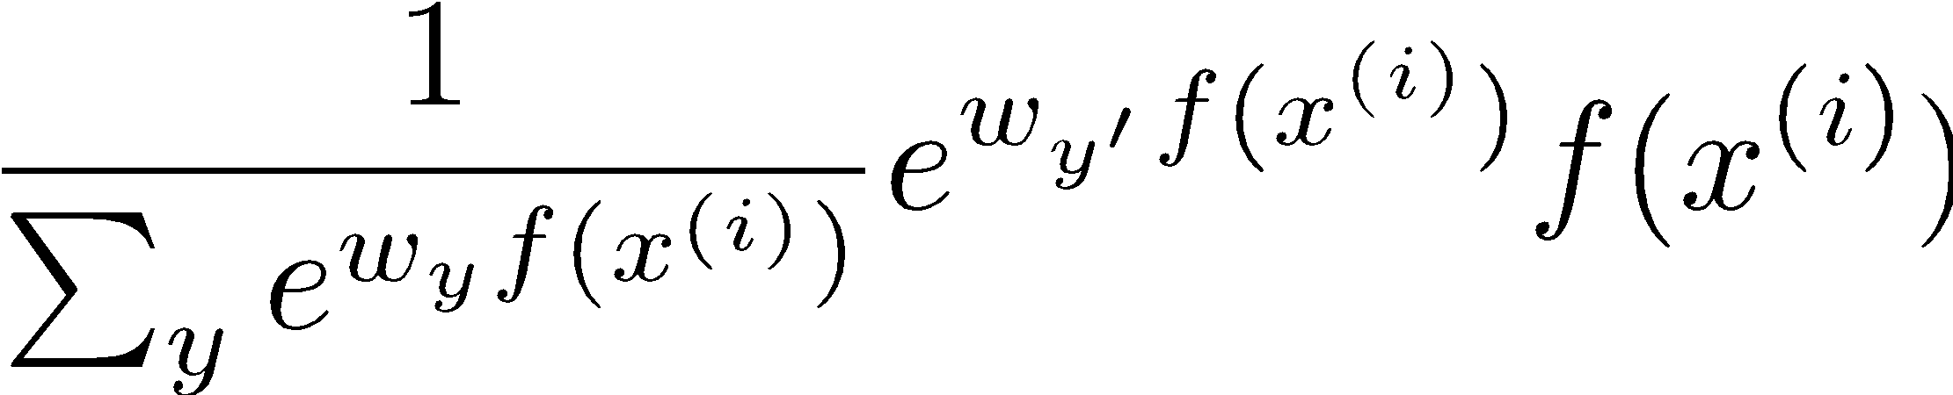
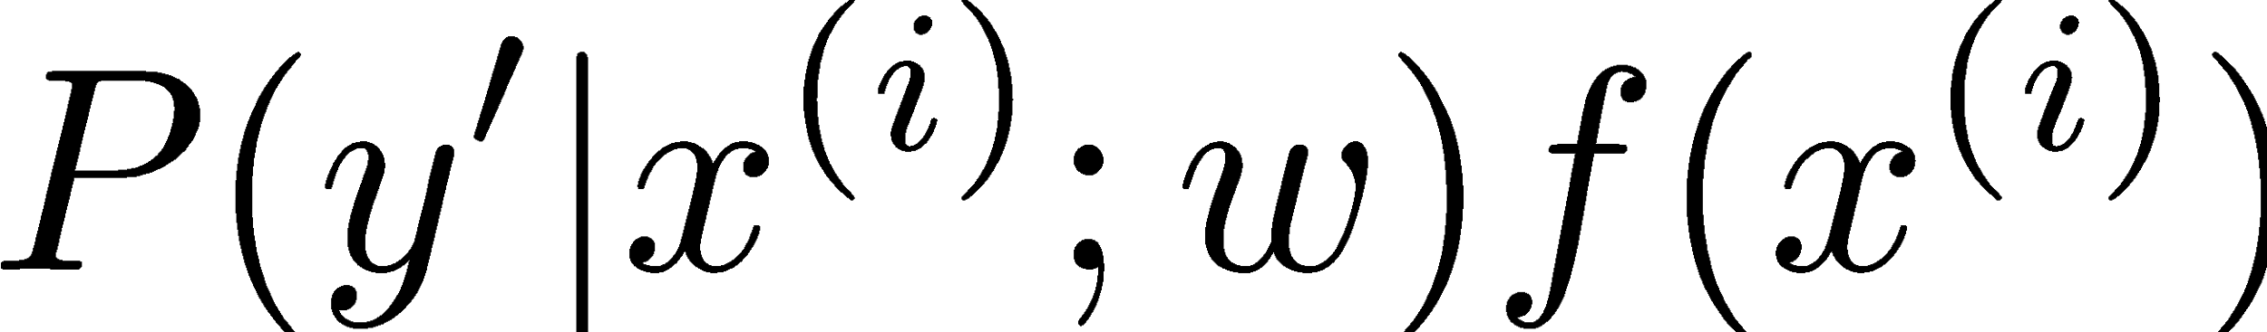
What will gradient ascent do in multi-class logistic regression?
adds f to the correct class weights
for y’ weights:
subtracts f from y’ weights in proportion to the probability current weights give to y’

Slide 32
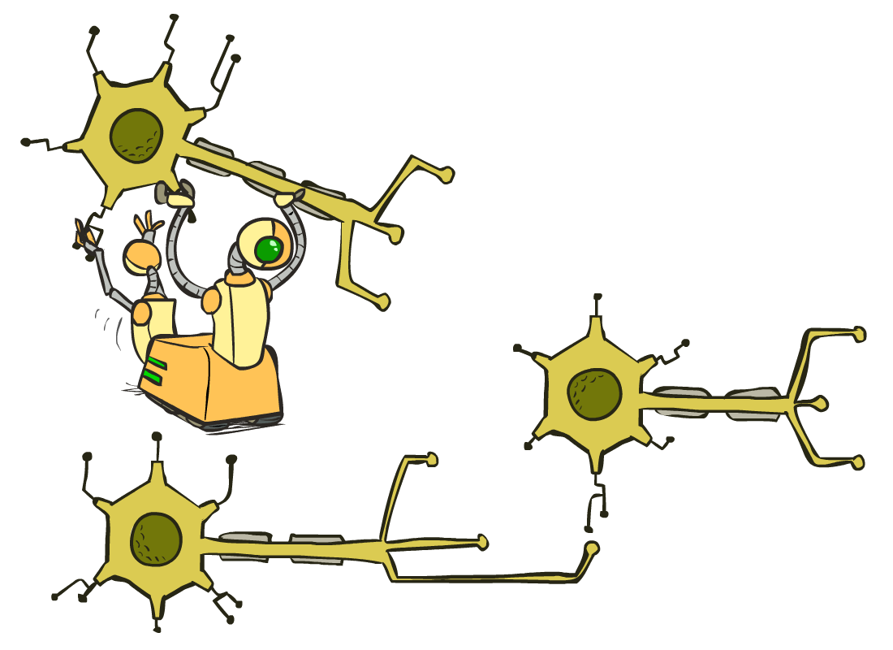
Neural Networks

Slide 33
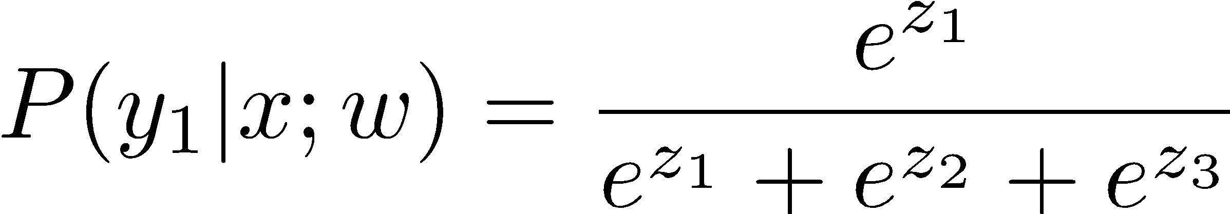
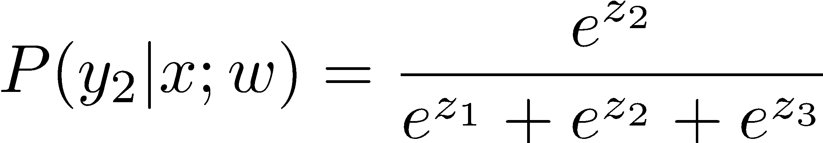
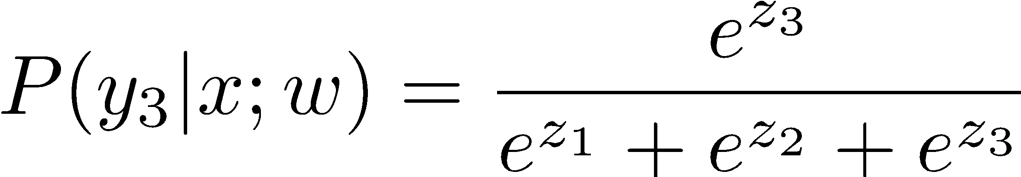
Multi-class Logistic Regression
= special case of neural network
f₁(x)
z₁
softmax
f₂(x)
z₂
f₃(x)
…
z₃
f_{K}(x)

Slide 34
Deep Neural Network = Also learn the features!
f₁(x)
z₁
softmax
f₂(x)
z₂
f₃(x)
…
z₃
f_{K}(x)

Slide 35




















Deep Neural Network = Also learn the features!
x₁
f₁(x)
softmax
x₂
f₂(x)
…
x₃
f₃(x)
…
…
…
…
…
x_{L}
f_{K}(x)
g = nonlinear activation function

Slide 36
Deep Neural Network = Also learn the features!
x₁
softmax
x₂
…
x₃
…
…
…
…
…
x_{L}
g = nonlinear activation function

Slide 37

Common Activation Functions
[source: MIT 6.S191 introtodeeplearning.com]

Slide 38
Deep Neural Network: Also Learn the Features!
Training the deep neural network is just like logistic regression:
  just w tends to be a much, much larger vector ☺
  just run gradient ascent
  + stop when log likelihood of hold-out data starts to decrease

Slide 39
Neural Networks Properties
Theorem (Universal Function Approximators). A two-layer neural network with a sufficient number of neurons can approximate any continuous function to any desired accuracy.
Practical considerations
  Can be seen as learning the features
  Large number of neurons
    Danger for overfitting
    (hence early stopping!)

Slide 40

Universal Function Approximation Theorem*
In words: Given any continuous function f(x), if a 2-layer neural network has enough hidden units, then there is a choice of weights that allow it to closely approximate f(x).
Cybenko (1989) “Approximations by superpositions of sigmoidal functions”
Hornik (1991) “Approximation Capabilities of Multilayer Feedforward Networks”
Leshno and Schocken (1991) ”Multilayer Feedforward Networks with Non-Polynomial Activation Functions Can Approximate Any Function”

Slide 41



Universal Function Approximation Theorem*
Cybenko (1989) “Approximations by superpositions of sigmoidal functions”
Hornik (1991) “Approximation Capabilities of Multilayer Feedforward Networks”
Leshno and Schocken (1991) ”Multilayer Feedforward Networks with Non-Polynomial Activation Functions Can Approximate Any Function”

Slide 42
Fun Neural Net Demo Site
Demo-site:
  http://playground.tensorflow.org/

Slide 43

How about computing all the derivatives?
Derivatives tables:
[source: http://hyperphysics.phy-astr.gsu.edu/hbase/Math/derfunc.html

Slide 44


How about computing all the derivatives?
But neural net f is never one of those?
  No problem: CHAIN RULE:
    If
    Then
    Derivatives can be computed by following well-defined procedures

Slide 45
Automatic Differentiation
Automatic differentiation software
  e.g. TensorFlow, PyTorch, Jax
  Only need to program the function g(x,y,w)
  Can automatically compute all derivatives w.r.t. all entries in w
  This is typically done by caching info during forward computation pass of f, and then doing a backward pass = “backpropagation”
  Autodiff / Backpropagation can often be done at computational cost comparable to the forward pass
Need to know this exists
How this is done? -- outside of scope of CS188

Slide 46
Summary of Key Ideas
Optimize probability of label given input
Continuous optimization
  Gradient ascent:
    Compute steepest uphill direction = gradient (= just vector of partial derivatives)
    Take step in the gradient direction
    Repeat (until held-out data accuracy starts to drop = “early stopping”)
Deep neural nets
  Last layer = still logistic regression
  Now also many more layers before this last layer
    = computing the features
    🡪 the features are learned rather than hand-designed
  Universal function approximation theorem
    If neural net is large enough
    Then neural net can represent any continuous mapping from input to output with arbitrary accuracy
    But remember: need to avoid overfitting / memorizing the training data 🡪 early stopping!
  Automatic differentiation gives the derivatives efficiently (how? = outside of scope of 188)

Slide 47


Change in Programming Paradigm!
Traditional Programming:
program by writing lines of code
Deep Learning (“Software 2.0”):
program by providing data
?
?
Poor performance on AI problems
Success!

