Slide 1

Scalable Video Delivery Techniques
Kien A. Hua
Data Systems Lab
School of EECS
University of Central Florida

Slide 2








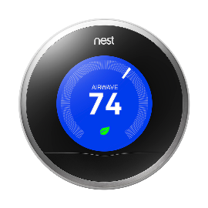
Communication Bottleneck
VoD streaming (e.g., Netflix, YouTube, Hulu) will make up about 80% of Internet traffic
Internet of Things are adding significant more traffic (continuous live streaming)

Slide 3

Server Channels
The unit of server capacity required to deliver a video stream is referred to as a channel.
These channels are dispatched to deliver various video streams at different times.
Streaming capacity

Slide 4

Using Dedicated Streams
Out of bandwidth
Waiting
Video Server
Dedicated stream
Client
Dedicated stream
Client
Client
Expensive & not scalable
Client

Slide 5
A Solution
Using broadcast to share the channels among users
Broadcast is essentially “free” for a large user community

Slide 6

Traditional Multicast
Video Server
Client
Client
Client
Client

Slide 7
Conflicting Goals in
Video Multicast ?
Low Latency: requests must be served as soon as possible
High Efficiency: each multicast should wait to serve a larger number of clients
Can we achieve both ?
Notes:
To achieve these two goals, the challenges are: First, We should not ask early customers to wait for latecomers. Second, it must be still highly efficient. That is, each video stream must still be able to serve a large number of users. It looks like these two goals conflicting each other. However, it is achievable in our new approach, Patching.

Slide 8
Broadcast for VOD
Requirement on server bandwidth is independent of the number of users the system is designed to support.
Less expensive & more scalable !!
Broadcast cannot deliver videos on demand ?
?
?
True | False

Slide 9
Skyscraper Broadcasting
Each video is fragmented into K segments, each repeatedly broadcast on a dedicated channel at the playback rate.
The sizes of the K segments have the following pattern:
[1, 2, 2, 5, 5, 12, 12, 25, 25, …, W, W, …, W]
w
Even group
Odd group
Even group
Odd group
Size of larger segments are constrained to W (width of the “skyscraper”)
w
Skyscraper

Slide 10
Generating Function
The broadcast series is generated using the following recursive function:
1 | If n = 1,
2 | If n = 2 or 3,
2 · f(n - 1)+1 | If n mod 4 = 0.
f(n-1) | If n mod 4 = 1,
2 · f(n - 1) + 2 | If n mod 4 = 2,
f(n – 1) | If n mod 4 = 3
f(n) =

Slide 11
Skyscraper Broadcasting
Playback Procedure
The Odd Loader and the Even Loader download the odd groups and the even groups, respectively.
The W-segments are downloaded sequentially using only one loader.
As the loaders fill the buffer, the Video Player consumes the data in the buffer.

Slide 12

Skyscraper Broadcasting
Playback Procedure
1
2
3
4
8 communication channels
5
6
W
7
8
Playback schedule:
Each segment is available before it is needed for the playback

Slide 13
Advantages of
Skyscraper Broadcasting
Unlimited scalability
Service latency can be reduced exponentially with increases in server bandwidth
Since W-segments are downloaded sequentially, buffer requirement is minimal.
Skyscraper

Slide 14
Client Centric Approach (CCA)
Segments are grouped according to the number of channels the clients can download simultaneously
Inside each group, each segment is twice the size of the last segment
The first segment of any group is the same size as the last segment of the previous group
1
2
4
4
8
C = 3 (Clients have three loaders)

Slide 15
CCA Broadcasting
Server broadcasts each segment at playback rate
Clients use c loaders
Each loader downloads its streams sequentially,
  e.g., i ^{th} loader is responsible for segments i, i+c, i+2c, i+3c, …
Equally-sized W-segments are downloaded sequentially using one loader
C = 3 (Clients have three loaders)
1st loader downloads from the first channel of each group
2nd loader downloads from the second channel of each group
3rd loader downloads from the third channel of each group

Slide 16
CCA Example
Group 1
Group 2
Group 3
Segments /w the same size

Slide 17
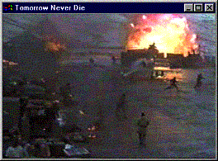

Advantages of CCA
Screen shot of prototype using C=3
It has the advantages of Skyscraper Broadcasting
It can leverage client bandwidth to improve performance
What if clients do not have the same streaming capability ?

Slide 18
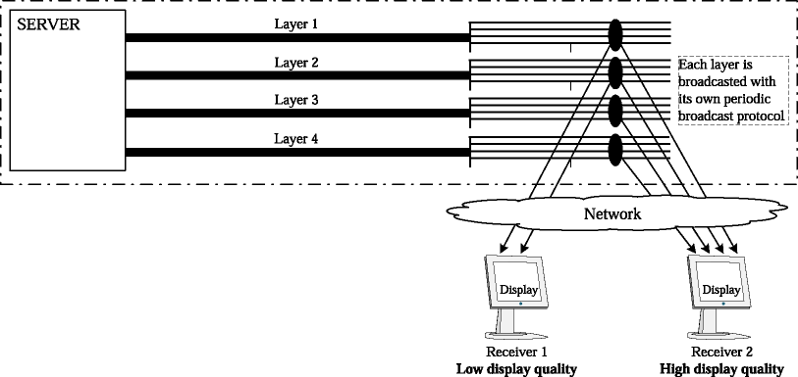
Support Client Heterogeneity
Encode the video data as a series of layers
A user can individually mould its service to fit its capacity
A user keeps adding layers until it is congested, then drops the higher layer
Multi-resolution encoding
Drawback: Compromise the display quality

Slide 19

HeRO: Heterogeneous
Receiver-Oriented Broadcasting
Allows receivers of various communication capabilities to share the same periodic broadcast
These receivers enjoy the same high video quality

Slide 20
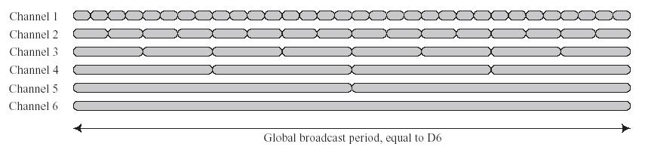
HeRO – Data Segmentation
The size of the i ^{th} segment is 2^{i-1} times the size of the first segment
1
2
4
8
16
32

Slide 21
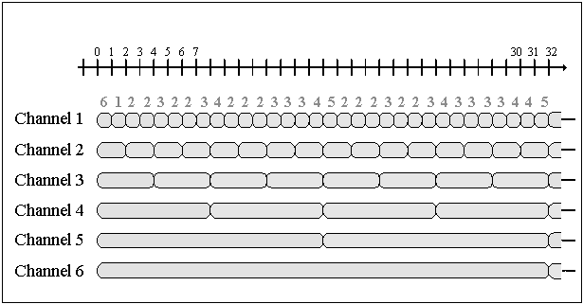
HeRO – Download Strategy
Loader i downloads segments i, i+C, i+2C, i+3C, etc. sequentially, where C is the number of loaders available.
The number of loaders needed depends on the arrival time of the service request (→ Service latency depends on the client’s capability)
Global Period

Slide 22
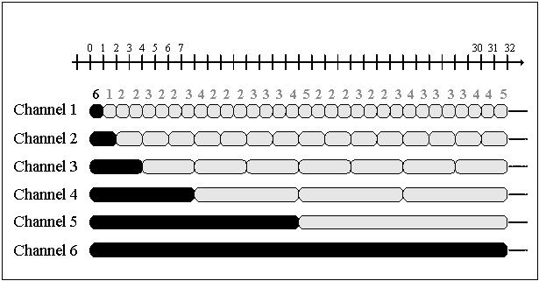
HeRO – Regular Channels
This user can download from six channels simultaneously
Request 1

Slide 23
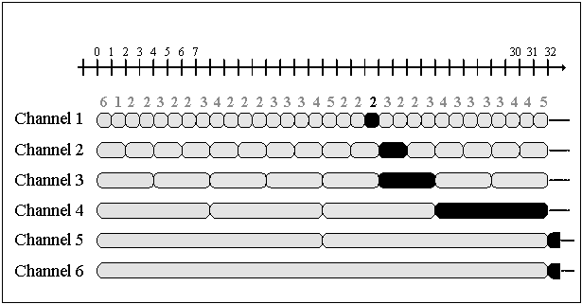
HeRO –Regular Channels
This user can download from two channels simultaneously
Request 2

Slide 24
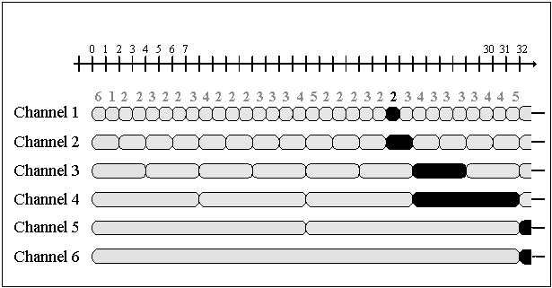
Worst-Case for Clients with
Two Loaders
Worst-case latency is 11 time units
The worst-cases appear because the broadcast periods coincide at the end of the global period
Request 2
11 time units
Coincidence of the
broadcast periods
require more
loaders
1 broadcast period

Slide 25
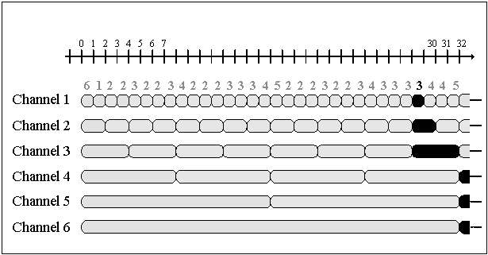
Worst Case for Clients with
Three Loaders
Worst-case latency is 5 time units
The worst-cases appear because the broadcast periods coincide at the end of the global period
Request
5 time units
Coincidence of the
broadcast periods

Slide 26
Observations of Worst-Cases
For a client with a given bandwidth, the time slots it can start the video are not uniformly distributed over the global period.
The non-uniformity varies over the global period depending on the degrees of coincidence among the various segments.

Slide 27
Observations of Worst-Cases
For a client with a given bandwidth, the time slots it can start the video are not uniformly distributed over the global period.
The non-uniformity varies over the global period depending on the degrees of coincidence among the various segments.
The worst non-uniformity occurs at the end of each global period when the broadcast periods of all segments coincide.
The non-uniformity causes long service delays for clients with less bandwidth.
We can minimize this coincidence to improve the worst case.

Slide 28
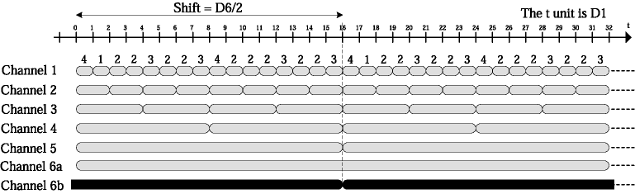
Adding one more channel
We broadcast the last segment on one more channel, but with a time shift half its size.
We now offer more possibilities to download the last segment; and above all, we eliminate the coincidence of all segments (i.e., no longer requiring 6 loaders).
Regular
Group
Shifted
Channel

Slide 29
HeRO
General Strategy: To reduce service latency for less capable clients, broadcast the longest segments on a second channel with a phase offset half their size.
Using 2 extra channels
Shifted
Channels

Slide 30
HeRO – Experimental Results
Under a homogeneous environment, HeRO is
  competitive in service latencies compared to other protocols
  the most efficient protocol to save client buffer space
HeRO addresses the heterogeneity in receiver bandwidth
Less capable clients enjoy the same playback quality

Slide 31
Multicast
We can use broadcast for near VOD
Can we also use multicast for VOD ?

Slide 32
Batching
A channel is available
Channel Pool
Batching Scheduler
Multicast

Slide 33











Video-on-Demand (VoD) Challenge
Multicast: Wait for multicast
time. This is not VoD
This is what we want: Do not
need to wait; but how ?

Slide 34
Patching – First Client Arrives
Video
Regular
Multicast
A

Slide 35
Patching – Second Client Arrives
Skew point
Video
t
Patching Stream
Regular
Multicast
Video Player
Buffer
A
B

Slide 36
Patching – Playback Strategy
Skew point
Video
2t
Skew point is absorbed by client buffer
Regular
Multicast
Video Player
Buffer
A
B

Slide 37
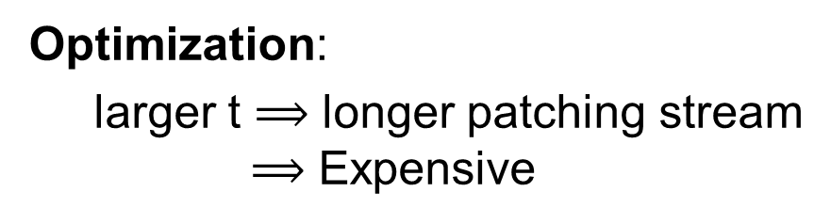
Patching – Playback Strategy
Skew point
Video
2t
Optimization:
larger t $⟹$ longer patching stream
$⟹$ Expensive
Regular
Multicast
Video Player
Buffer
A
B

Slide 38
Limitation of Patching
Performance of Patching is limited by server bandwidth.
Can we scale the application beyond the physical limitation of the server ?

Slide 39
Range Multicast
9
10
Video Server
8
5
6
4
7
RM Router 2
RM Router 1
1
2
3
Client 2
Client 1
Client 1
Client 1
Client 1
Client 1
Client 2
Client 1
Client 2
Client 1
Client 2
Client 1
Client 2
Client 2
Client 1
Client 1
Client 3
Client 3
Client 2
Client 3

Slide 40

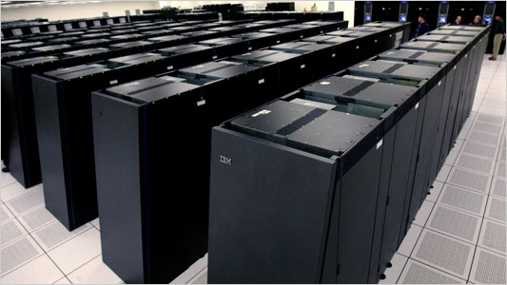
Range Multicast Environment
Client 2
Video Servers
Client 1
Client 3

Slide 41
Multicast Range
All members of a conventional multicast share the same play point at all time
  They must wait until the multicast time
Members of a range multicast can have a range of different play points
  They can join a range multicast at their leisure without waiting
Multicast Range at time 11: [0, 11]

Slide 42
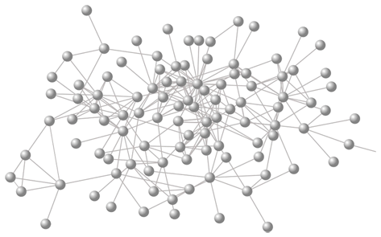
Multicast Range
Video Server
16
A window sliding over the video stream
5 6 7 8 9 10 11 12 13 14 15
C1
C2
C3
C4
Multicast Range at time 11: [0, 11]

Slide 43
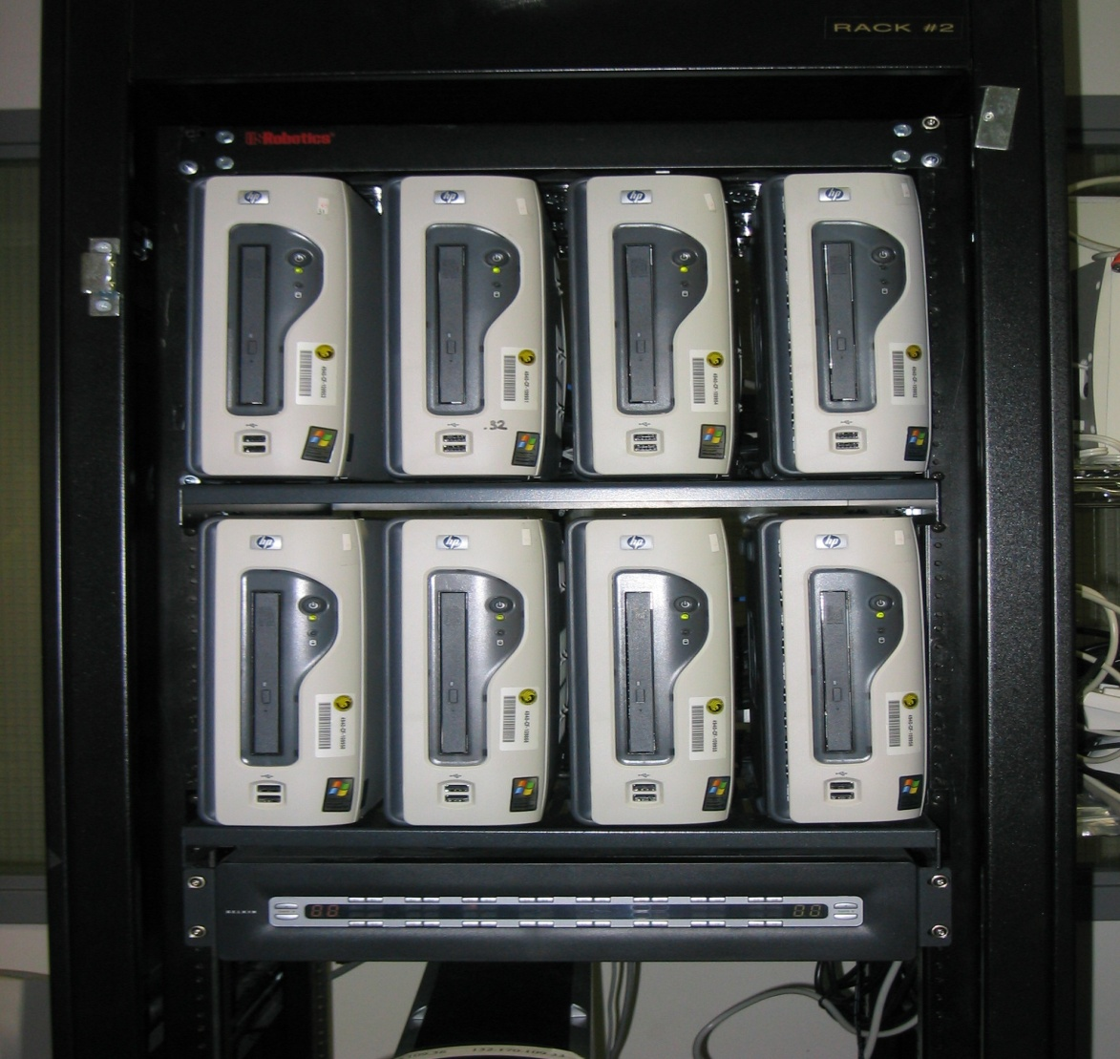
Prototype – RM Routers

Slide 44
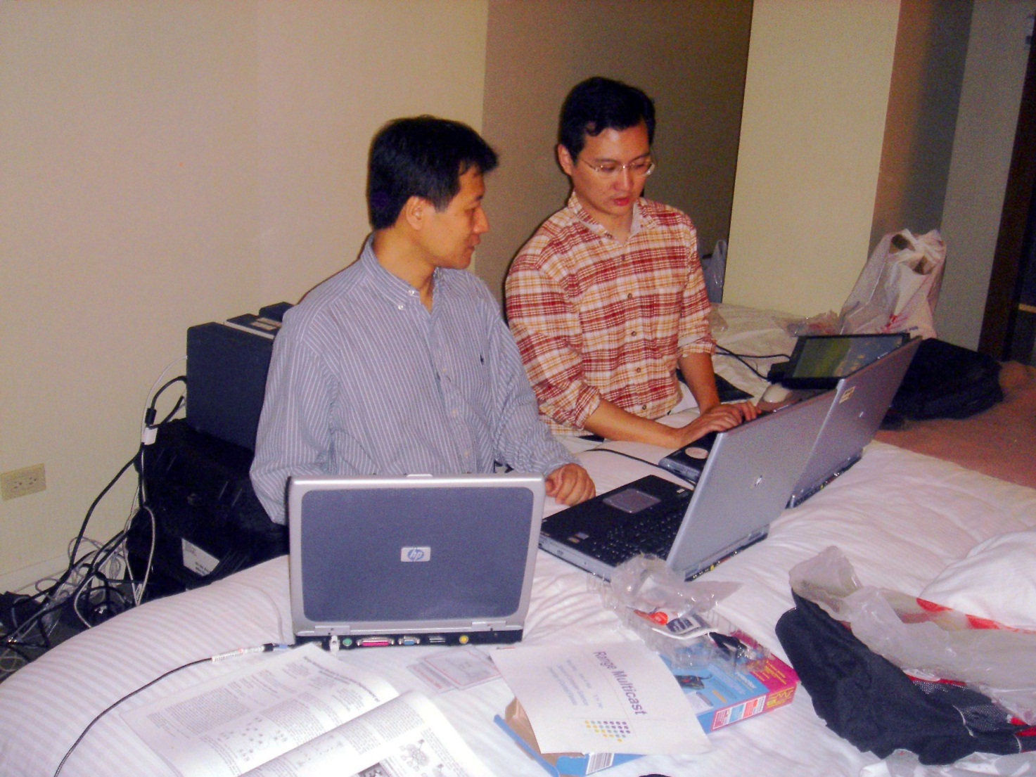
Preparation for Demo in NYC

Slide 45
Peer-to-Peer
Live Broadcast

Slide 46
Live Broadcast
Video on Demand: Each user plays the video from the beginning
Live Video Broadcast: A user joins an on-going live broadcast at the current play point of the video.
  ZIGZAG is a peer-to-peer technique for live broadcast
Notes:
46

Slide 47
Chaining: First P2P Streaming
Video Server
Client A
Screen
Client B
disk
Screen
Client C
disk
Screen
P2P Streaming is another way to scale beyond the bandwidth limitation of the server
disk

Slide 48
Chaining: First P2P Streaming
Video Server
Client A
Screen
Client B
disk
Screen
Client C
disk
Screen
This is the beginning of P2P data sharing and P2P computing
disk

Slide 49
Requirements for
P2P Live Broadcast
High Liveness
Low Overhead
Robustness

Slide 50
Liveness & Load Balancing
Server
I am overloaded
Too far from server?
new
I want to join fast

Slide 51
Robustness
The server is already busy
Server
Too many reconnections!
Notes:
51

Slide 52
Control Overhead
Peers periodically exchange information to maintain its position and connections in the topology.
The overhead of this task should be small and independent of the number of peers
Notes:
52

Slide 53
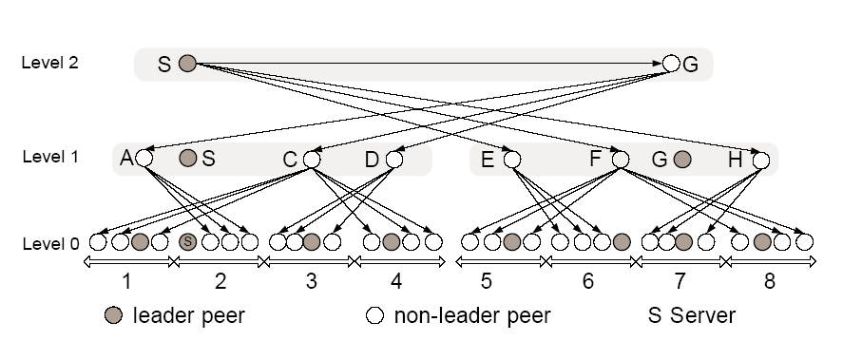
ZIGZAG Live Broadcast
A peer, at its highest level, connects to peers from a different cluster in the next level
Peers that are not leaders get data from a leader of a different cluster
Final position of node G
Notes:
53

Slide 54
ZIGZAG - Advantages
Short broadcast tree improves liveness
Small fanout keeps reconnecting cost low
Hierarchy helps reduce control message overhead
Notes:
54

Slide 55
Pull-based P2P Streaming
Join the network as a new peer
Obtain information of desired data through a gossip-based mechanism (or a hashing scheme, e.g., DHT)
Pull data from different peers
Notes:
Unstructured approach usually adopt the multiple sources, receiver-driven data transfer (i.e., pull-based).
It is interesting to notice that PPlive and PPstream has been upgraded supported VoD application since early this year.
I observe that they create a 1Gb size file for VoD usage under root directory C:/ . I suppose they use this
huge file to cache different video contents (even not viewed by the user of this computer), thus dramatically increase the diversity of
the video content in the Internet. Their VoD performance is not bad.

Slide 56
Pull vs Push
Push
  Peers at the edges of the multicast structures do not contribute resources
  Suitable for live broadcast (from a server)
Pull
  A lot of redundant data in the network
  Searching for data (gossiping or using DHT) incurs overhead
  Suitable for P2P data sharing (no server)
Notes:
graph topology can have multiple sources for single receiver.
Unstructured approach usually adopt the multiple sources, receiver-driven data transfer (i.e., pull-based).
Recently unstructured idea is adopted to VoD, like [6] and [7], this is more challenging than live streaming.
It is interesting to notice that PPlive and PPstream has been upgraded supported VoD application since early this year.
I observe that they create a 1Gb size file for VoD usage under root directory C:/ . I suppose they use this
huge file to cache different video contents (even not viewed by the user of this computer), thus dramatically increase the diversity of
the video content in the Internet. Their VoD performance is not bad.

Slide 57
Many P2P Streaming Systems on Internet
PPLive
PopCast
PPStream
Coolstreaming
TV Ants
QQLive

Slide 58
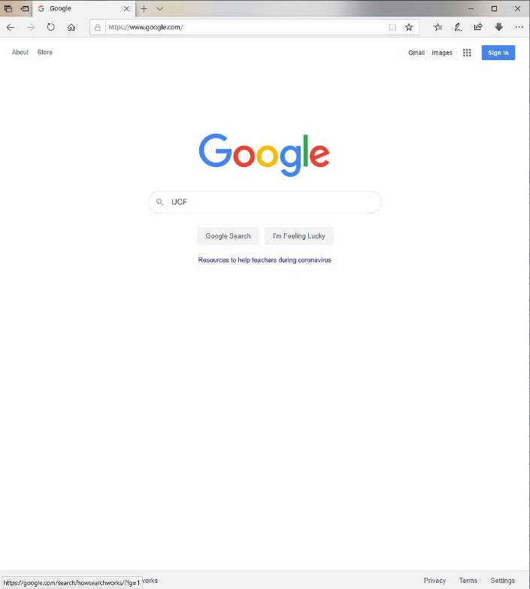
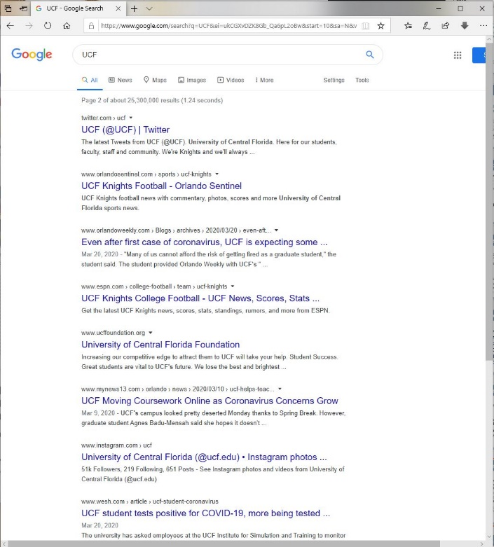
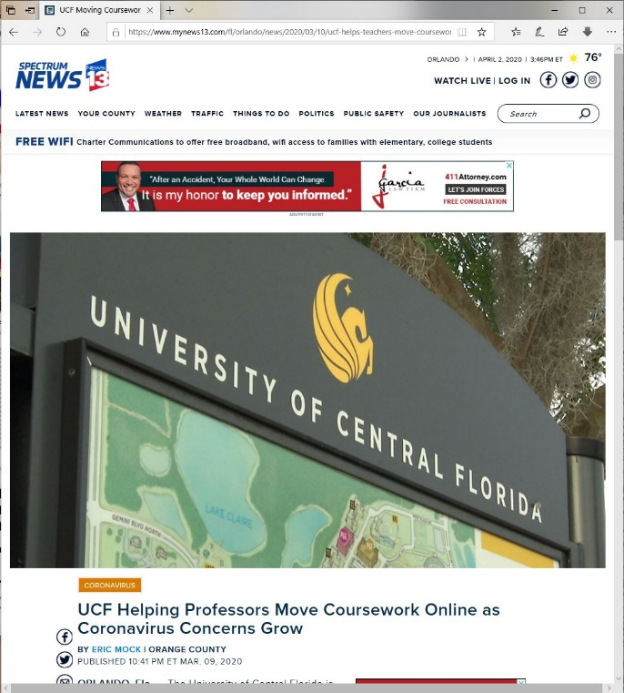
Video Search
Use keyword search to look for the candidate document.
Preview the document “summaries” to identify the desired document.
Browse the document to search for the desired text segment.

Slide 59

Video Search
Use similarity matching or keyword search to look for the candidate videos.
Preview some of the candidates to identify the desired video.
Apply VCR-style functions to search for the video segments.
Need to generate video summaries for Step 2
Use keyword search to look for the candidate document.
Preview the document “summaries” to identify the desired document.
Browse the document to search for the desired text segment.

Slide 60
Conventional Streaming
1. Download S_{o}
2. Download S₁
while playing S₀
3.
Download S₂
while playing S₁
.
.
.
Advantage:
Reduce wait time
Disadvantage:
Not suitable for searching video

Slide 61
Conventional Streaming
1. Download S_{o}
2. Download S₁
while playing S₀
3.
Download S₂
while playing S₁
.
.
.
Advantage:
Reduce wait time
Disadvantage:
Not suitable for searching video

Slide 62
Search Technique
Use extra preview files (e.g., movie trailers) to support the preview function
  Requires more storage space
  Downloading the preview file adds delay
Use separate fast-forward and fast-reverse files to provide VCR-style operations
  Requires more storage space
  Server can become a bottleneck

Slide 63
VCR-like Functionality is Expensive
Supporting VCR-like operations
  demands substantial network bandwidth, and
  requires significant server resources
Can we avoid these costs ?

Slide 64
2PSM - Preview Phase

Slide 65
Conventional Streaming
Video file from server
Video player
Buffer

Slide 66
Another Way - 2PSM
Video file from server
Video player
Initial download provides
a preview for the video
Buffer

Slide 67
2PSM: Playback Phase
t

Slide 68
2PSM: VCR Operations
Playing the L segments in forward and backward directions provides the fast forward and fast reverse functionalities, respectively.
t

Slide 69

2PSM - Advantages
1. It requires no extra files to provide the preview feature.
2. Downloading the preview frames does not incur extra cost.
3. It requires no extra files to support the VCR functionality.
4. Server is not involved in the VCR-style interaction.

Slide 70
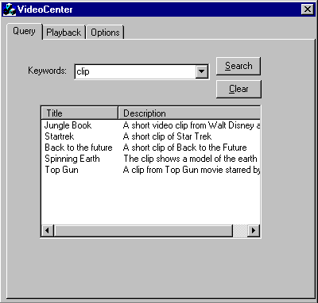
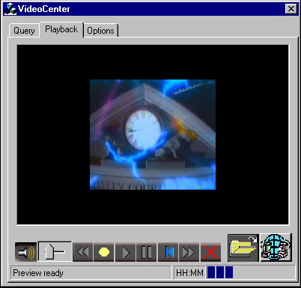
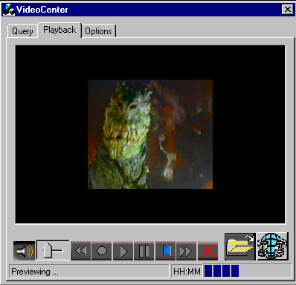
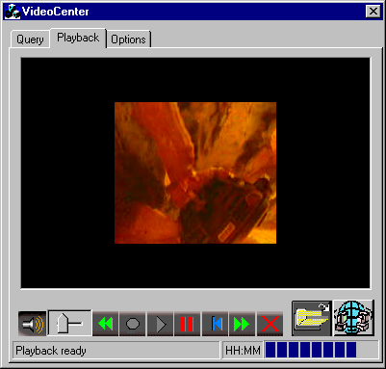
UCF Video Browser

Slide 71
Handling High Mobility in Mobile Ad Hoc Networks

Slide 72
What is a Mobile Ad Hoc Network?
No fixed routers
Mobile nodes function as relay nodes or routers
Source Node
Destination Node

Slide 73
Route Request
Source Node
Destination Node

Slide 74
Route Reply
Source Node
Destination Node

Slide 75
Data Transmission
The selected nodes participate in the data forwarding process
Source Node
Destination Node

Slide 76
Link Break
Source Node
Destination Node

Slide 77
Issue Route Request
Source Node
Selected new route
Destination Node

Slide 78
Challenge - Link Break
Supporting high-mobility applications is a great challenge
Source Node
Destination Node
Notes:
MANETs have no fixed routers. Instead, mobile nodes function as relay nodes or routers

Slide 79
One Idea - Fix the routers
Using Physical Nodes as Routers:
    Mobility
      → link breaks
      → rerouting
      → overhead !
D
S
Using Virtual Routers:
    Virtual routers are stationary
      → links are robust
      → fewer reroutes
      → less overhead !
Virtual Router
D
S

Slide 80
What is a Virtual Router ?
A virtual router is a spatial area
Physical nodes within this area alternate in forwarding data
Z
Virtual Router
X
D
S
Y

Slide 81
What is a Virtual Router ?
A virtual router is a spatial area
Physical nodes within this area alternate in forwarding data
When a node leaves the area, it is no longer obliged to forward the data
Virtual router is stationary
More suitable for high mobility applications such as vehicular networks
Z
Virtual Router
X
D
S
Y

Slide 82
Virtual Router Example
Source Node
Each node has GPS & grid map
Each cell is a virtual router
Destination Node

Slide 83
Virtual Router Approach: Requirements
Each mobile node needs to be equipped with a GPS
Each mobile node has a map of the virtual routers
Can we have a simpler technique without using GPS ?
Notes:
To address frequent link breaks in high mobility environments, some recent techniques (such as Contention-based forwarding [5], Connectionless Approach [10], and Trajectory Based Forwarding [17]) suggest to equip each node with a global positioning system (GPS), and let any node in the general direction of the destination node to relay the data without having to establish and maintain a communication route. This strategy incurs less control overhead and can tolerate a higher degree of node mobility. Extensive simulation results [9] confirmed this observation showing significant performance improvement over the rerouting methods can be achieved. Nevertheless, the GPS-based approach requires extra hardware that is GPS receiver on every mobile node, and accurate GPS locations, which may not always be provided by U.S. military. Some recent techniques such as [20] and [14] have been proposed to provide nodes location information in the absence of GPS. However, these positioning techniques incur overhead in periodic beacons and can significantly reduce the performance of the GPS-based routing protocols in high mobility environments.
[5] H. Fubler, J. Widmer, M. Kasemann, M. Mauve, and H. Hartenstein, “Contention-based forwarding for mobile ad hoc networks,” Ad Hoc networks, vol. 1, issue 4, pp.351-369, Nov. 2003.
[10] Y. H. Ho, A. H. Ho, K. A. Hua, and G. L. Hamza-Lup. “A Connectionless Approach to Mobile Ad hoc Networks,” Proc. of IEEE Symposium on Computers and Communications (ISCC 2004), Vol. 1, pp. 188 - 195. Alexandria, Egypt. 28 June-1 July 2004.
[17] D. Niculescu and B. Nath, “Trajectory Based Forwarding and Its Applications,” Proc. of ACM/IEEE MOBICOM ’03, pp. 260–272, San Diego, California, 2003.
[9] Y. H. Ho, A. H. Ho, and K. A. Hua, “Connectionless Protocol – A Localized Scheme to Ad Hoc Network.” Proc. of International Journal of Ad Hoc and Ubiquitous Computing (IJAHUC) 2007.
[20] A. Rao, C. Papadimitriou, S. Ratnasamy, S. Shenker, and I. Stoica. “Geographic Routing without Location Information,” In Proc. of the 9th Annual international Conference on Mobile Computing and Networking, 2003 (MobiCom ‘03). pp. 96-108.
[14] T. Moscibroda, R. O'Dell, M. Wattenhofer, and R. Wattenhofer, 2004. “Virtual coordinates for ad hoc and sensor networks,” In Proceedings of the 2004 Joint Workshop on Foundations of Mobile Computing, pp. 8-16.

Slide 84
Mercury-Like Routing: Establish Communication Path
S discovers D using some standard technique
D
S
D responds with a route reply packet
Nodes overhearing the route reply packet form the communication path
Notes:
To allow nodes to know which way on a virtual route is closer to the destination, VRA uses virtual routers. Suppose the grey line indicates a route traversed by a route request that the destination D receives.
Click the mouse to start animation.
As the route reply traversed from the destination back to the source S, neighbors can overhear the reply and form virtual routers with the nodes relying the packet. A virtual router is constructed when a node r on a route relays the route reply packet and r’s neighbors overhear the packet. Thus, a virtual router is centered at r and consisted of r and its neighbors. We note, by broadcasting and overhearing, a virtual router is associated with a location and yet nodes need not know their location to realize that they belong to the virtual router.
The main purpose of virtual routers is to guide the nodes which way on a virtual route to forward data packets toward the destination. As a result, there is no need for r to keep a track of its neighbors or coordinate them to forward data like a cluster head in a clustering protocol such as CGSR. By not tracking of the neighbors, there is also no need for nodes to periodically beacon its existence; such signal can congest the wireless medium.
Animation: Nodes are recruited to form the virtual routers as a route reply being relayed from the destination to the source.

Slide 85
Skeleton of Communication Path
D
S
Skeleton of the communication path
Notes:
Since nodes that receive the Route Reply can move away from the current route over time, the destination can recruit replacement nodes by periodically sending out an unsolicited Route Reply, called Route Update, to the source node. The destination includes its own node ID, the node ID of the source, the list of nodes traversed by the latest data packet received by the destination from the source, and a unique ID for the new route. Click the mouse to proceed to the next page.
Animation: 3 data packets traverse 3 different physical routes.

Slide 86
Data Forwarding
Data packet are forwarded by nodes in the communication path
D
S
Notes:
Since nodes that receive the Route Reply can move away from the current route over time, the destination can recruit replacement nodes by periodically sending out an unsolicited Route Reply, called Route Update, to the source node. The destination includes its own node ID, the node ID of the source, the list of nodes traversed by the latest data packet received by the destination from the source, and a unique ID for the new route. Click the mouse to proceed to the next page.
Animation: 3 data packets traverse 3 different physical routes.

Slide 87
Data Forwarding:
Details
n receives a data packet
If n is not in the path, n drops the packet.
Else, n sets a random delay
n drops the packet if it hears another node forwarding the packet before the end of the delay
Else n forwards the packet.
n
m
n
r2
r1
D
r7
r6
r5
r4
S
r3
Notes:
When a non-destination node n receives a never seen data packet from m, the data forwarding procedure is as follows:
Click the mouse for every step of the forwarding algorithm
If n is not in the VR of m, n drops the packet.
Else, n might need to forward the data and n delays the forwarding. n sets its delay as rand(node->seed)×t second
During this delay period, n will cancel the forwarding if n hears the same packet again broadcasted by another node.
At the end of the delay period, if the forwarding decision has not been cancelled, n forwards the data.
Animation: Steps 1, 2, 3, and 4.
In Step 1 of the above procedure, n determines if it is part of the path by comparing the Path ID field of the data packet with all the path ID’s the node has identified from the overheard Path Reply packets. If the path ID in the packet matches the path ID of one of the overheard path reply message packets saved in a cache, the node n is in the communication path. Periodically, each node can remove from its cache the path IDs that have not been heard for a predetermined period of time. Other cache replacement policy such as Least Recently Used can also be considered.
=============================================================================

Slide 88
Periodically Establishing
New Path
Forwarding route of the last data packet
D
S
Skeleton of current communication path
Notes:
Since nodes that receive the Route Reply can move away from the current route over time, the destination can recruit replacement nodes by periodically sending out an unsolicited Route Reply, called Route Update, to the source node. The destination includes its own node ID, the node ID of the source, the list of nodes traversed by the latest data packet received by the destination from the source, and a unique ID for the new route. Click the mouse to proceed to the next page.
Animation: 3 data packets traverse 3 different physical routes.

Slide 89
Periodically Establishing New Path
Route of last data packet is the skeleton of the new communication path
D
S
Skeleton of current communication path
Notes:
Continue from previous slide:
The nodes listed in the Route Update packet relay the Route Update to the source node. Each of these nodes establishes a new virtual router identified by the corresponding node ID, and these new virtual routers define a new route between the source and destination nodes. Once the source receives the Route Update, it will discard the old route and include the ID of new route in the headers of the subsequent data packets.
We note that a virtual route needs much less control overhead to maintain than a clustering structure. Unlike a clustering protocol that relies on periodic beaconing to detect the presence of a cluster member, VRA only uses the nodes that forward the last data packet to establish new virtual routers. Neighbors of these nodes only need to overhear the update to know they are part of the new virtual routers. The old virtual routers can simply be discarded as nodes do not see any data traversed over the old virtual route a while after the source starts to send out data over the new route.
Because the old virtual routers are simply discarded, VRA, unlike CGSR, does not need to keep track which node is in which virtual router nor require every node to periodically broadcast beacon messages. By not maintaining the virtual routers, VRA can easily be applicable in an environment where nodes move independent of each other and in high speed whereas a clustering protocol like CGSR is not suitable for such environment.
Animation: old virtual route fades away after a new virtual route is established.

Slide 90
Dynamic Mercury-like Routing
Communication path is dynamically updated according to the mobility of the source and destination
→ fluid and capable of following

Slide 91
Mercury-like
Communication Path
Communication path is dynamically updated according to the mobility of the source and destination
A communication path is more robust than a traditional connection
Traditional connection

Slide 92
Mercury-like
Communication Path
Broken path can still happen
S
Path update is essentially free
Frequent update prevents broken path – preventive approach
D
When a broken path occurs, source node issues a path_request packet to establish a new path

Slide 93

Conclusions
Mercury-like Routing has many advantages:
  Simplicity and low overhead
  → Highly efficient
  High data delivered rate with short delay
  → Good performance
  Less sensitive to high-speed mobility
  → Robust
  Supporting long connections in large terrains
  → Scalable
Suitable for a wide range of applications

