Slide 1
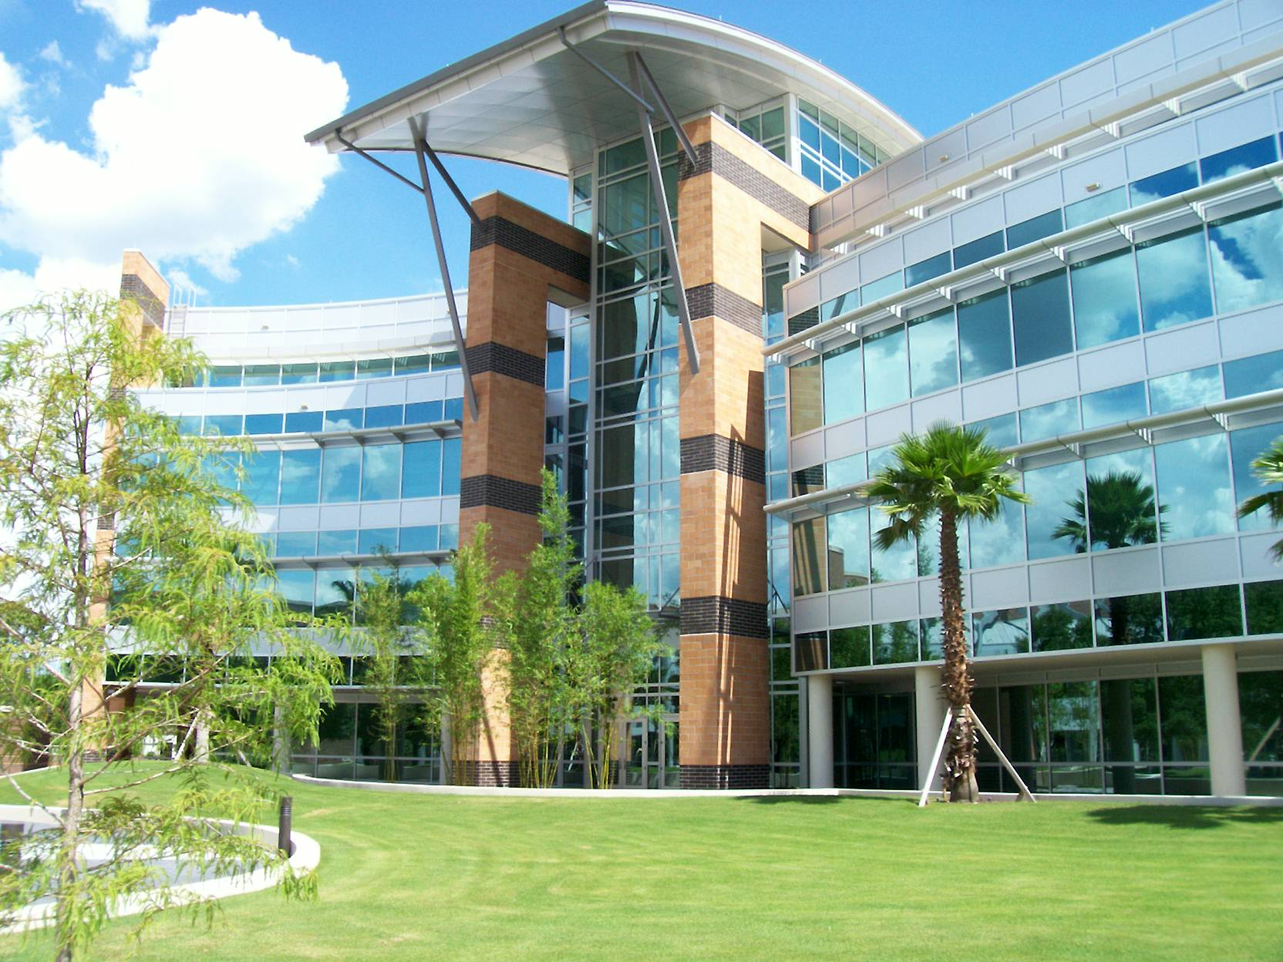



Internet of Things
THINGSTORE
Kien A. Hua
Department of Computer Science
University of Central Florida

Slide 2


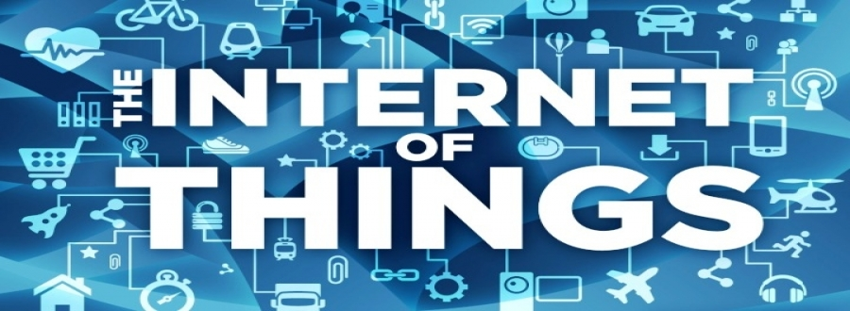
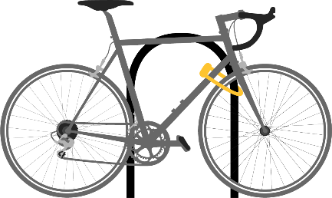
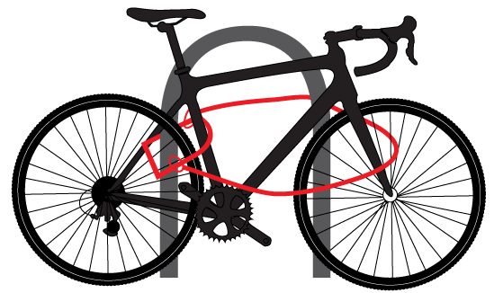
ThingStore
Collaboration in IoT Development and Deployment
ThingStore

Slide 3







Today’s Internet Users
This is changing

Slide 4




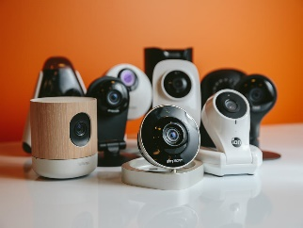
New Internet Users: “Things”
“Things” are connected devices
Regular cameras, thermal cameras, microphones, and a variety of sensors
Alert !
INTERNET

Slide 5



The Internet of Things (IoT)
There will be 28 billion “things” by 2020
Gartner, Inc.
“Things” are good helpers
Transmitting data
Sensing environment

Slide 6
The Internet of Things (IoT)
There will be 28 billion “things” by 2020
Gartner, Inc.
Biggest big data ever !!!

Slide 7

Big Data and Cloud Computing
Big data are at data center, ready for cloud computing

Slide 8
IoT Is a Different Kind of Big Data

Slide 9
IoT Is a Different Kind of Big Data
Potentially billions of live data sources continuously feeding from all across the Internet in real time
Conventional Big Data
Cloud Computing
IoT data source
1st IoT Challenge
Communication is potentially a serious bottleneck
1

Slide 10

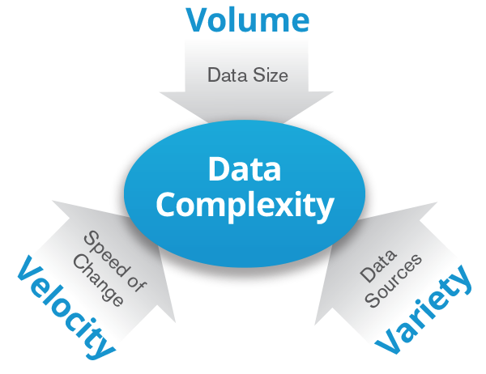


IoT Challenge #2
Today Focus in
Big Data research
Event notification
End users
‘Thing’ heterogeneity
Software development is complex
IoT App
2
Any kind of sensor
Any kind of camera
Notes:
From KSC slides

Slide 11

IoT Challenge #3
Event notification
End users
IoT App
IoT App
IoT App
3
No standard for IoT application development
How to share IoT infrastructure ?
Any kind of sensor
Any kind of camera
Notes:
From KSC slides

Slide 12
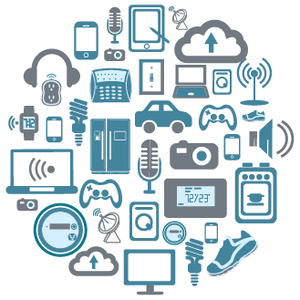
ThingStore
Addresses These Challenges
Avoids flooding the Internet
Simplifies software development
Enables sharing of IoT Infrastructure

Slide 13


‘Things’ in ThingStore
Internet of Things are made intelligent with event detection software, smart services
Smart services carry out computations upon raw data generated by their physically collocated or decoupled sensing components
Smart services
Thing Server
S1
S1
S1
S1
S1
S2
Deploy “things” with smart services
Thing Provider

Slide 14
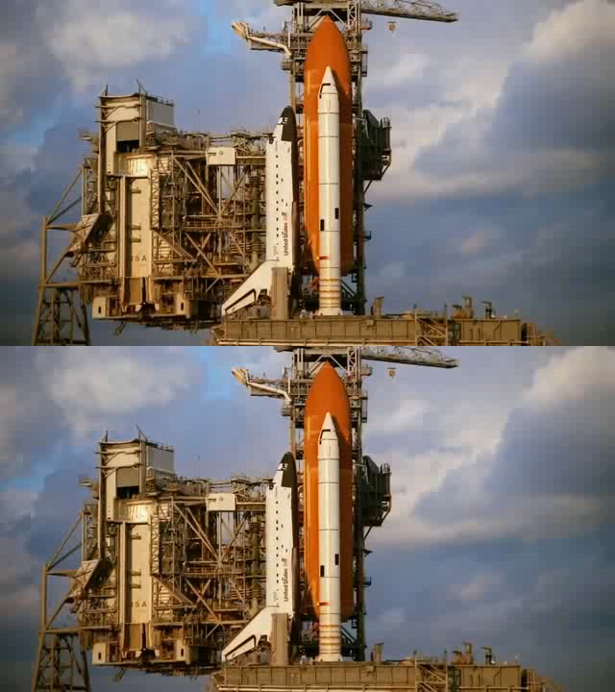
Smart Service Example
Camera
Simulated live camera view
A smart service of the camera
Other smart services of the camera
S2
Smoke detected by smart service
(color coded)
“1”
Thing Server
S1
S1
S1
S1
S1
S2
Deploy “things” with smart services
Thing Provider

Slide 15
Smart Service
Smart services transform raw data into meaningful information
Development of smart services (thing operators) is left to Thing experts
I have a PhD in multimedia computing
Thing Server
S1
S1
S1
S1
S1
S2
Deploy “things” with smart services
Thing Provider

Slide 16
System Overview
3
2
1
Applications
0
0
1
0
1
1
0
0
1
0
1
1
0
0
0
0
0
1
0
1
1
Complex events
EQL Processor
(Boolean Query Processing)
1
1
0
0
0
0
0
1
1
1
0
0
0
0
0
0
0
1
1
1
1
1
0
0
0
0
1
0
Atomic events
3 smart services
S6
S5
S4
S4
S3
S2
S1
4 smart services
Thing
Thing
Any kind of Camera
Any kind of sensor

Slide 17
Addressing Challenges
3
2
1
Applications
0
0
1
0
1
1
0
0
1
0
1
1
0
0
0
0
0
1
0
1
1
A programming interface for sharing IoT Infrastructure
EQL Processor
(Boolean Query Processing)
Challenge
3
App Developers only focus on the application logic
1
1
0
0
0
0
0
1
1
1
0
0
0
0
0
0
0
1
1
1
1
1
0
0
0
0
1
0
Boolean abstraction hides complexity due to device heterogeneity
Challenge
2
Thing servers at the “edge” of network
S6
S5
Edge computing → No need to stream raw data
S4
S4
S3
S2
S1
Thing
Thing
1
Challenge
This runs counter to the theme of consolidation and massive data centers that has dominated the discourse on cloud computing.

Slide 18
EQL Example
Computer program
Event specification
Event notification
Internet
End users
  SELECT event-handler
  FROM Thing1 T1
  WHEN Before(T1.S3, T1.S1)
  WITHIN 30 seconds
  UNTIL 60 minutes
IoT App
IoT App
IoT App
EQL query
EQL query
EQL query
Termination Clause:
UNTIL time
UNTIL true
UNTIL forever
1
0
0
0
0
1
1
0
S1
S1
S1
S1
S1
S2
T2
T1
Notes:
From KSC slides

Slide 19


Event Evidence
App may request event evidence for further processing
App
Thing Server
Query
…
“1”
Event handling
Evidence ?
Raw data
Further analysis
Optional

Slide 20

EQL vs SQL
SQL: Value-based search
EQL: Event-based search
Search
Search
Notes:
The Internet is your computer for IoT apps development

Slide 21

EQL Query Processing
Boolean abstraction as a framework for multimedia data stream processing
And
Before
Meets
Processing “WHEN” clause in EQL - Asynchronous Data stream processing
T7.S1
T1.S3
T7.S4
T1.S2
Multimedia Computing
S4
S3
S2
S1
S6
S4
S2
S1
Thing1
Thing7
Notes:
<click>
For query processing, event states are sampled in discrete time intervals and dynamic tables are created.
<click>
Logical and temporal query operations are performed on dynamic event tables.

Slide 22
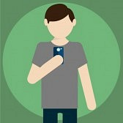




Ad Hoc EQL Query
Notification
Event-handling software
  SELECT event-handler
  FROM Thing1 T1
  WHEN Before(T1.S3, T1.S1)
  WITHIN 30 seconds
  UNTIL 60 minutes
Complex event
1
0
0
0
0
1
1
0
S1
Atomic event
S1
S1
S1
S1
S2
New observation
Notes:
From KSC slides

Slide 23
Embedded EQL
Computer program
  SELECT [event-handler]
  FROM Thing1 T1
  WHEN Before(T1.S3, T1.S1)
  WITHIN 30 seconds
  UNTIL 60 minutes
Call callback entry
Control command
1
0
0
0
0
1
1
0
S1
S1
S1
S1
S1
S2
Notes:
From KSC slides

Slide 24

Parameterized EQL Queries
  SELECT event-handler
  FROM heat h, noise n
  WHEN before(h(105), n(120))
  WITHIN 30 seconds
  UNTIL 60 minutes
Parameter
Default threshold if argument is not provided
  CREATE SERVICE heat (threshold INTEGER 100,
  until TIME 3600)
  FOR Sensor1 T1
  DECLARE start_time TIME
  BEGIN
  start_time = curr_time;
  WHILE (curr_time – start_time < UNTIL) {
  if (T1.next > threshold) THEN RETURN ‘true’
  }
  END
System time
RETURN does not terminate the execution
Notes:
From KSC slides

Slide 25
Callback Entry
IoT App
EQL Processor
Submit EQL7 with callback entry at “7”
EQL 7
7
Process EQL7
Handler for EQL7
Event is “1”
Calls App at “7”
EQL Processor is a server to the IoT App; but IoT App is also a server to the EQL Processor
→ Not conventional client/server computing

Slide 26
IoT App with n EQL Queries
IoT App
EQL Processor
.
.
.
Submit EQL1
.
.
.
EQL1
1
Process EQL1
Handler for EQL1
Calls App at “1”
Concurrent threads
Submit EQLn
EQLn
n
Process EQLn
Handler for EQLn
Calls App at “n”

Slide 27
ThingStore
ThingStore
IoT Market Place
S1
S1
An Ecosystem for IoT Collaboration
S1
S1
S1
S2
Network
Thing Server
S1
S1
S1
S1
S1
S2
Deploy “things” with smart services
Thing Provider

Slide 28
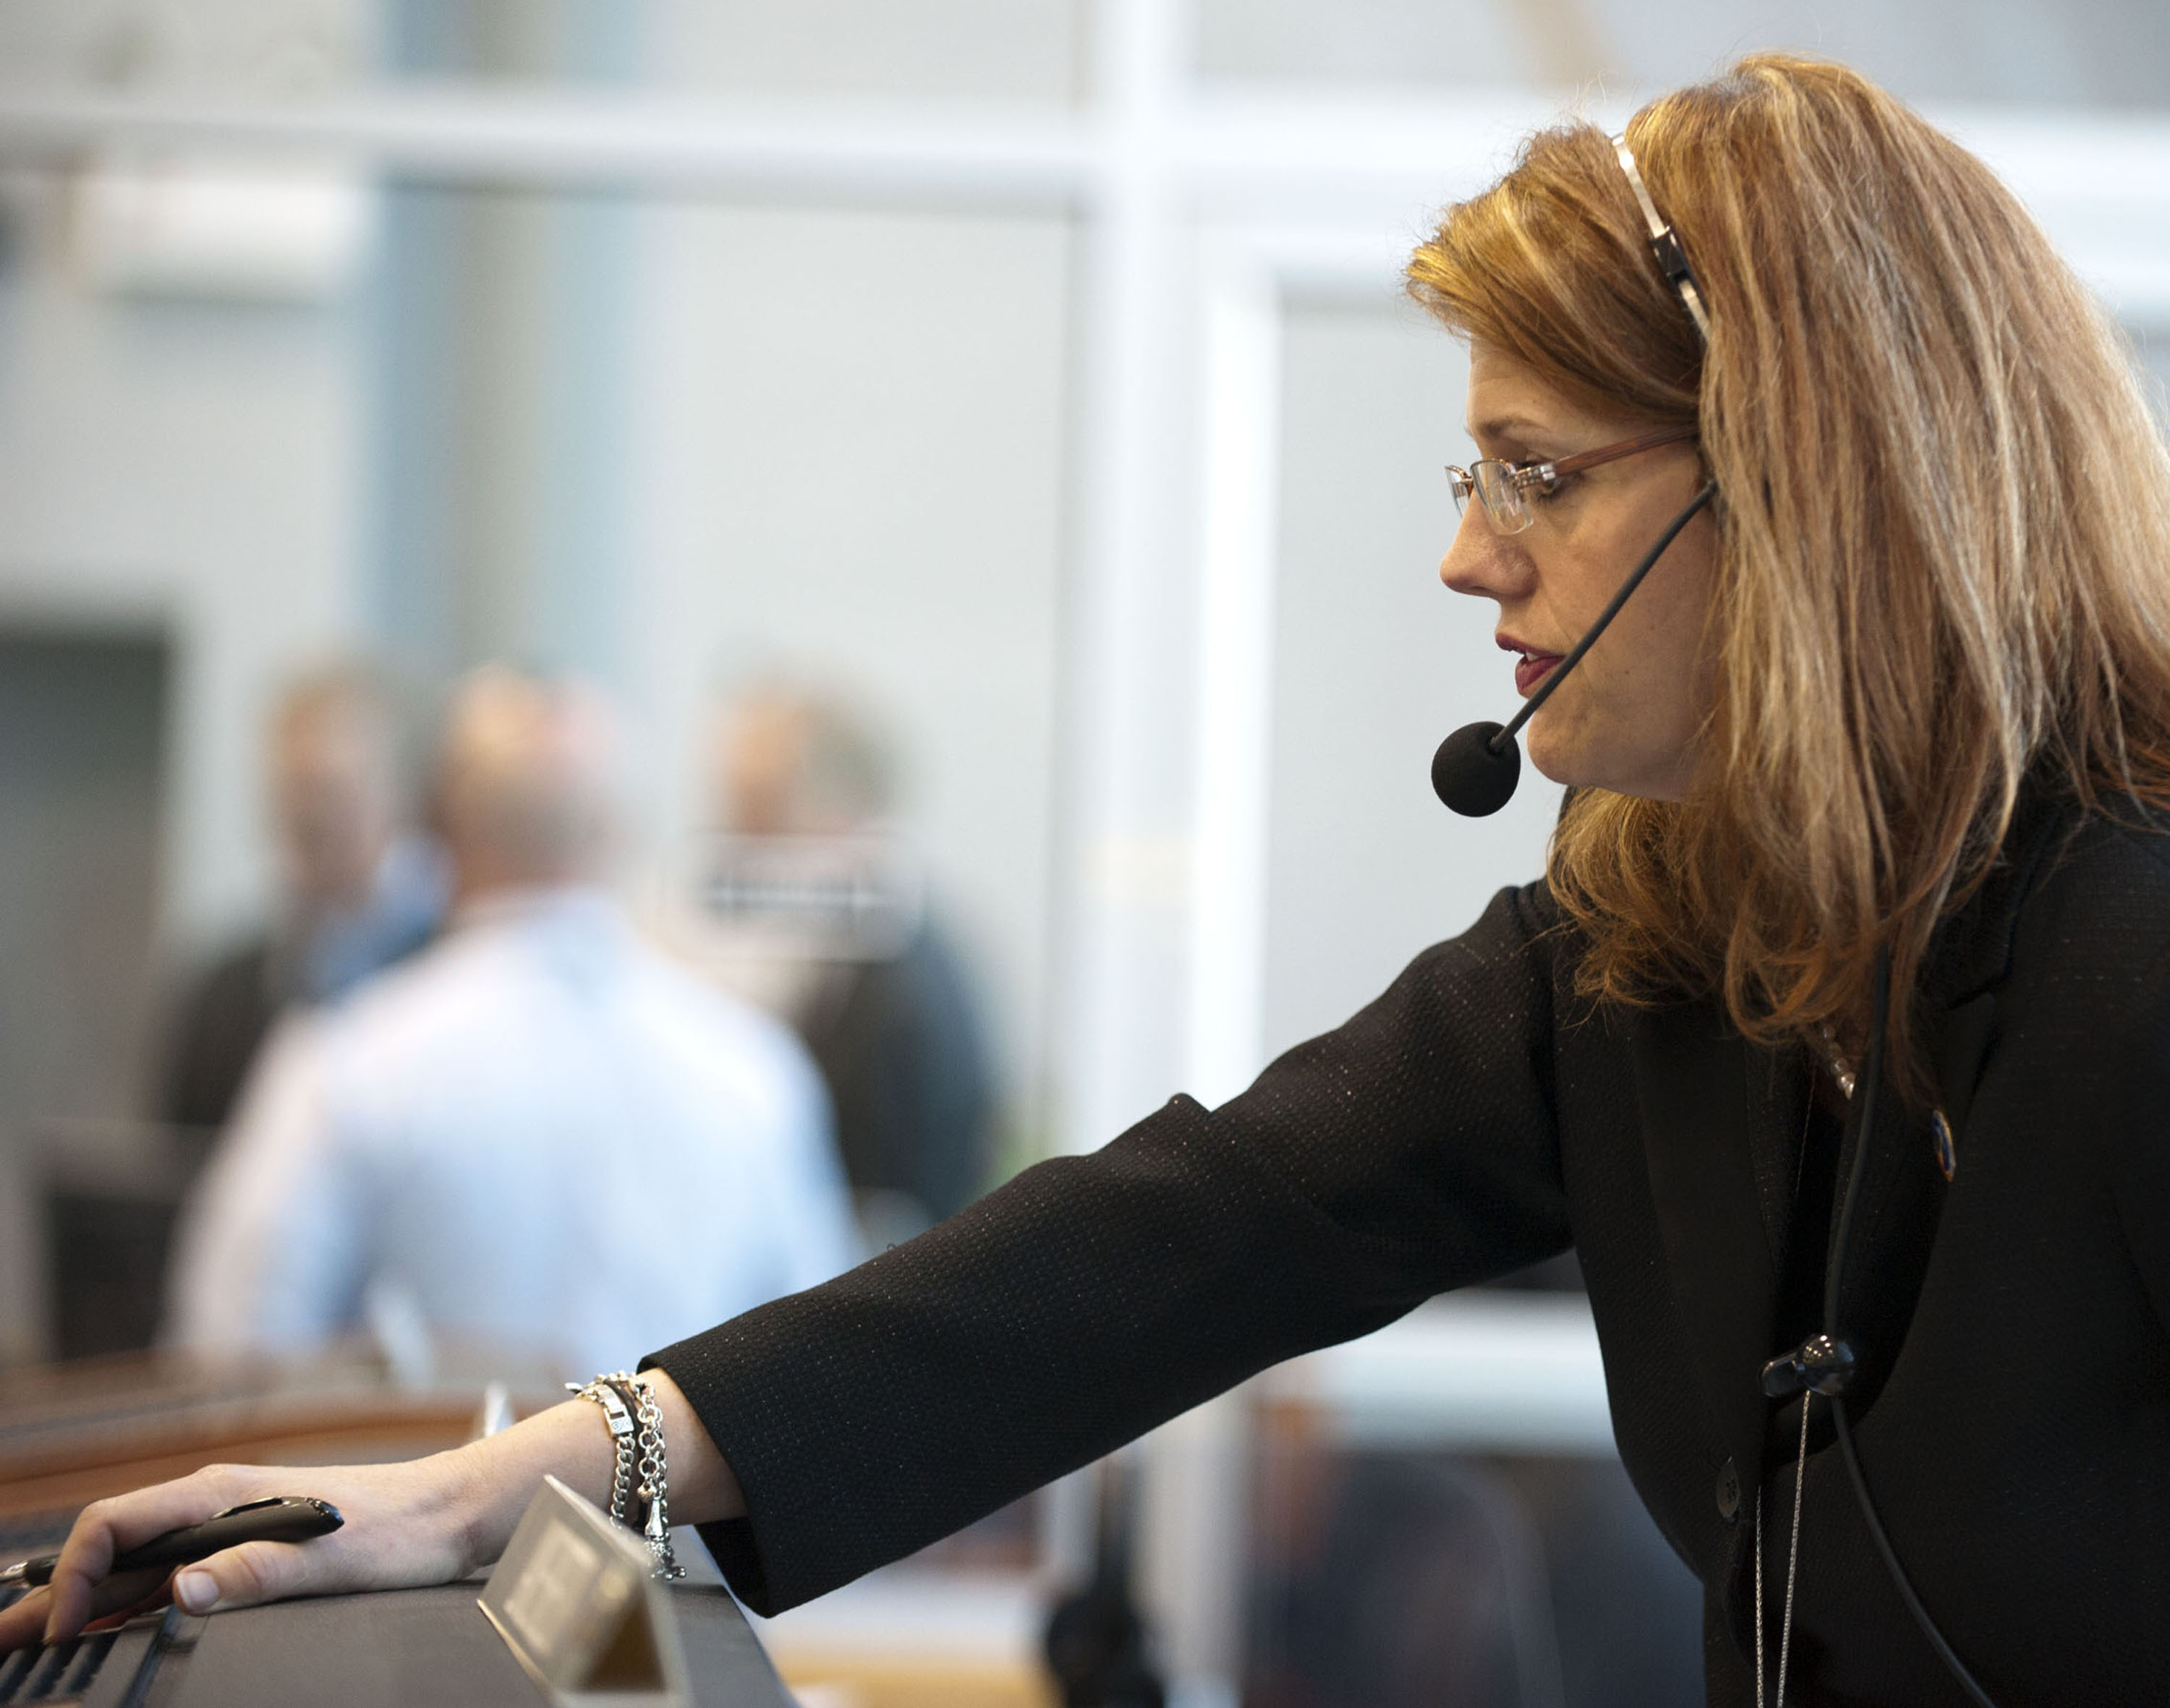
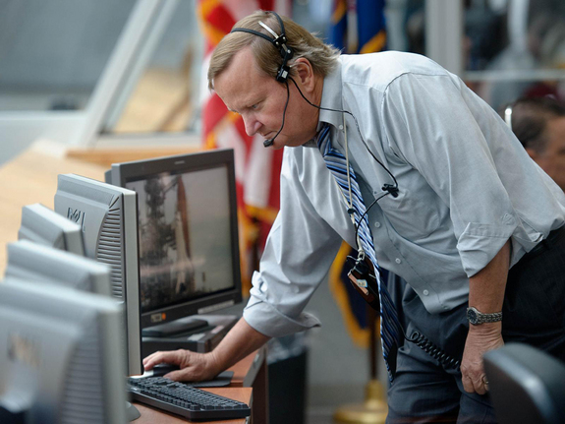
ThingStore
ThingStore
IoT Market Place
S1
S1
An Ecosystem for IoT Collaboration
S1
S1
S1
app
S2
app
app
Download
app
End Users
Query Processor
EQL queries
App Server
Develop apps as online services
Network
app
Subscription
app
app
IoT App Developer
Thing Server
S1
S1
S1
S1
S1
S2
Deploy “things” with smart services
Thing Provider

Slide 29
ThingStore
ThingStore
IoT Market Place
S1
S1
S1
S1
S1
app
S2
app
Cloud Computing
app
app
Query Processor
App Server
Edge Computing
Develop apps as online services
app
app
app
Thing Server
Deployed at data center
S1
S1
S1
S1
S1
S2
Leverage both parallel and distributed processing
Deploy “things” with smart services
Deployed at the edge

Slide 30
Query Optimization
Computation Sharing: Merging Queries
Execution Pool
A new query
Before
Join
Before
AND
S3
S3
S4
S1
S2
Duplicate computation
A forest of query trees

Slide 31
Computation Sharing
Execution Pool
New query
A new query
Before
Before
Join ?
After
AND
Buffer
S4
S2
S3
S1
S2
S3
Computation sharing

Slide 32
Query Optimization
Execution Plans
O4
O5
O3
O6
O2
O1
Query 34
Query 22
Query 16
Translator
O4
O5
O3
O6
O2
O1
Waiting Queue
O4
O5
O3
O6
O2
O1
Execution Pools (multithreaded)
EX1
Optimized queries for EX1
EX2
Optimized queries for EX2
Optimizer
EX3
Optimized queries for EX3
These queries share computation performed by executor EX3
Query Results

Slide 33


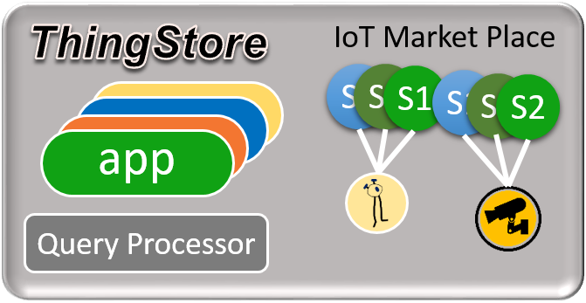
ThingStore
Thing Developer
IoT App Developer
An Ecosystem for IoT Collaboration
IoT Users
Collaboration platform for IoT development and deployment

Slide 34
First Assignment
Kutalmis Akpinar, Kien A. Hua, and Kai Li, “ThingStore: A Platform for Internet-of-Things Application Development and Deployment,” in Proc. of 9th ACM International Conference on Distributed Event-based Systems, Oslo, Norway, June 29 – July 3, 2015.
Kutalmis Akpinar and Kien A. Hua, “ThingStore - An Internet of Things Management System,” in Proc. of IEEE Int’l Conference on Multimedia Big Data, Laguna Hills, California, April 19-21, 2017.

Slide 35
Working with ‘Things’
Future Workplaces

Slide 36
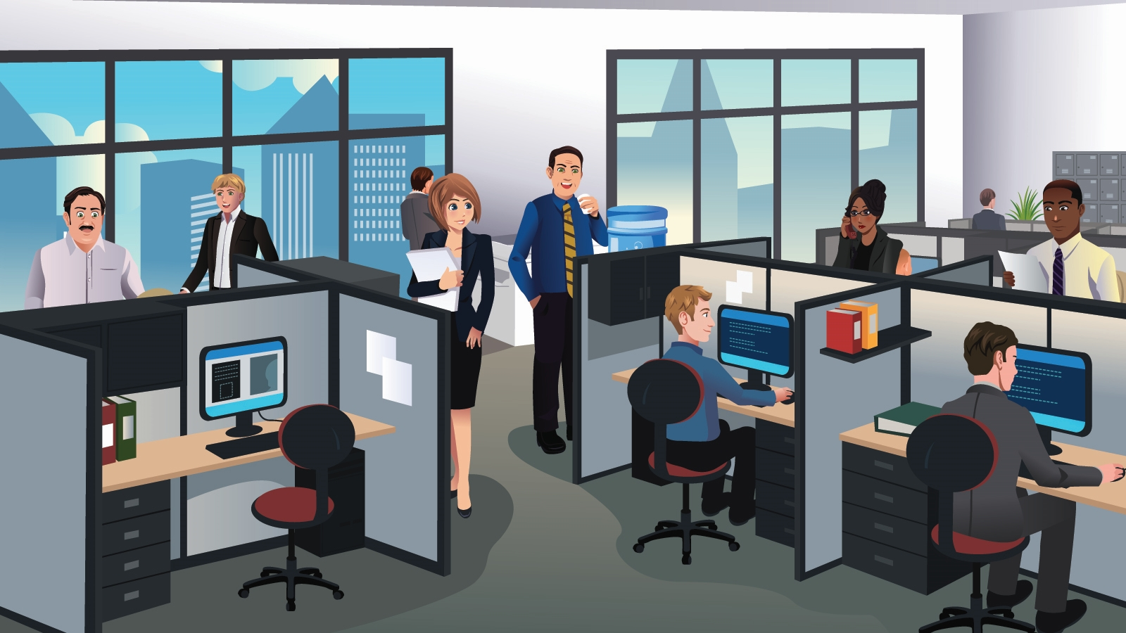


Today’s Workplaces
Most people collaborate using emails

Slide 37
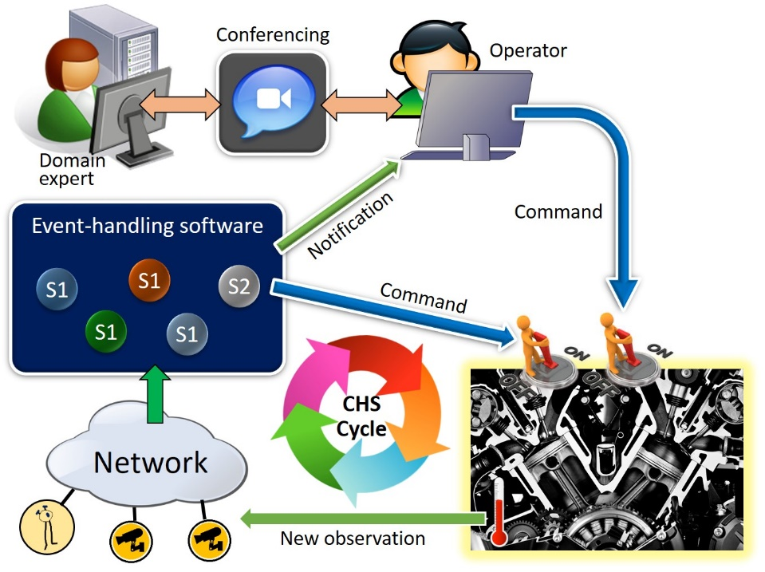
Future Workplace
Human-Things Teaming

Slide 38
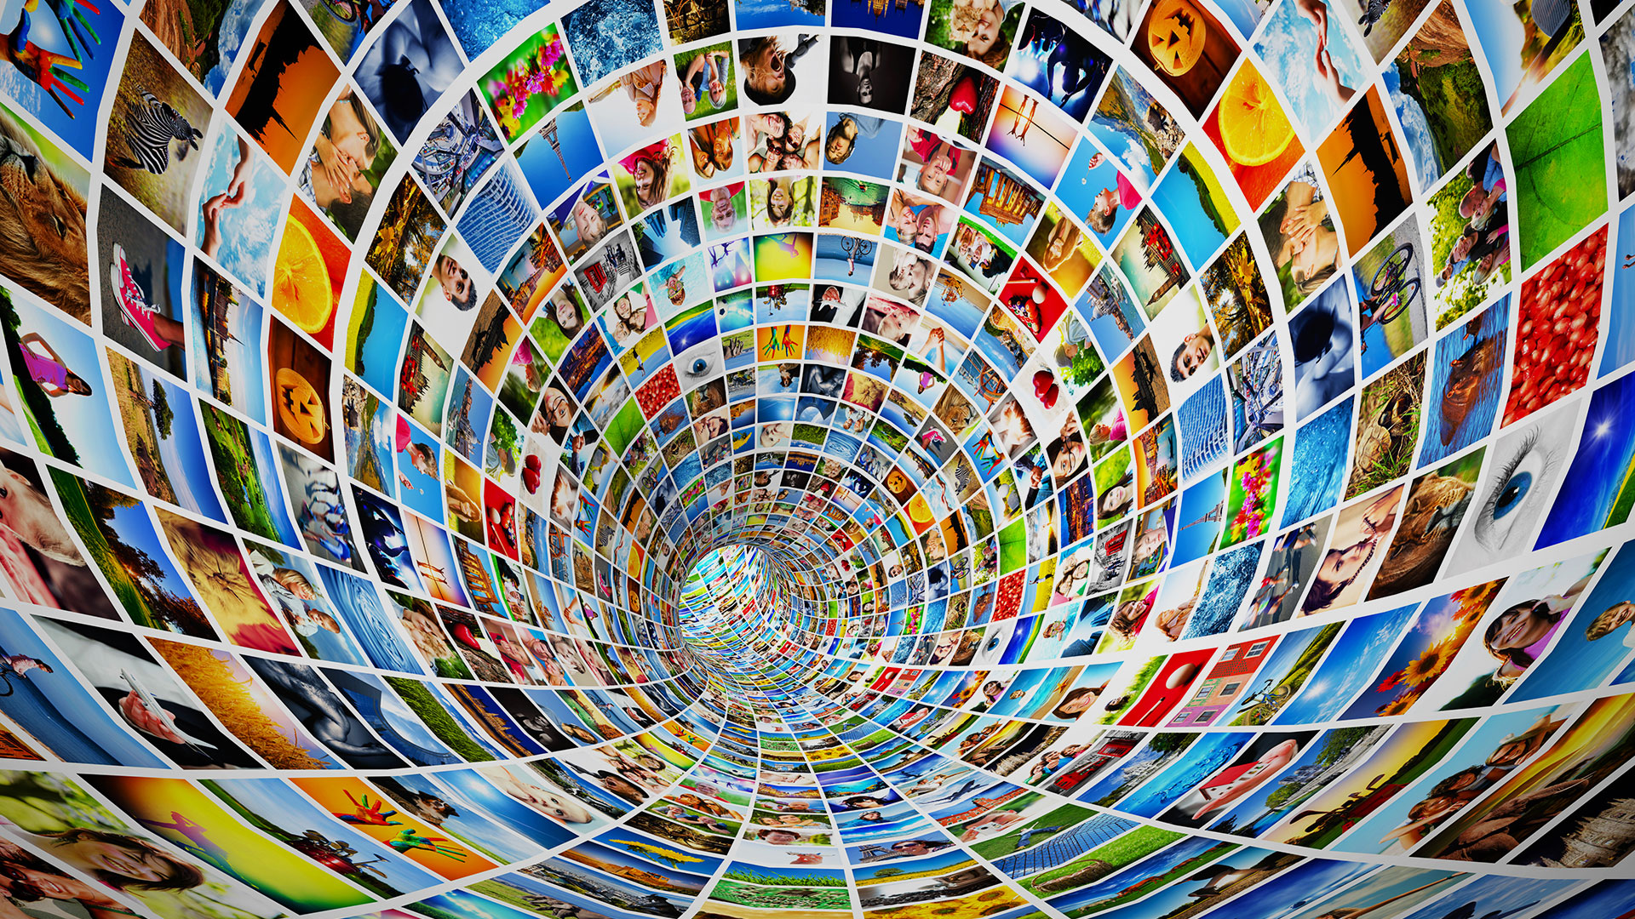
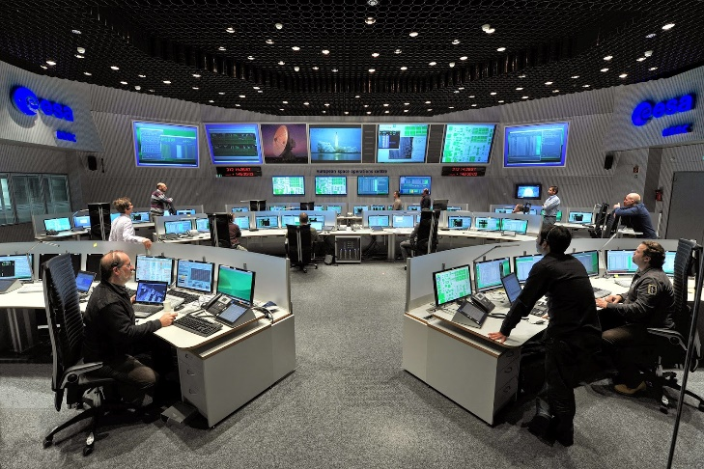
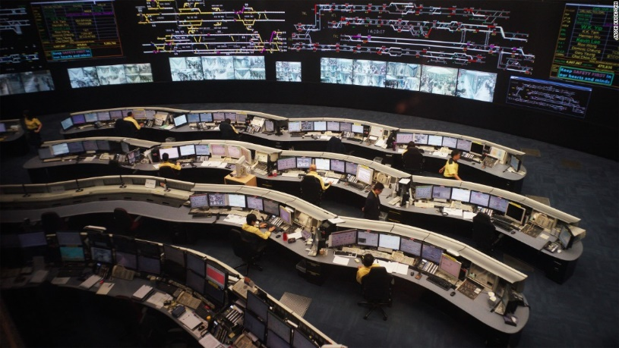
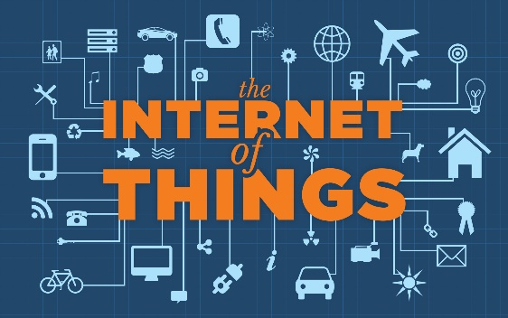
Future Workplaces with IoT
Fusing human and machine intelligence opening up a host of new opportunities

Slide 39
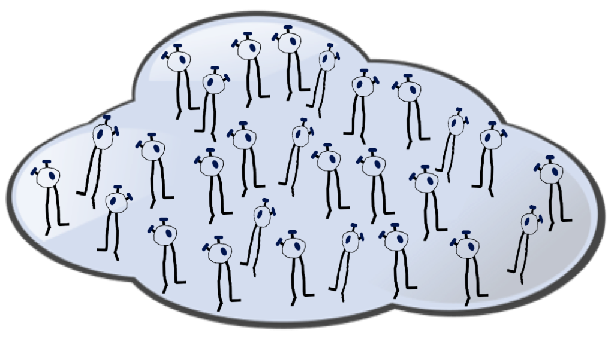

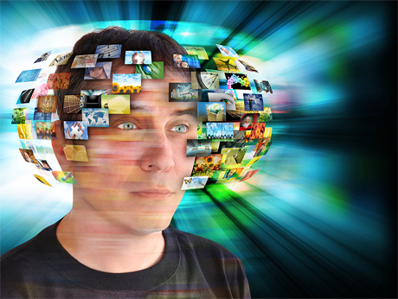
Collaborating with ‘Things’
Challenge: Human teams need to be much more efficient
Information overload

Slide 40
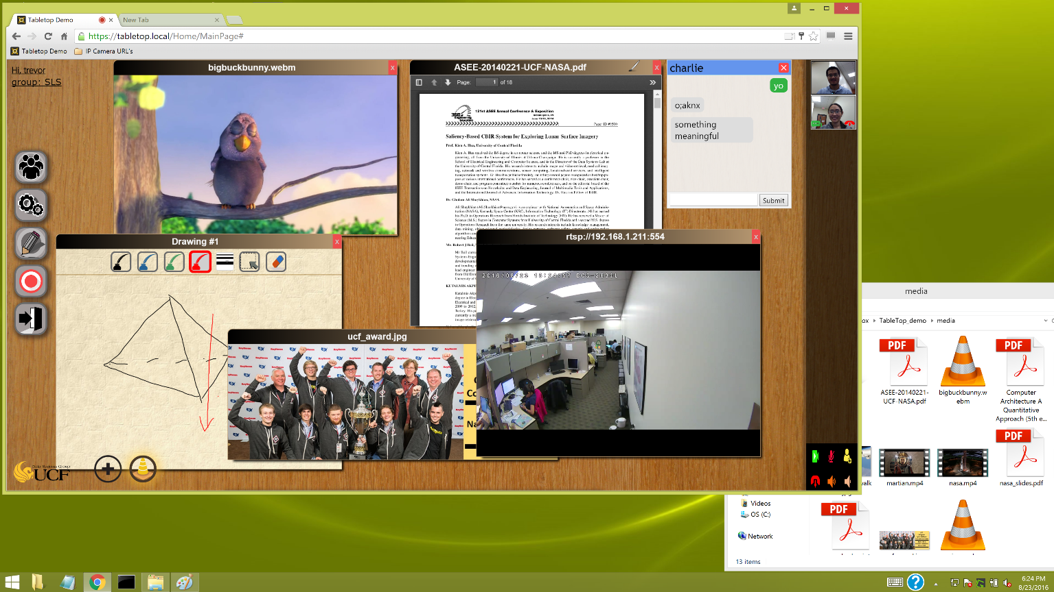
TABLETOP
A Multimedia virtual meeting room for time critical decision making

Slide 41

Sharing Desktop Objects
Tabletop
Collaboration space
Browser
The “world”
Desktop
Private space
Seamless interoperability of Tabletop and Windows Desktop enables fast access and sharing of private and Internet information in meetings

Slide 42
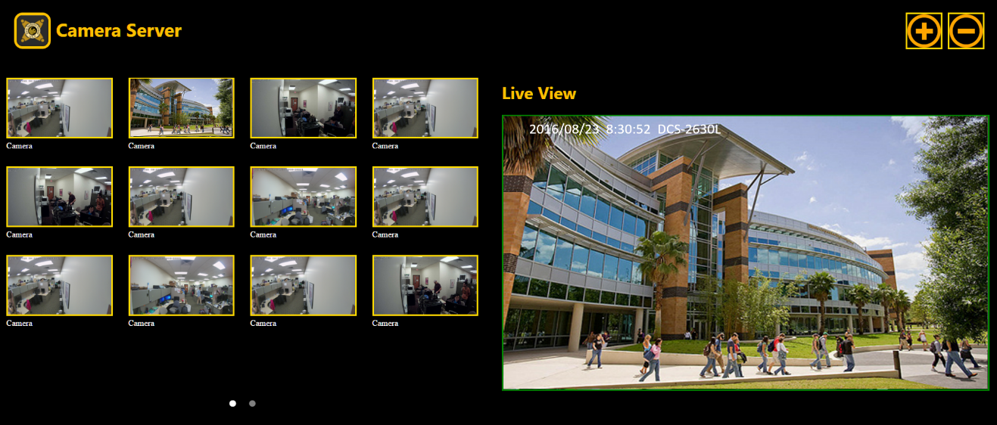


Sharing the Internet of Things
Users can co-operate on ‘things’ during a meeting
My IoT folder
Containing IoT bookmarks

Slide 43
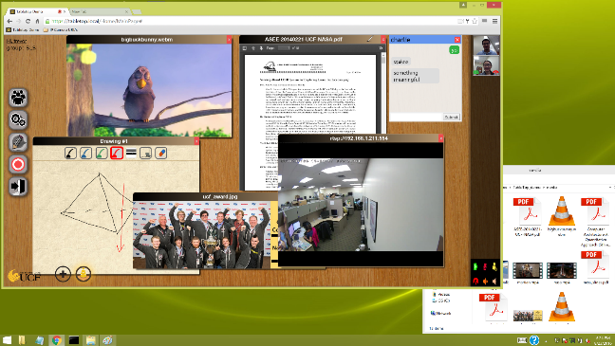


Tabletop collaboration
Operator
Domain expert
IoT Applications
Event Notification
Command
Future Workplace with human-machine teaming
Human-Things
collaboration
Command
Network
Thing Server
S1
S1
S1
S1
S1
S2
New observation

Slide 44

Collaboration Management
Leader of Tabletop 2 also participates in Tabletop 1
Top Leader
Tabletop 1
Middle-level leader
Tabletop 2
Tabletop 3
First-level leader
Tabletop 4
Tabletop 5
Tabletop 6
Reporting
Supporting large-team collaboration

Slide 45

Tabletop

