Slide 1
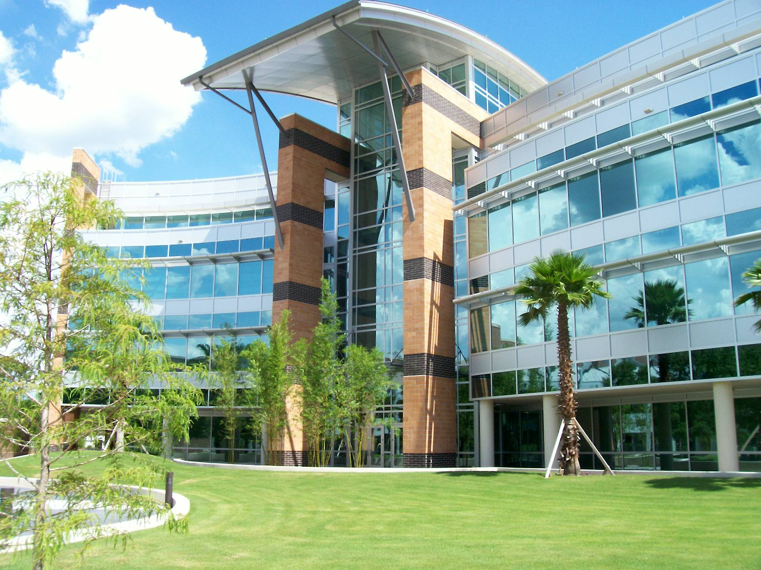



Internet of Things
A New Frontier of Multimedia Research
Kien A. Hua
Department of Computer Science
University of Central Florida

Slide 2
Three Topics
Continuous streaming from billions of Internet of things can be even more demanding
Where do we get network bandwidth for IoT ?
On-demand streaming will make up 82% of Internet traffic by 2021
Stress on Internet
100%
82%
2021
time
Sending emails
Web browsing
Video Streaming
Internet of Things (IoT)

Slide 3

Three Topics
Continuous streaming from billions of Internet of things can be even more demanding
Future workplaces with human-things teaming
On-demand streaming will make up 82% of Internet traffic by 2021
Stress on Internet
100%
82%
Tabletop
ThingStore
3
DON
2
1
time
Sending emails
Web browsing
Video Streaming
Internet of Things (IoT)

Slide 4
Deduplication Overlay Network (DON)

Slide 5


Video Dominating Internet
Even with caching, CDN, P2P, proxies, multicast streaming, etc., there is still a need to improve video streaming
82%
2021
80%
2020
79%
2019
77%
2018
75%
2017
72%
2016

Slide 6

Conventional Wisdom
Routing algorithms have been designed to avoid congestion
Traffic congestion
is bad for networks

Slide 7
Conventional Wisdom
… Is this
still true
today ?
Traffic congestion
What if we can turn congestion into advantage ?
is bad for networks

Slide 8






Communication Patterns Change …
PAST: One-to-one communication
TODAY: One-to-many communication
Congestion is bad !!
Congestion is still bad ?

Slide 9
Video Traffic Is Different
One-to-MANY communication
80:20 rule also applies to video streaming
Just 5% of the videos account for 95% of total views at YouTube
Majority of people watch the new movie releases

Slide 10
New Pattern New Solution
Since 80:20 rule also applies to video streaming
A lot of “duplicated” video traffic
Moving the duplicated traffic off the network helps, how ?
An idea: Video Streaming Tree

Slide 11
Dynamic Stream Merging
Deduplication router
S₁
Can also be a video segment
Packet P₁
Staging buffer
S₁
Stream S₁ begins

Slide 12
Dynamic Stream Merging
S₁
S₂
Packet P₁₀₀
Packet P₁
S₁
S₂
Stream S₂ begins

Slide 13
Dynamic Stream Merging
S₁
S₂
Packet P₁₅₀
Packet P₅₀
Packet P₁₀₀
S₁
S₂
Stream S₁ is recorded in preparation for merge

Slide 14
Dynamic Stream Merging
S₁
S₂
Saving bandwidth
Packet P₂₀₀
In this example, s₂ is merged with s₁ : (s₁ → s₂)
80:20 Rule - we can have s₁ → s₂ → s₃ → … → s_{k} and save k-1 streams
Packet P₁₀₀
S₁
S₂
Stream S₂ is blocked and merge begins

Slide 15
Dynamic Stream Merging
S₁
S₂
Saving bandwidth
Packet P₂₀₀
In this example, s₂ is merged with s₁ : (s₁ → s₂)
80:20 Rule - we can have s₁ → s₂ → s₃ → … → s_{k} and save k-1 streams
Packet P₁₀₀
S₁
S₂
Move redundant traffic off the network
Turn congestion into advantage

Slide 16
Video Streaming Tree
Deduplication routers

Slide 17
Video Streaming Tree
Merge

Slide 18
Video Streaming Tree
Merging taking place independently throughout the network incrementally constructs a video streaming tree – An opportunistic approach

Slide 19
Video Streaming Tree
Merging taking place independently throughout the network incrementally constructs a video streaming tree – An opportunistic approach

Slide 20
Video Streaming Tree
Merging taking place independently throughout the network incrementally constructs a video streaming tree – An opportunistic approach

Slide 21
Video Streaming Tree
Controlling redundancy prevents bottlenecks and reduces network traffic
Congested with “redundant” traffic
Substantial traffic reduction
With deduplication
Without deduplication
More traffic

Slide 22











Multicast Tree ≠ Streaming Tree
Server
Server
Multicast tree: Wait for multicast time
→ Not on demand
Streaming Tree: zero delay
→ Video on demand

Slide 23


Deduplication Overlay Network
Deduplication Overlay Network (DON) consists of deduplication routers capable of merging ‘duplicate’ video streams
DON reduces traffic for the underlying network
DON (Deduplication Overlay Network)
Deduplicationrouter
Logical link
Conventional router
Underlying network
Physical link

Slide 24
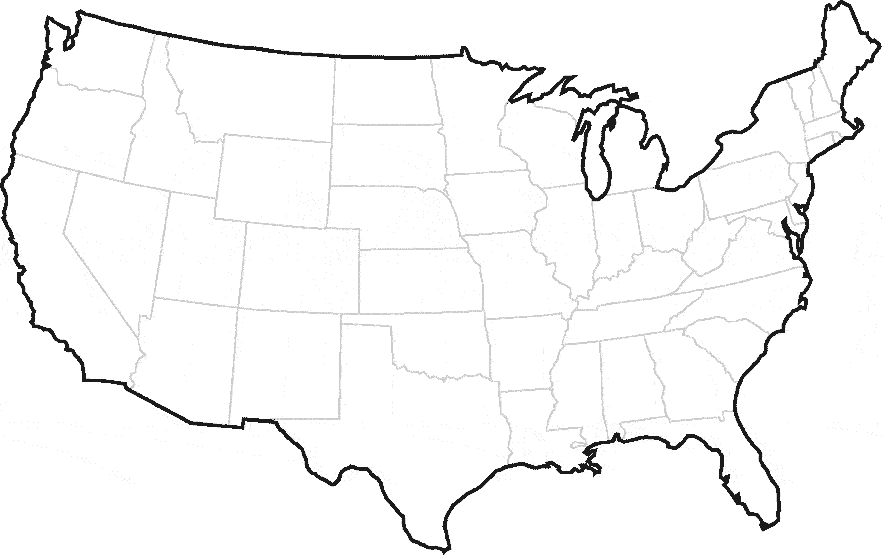

DON Experiment
PlanetLab Servers as DON routers
A line topology with DON routers in Florida, South Carolina, North Carolina, Washington D.C., and New York

Slide 25



A Wireless Setup
Limited number of mesh nodes available
Mesh gateway connected to campus network through Ethernet
Link 1
Link 2
Link 3
Link 4
Line-mesh topology allows us to maximize the number of hops (typically encountered in larger mesh networks)
Notes:
There are n+1 users. One of them requests video x , and all the other users request video y at different times. These users are randomly placed among nodes n₂ , n₃ , and n₄ .

Slide 26
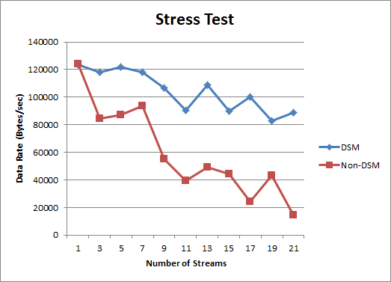
Video Stream Performance
Congestion impact on video X
With stream merging, video x continues to perform well
More congestion, video x becomes unwatchable
One request for video x
Increasing requests for video y (more congestion)

Slide 27
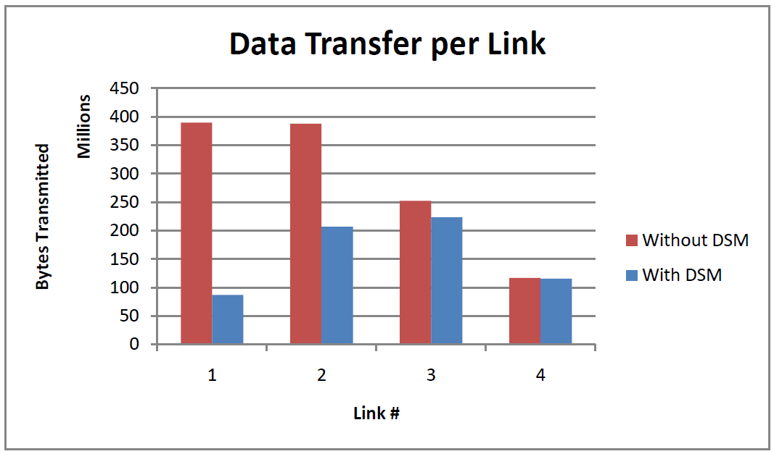
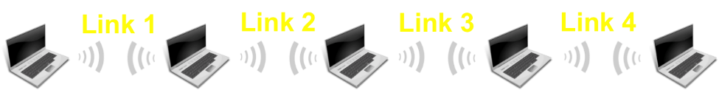
Stress Test on Network Links
20 requests for the same video
Plot shows accumulated data transmitted at each link
Without merging
With merging
Without merging: (1) More traffic (2) Routers near gateway completely saturated
With merging: (1) Nodes near gateway are not saturated (2) Supporting more than 20 video requests is possible

Slide 28
Merger-Aware Routing
Conventional routing algorithms are designed to reduce congestion by distributing load
We want to combine the load to increase merging opportunity
⇒ A merger-aware routing technique is helpful

Slide 29

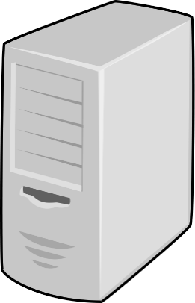


Simulation Setting
SERVER
Underlying network
DON overlay

Slide 30
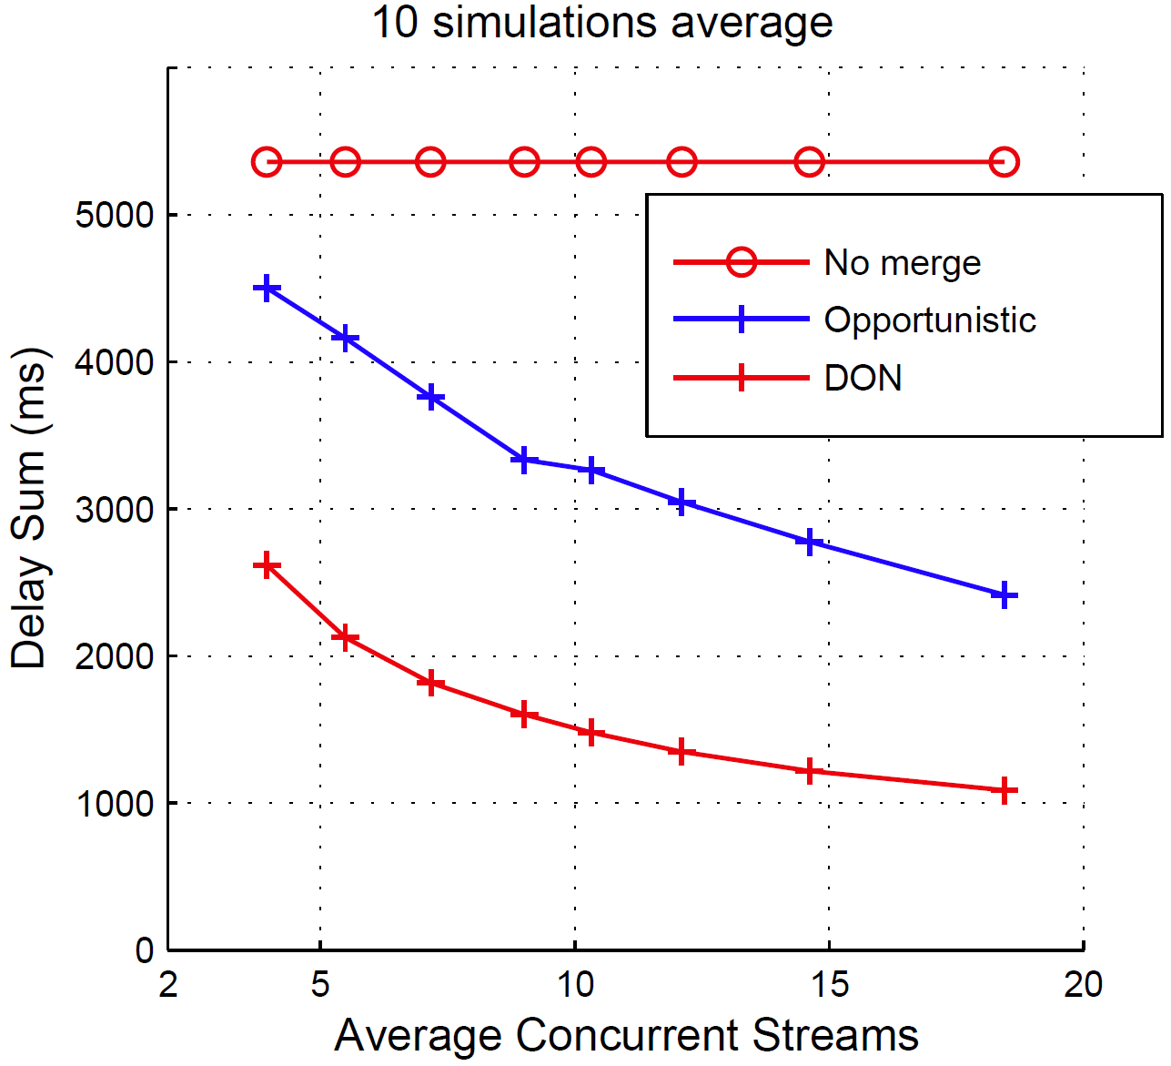
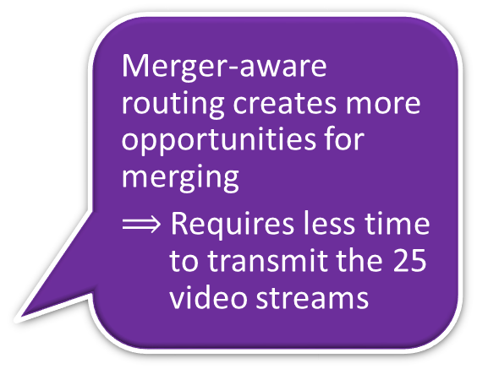
Merger-Aware Routing
Total transmission time for all 25 video streams
Merger-aware routing creates more opportunities for merging
$⟹$ Requires less time to transmit the 25 video streams
Notes:
In “No Merge,” the server takes the same amount of time to transmit the video 25 times regardless of the level of concurrency among these streams (i.e.,the same amount of total data need to be transmitted). With merging, the server needs to send less data for the 25 clients. With merging, the clients can receive data “originated” from many routers beside the server. As a result, the reduction in the server-transmitting data decreases with increases in the level of concurrency.
The simulation time is shorter for the case with a higher concurrency. Each simulation runs until all 25 streams are done. The level of concurrency is controlled by the video request rare.

Slide 31
Some Research Directions
Interesting topics
  Apply Dynamic Stream Merging to SDN -- A Deduplication Software-Defined Overlay Network
  Apply Dynamic Stream Merging to CDNs
Challenges: Support
  Adaptive bit rate,
  e.g., MPEG-DASH
  HTMLS

Slide 32


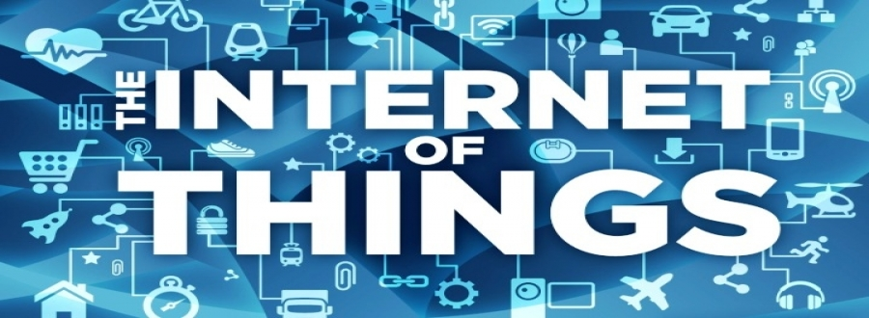
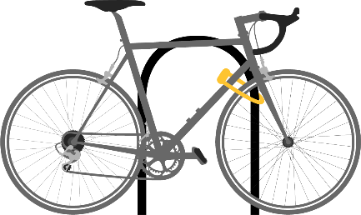
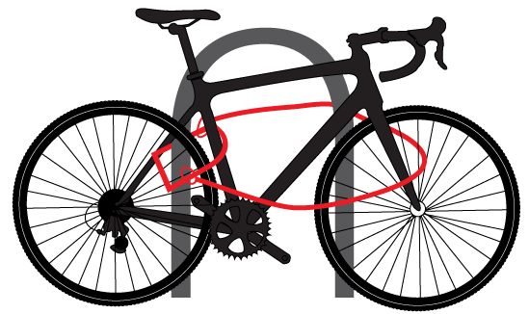
ThingStore
Collaboration in IoT Development and Deployment
ThingStore

Slide 33

Today’s Internet Users
This is changing

Slide 34



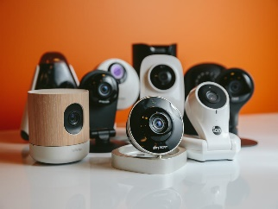
New Internet Users: “Things”
“Things” are connected devices
Regular cameras, thermal cameras, microphones, and a variety of sensors
Alert !
INTERNET

Slide 35



The Internet of Things (IoT)
There will be 28 billion “things” by 2020
Gartner, Inc.
“Things” are good helpers
Transmitting data
Sensing environment

Slide 36
The Internet of Things (IoT)
There will be 28 billion “things” by 2020
Gartner, Inc.
Biggest big data ever !!!

Slide 37

Big Data and Cloud Computing
Big data are at data center, ready for cloud computing

Slide 38
IoT Is a Different Kind of Big Data

Slide 39
IoT Is a Different Kind of Big Data
Potentially billions of live data sources continuously feeding from all across the Internet in real time
Conventional Big Data
Cloud Computing
IoT data source
1st IoT Challenge
Communication is potentially a serious bottleneck
1

Slide 40

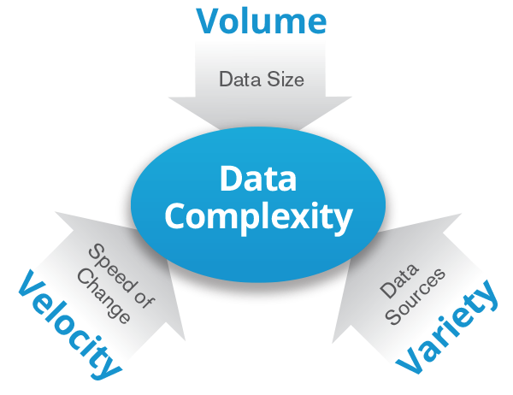


IoT Challenge #2
Today Focus in
Big Data research
Event notification
End users
‘Thing’ heterogeneity
Software development is complex
IoT App
2
Any kind of sensor
Any kind of camera
Notes:
From KSC slides

Slide 41

IoT Challenge #3
Event notification
End users
IoT App
IoT App
IoT App
3
No standard for IoT application development
How to share IoT infrastructure ?
Any kind of sensor
Any kind of camera
Notes:
From KSC slides

Slide 42
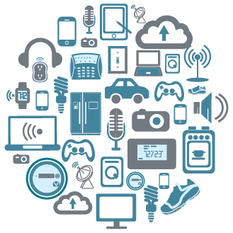
ThingStore
Addresses These Challenges
Avoids flooding the Internet
Simplifies software development
Enables sharing of IoT Infrastructure

Slide 43


‘Things’ in ThingStore
Internet of Things are made intelligent with event detection software, smart services
Smart services carry out computations upon raw data generated by their physically collocated or decoupled sensing components
Smart services
Thing Server
S1
S1
S1
S1
S1
S2
Deploy “things” with smart services
Thing Provider

Slide 44

Smart Service Example
Camera
Simulated live camera view
A smart service of the camera
Other smart services of the camera
S2
Smoke detected by smart service
(color coded)
“1”
Thing Server
S1
S1
S1
S1
S1
S2
Deploy “things” with smart services
Thing Provider

Slide 45
Smart Service
Smart services transform raw data into meaningful information
Development of smart services (thing operators) is left to Thing experts
I have a PhD in multimedia computing
Thing Server
S1
S1
S1
S1
S1
S2
Deploy “things” with smart services
Thing Provider

Slide 46
System Overview
3
2
1
Applications
0
0
1
0
1
1
0
0
1
0
1
1
0
0
0
0
0
1
0
1
1
Complex events
EQL Processor
(Boolean Query Processing)
1
1
0
0
0
0
0
1
1
1
0
0
0
0
0
0
0
1
1
1
1
1
0
0
0
0
1
0
Atomic events
3 smart services
S6
S5
S4
S4
S3
S2
S1
4 smart services
Thing
Thing
Any kind of Camera
Any kind of sensor

Slide 47
Addressing Challenges
3
2
1
Applications
0
0
1
0
1
1
0
0
1
0
1
1
0
0
0
0
0
1
0
1
1
A programming interface for sharing IoT Infrastructure
EQL Processor
(Boolean Query Processing)
Challenge
3
App Developers only focus on the application logic
1
1
0
0
0
0
0
1
1
1
0
0
0
0
0
0
0
1
1
1
1
1
0
0
0
0
1
0
Boolean abstraction hides complexity due to device heterogeneity
Challenge
2
Thing servers at the “edge” of network
S6
S5
Edge computing → No need to stream raw data
S4
S4
S3
S2
S1
Thing
Thing
1
Challenge
This runs counter to the theme of consolidation and massive data centers that has dominated the discourse on cloud computing.

Slide 48
EQL Example
Computer program
Event specification
Event notification
Internet
End users
  SELECT event-handler
  FROM Thing1 T1
  WHEN Before(T1.S3, T1.S1)
  WITHIN 30 seconds
  UNTIL 60 minutes
IoT App
IoT App
IoT App
EQL query
EQL query
EQL query
Termination Clause:
UNTIL time
UNTIL true
UNTIL forever
1
0
0
0
0
1
1
0
S1
S1
S1
S1
S1
S2
T2
T1
Notes:
From KSC slides

Slide 49


Event Evidence
App may request event evidence for further processing
App
Thing Server
Query
…
“1”
Event handling
Evidence ?
Raw data
Further analysis
Optional

Slide 50

EQL vs SQL
SQL: Value-based search
EQL: Event-based search
Search
Search

Slide 51

EQL Query Processing
Boolean abstraction as a framework for multimedia data stream processing
And
Before
Meets
Processing “WHEN” clause in EQL - Asynchronous Data stream processing
T7.S1
T1.S3
T7.S4
T1.S2
Multimedia Computing
S4
S3
S2
S1
S6
S4
S2
S1
Thing1
Thing7
Notes:
<click>
For query processing, event states are sampled in discrete time intervals and dynamic tables are created.
<click>
Logical and temporal query operations are performed on dynamic event tables.

Slide 52




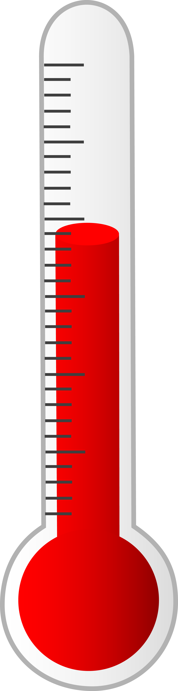
Ad Hoc EQL Query
Notification
Event-handling software
  SELECT event-handler
  FROM Thing1 T1
  WHEN Before(T1.S3, T1.S1)
  WITHIN 30 seconds
  UNTIL 60 minutes
Complex event
1
0
0
0
0
1
1
0
S1
Atomic event
S1
S1
S1
S1
S2
New observation
Notes:
From KSC slides

Slide 53
Embedded EQL
Computer program
  SELECT [event-handler]
  FROM Thing1 T1
  WHEN Before(T1.S3, T1.S1)
  WITHIN 30 seconds
  UNTIL 60 minutes
Call callback entry
Control command
1
0
0
0
0
1
1
0
S1
S1
S1
S1
S1
S2
Notes:
From KSC slides

Slide 54

Parameterized EQL Queries
  SELECT event-handler
  FROM heat h, noise n
  WHEN before(h(105), n(120))
  WITHIN 30 seconds
  UNTIL 60 minutes
Parameter
Default threshold if argument is not provided
  CREATE SERVICE heat (threshold INTEGER 100,
  until TIME 3600)
  FOR Sensor1 T1
  DECLARE start_time TIME
  BEGIN
  start_time = curr_time;
  WHILE (curr_time – start_time < UNTIL) {
  if (T1.next > threshold) THEN RETURN ‘true’
  }
  END
System time
RETURN does not terminate the execution
Notes:
From KSC slides

Slide 55
ThingStore
ThingStore
IoT Market Place
S1
S1
An Ecosystem for IoT Collaboration
S1
S1
S1
S2
Network
Thing Server
S1
S1
S1
S1
S1
S2
Deploy “things” with smart services
Thing Provider

Slide 56

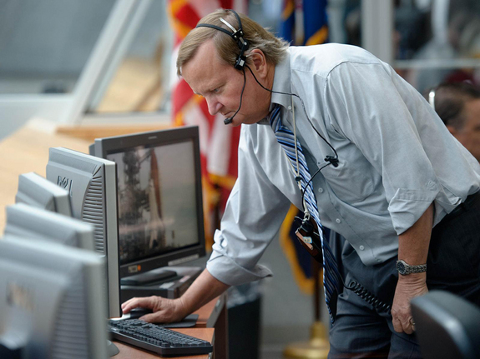
ThingStore
ThingStore
IoT Market Place
S1
S1
An Ecosystem for IoT Collaboration
S1
S1
S1
app
S2
app
app
Download
app
End Users
Query Processor
EQL queries
App Server
Develop apps as online services
Network
app
Subscription
app
app
IoT App Developer
Thing Server
S1
S1
S1
S1
S1
S2
Deploy “things” with smart services
Thing Provider

Slide 57
ThingStore
ThingStore
IoT Market Place
S1
S1
S1
S1
S1
app
S2
app
Cloud Computing
app
app
Query Processor
App Server
Edge Computing
Develop apps as online services
app
app
app
Thing Server
Deployed at data center
S1
S1
S1
S1
S1
S2
Leverage both parallel and distributed processing
Deploy “things” with smart services
Deployed at the edge

Slide 58
Query Optimization
Computation Sharing: Merging Queries
Execution Pool
A new query
Before
Join
Before
AND
S3
S3
S4
S1
S2
Duplicate computation
A forest of query trees

Slide 59
Computation Sharing
Execution Pool
New query
A new query
Before
Before
Join ?
After
AND
Buffer
S4
S2
S3
S1
S2
S3
Computation sharing

Slide 60
Query Optimization
Execution Plans
O4
O5
O3
O6
O2
O1
Query 34
Query 22
Query 16
Translator
O4
O5
O3
O6
O2
O1
Waiting Queue
O4
O5
O3
O6
O2
O1
Execution Pools (multithreaded)
EX1
Optimized queries for EX1
EX2
Optimized queries for EX2
Optimizer
EX3
Optimized queries for EX3
These queries share computation performed by executor EX3
Query Results

Slide 61


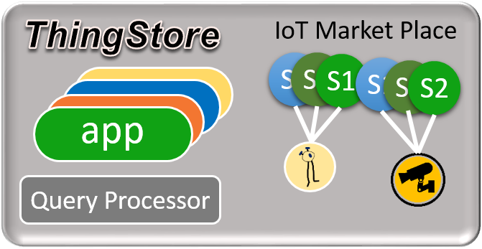
ThingStore
Thing Developer
IoT App Developer
An Ecosystem for IoT Collaboration
IoT Users
Collaboration platform for IoT development and deployment

Slide 62
Some Research Directions
Leverage ThingStore Architecture (e.g., EQL Processor as the only gateway to IoT) to better protect IoT security
Extend ThingStore to support also cyber ‘things’ - Soft sensors

Slide 63
Working with ‘Things’
Future Workplaces

Slide 64
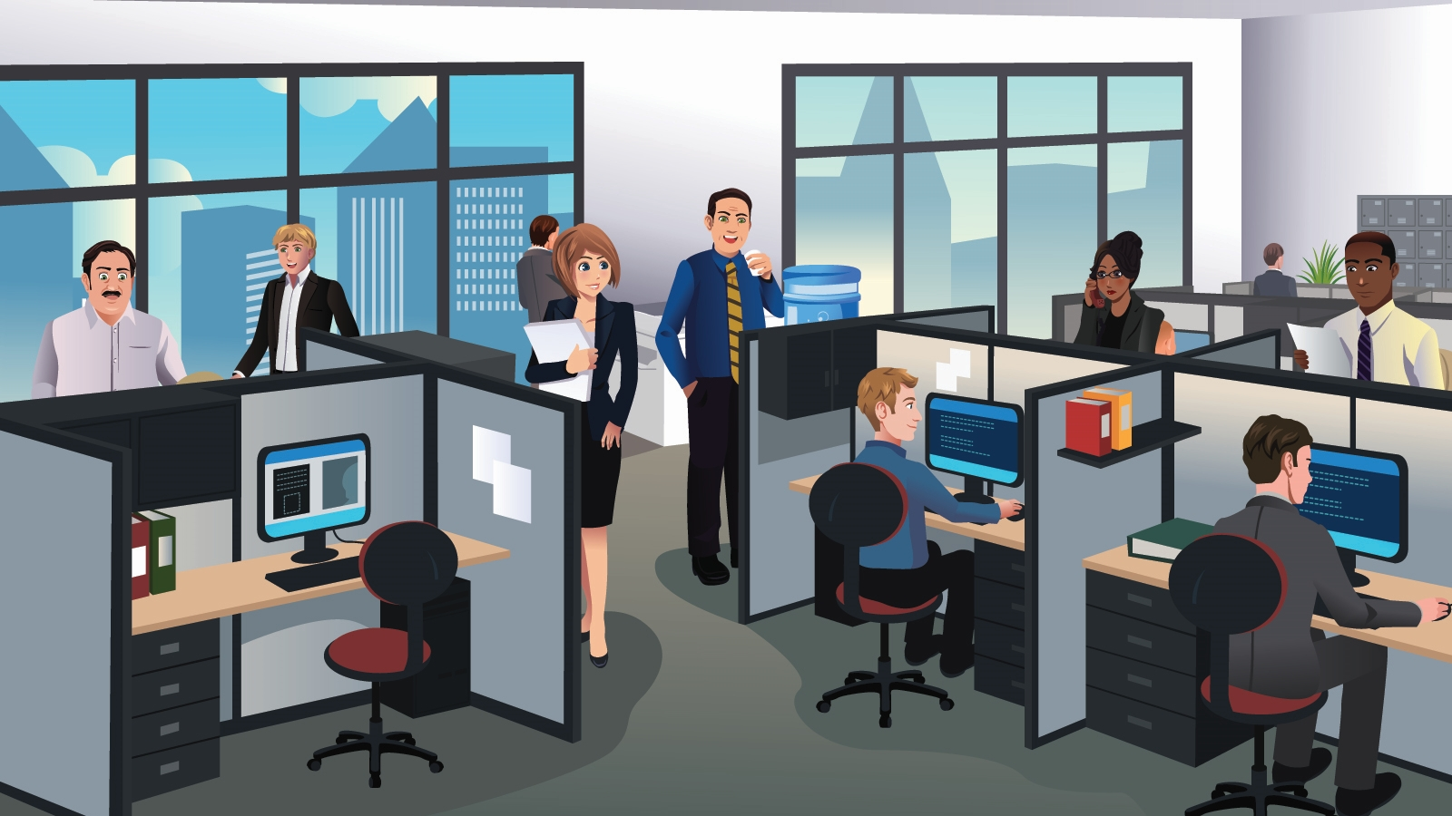


Today’s Workplaces
Most people collaborate using emails

Slide 65
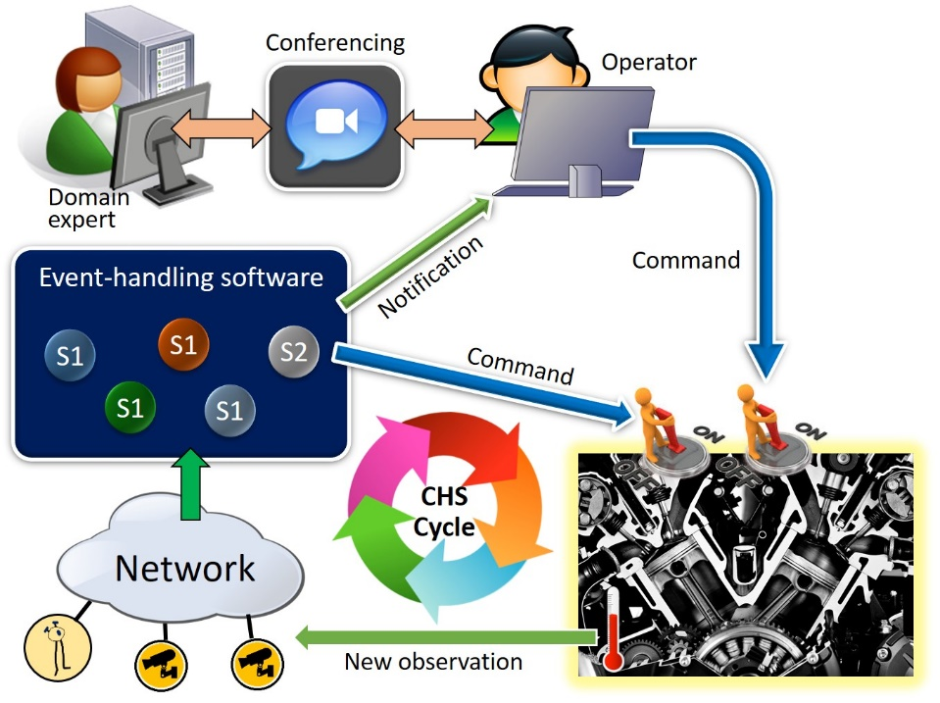
Future Workplace
Human-Things Teaming

Slide 66

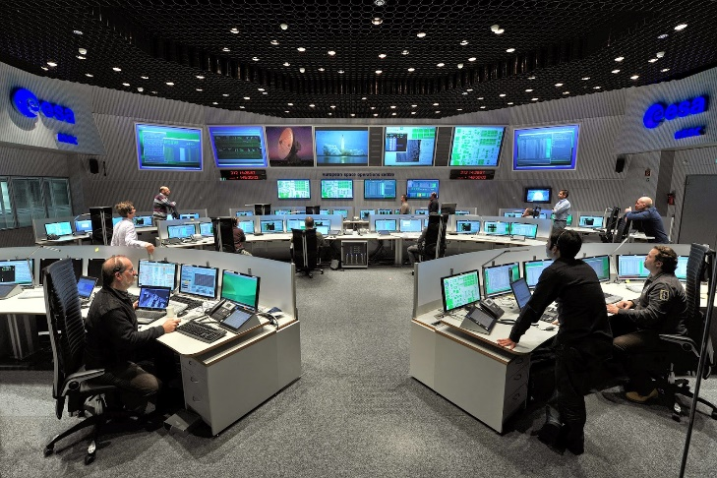
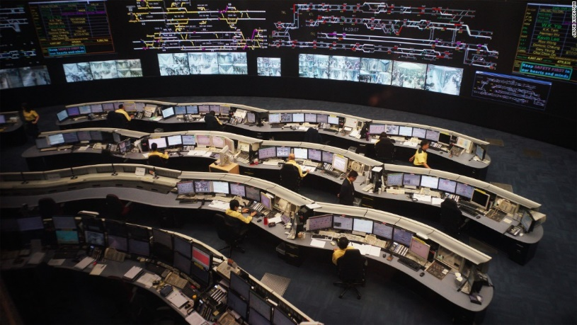
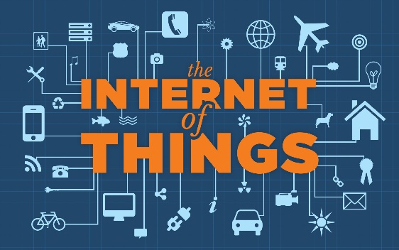
Future Workplaces with IoT
Fusing human and machine intelligence opening up a host of new opportunities

Slide 67
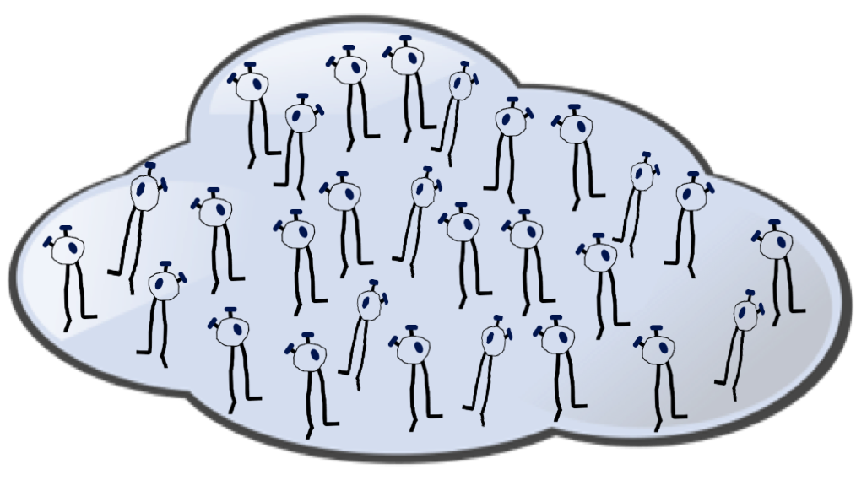


Collaborating with ‘Things’
Challenge: Human teams need to be much more efficient
Information overload

Slide 68
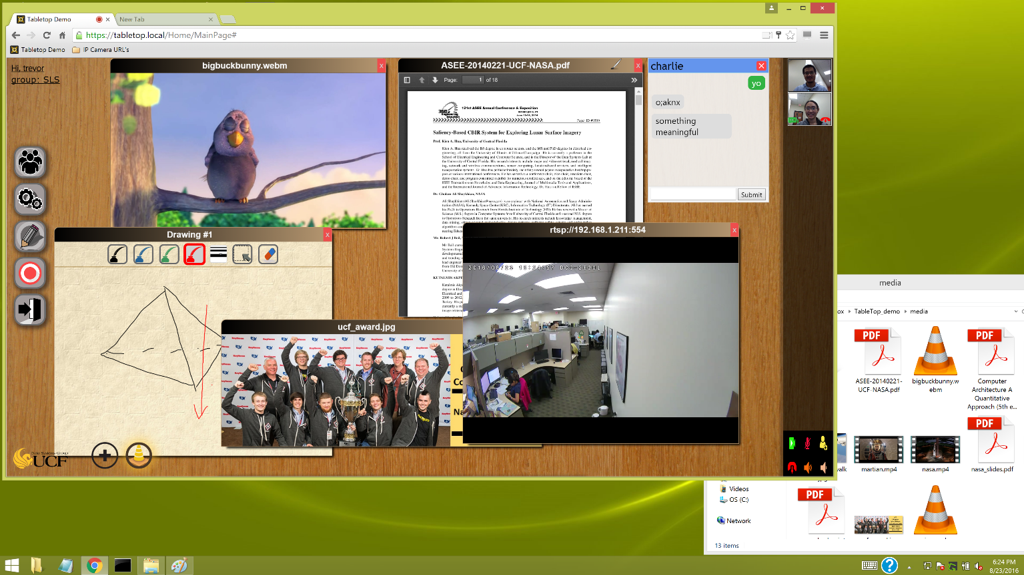
TABLETOP
A Multimedia virtual meeting room for time critical decision making

Slide 69

Sharing Desktop Objects
Tabletop
Collaboration space
Browser
The “world”
Desktop
Private space
Seamless interoperability of Tabletop and Windows Desktop enables fast access and sharing of private and Internet information in meetings

Slide 70
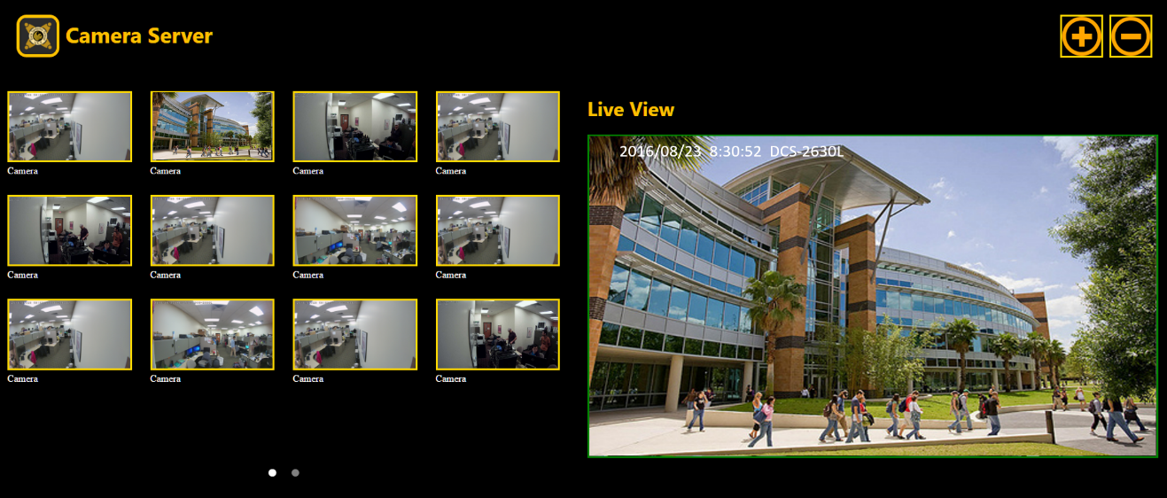


Sharing the Internet of Things
Users can co-operate on ‘things’ during a meeting
My IoT folder
Containing IoT bookmarks

Slide 71
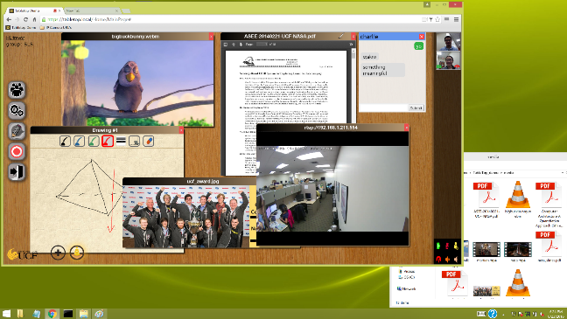


Tabletop collaboration
Operator
Domain expert
IoT Applications
Event Notification
Command
Future Workplace with human-machine teaming
Human-Things
collaboration
Command
Network
Thing Server
S1
S1
S1
S1
S1
S2
New observation

Slide 72

Collaboration Management
Leader of Tabletop 2 also participates in Tabletop 1
Top Leader
Tabletop 1
Middle-level leader
Tabletop 2
Tabletop 3
First-level leader
Tabletop 4
Tabletop 5
Tabletop 6
Reporting
Supporting large-team collaboration

Slide 73

Tabletop

Slide 74
Summary
DON - Turning Traffic Congestion into Advantage
1
2. ThingStore - An ecosystem for IoT Development and Deployment
2
Tabletop - Collaboration in Future IoT Workplaces
3

Slide 75
Some Related Publications
Kien A. Hua, Ning Jiang, Jason Kuhns, Vaithiyanathan Sundaram, and Cliff Zou, “Redundancy Control through Traffic Deduplication,” in Proc. of Infocom 2015, April 26 – May 1, 2015.
DON
Kutalmis Akpinar and Kien A. Hua, “Deduplication Overlay Network,” in Proceedings of IEEE International Symposium on Network Computing and Applications, Cambridge, October 30 – November 1, 2017.
Kutalmis Akpinar, Kien A. Hua, and Kai Li, “ThingStore: A Platform for Internet-of-Things Application Development and Deployment,” in Proc. of 9th ACM International Conference on Distributed Event-based Systems, Oslo, Norway, June 29 – July 3, 2015.
ThingStore
Kutalmis Akpinar and Kien A. Hua, “ThingStore - An Internet of Things Management System,” in Proc. of IEEE Int’l Conference on Multimedia Big Data, Laguna Hills, California, April 19-21, 2017.
Kutalmis Akpinar, Trevor Ballard, Kien A. Hua, Kai Li, Sansiri Tarnpradab, and Jun Ye, “COMMIT: A Multimedia Collaboration System for Future Workplaces with the Internet of Things,” in Proc. ACM International Conference on Multimedia Systems, Taipei, June 20-23, 2017.
Tabletop
Kutalmis Akpinar, Fereshteh Jafariakinabad, Kien A. Hua, Omar Nakhila, Jun Ye, and Cliff Zou, “Fault-Tolerant Network-Server Architecture for Time-Critical Web Applications,” in Proceedings of IEEE International Conference on Dependable, Autonomic and Secure Computing, Orlando, November 6-10, 2017.

