Slide 1
Mobile Data Collection Networks for Wireless Sensor Networks
Kien A. Hua
Department of Computer Science
University of Central Florida

Slide 2
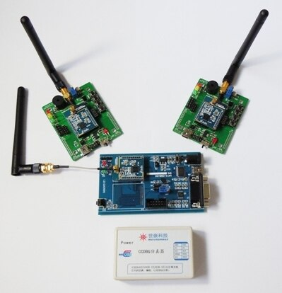
Wireless Sensor Network (WSN)
Wireless Sensor Network is composed of a large number of wireless sensors
Wireless sensors are
small size, low cost, low power, and irreplaceable in many applications
normally distributed in an ad hoc manner
These sensors gather information, such as pressure, humidity, temperature, speed etc.

Slide 3
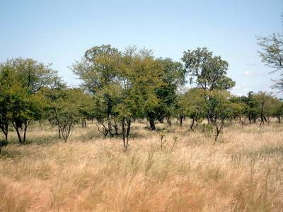
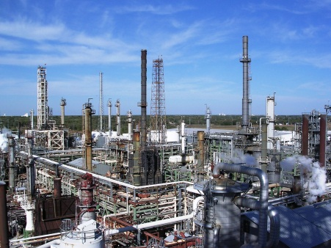
Many Applications
Rescue Operations
Damage assessment, fire monitoring, radiation detection, chemical sensing
Environment
Forest fire detection, water quality assessment, habitat monitoring
Health applications
Patients monitoring, drug administration
Industry
Production temperature, humidity, pressure control

Slide 4
Traditional Wireless Sensor Network
Internet
Sink/Base Station
Sensing data routed to sink or base-station (sometimes further transmitted over the Internet) for further analysis or applications.
Data generated at each sensor can only reach their neighbors within communication range
Data go through multiple sensors on their way to the sink
Wireless Sensor

Slide 5
Data Collection Issues
Multi-hop communication: a major limitation for these energy-constrained sensors
Energy hole problem: Sensors near the sink deplete their energy faster. This renders the WSN inoperable prematurely
Sink/Base Station
Wireless Sensor
Notes:
Sensors assume dual roles: data source and data forwarder

Slide 6
Some Solutions
Adding mobile elements is considered a promising solution to reduce sensor energy consumption
Two approaches
Mobile Sink Approach
Mobile Messenger Approach

Slide 7
Mobile Sink Approach
Sinks moves to different locations in the network field during WSN lifetime
Sojourn for a time interval at each location
When sojourning, routing path of sensors are updated and traffic is redirected towards the current sink location
Mobile Sink

Slide 8
Mobile Sink Approach
Advantages
The “neighborhood” of the sink change for each new sink position
Distribute burden of data forwarding over the whole network
Prevent premature cessation of network operation.
Limitations
Sensors still do multi-hop communication
Mobile sink is not feasible for some applications (e.g. it might not be possible to have access to Internet at some of the positions in a harsh environment)
Not scalable for large-scale WSNs

Slide 9
Mobile Messenger Approach
Sinks are static
Mobile messengers start out from the sink site, following a path, to visit each sensor
Sensors upload their data to the messenger (in a single hop) when they approach.
Mobile messengers go back to the sink to deliver the collected data
Sink
Mobile Messenger

Slide 10
Mobile Messenger Approach
Advantages
Sensors transmit data in a single hop, and do not forward data for other sensors
Less communication overhead w.r.t. routing
Energy consumption at each sensor greatly reduced
Limitations
Sensors have to wait for the messenger to approach, resulting in long or unpredictable latency
long waits may cause sensor buffer overflows, reducing data delivery ratio
Adding mobile messengers reduces average wait time; however they quickly increase the cost of the system

Slide 11
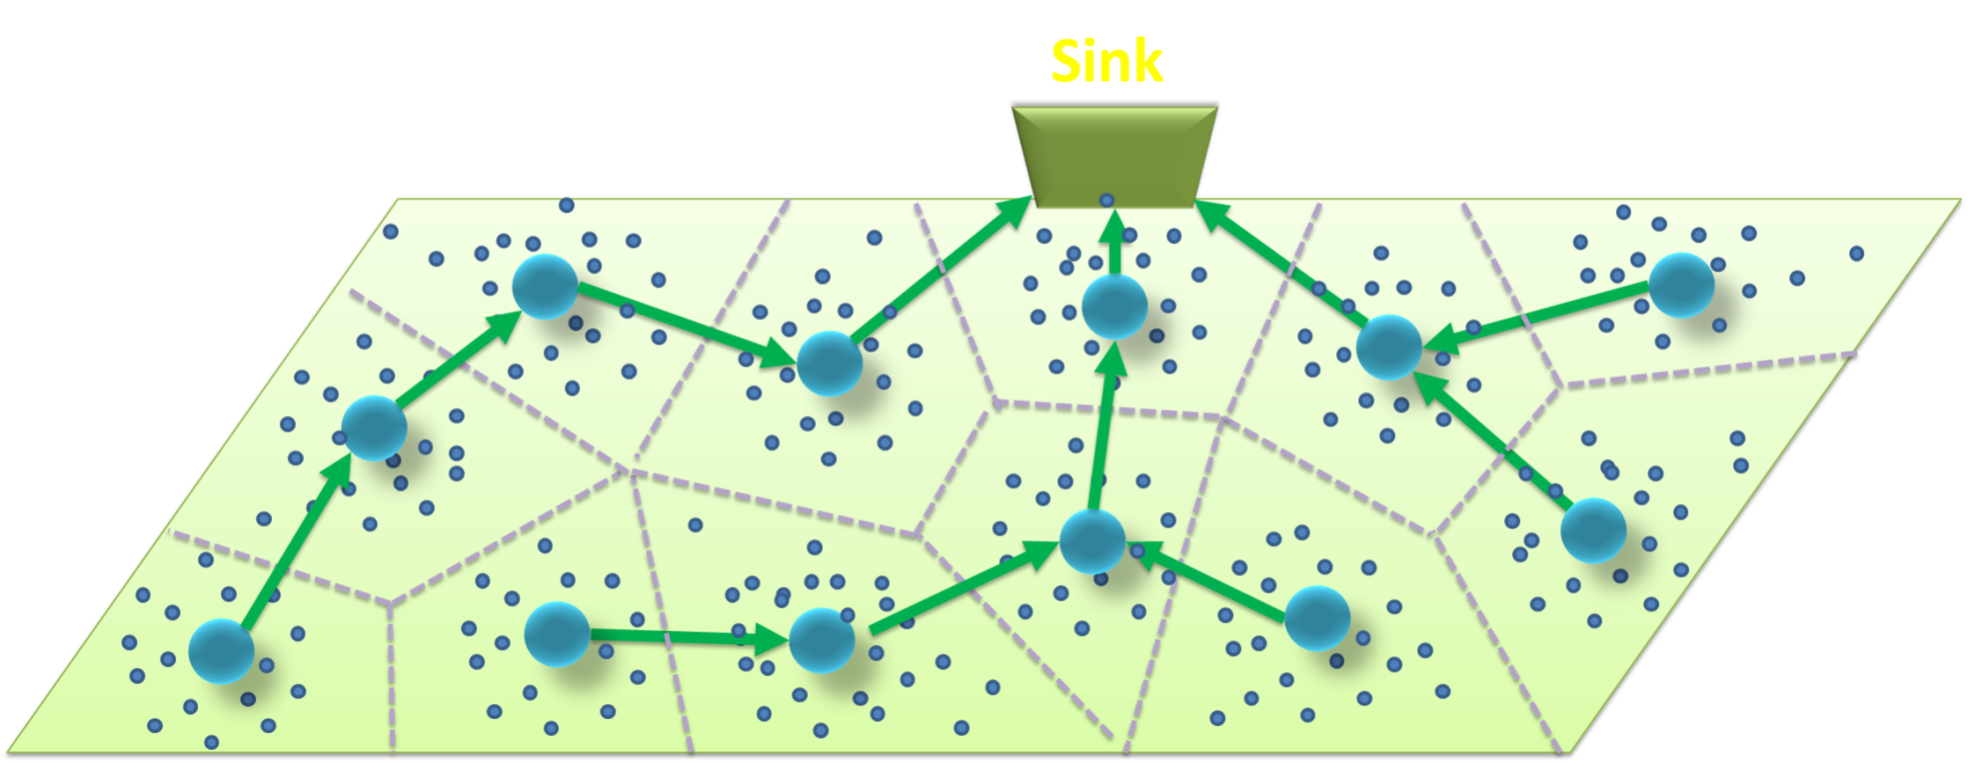
Another Data Collection Paradigm
MDCNet - Mobile Data Collection Network
1
2
Electronic data transmission → low latency, high data delivery ratio
Sensor: one-hop communications → energy efficient
Mobile Relay Node: service load adjusted to achieve desired performance
3

Slide 12
MDCNet – Approach
Approach: MDCNet is a wireless mesh network with virtual mesh nodes
Sensors are clustered into groups, each serviced by a virtual mesh node
Sensors communicate with their designated virtual mesh node through single-hop communications
Through the mesh nodes, sensors can upload data and electronically transmit them towards the sink(s)
What is a virtual mesh node ?
Intermittent connection
Virtual mesh node
Connected only when data transmission is needed

Slide 13
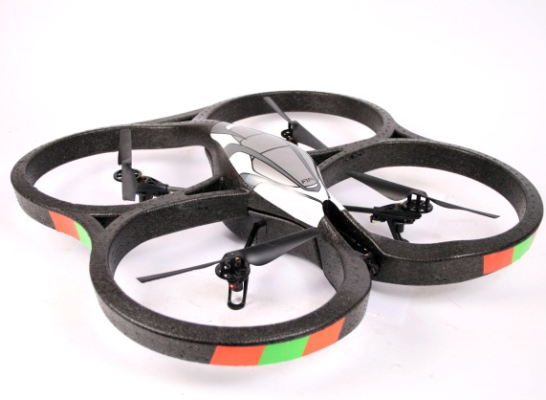
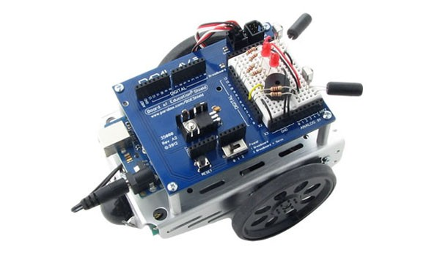
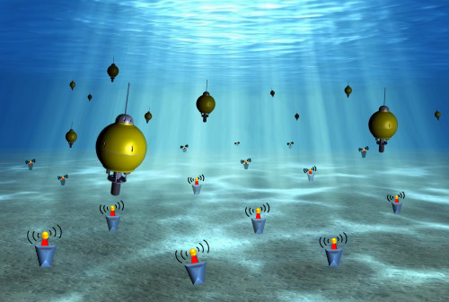
Mobile Mesh Nodes (Relay Nodes)
Land-based:
mini autonomous vehicle
Airborne: quadricopter
Underwater:
mini communication satellite

Slide 14
MDCNet – Challenges
What is a virtual mesh node ?
Intermittent connection
Virtual mesh node
Connected only when data transmission is needed
MDCNet (i.e., the virtual mesh nodes) must be self-deployed
Need a data collection protocol
Need a data forwarding protocol

Slide 15
MDCNet – Design Considerations
Each MRN should serve about the same number of sensors to reduce sensor contention
Sensor’s data should be collected in a timely manner to avoid data loss caused by sensor buffer overflows
Data relay among MRNs should conform to a reliable protocol to guarantee safe arrival at the sink

Slide 16
MDCNet Self-deployment Techniques
Deterministic Area Partitioning (DAP) Scheme
Adaptive Search & Conquer (ASC) Scheme

Slide 17
Self-Deployment: DAP Scheme
$$R$$
Assumption
Sensors are uniformly distributed over the sensing field
Deployment strategy
Evenly divide the region into equal partitions
Associate each partition with a mobile relay node
MRN moves back and forth in a snake-like pattern to collect data from sensors
$$\frac{R}{\sqrt{2}}$$
$$2R$$
R: Wireless communication range

Slide 18
Self-Deployment: ASC Scheme
Adaptive Search and Conquer (ASC) approach has the following characteristics
It assumes no knowledge of sensor distribution
MRNs cooperatively and incrementally search and conquer different regions until the whole WSN has been covered, i.e., self deployment

Slide 19
Self-Deployment: ASC Scheme
1
2
These target areas are explored in parallel
4th expansion by 2·R
2nd expansion by 2·R
3
MRNs set a random timer. The MRNs whose timer expire first start out to claim the next service areas.
After claiming the service area, the MRN moves in a snake-like pattern to collect data from the sensors
L+2·R
$$L$$
$$\text{2}\text{R}$$
$$L$$
1st expansion by 2·R
3rd expansion by 2·R
L+2·R
Notes:
MTNs set a random timer in the beginning, the MRN whose timer expires first will be the first to start out, and at the same time send out a TIMEOUT message. Other MRNs will cancel their timer upon receipt of this message.
The other three target areas will be explored by other MRNs upon their receipt of the NOTICE message from the MRN that claimed the bottom-left region.

Slide 20
ASC Search Hierarchy
Regions are explored in parallel in a hierarchical manner
Sink
1
2
4
3
6
9
2
8
7
1
3
5
4
8
5
6
7
9
O(Sink Location)

Slide 21
ASC Search Hierarchy
Regions are explored in parallel in a hierarchical manner
C
1
Sink
1
1
1
1
2
4
3
A
1
B
6
9
2
8
7
1
3
5
4
8
5
6
7
9
O(Sink Location)

Slide 22
Data Collection Protocol
Mobile Relay Node
The sensor has not received service within a predefined time period. (This is to make sure that a sensor does not get repetitive service when MRN is within its communication range )
Sensor
1. HELLO message
Move& broadcast
2. ACK message
Data not coming
If satisfy service requirement, set a wait timer and wait for data
3. START message
time
Cancel timer & receive data
4. Start sending data packet
.
.
.
Timeout if sensor still has not started data transmission
5. FINISH message
End Session

Slide 23
DAP: Data Relay Hierarchy
Parent node is the neighbor node closest to the sink
7
8
9
Sink
1
4
5
6
4
5
2
1
2
3
7
8
6
6
3
O(Sink Location)

Slide 24
DAP: Data Relay Hierarchy
Nodes 2 and 4 communicate directly with sink if they are within the radio range
7
8
9
Sink
1
4
5
6
4
5
2
1
2
3
7
8
6
6
3
O(Sink Location)

Slide 25
DAP: Data Relay Hierarchy
MRNs form a mesh network with intermittent connections between the mobile mesh nodes
7
8
9
Sink
1
4
5
6
4
5
2
1
2
3
7
8
6
6
3
O(Sink Location)

Slide 26
ASC: Data Relay Hierarchy
The data relay hierarchy is the same as the search hierarchy
9
5
6
Sink
Communicate directly with sink if node 3 within radio range
3
4
7
1
2
4
3
1
2
8
8
5
6
7
9
O(Sink Location)

Slide 27
Data Relay Protocol
MRN (child)
MRN (parent)
Serving sensors
Serving sensors
HELP message
Stop serving & seek help
Ready message
Stop serving sensors and set a wait timer
Data not coming
start sending data packet
Cancel timer & receive data
Transmit data
.
.
.
Timeout
Resume serving sensors
FINISH message
Session ends
time

Slide 28
Simulation Study
Environment: NS2
Sensing Area: 100m х 100m
Sensor Nodes
data generation rate: 10bit every 0.1 seconds
buffer capacity: 10KB
communication radius: 7m
random distribution
Mobile Relay Nodes
moving speed: 2m/s
communication radius: 40m

Slide 29
Performance Metrics
Data delivery ratio
Percentage of data packets delivered to the sink
Latency
Average service interval by mobile relay nodes
Deployment time (for ASC approach)
Total search time of mobile relay nodes

Slide 30
Placement of Sensors
2
7
8
1
4
5
6
3
9
12
Number of sensors are evenly divided among the cells
Sensors are randomly placed within their own cell
10
18
16
15
20
13
14
11
17
19
21
22
24
26
27
23
25
29
36
28
34
31
32
33
30
37
38
35

Slide 31
Area Fragmentation
Determined in 1st round
Determined in 2nd round
Target Area for 3rd Round

Slide 32
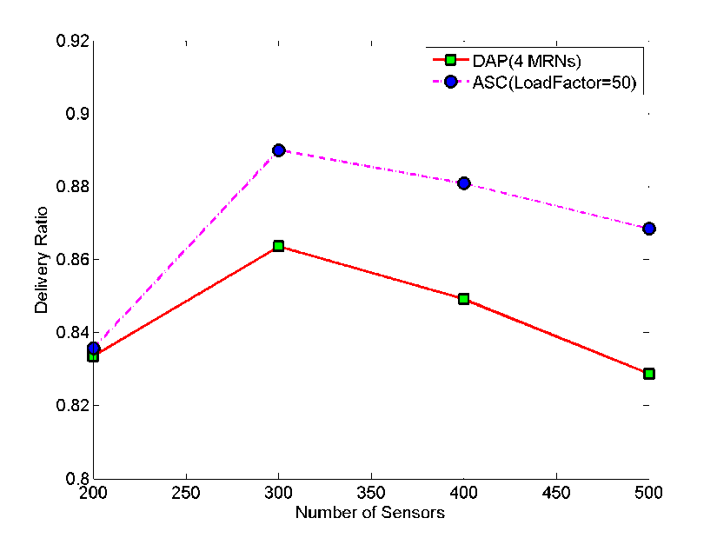
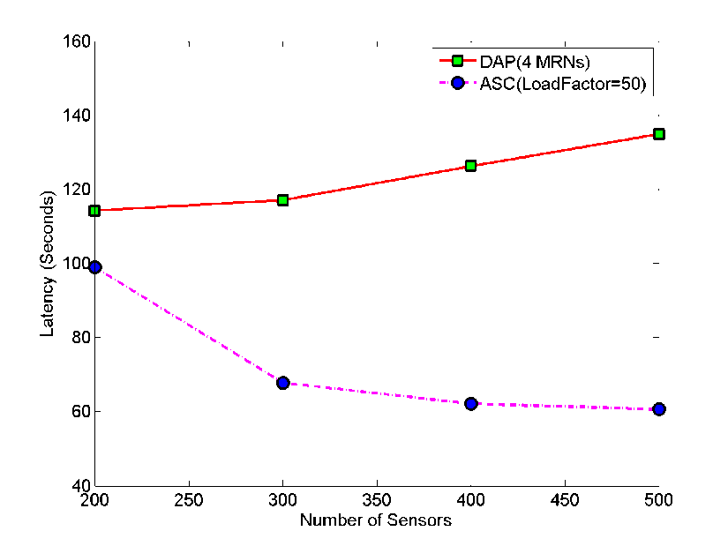
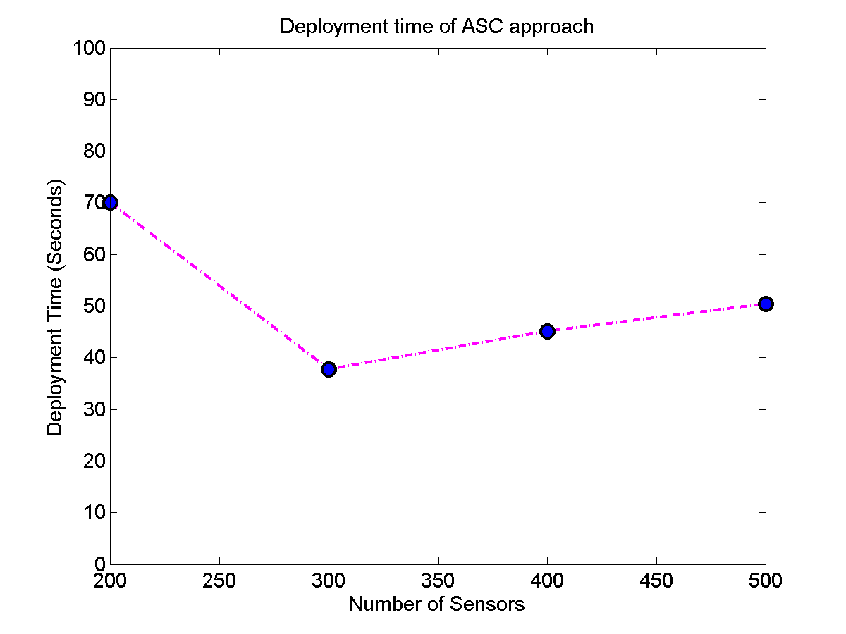
Effect of Sensor Density
DAP: 4 MRNs
ASC: 50 sensors per MRNs
When there are less than 300 sensors, MRNs have not reach full load. Thus, 300 is the full load point for our setting
Increasing in number of MRNs reduces the latency
MRNs experiencing increasingly higher load
When sensors are very sparse, It takes the 1st MRN a long time to discover its service area, which dominates the deployment time
As sensors density increases, more MRNs are dispatched, which contributes to the gradual increase in deployment time
DAP 4 MRNs are enough for the spatial coverage of the application terrain. Increases in number of sensors increases the load for each MRN.
ASC keeps the workload at 50 sensors per MRN, and adjusts the sizes of the service areas accordingly. Using more sensors requires more MRNs
With more sensors, it takes less time to deploy the first MRN
Notes:
ASC Deployment: 50 sensors per MRN. Add more MRNs for more sensors. When the number of sensors is very low, only a small number of MRNs is needed. However, they have a larger service area resulting in less than optimal performance (lower delivery ratio).
ASC: Increasing in the number of MRNs reduce the service area for each node. This helps to reduce the latency.

Slide 33
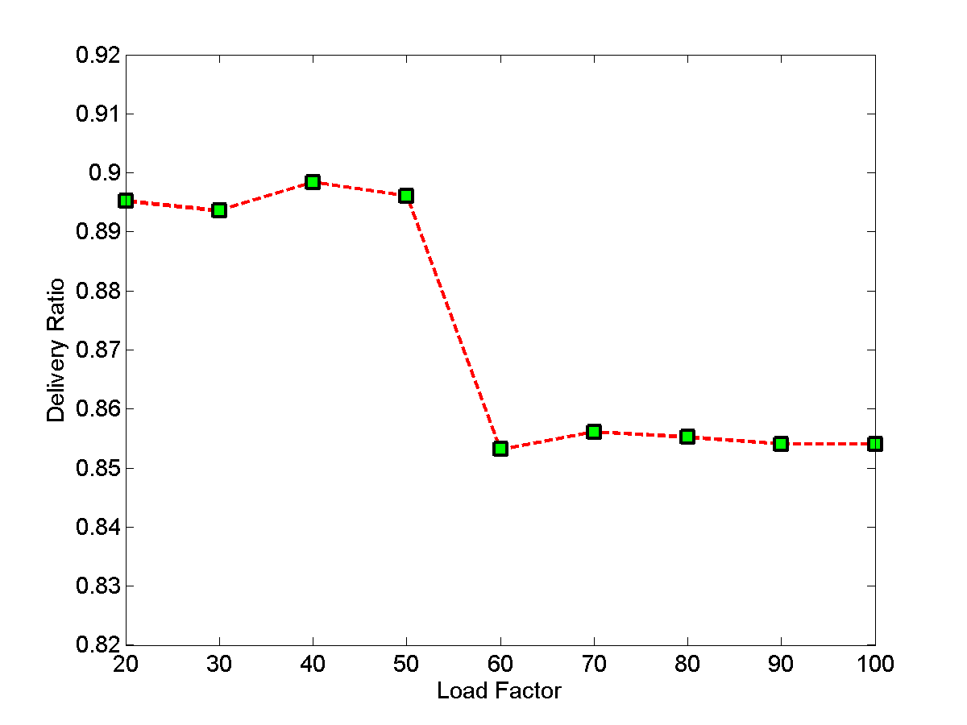
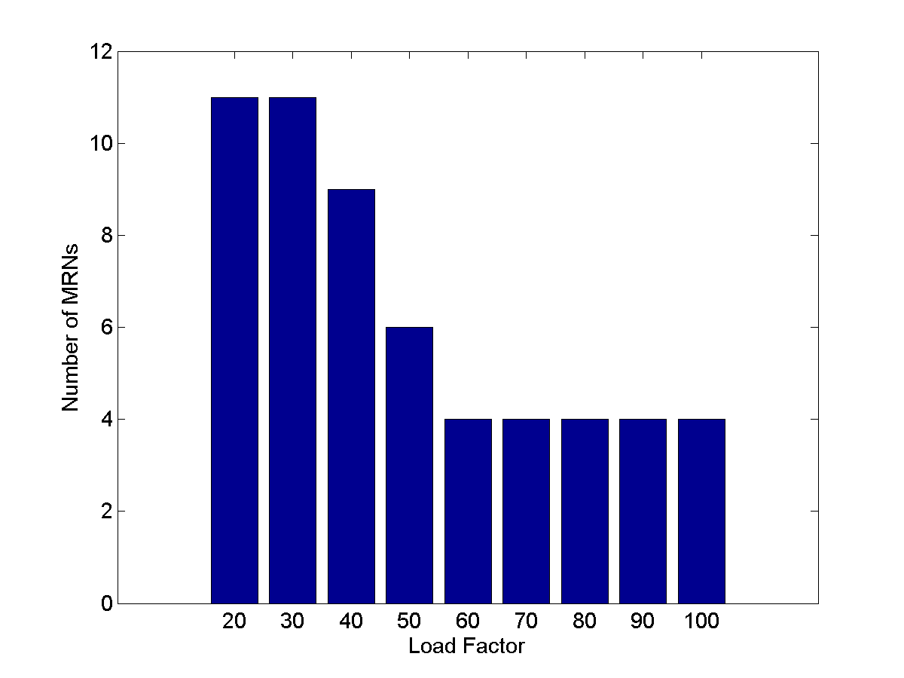
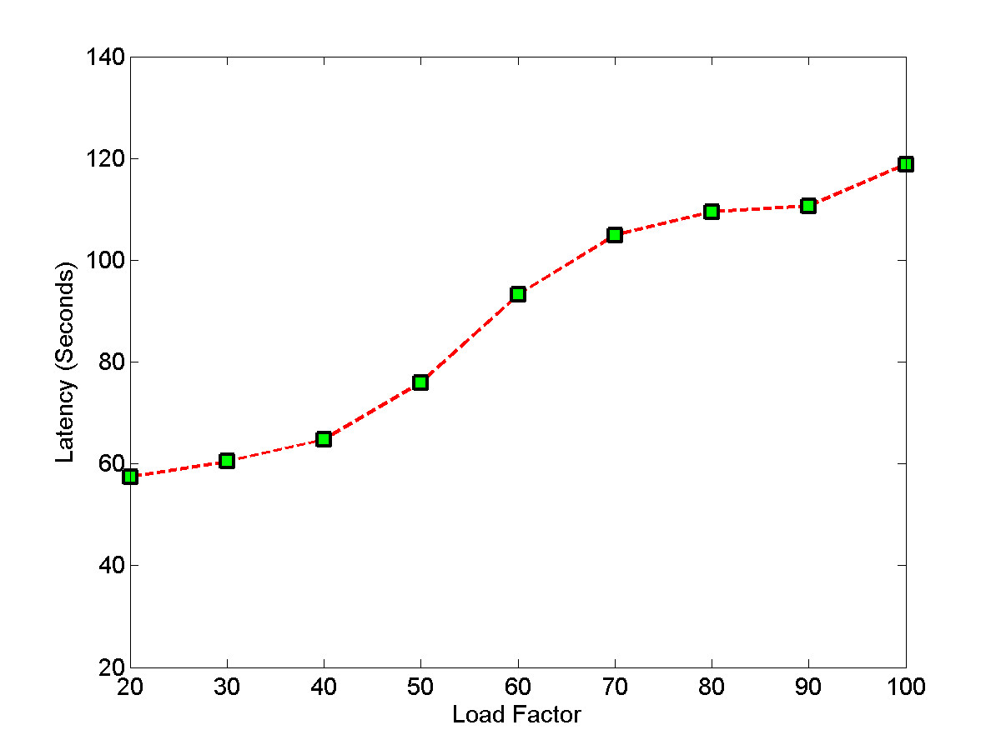
Effect of Load factor (ASC approach)
performance does not degrade anymore, because partition number has reached minimum
2
3
1
4
Too many sensors per MRN. They are overloaded
When load factor exceeds 60, the number of partitions can not decrease any more given the number of sensors (i.e. at least 4 parts)
Taking all factors (latency, data delivery ratio, cost in terms of number of MRNs needed) into account, the optimal load factor in our setting should be between 40 to 50.
Latency shows rapid increase around 50, as a result of overload
Notes:
We need 11 MRNs for both 20 and 30 load factors. This is due to rectangular shape of each monitoring subregion. A subregion might have slightly more sensors than the specified load factor if the MRN has found “enough” sensors before it reaches the end of the current row or column of the rectangular monitoring region.

Slide 34
Conclusion and Future Work
A Mobile Data Collection Network (MDCNet) is a wireless mesh network with intermittent connections between mobile mesh nodes
MDCNet has a number of advantages
Single-hop communication saves sensors energy
Electronic transmission of sensing data (instead of carried by messenger nodes) results in shorter latency
It is self-deployed and capable of preventing network partitions
Room for Improvement
Self-deployment techniques that do not require mobile relay nodes with GPSs are desirable
Generalization to irregular-shaped service areas
Consideration of obstacles and/or constrained paths

Slide 35
kienhua@cs.ucf.edu

