Slide 1
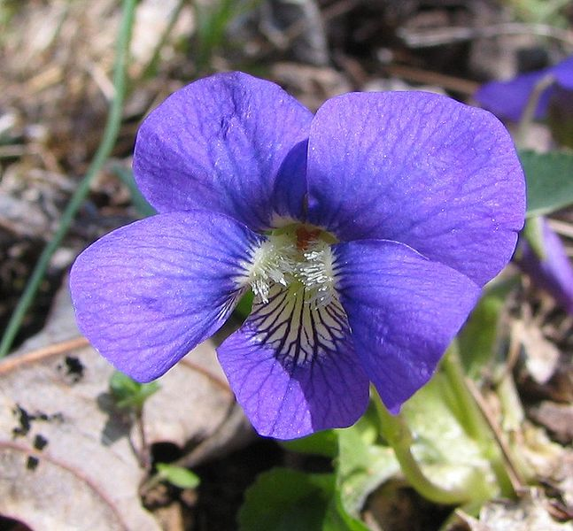



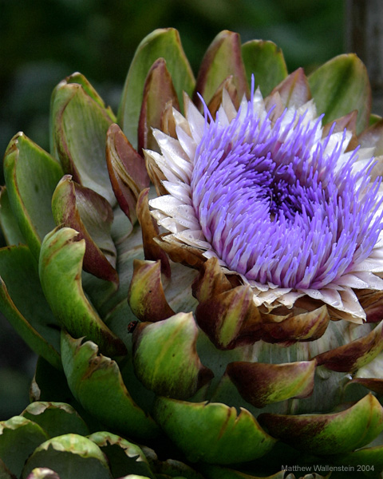
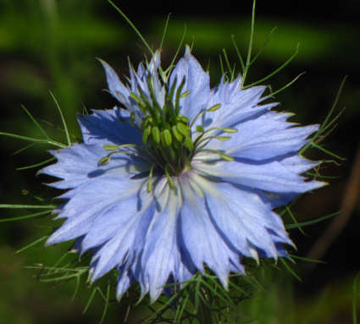
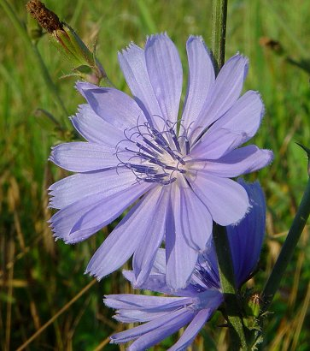
Image and Video Retrieval
Kien A. Hua
University of Central Florida

Slide 2
Image Applications
Information Systems
Medical Diagnosis
Computer Forensics
Digital Library
E-commerce
Genomic Analysis
Security Surveillance

Slide 3

Core Technology: Image Matching
They are
similar !

Slide 4
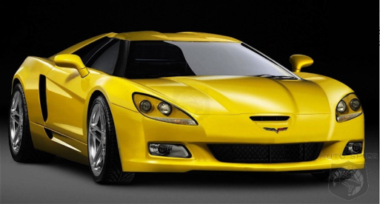
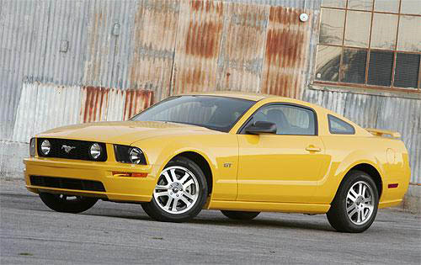
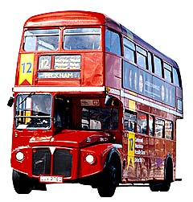
Matching Visual Features
Image features: Shape, Color, Texture, Size, etc.
Images are represented by their feature vector, i.e., a point in the feature space
Two images are similar if they are near each other in the feature space
Similar
Less similar

Slide 5
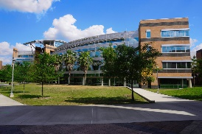
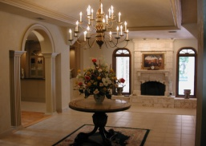
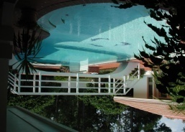
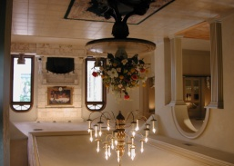
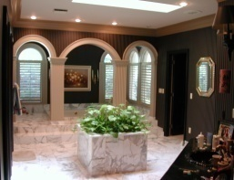

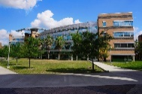





Image Retrieval - QBE
Database Images
Query Image
Image Database
Feature
Extraction
Feature
Extraction
Select
Metadatabase
Compare
Feature Vectors
Query Result

Slide 6
Noise-Free Queries (NFQ’s)
NFQ is more precise.
User can specify semantic constraints:
  Spatial constraints (relative distances)
  Scaling constraints (relative sizes)
Rectangular query
Noise-free
query
Similar
Less relevant

Slide 7
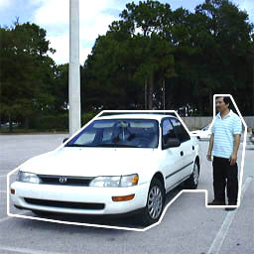
Challenges
How do we extract features to build the metadatabase if we do not know the matching areas beforehand ?
How do we index the images ?
Noise-free
query

Slide 8
One Solution – Local Color Histogram (LCH)
Each subimage has a color histogram.
Any combination of the histograms can be selected for comparison.

Slide 9
Limitations of LCH
Noise
Dilemma:
  Using large partitions is not precise (due to noise)
  Using small partitions is too expensive
Limitation:
  difficult to handle scaling

Slide 10
Sampling-Based Approach
Idea:
  Sampling 113 16x16 blocks, each represented by the quantized mean color
  Comparing only the relevant blocks
Comparing blocks within query contour
  Low storage overhead
  Support NFQ’s
  Robust to translation and scaling
  Support spatial and scaling constraints
Advantages

Slide 11
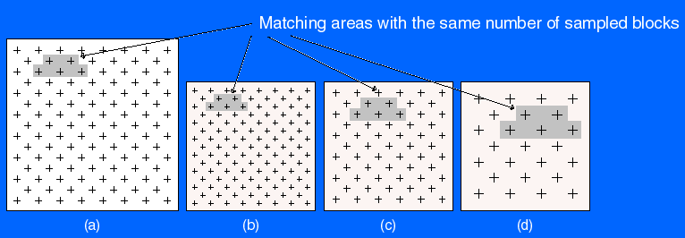
Handling Scaling
Database
Image
Query 1
Query 2
Query 3
A fixed sampling rate for all database images
Three different sampling rates for the query images

Slide 12
Handling Scaling
Database
Image
Query 1
Query 2
Query 3
The same sampling rate to find matching objects of the same size

Slide 13
Handling Scaling
Database
Image
Query 1
Query 2
Query 3
A higher sampling rate to find larger matching objects

Slide 14
Handling Scaling
Database
Image
Query 1
Query 2
Query 3
A slower sampling rate to find smaller matching objects

Slide 15
Handling Scaling
Queries at 3 different sampling rates
Database
Image
Query 1
Query 2
Query 3
A fixed sampling rate for all database images
A higher sampling rate to find larger matching objects
The same sampling rate to find matching objects of the same size
A slower sampling rate to find smaller matching objects

Slide 16
Handling Scaling
Queries at 3 different sampling rates
Database
Image
Query 1
Query 2
Query 3
Good to have an efficient indexing scheme for this search technique

Slide 17
Handling Scaling and Translation
We slide square windows of sizes 25, 41, 61, 85, and 113 sampled blocks over each database image.
85 indexing subimages are captured at various sliding positions of the square windows.
Sliding a window of size 25
Window of size 61
Window of size 25
Database image with 113 sampling blocks
5 categories of indexing subimages
A size-25 indexing subimage

Slide 18
Feature Extraction for Each indexing subimage
For each indexing subimage, we compute its feature vector as seven average-variance pairs:
  1 from all the enclosed sampled blocks.
  4 from sampled blocks in the four quarters,
  2 from sampled blocks along the two diagonals
1
2
3
6
Compute average and variance
Compute average and variance
4
5
7

Slide 19
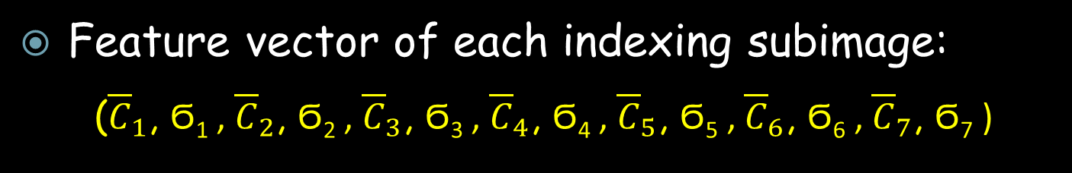
Feature Vectors
Feature vector of each indexing subimage:
  (${\overline{C}}_{1}$, Ϭ₁ , ${\overline{C}}_{2}$, Ϭ₂ , ${\overline{C}}_{3}$, Ϭ₃ , ${\overline{C}}_{4}$, Ϭ₄ , ${\overline{C}}_{5}$, Ϭ₅ , ${\overline{C}}_{6}$, Ϭ₆ , ${\overline{C}}_{7}$, Ϭ₇ )
An image has 85 indexing subimages and therefore 85 feature vectors
14 dimensional
(Multipoint representation)
1
2
3
6
Compute average and variance
Compute average and variance
4
5
7

Slide 20

Indexing
Extract 85 feature vectors
One of 85 subimages
Group them into 5 clusters
For each image, we group its 85 feature vectors into five clusters (data clustering)
The centroids of these cluster are inserted into an R*-tree
Compute cluster centroids
R*-tree
Each image is represented by any one of its five centroids in the 14-dimensional feature space
14D Feature space

Slide 21

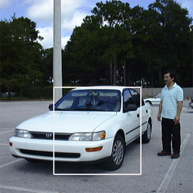
Core Area
Sample the query image at different rates.
For each sampling rate:
  Determine the core area that contains the maximum number of relevant sampled blocks and least noise (highest relevance-to-noise ratio).
  Compute the feature vector of the core area.
Noise
Query drawn by user
Too much noise !
Better core area

Slide 22

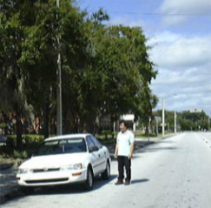
Initial Matching
Core area
Query image
Any database image with at least one “matching” centroid is considered potentially similar
Extract feature vector
Each database image is represented by 5 centroids in the 14-dimensional feature space
Potentially similar
Feature Space

Slide 23

Query Processing
Query
Compute core area
Extract feature vector
Database
R*-tree
Block-to-block comparison
(Pages 10-15)
A matching centroid
Retrieve sampled blocks of candidate images
Repeat this procedure for each sampling rate of the query image
Query results
Feature Space

Slide 24
Summary: 2-Phase Search Strategy
A database image
Used in Phase 1: Quick & Dirty Filtering
85
indexing
subimages
85
feature
vectors
5
cluster
centroids
Substantially reduce search time
113
color
averages
Used in Phase 2:
Verification using Block-to-Block
Comparisons
A candidate image determined in Phase 1

Slide 25
Performance Comparison
LCH
  NFQ-capable
Correlogram
  A good whole matching techniques

Slide 26
Experimental Studies
Database: 15,808 images of various categories
Workload: 100 queries
  Type 1: Query and database images have the same size; and the NFQ covers less than half of the query image (30 queries) - more noise
  Type 2: Query and database images have the same size; and the NFQ covers more than one half of the query image (20 queries) - less noise
  Type 3: query and database images have different sizes (50 queries)

Slide 27
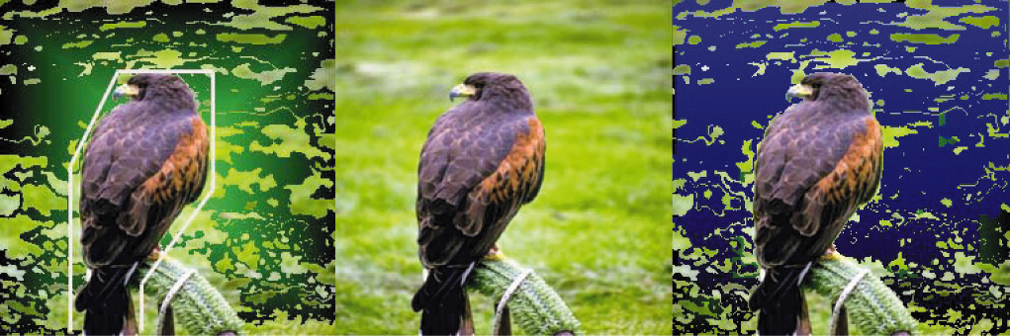
Performance Results (Type 1)
Similarity rank is very low
Noises dilute the intent of the query
Query
SM: 2
Corr: 1965
LCH: 2
SM: 3
Corr: 2336
LCH: 5
LCH is better for matching smaller matching regions with different appearances, i.e., matching only the relevant color histograms

Slide 28
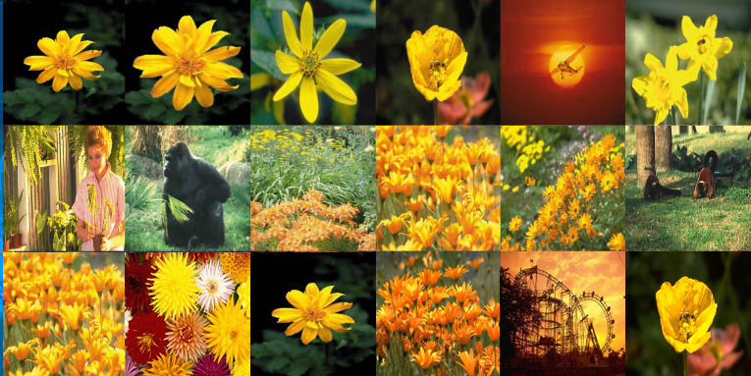
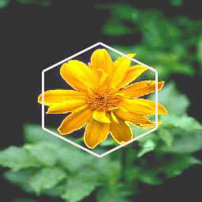
Performance Results (Type 1)
Query
SM: 2
Corr: 1965
LCH: 2
SM: 3
Corr: 2336
LCH: 5
SM
Corr.
LCH

Slide 29
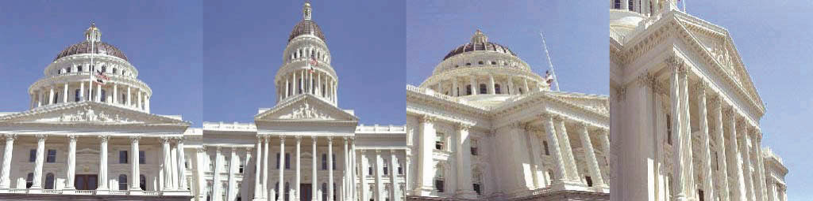
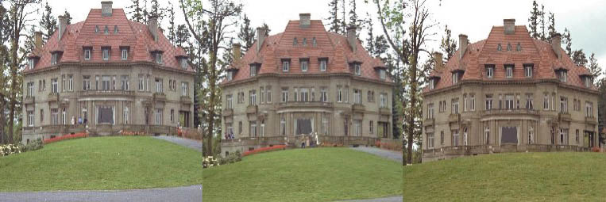
Performance Results (Type 2)
Less noise in matching a larger area, i.e., almost the entire image area is relevant to the query
Query
SM: 2
Corr: 2
LCH: 2
SM: 21
Corr: 89
LCH: 201
LCH is better for matching smaller matching regions with different appearances
Query
SM: 2
Corr: 2
LCH: 2
SM: 16
Corr: 9
LCH: 93
SM: 41
Corr: 223
LCH: 1258

Slide 30

Performance Metric
Number of relevant images in returned set
$R/S$= $\frac{\left|\left\{A_{i }| rank(A_{i})≤Th\right\}\right|}{n}$
A_{i} denotes a relevant image returned by the system
Th is the scope of the query (i.e., maximum number of images returned)
n is the total number of relevant images in the database
Rationale: Low-ranked Images do not make it to the user.

Slide 31
Performance Metric
Number of relevant images in returned set
$R/S$= $\frac{\left|\left\{A_{i }| rank(A_{i})≤Th\right\}\right|}{n}$
A_{i} denotes a relevant image returned by the system
Th is the scope of the query (i.e., maximum number of images returned)
n is the total number of relevant images in the database
What is the recall given the number of images returned ?
Rationale: Low-ranked Images do not make it to the user.

Slide 32
Effectiveness
R/S average
  Type 1 Type 2
  Higher R/S is better.

Slide 33
Type-3 Queries
LCH does not support Type-3 queries.
In the following example, there is no easy way to match the two identical apples using LCH.
Type 3: query and database images have different sizes

Slide 34
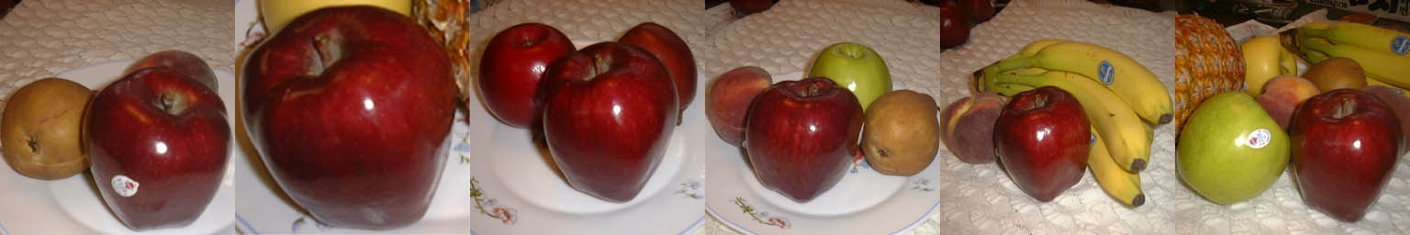
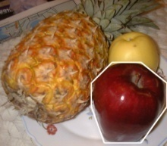
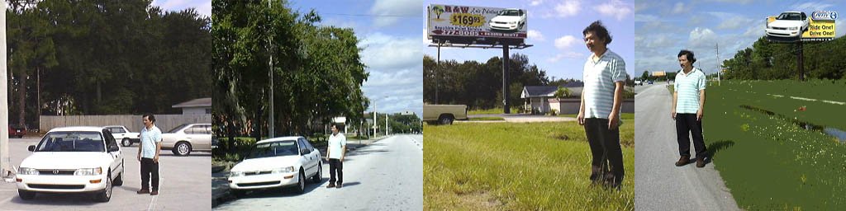
Performance Results (Type 3)
The sizes of queries are different from those of database images
Query
2
3
4
5
12
18
Query
2
3
216
396

Slide 35
Time & Space
SamMatch requires much less storage overhead
  LCH uses 21 color histograms: 21 × 256 × 2 bytes
  Correlogram uses 4 color histograms: 4 × 256 × 2 bytes
  SamMatch uses one byte per sampled block: 113 bytes
In terms of exhaustive search (i.e., without indecxing), SamMatch is
  100% faster than Correlogram, and
  200% faster than LCH

Slide 36
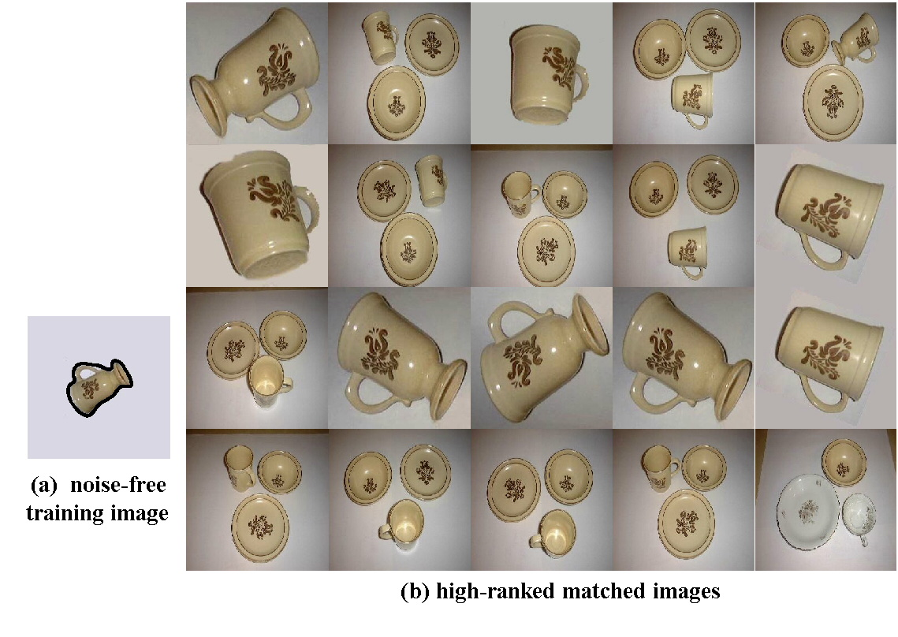
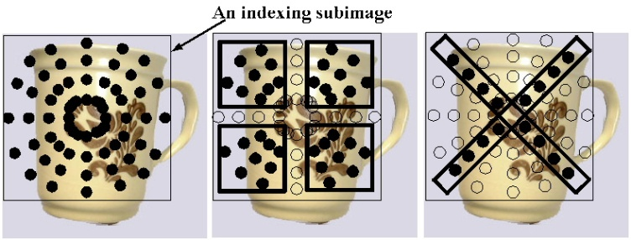
Rotational Invariance

Slide 37
















CBIR Using Keywords
Concept Dictionary
Use representative images to query the database
Keywords
Concept
Representative Images
Flower
Car
Flower
Index
.
.
.
Image Database

Slide 38
Concluding Remarks
Reducing noise interference is essential to achieving more reliable image retrieval
SamMatch supports NFQs effectively and efficiently
  Two times faster than LCH, and one time faster than Correlogram under exhaustive search (i.e., not using index)
Other benefits of SamMatch include:
  Matching objects at different scales
  Handling translation in the matching areas
  Supporting spatial and scaling constraints
SamMatch uses less than 1/16 the storage space required by LCH and Correlogram

Slide 39
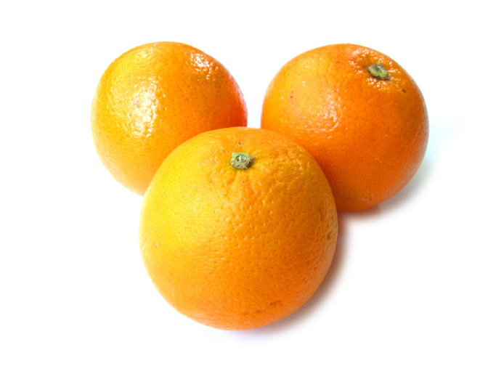
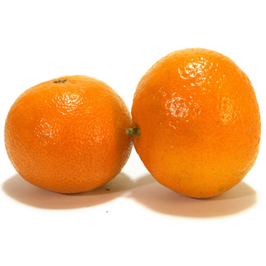
Similarity Matching
Visually similar
  Relatively easy
Semantically similar
  Great challenge !!
Oranges
Tangerines

Slide 40
General Image Matching
Semantic gap
  Visual features cannot always capture the semantics of images
  Comparing visual features may not find semantically similar images
Some research directions
  Better image modeling techniques
  Better feature extraction techniques
  Better search models

Slide 41









Better Image Modeling
Images
Standard techniques represent each image as a feature vector, i.e., a point in the feature space
Point-Set approach represents each image as a set of feature vectors, i.e., a set of points in the feature space
  Capture local image structure
  Reduce the effect of semantic gap
Segmented areas
One vector for each region
Feature space
Point set:

Slide 42










How to do Matching ?
Point-set objects
How to measure similarity d(X, X’) ?
There are |X|×|X’| matching pairs
.
.
.
.
.
.

Slide 43








Comparison: Assignment Problem
Workers can be assigned any task
Cost of a task depends on the worker-task assignment
Assign exactly one worker to each task in such a way to minimize the total cost
Cost(worker₁,task₂)
Workers
Tasks
Idea: Comparing two point sets by matching the most similar points of the two sets
Find the smallest sum of pairwise-distances between the two point sets

Slide 44



Assignment Problem
Find the smallest sum of pairwise-distances between the two point sets
W(agent₁, task₂)
m is specified by user
|X| ≠ |X’|
Two point sets may have different cardinalities

Slide 45
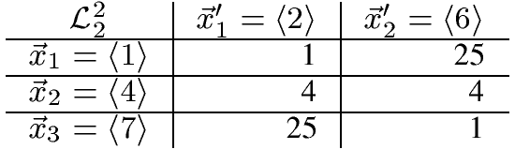



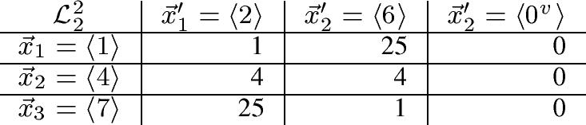
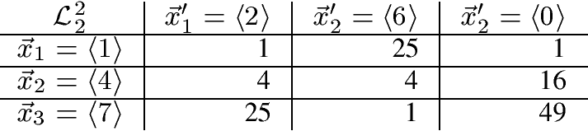
Square Cost Matrix
User wants two matches
Using virtual zero’s
User wants three matches
Using real zero’s
d(X,X’) = 1+1+0 = 2
d(X,X’) = 4+1+1 = 6
NOTE: Virtual zero zeros out the third matching (i.e., no impact on distance computation); and the real zero includes the third matching in the computation

Slide 46
























Two Matching Scenarios
Matching cardinality
1
2
X’ does not have enough matching vectors
X’ has enough matching vectors
$${\vec{x}}_{1}$$
$${\vec{x}}_{2}$$
$${\vec{x}}_{3}$$
$${\vec{x}}_{4}$$
$${\vec{x}}_{5}$$
$${\vec{x}}_{6}$$
$${\vec{x}}_{\left|X\right|}$$
$${\vec{x}}_{1}$$
$${\vec{x}}_{3}$$
…
$${\vec{x}}_{2}$$
$${\vec{x}}_{4}$$
$${\vec{x}}_{5}$$
$${\vec{x}}_{6}$$
$${\vec{x}}_{\left|X\right|}$$
…
m = 4 matches
m = 6 matches
$\vec{x_{1}^{,}}$
$\vec{x_{2}^{,}}$
$\vec{x_{3}^{,}}$
$\vec{x_{4}^{,}}$
$\vec{x_{\left|X^{′}\right|}^{,}}$
…
$\vec{x_{1}^{,}}$
$\vec{x_{2}^{,}}$
$\vec{x_{3}^{,}}$
$\vec{x_{4}^{,}}$
|X’| ≤ $\left|X\right|$
|X’| = 4

Slide 47

Scenario 1: X’ has enough components for matching
Image X:
Image X’:
Matching cardinality
|X| ≥ |X’|
|X|
|X’ | - m
... …
...
Used to zero out some of the X’ components so that only m of its components participate in matching
...
... …
|X’|
|X| - m

Slide 48
Scenario 1: X’ has enough components for matching
Select m components from each vector such that their difference is minimized
Image X:
Image X’:
|X| ≥ |X’|
|X|
|X’ | - m
|X| - (|X| - m ) ⇒ Only m components of X’ participate in matching
... …
...
|X’| - (|X’|-m) ⇒ Only m components of X participate in matching
...
... …
|X’|
|X| - m

Slide 49
Scenario 2: X’ does not have enough components for matching
Image X:
Image X’:
NOTE
|X’| + (m - |X’|) = m
→ Add (m - |X’|) zero
components to X’ for
matching
|X| - (|X| - m) = m
→ Zero out (|X| - m) X
components to select only m components for matching
|X| ≥ |X’|
|X|
... …
... …
...
...
...
|X’|
m - |X’|
|X| - m

Slide 50









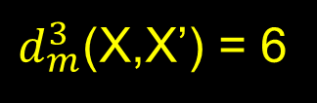
Scenario 2: Example
Image X:
Image X’:
Example
|X| ≥ |X’|
|X|
m = 3
... …
... …
$d_{m}^{3}$(X,X’) = 6
...
...
...
|X| - m
= 4 – 3
= 1
m - |X’|
= 3 – 2
= 1
|X’|
m - |X’|
|X| - m

Slide 51


m: User-Specified Matching Cardinality
m = 1
m = 2
m = 3
Database image
Query image
A point set can be viewed as a polygon
Example: User does not want to match small insignificant image regions

Slide 52



















Some Example Results
m = 2
m = 2

Slide 53
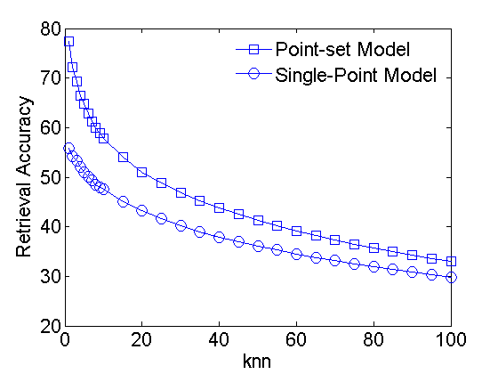
Experimental Results: Accuracy
The data set has 20 classes, and 100 images per class

Slide 54




Image categorization
Image categorization is a systematic process that determines the class label for each image, from a set of pre-defined labels.
Predefined labels
Horses
What is the label ?
“Horses”
Flowers
Dinosaur

Slide 55

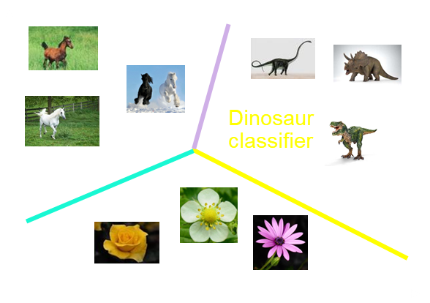
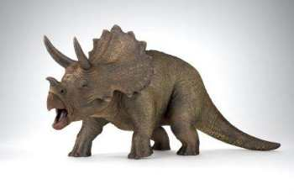
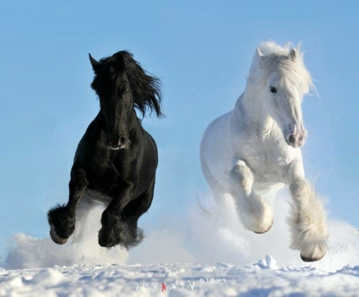
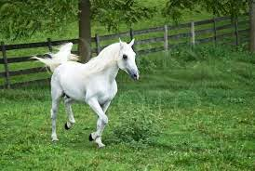

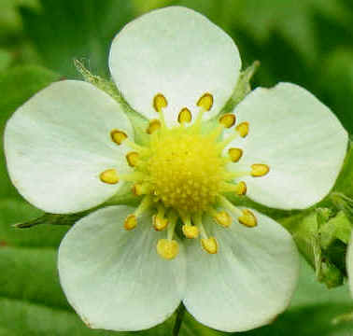


Classifiers
Training dataset
Horses
Flowers
Dinosaur
Predefined labels
Training
Dinosaur classifier
“Flower”
Multidimensional feature space

Slide 56





Frequent Itemset Mining
Percentage of itemsets that contain item c₁
Mining frequent closed itemsets.
Itemsets
e.g., 40%
Frequent itemset: the support is larger than a threshold.
A set of itemsets is closed if all of the supersets of each itemset have a smaller support. (we can use this to characterize an image category)
Notes:
`

Slide 57

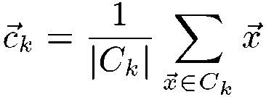
G-Means
“arg min” stands for the argument of the minimum - the k value for which the distance function attains its minimum value
G-Means is the wrapper of K-Means. Require no tuning.
Start with initial centroids.
S1: Assign points to closest centroids.
S2: Update centroids.
Iterate until convergence.
If any cluster does not appear Gaussian, split the cluster into two.

Slide 58
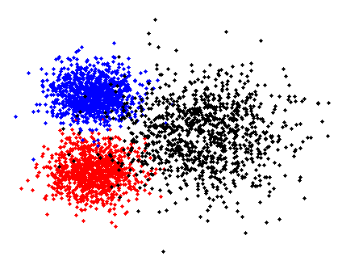
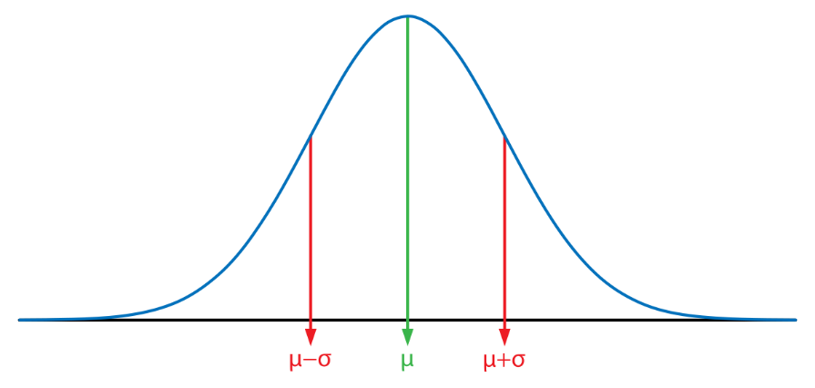
G-Means
“arg min” stands for the argument of the minimum - the k value for which the distance function attains its minimum value
G-Means is the wrapper of K-Means. Require no tuning.
Gaussian distribution describes data that cluster around the mean
Start with initial centroids.
Start with 2 clusters
Gaussian distribution
S1: Assign points to closest centroids.
S2: Update centroids.
Split
Iterate until convergence.
If a cluster does not appear Gaussian, split the cluster into two.
Statistical testing: whether the clusters follow Gaussian (or normal) distribution?

Slide 59















Step 1: Image Segmentation
Apply segmentation to
each image
to create a point set

Slide 60
Step 2: Determine Cluster Labels
Multidimensional feature space
Cluster the points in the feature space

Slide 61
Step 2: Determine Cluster Labels
C1
C2
C4
C5
C3
C6
Label each cluster
C7

Slide 62
Step 3: Label Images /w Cluster Labels
Labels
{C₄, C₅}
{C₄, C₅}
{C₄, C₅}
{C₁, C₂}
C1
{C₁, C₂}
{C₁, C₁, C₂}
C2
C4
C5
C3
Represent images using relevant cluster labels
C6
{C₆, C₇, C₁₁}
C7
{C₆, C₇}
{C₂, C₃, C₈}
{C₂, C₃, C₉}
{C₂, C₃, C₁₀}
{C₆, C₇, C₇, C₁₂}

Slide 63
Step 4: Determine Key Label Patterns
For each category, perform frequent itemset mining to determine the common patterns
Itemsets of some image category
Key patterns for this category, i.e., each has enough statistical support
(see Slide 55)
{C₁, C₂}
{C₁, C₂}
{C₁, C₃}
{C₁, C₂, C₅}
{C₁, C₂, C₆}
{C₁, C₃, C₄}
{C₁, C₃, C₅}
Frequent patterns
{C₁}
{C₁, C₂}
{C₁, C₃}
MINING
Closed frequent itemsets

Slide 64


Step 5: Determine Key-Point Sets
{C₁, C₂}
c2
Compute mean feature vector for each cluster
c1
c2
Mean Feature Vector
c1
c2
c1
c1
C₁
Multidimensional feature space

Slide 65










Step 5: Determine Key-Point Sets
{C₁, C₂}
c2
Create key-point sets for each image category by replacing the cluster labels with the corresponding mean feature vectors
c1
c2
Mean Feature Vector
c1
c2
c1
c1
{C₁, C₈}
Key Label
Patterns
Key-point Sets
c2
{C₁, C₂}
c2
{C₁, C₈}
c2

Slide 66





Key-Point Sets of Four Categories
Dinosaurs
Horses
Dogs
Snow Mountains

Slide 67






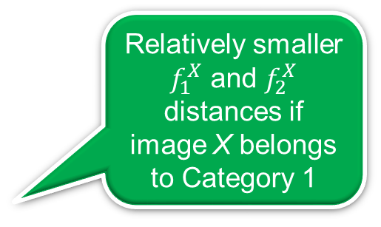
Step 6: Map Point Set to Vector
A point set (some image)
Relatively smaller $f_{1}^{X}$ and $f_{2}^{X}$ distances if image X belongs to Category 1
Matching distances
Matching
Category 1
Matching
Mapping
a point set
to a vector
Matching
Category 2
Matching
Matching
All key-point sets
Feature vector of image X
(All categories)

Slide 68







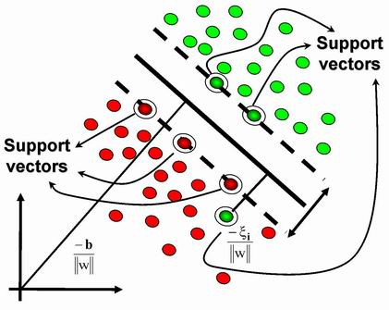

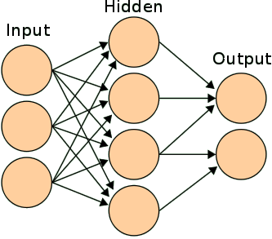

Step 7: Train Classifier
Training dataset
…
What is the label?
Key-point Sets
Horses
Dogs
Dinosaurs
Can use standard supervised learning algorithms
Snow mountains
Horses

Slide 69
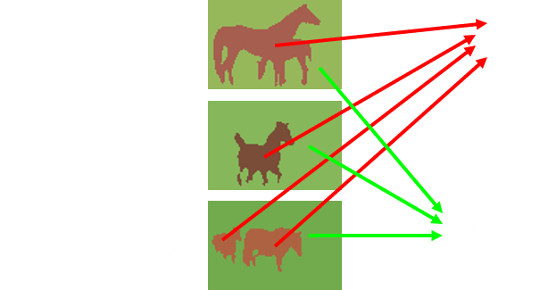
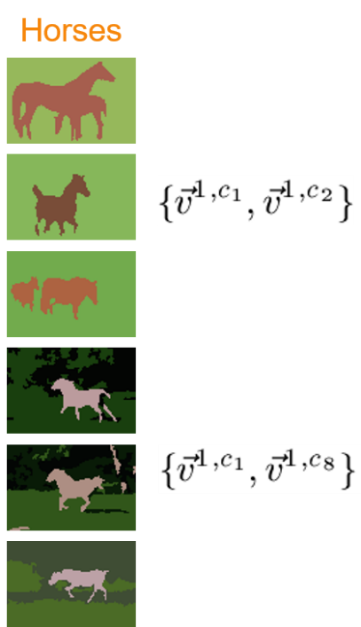
Overall Idea
Create a point set for each image in the training set based on the prominent regions in the image
Apply g-means clustering to cluster all the point sets to create cluster labels (i.e., cluster IDs)
Each image is represented by its set of cluster labels
Apply Frequent Itemset Mining to determine the sets of common cluster labels for each image category (e.g., horses)
Each image category is represented by a key-point set (i.e., vector version of the cluster centroids)
Compute the feature vector of each training image by matching its point set against each of the key-point sets of the image categories.
Using the feature vectors of the training images to train a classifier

Slide 70
Support Vector Machine (SVM)
Transform the data into a higher dimensional space and find the optimal hyperplane that maximizes the margin between the two classes
Support vectors: subset of training data used to define the boundary
Larger margin is superior
Training data

Slide 71
Multi-Class SVM
SVMs were originally designed for binary classifications
One-against-one multi-class SVM
  Construct binary SVM for each pair of classes (e.g., dinosaur vs. horses)
  An instance is assigned to a class which has the largest number of votes (from the SVMs)

Slide 72










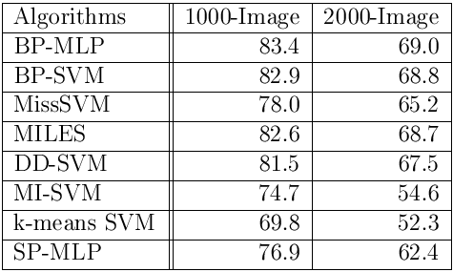
Categorization Accuracy
10 Categories
Vector-based point-set technique
Point-set categorization
techniques
Standard
vector-based technique

Slide 73
Categorization Accuracy
10 Categories
1.3% of Cat. 9 are classified as Cat. 3
images of Cat. 9 are mostly classified correctly

Slide 74
Semantic Gap
Content-based image retrieval is challenging due to semantic gap
Semantic gap: Low-level visual features cannot capture high-level semantics
A solution:
User relevance feedback

Slide 75
Relevance Feedback (RF)
User identifies relevant images within the returned set
System utilizes feedback to modify the query to retrieve better results in the next round
This process repeats until user is satisfied with the results

Slide 76
Search with User Feedback
Relevant
Returned set based on new centroid
Not relevant
Result
Returned set
Query refinement
using new centroid

Slide 77
Query Shape Optimization
A query consists of multiple example images
Neighboring images of the example images define an area in the feature space, i.e., query shape (or footprint)
Various techniques manipulate the query shape to cover more relevant images and exclude irrelevant ones
Example
Query image
Relevant image
Query shape
Irrelevant image

Slide 78
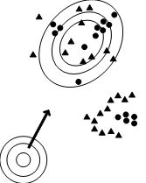
Single-point Query
The centroid of the relevant images is the new query point in the next iteration
Distance function is weighted (e.g., adjusted based on the statistical variance of the relevant images) such that the query contour is shaped to optimize the query result
Smaller
Relevant image
Larger variance

Slide 79
Multipoint Query
W₁
Relevant points according to user feedback are grouped into clusters, each represented by its centroid.
Distance of a data point is computed as weighed combination of individual distances from the centroids.
Weight factor is proportional to the cluster size
Query result
W₁
W₂
O
P
W₃
Not relevant
Similarity(O) = w₁ ∙ d₁ + w₂ ∙ d₂ + w₃ ∙ d₃
w₁ < w₂ < w₃

Slide 80

Multiple Viewpoints
Based on negative
Based on color
Searching for relevant images using variants of the query image (i.e., color, negative, grayscale).
Recognizes red cars and white cars as cars, but
  not all cars from various viewpoints,
  nor cars with different appearances.
Based on grayscale
Address this later

Slide 81
RF Techniques - Summary
Query Point Movement
  Single-point Query: Distance function is weighed to shape the “query contour” to contain maximum number of relevant images and least number of irrelevant ones
  Multipoint Query: Distance is computed as weighted sum of individual distance from cluster centroids.
Multiple Viewpoints: Retrieving images using variants of the query image

Slide 82
Semantic Gap
Assumption: semantically similar images are located “close” to each other in the feature space, according to some distance measure.
Reality: semantically similar images can look very different, and are therefore located far apart in the feature space or sub-spaces.
Semantic gap between low-level visual features and the high-level concepts conveyed by the query images

Slide 83
Standard Relevance Feedback
Relevant
Not relevant
Returned set
Result
Returned set
Better result

Slide 84
Standard k-NN Approach - Limitation
Search Space
Matching
threshold
The goal of standard k-NN approach is to avoid being trapped in a local minimum
Cluster 1
Cluster 2
Cluster 3
All clusters 1, 2, and 3 should be returned to user
Best result for standard approach – suboptimal !

Slide 85
Search Models
An effective approach to mitigate the effect of semantic gap is to leverage user relevance feedback
Traditional model: Find k nearest neighbors (k-NN)
Better model: Query Decomposition

Slide 86
Query Decomposition
Relevant
Not relevant
Two distinct clusters
→ Decompose query
into two subqueries
to explore in different directions
Returned set

Slide 87
Query Decomposition (QD)
Decompose an initial query into subqueries based on user relevance feedback
Subqueries are processed independently
Their local results are merged into a single ranked list to form the final result

Slide 88
Query Decomposition Example
Relevant
Not relevant
Result
Returned set
Returned set
Result
Capture both semantic subclasses

Slide 89

Screenshot of the QD system
Control panel
Relevant images
Result panel
The subqueries are “dinosaur,” “eagle,” “Owe,” “Cat,” and “Horse.” Query results are presented in the left panel.

Slide 90
Exploring Relevant
Semantic Subclasses
Search is a generalization process guided by the user
A Class hierarchy
Vehicles
Passenger cars
Trucks
Conventional techniques find passenger cars or trucks, but not both

Slide 91
RF Support (RFS) Structure
Hierarchically cluster database images into a tree structure to form a RFS structure
Representative images are selected for each cluster in the RFS structure in a bottom-up fashion
Representative images from the lower level
……
……
……
……

Slide 92

Query Decomposition (1)
A new RF technique
Repeat until leaf level:
  For each relevant cluster at a given level in the RFS tree, representative images are randomly selected for user relevance feedback
  Positive feedback images are used to identify relevant clusters in the next level of the RFS structure

Slide 93
Query Decomposition (2)
A new RF technique
Too far from the centroid, compute k-NN over the parent cluster
Repeat until leaf level:
  FRelevant or each relevant cluster at a given level in the RFS tree, representative images are randomly selected for user relevance feedback
  Positive feedback images are used to identify relevant clusters in the next level of the RFS structure
k-NN computation is performed independently for each relevant cluster at the leaf level (e.g., using the centroid of the relevant images in the cluster)
Local results from the clusters are merged
Relevant clusters at leaf level

Slide 94
QD Illustration
Node 1
Level 1
Level 2
Level 3
Node 4
……
Node 2
Node 3
Node 5
Node 6
Node 7
Node 8

Slide 95
Localized k-NN Computation
Localized k-NN computations are done independently over their respective cluster at a leaf node (not over the entire database as in conventional RF techniques)

Slide 96
Hiding Complexity
User is not aware of the internal query decomposition process
User is presented a single list of ranked image for each round of RF (as in conventional RF techniques)
Subqueries and their local results are maintained internally without the knowledge of the user

Slide 97

Precision & Recall (1)
Precision: The percentage of retrieved images that are correct
Recall: The percentage of correct images retrieved
Wrong answers
Correct answers
Query result
Recall
Precision

Slide 98


Precision & Recall (2)
Precision: The percentage of retrieved images that are correct
Recall: The percentage of correct images retrieved
Wrong answers
Correct answers
FN
TP
FP

Slide 99
Performance Metric
Each query has 100 correct images (i.e., TP+FN = 100)
100 images are returned for each query (i.e., TP+FP = 100)
Since (TP+FN)=(TP+FP), we have Precision = Recall
Wrong answers
Correct answers
FN
TP
FP

Slide 100
Query Decomposition: Some Results
Query | Precision | Recall | Semantic hit ratio
Horse (polo, wild horse, race) | 0.97 | 0.97 | 1
Plant (potted pine, wild plant, specimen) | 0.85 | 0.85 | 1
Flower (single rose, group, close-view, orchid) | 0.82 | 0.82 | 1
Vehicle (sedan, steamed car, train, bus) | 0.85 | 0.85 | 1
Building (skyscraper, palace, pyramid, residence house) | 0.55 | 0.55 | 0.75
Average | 0.81 | 0.81 | 0.95
37 Features:
  9 color moments,
  10 Wavelet-based Texture, and
  17 edge-based structural features.
Each query has 100 correct images (ground truth)
100 images are returned for each query
Precision = Recall
Dataset has 20,000 images from COREL and Internet

Slide 101
Compared to Multiple Viewpoints
Precision & Recall
Feed-back Round | Techniques
 | MV |  | QD
 | Precision | Recall | Precision | Recall
1 | 0.1 | 0.1 | n/a | n/a
2 | 0.31 | 0.31 | n/a | n/a
3 | 0.33 | 0.33 | 0.74 | 0.74
Hit ratios of semantics
Approach | Flower | Vehicle | Building
MV | 0.5 | 0.5 | 0.5
QD | 1.0 | 1.0 | 0.75
Performance improvement is more than double
Based on three types of queries:
Flower (single rose, group, close-view, orchid)
Vehicle (sedan, steamed car, train, bus)
Building (skyscraper, palace, pyramid, residence house)

Slide 102

Neural Hashing
Another way to extract features
Ranking-based hashing
Find more discriminative ranking subspaces by exploiting nonlinearities (patterns separated by curves) with deep neural networks
A deep network can be designed to learn the hash codes such that hash keys of similar objects are similar
111
101
001
Feature space
101
100
Kevin Joslyn, Kai Li, and Kien A. Hua, “Cross-Modal Retrieval Using Deep De-correlated Subspace Ranking Hashing,” in Proceedings of ACM International Conference on Multimedia Retrieval (ICMR) 2018, Yokohama, Japan, June 11-14, 2018. (Best Multimodal Paper Award)

Slide 103
Neural Hashing
Another way to extract features
Ranking-based hashing
Find more discriminative ranking subspaces by exploiting nonlinearities (patterns separated by curves) with deep neural networks
A deep network can be designed to learn the hash codes such that hash keys of similar objects are similar
111
101
001
Feature space
101
100
Kevin Joslyn, Kai Li, and Kien A. Hua, “Cross-Modal Retrieval Using Deep De-correlated Subspace Ranking Hashing,” in Proceedings of ACM International Conference on Multimedia Retrieval (ICMR) 2018, Yokohama, Japan, June 11-14, 2018. (Best Multimodal Paper Award)

Slide 104
Browsing and Searching Video Data

Slide 105
Shot Boundary Detection
Concepts like ‘tuple’ or ‘record’ do not apply to video data
  What is the unit for data access ?
  Need video data segmentation techniques

Slide 106

Units for Video Data
Shot is a sequence of frames recorded in one camera operation.
  Shot is the unit for handling video data.
Scene is a sequence of semantically related shots

Slide 107

Shot Boundary Detection (Content-based Segmentation)
Pixel Matching
Color Histogram
Edge Change Ratio

Slide 108
Existing SBD Techniques (1)
Pixel Matching
  Comparing corresponding and neighboring pixels.
  Sensitive to noise and object movement.
Frame n-1
Frame n
Frame n+1
Boundary
Many pixels are different
These two pixels are similar
This pixel is different

Slide 109
Existing SBD Techniques (1)
Pixel Matching
  Comparing corresponding and neighboring pixels.
  Sensitive to noise and object movement.
Color Histograms
  Count pixels of each color.
  Significant difference between two consecutive color histograms indicates a shot boundary
  Cannot distinguish images with different structures, but similar color distribution.

Slide 110
Existing SBD Techniques (2)
Edge Change Ratio
  Counting entering and exiting edge pixels.
  Very expensive; the user must provide many parameters, e.g., matching distance.
Entering edge pixels
Comparing the two triangles we can detect and count the number of exiting edge pixels
Similarly, we can count the number of entering edge pixels
Frame n-1
Frame n
Exiting edge pixels

Slide 111

Existing SBD Techniques (2)
Edge Change Ratio
  Counting entering and exiting edge pixels.
  Very expensive; the user must provide many parameters, e.g., matching distance.
Number of entering edge pixels
Number of exiting edge pixels
Entering edge pixels
ECR
Frame n-1
Frame n
Boundary
Number of edge pixels in frame n
1
Exiting edge pixels
0
Frame ID

Slide 112
Drawbacks of
Pixel Matching, Color Histogram, and Edge Change Ratio
Difficult to determine many input parameters
Accuracy varies from 20% to 80% - not robust
Computationally expensive

Slide 113
Focusing on Background
Definition: Shot is a sequence of frames recorded from a single camera operation.
Observation: Tracking camera operation is the most direct way to detect shot boundaries.
Idea: Tracking camera motion by tracking background area of video.

Slide 114

Another Reason for Focusing on Background
Frames consist of Object(s) and Background.
While objects move, background change slowly.
Pixel Matching technique
Not effective when objects move quickly
# 234
# 253
# 271
# 283
# 296

Slide 115




Fixed Background & Object Areas
FBA
FOA

Slide 116

Facilitate Comparison
(Transform FBA to TBA)
TBA ₂₈₂

Slide 117

Background Tracking (BGT)
Measure how much they share the common background.
Longest run of continuous matches is the matching score
#282
#283
TBA ₂₈₂
TBA ₂₈₃

Slide 118


How Does FBA Track Camera Panning ?
TBA ₂₈₂
Horizontal camera movement
TBA ₂₈₃
Matching area
Panning: Swiveling the camera horizontally

Slide 119
Tracking Different Camera Movement
TBA ₂₈₂
Horizontal camera movement
TBA ₂₈₃

Slide 120

Signature & Sign
Average color of the TBA
Gaussian Pyramid was used to reduce an image to a smaller size.
We adapt it to reduceTBA and FOA to their ‘signature’ and ‘sign’.

Slide 121

Background Tracking (BGT)
The longest run of continuous matches is the score.
Measure how much they share the common background.

Slide 122

Shot Detection Procedure
Only applied to background area
Notes:
Using “D_p < 3%” may increase false positive in Stage 1. It is a good idea to further examine the case in the next two stages. In this technique, Stage 1 identifies candidate frames for further verification in the subsequent stages.

Slide 123
A Shot Detected by BGT
# 234
# 253
# 271
# 283
# 296
Edge Change Ratio and Color Histogram
incorrectly detect this sequence as two
shots.

Slide 124

Test Set
Comparison
BGT : Background Tracking
CHD : Color Histogram Difference
ECR : Edge Change Ratio

Slide 125
Performance Metrics
Recall: The ratio of the number of shots detected correctly over the actual number of shots.
Precision: The ratio of the number of shots detected correctly over the total number of shots detected.

Slide 126

BGT is Better

Slide 127
BGT is Better
ECR and CHD detect many more shots resulting in good recall. However many of these shots are not correct (i.e., bad precision).

Slide 128




BGT is more robust
(Matching only the Sign bits)
D_{s}
CHD
ECR
Performance of ECR and CHD is highly sensitive to the setting of the parameters
Threshold

Slide 129
Advantages of
Focusing on Background
Less sensitive to thresholds
More reliable
Less computation

Slide 130
Non-Linear Approach to Shot Boundary Detection

Slide 131
SBD is very expensive
Consider a video clip with 30 frames/second, 320 x 240 pixels, 3 bytes/pixel.
We need to deal with more than 2 Gigabytes for only 5 minutes of video.

Slide 132
What can we do?
Conventional techniques can be regarded as linear approach since they compare every two consecutive frames.
Observations:
  There is little difference between consecutive frames within a shot.
  Frames do not have to be examined in the order they appear in the video clip.

Slide 133

Regular Skip
Compare every other d^{th} frames
Reduce the number of comparisons substantially

Slide 134

Adaptive Skip
Optimal d varies from video to video
  Determine d dynamically based on the difference between the two frames being compared

Slide 135
Experiments
Performance metrics :
- Total Execution Time and
- Total Number of Frame Comparisons.
Color Histogram Method is used to compute inter-frame difference.

Slide 136
Workload
26 video clips
6 categories (news, movies, sports, documentaries, etc.)
322 minutes of total video

Slide 137
Comparisons of Costs

Slide 138






Example 1 – News Conference
# 1
# 1500
# 2952
# 2953
# 3184
# 3185
Average Shot length is very long
Around 17x improvement

Slide 139






Example 2 – TV Commercial
# 1581
# 1610
# 1611
# 1643
# 1644
# 1669
Average Shot length is very short
Around 2.6x improvement

Slide 140
Concluding Remarks
Non-linear approach to SBD is reliable and cost effective
Our experiments showed 2.6x to 17x improvement in computation costs

Slide 141
Browsing Environment
Video retrieval is based on similarity search
  Retrieval results are ranked
  Need video browsing mechanism to determine good matches

Slide 142
Scene Hierarchy
Shot is a good unit for video abstraction.
Scene is often a better unit to convey the semantic meaning.
A scene hierarchy allows browsing and retrieving video information at various semantic levels.

Slide 143
Some Schemes for Scenes
Ignore the video content,
  e.g., At each level, a segment is evenly divided into smaller segments for the next level.
Limited to low-level scene construction,
  e.g., video-scene-group-shot hierarchy is used.
Reliance on explicit models of scene boundary characteristics,
  e.g., CNN "Headline News" begins and ends with a computer graphics shot of flying letters reading "Headline News.”

Slide 144
Scene Tree
We group neighboring shots that are related (i.e., sharing similar background) into scenes.
Scenes with related shots are assembled into a higher-level scene of arbitrary level.
Note: The size and shape of a scene tree depend on the semantic complexity of the video.

Slide 145


Related Shots
TBA
Two shots are ‘related’ if they share at least one TBA (by comparing the signs)
  e.g., shots in a telephone conversation scene are related.

Slide 146

Scene Tree Building

Slide 147

An Automatically Generated
Scene Tree
Use more keyframes for higher-level scenes
Keyframes to capture the semantics of the video segment

Slide 148

Live Video Computing

Slide 149

Live Video Computing (LVC)
Conventional Computing
Live Video Computing
Process data captured on disks
Process live video feeds

Slide 150

We focus on Video Surveillance
www.webcam-spy.com

Slide 151

Video Surveillance Challenge
Cost effective to deploy many cameras
Numerous live video streams
Problem: who is watching them
  Impractical to scale number of human operators as the number of cameras increases
  Issues include fatigue, taking breaks, distraction, …
Traditional video processing solutions are vertical applications
  e.g., a traffic monitoring application cannot be used to monitor patients in a hospital

Slide 152
Platform for Software Development
Current Approach:
Customized software development
Proposal:
A Live Video Database Management System (LVDBMS)
A special class of storage
Motivation:
A general platform enables rapid development of LVC applications much like database applications are developed today

Slide 153



Domain-Specific Systems
Systems customized for different applications
IP: Image Processor
Application specific, limited or no programming support
SP: Surveillance Processor
SP 1
SP 2
SP 3
IP 1
IP 2
IP 3
A specific set of known cameras

Slide 154
LVDBMS Approach
IP: Image Processor
SP: Surveillance Processor
Programmable, not application specific
LVDBMS
SP 1
Query interface
SP 2
SP 3
IP 1
IP 2
IP 3
IP
Different user groups can share the cameras for different purposes
Live video streams as database content

Slide 155
Cross-Camera Object Tracking
Object tracking is essential to a LVDBMS
Standard face recognition techniques
  Computationally expensive and may not be suitable for real-time applications
  Video frames may not have enough resolution for face analysis
Observation:
  We typically want to recognize reappearance of objects within minutes or hours
  Comparing overall appearance of objects (instead of focusing on faces) is a much easier task

Slide 156



Tracking: Informatics-based Approach
=
Insert at
time t₁
Retrieve at
time t₂
Jane moves from
A to B
Live Database
Jane
Jane
LOCATION B
LOCATION A
A new object is used to retrieve similar objects recently captured by the database system
By logging the sequence in which the different cameras detect the same object we can track its trajectory

Slide 157
Informatics-based Approach
A distributed
in-memory image retrieval subsystem
=
Insert at
time t₁
Retrieve at
time t₂
Jane moves from
A to B
Live Database
Jane
Jane
LOCATION B
LOCATION A

Slide 158

Object Representation
Multifaceted Object Model
Each snapshot of an object is represented as a visual feature vector (i.e., a point in the multidimensional space)
Each object is represented as a point set allowing multiple views/orientations to contribute to representation

Slide 159
Object Feature Extraction
Object detected and segmented in stream
Feature vectors (FVs) extracted from sample frames
Object represented as bag of feature vectors over time in stream (i.e., a point set)
Window for point set extraction
Sample frame
Video frames
FV
FV
FV
FV
FV
FV
A point set

Slide 160

Comparison - General Idea

Slide 161

Object Comparison
Let X and X’ be two bags (point sets)
Squared distance
Minimum sums of pairwise distances

Slide 162
Dual-Layer Computation Framework
Query results
2
Process spatial operations over abstract objects (e.g., sitting on a chair) to convert real-time imagery information into bit streams
Process temporal and logical operations over bit streams to detect events, i.e., correlating objects across video streams to detect complex events
Stream Processor
0
1
1
0
1
1
0
1
Motion Imagery Processor
3
A live video database management system
Camera as a special class of storage system
1

Slide 163


Hardware Environment
Results
Query
Distributed Live Video Database

Slide 164


Web Services Architecture
Web services are self-contained applications that can be described, published, located, and invoked over WWW
Find
Using WSDL
Service
broker
Publish
using WSDL
Service
provider
Service
requester
Bind & use service
thru SOAP messages
LVDBMS implementation is based on Web Services for distributed computing

Slide 165

Event Model – Spatial Event
Snapshot of an object
E_{s}(t₁) = T
E_{s}(t₂) = T
E_{s}(t₃) = T
Spatial event
  E_{s}(t₁) = disjoint(O_{i}(t₁), O_{j}(t₁))
Spatial event stream
  Stream of spatial events on two objects
E_{s}(t₄) = T
E_{s}(t₅) = T
E_{s}(t₆) = T
E_{s}(t₇) = F
E_{s}(t₈) = F
E_{s}(t₉) = F
E_{s} = {T, T, T, T, T, T, F, F, F}_{o}

Slide 166
Event Model – Composite Event
Spatial Event e.g., Overlap(O₁, O₂)
Temporal Operator e.g., before(E_{s1}, E_{s2})
  E_{c} → E_{s} | T_{o}(E_{c1}, E_{c2}) | L_{o}(E_{c1}, E_{c2})
Composite Event
Logical Operator e.g., E_{s1} and E_{s2}

Slide 167
Query language
E.g., archive the video for the last 15 minutes
ACTION <action>
ON EVENT <composite event> <window>
An event composition expression
Processing window, e.g., last 15 minutes

Slide 168
Query Translation
Temporal operator
Parse the expression to construct the execution tree
Logical operator
before
(overlap(v1.o1,v1.o2)
and
overlap(v1.o3, v1.o4))
before
(contains(v2.o1, v2.o2)
during
appear(v2.o3)) last 1000
Spatial operator
and
during
overlap
overlap
contains
appears
o1
o2
o3
o4
o1
o2
o3

Slide 169
Query Processing: Dual Layers
Results
before
Stream Processor
Process the bit streams to detect complex events
0
1
1
0
1
1
0
1
and
during
Video Processor
overlap
overlap
contains
appears
Convert video information into bit streams
o1
o2
o3
o4
o1
o2
o3

Slide 170



Distributed Processing
Results
(overlap(v1.o1, v1.o2) and overlap(v1.o3, v1.o4)) before
(contains(v2.o1, v2.o2) during appears(v2.o3)) 1000
Query
Query translation
Further processing
Sub-query results
Sub-queries

Slide 171
Computation Sharing (1)
Execution Pool
A new query
Before
Join
Before
Cover
Appear
Appear
Appear
C1.*
C0.*
C2.*
S1
C1.*
Duplicate computation

Slide 172

Computation Sharing (2)
Execution Pool
Before
New query
Before
Cover
Buffer
Appear
C2.*
S1
C0.*
Appear
Computation sharing
C1.*

Slide 173
Query Optimization
Execution Plans
O4
O5
O3
O6
O2
O1
Query 34
Query 22
Query 16
Translator
O4
O5
O3
O6
O2
O1
Waiting Queue
O4
O5
O3
O6
O2
O1
Execution Pools (multithreaded)
EX1
Optimized queries for EX1
EX2
Optimized queries for EX2
Optimizer
EX3
Optimized queries for EX3
These queries share computation performed by executor EX3
Query Results

Slide 174




Limitation of 2D Spatial Representation
Behind
a chair
In front of a chair
These two spatial relationships are not distinguishable

Slide 175



Supporting 3D Spatial Logic
Adding two major directions, “above” (A) and “below” (B), to 2D plane
By combing the eight 2D directions with A and B, we obtain 26 3D directions
26 3D directions
2D plane
3D space
ANW

Slide 176





26 3D Directions
AW
ANE
Above-NE of the center
SW
26 3D directions
SW of the center

Slide 177


Using Depth Sensor
Microsoft Kinect
Include a range scanner (active infrared sensor)
Depth image
RGB image

Slide 178

Point Cloud
A point cloud is a set of vertices in a 3D coordinate system. They are representative of external surface of an object

Slide 179



Point Cloud
RGB
A point cloud is a set of vertices in a 3D coordinate system. They are representative of external surface of an object
We can compute point cloud of an object using the depth image
Depth
Point clouds
Colors only for illustration purposes

Slide 180
3D Reconstruction
Single view provides only front view of objects
Point cloud is incomplete with back side empty → only a half model (for understanding spatial relationship in 3D space)
Fill up the model using heuristics
  The hidden points on the back of an object have the same depth value of the corresponding point on the top or bottom contour of the object (i.e., the back is flat)
Front
Estimated back

Slide 181

3D Reconstruction Example
Back side of chair (as viewed from the back)
Front side of chair
Colors only computed for illustration purposes

Slide 182

Octree Representation
Point cloud is too computational intensive to use
Octree coding is used to represent objects
An octree partitions a 3D space by recursively subdividing it into 8 octants
N levels of octree decomposition generates 8^{N} sub-cubicles

Slide 183



Object Representation
Octree decomposition is performed to the minimum bounding rectangular cuboid of the point cloud
Three level of decomposition generates 512 sub-cubicles
Very sparse sub-cubicles are removed
Internal sub-cubicles are also removed
A low-resolution model of the point cloud

Slide 184



Computing 3D Directional Logic
The idea is adopted from ray tracing (graphics techniques for rendering)
Both reference object and target object are octree-decomposed into sub-cubicles (3 levels)
840 rays are originated from the centroid of the each sub-cubicle of the reference object to sample the entire space.
Target
Reference

Slide 185
Computing 3D Directional Logic
The idea is adopted from ray tracing (graphics techniques for rendering)
Both reference object and target object are octree-decomposed into sub-cubicles (3 levels)
840 rays are originated from the centroid of the each sub-cubicle of the reference object to sample the entire space.
Each of these rays produces a result of 1 if it hits any of the sub-cubicle of the target object, and 0 otherwise
“1”
“0”
Target
Reference
“0”
“0”

Slide 186
Computing 3D Directional Logic
0
1
1
1
The idea is adopted from ray tracing (graphics techniques for rendering)
Both reference object and target object are octree-decomposed into sub-cubicles (3 levels)
840 rays are originated from the centroid of the each sub-cubicle of the reference object to sample the entire space.
Each of these rays produces a result of 1 if it hits any of the sub-cubicle of the target object, and 0 otherwise
These 840-component binary vectors (000∙∙∙01111 ∙∙∙ 1000) are used to compute the directional relationship between the sub-cubicle of the reference object and the target object
  Results of all sub-cubicles from the reference object are combined to form the final result.
0
0
1
1
0
Target object is in ANE of reference object

Slide 187
Privacy Filters
Privacy filters can be defined using a privacy specification language
Privacy filters can be used to implement privacy policies – when and under what circumstances the identity of an individual may be observed or recorded
Privacy filters can be declared at the different levels of the system hierarchy, e.g., at the individual camera level or associated with specific queries or users

Slide 188


Privacy Views vs. Relational Views
View2 defined from View1
Name
Fred
Terminal 1
Terminal 2
Terminal 3
Privacy Filter 2
F2
View 1 defined from Table1
ID | Name
12 | Fred
Privacy Filter 1
F2
User Without Privacy Filter
Privacy Filter 2
F1
F1
ID | Name | Address
12 | Fred | 12 East Bullard
Video Stream
Privacy Filter 1
Physical table Table1

Slide 189



Privacy Filter Examples
Removed from all consumers of this camera
All moving objects hidden from User 2
Plaque redacted from view of all users
Video observed by some users
Video observed by User 2

Slide 190

Privacy Certification
A privacy specification language allows for a formal way to design, verify, test, and deploy privacy policies
Having a standardized privacy specification language is an important step toward privacy certification

Slide 191


User Interface
Let me know when someone uses my laptop computers at home

Slide 192


Summary: A DBMS Approach to LVC
Ad hoc Queries
Developers focus on
application logic
Application 1
Application 7
Application 2
Application 3
Application 4
Application 5
Application 6
Application 8
Data access supported by Live VDBMS through event-based search
Query Interface
Live VDBMS
Live video feeds from a new class of storage devices

