Slide 1
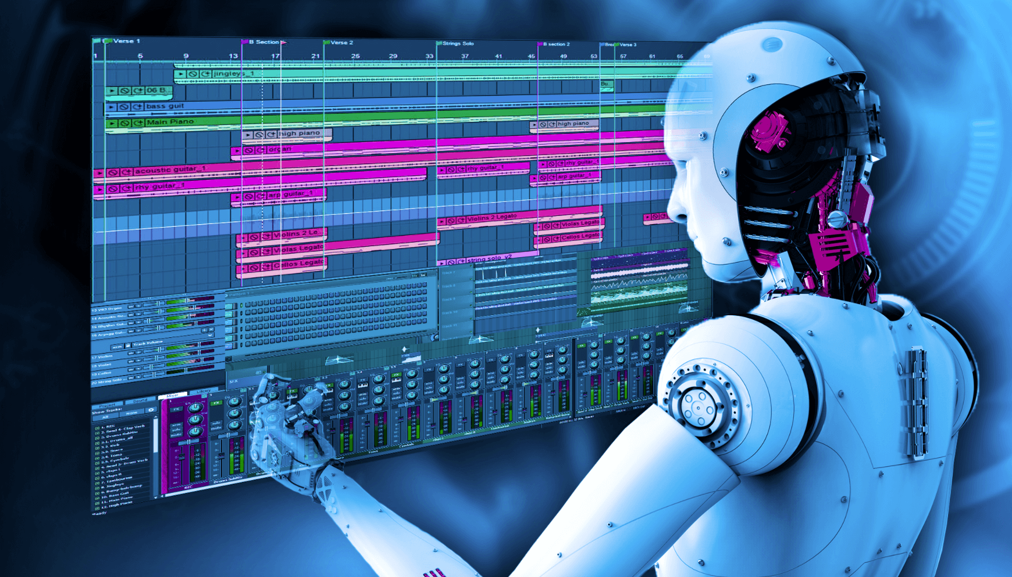
Intelligence Duplication
Deep Composer

Slide 2
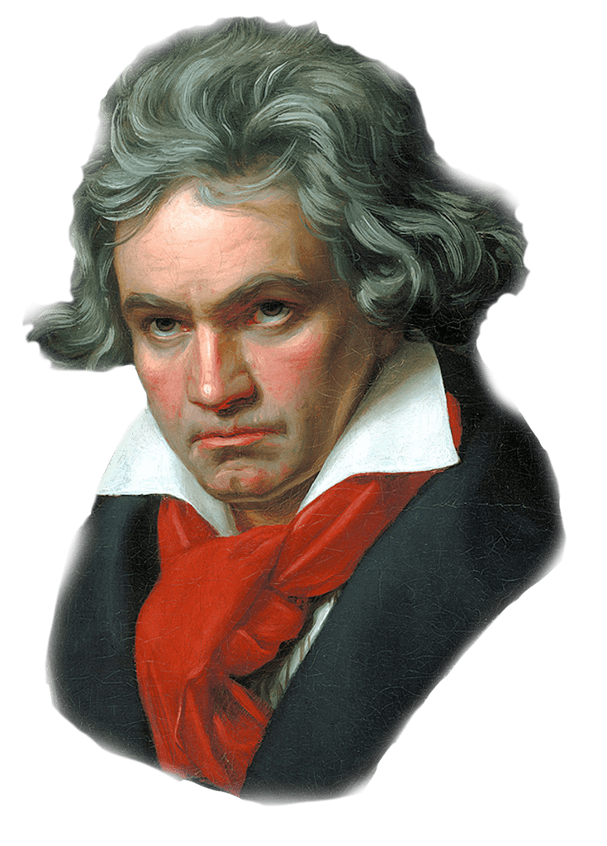
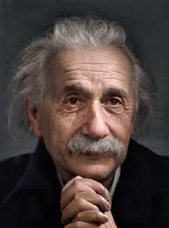
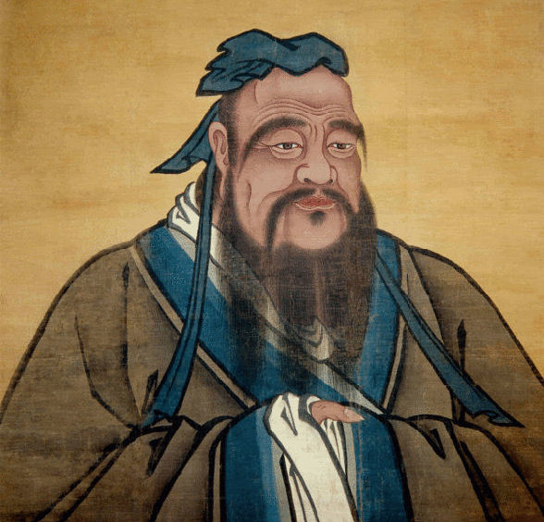
A Different Focus
Running
Learning Universal Ability: Learning and mimicking universal human ability as in computer vision
Intelligence Duplication: Learning a specific mind such as Mozart or Chopin

Slide 3
ID Motivation
Learning universal ability has automated many applications
Duplication of experts can take automation to a new level

Slide 4
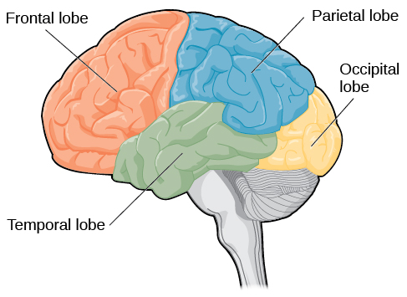
Pattern Recognition vs. Reasoning and Invention
Reasoning
Creativity
Invention
Processing information from body’s senses
Interpreting visual information
To Illustrate ID, we can demonstrate:
Hearing
Memory
Language
Reasoning
Creativity
Invention
Notes:
Temporal lobe: Some aspect of language

Slide 5
ID: Can We Bring Back the Greatest?
They lived between 1685 and 1893
Can they compose their new music for us today ?
Offer them the opportunity to collaborate ?

Slide 6
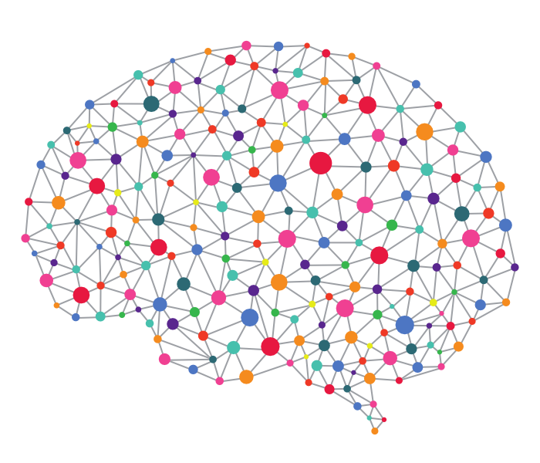
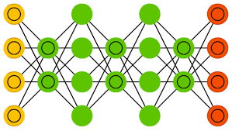
Intelligence Duplication (ID)
Facts
(Raw Data)
Reasoning
Mind Builder
Knowledge Base
(A particular mind)
Invention
The knowledge base must have a structure that facilitates the reasoning

Slide 7
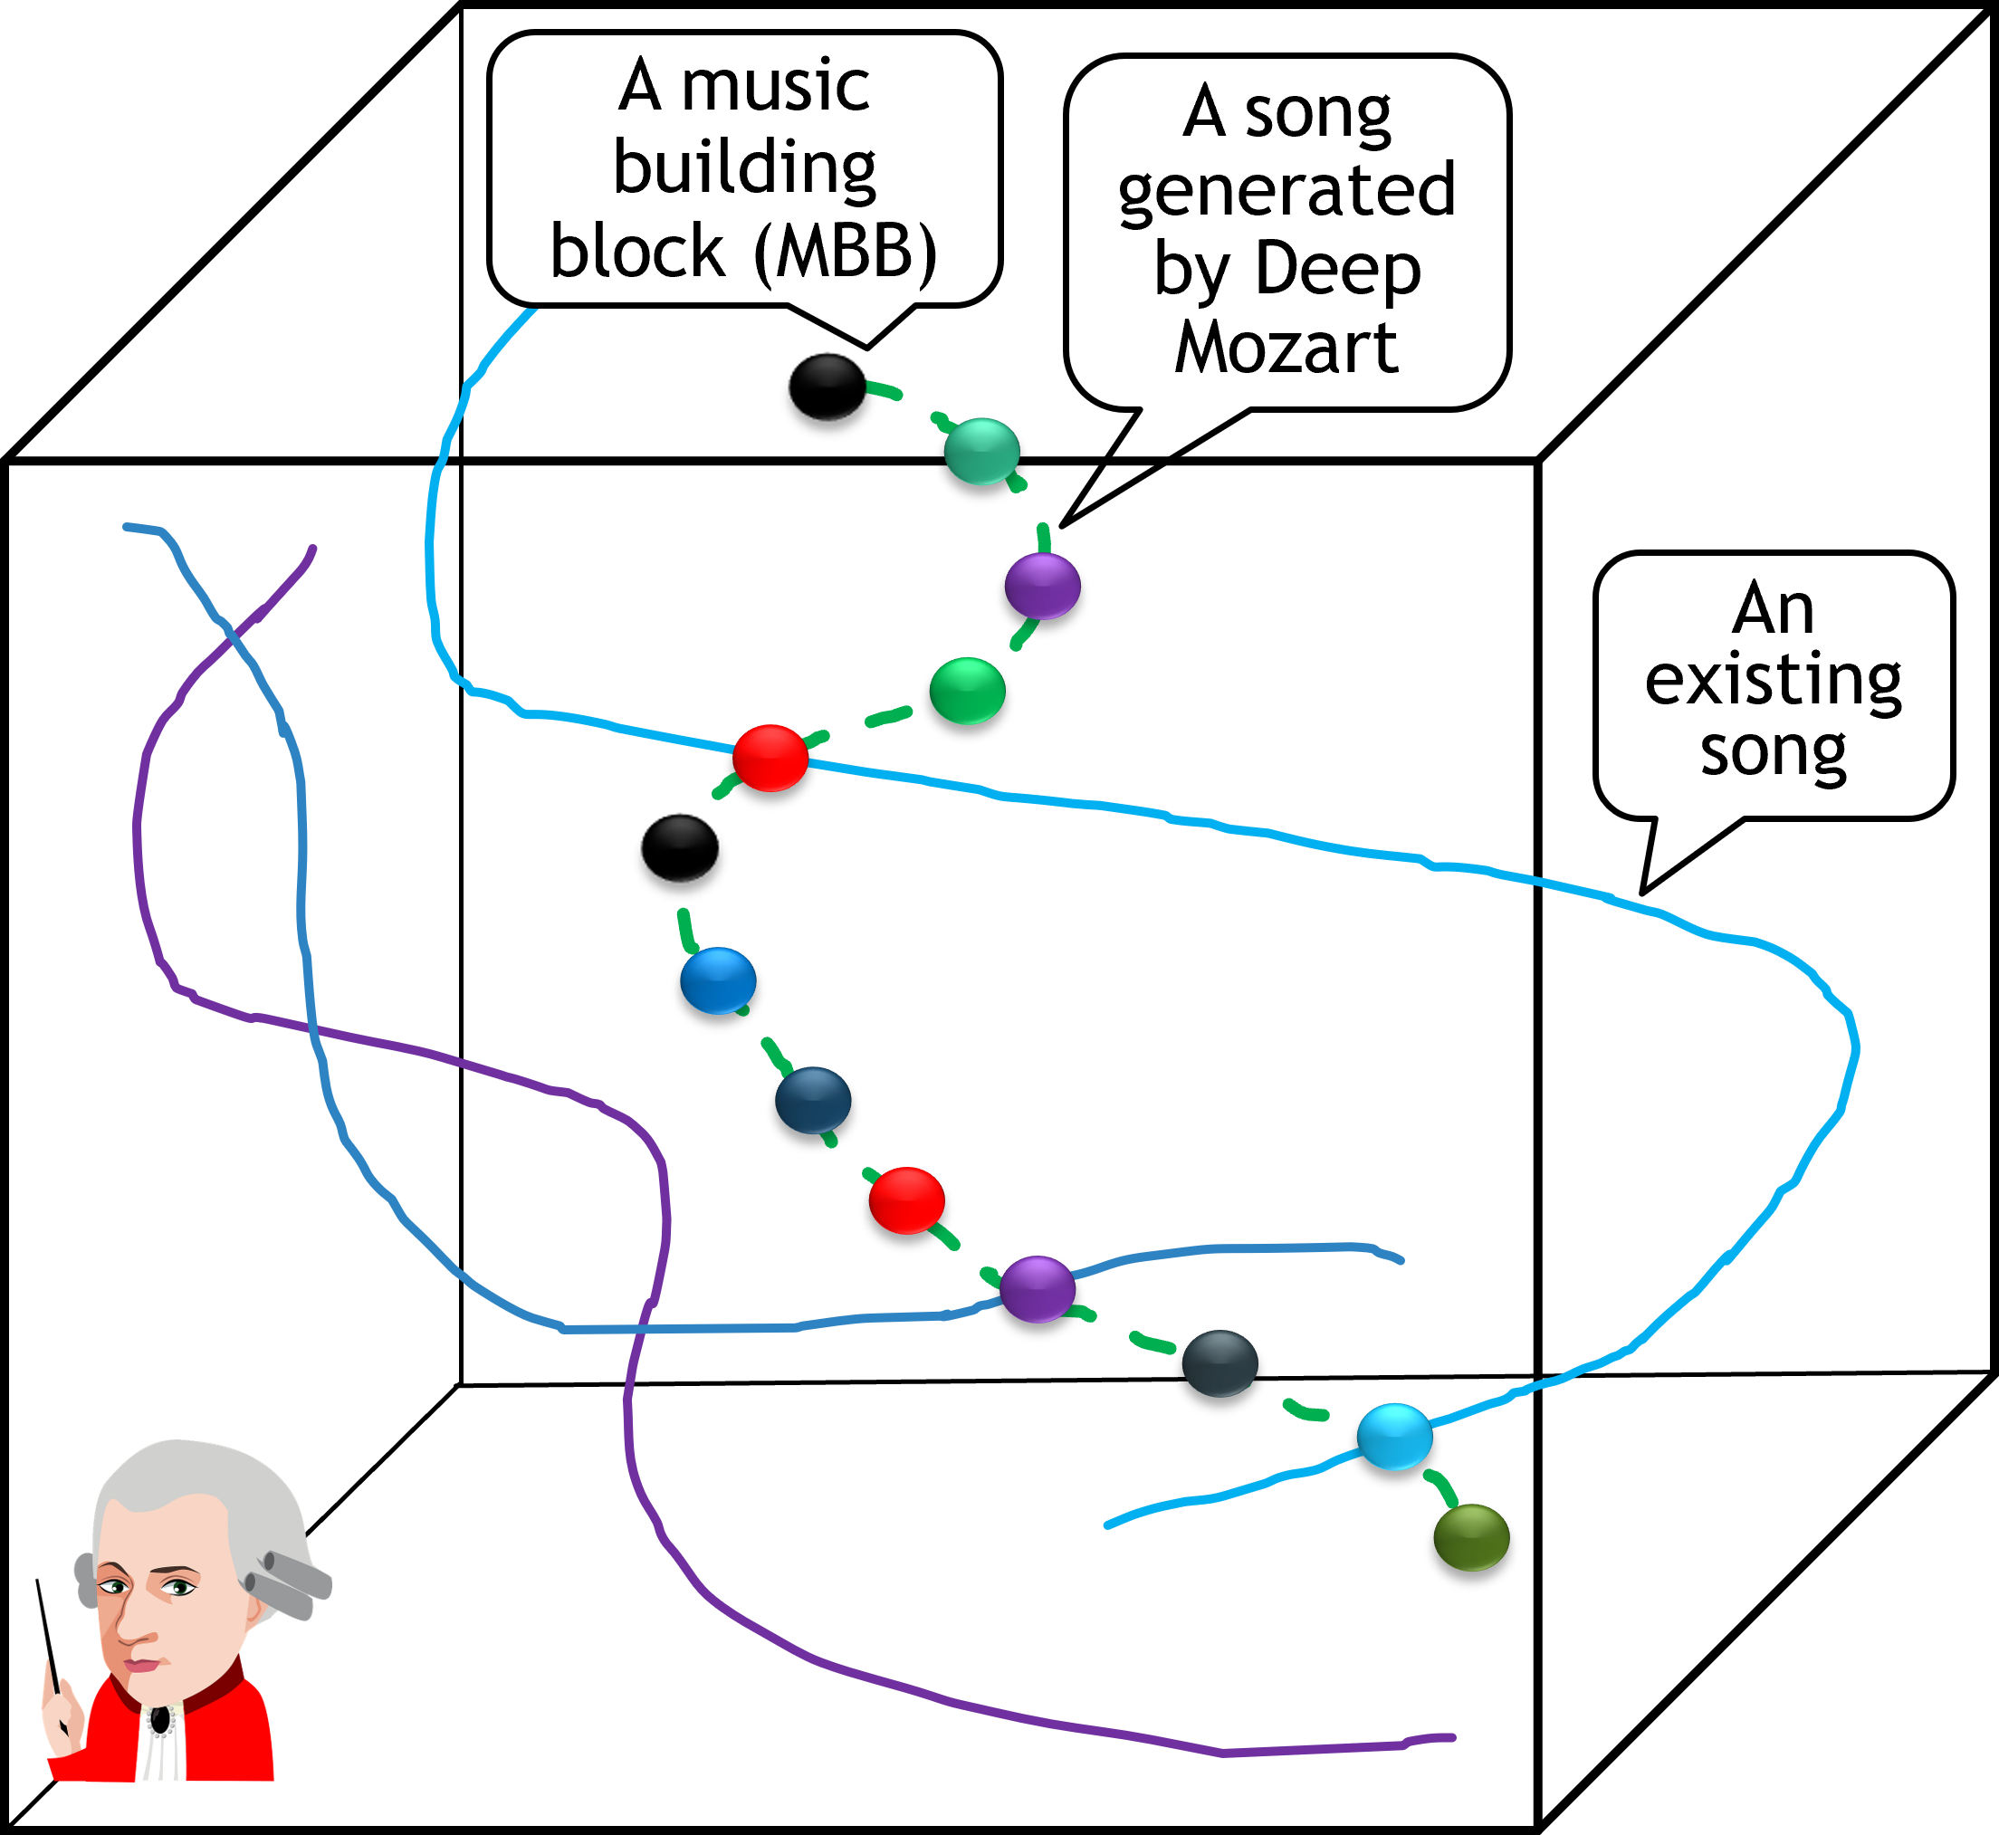
Intelligence Duplication (ID) Music Composition
Facts
(Raw Data)
Reasoning
Information
Retrieval
Mind Builder
Knowledge Base
(A particular mind)
New Original Music

Slide 8
Deep Composer
An Information Retrieval Approach to Music Composition
Database of
hashed segments
KNN Retrieval is based on composability, instead of the conventional similarity
Query
Retrieve
Query
Retrieve
Content-based feature extraction does not work
Need learned metrics

Slide 9
Forward and Backward Hash Codes
Forward Hash Code: Analyze segment in forward direction (in time)
Backward Hash Code: Analyze segment retrograde (backwards in time)
Segment 1
Segment 2
101
201
221
101

Slide 10
Hamming Distance
Number of bits that differ between two hash codes
For composable (positive) pairs, want Hamming distance to be low
For non-composable (negative) pairs, want Hamming distance to be high
Hamming distance: 2
10320121
11323121
Notes:
In essence, we can think of these hash codes as being representations for a certain “virtual state” that exists between the two segments; thus, the transition from the first segment to the second segment is admissible.

Slide 11
Segment Concatenation via Hash Codes
Compact Representation
Efficient Retrieval
Database of
hashed segments
Clearly, this approach to music composition cannot base on similarity matching!
Query
Retrieve
322
Query
Retrieve
021
021
322
322
322
021
021
110
210
322
322
021

Slide 12
“Composable” Pair
A
B
Adjacent segment pair in the same song is composable
A
They are composable
$⟹$Need metric learning
B
Notes:
The top LSTM predicts the note that goes after the current segment. The bottom LSTM predicts the node that goes before the second segment - It makes sense to input this segment in reversed order.

Slide 13
Neural Hashing
Improve
ranking-based hashing
Find more discriminative ranking subspaces by exploiting nonlinearities (patterns separated by curves) with deep neural networks
A deep network can be designed to learn the hash codes such that hash keys of similar objects are similar
111
101
001
Feature space
101
100
Kevin Joslyn, Kai Li, and Kien A. Hua, “Cross-Modal Retrieval Using Deep De-correlated Subspace Ranking Hashing,” in Proceedings of ACM International Conference on Multimedia Retrieval (ICMR) 2018, Yokohama, Japan, June 11-14, 2018. (Best Multimodal Paper Award)

Slide 14
Neural Hashing
Deep Composer uses this technique for music generation
Need new concept of “similarity” – composibility measure
111
101
001
Feature space
101
100
Kevin Joslyn, Kai Li, and Kien A. Hua, “Cross-Modal Retrieval Using Deep De-correlated Subspace Ranking Hashing,” in Proceedings of ACM International Conference on Multimedia Retrieval (ICMR) 2018, Yokohama, Japan, June 11-14, 2018. (Best Multimodal Paper Award)

Slide 15
Deep Metric Learning
Deep neural networks, with the nonlinear feature representation learning ability and discrimination power of metric learning, can learn the composability measures.
Notes:
The top LSTM predicts the note that goes after the current segment. The bottom LSTM predicts the node that goes before the second segment - It makes sense to input this segment in reversed order.

Slide 16
“Composable” Pair
A
B
Segment (in MIDI representation) pair is adjacent in the same song
Feed Sequentially
Forward Network
A
h_{a} Hash Code
LSTM
101
Similarity Loss
B
B’
Backward Network
LSTM
h_{p} Hash Code
101
Reverse
Notes:
The top LSTM predicts the note that goes after the current segment. The bottom LSTM predicts the node that goes before the second segment - It makes sense to input this segment in reversed order.

Slide 17
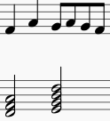
“Non-Composable” Pair
A
B
Segment (in MIDI representation) pair is not adjacent, either in different songs or the same song
More on this network later
Feed Sequentially
Forward Network
A
LSTM
h_{a} Hash Code
203
Similarity Loss
B
B’
Backward Network
LSTM
h_{p} Hash Code
101
Reverse

Slide 18
Music Segment representation
In 4/4-time music, each measure has four beats, and each beat has four notes
$⇒$Each measure has 16 notes
Measure is a good unit for the building blocks called segments
$⇒$Each segment has 16 time steps
Each time step is represented by a binary feature vector with 29 elements (next slide)
$⟹$ Each segment is represented by a series of 16 feature vectors

Slide 19
Features
Bit | Title | Description
0 | Melody articulation | 1 if the note in the melody is articulated at this timestep and 0 otherwise
1-4 | Melody octave | One-hot representation of the octave in which the melody is playing (all 0 if the melody is resting)
5-16 | Melody pitch class | One-hot representation of the pitch class (C, C#, D, etc.) of the melody note (all 0 if rest).
17-28 | Chord class | One-hot representation of the chord class (all 0 if no chord)

Slide 20
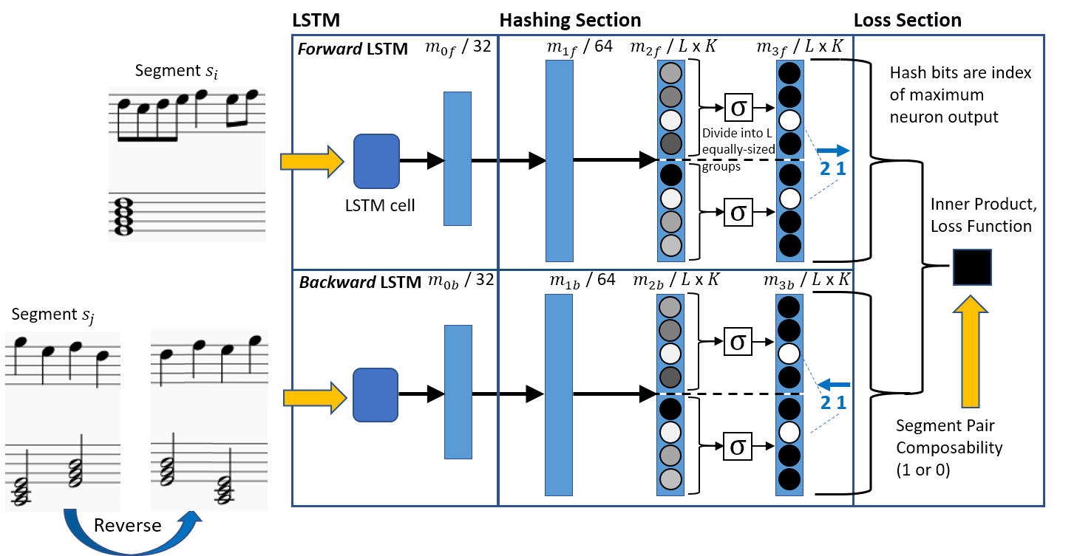
DSHL
Pretrain to predict the next melody pitch and chord
Deep Segment Hash Learning
The last hidden state contains all the information to represent the segment for the purpose of determining segment pair composability
Notes:
Why reversing the Segment S_j? LSTM remember the last few items of the data stream better than the first or middle few items. Since the last few bits of S_i and first few bits of S_j are more significant to the composibility of these two segments., we want the LSTMs to process the last few bits of S_i and the first few bits of S_j last to better characterize these segments for composibiliy analysis in the second part of the network.

Slide 21
LSRH
Original 3D space
Z
Linear Subspace Ranking Hashing
One of the three 2D subspaces
(x,y,z)
X
Y
(x,y)
X
Y

Slide 22
LSRH
Linear Subspace Ranking Hashing
Original n-dimensional feature space

Slide 23
LSRH
01
Linear Subspace Ranking Hashing
First embedding subspace
MAX(2.8, 5.2, 7.9) = 7.9
Hash Code = 10
00
10
5.2
2.8
7.9
Original n-dimensional feature space

Slide 24
LSRH
Linear Subspace Ranking Hashing
00
01
Second embedding subspace
MAX(3.4, 8.1, 7.5) = 8.1
Hash Code = 01
8.1
3.4
10
7.5
Original n-dimensional feature space

Slide 25
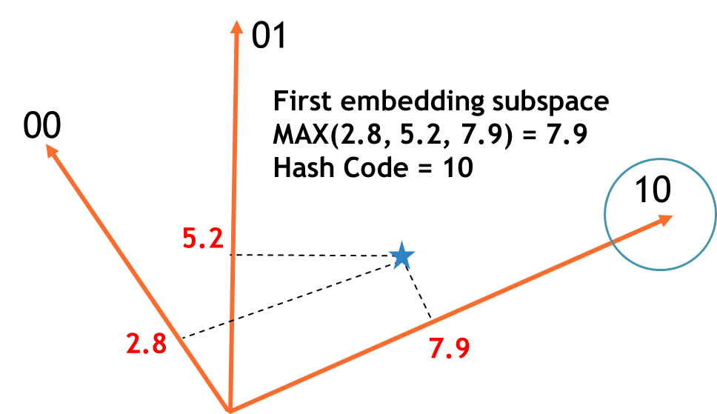
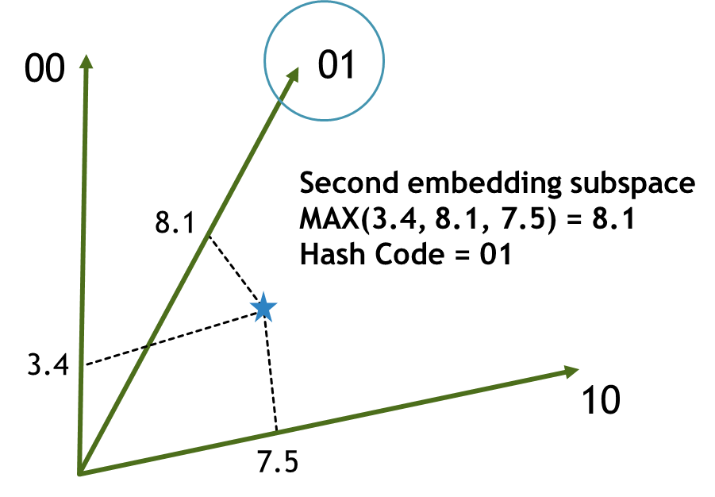
LSRH
Linear Subspace Ranking Hashing
Final hash code for the vector
Hash Code = 10 01 …
Original n-dimensional feature space

Slide 26
LSRH
Linear Subspace Ranking Hashing
How do we do this with a deep network in deep learning
Original n-dimensional feature space

Slide 27
Next slide
Notes:
We apply ReLU function after Layer m_{2*}

Slide 28
L x k
L groups of k neurons
Each group represents one of the k-dimensional learned embeddings
2.3
1.1
k
7.0
0.8
0.1
L x k
5.2
1.4
1.8
Notes:
1: These four bits will form the first hash bit
2: There are L hash bits

Slide 29
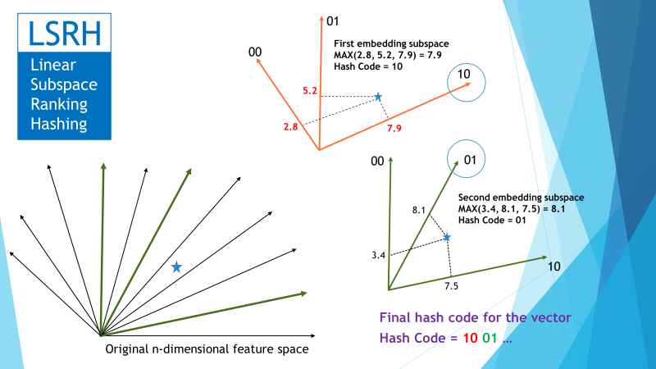
L x k
L groups of k neurons
Each group represents one of the k-dimensional learned embeddings
2.3
1.1
k
7.0
0.8
0.1
L x k
5.2
Ranking-based Hashing
Find L k-dimensional imbeddings of the input
One hash bit is set equal to the index of the maximum dimension of each imbedding
1.4
1.8
Notes:
1: These four bits will form the first hash bit
2: There are L hash bits

Slide 30
L x k
k-ary code
2.3
Hash Code: 2 1 1 2 0 3
Index of Max element of the first imbedding
L bits
1.1
7.0
2
0.8
First two bits of hash code: 2 1
0.1
5.2
1
Index of Max element of the second imbedding
1.4
1.8
Notes:
1: These four bits will form the first hash bit
2: There are L hash bits

Slide 31
L x k
2.3
.009
2.3
1.1
Softmax
.003
1.1
7.0
.986
7.0
0.8
.002
0.8
0.1
.006
0.1
5.2
.942
5.2
1.4
.021
1.4
1.8
.031
1.8
Notes:
Softmax Function: Prior to applying softmax, some vector components could be negative, or greater than one; and might not sum to 1; but after applying softmax, each component will be in the interval (0,1), and the components will add up to 1, so that they can be interpreted as probabilities.

Slide 32
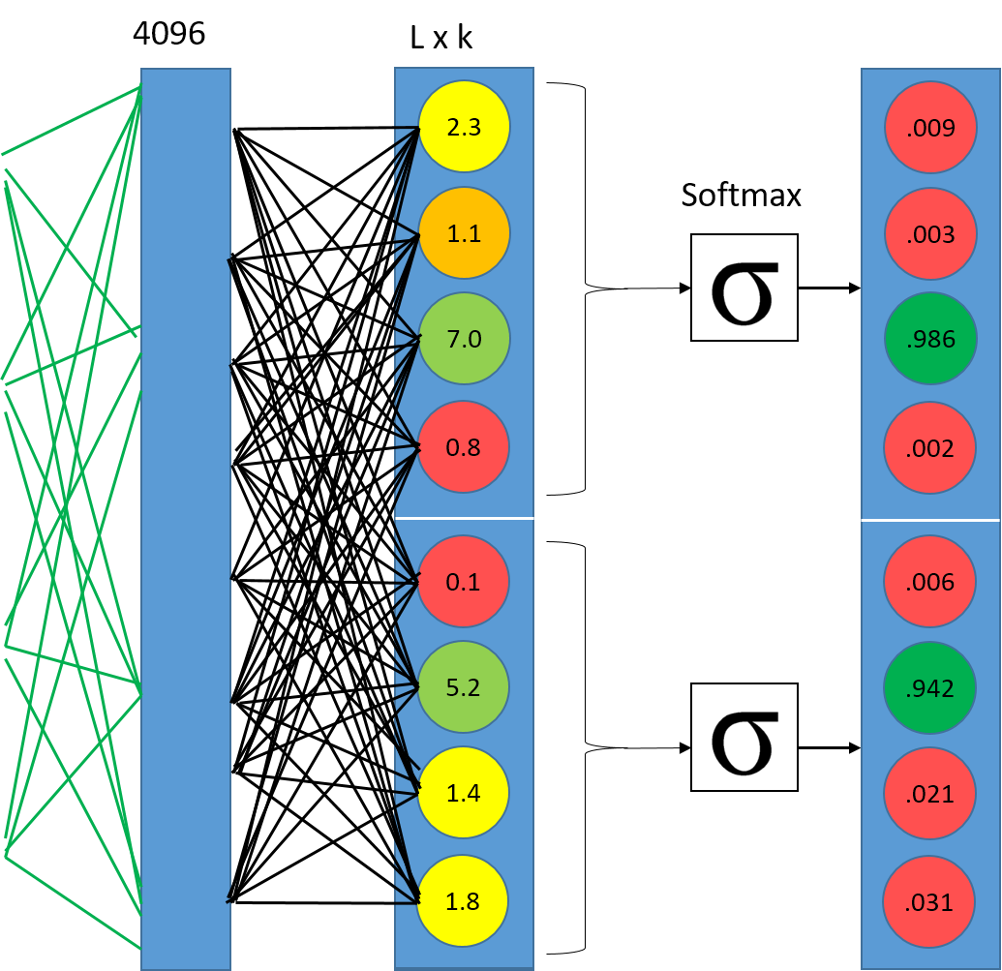
k-ary code
Hash Code: 2 1 1 2 0 3
L bits
2
1
Notes:
1: These four bits will form the first hash bit
2: There are L hash bits

Slide 33
Notes:
1: These four bits will form the first hash bit
2: There are L hash bits

Slide 34
O_{i}
Multiply
Add
x
Segment
$$s_{i}$$
Inner Product $= O_{i }\text{·}{ O}_{j}$
$≈$1
+
∈ [0, L]
O_{j}
$≈$1
If $O_{i }\text{·}{ O}_{j }≈L$, all the maximum indices agree
→ Desired if the segments are composable
If $O_{i }\text{·}{ O}_{j }≈0$, the maximum indices are all different
→ Desired if the segments are not composable
Segment
$$s_{j}$$
Want $O_{i }\text{·}{ O}_{j }= s_{i,j}L$, where $s_{i,j}$ = 1 if composable, 0 otherwise
Similarity Loss Term = (O_{i} · O_{j} – s_{i,j}L)²

Slide 35
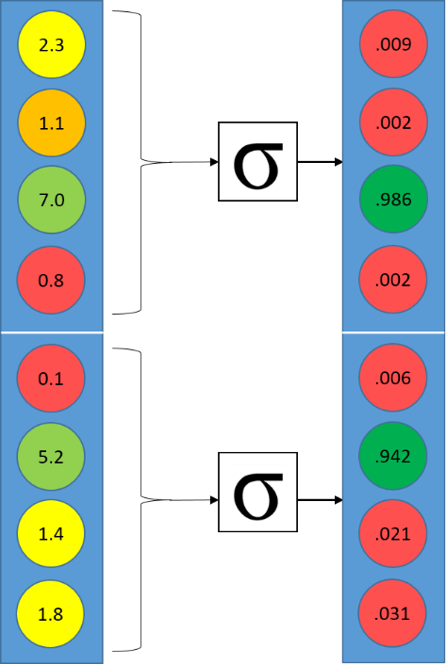
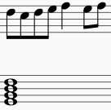
Training
The network learns the parameters to minimize:
Loss Function = S + $α$B
S = (O_{i} · O_{j} – s_{i,j}L)²
B is a bit balancing term
LSTM Hashing Section
Forward LSTM
L x k
O_{i}
LSTM cell
Inner Product O_{i} · O_{t}
Backward LSTM
L x k
O_{j}
Segment $s_{j}$
LSTM cell
Reverse
Notes:
Trained in two stages: prediction pre-training and hash function learning. Prediction pre-training trains the forward and backward LSTM’s to predict the next and previous time step, respectively. In the hash function learning stage, we initialize the LSTM weights with the values pre-trained on the prediction task, and then allow them to be updated while the weights for the hashing component of the networks are learned.
The bit balancing term ensures that each K-ary bit is balanced among the K possible values that it can take on. For example, if bit 0 in every hash code takes the value “2”, this bit does not contain useful discriminative information. This just helps the algorithm along as it attempts to find a meaning/purpose for each of the bits.
Kevin Joslyn, Naifan Zhuang, and Kien A. Hua, “Deep Segment Hash Learning for Music,” in Proceedings of International Conference on Computer Simulation of Musical Creativity (CSMC2018), Dublin, Irland, August 20-23, 2018.

Slide 36
Structured Music
The Deep Segment Hash Learning (DSHL) technique offers a new way to generate music via segment concatenation
Generate pleasant melody
Further work is required to generate structurally-sound music at a more global level
Create complete songs
Notes:
Brandon Royal, Brenton Zhang, and Kien A. Hua, “Deep Composer: Deep Neural Hashing and Retrieval Approach to Automatic Music Generation,” in Proc. of IEEE International Conference on Multimedia and Expo (ICME 2020), London, July 6-10, 2020.

Slide 37
Structural Segmentation
Group segments of each song into four structural groups: beginning (40%), middle (40%), end (20%), and final (1 segment)
Overlap segments are used to help create transitions between structure groups

Slide 38
Segment Hash Encoding
Using the trained models, each segment in the database is given eight hash codes
Four hash codes in the forward, and
Four hash codes in the backward direction
Each hash code is used for a structural location of the song: beginning, middle, end, and final

Slide 39
Segment Retrieval
The hash code used for a KNN retrieval depends on what type of song structure is currently being built

Slide 40
Dataset
Nottingham dataset
1034 folk tunes represented in the MIDI file format
496 songs chosen from the dataset
Only considered songs in major key and 2/4 or 4/4 time
4-beat segments (16 notes)
Segments based on structure groups:
6,755 beginning segments
8,620 middle segments
5475 ending segments
322 final segments

Slide 41
Experiments
First Survey
Compare Deep Composer to the basic DSHL (structure not considered)
Assess the benefit of considering music structure in composing a complete song
Second Survey
Compare against non concatenation based music generation
Diversity
Ensure our generated music is unique and original

Slide 42
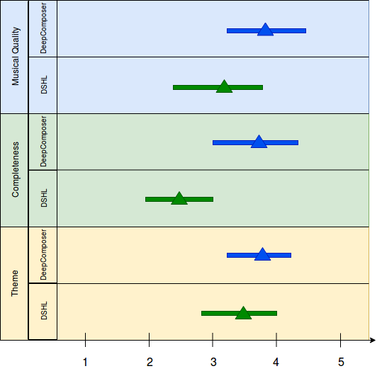
First Survey Results (Non-Musical)
Musical Quality
Was the song pleasing to listen to?
Completeness
Did the song have structure, transitions, and a nice ending?
Theme
Was there an overall theme throughout the song?

Slide 43
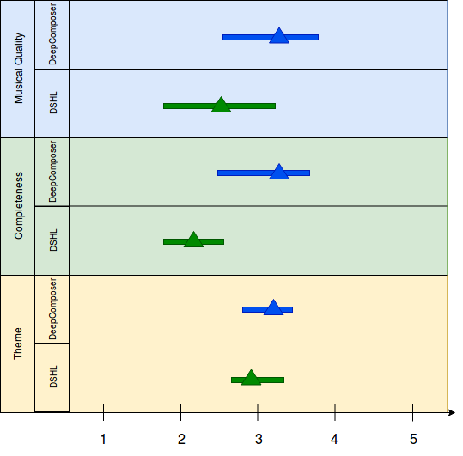
First Survey Results (Musical)
Musical Quality
Was the song pleasing to listen to?
Completeness
Did the song have structure, transitions, and a nice ending?
Theme
Was there an overall theme throughout the song?

Slide 44
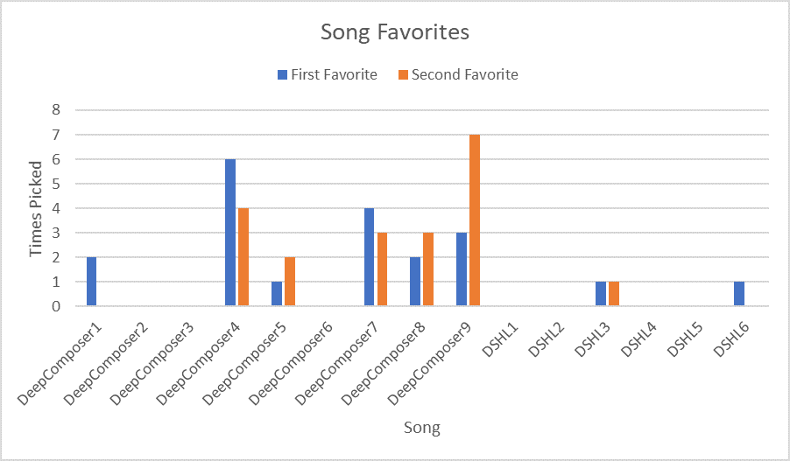
First Survey Song Favorites

Slide 45
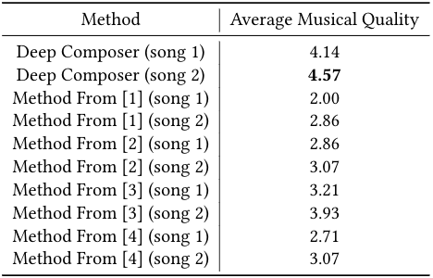
Second Survey Results
[1] Gabriele Medeot, Srikanth Cherla, Katerina Kosta, Matt McVicar, S Abdalla, MSelvi, E Rex, and K Webster. 2018. Structure Net: INDUCING STRUCTURE INGENERATED MELODIES. InThe 19th International Society for Music Information Retrieval Conference.
[2] Daniel D Johnson. 2017. Generating polyphonic music using tied parallel net-works. International conference on evolutionary and biologically inspired musicand art. Springer, 128–143.
[3] Ke Chen, Weilin Zhang, Shlomo Dubnov, Gus Xia, and Wei Li. 2019. The effect of explicit structure encoding of deep neural networks for symbolic music gen-eration. In2019 International Workshop on Multilayer Music Representation andProcessing (MMRP). IEEE, 77–84.
[4] Nicolas Boulanger-Lewandowski, Yoshua Bengio, and Pascal Vincent. 2012. Modeling temporal dependencies in high-dimensional sequences: Application topolyphonic music generation and transcription.arXiv preprint arXiv:1206.6392(2012)
Notes:
For the second survey our method was compared to 4 others using the Nottingham dataset. Song1 and 2 are just random samples from each method. In this survey we compared musical quality

Slide 46
Diversity
Diversity is used to measure the originality of a generated piece of music
How unique each generated song is compared to the original songs in the database
Generated songs should use segments from many different songs
Generated 100 songs, each with 32 segments to evaluate diversity
Diversity is measured as the total number of distinct database songs the selected segments came from

Slide 47
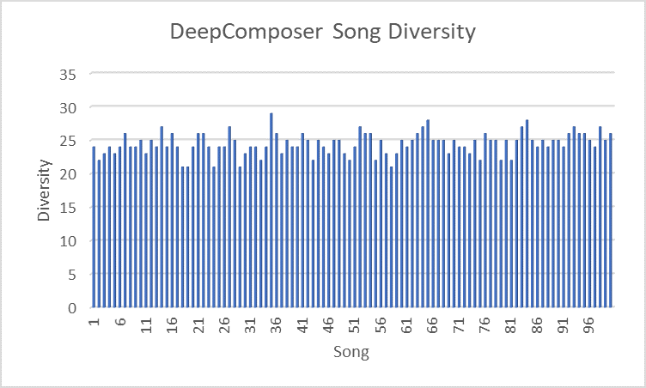
Diversity
Each song has 32 music segments
Notes:
Segments from the same original song are repetition of the same segment for better musical quality
These repetitions are desirable to give the song a theme

Slide 48
Diversity
Each song has 32 music segments
Segments from the same original song are repetition of the same segment for better musical quality
These repetitions are desirable to give the song a theme

Slide 49
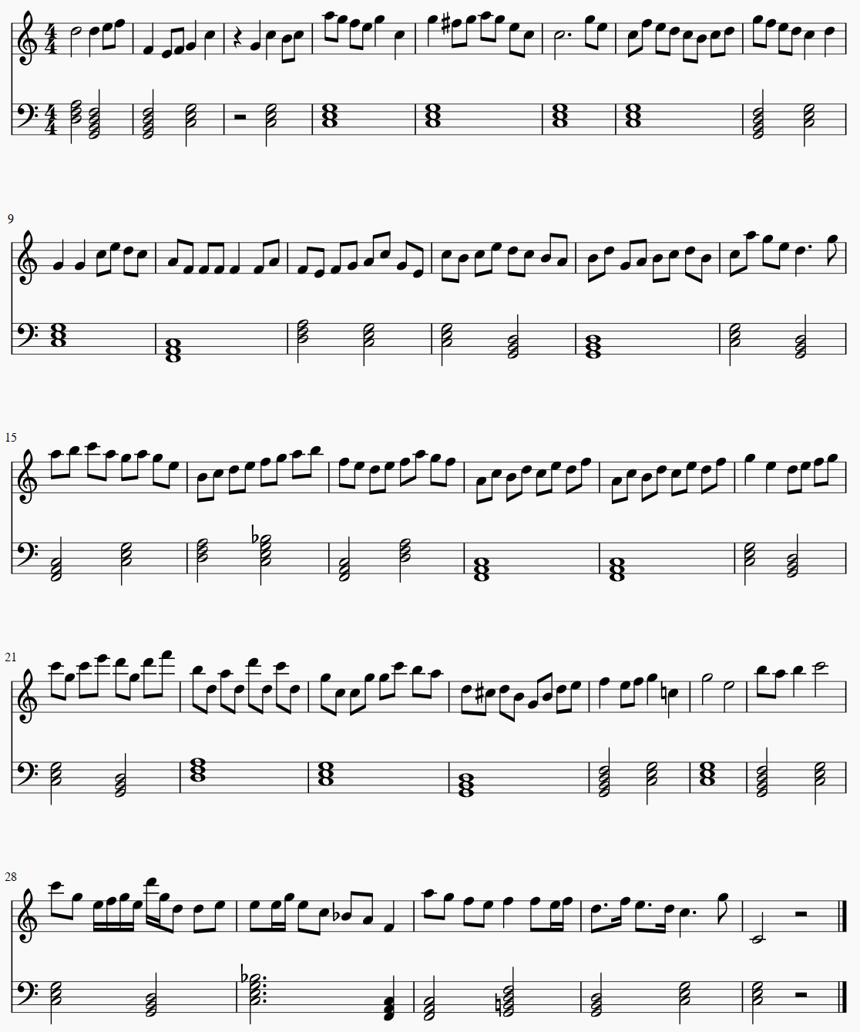
Sample Generated Song 1

Slide 50
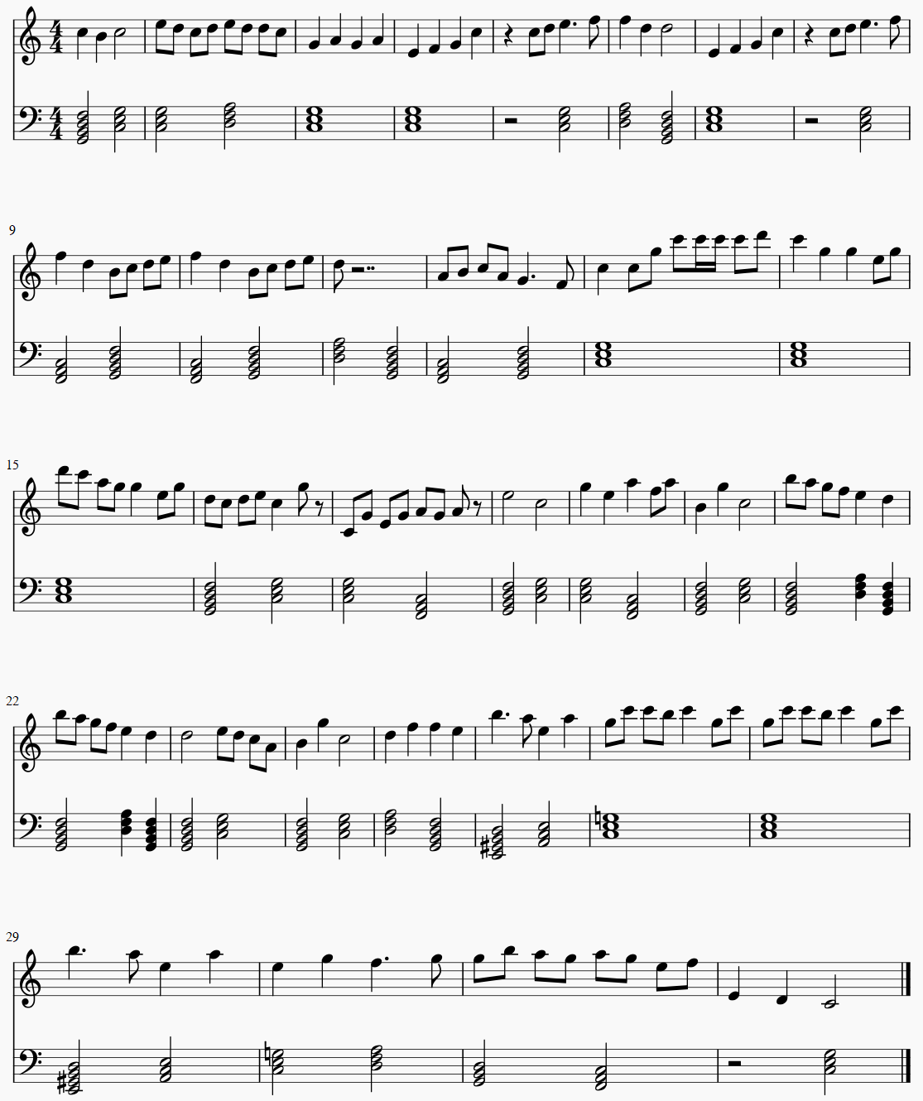
Sample Generated Song 2

Slide 51
Sample Generated Song 3

Slide 52
Revive Mozart
Challenges:
Music building blocks are not uniformly distributed
Retrieval in sparse region may returns non-compossible music segments
Hash imbedding (music space)
KNN Retrieval
Mind Builder
New Original Music
Music Segments
Mozart Music

Slide 53
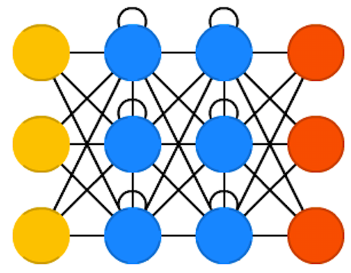
Synthetic Music Building Blocks
Generating synthetic music segments
Hash imbedding (music space)
KNN Retrieval
Knowledge
Generator
Mind Builder
New Original Music
Music Segments
Mozart Music

Slide 54
Synthetic Music Building Blocks
Generating synthetic music segments
Potential Solution:
Adversarial learning techniques
How to verify the synthetic building blocks are still “Mozart”?
Knowledge
Generator

Slide 55
Bring the World Together
Earth Music

Slide 56
Magic Baton
Segment hash space
1
2
3
4
5
Take music performance to a new level
6
7
8
2
: Hash code of a music segment
Magic Baton: Compose and play music by waving the music baton

Slide 57
Using Phones
Most mobile phones can track gestures using the accelerometer and gyroscope
We can compose music using our phone

Slide 58
Remarks
ThingStore
Killer applications on Internet: Email → Browser → Video Streaming → Internet of Things
An Internet-scale ecosystem for marketing and collaboration on IoT technology
Deep Composer
A novel and effective approach to automatic music generation
A promising framework for intelligence duplication (DI)
DI can take automation to a new level

Slide 59
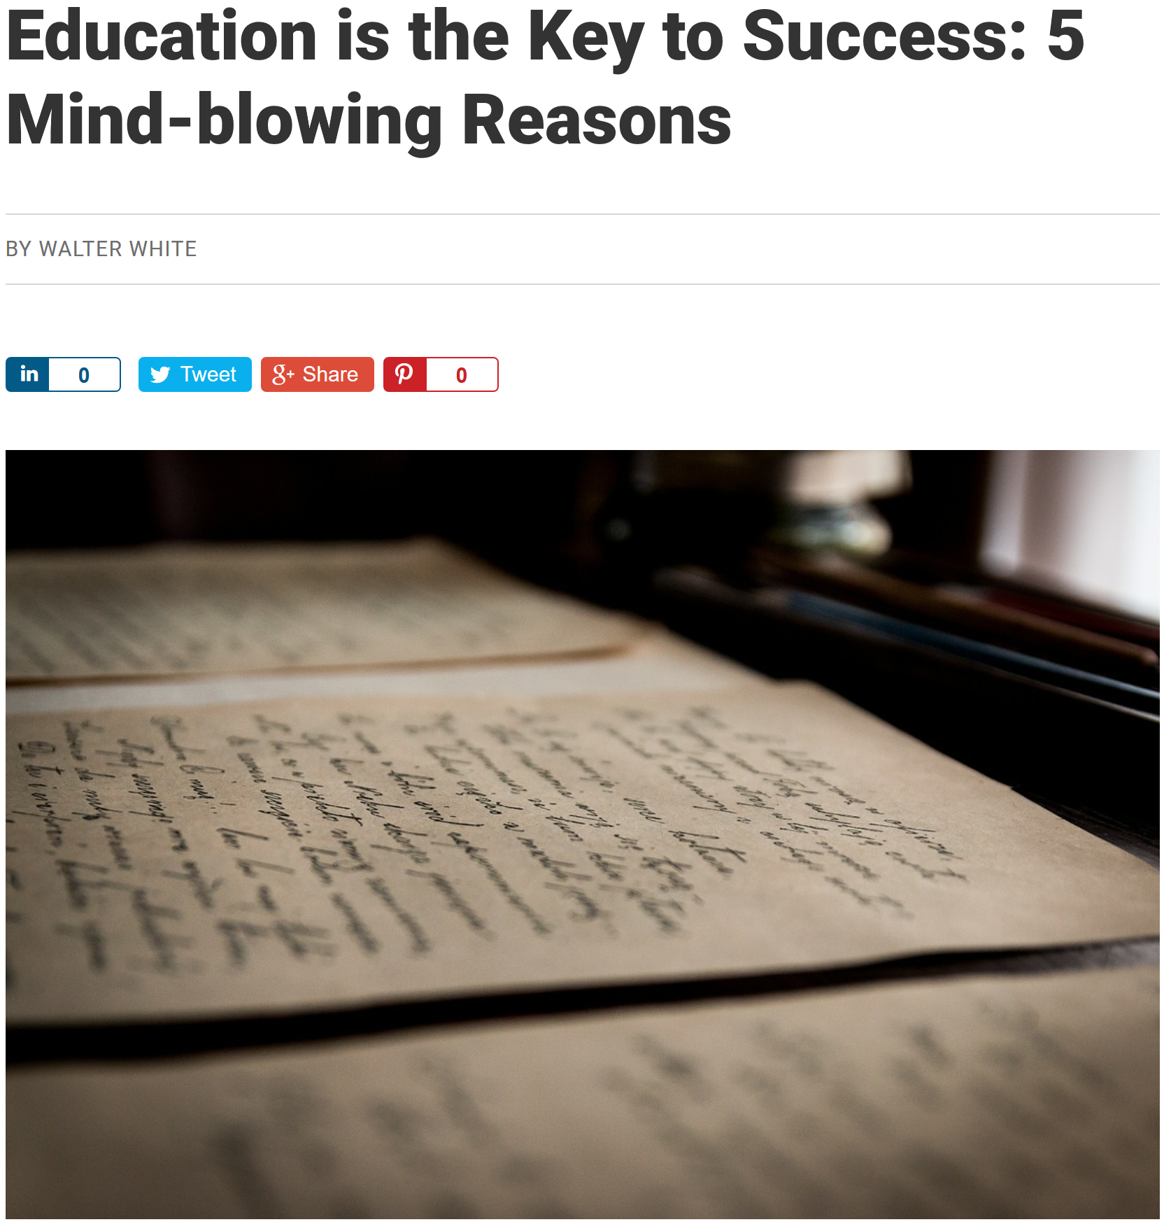
Copyright
All these four documents contain the sentence “Education is the key to success”
- A copyright infringement ??

Slide 60
Jun Ye, Kai Li, and Kien A. Hua, “WTA Hash-based Multimodal Feature Fusion for 3D Human Action Recognition,” in Proc. of IEEE International Symposium on Multimedia, Miami, December 14-16, 2015, pp. 184-190. (Best Paper Award).
Naifan Zhuang, Jun Ye, and Kien A. Hua, “DLSTM Approach to Video Modeling with Hashing for Large-Scale Video Retrieval,” in Proc. of International Conference on Pattern Recognition (ICPR2016), December 4-8, 2016.
K Li, G. Qi, J. Ye, and Kien A. Hua, “Linear Subspace Ranking Hashing for Cross-Modal Retrieval,” IEEE Transactions on Pattern Analysis and Machine Intelligence (2016)
Kevin Joslyn, Kai Li, and Kien A. Hua, “Cross-Modal Retrieval Using Deep De-correlated Subspace Ranking Hashing,” in Proceedings of ACM International Conference on Multimedia Retrieval (ICMR) 2018, Yokohama, Japan, June 11-14, 2018, pp 55-63. (Best Multimodal Paper Award)
Kai Li, Guo-Jun Qi, and Kien A. Hua, “Learning Label Preserving Binary Codes for Multimedia Retrieval: A General Approach” in ACM Transactions on Multimedia Computing, Communications and Applications, Volume 14, Issue 1, January 2018.
Kevin Joslyn, Naifan Zhuang, and Kien A. Hua, “Deep Segment Hash Learning for Music,” in Proceedings of International Conference on Computer Simulation of Musical Creativity (CSMC2018), Dublin, Irland, August 20-23, 2018.
Jun Ye, Guo-Jun Qi, Naifan Zhuang, Hu Hao, and Kien A. Hua, “Learning Compact Features for Human Activity Recognition via Probabilistic First-Take-All,” to appear in IEEE Transactions on Pattern Analysis and Machine Intelligence (TPAMI).
Brandon Royal, Brenton Zhang, and Kien A. Hua, “Deep Composer: Deep Neural Hashing and Retrieval Approach to Automatic Music Generation,” in Proc. of IEEE International Conference on Multimedia and Expo (ICME 2020), London, July 6-10, 2020.
Some Hashing Papers

