Slide 1

Computer-aided diagnosis of Lumbar Spinal Stenosis
Kien A. Hua
University of Central Florida

Slide 2
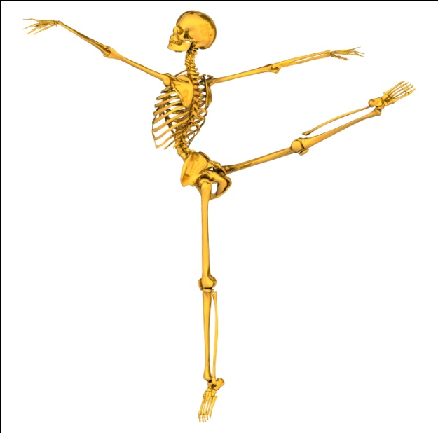
Outline
Background: lumbar spinal stenosis
Our initial research - CAD using X-ray
Updated system uses MRI
Performance Results

Slide 3
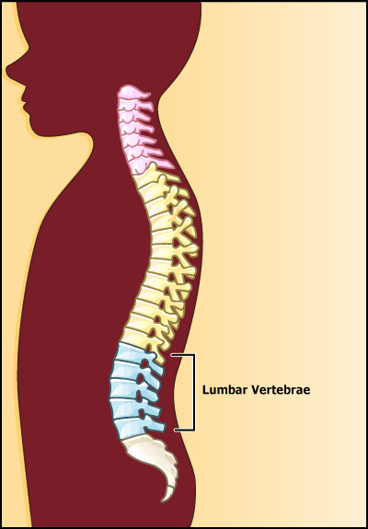
Spine Anatomy
Spine consists of a column of bones called vertebrae
First three sections of the spine:
Cervical Spine: Neck – C1 through C7
Thoracic Spine: Upper and mid back – T1 through T12
Lumbar Spine: Lower back - L1 through L5
Cervical
Thoracic
Our focus
Sacrum

Slide 4
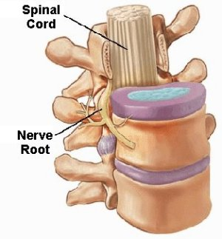
Intervertebral Disc
Between every two vertebrae is a gel-like intervertebral disc
Jelly-like
nucleus
Tough
outer
shell

Slide 5
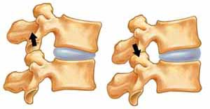
Facet Joints
Each vertebra has two sets of facet joints, one pair facing upward and one downward
Facet joints are hinge-like and connect the two vertebrae together
Facet joints and discs allow the spine to bend and twist
Facet joint facing down
Facet joint facing up
Flexion
(bending forward)
Extension
(bending backward)

Slide 6
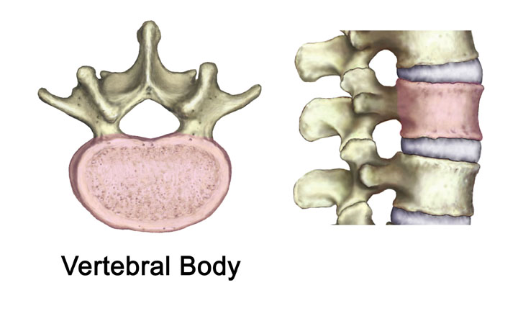
Spinal Cord
Each vertebra has a hole through it
These holes line up to form the spinal canal
A large bundle of nerves called the spinal cord runs through the spinal canal
Hole
Spinal
canal

Slide 7
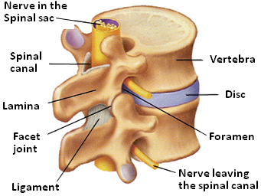
Intervertebral Foramina
Lumbar canal is the vertical space within the spinal column which contains the spinal cord
Nerves travel through the spinal canal and exit the canal through small pathways on the sides, called intervertebral foramina.
Foramen provides a passage for a spinal nerve
Image courtesy of St. Joseph’s Hospital Health Center

Slide 8
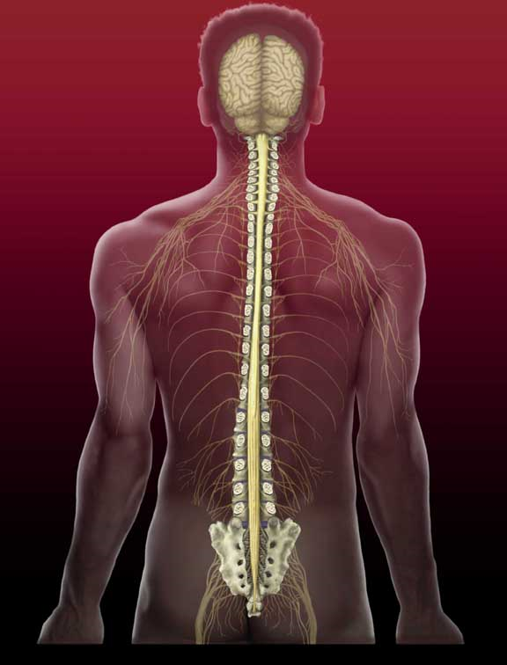
Spinal Nerves
Spinal cord has 31 segments; and a pair of spinal nerves exits from each segment
These nerves carry messages between the brain and the various parts of the body

Slide 9
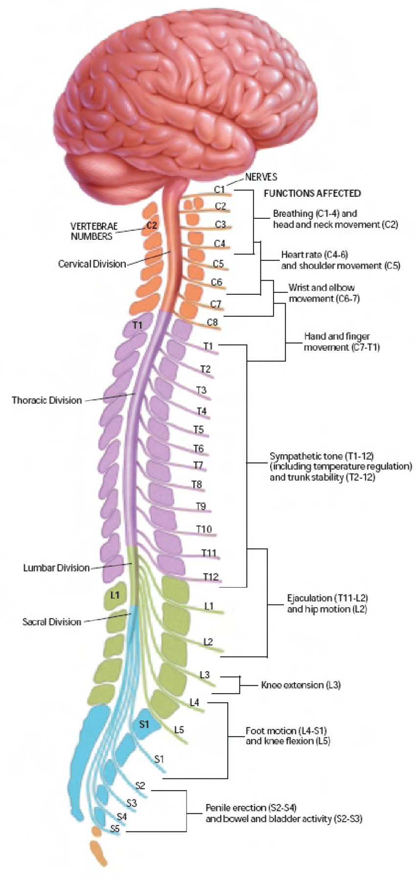
Spinal Cord
Spinal cord is much shorter than the length of the spinal column
Spinal cord extends down to only the last of the thoracic vertebrae
Cervical
Spinal cord
Thoracic
Lumbar
vertebrae

Slide 10
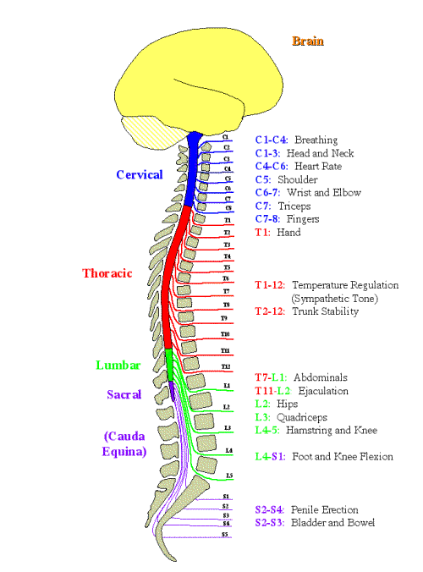
Spinal Cord is Shorter
Nerves that branch from the spinal cord from the lumbar level must run in the vertebral canal for a distance before they exit the vertebral column

Slide 11
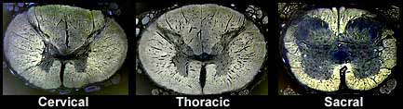
Sizes of Spinal Segments
Nerve cell bodies are located in the “gray” matter
Axons of the spinal cord are located in the “white” matter. They carry messages.
Spinal segments closer to the brain have larger amount of “white” matter
  Allow many axons go up to the brain from all levels of the spinal cord
Cervical
Thoracic
Sacrum
More “white”
matter

Slide 12
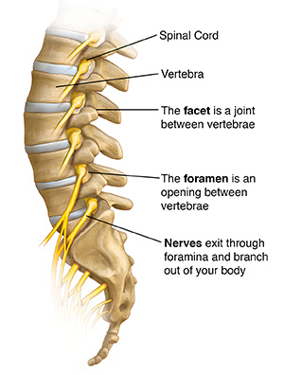
Lumbar Spine
Lumbar spine is the lower portion of the spine structure
Most people have five bones or vertebrae in the lumbar spine
Between every two vertebrae is a gel-like intervertebral disc

Slide 13
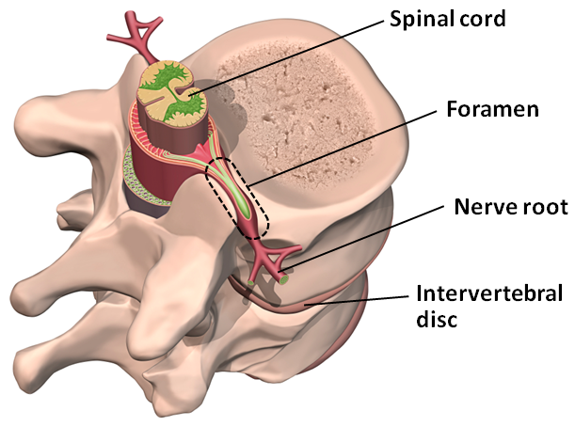
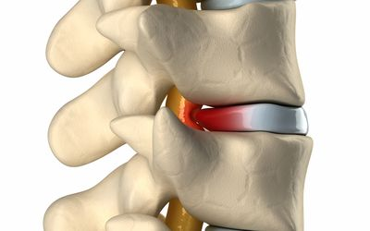
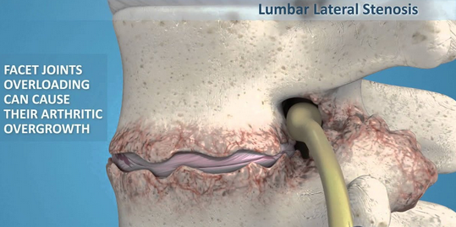
Lumbar Spinal Stenosis
Spinal stenosis is a narrowing of
  the central spinal canal (central stenosis), or
  the pathway through the foramen (lateral stenosis)
The symptoms are back and leg pain due to compression of the nerves
Central stenosis
Lateral stenosis

Slide 14
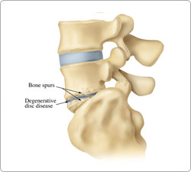
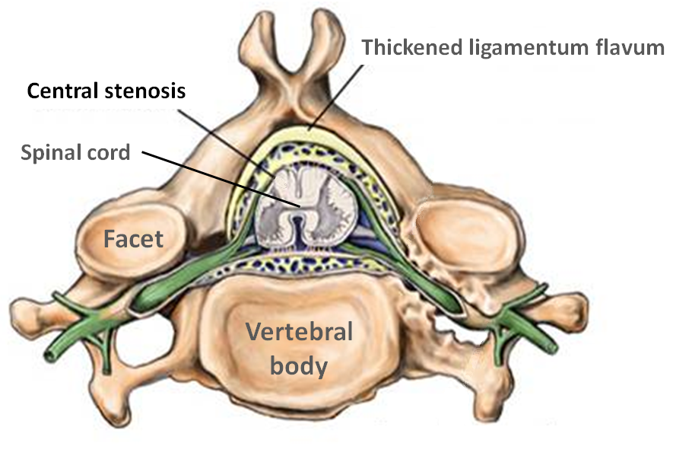
One Scenario
Degenerative Disc Disease
Degenerative disc due to wear and tear weakens the disc wall
Disc center becomes damaged and loses some of its water content
Unable to act as a cushion, the disc flattens causing facet joints misaligned
Facet
joint
Disc flattens
This condition encourages bone spurs
If these spurs grow into the foramen area, they pinch the spinal nerve root
Bone spurs pinch nerve

Slide 15

One Scenario
Degenerative Disc Disease
If bone spurs grow into the foramen area, they pinch the spinal nerve root

Slide 16
Statistics
Global prevalence of lower back pain is as high as 42%
Second most common neurological ailment in the United States, only headache is more common
2% of workers injure their back each year
Americans spend $50 billion each year due to low back pain

Slide 17
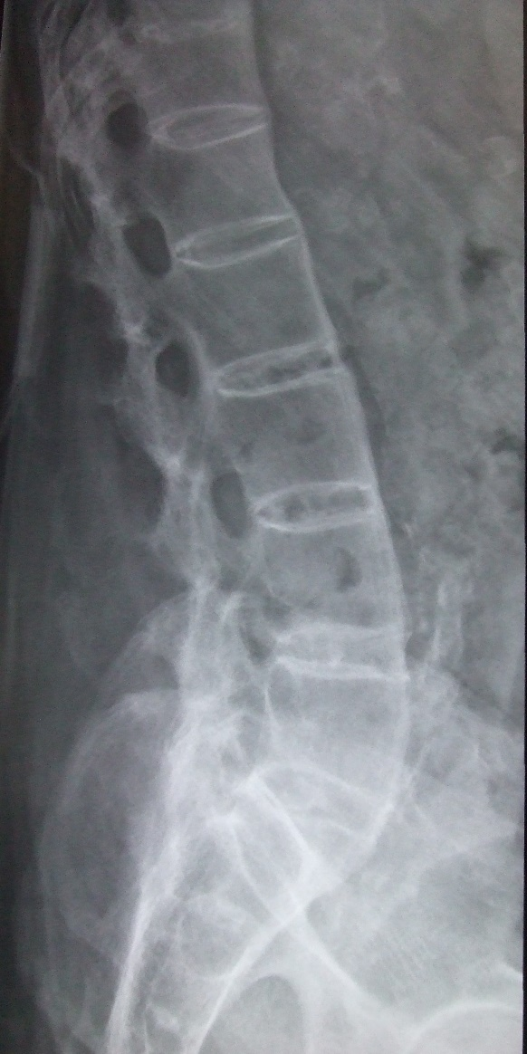
Our Initial Research
CAD for Lumbar Stenosis Using X-ray
Automatic Feature Extraction
  Active Appearance Modeling technique is used to label the boundary points of the vertebrae
  A vertebral morphology technique is then used to compute the spinal features as distances between various boundary points
Automatic Stenosis Diagnosis
  A neural network is trained with the spinal features to recognize various stenosis conditions
Performance is constrained to the side view of lumbar spine X-ray images

Slide 18
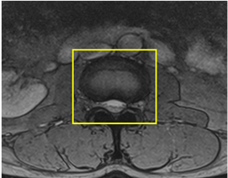
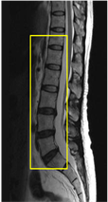
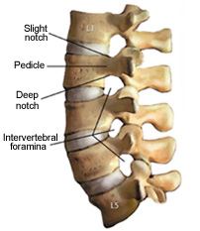
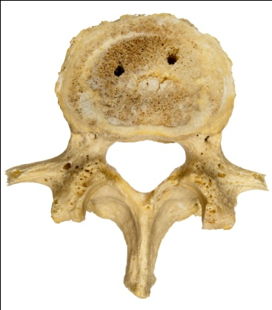
Two Different Views
Magnetic Resonance Imaging (MRI)
Transverse view
(Axial view)
Sagittal view
(Side view)

Slide 19
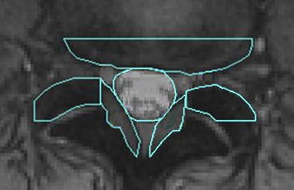
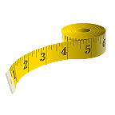
Our System Environment
Spinal components recognition
Spinal features extraction

Slide 20

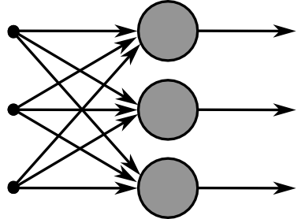

Our System Environment
Spinal components recognition
Spinal features extraction
Train Multilayer Perceptrons using the spinal features
TRAINING
DATA

Slide 21

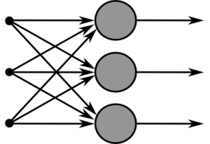
Our System Environment
Spinal components recognition
Spinal features extraction
Train Multilayer Perceptrons using the spinal features
Use the Perceptrons as a diagnosis system for new cases

Slide 22
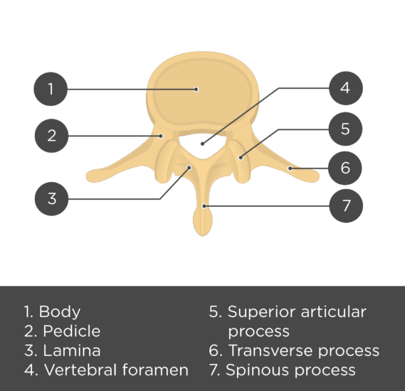
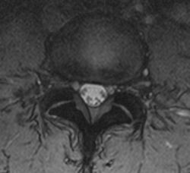
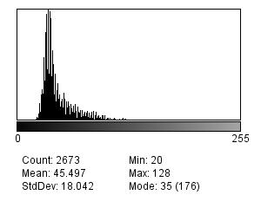
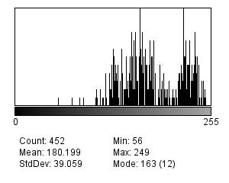
Spinal Canal Area
The spinal canal area is the brightest area near the center of the image
Superior articular process
Histograms
Superior articular process
Spinal canal
Mostly dark pixels
Many bright pixels
Dark
Bright

Slide 23
Find 4 Regions of Interests (ROIs)
Find the spinal canal area
  Find a very bright pixel near center of image
  Perform image segmentation using region growing
  First ROI is the minimum bounding rectangle
Determine the remaining three ROI’s based on the first one
5 pixels
25 pixels
5 pixels
25 pixels
CANAL
5 pixels
1
5 pixels
2
15 pixels
3
4

Slide 24
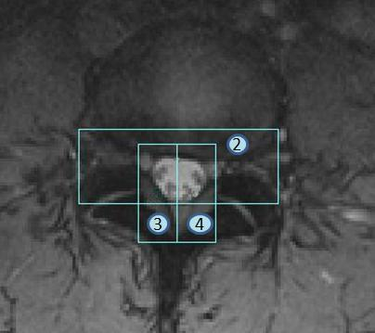
Example: Regions of Interest
ROI’s detected by our technique
1

Slide 25
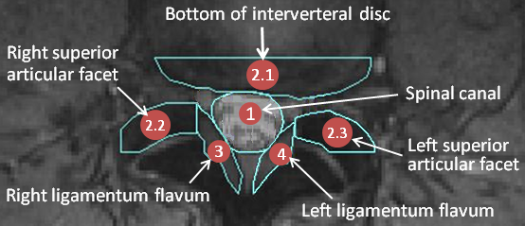
Finding 6 Spinal Components
The system determines the six spinal components from the four ROI’s using pixel classifiers
1
Four ROI’s
A pixel
Six spinal components
Pixel Classification

Slide 26
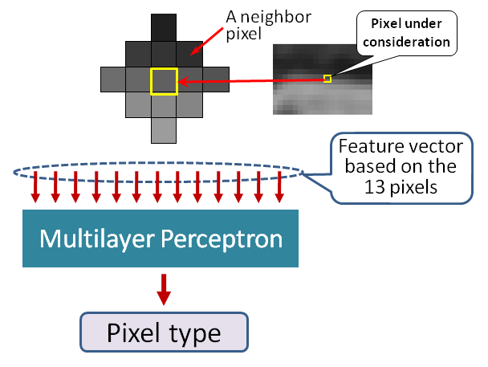
Finding 6 Spinal Components
Four multilayer perceptrons (MLP’s) are trained to examine pixels in the four ROI’s and assign them to one of the six segmented areas
1
Four ROI’s
Six spinal components

Slide 27
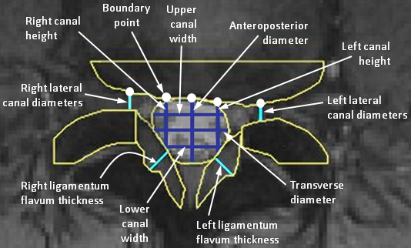
Spinal Feature Extraction (1)
Some landmarks of the spinal components are used to measure the spinal features

Slide 28
Spinal Feature Extraction (2)
Posterior border of vertebral body
(or Intervertebral disc)
Boundary point
BP₅
BP₁
BP₂
BP₃
BP₄
1st ROI
Upper canal width
H₁
Spinal
canal
Transverse diameter
H₂
Right canal height
Lower canal width
H₃
Left canal height
Anteroposterior
diameter
V₁
V₂
V₃
V₄
V₅

Slide 29
Spinal Feature Extraction (3)
Boundary point
BP₅
BP₁
BP₂
BP₃
BP₄
Upper canal width
Transverse diameter
Right canal height
Left canal height
Anteroposterior
diameter
Lower canal width

Slide 30
Spinal Feature Extraction (4)
Right lateral canal
diameter
BP₁
BP₅
Left lateral canal
diameter
Right superior articular facet
Left superior articular facet

Slide 31
Spinal Feature Extraction (5)
Anteroposterior diameter
Right ligamentum
flavum thickness
Left ligamentum
flavum thickness
Right ligamentum flavum
Left ligamentum flavum

Slide 32
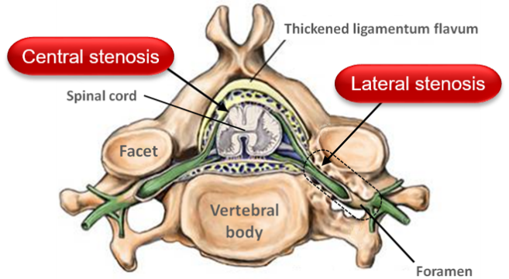
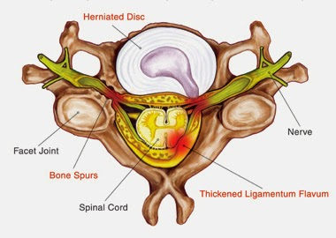
Purposes of Spinal Features
Increase in volume
Spinal Features | Compression Mechanism |  | Stenosis Categories
 | Disc Herniation | Hypertrophy of Ligament or Facet | Central | Lateral
Left & Right Canal Heights | √ | √ | √ | √
Anteroposterior Diameter | √ |  | √
Transverse Diameter |  | √ | √
Upper Canal Width | √ |  | √
Lower Canal Width |  | √ | √
Lateral Canal Diameter | √ |  |  | √
Ligamentum Flavum Thickness |  | √ | √ | √

Slide 33
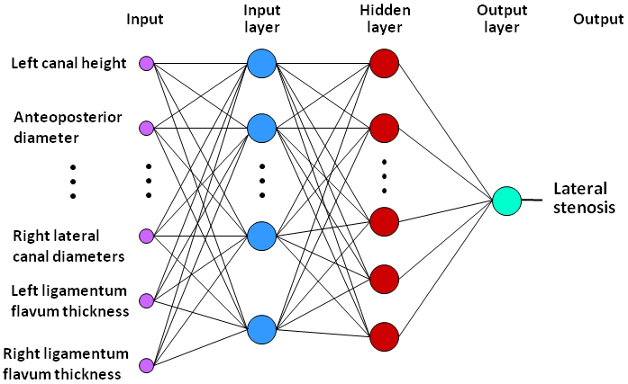
Stenosis Condition Classification
Stenosis diagnosis is performed using a multilayer perceptron for each of the four stenosis conditions
  Input is the set of spinal features
  Output yields positive or negative results of various spinal conditions

Slide 34
Experiment Setting
50 MRI volumes of female patients were used
Their ages range from 18 to 74, with a mean of 48
MR images were generated using:
  1000ms ≤ TR ≤ 2500ms, mostly 1290
  25ms ≤ TE ≤ 30ms, mostly 26
Ground truth for stenosis conditions were obtained from clinical diagnosis reports
Each report was generated by agreement between at least one radiologist and one orthopedist
Manual segmentation by radiologists provided ground truth for segmentation study

Slide 35
Performance Evaluation
We performed ten-fold cross validation
  Data set of 50 subjects is randomly split into ten partitions
  Each partition is used in turn for testing while the remaining partitions are used for training
  This process is repeated ten times; and overall performance is the average over the ten rounds

Slide 36

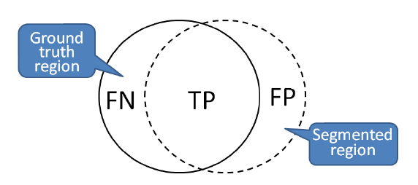
Segmentation Performance
Performance metric is the accuracy of the segmentation
Spinal Components | Segmentation Quality
Spinal canal | 92.47
Intervertebral discs | 91.47
Superior articular facet | 92.29
Ligamentum flavum & facet | 97.68

Slide 37
Diagnosis Performance
Spinal Conditions | Percentage of Correctness
Hypertrophy of ligament flavum & facet | 96.82
Disc Herniation | 92.31
Central Spinal Stenosis | 92.66
Lateral Spinal Stenosis | 96.29
      Further improvement can be achieved by considering also the sagittal views

Slide 38
Conclusions
The proposed CAD system can detect various conditions of lumbar spinal stenosis due to bone spur, bulging discs, or thickening of ligaments
Diagnosis accuracy ranges from about 92% to 97%
Good performance can be attributed to the accurate segmentation results

Slide 39
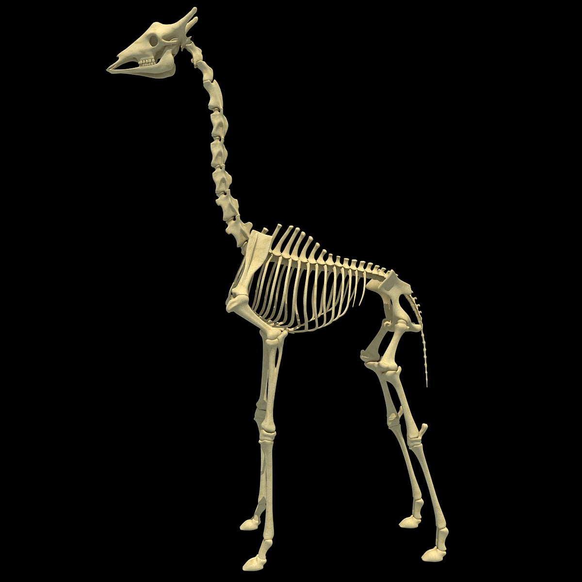
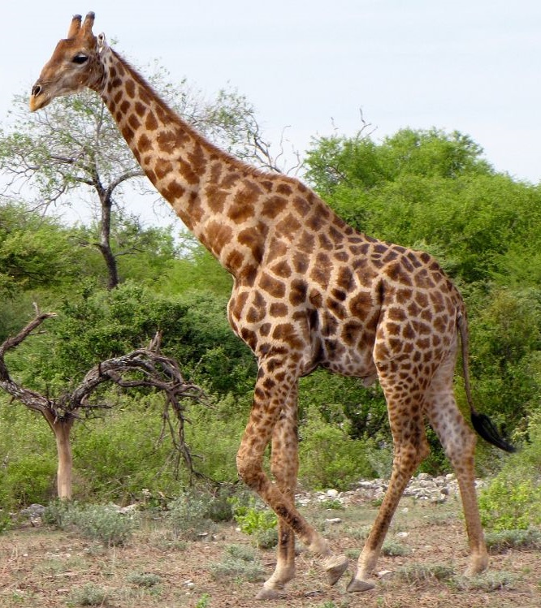
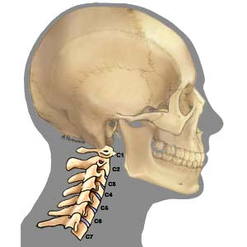
Giraffe vs Human
Object-oriented design ?

Slide 40
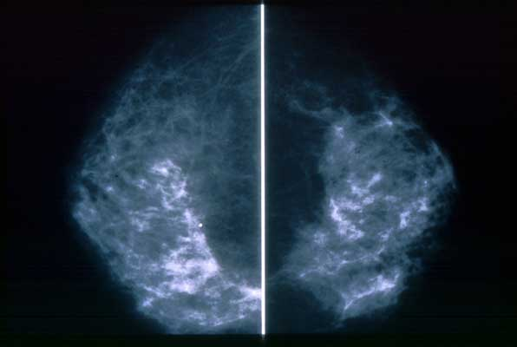
Digital Mammography and
Computer-Aided Diagnosis

Slide 41
Breast Cancer
Breast cancer is second only to lung cancer as a cause of cancer deaths in American women
One out of every seven women were diagnosed with breast cancer in 2007
Fortunately, radical mastectomy (surgical removal) is rarely needed today with better treatment options

Slide 42
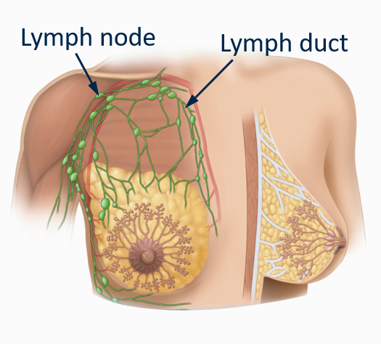
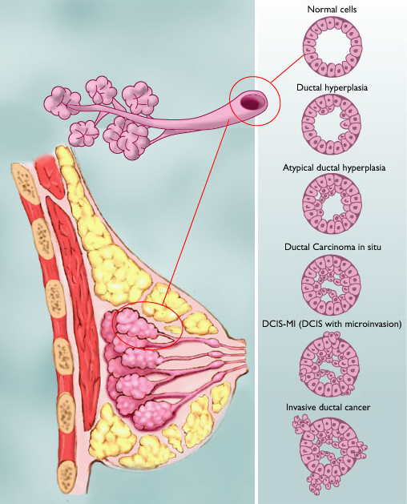
Causes
Cancerous cells divide more rapidly than healthy cells do and may spread through the breast, to the lymph or to other parts of the body (metastasize)
The most common type of breast cancer begins in the milk-production ducts, but cancer may also occur in the lobules or in other breast tissue
A network of vessels
Illustration © Mary K. Bryson
Ductal cancer cells may break through the wall
Notes:
Lymph ducts: Drain fluid that carries white blood cells (that fight disease) from the breast tissues into lymph nodes under the armpit and behind the breastbone
Lymph nodes: Filter harmful bacteria and play a key role in fighting off infection

Slide 43
Computer-Aided Diagnosis
Mammography allows for efficient diagnosis of breast cancers at an earlier stage
Radiologists misdiagnose 10-30% of the malignant cases
Of the cases sent for surgical biopsy, only 10-20% are actually malignant
CAD systems can assist radiologists to reduce the above problems
National Cancer Institute

Slide 44
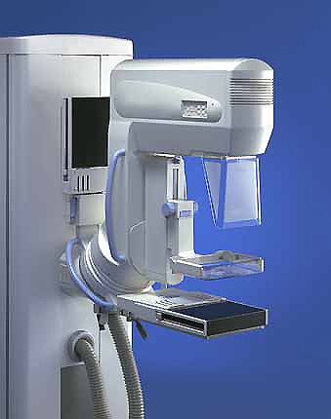
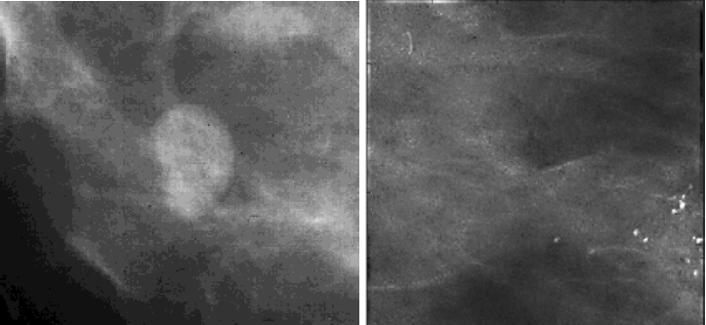
What Mammograms Show
Two of the most important mammographic indicators of breast cancers
  Masses
  Microcalcifications: Tiny flecks of calcium – like grains of salt – in the soft tissue of the breast that can sometimes indicate an early cancer.
1
2

Slide 45
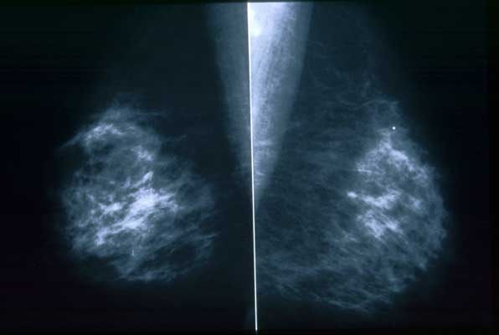
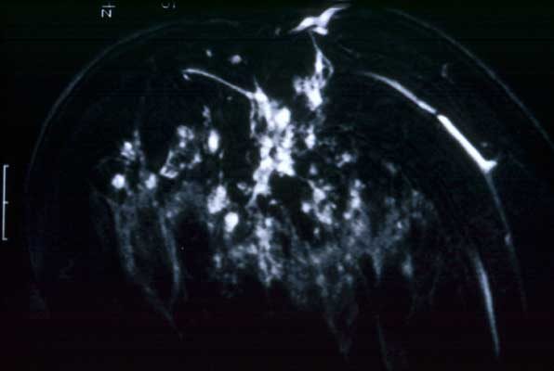
Different Views
Side-to-Side
MRI - Cancer can have a unique
appearance – many small irregular
white areas that turned out to be
cancer (used for diagnosis)
Top-to-Bottom

Slide 46
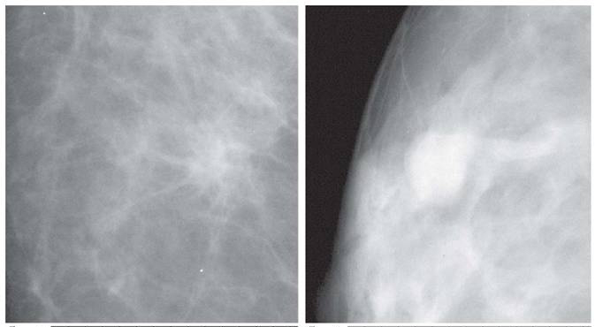
Detection of Malignant Masses
Malignant masses have a more spiculated appearance
benign
malignant

Slide 47
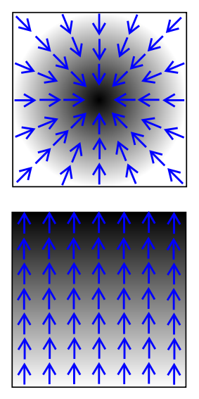
Scalar Field and Gradient
Black representing
Higher values
A scalar field is a n-dimensional space with a scalar value attached to each point in the space (e.g., a gray-scale image)
The derivative of a scalar field results in a vector field called the gradient
  i.e., the gradient is a vector field
    which points in the direction of the greatest rate of increase of the scalar field, and
    whose magnitude is the greatest rate of change

Slide 48
Cartesian Gradient
For an image function I(P) where P is a pixel, the Cartesian gradient at P is:
P
Orientation:
Magnitude:

Slide 49
Radial Gradient
Radial gradient
The radial gradient vector has the same magnitude as the Cartesian gradient vector, but
the orientation is given as:
P

Slide 50
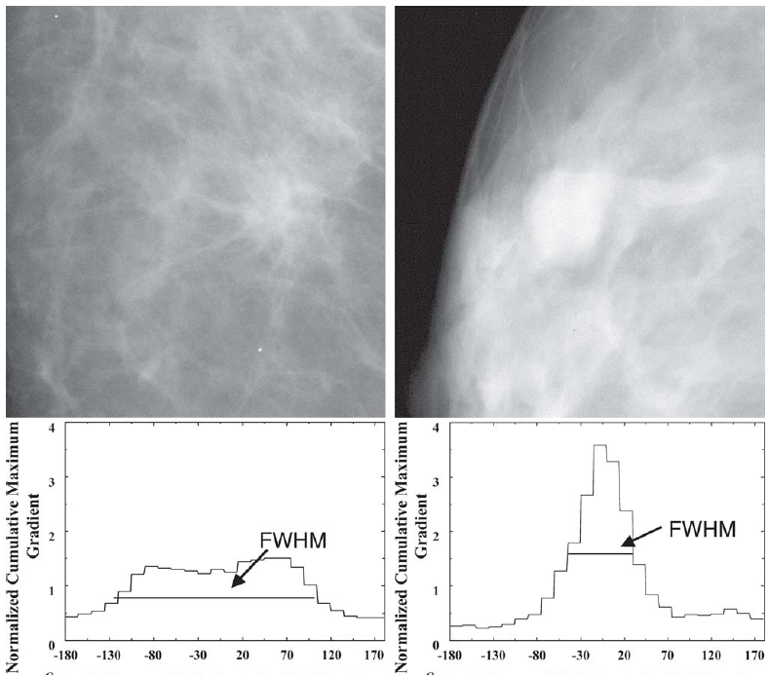
Feature: Spiculation [Huo et al.]
Extract the mass using a region-growing technique
The maximum gradient and its angle relative to the radial direction, i.e., r(P), are computed
Calculate the full-width at half-maximum (FWHM) from the cumulative gradient orientation histogram
more spiculated appearance

Slide 51


Feature: Spiculation [Chan et al.]
Determine the outline of the segmented mass
Obtain the rubber-band-straightening-transformed image
  The spicules become approximately aligned in a similar direction
The rectangular region can then be subjected to texture analysis

Slide 52

Breast Calcifications
Calcifications show up as white spots on a mammogram
Round well-defined, larger calcifications (left column) are more likely benign
Tight cluster of tiny, irregularly shaped calcifications (right column) may indicate cancer

Slide 53
Calcification Features
The morphology of individual calcification, e.g., shape, area, and brightness
The heterogeneity of individual features characterized by the mean, the standard deviation, and the maximum value for each feature.
Cluster features such as total area, compactness

Slide 54

Database Approach to
Computer-Aided Diagnosis
Content-based image retrieval techniques can provide radiologists “visual aids” to increase confidence in their diagnosis
The database consists of a large number of images with verified pathology results
Diagnosis is done by submitting the suspected mass region as a query to retrieve similar cases from the database

Slide 55

A Mammography CAD System
[Giger et al.]
Probability of
malignancy
Similar images of
known diagnosis
Indicates the unknown
lesion relative to all
lesions in the database

