Slide 1
Location-based services
Moving Object Ddatabases
Kien A. Hua
University of Central Florida

Slide 2
Overview
Background - Location-based services & challenges
Range Query in Open Space
Dynamic Range Query in Road Networks
Sensor Approach to Location-based Services

Slide 3
Location-based Services (LBS)
Rapid development and commercialization of
  wireless network technology
  localization technologies
  smart mobile devices
  sensor networks
Location-based Services
Allow users to query their environment and use the spatial data for various purposes

Slide 4
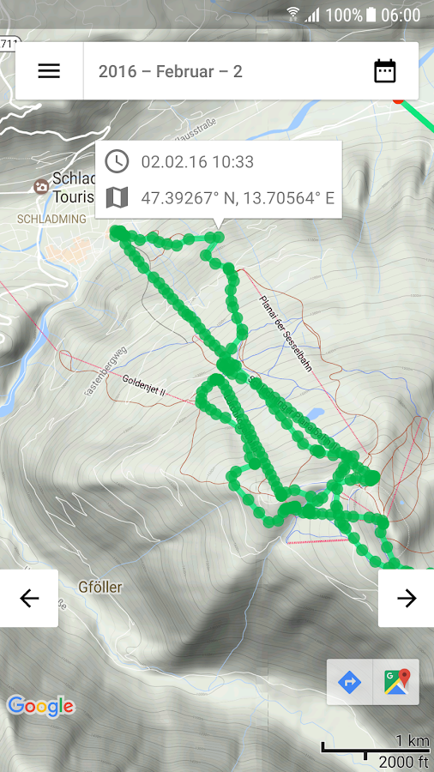
A Simple LBS Example
Integrate a mobile device’s position with other information so as to provide added value to the users.
The phone uploads its GPS coordinates to the LBS server every few seconds.
You can share with friends your location history on a map.

Slide 5
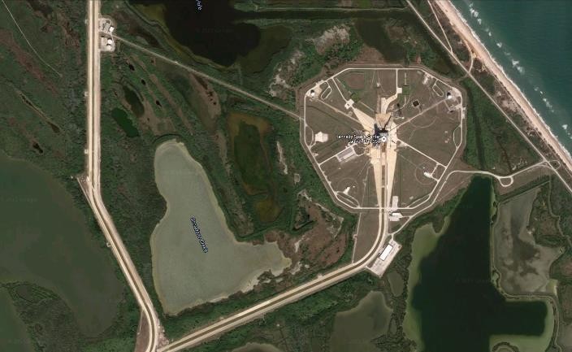






Example 2: Evacuation Management
Look up people still in danger zone
No Response
Jason
Steven
12 people remain in danger zone
MISSING:
12
Not yet respond to the evacuation order

Slide 6

Identify a Person
Identify a person
No Response
Jason
Jason
Steven
MISSING:
12

Slide 7
Call The Person
Call Jason
No Response
Jason
Jason
Steven
MISSING:
12

Slide 8
Spatial Query - Who are still here ?
Query result
People
Amanda
Jason
Mike
Steven
Spatial range query - Find people still in this rectangular area
MISSING:
12

Slide 9
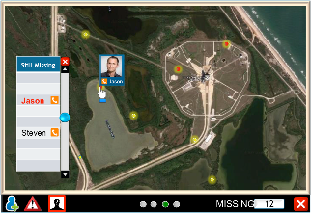


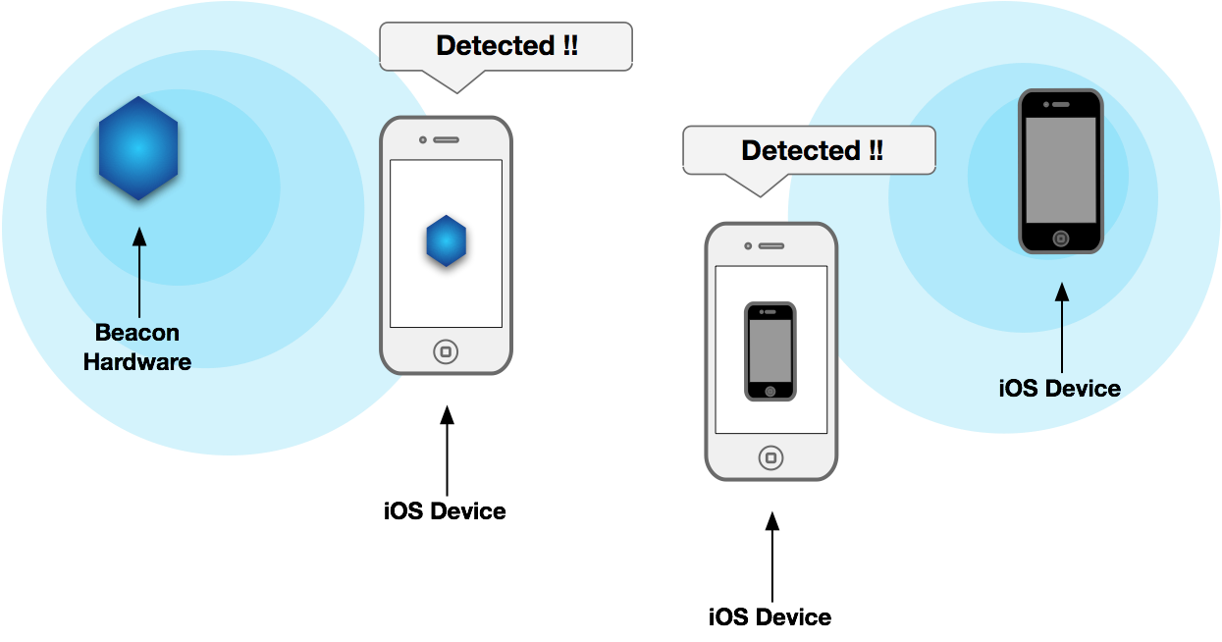
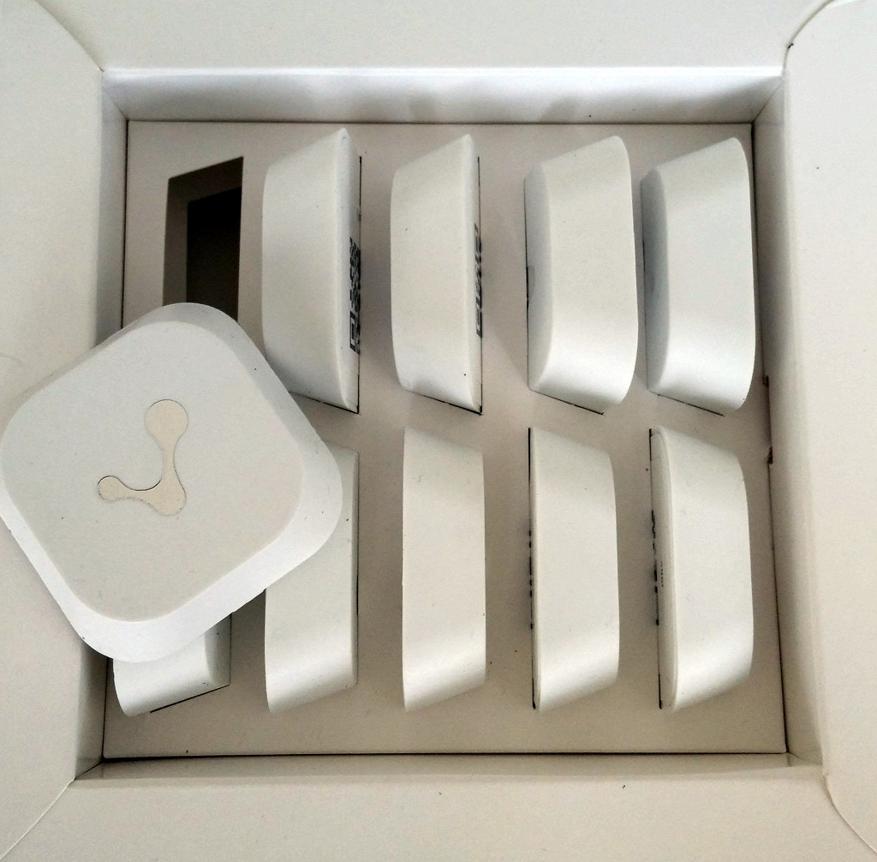


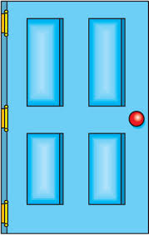
Indoor Positioning Using BLE Beacons
BLE beacon = Bluetooth Low Energy signal
Jessica in Room 229
BLE beacons are small devices which can be mounted on walls
In room 229
229

Slide 10
Range Monitoring Queries in
Location-based Services

Slide 11
Moving Object Database
Moving object database is the core of a location-based service
J
E
G
C
K
F
H
D
L
A
I
B
Range Query
k-NN Query

Slide 12
Location-Based Queries
Two kinds of location-based queries:
  Snapshot queries: “Tell me the 3 nearest cars around me now ”
  Continuous queries: “Monitor 3 nearest restaurants around me for the next 10 minutes ”
Range Monitoring Query (RMQ) is a continuous query

Slide 13
Range-Monitoring Query (RMQ)
  Retrieve mobile objects in a spatial region, and
  continuously monitor the population in the region

Slide 14
RMQ Example
Q₂
a
d
Q₁
e
c
b
f
Query footprint

Slide 15
RMQ Example
Q₂
a
d
Q₁
b
e
c
f

Slide 16
Key Challenges
Server Communication bottleneck
  Very large number of mobile objects repeatedly update their locations
Server Computation bottleneck
  Maintain a very large constantly changing location databases
  Constantly compute many queries
Location uncertainty
  Location of moving objects known when sampled, may have moved by time server processes the queries

Slide 17
Performance Issues
How to minimize location updates ?
  Each update involves mobile communication costs and server processing costs
How to minimize query processing cost ?
  Query results keep changing
Traditional and spatial databases (based on a database snapshot) are not suitable for these tasks

Slide 18
Safe Region
Object does not need to report its location while moving within its “safe” region. Why ?
Query footprint
Rectangular
Safe Region
Q₁
Q₂
Q₅
a
Q₃
Q₄
Circular
Safe Region

Slide 19
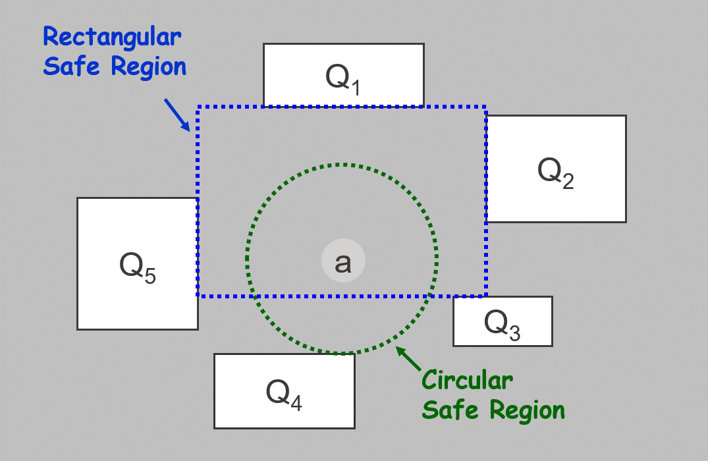
Weaknesses of Safe Regions
Computing a safe region is expensive
  A solution - Using Resident Domain
Adding a new query requires recomputation of safe regions for all objects
  A solution - Using Spatial Index
Notes:
n is the number of queries

Slide 20
MQM - Resident Domain
A mobile object A contacts the server when A
  exits the current resident domain (to report its location for a new resident domain), or
  enters or exits a query in the resident domain (to update the query)
Q₉
Q₁
Q₃
Q₆
Resident Domain
Q₂
A
Q₅
Q₇
Q₄
N = 3
Q₈

Slide 21
Safe Region vs. Resident Domain
Safe Region is relatively smaller, and incurs significantly more communication (location updates) and computation (computing new safe regions)
Q₉
Q₁
Q₃
Q₆
Q₂
Safe region
A
Q₅
Resident domain of
mobile object A
Q₇
Q₄
Q₈

Slide 22
Safe Region vs. Resident Domain
When an object enters a query region, both techniques need to communicate with the server
Q₉
Q₁
Q₃
Q₆
Need to update Q₃
Q₂
Need a new safe region
A
Q₅
Q₇
Q₄
Q₈

Slide 23
Safe Region vs. Resident Domain
Resident Domain: the object tells the server which queries to update
  Distributed processing
Safe Region: The server needs to determine the queries to update given the object location
  Centralized processing
Q₉
Server needs to determine the affected queries and update them accordingly
Q₁
Q₃
Q₆
Need to update Q₃
Q₂
Safe region
A
Q₅
Resident domain of
mobile object A
Q₇
Q₄
Q₈

Slide 24
Determine the Resident Domain
R₂₁ is a monitoring region of Q₂
R₂₂ is the monitoring region of both Q₂ and Q₃
Space is dynamically partitioned into disjoint subdomains
Q₂
Q₂
Q₁
Q₃
R₁
R₂₁
R₂₂
R₃₁
Q₄
R₄₁
R₄₂
R₃₁ is a monitoring region of Q₃
Query Q₂ overlaps query Q₃

Slide 25
Determine the Resident Domain
Q₂
Q₁
Q₃
R₁
R₂₁
R₂₂
R₃₁
a
Q₄
R₄₁
R₄₂
Too small for mobile node a

Slide 26
Determine the Resident Domain
Q₂
Q₁
Q₃
R₁
R₂₁
R₂₂
R₃₁
a
Q₄
R₄₁
R₄₂
Use a larger Resident domain for a, less communication but more local query computation

Slide 27
Domain Decomposition
Suddomains and monitoring regions are maintained using BP-tree (Binary Partitioning Tree)
For each new query,
  Search BP-tree to find subdomains that overlap with the footprint of the query.
  Insert the monitoring regions of the query into their respective subdomain
  Split a subdomain if its number of monitoring regions exceeds the threshold
BP-tree
NewQuery
R₁₁
R₁₂
Two monitoring regions

Slide 28

Domain Decomposition
BP-tree
Queries are indexed as spatial data
NewQuery
R₁₁
R₁₂
Two monitoring regions

Slide 29
BP-tree Example
D
D
domain node
data node
R₁
Q1

Slide 30
BP-tree Example
A subdomain
D
d₁
d₂
d₁
d₂
Q1
There are seven RMQs

Slide 31
BP-tree Example
A subdomain
D
d₁
d₂
d₁
d₂
NewQuery
Q1
R₈₁
R₈₂
Q₈
R₈₁
R₈₂
After inserting Q₈, there are eight RMQs

Slide 32
BP-tree Example
D
NewQuery
d₁
d₂
d₁
d₂
Q₉
R₉₁
d₂₁
d₂₂
Q1
Q₈
R₉₂₁
R₉₂₂
Insert new query Q₉

Slide 33
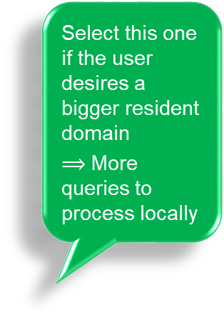
Find Resident Domain for an Object
D
Select this one if the user desires a bigger resident domain
$⟹$ More queries to process locally
Each tree node corresponds to a resident domain
Given the location of an object, descend the tree to select a desired tree node as its new resident domain
The selected tree node spatially contains the object
Note: Tree nodes in the lower level of the tree correspond to smaller resident domains
d₁
d₂
d₃
d₄
d₅
d₆
d₇
Select this one
d₈
d₉
R₁
R₂
R₃
Queries relevant to the resident domain

Slide 34
Advantages over Safe Regions
Resident domains can be determined efficiently (descending the tree instead of computation)
A new query generally affects only a small subtree (easily identify the affected resident domains)
Resident domain are generally much larger resulting in less location updates
Offloads query processing tasks to mobile units
  Distributed processing
  Trading computation for communications to conserve energy

Slide 35
Mobile Communication Cost
30
25
20
Safe Region
15
Number of messages sent by mobile objects (millions)
MQM
10
5
0
10
20
30
40
50
60
70
80
90
100
Number of monitoring queries (thousands)

Slide 36
Server Processing Cost
1000
100
Safe Region
10
MQM
Number of index nodes accessed (millions)
1
0.1
10
20
30
40
50
60
70
80
90
100
Number of monitoring queries (thousands)
Notes:
Safe Region: A spatial index is used to maintain the safe regions. This can be used to quickly identify safe regions that need to be revised given a new query. Every new safe region needs to update this index tree resulting in very expensive update costs.

Slide 37
Resident Domain - Summary
Resident Domain approach is highly scalable in terms of
  Mobile communication costs, and
  Server processing costs
for real-time range monitoring queries

Slide 38



Moving Range Query (in open space)
Defined by a range (e.g., within 5 miles)
Moves in accordance with a specific moving object (e.g., car)
Results include objects (e.g., restaurants, gas stations) currently inside the specified range.
Safe Region and Resident Domain are proposed for stationary queries over moving objects

Slide 39

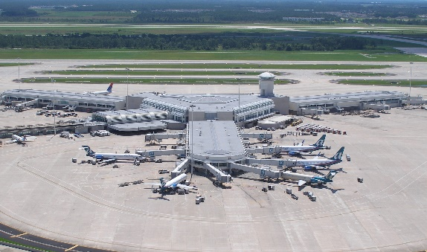
Moving Range Queries Example
Tell me Italian restaurants within 3 miles of my current location
Show me Italian restaurants within 5 miles
Airport

Slide 40

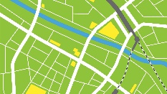

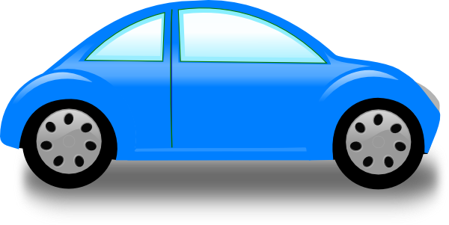
Moving Range Queries Example
Tell me Italian restaurants within 3 miles of my current location
1
2
Process my own query
Your Self Computing Region (SCR) with restaurants
3
    The querying object contacts the server when it moves out of its current SCR

Slide 41


Dynamic Range Query in Spatial Network Environments

Slide 42
Query Properties
Query Mobility: moving vs. stationary
Query Shape: static vs. dynamic
Objects: moving vs. stationary
Environment: open space vs. network
  Open space: dealing with Euclidean distance
  Network: dealing with network distance

Slide 43
Dynamic Range Query (DRQ)
 | Moving Range Query | Dynamic Range Query
Query Mobility | Moving | Moving
Query Shape | Static | Dynamic*
Database Objects | Stationary | Moving
Environment | Network | Network
Complexity | Challenging | More challenging
* Shape of query footprint changes dynamically

Slide 44
Network Distance
Euclidian Distance: Included in the query result
d
Static
Range Query
Network Distance: Not included in the query result
d
Dynamic Range Query

Slide 45
Example – Dynamic Range Query
Give me all the AAA vehicles on service within five miles from me, while I am driving from Orlando to Miami.
How to answer such queries efficiently ?

Slide 46
DRQ - Dynamic Footprint
Query Object

Slide 47
DRQ - Dynamic Footprint

Slide 48
DRQ - Dynamic Footprint

Slide 49
DRQ - Dynamic Footprint

Slide 50
DRQ - Dynamic Footprint

Slide 51
Challenges
Server workload
Communication bandwidth
Limited battery power on client side
Dynamic query footprints
One additional challenge !

Slide 52
System Assumptions
Every moving object is equipped with a positioning device.
Every moving object has some computing capability.
Similar to a smart phone

Slide 53
Modeling Graph
Network
  Undirected graph G = (N, E)
  N: a set of nodes
  E: a set of edges
Edge
  e = <n_{i}, n_{j}>
  i < j
    n_{i}: start node
    n_{j}: end node
n₄ - end node
<n₃, n₄>
n₃ - start node

Slide 54
Edge Distance
Network Distance between two edges
  Four types of edge distance between two distinct edges: d_{SS}, d_{SE}, d_{ES} , and d_{EE}
d_{EE}
d_{SE}
d_{ES}
d_{SS}
Edge distance is the shortest netwrok distance between two edges:
d(e_{i} , e_{j}) = min( (d_{SS}(e_{i} , e_{j}), d_{SE}(e_{i} , e_{j}), d_{ES}(e_{i} , e_{j}), d_{EE}(e_{i} , e_{j}) )

Slide 55

Edge Distance Example
D(n₁n₆ , n₂n₁₀ ) = min (3, 4, 7, 8) = 3
3
2+2
4+3
4+2+2
n₁₀
4
n₂
n₃
5
n₄
2
2
3
n₅
n₆
6
n₁
Q
4
6
7
6
n₉
n₇
n₈

Slide 56
Two Types of Moving Objects
  Query object: the moving object at the spatial center of the dynamic range query
  Data object: other objects
Data object
Query object
Note: Every query object is also a data object to other queries

Slide 57
Report Mobile Status
A moving object is a moving point in the road network
< o, pos, direction, speed, reportTime, IsQuery >
+1 if moving from S-node to E-node
-1, otherwise.
IsQuery = 1 if this object is a query object
Relative position from the start node (S-node) of the current road segment
Speed reported by the mobile object

Slide 58
New Position Estimation
A moving object is a moving point in the road network
< o, pos, direction, speed, reportTime, IsQuery >
  pos = relative position from the S-node (start node)
  direction = +1 if moving from S-node to E-node; -1, otherwise.
  Speed = object speed. Query objects must report new speed
  IsQuery = 1 if the object is a query object
E
+1
o
pos
S
Previous position
Estimate New position of a moving object:
newPos = (currentTime – reportTime) × speed × direction + pos

Slide 59
Object Distance
Four possible network distances between two objects
Network distance
n_{b}
n_{d}
n_{b}
n_{d}
n_{b}
n_{d}
n_{b}
n_{d}
o_{i}
o_{i}
o_{j}
o_{i}
o_{j}
o_{j}
o_{i}
n_{a}
n_{a}
n_{a}
o_{j}
n_{c}
n_{c}
n_{c}
n_{a}
n_{c}
SS
SE
ES
EE
The object distance is the minimum of the four, i.e., the shortest network distance.

Slide 60
Dynamic Range Query (DRQ)
Query has two parameters q = <O_{q} , range>
  O_{q} : query object
  range : the network space within the range distance from O_{q} makes up the query range
Query result all moving objects within the query range (e.g., O_{d} in diagram)
Example
Query object O_{q} &
query range = .5 Km
Query
range
O_{d}
In the
result
range
range
Query
object
O_{q}
Query object
Query result = {o_{i} | o_{i} ≠ o_{q} , d(o_{i} , o_{q}) ≤ range}

Slide 61
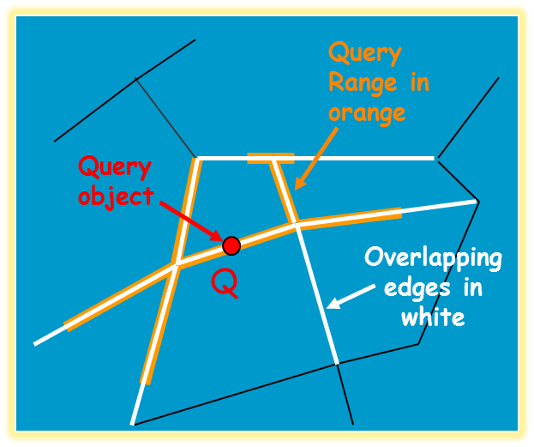
Query Range
The current position of query object Q defines the current query range (orange color)
A query range overlaps with a set of road segments (edges in white)

Slide 62
Monitoring Region
As Q moves along its current road segment E, the set of white segments changes
The spatial union of the aforementioned white segments is the monitoring region for Q w.r.t. E

Slide 63
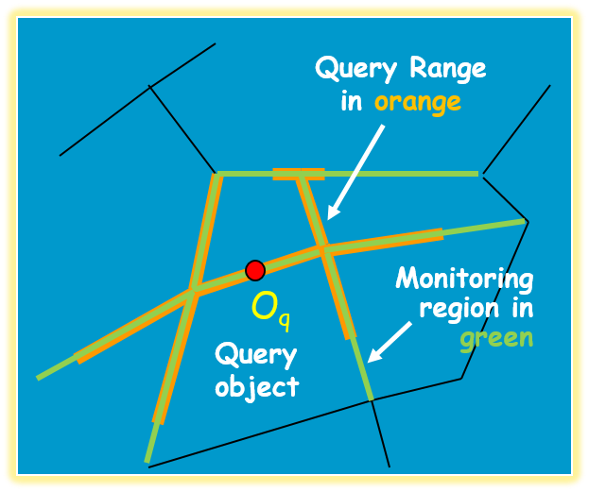
Monitoring Region
As Q moves along its current road segment E, the set of white segments changes
The spatial union of the aforementioned white segments is the monitoring region for Q w.r.t. E
Monitoring Region: The portion of the map relevant to the query while the query object is in its current road segment

Slide 64
Monitoring Region Example
Road segment S_{i}
Time 1 (Entering S_{i})
Time 2 (In S_{i})
Time 3 (Exiting S_{i})
Monitoring region consists of road segments relevant to the query from Time 1 to Time 3 (moving along S_{i})
Spatial union of Times 1-3
Monitoring region w.r.t. S_{i}

Slide 65
Monitoring Region Example
The server first determines the monitoring region for n₁n₆ (i.e., the purple segments within a distance of 5 from n₁n₆), e.g.,
Consider a query object Q moving on edge n₁ n₆ with a query range of 5
D(n₁n₆ , n₂n₁₀ ) = min (3, 4, 7, 8) < 5
n₂n₁₀ is part of the monitoring region
The server then multicasts (to the mobile objects in the monitoring region) the four edge distances from <n₁,n₆> to each of the segments in the monitoring region.
n₁₀
4
n₂
n₃
5
n₄
2
2
3
n₅
<n₁n₆, SS, 0>, <n₁n₆, EE, 0>
n₁
n₆
6
4
Q
<n₁n₂, SS, 0>, <n₁n₈, SS, 0>, <n₁n₉, SS, 0>
6
7
<n₂n₃, SS, 3>, <n₂n₁₀, SS, 3>
6
n₉
n₇
<n₃n₆, EE, 0>, <n₅n₆, EE, 0>, <n₆n₇, SE, 0>
Monitoring region
n₈
<n₂n₃, EE, 2>, <n₃n₄, SE, 2>
The SE-distance from n₁n₆ is 2
<n₁n₂, EE, 4>, <n₂n₁₀, SE, 4>

Slide 66
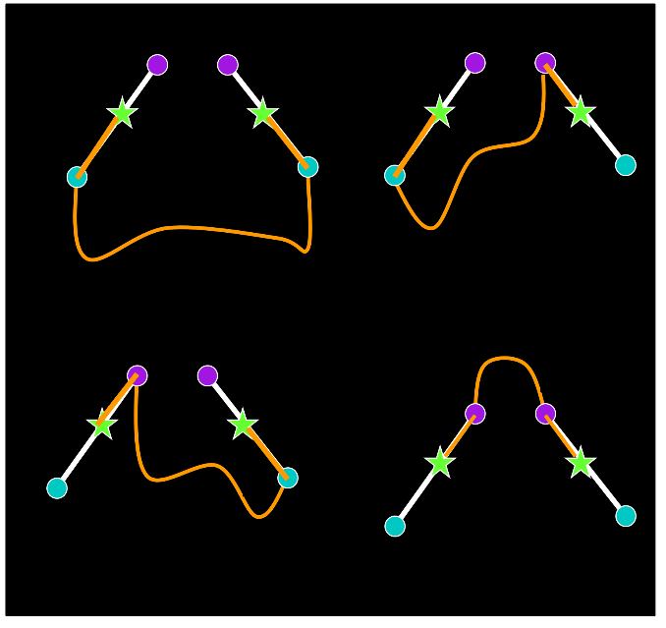
Monitoring Region Example
The server first determines the monitoring region for n₁n₆ (i.e., the purple segments within a distance of 5 from n₁n₆), e.g.,
Consider a query object Q moving on edge n₁ n₆ with a query range of 5
D(n₁n₆ , n₂n₁₀ ) = min (3, 4, 7, 8) < 5
n₂n₁₀ is part of the monitoring region
The server then multicasts (to the mobile objects in the monitoring region) the four edge distances from <n₁,n₆> to each of the segments in the monitoring region.
n₁₀
4
n₂
n₃
5
n₄
2
2
3
n₅
n₁
n₆
6
4
Q
Each mobile object in the monitoring region uses the broadcast data to compute its distance to the query point Q
Mobile objects within 5 length units from Q are part of the current query result
6
7
6
n₉
n₇
Monitoring region
n₈

Slide 67
Processing on Mobile Host (1)
Query object Q /w range = 5, at location 3.6 on edge n₁n_{6.}
Data object D at location 0.5 on edge n₂n₁₀.
Edge distances from <n₁,n₆>
n₁₀
Multicast Message:
E
4
D
S
2
n₃
5
n₄
<n₁n₆, SS, 0> , <n₁n₆, EE, 0>
n₂
6
3
4
2
E
n₅
<n₁n₂, SS, 0>, <n₁n₈, SS, 0>, <n₁n₉, SS, 0>
S
Q
n₆
<n₂n₃, SS, 3>, <n₂n₁₀, SS, 3>
6
n₁
7
<n₃n₆, EE, 0>, <n₅n₆, EE, 0>, <n₆n₇, SE, 0>
6
<n₂n₃, EE, 2>, <n₃n₄, SE, 2>
n₉
n₇
n₈
<n₁n₂, EE, 4>, <n₂n₁₀, SE, 4> , …
Object D picks up only relevant part of the message:
{ <n₂n₁₀, SS, 3> , <n₂n₁₀, SE, 4> , …, object Q ’s information }

Slide 68
Processing on Mobile Host (2)
Query object Q /w Range = 5, at location 3.6 on edge n₁n₆
Data object D at location 0.5 on edge n₂n₁₀
0.4
3.6
n₆
n₁₀
E
4
S
2
n₃
5
n₄
n₁
4.0
D
n₂
6
3
4
2
E
n₅
Object D uses the edge distances received from the multicast to compute its distance to Q
S
Q
n₆
6
n₁
7
6
<n₂n₁₀, SS, 3> <n₂n₁₀, SE, 4>
n₉
n₇
n₈
0.5 + 3 + 3.6
= 7.1 > 5
0.5 + 4 + (4 – 3.6) = 4.9 < 5
Need to know location of Q in n₁n₆

Slide 69
Processing on Mobile Host (2)
Query object Q /w Range = 5, at location 3.6 on edge n₁n₆
Data object D at location 0.5 on edge n₂n₁₀
n₁₀
<n₂n₁₀, SS, 3> <n₂n₁₀, SE, 4>
E
4
D
S
2
n₃
5
n₄
n₂
0.5 + 3 + 3.6
= 7.1 > 5
0.5 + 4 + (4 – 3.6) = 4.9 < 5
3
4
2
E
6
n₅
S
Q
n₆
6
n₁
7
6
d(D,Q) = 4.9 < 5 ⇒ Object D should be included in the query’s result
n₉
n₇
n₈
Object D continues to monitor its distance from Q (by estimating Q’s current positions) and update the query result on the server accordingly

Slide 70
Summary
The server
  computes the monitoring region for each DRQ, and
  multicasts the information to moving objects inside the monitoring region.
Moving object
  uses the information received from the server to monitor if it is inside the query’s range.
  updates the server only when the new location changes the query result (no location update is necessary)
SERVER
Multicast Monitoring region for Q
Q
Update query Q
A
C
B
I am within the range

Slide 71
Simulation Setup
Area of interest
  a square shaped region of 100x100 square miles
  2000 nodes (intersections)
  4000 edges (road segments)
100,000 moving objects
  Speeds vary between 0.5 and 1 mile per time unit
  Initial speeds follow a Zipf distribution with a skew factor of 0.7 (i.e., most have similar speeds)
  Every time step, 10% of the objects change their speed at a small increment
10 to 1,000 queries

Slide 72
Query-Blind Optimal (QBO)
  Compare DRQ to a Query-Blind Optimal (QBO) technique:
    Moving objects send messages to server whenever they change speed or move to a new road segment
      No location update → This scheme incurs very low communication cost (“optimal”)
    Server estimates object locations and update query results.
      Server processes all queries → It can become a bottleneck

Slide 73
Server Communication Cost
Effect of # of queries on server communication cost
Every object constantly updates its location regardless of number of queries.
Objects updates their location when they enter a new road segment or change speed regardless of number of queries.
As number of queries increases, objects have more queries to update their results

Slide 74
Object Communication Cost
Effect of # of queries on object-side communication cost
This cost is distributed among 100,000 objects
Query Blind Optimal - Server Computation Cost is very high

Slide 75
Query Indexing
  Adapted the Query Indexing technique to improve server computation cost for QBO
  Server maintains a list of relevant queries for each road segment E,
      i.e., E is within the monitoring region of these queries
Expensive

Slide 76
Query Indexing - Query Processing
When server receives location update from an object, the server
    determines the segment the object is on
    retrieves the relevant queries using a spatial index
    computes the distances and updates the affected queries.

Slide 77
Server Computation Cost
(#segments loaded per time unit)
100x more I/O operations
Due to server computation
Offloading query processing to mobile nodes greatly reduces server computation cost

Slide 78
Remarks
Use “road segment” as the unit for monitoring regions
Moving objects utilize their own computing power to help reduce server load and save wireless bandwidth
Distributed servers can be used for a very-large deployment, in which case the proposed technique keeps the number of servers low

Slide 79
A Sensor-BASED approach to
Location-based Services

Slide 80
Limitations
To mitigate communication bottleneck at the database server
  Safe Region
  Resident Domain
Limitations
  Communication Cost: still increases with the increases in number of participating objects
  Deployment Cost: is proportional to the number of participating objects
    Objects must be equipped with a GPS, computing device, and communication apparatus

Slide 81
A Challenge
A solution in which the deployment cost and the demand on server bandwidth are fixed regardless of the number of participants is desirable.
Such an approach would be
  less expensive, and
  scalable to support a very large user community

Slide 82
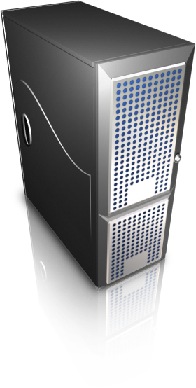
Using Sensors
Sensor-based Location-based Services (SLBS)
  Instead of location updates from the mobile objects, mobile sensors (e.g., RFID readers) report the identities of mobile objects they detect
Two updates instead of 10

Slide 83



SLBS - Advantages
Number of sensors required is proportional to the area of the application terrain, not the number of participants
Demand on server bandwidth is proportional to the number of sensors, not the number of participants
Participants are not required to carry GPS and computing equipment

Slide 84
SLBS - Challenges
Standard LBS approach processes queries based on “precise” locations of moving objects
SLBS processes queries based on the presence of moving objects
  Due to location uncertainty, server must fuse information from multiple sensors to deduct the query results

Slide 85


Standard LBS deals with a Different Kind of Location Uncertainty
Location uncertainty due to communication delay
Some solutions
  Apply dead-reckoning update policy
    Both server and mobile node estimate the new node location using the same algorithm
    If an estimated location deviates from the actual location by a certain threshold, the mobile node updates its location with the server
Car at X
Y
Server
Change location to Y
Car at X
Algorithm
Algorithm

Slide 86
Standard LBS deals with a Different Kind of Location Uncertainty
Location uncertainty due to communication delay
Some solutions
  Apply dead-reckoning update policy
    Both server and mobile node estimate the new node location using the same algorithm
    If an estimated location deviates from the actual location by a certain threshold, the mobile node updates its location with the server
  Update when condition changes
    Assume that objects generally move at constant speed on a known road
    Objects notify server every time there is a change in direction or speed of movement

Slide 87

SLBS Example - RFID
RFID tags and readers
  Passive Tags: Use the radio frequency from the reader to transmit their data signal (i.e.. ID)
  Active Tags: Have on-board battery for power to transmit their data signal.

Slide 88
SLBS Example - RFID
RFID tags and readers
  Passive Tags: Use the radio frequency from the reader to transmit their data signal (i.e.. ID)
  Active Tags: Have on-board battery for power to transmit their data signal.
RFID Readers can detect the identification of mobile objects in the proximity (as opposed to sending location updates from objects to server)
The exact locations of the target objects are not known

Slide 89
CAWA: Continuous Approximate Where-About Queries
A CAWA query is a continuous query that tracks locations of a moving object to determine its whereabouts in the past t time units
The whereabouts of the object are represented by an MBR that encompasses the locations of the query object in the past t time units
Query result Whereabouts in the past 4 time units
t = 4
t = 5
t = 2
t = 1
t = 3

Slide 90
Motivation
Many applications do not demand the precise locations of the objects of interest
Parents want to know if their child is still waiting at school
A student wants to know if a particular book has been returned to the library
A passenger wants to know if the next bus is arriving soon
The army wants to know that the convoy is currently contained within a friendly area

Slide 91
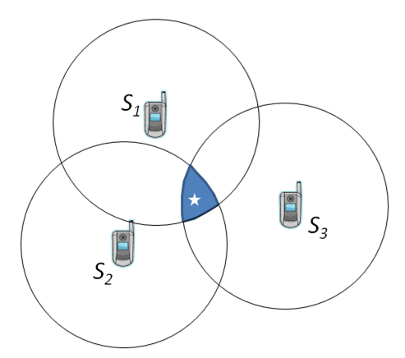
Uncertainty Region
If a target object is detected by one sensor, its uncertainty region is the entire sensing area
If a target object is detected by multiple sensors, its whereabouts can be narrowed down to a small region
Whereabouts
Whereabouts

Slide 92
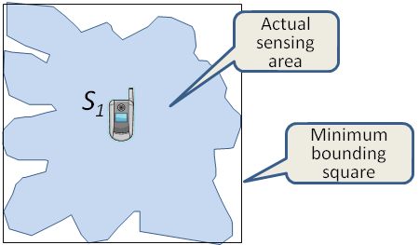
Approximate Sensing Range
Approximating the sensing area with a minimum bounding square

Slide 93
Uncertainty Region
Object detected by a single sensor
Sensing range
Moving object

Slide 94
Uncertainty Region
Object detected by a single sensor
Sensing range
Moving object
Uncertainty region (i.e., whereabouts) equals the sensing range

Slide 95
Uncertainty Region
Object detected by two sensors
Smaller whereabouts means Less uncertainty

Slide 96
Uncertainty Region
Object detected by multiple sensors
Uncertainty reduces rapidly with increases in number of sensors

Slide 97
CAWA: Continuous Approximate Whereabouts Query
Precise Answer
t = 4
t = 5
t = 2
t = 1
t = 3

Slide 98
CAWA Query Processing
Whereabouts
at time 1
CAWA result
at time 2
t = 2
t = 1
Whereabouts
at time 2

Slide 99
CAWA Query Processing
CAWA result at
time 3
t = 2
t = 1
t = 3

Slide 100
CAWA Query Processing
CAWA result at
time 4
t = 4
t = 2
t = 1
t = 3

Slide 101
CAWA Query Processing
CAWA answer
Query Window = 4
t = 4
t = 5
t = 2
t = 1
t = 3

Slide 102
CAWA Query Processing
CAWA answer
Query Window = 4
t = 4
t = 5
t = 5
t = 2
t = 1
t = 3
Next CAWA answer, i.e., whereabouts in the last
5 time units

Slide 103
False Positive
CAWA answer
False positive
t = 4
Precise answer
t = 5
t = 2
t = 1
t = 3

Slide 104
CAWA Algorithm
SensorLocTable | Contains the location of each mobile sensor
QueryTable | Contains current query objects
DedectedObjTable | Contains query objects and their detecting sensors (in the current iteration)
WhereaboutsTable | The whereabouts of each query object Q_{i} for each of the last t_{i} time units (i.e., the last t_{i} whereabouts)

Slide 105
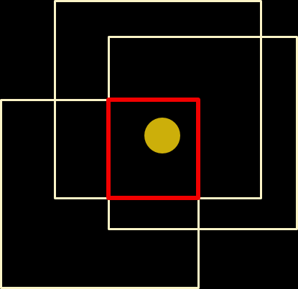
CAWA Algorithm
SensorLocTable | Contains mobile sensor locations
QueryTable | Contains current query objects
DedectedObjTable | Contains query objects and their detecting sensors (in the current iteration)
WhereaboutsTable | The whereabouts of each query object Q_{i} for each of the last t_{i} time units (i.e., the last t_{i} whereabouts)
Locate each query object
Update Whereabouts Table
SensorLocTable
DetectedObjTable
Update Query Results
Query Results
Localization of query object

Slide 106
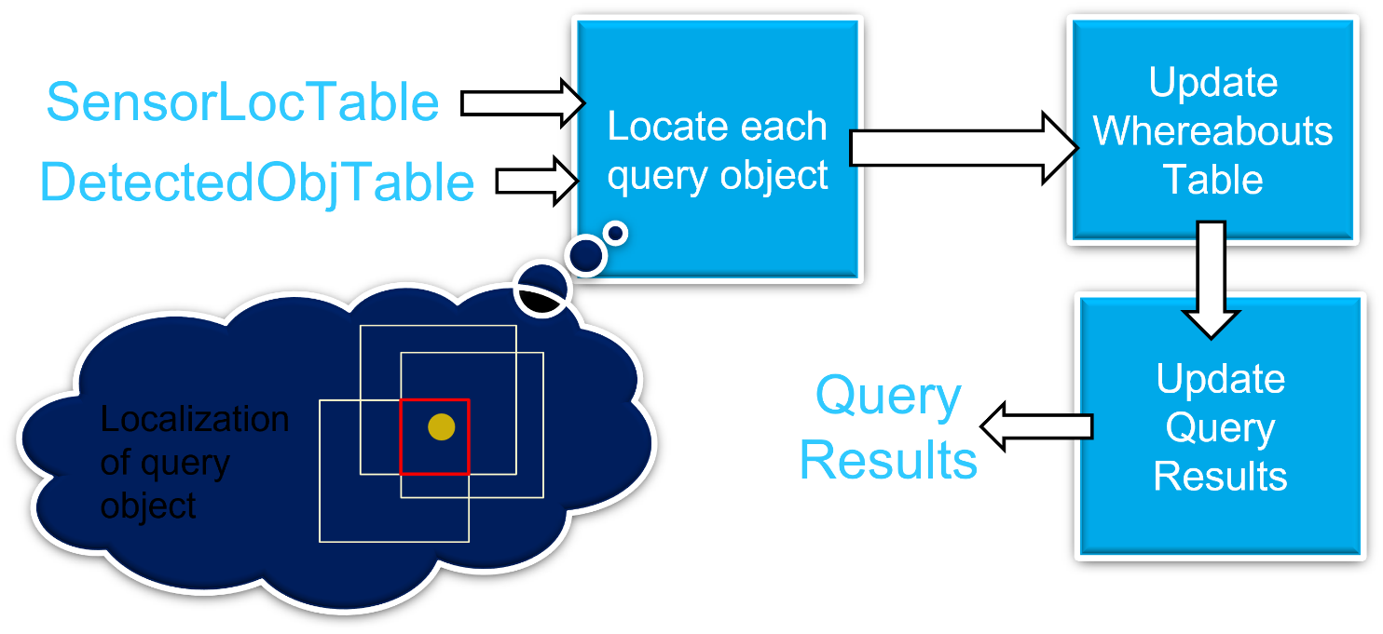
CAWA Algorithm
2
1
3
4
Localization of query object
Periodically, the server performs the following procedure
  Receives updates from sensors, updates SensorLocTable and DetectedObjTable /* location info. for localization
  Update the WhereabotsTable with new whereabouts computed from DetectedObjTable /* Localize query objects
  Scan WhereaboutsTable to compute the query result for each query object Q_{i} by computing the MBR for the whereabouts in the past W_{i} time units.
  Reports new query results to users

Slide 107
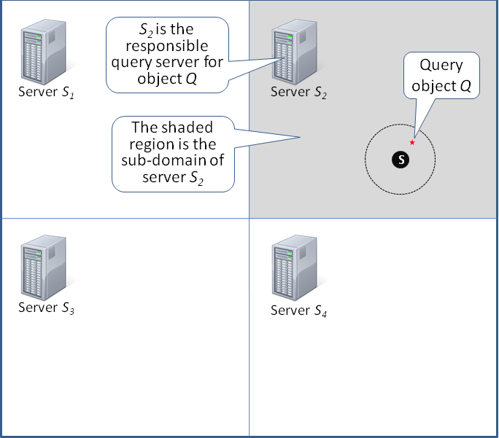
Distributed Processing - Initial Assignment
A query can be submitted to any one of the servers
When a query object leaves the subdomain of its current host server, the server notifies other servers about this missing query
The server that detects the missing query object takes ownership of this new query (query handover)

Slide 108


Distributed Processing - Handover
When a query object is within a threshold of a neighboring subdomain belonging to server S_{i}
  The current server informs S_{i} about the query
  S_{i} activates a timer and expects the query object to cross over by the end of the set time
O on its way to you
Server S_{i}
O

Slide 109

Distributed Processing - Handover
When a query object is within a threshold of a neighboring subdomain belonging to server S_{i}
  The current server informs S_{i} about the query
  S_{i} activates a timer and expects the query object to cross over by the end of the set time
  If S_{i} still does not see the query object when the timer expires, S_{i} can discard this handover request; otherwise S_{i} is elevated to be the new host for this particular query

Slide 110


Performance Study
Metric | Description
TP, true positive | The overlapping area between the CAWA area and the true area (correct answer)
FN, false negative | The area of the true area that is not a part of the TP area
FP, false positive | The CAWA area that is not a part of the TP area
How true is the result
FP
Correct Answer
Query
Result
TP
Percentage of truth retrieved
FN

Slide 111
Parameters - Default Values
Terrain: 200 × 200 m²
Sensing Coverage: 500%
Sensing Range: 2 × 2 m²
Number of mobile nodes: 1,000
Number of queries: 100
Mobility Model: Random Waypoint model
Total simulation time is 1,000 seconds
Query window is 50 seconds
For each iteration, new location of each object is determined randomly and independently of other objects.

Slide 112

Effect of Sensor Coverage
Sensor Coverage

Slide 113


Performance Study
Query
Result
FP
Correct answer
Correct answer
Query
Result
TP
FN
Not enough sensors
$⟹$ large whereabout areas
$⟹$ large CAWA result
$⟹$ good recall, but very bad precision
Increasing number of sensors
$⟹$ better localization result
$⟹$ smaller whereabout areas
$⟹$ more precise CAWA result
$⟹$ precision improves

Slide 114

Effect of Sensor Range
Sensor range too small
$⟹$ Not enough sensors to achieve precise
whereabouts
$⟹$ Large whereabouts result in bad precision
Better precision

Slide 115
Effect of Node Mobility
Moving faster

Slide 116
Effect of relatively slow mobility
CAWA answer
The object moves within some initial where-about area
  A large CAWA answer compared to the correct answer
To address this effect, we need more mobile sensors to better localize mobile objects.
Sensor S₁
Correct answer
Sensor S₂

Slide 117
Conclusions
CAWA is a less expensive framework for location-based services
  Deployment cost is proportional to the area of the application terrain, not the number of participating mobile objects
  Precision and Recall are excellent with adequate sensing coverage (about 300% in our simulation study)
Communication cost is proportional to the number of sensors, not mobile objects.

Slide 118
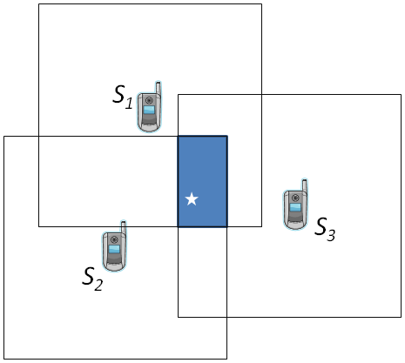
k-NN Query
Object is assumed to be at center of its uncertainty region
3-NN of query O_{k} are T₁ , T₃ , T₄.
Uncertainty region

Slide 119
k-NN Query
Object is assumed to be at center of its uncertainty region
3-NN of query O_{k} are T₁ , T₃ , T₄.
Comparing the query objects against all the objects in the database is very expensive
How do we determine the small number of candidates for k-NN comparisons ?

Slide 120
k-NN Query Processing
Determine the MBR that encloses the sensing ranges of all sensors that detect the query object
MBR
S₁
S₂
Q
S₃

Slide 121

k-NN Query Processing
Determine the MBR that encloses the sensing ranges of all sensors that detect the query object
Count number of objects, O_{MBR} , detected inside the MBR
Compute area per object (i.e., inverse of density):
MBR
S₁
S₂
Q
S₃

Slide 122
k-NN Query Processing
Determine query area:
Determine dimensions of initial query area S×S:
Expand the query area, centered at query object, if there are less than k objects inside
Determine the k-NN from the set of objects inside the query area
SxS square query area
S₁
S₂
Q
S₃

Slide 123
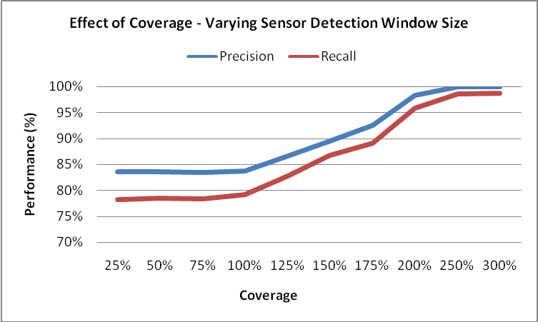
Performance

