Slide 1
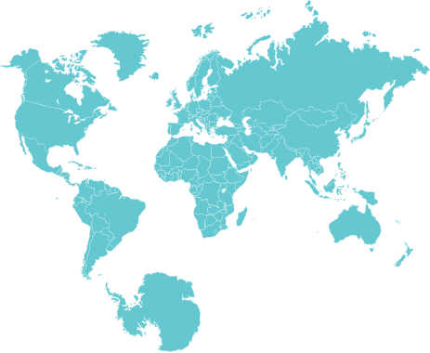
Distributed Database Systems
COP5711

Slide 2
Outline
Introduction
Distributed Database Architectures
Distributed Database Design
Query Processing

Slide 3
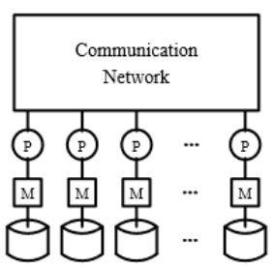
What is a Distributed Database System ?
A distributed database is a collection of databases which are distributed over different computers of a computer network.
Each site has autonomous processing capability and can perform local applications.
Each site also participates in the execution of at least one global application which requires accessing data at several sites.
Shared-Nothing System
Local application
Global application
No local applications

Slide 4
Replication & Fragmentation Transparency
The user is unaware of the replication of fragments
Queries are specified on the relations (rather than the fragments).
Applications do not need to know this
Data fragments
Copy 1 of R1
Site A
Relation R
Copy 1 of R2
Fragment R1
Copy 2 of R1
Site B
Applications see only
the relations
Fragment R2
Fragment R3
Fragment R4
Site C
Copy 2 of R2

Slide 5
Why Distributed Databases ?
Local Autonomy: permits setting and enforcing local policies regarding the use of local data (suitable for organization that are inherently decentralized).
Improved Performance: The regularly used data is proximate to the users and given the parallelism inherent in distributed systems.
Improved Reliability/Availability:
  Data replication can be used to obtain higher reliability and availability.
  The autonomous processing capability of the different sites ensures a graceful degradation property.
Incremental Growth: supports a smooth incremental growth with a minimum degree of impact on the already existing sites.
Shareability: allows preexisting sites to share data.
Reduced Communication Overhead: The fact that many applications are local clearly reduces the communication overhead with respect to centralized databases.

Slide 6
Distributed DBMS Architecture

Slide 7
ANSI/SPARC Architecture
CREAT VIEW …
External Schema
External view
External view
External view
Conceptual Schema
Conceptual view
CREAT TABLE …
Internal Schema
Internal view
B⁺-tree Index …
Internal view: deals with the physical definition and organization of data.
Conceptual view: abstract definition of the database. It is the “real world” view of the enterprise being modeled in the database.
External view: individual user’s view of the database.

Slide 8
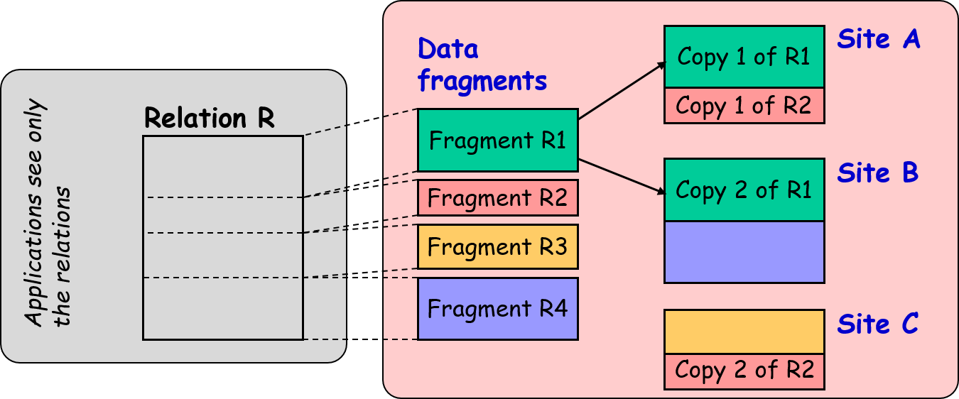
Distributed Data Systems
Simplify software development
A distributed database can be defined as
a logically integrated collection of shared data which is
physically distributed across the nodes of a computer network.
Improve system performance
Physically distributed
Logically integrated

Slide 9
A Taxonomy of Distributed Data Systems
Distributed data systems
No local user
Heterogeneous
(Multidatabase)
Homogeneous
Loosely coupled
(interoperable DB
systems using
export schema)
Tightly coupled
(/w global schema)

Slide 10
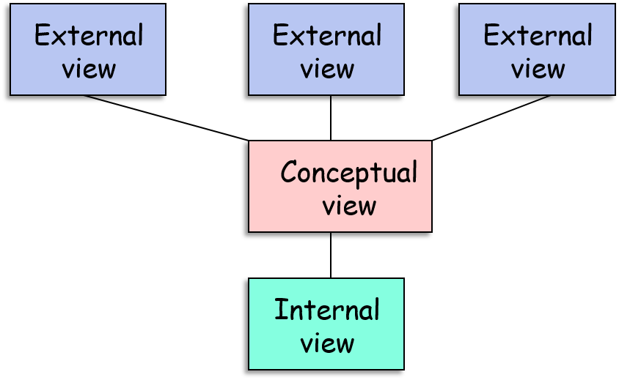
Architecture of a Homogeneous DDBMS
Global user view 1
. . .
Global user view n
A homogeneous DDBMS resembles a centralized DB, but instead of storing all the data at one site, the data is distributed across a number of sites in a network.
Global Schema
Fragmentation
Schema
Allocation
Schema
Local conceptual schema 1
Local conceptual schema n
Local internal schema 1
Local internal schema n
Local DB 1
Local DB n

Slide 11
Deployment: Homogeneous DDBMS
Global
user view
1
...
Global
user view
n
Global
user view
1
...
Global
user view
n
Global
user view
1
...
Global
user view
n
Global Schema
Global Schema
Global Schema
Fragmentation
Schema
Fragmentation
Schema
Fragmentation
Schema
Allocation
Schema
Allocation
Schema
Allocation
Schema
NETWORK
Local internal schema 1
Local internal schema 1
Local internal schema 1
Local DB 1
Local DB 2
Local DB 3
Location 1
Location 2
Location 3

Slide 12
Homogeneous DDBMS: Local Application
Global
user view
1
...
Global
user view
n
Global
user view
1
...
Global
user view
n
Global
user view
1
...
Global
user view
n
Global Schema
Global Schema
Global Schema
Fragmentation
Schema
Fragmentation
Schema
Fragmentation
Schema
Allocation
Schema
Allocation
Schema
Allocation
Schema
Local internal schema 1
Local internal schema 1
Local internal schema 1
Local DB 1
Local DB 2
Local DB 3
Location 1
Location 2
Location 3

Slide 13
Homogeneous DDBMS: Global Application
Global
user view
1
...
Global
user view
n
Global
user view
1
...
Global
user view
n
Global
user view
1
...
Global
user view
n
Global Schema
Global Schema
Global Schema
Fragmentation
Schema
Fragmentation
Schema
Fragmentation
Schema
Allocation
Schema
Allocation
Schema
Allocation
Schema
Local internal schema 1
Local internal schema 1
Local internal schema 1
Local DB 1
Local DB 2
Local DB 3
Location 1
Location 2
Location 3

Slide 14
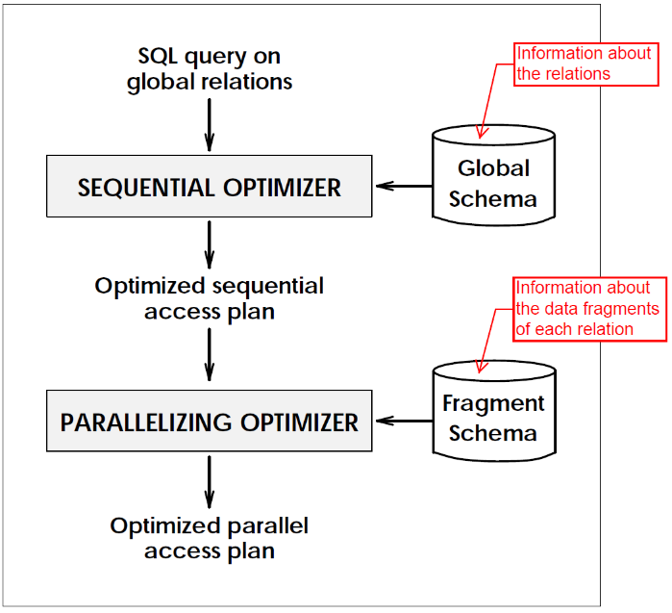
Homogeneous DDBMS vs. Shared Nothing
Global
user view
1
...
Global
user view
n
Global
user view
1
...
Global
user view
n
Global
user view
1
...
Global
user view
n
Global Schema
Global Schema
Global Schema
Fragmentation
Schema
Fragmentation
Schema
Fragmentation
Schema
Allocation
Schema
Allocation
Schema
Allocation
Schema
NETWORK
Local internal schema 1
Local internal schema 1
Local internal schema 1
Local DB 1
Local DB 2
Local DB 3
Location 1
Location 2
Location 3

Slide 15
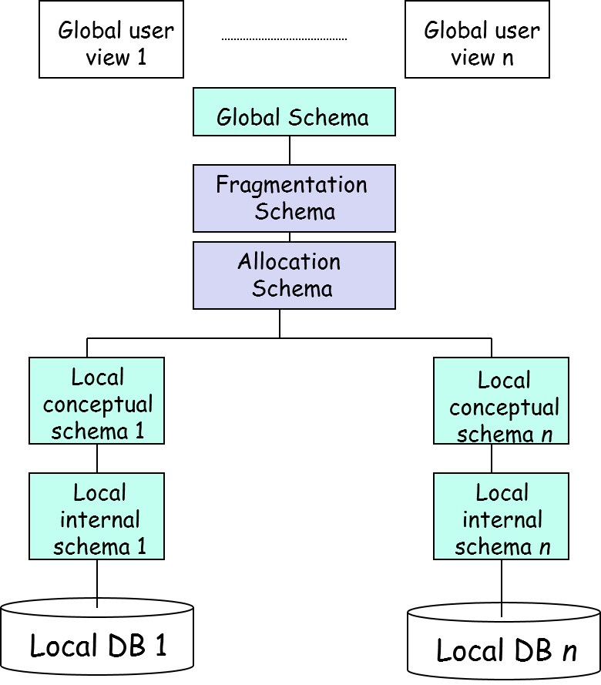

Fragmentation Schema & Allocation Schema
Fragmentation Schema: describes how the global relations are divided into fragments.
Allocation Schema: specifies at which sites each fragment is stored.
Allocation
Copy 1 of R1
Site A
Fragmentation
Relation R
Copy 1 of R2
Fragment R1
Applications see only
the relations
(global schema)
Copy 2 of R1
Site B
Fragment R2
Fragment R3
Fragment R4
Site C
Copy 2 of R2

Slide 16



Homogeneous vs. Heterogeneous
Global users
Homogeneous DDBMS
  No local users
  Most systems do not have local schemas (i.e., every user uses the same schema)
Heterogeneous DDBMS
Homogeneous
Database management
system
DBMS
DBMS
DBMS
DBMS

Slide 17


Homogeneous vs. Heterogeneous
Homogeneous DDBMS
  No local users
  Most systems do not have local schemas (i.e., every user uses the same schema)
Heterogeneous DDBMS
  There are both local and global users
  Multidatabase systems are split into:
    Tightly Coupled Systems: have a global schema
    Loosely Coupled Systems: do not have a global schema.
Global
user
Multidatabase
Management
system
Local
user
Local
user
DBMS
DBMS
DBMS
DBMS

Slide 18
Schema Architecture of a Tightly-Coupled System
. . .
Global user view 1
Global user view n
An individual node’s participation in the MDB is defined by means of a participation schema.
Global Conceptual Schema
Auxiliary Schema 1
Local Participation Schema 1
Local Participation Schema n
Auxiliary Schema 1
Local user view 1
. . .
Local Conceptual Schema 1
Local Conceptual Schema n
Local user view 1
Local user view 2
Local Internal Schema 1
Local Internal Schema n
Local user view 2
Local DB 1
Local DB n

Slide 19
Auxiliary Schema (1)
Auxiliary schema describes the rules which govern the mappings between the local and global levels.
Rules for unit conversion: may be required when one site expresses distance in kilometers and another in miles, …
Rules for handling null values: may be necessary where one site stores additional information which is not stored at another site.
  Example: One site stores the name, home address and telephone number of its employees, whereas another just stores names and addresses.

Slide 20
Auxiliary Schema (2)
Rules for naming conflicts: naming conflicts occur when:
  semantically identical data items are named differently
    DNAME → Department name (at Site 1)
    DEPTNAME → Department name (at Site 2)
  semantically different data items are named identically.
    NAME → Department name (at Site 1)
    NAME → Manager name (at Site 2)
Rules for handling data representation conflicts: Such conflicts occur when semantically identical data items are represented differently in different data source.
  Example: Data represented as a character string in one database may be represented as a real number in the other database.

Slide 21
Auxiliary Schema (3)
Rules for handling data scaling conflicts: Such conflicts occur when semantically identical data items stored in different databases using different units of measure.
  Example: “Large”, “New”, “Good”, etc.
These problems are called
domain mismatch problems

Slide 22
Loosely-Coupled Systems
(Interoperable Database Systems)
No global conceptual schema
Global
user view 1
Global
user view 2
Global
user view 3
Local
user view 1
Local
Conceptual
schema 1
Local
Conceptual
Schema 2
Local
Conceptual
Schema n
Local
user view 2
Local
internal
schema 1
Local
internal
Schema 2
Local
internal
Schema n
Local DB 1
Local DB 2
Local DB n

Slide 23
Loosely-Coupled Systems
No global conceptual schema
Global
user view 1
Global
user view 2
Global
user view m
Interoperable DB system using export schema
Export
schema 1
Export
schema 2
Export
Schema 3
Export
Schema n
Local
user view 1
Local
Conceptual
schema 1
Local
Conceptual
Schema 2
Local
Conceptual
Schema n
Local
user view 2
Local
internal
schema 1
Local
internal
Schema 2
Local
internal
Schema n
Local DB 1
Local DB 2
Local DB n

Slide 24
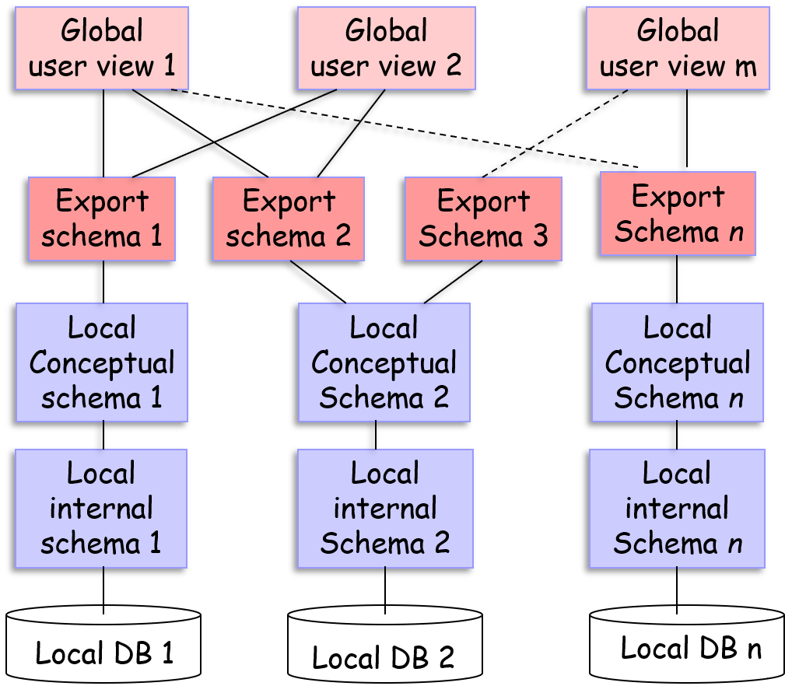
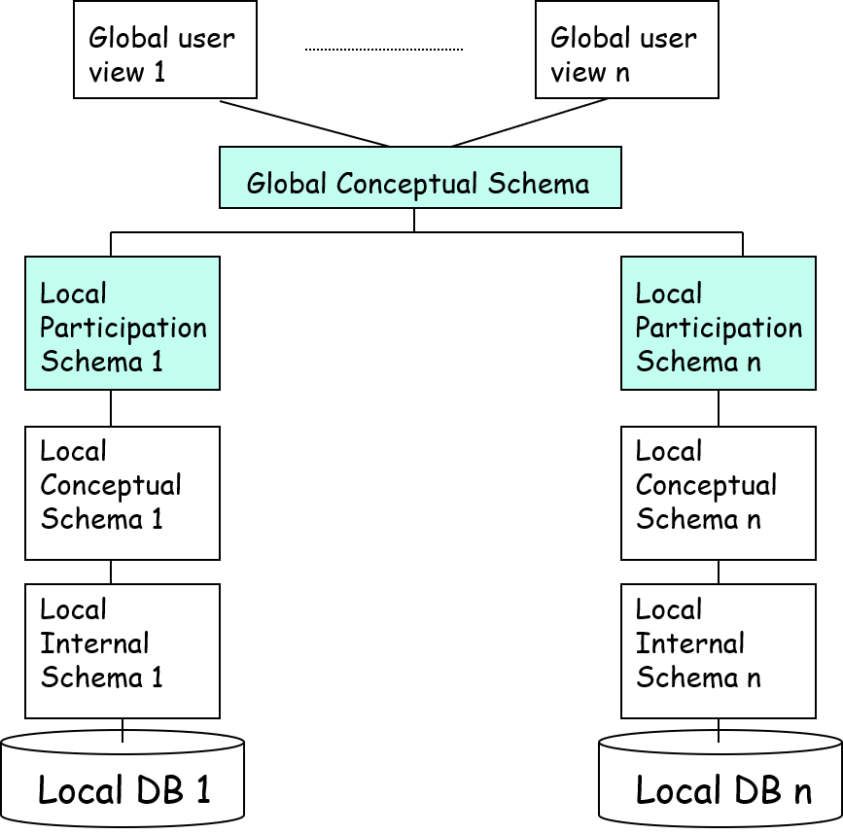
Loosely Coupled vs. Tightly Coupled
No global conceptual schema

Slide 25
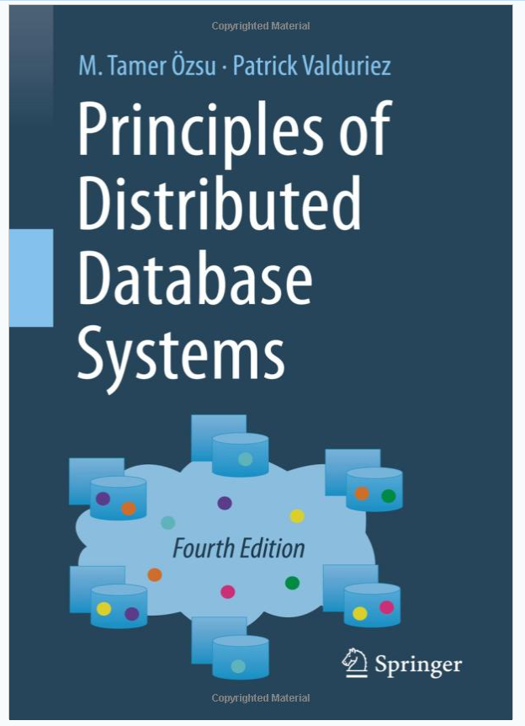
A Book on Distributed DB
2020 edition
ISBN-13: 978-3030262525
ISBN-10: 3030262529

Slide 26


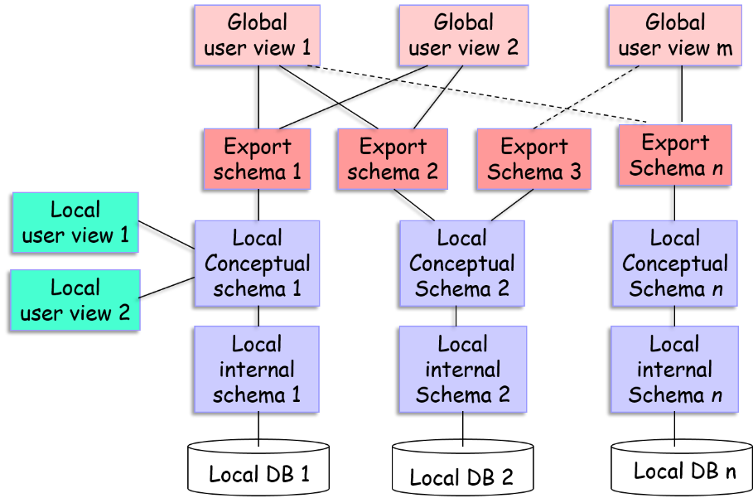
Distributed Database Design
Top-Down Approach: The database system is being designed from scratch.
  Issue: fragmentation & allocation
Bottom-up Approach: Integrating existing databases into one database
  Issue: Design of the export and global schemas.

Slide 27
Fragmentation Alternatives
J
JNO JNAME BUDGET LOC
J1 Instrumental 150,000 Montreal
J2 Database Dev. 135,000 New York
J3 CAD/CAM 250,000 New York
J4 Maintenance 350,000 Paris
Horizontal Partitioning
Vertical Partitioning
J1
JNO JNAME BUDGET LOC
J1 Instrumental 150,000 Montreal
J2 Database Dev. 135,000 New York
JNO BUDGET
J1 150,000
J2 135,000
J3 250,000
J4 350,000
J2
JNO JNAME BUDGET LOC
J3 CAD/CAM 250,000 New York
J4 Maintenance. 350,000 Paris
JNO JNAME LOC
J1 Instrumentation Montreal
J2 Database Dev. New York
J3 CAD/CAM New York
J4 Maintenance Paris
Must ensure lossless join

Slide 28
Why fragment at all?
Reasons:
  Interquery concurrency: Executing multiple queries on different fragments simultaneously
  Intraquery concurrency: Executing multiple subqueries of a query on different fragments simultaneously
Query 1
Query 2
Intraquery concurrency
Interquery concurrency
Query 1.1
Query 1.2
F1
F2
F3
F4
F4
F5
Data Fragments at different locations

Slide 29

Degree of Fragmentation
Employee
Application views are usually subsets of relations, e.g.,
SELECT E.Eno
FROM Employee E
Where E.Salary > 500000
/* Subset of Employee
It is only natural to consider subsets of relations as distribution units.
The appropriate degree of fragmentation is dependent on the applications.
A distribution unit
Salary > 500000
Very popular at location i
Query
A distribution unit
40 tuples

Slide 30
Simple Predicates
Given a relation R(A₁, A₂, …, A_{n}) where A_{i} has domain D_{i}, a simple predicate p_{j} defined on R has the form
  p_{j}: A_{i} Value
  where
and Value
Example:
J
JNO JNAME BUDGET LOC
J1 Instrumental 150,000 Montreal
J2 Database Dev. 135,000 New York
J3 CAD/CAM 250,000 New York
J4 Maintenance 350,000 Orlando
p₂
A simple predicate defines a data fragment
Simple predicates:
p₁: JNAME = “Maintenance”
P₂: BUDGET < 200,000

Slide 31
MINTERM PREDICATE
Given a set of simple predicates for relation R.
  P = {p₁, p₂, …, p_{m}}
The set of minterm predicates
  M = {m₁, m₂, …, m_{n}}
is defined as
  M = {m_{i} | m_{i} = }
  where
Employee
NAME | TITLE | SAL
Brandon | Elect. Eng. | 40,000
Kacey | Syst. Analy. | 54,000
Jacob | Mech. Eng. | 32,000
Kevin | Programmer | 42,000
Possible simple predicates:
P₁: TITLE=“Elect. Eng.”
P₂: TITLE=“Syst. Analy”
P₃: TITLE=“Mech. Eng.”
P₄: TITLE=“Programmer”
P₅: SAL ≤ 35,000
P₆: SAL > 35,000
Some corresponding minterm predicates:
A minterm predicate defines
a data fragment

Slide 32
MINTERM PREDICATE
Given a set of simple predicates for relation R.
  P = {p₁, p₂, …, p_{m}}
The set of minterm predicates
  M = {m₁, m₂, …, m_{n}}
is defined as
  M = {m_{i} | m_{i} = }
  where
Employee
NAME | TITLE | SAL
Brandon | Elect. Eng. | 40,000
Kacey | Syst. Analy. | 54,000
Jacob | Mech. Eng. | 32,000
Kevin | Programmer | 42,000
Some corresponding minterm predicates:
SELECT *
FROM Employee
WHERE Title = “Elect.Eng.”
AND SAL > 30,000
Query predicate is a minterm predicate
A minterm predicate defines
a data fragment

Slide 33
Primary Horizontal Fragmentation
A primary horizontal fragmentation is defined by a selection operation on the relation
A possible fragmentation of J is defined as follows:
E
ENO ENAME TITLE
J
JNO JNAME BUDGET LOC
L₂
L₃
G
ENO JNO RESP DUR

Slide 34
Horizontal Fragments
Thus, a horizontal fragment R_{i} of relation R consists of all the tuples of R that satisfy a minterm predicate m_{i}
Example: Salary > 100000 Λ Age < 20
RELATION
There are as many horizontal fragments (also called minterm fragments) as there are minterm predicates.
Minterm fragment
Minterm fragment
Minterm fragment
Minterm fragment
Minterm fragment

Slide 35
Completeness: Scenario 1
Simple Predicates Minterm Fragments Applications
A₁ ≥ k₁
A₂ = k₂
A₃ ≤ k₃
A₄ = k₄
p₁
F₁
App₁
p₁
p₃
App₂
F₂
p₃
App₃
F₃
p₄
Pr
App₄
p₄
App₁ accesses F₁ with probability p₁. When it accesses F₁, it retrieves all tuples in F₁

Slide 36
Completeness: Scenario 1
Simple Predicates Minterm Fragments Applications
A₁ ≥ k₁
A₂ = k₂
A₃ ≤ k₃
A₄ = k₄
p₁
F₁
App₁
p₁
p₃
App₂
F₂
p₃
App₃
F₃
p₄
Pr
App₄
p₄
Complete ⇒ The fragments look homogeneous (i.e., accessed with the same probability) to any of the applications

Slide 37

Completeness: Scenario 2
Simple Predicates Minterm Fragments Applications
A₁ ≥ k₁
A₂ = k₂
A₃ ≤ k₃
A₄ = k₄
p₁
F₁
App₁
p₁
p₃
App₂
F₂
p₃
App₃
F₃
p₄
App₄
SELECT …
FROM …
WHERE A₅ > k₅
p₅
?
A5 was not considered
Not homogeneous
$⟹$ Incomplete !!

Slide 38


Completeness: Scenario 2
Simple Predicates Minterm Fragments Applications
A₁ ≥ k₁
A₂ = k₂
A₃ ≤ k₃
A₄ = k₄
A₅ < k₅
p₁
F₁
App₁
p₁
p₃
App₂
F₂
p₃
App₃
F₃
F₃₁
p₄
App₄
A₅ < k₅
p₅
F₃₂
Additional simple predicate
A₅ ≥ k₅
Now complete !

Slide 39
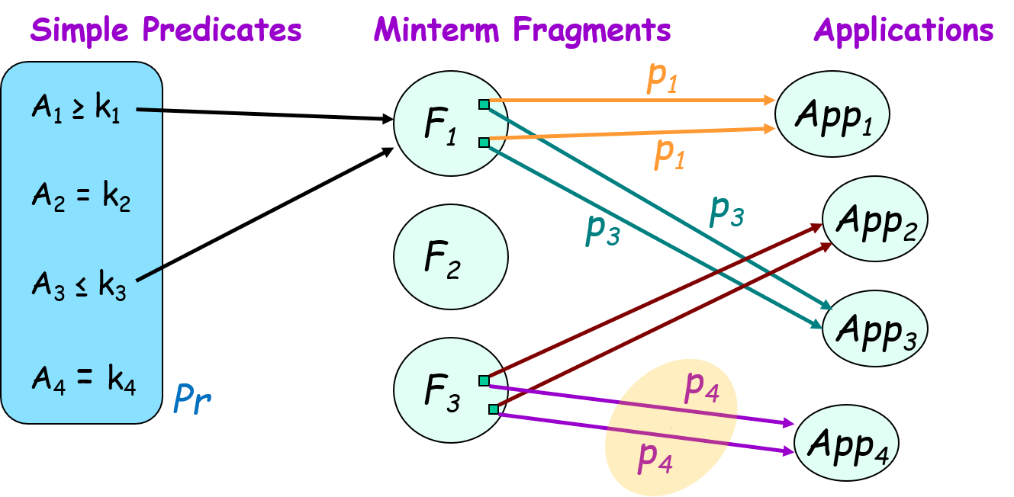
Completeness
A set of simple predicate Pr is said to be complete if and only if there is an equal probability of access by every application to any two tuples belonging to any minterm fragment that is defined according to Pr.

Slide 40
Completeness Example 1
Case 1: The only application that accesses J wants to access the tuples according to the location.
The set of simple predicates
LOC=“Montreal”, Pr = LOC=“New York”,
LOC=“Orlando”
Horizonal fragmentation
LOC=“Montreal”
J₁
30%
J
LOC=“New York”
30%
is complete because the application retrieve the entire fragment given the “WHERE” clause.
J₂
40%
Application
40%
J₃
30%
LOC=“Orlando”
30%

Slide 41
Completeness Example 2
Example:
LOC=“Montreal”,
Pr = LOC=“New York”,
LOC=“Orlando”
J1
JNO JNAME BUDGET LOC
001 Instrumental 150,000 Montreal
JNO JNAME BUDGET LOC
004 GUI 135,000 New York
007 CAD/CAM 250,000 New York
Application 1
Budget < $200,000
J2
J3
Application 2
JNO JNAME BUDGET LOC
003 Database Dev. 310,000 Orlando
Not homogeneous
Case 2: There is a second application which accesses only those project tuples where the budget is less than $200,000.
  Since tuple “004” is accessed more frequently than tuple “007” by this application, Pr is not complete.
  To make the set of simple predicates complete, we need to add (BUDGET< 200,000) to Pr.

Slide 42
Completeness Example 2
Example:
LOC=“Montreal”,
Pr = LOC=“New York”,
LOC=“Orlando”
J1
JNO JNAME BUDGET LOC
001 Instrumental 150,000 Montreal
JNO JNAME BUDGET LOC
004 GUI 135,000 New York
007 CAD/CAM 250,000 New York
Application 1
Small-budget projects
J2
J3
Application 2
JNO JNAME BUDGET LOC
003 Database Dev. 310,000 Orlando
Not homogeneous
The set of simple predicates should include
“BUDGET” !

Slide 43

Completeness Example 2
BUDGET<=200,000
J₁₁
LOC=“Montreal”
J₁
J₁₂
BUDGET>200,000
Homogeneous again
J
LOC=“New York”
BUDGET<=200,000
J₂
Small-budget projects in New York
J₂₁
LOC=“Orlando”
J₂₂
J₃
BUDGET>200,000
BUDGET<=200,000
J₃₁
J₃₂
BUDGET>200,000

Slide 44
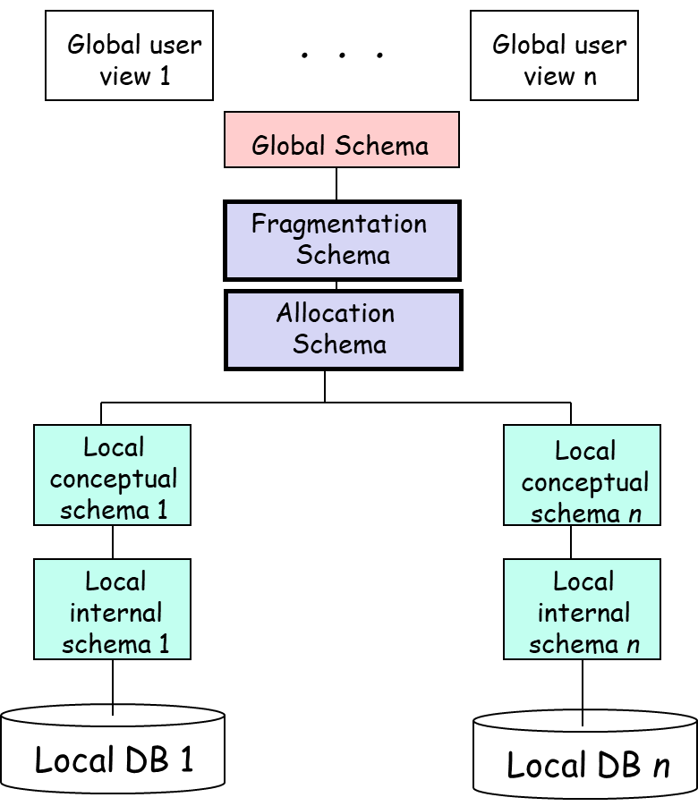
Completeness Example 2
Homogeneous
This makes data allocation easier
Completeness is a desirable property because a complete set defines fragments that are not only logically uniform (in that they all satisfy the minterm predicate), but statistically homogeneous.

Slide 45





Redundant Fragmentation
I want only apples
I also want the other basket
Too much fragmentation !
Fragment 1
Logically uniform & statistically homogeneous fragment
Fragment 2

Slide 46
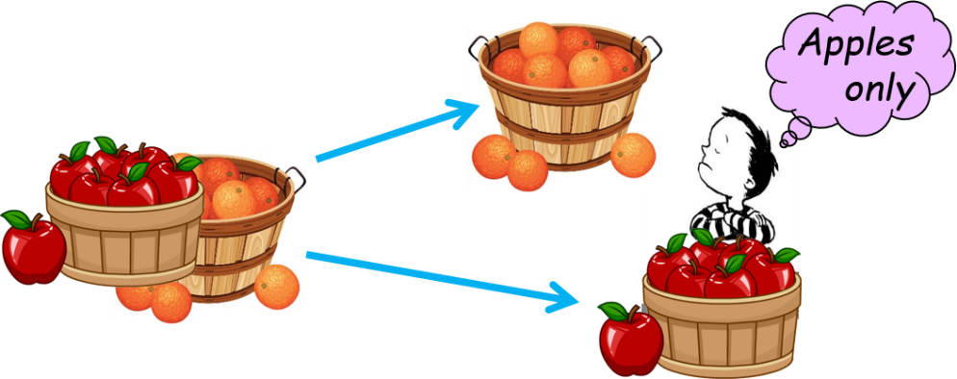
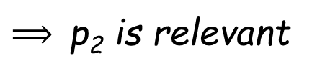
Relevant
That is, there should be at least one application that accesses f_{i} and f_{j} differently.
  i.e., The simple predicate p_{i} should be relevant in determining a fragmentation.
p₁
f₁
p₂
f_{i}
Prob₁
p₃
A
f
f₁₂
¬p₂
f_{j}
Prob₂
Prob₁ ≠ Prob₂
$⟹$p₂ is relevant

Slide 47
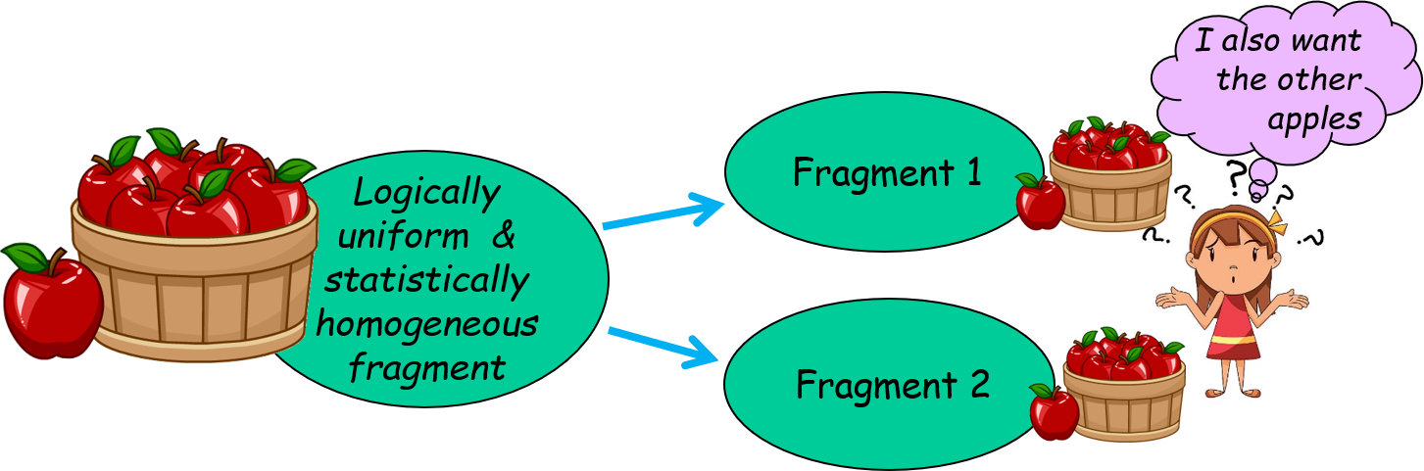
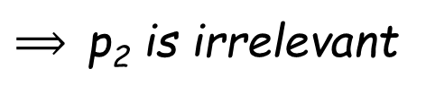
Minimality
If all the predicates of a set Pr are relevant, Pr is minimal.
p₁
f₁
p₂
f_{i}
Prob₁
p₃
A
f
f₁₂
¬p₂
f_{j}
Prob₂
Prob₁ = Prob₂
$⟹$p₂ is irrelevant

Slide 48
A Complete and Minimal Example
Two applications:
One application accesses the tuples according to location.
Another application accesses only those project tuples where the budget is less than $200,000.
  Case 1: Pr={Loc=“Montreal”, Loc=“New York”, Loc=“Orlando”, BUDGET<=200,000,BUDGET>200,000} is
  complete and minimal.
  Case 2: If, however, we were to add the predicate JNAME= “Instrumentation” to Pr, the resulting set would not be minimal since the new predicate is not relevant with respect to the applications.
(see next slide)

Slide 49
“Relevant” Example
BUDGET<=200,000
No application
using JNAME as
a search key!
JNAME = “Instrument”
J₁₁
J₁₂₁
LOC=“Montreal”
J₁
J₁₂
J₁₂₂
BUDGET>200,000
JNAME! ≠ “Instrument”
J
LOC=“New York”
BUDGET<=200,000
J₂
J₂₁
[ JNAME = “Instrument” ] is not relevant.
LOC=“Orlando”
J₂₂
J₃
BUDGET>200,000
Database Fragmentation should base on the applications
BUDGET<=200,000
J₃₁
J₃₂
BUDGET>200,000
Relevant
Irrelevant

Slide 50
Derived Horizontal Fragmentation
In some cases, the horizontal fragmentation of a relation cannot be based on a property of its own attributes, but is derived from the horizontal fragmentation of another relation.
Derived fragmentation is used to facilitate the join between fragments.
Example: Not a good idea to fragment these two relations independently
PAY (TITLE, SAL)
EMP (ENO, ENAME, TITLE)

Slide 51
Not Using Derived Fragmentation
Example: Not a good idea to fragment these two relations independently
PAY (TITLE, SAL)
EMP (ENO, ENAME, TITLE)
One can divide EMP into EMP1 and EMP2 based on TITLE and divide PAY into PAY1, PAY2, PAY3 based on SAL using primary fragmentation. To join EMP and PAY, we have the following scenarios.
EMP₁
PAY₁
More communication overhead !
EMP₂
PAY₂
EMP₃
PAY₃
Fragments based on ENO
Fragments based on TITLE

Slide 52
Benefits of Derived Fragmentation
PAY (TITLE, SAL)
EMP (ENO, ENAME, TITLE)
SJ: semi-join
Primary Fragmentation:
EMP₁ = EMP SJ PAY₁
EMP₂ = EMP SJ PAY₂
EMP₃ = EMP SJ PAY₃
EMP₁ and PAY₁ can be allocated to the same site
EMP₁
PAY₁
EMP₂
PAY₂
EMP₃
PAY₃
Derived fragmentation
Primary fragmentation based on TITLE

Slide 53
VERTICAL FRAGMENTATION
Purpose: Identify fragments Ri such that many applications can be executed using just one vertical fragment.
Advantage: When many applications which use R₁ and many applications which use R₂ are issued at different sites, fragmenting R avoids communication overhead.
Local access. No communication
A₇
A₁
R₁
R₂
Site 1
Site 2

Slide 54
Split Approach
A | B | C | D | E | F | G | H
Splitting is considered only for attributes that do not participate in the primary key. (Primary key must be in each vertical fragment)
The split approach involves three steps:
 | A | B | C | D | E | F | G | H
A |  |  |  | H
B |  |  | H
C | H | H |  |  |  | H
D | H
E | L | L | L | L | L | L | L | L
F |  |  | H
G | L | L | L | L | L | L | L | L
H
Obtain attribute affinity matrix.
Use a clustering algorithm to group some attributes together based on the attribute affinity matrix. This algorithm produces a clustered affinity matrix.
Use a partitioning algorithm to partition attributes such that set of attributes are accessed solely or for the most part by distinct set of applications.
A
B
C
D
E
F
G
A
D
B
C
F
E
G

Slide 55
Attribute Usage Matrix
Attribute-query relationship
PROJ
PNO PNAME BUDGET LOC
A₁ A₂ A₃ A₄
use(q_{i},A_{j}) =
1 if A_{j} is referenced by q_{i}
0 otherwise
q₁: SELECT BUDGET
FROM PROJ
WHERE PNO=Value;
q₂: SELECT PNAME, BUDGET
FROM PROJ;
q₃: SELECT PNAME
FROM PROJ
WHERE LOC=Value;
q₄: SELECT SUM(BUDGET)
FROM PROJ
WHERE Loc=Value
A₁ A₂ A₃ A₄
q₁
q₂
q₃
q₄
Attribute Usage Matrix

Slide 56

Attribute Affinity Measure
I use application
at Site m
a_{k}
Relation R
Site m
Site n
A_{i}
a_{k}
a_{i}
a_{i}
a_{i}
A_{k}
A_{j}
Site s
a_{k}
ref_{s}(a_{k}) : Number of accesses to attributes (A_{i},A_{j}) for each execution of a_{k} at site s
$${acc}_{s}\left(a_{k}\right)$$
a_{i}
acc_{s} (a_{k}) : Application access frequency of a_{k} at site s.
ref_{s}(q_{k}) x acc_{s}(q_{k}) = How much Site S would like A_{i} and A_{j} together due to application a_{k}

Slide 57
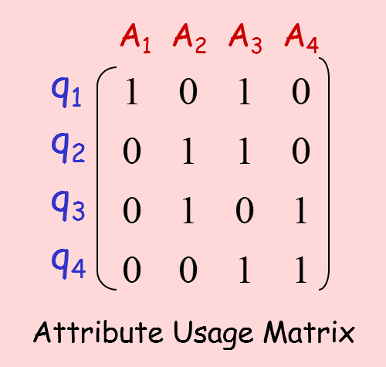

Attribute Affinity Measure
Relation R
Site s
Site n
A_{i}
a_{k}
a_{i}
a_{i}
a_{i}
A_{k}
A_{j}
Site m
a_{k}
Affinity measure due to all applications at site s, that use A_{i} and A_{j}
use$\left(a_{k},A_{i}\right)$ = 1
a_{i}
Application a_{k} accesses attribute A_{i}
aff$\left(A_{i},A_{j}\right)$ = $\sum_{all sites}{\left(\sum_{∀k, use\left(a_{k},A_{i}\right)=1 ∧ use\left(a_{k},A_{j}\right)=1}{{ref}_{s}\left(a_{k}\right)∙{acc}_{s}\left(a_{k}\right)}\right)}$

Slide 58
Attribute Affinity Measure
Relation R
Site m
Site n
A_{i}
q_{k}
q_{i}
q_{i}
q_{i}
A_{k}
A_{j}
Site s
q_{k}
Affinity measure due to all such queries at ALL site
Popularity of using A_{i} and A_{j} together
q_{i}
aff$\left(A_{i},A_{j}\right)$ = $\sum_{all sites}{\left(\sum_{∀k, use\left(a_{k},A_{i}\right)=1 ∧ use\left(a_{k},A_{j}\right)=1}{{ref}_{s}\left(a_{k}\right)∙{acc}_{s}\left(a_{k}\right)}\right)}$

Slide 59
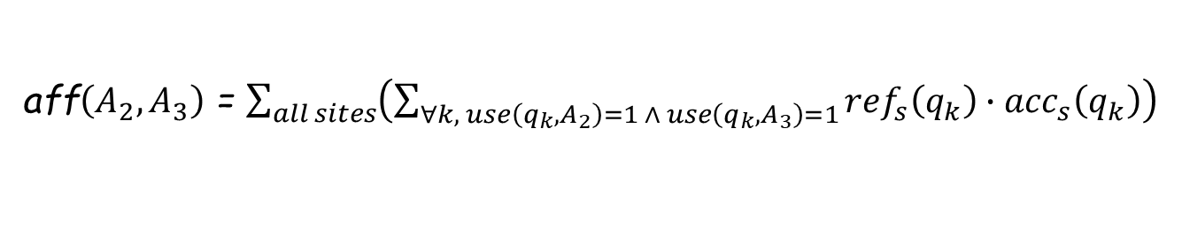
Attribute Affinity Matrix
aff$\left(A_{2},A_{3}\right)$ = $\sum_{all sites}{\left(\sum_{∀k, use\left(q_{k},A_{2}\right)=1 ∧ use\left(q_{k},A_{3}\right)=1}{{ref}_{s}\left(q_{k}\right)∙{acc}_{s}\left(q_{k}\right)}\right)}$
A₁ A₂ A₃ A₄
A₁
A₂
A₃
A₄
Attribute Affinity Matrix

Slide 60
Attribute Affinity Matrix Example
A₁ A₂ A₃ A₄
A₁ A₂ A₃ A₄
q₁
q₂
q₃
q₄
A₁
A₂
A₃
A₄
Attribute Usage Matrix
Attribute Affinity Matrix (AA)
Next Step - Determine clustered affinity (CA) matrix

Slide 61
Clustered Affinity Matrix
Step 1: Initialize CA
Copy first 2 columns
A₁ A₂ A₃ A₄
A₁ A₂ A₃ A₄
A₁
A₂
A₃
A₄
A₁
A₂
A₃
A₄
Attribute Affinity Matrix (AA)
Clustered Affinity Matrix (CA)

Slide 62
Clustered Affinity Matrix
Step 2: Determine Location for A₃
3 possible
positions
for A₃
Which one is the best ?
A₁ A₂ A₃
Dummy attribute
A₁ A₃ A₂
A₀ A₃ A₁
A₀
A₁ A₂ A₃ A₄
A₅
A₀
A₁ A₂
A₃ A₄
A₅
A₁
A₂
A₃
A₄
A₁
A₂
A₃
A₄
Attribute Affinity Matrix (AA)
Clustered Affinity Matrix (CA)
Answer: Compare Cont(A₀,A₃,A₁), Cont(A₁,A₃,A₂), and Cont(A₁,A₂,A₃)

Slide 63



Clustered Affinity Matrix
Step 2: Determine the order for A₃
A_{i}
A_{k}
A_{j}
Contribution

Slide 64

Clustered Affinity Matrix
Step 2: Determine the order for A₃
$$cont(A_{i},A_{k},A_{j})=bond(A_{i},A_{k})+bond(A_{k},A_{j})−bond(A_{i},A_{j})$$
Cont(A₀,A₃,A₁) = 8820 Cont(A₁,A₃,A₂) = 10150 Cont(A₁,A₂,A₃) = 1780
Since Cont(A₁,A₃,A₂) is the greatest, [A₁,A₃,A₂] is the best order (configuration).
A₁ A₂ A₃ A₄
A₁ A₃ A₂ A₄
A₁
A₂
A₃
A₄
A₁
A₂
A₃
A₄
Attribute Affinity Matrix (AA)
Clustered Affinity Matrix (CA)
Note: aff(A₀,A_{i})=aff(A_{i},A₀)=aff(A₅,A_{i})=aff(A_{i},A₅)=0 by definition

Slide 65
Clustered Affinity Matrix
Step 2: Determine the order for A₄
Since Cont(A₃,A₂,A₄) is the biggest, [A₃,A₂,A₄] is the best order.
A₁ A₂ A₃ A₄
A₁ A₃ A₂ A₄
A₁
A₂
A₃
A₄
A₁
A₂
A₃
A₄
Attribute Affinity Matrix (AA)
Clustered Affinity Matrix (CA)

Slide 66
Clustered Affinity Matrix
Step 3: Re-order the Rows
Arrange the rows in the same order as the columns
A₁ A₃ A₂ A₄
A₁ A₃ A₂ A₄
A₁
A₂
A₃
A₄
A₁
A₃
A₂
A₄
Clustered Affinity Matrix (CA)
Clustered Affinity Matrix (CA)

Slide 67
Partitioning
Bad grouping since A₁ and A₂ are never accessed together
A₄ and A₃ are usually not accessed together
Find the sets of attributes that are accessed, for the most part, by distinct sets of applications
We look for a good dividing points along the diagnose
A₁ A₃ A₂ A₄
A₁
A₃
A₂
A₄
A₄ and A₂ are often accessed together
Clustered Affinity Matrix (CA)
Cluster 1: A₁ & A₃
Cluster 2: A₂ & A₄
Two vertical fragments:
PROJ1(A₁, A₃) and PROJ2(A₂, A₄)

Slide 68
MIXED FRAGMENTATION
Apply horizontal fragmentation to vertical fragments.
Apply vertical fragmentation to horizontal fragments.
Example: Applications about work at each department reference tuples of employees in the departments located around the site with 80% probability.
  EMP(ENUM,NAME,SAL,TAX,MGRNUM,DNUM)
ENUM NAME TAX SAL
ENUM NAME MGRNUM DNUM
Jacksonville
Orlando
Miami
Not related to
work
Work related
Horizontal Fragmentation
(local work)
Vertical fragmentation

Slide 69



Fragment Allocation
Fragmentation
Allocation

Slide 70
ALLOCATION – Notations
Should Site j have this fragment?
i: | fragment index
j: | site index
k: | application index
f_{kj}: | the frequency of application k at site j
Site j
Fragment i
Application k at Site j
/w freq. f_{kj}

Slide 71
ALLOCATION – Notations
i | fragment index
j | site index
k | application index
f_{kj} | the frequency of application k at site j
n_{ki} | Number of operations on fragment i by application k
u_{ki} | Number of times application k updates fragment i
Site j
Fragment i
n_{ki}
Application k
/w freq. f_{kj}

Slide 72

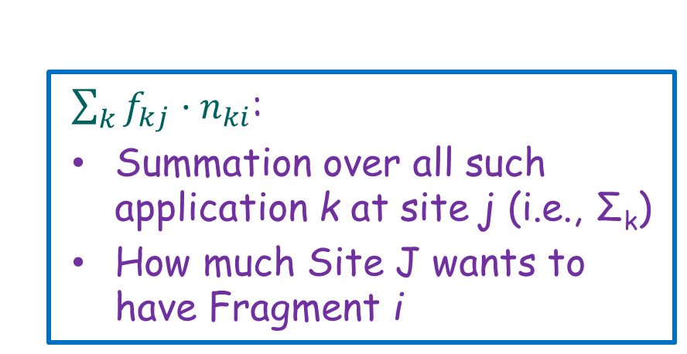
ALLOCATION –
Notations
Application k
Fragment i
$$f_{kj}∙n_{ki}$$
How much Site j would like to have fragment i due to application k
Site j
Site j
Fragment i
Application k
n_{ki}
Application k
/w freq. f_{kj}
$\sum_{k}{f_{kj}·n_{ki}}$:
Summation over all such application k at site j (i.e., Σ_{k})
How much Site J wants to have Fragment i

Slide 73
Information for Fragment Allocation
Minterm Selectivity sel(m_{i}): number of tuples that would be accessed by a query specified according to a given minterm predicate.
Access Frequency acc(q_{i}): the access frequency of queries in a given period.
How big is the fragment ?
How popular is the fragment ?
Very popular at location i
Minterm selectivity and access frequency guide the allocation activity
Give this fragment to
location i
Query
4000 tuples

Slide 74
Allocation of Data Fragments (1)
No replication: Best Fit Strategy
The number of local references of R_{i} at site j is
R_{i} is allocated at site j* such that B_{ij*} is maximum.
Fragment i
Benefit fragment i
toSite j
How much Site j would like to have fragment i due to Application k
Site j
Sum over all applications k at Site j
Application k
Advantage: A fragment is allocated to a site that needs it most.
Note: The units for allocation can take into consideration the derived fragmentation - placing related fragments due to derived fragmentation to the same site.

Slide 75
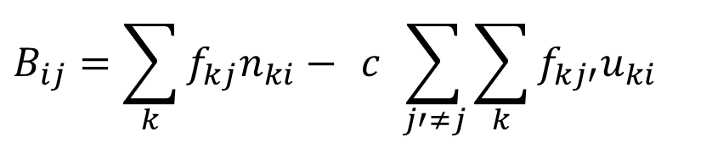
Allocation of Data Fragments (2)
All beneficial sites approach (replication)
Good for Site j
Bad for other sites
$$B_{ij}=\sum_{k}{f_{kj}n_{ki}− c \sum_{j′≠j}{\sum_{k}{f_{kj′}u_{ki}}}}$$
Fragment i
Other sites (not site j)
Cost of update references from other sites
Site j
Savings due to having a local copy
R_{i} is allocated at all sites j* such that B_{ij*} > 0.
When all B_{ij}’s are negative, a single copy of R_{i} is placed at the site such that B_{ij*} is maximum.
Notes:
Other sites can have a copy too; but they would need to update the copy belonging to site j.

Slide 76
Allocation of Data Fragments (3)
Considering reliability and availability:
d_{i} | The degree of redundancy of R_{i}
F_{i} | The reliability and availability benefit of having R_{i} fully replicated.
β(d_{i}) | The reliability and availability benefit when the fragment has d_{i} copies.
β
F_{i}
The benefit of introducing a new copy of R_{i} at site j :
Reliability
d_{i}
1
Redundancy
Also takes into account the benefit of availability
Same as All Beneficial
Sites approach in last slide

Slide 77
Relocation of Data Fragments
R
Applications of type A₃ at site PS_{r} that access R (i.e., both R_{s} and R_{t})
Applications of type A₂ at site PS_{r} , that access only R_{t}
R_{s}
R_{t}
PS_{r}
A₁
A₃
A₂
R_{s} and R_{t} are two vertical fragments of relation R
Processing Site PS_{r}
R
R_{s}
R_{t}
A_{s}
A_{t}
A₄
. . .
A_{n}
Should we move fragments R_{s} and R_{t} to other sites instead ?
PS_{s}
PS_{t}
PS₄
PS_{n}
Other processing sites

Slide 78

Relocation of Data Fragments
PS_{r}
A₁
A₃
A₂
PS_{t}
A_{s}
R_{s}
R_{t}
A_{t}
PS_{s}
PS_{r}
A₁
A₃
A₂
A₄
PS₄
.
.
.
R
R_{s}
R_{t}
A_{n}
PS_{n}
A_{s}
A_{t}
A₄
. . .
A_{n}
Should we move fragments R_{s} to A_{s} and R_{t} to A_{t} ?
PS_{s}
PS_{t}
PS₄
PS_{n}
Other processing sites

Slide 79
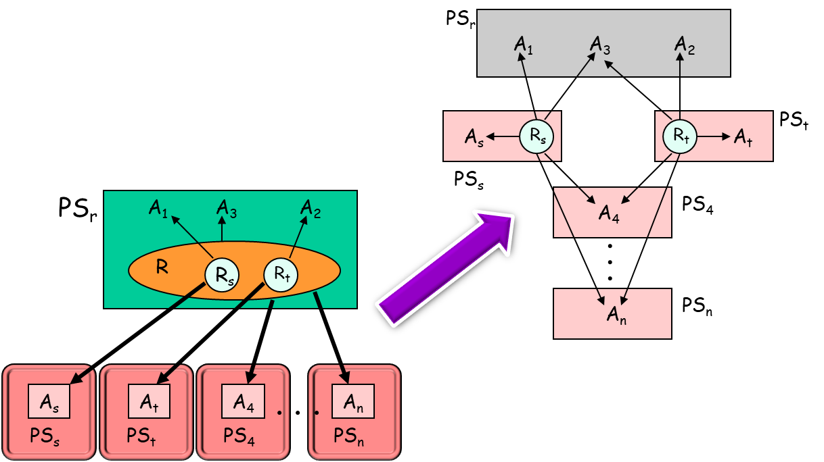
Reallocation of Data Fragments

Slide 80



Relocation of Data Fragments
The remaining locations do not like it because the fragments must be downloaded from two (instead of one) locations
PS_{s} likes it
PS_{t} also likes it
Applications of type A_{s} at PS_{s}
PS_{r} loses the two fragments and does not like it

Slide 81
Relocation of Data Fragments
The remaining locations do not like it because the fragments must be downloaded from two (instead of one) locations
PS_{s} likes it
PS_{t} also likes it
Applications of type A_{s} at PS_{s}
PS_{r} loses the two fragments and does not like it

Slide 82
Relocation of Data Fragments
This formula can be used within an exhaustive “splitting” algorithm by trying all possible combinations of sites s and t.
PS_{r}
A₁
A₃
A₂
PS_{t}
A_{s}
R_{s}
R_{t}
A_{t}
PS_{s}
A₄
PS₄
PS_{s} likes it
PS_{t} also likes it
.
.
.
A_{n}
PS_{n}
Applications of type A_{s} at PS_{s}
PS_{r} loses the two fragments and does not like it
The remaining locations do not like it because the fragments must be downloaded from two (instead of one) locations

Slide 83
SUMMARY
Top-Down Design of a distributed DB consists of 4 phases:
  Phase 1: Global schema design (same as in centralized DB design)
  Phase 2: Fragmentation
    Horizontal Fragmentation
      Primary fragmentation: Determent a complete and minimal set of predicates
      Derived fragmentation: Use semijoin
    Vertical Fragmentation
      Identify fragments such that many applications can be executed using just one fragment (clustering the attributes).
  Phase 3: Allocation
    Minimize the number of remote accesses
  Phase 4: Physical schema design (same as in centralized DB design).

Slide 84
Database Integration
Bottom-up Design

Slide 85

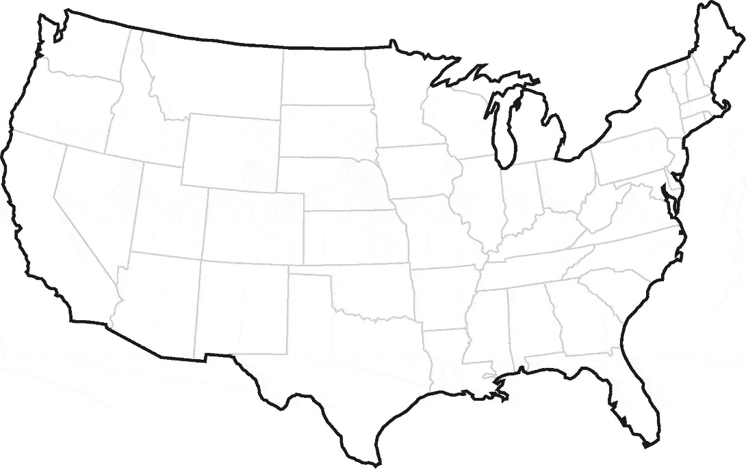

Overview
The design process in multidatabase systems is bottomup.
  The individual databases actually exists
  Designing the global conceptual schema (GCS) involves integrating these local databases into a multidatabase.
Global Applications
Global Conceptual Schema

Slide 86
Overview
The design process in multidatabase systems is bottomup.
  The individual databases actually exists
  Designing the global conceptual schema (GCS) involves integrating these local databases into a multidatabase.
Database integration can occur in two steps:
  Schema Translation
  Schema Integration
Database 1
Database 2
Database 3
1
Translator 1
Translator 2
Translator 3
InS₁
InS₂
InS₃
Intermediate
schema in
canonical
representation
2
INTEGRATOR
GCS

Slide 87
Network Data Model (Review)
There are two basic data structures in the network model: records and sets.
  Record type: a group of records of the same type.
  Set type: indicates a many-to-one relationship in the direction of the arrow.
  DEPARTMENT (DEPT-NAME, BUDGET, MANAGER)
  EMPLOYEE (E#, NAME, ADDRESS, TITLE, SALARY)
Implementation of set instances:
owner record type
Employs
set type (many-to-1)
member record type
A one-to-many relationship for “Database” department
DEPARTMENT (owner record)
Database
EMPLOYEE
(member records)
Jones, L.
Patel, J.
Vu, K.

Slide 88
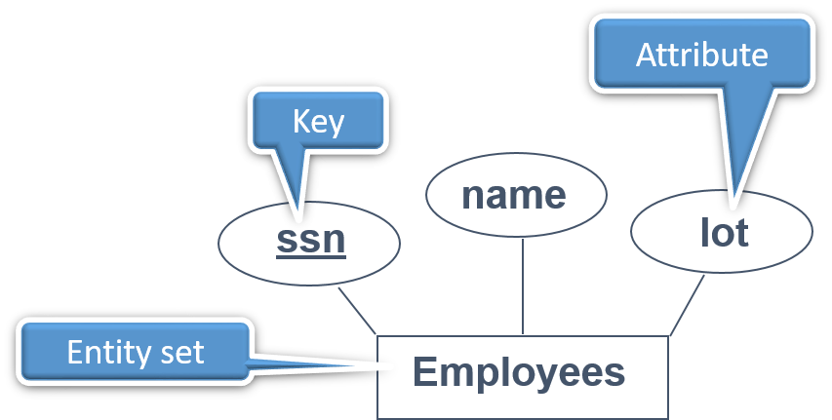
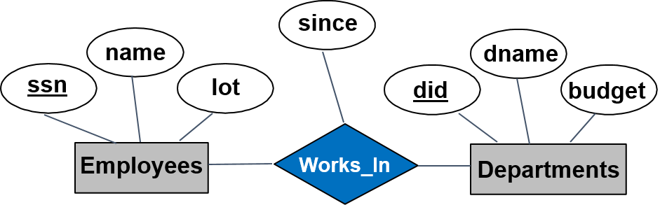
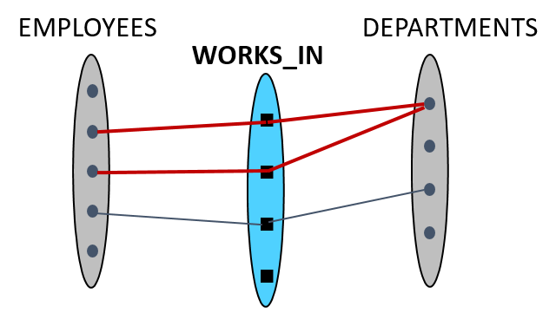
Review: Entity-Relationship (ER) Model
Entity & Entity Set
Relationship
Notes:
18

Slide 89
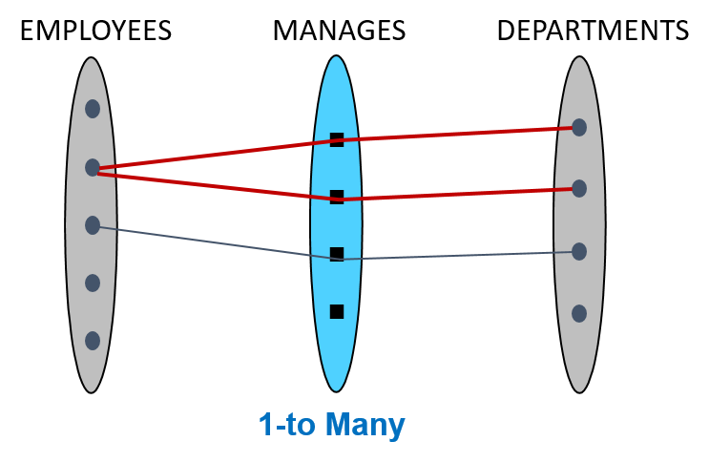
Review: Entity-Relationship (ER) Model
from
to
name
dname
ssn
lot
did
budget
No Constraint
Employees
Works_In
Departments
many-to-many
since
name
dname
ssn
lot
did
budget
Employees
Manages
Departments
Key Constraint
1-to-many
Notes:
18

Slide 90
Review: ER vs Relational
KEY
KEY
KEY
Many-to-many
KEY
KEY
KEY
Key constraint
KEY
Foreign Key
KEY
KEY
Merge
Notes:
18

Slide 91
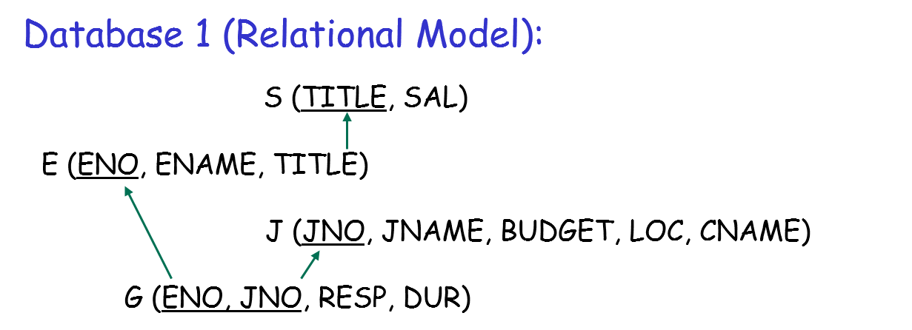
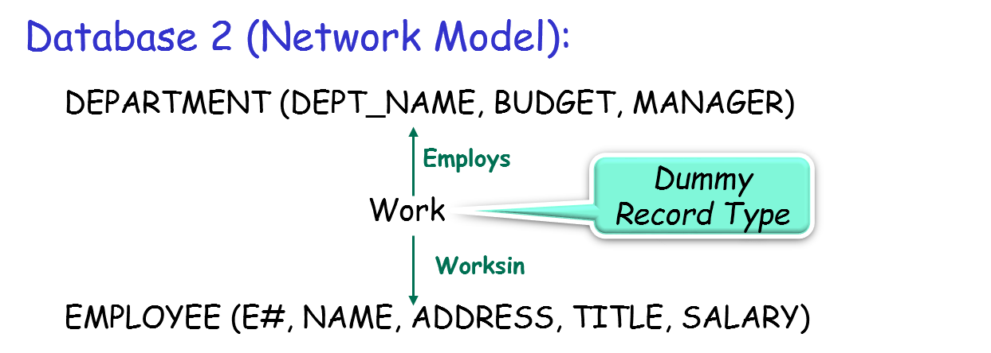
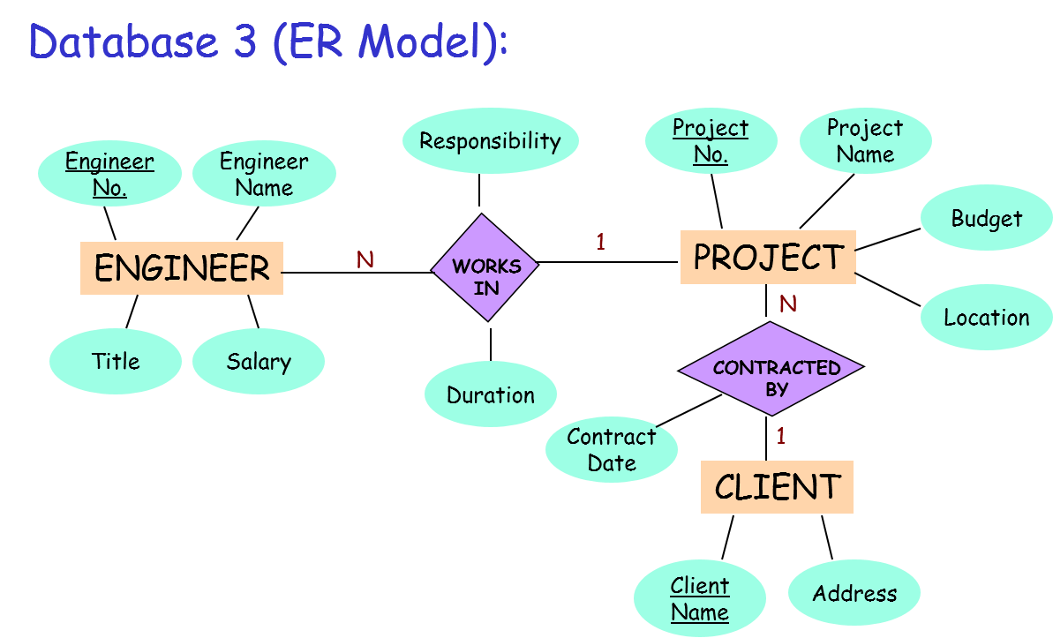
Example: Three Local Databases
We choose ER as the canonical representation
Need translation for Database 1 and Database 2

Slide 92
Schema Translation: Relational to ER
Database 1
S (TITLE, SAL)
E (ENO, ENAME, TITLE)
J (JNO, JNAME, BUDGET, LOC, CNAME)
G (ENO, JNO, RESP, DUR)
ENO
ENAME
RESP
JNO
JNAME
E
N
G
M
J
N
DUR
BUDGET
LOC
PAY
CNAME
E & J have a many-to-many relationship
E & S have a 1-to-many relationship
1
S
SAL
Treat salary as an attribute of E to make E look more like the entity set Engineer in Database 3 (see last slide)
TITLE
ENO
ENAME
RESP
JNO
JNAME
E
N
G
M
J
TITLE
SAL
DUR
BUDGET
LOC
Relationships may be identified from
the foreign keys defined for each
relation.
CNAME
Database 1 in ER representation

Slide 93
Schema Translation: Network to ER
Database 2
DEPARTMENT
EMPLOYEE
DEPARTMENT
EMPLOYEE
1
1
EMPLOYS
WORKS-IN
Employs
Works-in
WORK
N
M
Dummy record type
WORK
DEPARTMENT
EMPLOYEE
DEPARTMENT
N
EMPLOYS
M
EMPLOYEE
Database 2 in ER representation
WORK
Map each record type in the network schema to an entity and each set type to a relationship.
Network model uses dummy records in its representation of many-to-many relationships that need to be recognized during mapping.

Slide 94
After Translation
Responsibility
Project
No.
Project
Name
Engineer
No.
Engineer
Name
Budget
Database 3
1
PROJECT
ENGINEER
N
WORKS
IN
N
Location
Title
Salary
Duration
CONTRACTED
BY
Contract
Date
1
Database 1
CLIENT
ENO
ENAME
RESP
JNO
JNAME
N
G
M
Client
Name
Address
E
J
TITLE
SAL
DUR
BUDGET
LOC
All three databases in ER representation, ready for integration
CNAME
Database 2
DEPARTMENT
N
EMPLOYS
M
EMPLOYEE

Slide 95
Schema Integration
Schema integration follows the translation process and generates the GCS by integrating the intermediate schemas.
  Identify the components of a database which are related to one another.
    Two components can be related as (1) equivalent, (2) one contained in the other one, (3) overlapped, or (4) disjoint.
  Select the best representation for the GCS.
  Integrate the components of each intermediate schema.

Slide 96
Integration Methodologies
Integration
Process
Binary: Decreases the potential integration complexity and lead toward automation techniques.
One-shot: There is no implied priority for integration order of schemas, and the trade-off can be made among all schemas rather than among a few.
Binary
N-ary
Ladder
Balanced
One-shot
Iterative

Slide 97
Integration Process
Schema integration occurs in a sequence of four steps:
Preintegration: establish the “rules” of the integration process before actual integration occurs.
Comparison: naming and structural conflicts are identified.
Conformation: resolve naming and structural conflicts
Merging and restructuring: all schemas must be merged into a single database schema and then restructured to create the “best integrated schema.

Slide 98
Step 1: Preintegration
An integration method (binary or n-ary) must be selected and the schema integration order defined.
  The order implicitly defines priorities.
Candidate keys in each schema are identified to enable the integrator to determine dependencies implied by the schemas.
The mapping or transformation rules should be described before integration begins.
  e.g., mapping from degree Celsius in one schema to degrees Fahrenheit in another.

Slide 99
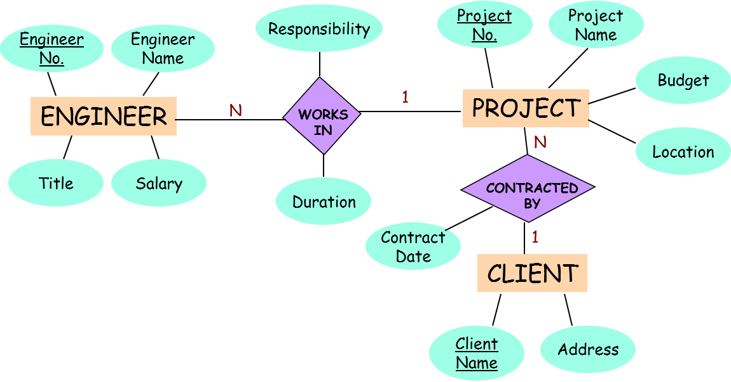
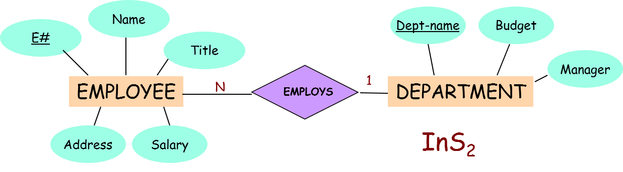
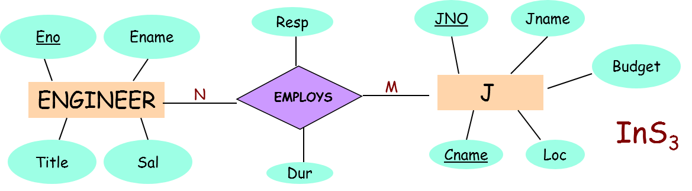
Preintegration Example
(NOTE: This three databases are different from the last example)
InS₁
More similar
Integrate these two first
They do not work on projects

Slide 100
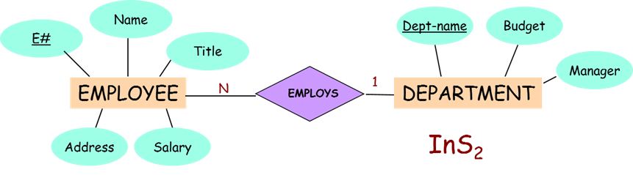


Integration Method
Integration order: InS₁ and InS₃ are subsets of InS₂
The schema of the non-engineering location looks quite different
Integrate the engineering centers first. Their schemas look similar
2
1
InS₃
InS₂
InS₁

Slide 101

Key Identification
to determine dependencies implied by the schemas
InS₁
KEYS
InS1: Engineer No. in ENGINEER
Project No. in PROJECT
Client name in CLIENT
InS2: E# in EMPLOYEE
Dept-name in DEPARTMENT
InS3: Eno in E
Jno in J

Slide 102
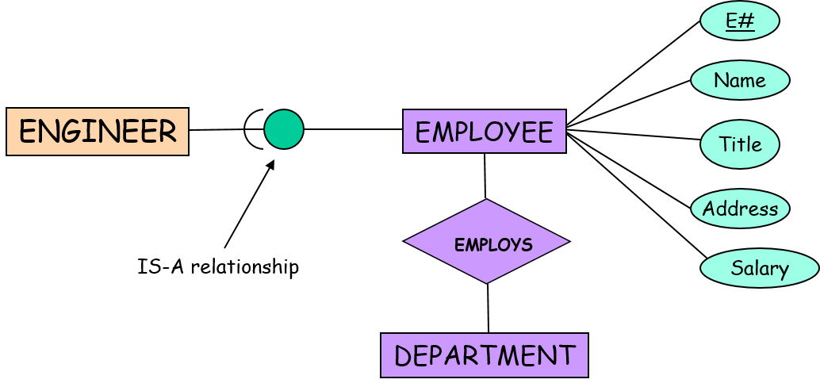
Schema Comparison
Some parts of InS₁ (about engineers) and InS₃ (about engineers) occur in InS₂ (about employees)
InS₁
InS₁ and InS₃ are subsets of InS₂

Slide 103
Step 2: Schema Comparison
Naming Conflict (1)
Synonyms: Two identical entities that have different names.
InS₁ | InS₃
ENGINEER Engineering No Engineer Name Salary WORKSIN Responsibility Duration PROJECT Project No Project Name Location | E Eno Ename Sal G Resp Dur J Jno Jname Loc
InS₁

Slide 104
Step 2: Schema Comparison
Naming Conflict (2)
Homonyms: Two different entities that have identical names.
In InS₁, ENGINEER.Title refers to the title of engineers.
In InS₂, EMPLOYEE.Title refers to the title of all employees.
InS₁
domain (EMPLOYEE.Title) >> domain (ENIGNEREER.Title)

Slide 105
Schema Comparison – Structural Conflicts (1)
Type conflicts: occur when the same object is represented by an attribute in one schema and by an entity in another schema.
  The client of a project is modeled as an entity in InS₁, however
  the client is included as an attribute of the J entity in InS₃
Resp
JNO
Jname
N
CONTRACTED
BY
PROJECT
Budget
M
Contract
Date
1
EMPLOYS
J
CLIENT
InS₁
InS₃
Cname
Loc
Client
Name
Address
Dur

Slide 106
Schema Comparison – Structural Conflicts (2)
This is
1-to-many
Dependency conflicts: occur when different relationship modes are used to represent the same thing in different schemas.
Engineer
No.
Engineer
Name
Project
No.
ENGINEER
N
WORKS
IN
1
PROJECT
Title
Salary
InS₁
This is
many-to-many
Eno
Ename
Resp
ENGINEER
N
EMPLOYS
M
J
Title
Sal
InS₃
Dur

Slide 107
Schema Comparison: Structural Conflicts (3)
Key conflicts: occur when different candidate keys are available and different primary keys are selected in different schemas
Behavioral conflicts: are implied by the modeling mechanism,
  e.g., deletion of the last employee causes the dissolution of the department.

Slide 108
Step 3: Conformation
Naming Conflicts
Naming conflicts are resolved simply by renaming conflict ones.
Synonyms: rename the schema of InS₃ to conform to the naming of InS₁.
Homonyms:
  Prefix each attribute by the name of the entity to which it belong,
    e.g., ENGINEER.Title
    EMPLOYEE.Title
  and prefix each entity by the name of the schema to which it belongs.
    e.g., InS1.ENGINEER
    InS2.EMPLOYEE
InS₃ | InS₁
E Eno → Engineering No Ename → Engineering Name Sal → Salary G Resp → Responsibility Dur → Duration J Jno → Project No Jname → Project Name Loc → Location | ENGINEER Engineering No Engineer Name Salary WORKSIN Responsibility Duration PROJECT Project No Project Name Location

Slide 109


Step 3: Resolving Structural Conflict
InS₁
Transform this attribute to an entity C

Slide 110
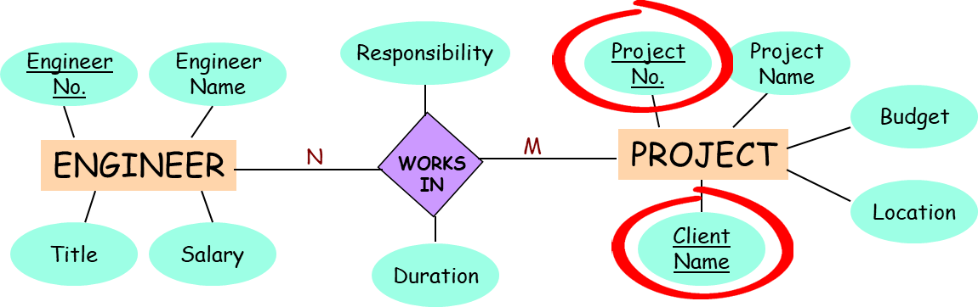
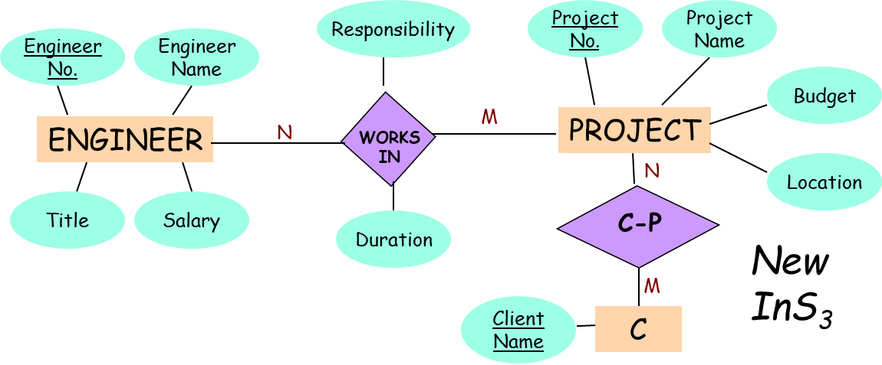
Step 3: Resolving Structural Conflict
ProjectNo and ClientName form the primary key
→ Relationship between projects and clients is m:n
InS₁
InS₃
Client is now an entity C

Slide 111

Integrate InS₁ & InS₃
The many-to-many relationship in InS₃ is more general
Use InS₃ as the final schema
Responsibility
Project
No.
Project
Name
Engineer
No.
Engineer
Name
Budget
ENGINEER
N
1
PROJECT
WORKS
IN
N
Location
Title
Salary
CONTRACTED
BY
Duration
InS₁
Contract
Date
1
CLIENT
Client
Name
Address
Responsibility
Project
No.
Project
Name
Engineer
No.
Engineer
Name
Budget
ENGINEER
N
M
PROJECT
WORKS
IN
N
Location
Title
Salary
N:M is used
Duration
CONTRACTED
BY
InS₃
M
Client
Name
C

Slide 112
Step 3: Schema Integration
Merging & Restructuring
Merging requires that the information contained in the participating schemas be retained in the integrated schema.
Merging using the IS-A relationship (Employees vs Engineers)
2
Use InS₃ as the final schema since it is more general in terms of the C-P relationship
(many-to-many vs 1-to-many)
(next page)
1
InS₂
InS₃
InS₁
(Employees)
(Engineers)
(Engineers)

Slide 113
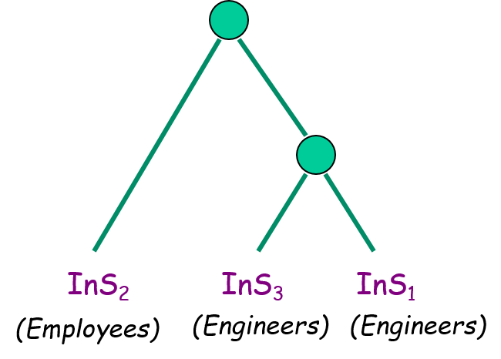
Merging & Restructuring Example
Final Result:
Duration
Project
No.
Project
Name
Responsibility
Budget
ENGINEER
N
M
PROJECT
WORKS
IN
N
Location
E#
CONTRACTED
BY
Name
M
CLIENT
InS₁/InS₃
EMPLOYEE
Title
N
Address
Client
name
Address
EMPLOYS
1
SAL
InS₂
DEPARTMENT
Unfortunately, Conformation and restructuring stages are an art rather then a science
Budget
Manager
Dept-name

Slide 114
Query Processing in
Multidatabase Systems

Slide 115
Query Processing in Three Steps
Schema Integration
Local Schema 1
Local Schema 2
Local Schema 3
Translator 1
Translator 2
Translator 3
InS₁
InS₂
InS₃
INTEGRATOR
GCS

Slide 116
Query Processing in Three Steps
Global query is decomposed into local queries
Query Processing
Local Schema 1
Local Schema 2
Local Schema 3
Translator 1
Translator 2
Translator 3
InS₁
InS₂
InS₃
Q_{1,1}
Q_{1,2}
Q_{1,3}
INTEGRATOR
Q₁
GCS

Slide 117
Query Processing in Three Steps
Each local query is translated into queries over the corresponding local database system
Query Processing
Local Schema 1
Local Schema 2
Local Schema 3
Q’_{1,1}
Q’_{1,2}
Q’_{1,3}
Translator 1
Translator 2
Translator 3
InS₁
InS₂
InS₃
Q_{1,1}
Q_{1,2}
Q_{1,3}
INTEGRATOR
Q₁
GCS

Slide 118
Query Processing in Three Steps
Results of the local queries are combined into the answer
Query Processing
Local Schema 1
Local Schema 2
Local Schema 3
Q’_{1,1}
Q’_{1,2}
Q’_{1,3}
Translator 1
Translator 2
Translator 3
Final
answer
Combine
InS₁
InS₂
InS₃
Q_{1,1}
Q_{1,2}
Q_{1,3}
INTEGRATOR
Q₁
GCS

Slide 119
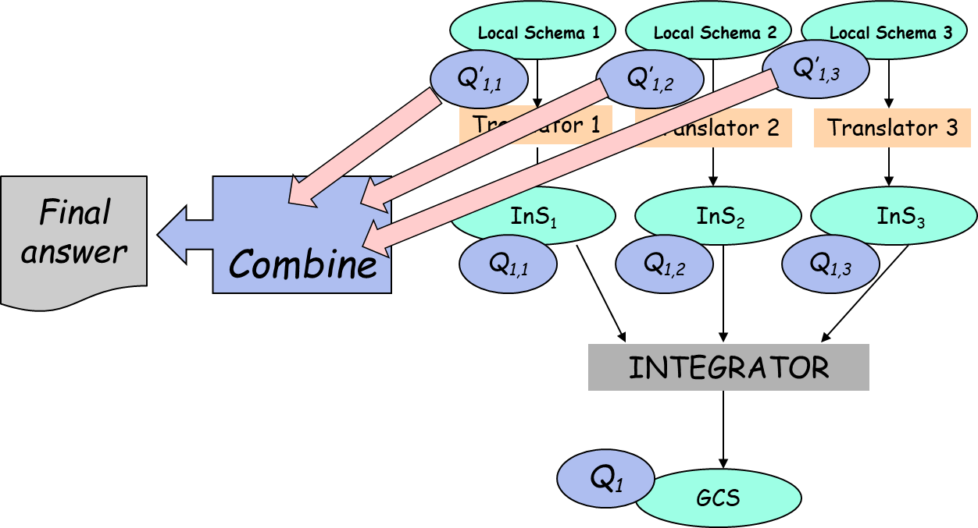

Query Processing
  Query Decomposition
  Query Translation
  Global Query Optimization

Slide 120
Query Decomposition
Overview
Global Query
Query decomposition &
global optimization
. . .
…
SQ_{n}
PQ₁
PQ_{n}
SQ₁
SQ₂
…
SQ_{i} export-schema subquery in global query language
TQ_{i} target query (local subquery) in local query language
PQ_{i} postprocessing query used to combine results returned by subqueries to form the answer
Query
translator 1
Query
translator 2
Query
translator n
. . .
TQ₁
TQ₂
TQ_{n}
DB₁
DB₂
DB_{n}

Slide 121
The Local Databases
We use the object-oriented data model to present a query decomposition algorithm
To simplify the discussion, we assume that there are only two export schemas (e.g., two data centers):
ES1 ES2
Emp1: SSN Emp2: SSN
Name Name
Salary Salary
Age Rank

Slide 122
Object-Oriented DB
This object is not of type(C)
World
Type
type: Given a class C, the type of C, denoted by type(C), is the set of attributes defined for C and their corresponding domain.
This object is of type(C)
Extension
A Persistent Class C

Slide 123
Object-Oriented DB
Objects belong to other persistent classes
world: The world of C, denoted by world(C), is the set of real-world objects described by C.
World
extension: The extension of C, denoted by extension(C), is the set instances contained in C.
Type
type: Given a class C, the type of C, denoted by type(C), is the set of attributes defined for C and their corresponding domain.
Extension
A Persistent Class C

Slide 124
Object-Oriented DB
Cars, tables, trees, apples, buildings
world: The world of C, denoted by world(C), is the set of real-world objects described by C.
World
extension: The extension of C, denoted by extension(C), is the set instances contained in C.
Type
type: Given a class C, the type of C, denoted by type(C), is the set of attributes defined for C and their corresponding domain.
Extension
A Persistent Class C

Slide 125
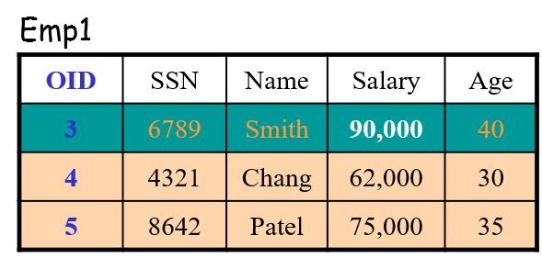
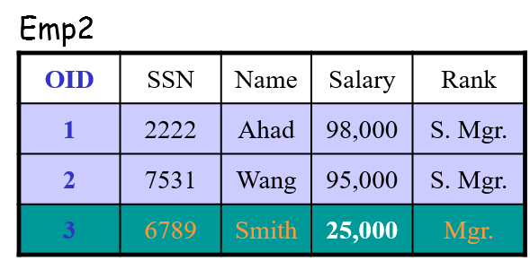
Schema Integration
Integration through outerjoin
Integration through outerunion (generalization)
Two local databases

Slide 126


Outerjoin R₁ ⋈_{o} R₂
The outerjoin of relation Emp₁ and Emp₂ is the union of three components.
Emp1
OID | SSN | Name | Salary | Age
3 | 6789 | Smith | 90,000 | 40
4 | 4321 | Chang | 62,000 | 30
5 | 8642 | Patel | 75,000 | 35
EmpO = Emp1 ⋈_{o} Emp2 (Outerjoin on OID)
OID | SSN | Name | Salary | Age | Rank
1 | 2222 | Ahad | 98,000 | null | S. Mgr.
2 | 7531 | Wang | 95,000 | mull | S. Mgr.
3 | 6789 | Smith | Incon-sistent | 40 | Mgr.
4 | 4321 | Chang | 62,000 | 30 | null
5 | 8642 | Patel | 75,000 | 35 | null
$$⋈$$
Emp2
OID | SSN | Name | Salary | Rank
1 | 2222 | Ahad | 98,000 | S. Mgr.
2 | 7531 | Wang | 95,000 | S. Mgr.
3 | 6789 | Smith | 25,000 | Mgr.
No match in Emp2
No match in Emp1

Slide 127
Outerunion
Emp2
OID | SSN | Name | Salary | Rank
1 | 2222 | Ahad | 98,000 | S. Mgr.
2 | 7531 | Wang | 95,000 | S. Mgr.
3 | 6789 | Smith | 25,000 | Mgr.
EmpG = Emp1 U_{o} Emp2
OID | SSN | Name | Salary | Age | Rank
1 | 2222 | Ahad | 98,000 | null | S. Mgr.
2 | 7531 | Wang | 95,000 | mull | S. Mgr.
3 | 6789 | Smith | Conflict | null | Mgr.
3 | 6789 | Smith | Conflict | 40 | null
4 | 4321 | Chang | 62,000 | 30 | null
5 | 8642 | Patel | 75,000 | 35 | null
Emp1
OID | SSN | Name | Salary | Age
3 | 6789 | Smith | 90,000 | 40
4 | 4321 | Chang | 62,000 | 30
5 | 8642 | Patel | 75,000 | 35

Slide 128
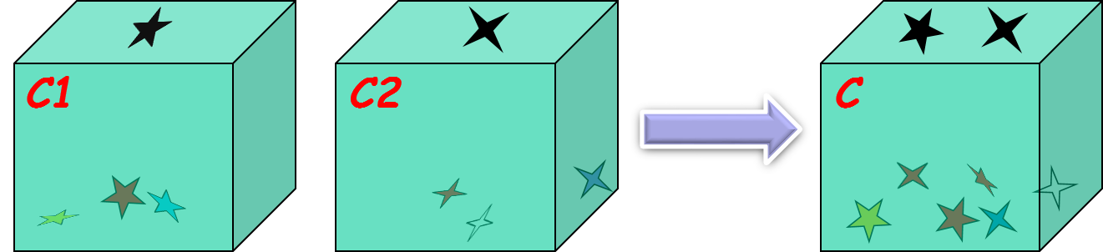
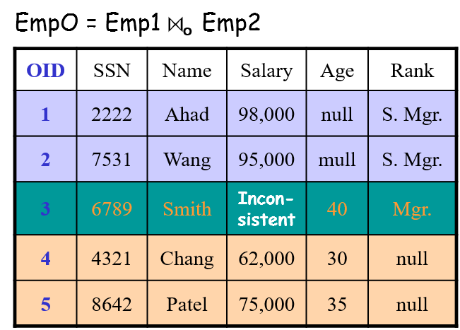


Schema Integration Using Outerjoin
Two classes C1 and C2 can be integrated by equi-outerjoining the two classes on the OID to form a new class C. /* C = C1 ⋈_{o} C2
  extension(C ) = extension(C1 ) ⋈_{o} extension(C2 )
  type(C ) = type(C1 ) ⋃ type(C2 )
  world(C ) = world(C1 ) ⋃ world(C2 )
As seen by global applications
Integration
Two local databases

Slide 129
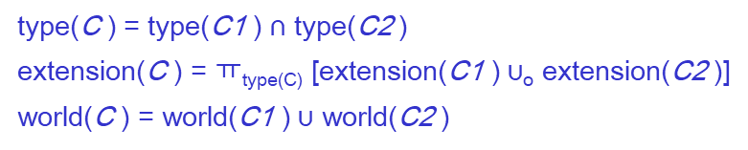
Schema Integration thru Generalization
thru Outer Union
Emp1: SSN
Name
Salary
Age
Generalization
EmpG
SSN
Name
Salary
More
specific
Emp2: SSN
Name
Salary
Rank
Emp1
Age
Rank
Emp2
Go to Emp1 for “Age” and Emp2 for “Rank”

Slide 130


Inconsistency Resolution
The schema integration techniques work as long as there is no data inconsistency
Aggregate functions may be used to resolve the problem (i.e., compute the value when needed)
Example:
EmpO.Salary
= Emp1.Salary + Emp2.Salry
Local databases

Slide 131
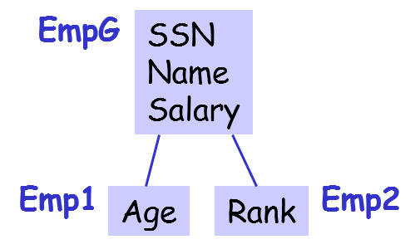
Inconsistency Resolution: Generalization
Export Schemas Integrated Schema
Emp1: SSN Emp2: SSN
Name Name
Salary Salary
Age Rank
Aggregate Functions for Name:
EmpG.Name = Emp1.Name, if EmpG is in world(Emp1)
= Emp2.Name, if EmpG is in world(Emp2) – world(Emp1)
Generalization
World (Emp2)
World (Emp1)
world(Emp2) – world(Emp1)
world(Emp1) ⋂ world(Emp2)
world(Emp1) – world(Emp2)
Location
1
Location
2
Use the name at location 2
Use the name at location 1

Slide 132
Inconsistency Resolution: Generalization
Export Schemas Integrated Schema
Emp1: SSN Emp2: SSN
Name Name
Salary Salary
Age Rank
Aggregate Functions for Salary:
EmpG.Name = Emp1.Name, if EmpG is in world(Emp1)
= Emp2.Name, if EmpG is in world(Emp2) – world(Emp1)
EmpG.Salary = Emp1.Salary, if EmpG is in world(Emp1) – world(Emp2)
= Emp2.Salary, ifEmpG is in world(Emp2) – world(Emp1)
= Sum(Emp1.Salary, Emp2.Salary), if EmpG is in world(Emp1) ⋂ world(Emp2)
Generalization
World (Emp2)
World (Emp1)
world(Emp2) – world(Emp1)
world(Emp1) ⋂ world(Emp2)
world(Emp1) – world(Emp2)
Employees working at both locations. They have two salaries

Slide 133
Inconsistency Resolution: Outerjoin
Export Schemas Integrated Schema
Emp1: SSN Emp2: SSN EmpO: SSN
Name Name Name
Salary Salary Salary
Age Rank Age
Rank
Aggregate Functions – Some examples:
EmpO.Age = Emp1.Age, if EmpO is in world(Emp1)
= Null, if EmpO is in world(Emp2) – world(Emp1)
EmpO.Rank = Emp2.Rank, if EmpO is in world(Emp2)
= Null, if EmpO is in world(Emp1) – world(Emp2)
EmpO.Salary = Emp1.Salary, if EmpO is in world(Emp1) – world(Emp2)
= Emp2.Salary, if EmpO is in world(Emp2) – world(Emp1)
= Sum(Emp1.Salary, Emp2.Salary), if EmpO is in world(Emp1) ⋂ world(Emp2)
Outer join
world(Emp2) – world(Emp1)
world(Emp1) ⋂ world(Emp2)
world(Emp1) – world(Emp2)
World (Emp1)
World (Emp2)

Slide 134
Inconsistency Resolution: Outerjoin
Export Schemas Integrated Schema
Emp1: SSN Emp2: SSN EmpO: SSN
Name Name Name
Salary Salary Salary
Age Rank Age
Rank
Relevant Aggregate Functions:
EmpO.Name = Emp1.Name, if EmpO is in world(Emp1)
= Emp2.Name, if EmpO is in world(Emp2) – world(Emp1)
EmpO.Rank = Emp2.Rank, if EmpO is in world(Emp2)
= Null, if EmpO is in world(Emp1) – world(Emp2)
EmpO.Age = Emp1.Age, if EmpO is in world(Emp1)
= Null, if EmpO is in world(Emp2) – world(Emp1)
EmpO.Salary = Emp1.Salary, if EmpO is in world(Emp1) – world(Emp2)
= Emp2.Salary, if EmpO is in world(Emp2) – world(Emp1)
= Sum(Emp1.Salary, Emp2.Salary), if EmpO is in world(Emp1) ⋂ world(Emp2)
Outer join

Slide 135

Query Decomposition
Note that EmpO is not stored
Emp1
OID | SSN | Name | Salary | Age
3 | 6789 | Smith | 90,000 | 40
4 | 4321 | Chang | 62,000 | 30
5 | 8642 | Patel | 75,000 | 35
EmpO = Emp1 ⋈_{o} Emp2 (Outerjoin on OID)
OID | SSN | Name | Salary | Age | Rank
1 | 2222 | Ahad | 98,000 | null | S. Mgr.
2 | 7531 | Wang | 95,000 | mull | S. Mgr.
3 | 6789 | Smith | Incon-sistent | 40 | Mgr.
4 | 4321 | Chang | 62,000 | 30 | null
5 | 8642 | Patel | 75,000 | 35 | null
$$⋈$$
Emp2
OID | SSN | Name | Salary | Rank
1 | 2222 | Ahad | 98,000 | S. Mgr.
2 | 7531 | Wang | 95,000 | S. Mgr.
3 | 6789 | Smith | 25,000 | Mgr.

Slide 136
Query Decomposition
Global Query Q
e.g., Salary > 70,000
From Emp2
Decomposition
EmpO = Emp1 ⋈_{o} Emp2 (Outerjoin on OID)
OID | SSN | Name | Salary | Age | Rank
1 | 2222 | Ahad | 98,000 | null | S. Mgr.
2 | 7531 | Wang | 95,000 | mull | S. Mgr.
3 | 6789 | Smith | SUM | 40 | Mgr.
4 | 4321 | Chang | 62,000 | 30 | null
5 | 8642 | Patel | 75,000 | 35 | null
Q₁
From both
Q₂
Q₃
From Emp1
EmpO.Salary = Emp1.Salary, if EmpO is in world(Emp1) – world(Emp2)
= Emp2.Salary, if EmpO is in world(Emp2) – world(Emp1)
= Sum(Emp1.Salary, Emp2.Salary), if EmpO is in world(Emp1) ⋂ world(Emp2)

Slide 137
Query Decomposition
Global Query Q
e.g., Salary > 70,000
What if we have a more complex predicate?
Decomposition
Salary > 80,000 AND Age > 35
Q₁
Q₂
Number of expressions determines the number of subqueries
Q₃
EmpO.Salary = Emp1.Salary, if EmpO is in world(Emp1) – world(Emp2)
= Emp2.Salary, if EmpO is in world(Emp2) – world(Emp1)
= Sum(Emp1.Salary, Emp2.Salary), if EmpO is in world(Emp1) ⋂ world(Emp2)

Slide 138
Query Decomposition
Step 1: Determine Number of Subqueries
Global Select EmpO.Name, EmpO.Rank
Query From EmpO
Where EmpO.Salary > 80,000 AND
EmpO.Age > 35
Obtain a partition of world(EmpO) based on the following aggregate function used to resolve the data inconsistency.
Assume Outerjoin is used for schema integration
Part 1
EmpO.Salary = Emp1.Salary, if EmpO is in world(Emp1) – world(Emp2)
= Emp2.Salary, ifEmpO is in world(Emp2) – world(Emp1)
= Sum(Emp1.Salary, Emp2.Salary), if EmpO is in world(Emp1) ⋂ world(Emp2)
Part 2
Part 3
world(Emp1)
Part 2
Part 3
Part 1
world(Emp2)

Slide 139
Query Decomposition
Step 1: Determine Number of Subqueries
Global Select EmpO.Name, EmpO.Rank
Query From EmpO
Where EmpO.Salary > 80,000 AND
EmpO.Age > 35
Obtain a partition of world(EmpO) based on the aggregate function (last slide) used to resolve the data inconsistency.
Option 1 (based on Salary)
part. 1: world(Emp1) – world(Emp2)
part. 2: world(Emp2) – world(Emp1)
part. 3: world(Emp1) ⋂ world(Emp2)
Assume Outerjoin is used for schema integration
Inconsistency Function:
EmpO.Salary = Emp1.Salary, if EmpO is in world(Emp1) – world(Emp2)
= Emp2.Salary, if EmpO is in world(Emp2) – world(Emp1)
= Sum(Emp1.Salary,Emp2.Salary), if EmpO is in world(Emp1) ⋂ world(Emp2)
world(Emp1)
Part 2
Part 3
Part 1
world(Emp2)

Slide 140
Query Decomposition
Step 1: Determine Number of Subqueries
Global Select EmpO.Name, EmpO.Rank
Query From EmpO
Where EmpO.Salary > 80,000 AND
EmpO.Age > 35
Obtain a partition of world(EmpO) based on the following aggregate function used to resolve the data inconsistency.
Part 1
Part 2
world(Emp2)
world(Emp1)
Part 2
Part 1
“Age” is not stored at Location 2

Slide 141
Query Decomposition
Step 1: Determine Number of Subqueries
Global Select EmpO.Name, EmpO.Rank
Query From EmpO
Where EmpO.Salary > 80,000 AND
EmpO.Age > 35
Obtain a partition of world(EmpO) based on the following aggregate function used to resolve the data inconsistency.
Part 1
Part 2
world(Emp2)
world(Emp1)
Part 2
Part 1
“Age” is not stored at Location 2

Slide 142
Query Decomposition
Step 1: Determine Number of Subqueries
Global Select EmpO.Name, EmpO.Rank
Query From EmpO
Where EmpO.Salary > 80,000 AND
EmpO.Age > 35
Obtain a partition of world(EmpO) based on the aggregate function used to resolve the data inconsistency.
Option 2 (based on Age)
part. 1: world(Emp1)
part. 2: world(Emp2) – world(Emp1)
Inconsistency Function:
EmpO.Age
= Emp1.Age, if EmpO is in world(Emp1)
= Null, if EmpO is in world(Emp2) – world(Emp1)
world(Emp2)
world(Emp1)
Part 2
Part 1
“Age” is not stored at Location 2

Slide 143

Query Decomposition
Step 1: Determine Number of Subqueries
Global Select EmpO.Name, EmpO.Rank
Query From EmpO
Where EmpO.Salary > 80,000 AND
EmpO.Age > 35
Obtain a partition of world(EmpO) based on the aggregate function used to resolve the data inconsistency.
Option 1 (based on Salary) Option 2 (based on Age)
part. 1: world(Emp1) – world(Emp2) part. 1: world(Emp1)
part. 2: world(Emp2) – world(Emp1) part. 2: world(Emp2) –
part. 3: world(Emp1) ⋂ world(Emp2) world(Emp1)
We use Option 1 since it is the finest partition among all the partitions
Using two partitions cannot resolve inconsisitency due to “Salary”
world(Emp1)
world(Emp1)
3
2
2
1
1
world(Emp2)
world(Emp2)
Decompose the query into 3 subqueries

Slide 144
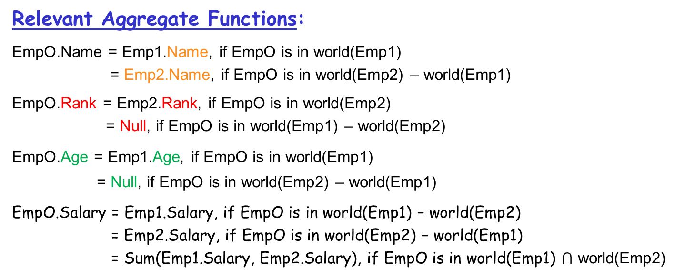
Query Decomposition
Step 1: Determine Number of Subqueries
Global Select EmpO.Name, EmpO.Rank
Query From EmpO
Where EmpO.Salary > 80,000 AND
EmpO.Age > 35
world(Emp1)
3
2
1
world(Emp1)
2
world(Emp2)
1
world(Emp2)
Decompose the query into 3 subqueries

Slide 145
Query Decomposition
Another Example
Option 1:
Option 2:
world(Emp1)
world(Emp1)
2
2
1
1
world(Emp2)
world(Emp2)
Use finer partition (Option 3):
world(Emp1)
3
2
1
world(Emp2)

Slide 146
Query Decomposition
Step 2: Query Decomposition
Global Query:
Select EmpO.Name, EmpO.Rank
From EmpO
Where EmpO.Salary > 80,000 AND
EmpO.Age > 35
Partition:
Query Decomposition: Obtain a query for each subset in the chosen partition.
1
3
2
world(Emp1)
world(Emp2)
Aggregate functions relevant to the query
EmpO.Age = Emp1.Age, if EmpO is in world(Emp1)
= Null, if EmpO is in world(Emp2) – world(Emp1)
EmpO.Salary = Emp1.Salary, if EmpO is in world(Emp1) – world(Emp2)
= Emp2.Salary, ifEmpO is in world(Emp2) – world(Emp1)
= Sum(Emp1.Salary, Emp2.Salary), if EmpO is in world(Emp1) ⋂ world(Emp2)

Slide 147

Query Decomposition
Step 2: Query Decomposition
Global Query:
Select EmpO.Name, EmpO.Rank
From EmpO
Where EmpO.Salary > 80,000 AND
EmpO.Age > 35
Partition:
Query Decomposition: Obtain a query for each subset in the chosen partition.
part. 1: Select Emp1.Name
From Emp1
Where Emp1.Salary > 80,000 AND
Emp1.Age > 35 AND
Emp1.SSN NOT IN
(Select Emp2.SSN
From Emp2)
part. 2: This subquery is discarded because EmpO.Age is Null.
Select Emp2.Name, Emp2.Rank
From Emp2
Where Emp2.Salary > 80,000 AND
Emp2.Age > 35 AND
Emp2.SSN NOT IN
(Select Emp1.SNN
From Emp 1)
Exclude Part 3
1
3
2
world(Emp1)
world(Emp2)
Result is empty
EmpO.Age = Emp1.Age, if EmpO is in world(Emp1)
= Null, if EmpO is in world(Emp2) – world(Emp1)
EmpO.Salary = Emp1.Salary, if EmpO is in world(Emp1) – world(Emp2)
= Emp2.Salary, ifEmpO is in world(Emp2) – world(Emp1)
= Sum(Emp1.Salary, Emp2.Salary), if EmpO is in world(Emp1) ⋂ world(Emp2)
Part 2

Slide 148
Query Decomposition
Step 2: Query Decomposition
Global Query:
Select EmpO.Name, EmpO.Rank
From EmpO
Where EmpO.Salary > 80,000 AND
EmpO.Age > 35
Partition:
Query Decomposition: Obtain a query for each subset in the chosen partition.
part. 1: Select Emp1.Name
From Emp1
Where Emp1.Salary > 80,000 AND
Emp1.Age > 35 AND
Emp1.SSN NOT IN
(Select Emp2.SSN
From Emp2)
part. 2: This subquery is discarded because EmpO.Age is Null.
part. 3: Select Emp1.Name, Emp2.Rank
From Emp1, Emp2
Where Sum(Emp1.Salary,
Emp2.Salary) > 80,000 AND
Emp1.Age > 35 AND
Emp1.SSN = Emp2.SSN
1
3
2
world(Emp1)
world(Emp2)
EmpO.Age = Emp1.Age, if EmpO is in world(Emp1)
= Null, if EmpO is in world(Emp2) – world(Emp1)
EmpO.Salary = Emp1.Salary, if EmpO is in world(Emp1) – world(Emp2)
= Emp2.Salary, ifEmpO is in world(Emp2) – world(Emp1)
= Sum(Emp1.Salary, Emp2.Salary), if EmpO is in world(Emp1) ⋂ world(Emp2)
Part 3

Slide 149
Query Decomposition
Step 2: Query Decomposition
Global Query:
Select EmpO.Name, EmpO.Rank
From EmpO
Where EmpO.Salary > 80,000 AND
EmpO.Age > 35
Query Decomposition: Obtain a query for each subset in the chosen partition.
part. 1: Select Emp1.Name
From Emp1
Where Emp1.Salary > 80,000 AND
Emp1.Age > 35 AND
Emp1.SSN NOT IN
(Select Emp2.SSN
From Emp2)
part. 2: This subquery is discarded because EmpO.Age is Null.
part. 3: Select Emp1.Name, Emp2.Rank
From Emp1, Emp2
Where Sum(Emp1.Salary,
Emp2.Salary) > 80,000 AND
Emp1.Age > 35 AND
Emp1.SSN = Emp2.SSN
Query Modification
Emp1.Salary
3
Emp1.Age
Emp1.Salary + Emp2.Salary
2
1
Emp1.Age
Emp2.Salary
Age = null
world(Emp1)
world(Emp2)
Query Modification

Slide 150
Query Decomposition
Step 3: Further Decomposition
STEP 3: Some resulting query may still reference data from more than one database. They need to be further decomposed into subqueries and possibly also postprocessing queries
Select Emp1.Name
From Emp1
Where Emp1.Salary > 80,000 and
Emp1. Age > 35 and
Emp1.SSN NOT IN X
Insert INTO X
Select Emp2.SSN
From Emp2)
Before STEP 3:
Select Emp1.Name
From Emp1
Where Emp1.Salary > 80,000 and
Emp1. Age > 35 and
Emp1.SSN NOT IN
(Select Emp2.SSN
From Emp2)
X

Slide 151
Query Decomposition
Step 4: Query Optimization
STEP 4: It may be desirable to reduce the number of subqueries by combining subqueries for the same database.

Slide 152
Query Translation

Slide 153
Query Translation (1)
IF Global Query Language ≠
Local Query Language
THEN Export Local
Schema Query
Subquery Language
Translator

Slide 154
Query Translation (2)
IF the source query language has a higher expressive power THEN EITHER
  Some source queries cannot be translated; or
  they must be translated using both
    the syntax of the target query language, and
    some facilities of a high-level programming language.
Example: A recursive OODB query may not be translated into a relational query using SQL alone.

Slide 155
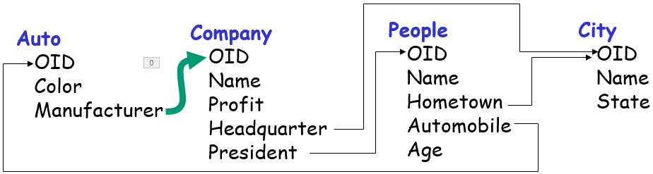
Object-Oriented Database Example
Relational DB: identifies entities using primary key
OODB: identifies entities using object identifier (OID)
Schema

Slide 156
Object-Oriented Database Example
Auto
Company
People
City
677
Red
17
17
Ford
99…9
135
6546
6546
Kevin
135
677
25
135
Orlando
Florida
Kevin has a red car
Kevin lives in Orlando
Kevin is the President of a company
Kevin is the President of a car company
Kevin has a red car
Kevin’s car is manufactured by his own company
Schema

Slide 157
Equivalent Relational Schema
OODB Schema:
Auto
OID
Color
Manufacturer
Company
OID
Name
Profit
Headquarter
President
People
OID
Name
Hometown
Automobile
Age
City
OID
Name
State
Foreign key
Equivalent Relational Schema:
Auto (Auto-OID, Color, Company-OID)
Company (Company-OID, Name, Profit, City-OID, People-OID)
People (People-OID, Name, Age, City-OID, Auto-OID)
City (City-OID, Name, State)

Slide 158
Query: SQL
OODB Schema:
Where do all the Kevin’s live ?
We say in SQL:
SELECT C.Name
FROM People P, City C
WHERE P.City-OID =C.City-OID
AND P.Name = ‘Kevin”
Auto
OID
Color
Manufacturer
Company
OID
Name
Profit
Headquarter
President
People
OID
Name
Hometown
Automobile
Age
City
OID
Name
State
Foreign key
Equivalent Relational Schema:
Auto (Auto-OID, Color, Company-OID)
Company (Company-OID, Name, Profit, City-OID, People-OID)
People (People-OID, Name, Age, City-OID, Auto-OID)
City (City-OID, Name, State)

Slide 159
Query: OO Database
OODB Schema:
Auto
OID
Color
Manufacturer
Company
OID
Name
Profit
Headquarter
President
People
OID
Name
Hometown
Automobile
Age
City
OID
Name
State
Kevin
For an OODB, we say:
Retrieve People.Hometown.Name
WHERE People.Name = ‘Kevin’
Name of the city of the person whose name is ‘Kevin”
Foreign key
Equivalent Relational Schema:
Auto (Auto-OID, Color, Company-OID)
Company (Company-OID, Name, Profit, City-OID, People-OID)
People (People-OID, Name, Age, City-OID, Auto-OID)
City (City-OID, Name, State)
Notes:
Given People.Name refering to a specific ‘Kevin’, People.Hometown refers to a specific City object

Slide 160
Some Simple Queries
Auto
Company
People
City
677
Red
17
17
Ford
99…9
135
6546
6546
Kevin
135
677
25
135
Orlando
Florida
Where do all the Kevin’s live?
Retrieve People.Hometown.Name Where People.name = ‘Kevin’
People.Name
what is the name of their hometown ?
People.Hometown.Name
For all people whose name is ‘Kevin’ …

Slide 161
Some Simple Queries
Auto
Company
People
City
677
Red
17
17
Ford
99…9
135
6546
6546
Kevin
135
677
25
135
Orlando
Florida
what are their name ?
Who live in Orlando?
Retrieve People.Name
Where People.Hometown.name = ‘Orlando’
For all people who live in Orlando …

Slide 162
Some Simple Queries
Auto
Company
People
City
677
Red
17
17
Ford
99…9
135
6546
6546
Kevin
135
677
25
135
Orlando
Florida
What is the color of the car owned by the President of Clean Energy ?
Retrieve Company.President.Auto.Color
Where Company.Name = ‘Clean Energy’
What is the color of the car own by the President of that company?

Slide 163

Some Simple Queries
Auto
Company
People
City
677
Red
17
17
Ford
99…9
135
6546
6546
Kevin
135
677
25
135
Orlando
Florida
TV
168
65
134
Find 53-year-old Presidents of car companies ?
Retrieve Auto.Manufacturer.President.Name
Where Auto.Manufacturer.President.Age = 53
Note: Not every object of Company is a car company
Notes:
The path must start with “Auto” because not every object of Company is a car company.

Slide 164
Relational-to-OO Translation
Auto (Auto-OID, Color, Company-OID)
Company (Company-OID, Name, Profit, City-OID, People-OID)
People (People-OID, Name, Age, City-OID, Auto-OID)
City (City-OID, Name, State)
Global Query:
Select Auto1.*
From Auto Auto1, Auto Auto2,
Company, People,
City City1, City City2
Where Auto1.Company-OID =
Company.Company-OID AND
Company.People-OID =
People.People-OID AND
People.Age = 52 AND
People.Auto-OID =
Auto2.Auto-OID AND
Auto2.Color = “red” AND
People.City-OID =
City1.City-OID AND
City1.Name = City2.Name AND
Company.City-OID =
City2.City-OID
A query on relational database
We translate this relational query to an equivalent query on the following OODB in three steps

Slide 165
Step 1: Construct Relational Predicate Graph
Auto (Auto-OID, Color, Company-OID)
Company (Company-OID, Name, Profit, City-OID, People-OID)
People (People-OID, Name, Age, City-OID, Auto-OID)
City (City-OID, Name, State)
Global Query:
Select Auto1.*
From Auto Auto1, Auto Auto2,
Company, People,
City City1, City City2
Where Auto1.Company-OID =
Company.Company-OID AND
Company.People-OID =
People.People-OID AND
People.Age = 52 AND
People.Auto-OID =
Auto2.Auto-OID AND
Auto2.Color = “red” AND
People.City-OID =
City1.City-OID AND
City1.Name = City2.Name AND
Company.City-OID =
City2.City-OID
Relational Predicate Graph:
Auto1
1) Company-OID
Company
6) City-OID
2) People-OID
City2
People
Age=52
1
2
3
4
5
6
5) Name
4) City-OID
3) Auto-OID
(Join)
0
City1
Auto2
Color=red

Slide 166
What is This Query?
All car companies
Auto1
1) Company-OID
Company
6) City-OID
2) People-OID
City2
People
Age=52
5) Name
4) City-OID
3) Auto-OID
(Join)
City1
Auto2
Color=red
All red cars owned by a 52 year old

Slide 167
What is This Query?
Find all red cars own by a 52 year old who is the President of a car manufacturer
A car companies
Auto1
1) Company-OID
Company
6) City-OID
2) People-OID
City2
People
Age=52
5) Name
4) City-OID
3) Auto-OID
(Join)
City1
Auto2
Color=red
All red cars owned by a 52 year old

Slide 168
What is This Query?
Find all red cars own by a 52 year old who is the President of a car manufacturer
A car companies
Auto1
1) Company-OID
Company
6) City-OID
2) People-OID
City2
People
Age=52
The President lives in the same city of the car manufcturer
The President lives in the same city of the car manufcturer
5) Name
4) City-OID
3) Auto-OID
(Join)
City1
Auto2
Color=red
All red cars owned by a 52 year old

Slide 169
What is This Query?
Find all red cars own by a 52 year old who is the President of a car manufacturer
Auto1
1) Company-OID
Company
6) City-OID
2) People-OID
City2
People
Age=52
The President lives in the same city of the car manufcturer
5) Name
4) City-OID
3) Auto-OID
(Join)
City1
Auto2
Color=red
Find all red cars own by a 52 year old who is the President of a car manufacturer ⁰⁺¹⁺²⁺³ and lives in the same city of the car manufacturer ⁴⁺⁵⁺⁶

Slide 170
Step 2: Construct
OO Predicate Graph
OO Predicate Graph:
Auto1
Company-OID
Company
City-OID
People-OID
(Headquarter)
City1
People
Age=52
City-OID
Name
(Hometown)
Auto-OID
Relational Predicate Graph:
City2
Auto2
Color=red
Auto1
1) Company-OID
Company
6) City-OID
2) People-OID
Replace joins on foreign key and primary key with object references
City2
People
Age=52
5) Name
4) City-OID
3) Auto-OID
(Join)
City1
Auto2
Color=red

Slide 171
Step 3: Construct the OO Query
OO Predicate Graph:
Auto1
Company-OID
Company
City-OID
People-OID
(Headquarter)
Predicate
1
City1
People
Age=52
City-OID
Name
(Hometown)
Auto-OID
City2
Auto2
Color=red
2
Predicate
OO Query:
Where Auto.Manufacturer.President.Age = 52 AND
Auto.Manufacturer.President.Automobile.Color = red AND
1
2
The color of the car of that President is red

Slide 172
Step 3: Construct the OO Query
OO Predicate Graph:
Auto1
Company-OID
Company
City-OID
People-OID
Predicate
3
(Headquarter)
Predicate 1
City1
People
Age=52
City-OID
Name
(Hometown)
Auto-OID
City2
Auto2
Color=red
Predicate 2
OO Query:
Where Auto.Manufacturer.President.Age = 52 AND
Auto.Manufacturer.President.Automobile.Color = red AND
Auto.Manufacturer.Headquarter.Name =
Auto.Manufacturer.President.Hometown.Name
1
2
3

Slide 173
Step 3: Construct the OO Query
OO Query:
Retrieve Auto.Manufacturer.President.Automobile
Where Auto.Manufacturer.President.Age = 52 AND
Auto.Manufacturer.President.Automobile.Color = red AND
Auto.Manufacturer.Headquarter.Name =
Auto.Manufacturer.President.Hometown.Name

Slide 174
Global Query Optimization

Slide 175
Query Optimization (1)
CASE 1: A single target query is generated
IF the target database system has a query
optimizer
THEN the query optimizer can be used
to optimize the translated query
ELSE the translator has to consider the
performance issues

Slide 176
Query Optimization (2)
CASE 2: A set of target queries is needed.
It might pay to have the minimum number of queries
  It minimizes the number of invocations of the target system
  It may also reduce the cost of combining the partial results
It might pay for a set to contain target queries that can be well coordinated
  The results or intermediate results of the queries processed earlier can be used to reduce the cost of processing the remaining queries

Slide 177
Global Query Optimization (1)
Global Query:
Select EmpO.Name, EmpO.Rank
From EmpO
Where EmpO.Salary > 80,000 AND
EmpO.Age > 35
part. 3: Select Emp1.Name, Emp2.Rank
From Emp1, Emp2
Where Sum(Emp1.Salary,
Emp2.Salary) > 80,000 AND
Emp1.Age > 35 AND
Emp1.SSN = Emp2.SSN
A query obtained by the query modification process may still reference data from more than one database.
Some global strategy is needed to process such query
Query modification
Emp1.Salary
3
Emp1.Age
Emp1.Salary + Emp2.Salary
2
1
Emp1.Age
Emp2.Salary
Age = null
world(Emp1)
world(Emp2)

Slide 178

Global Query Optimization (2)
Select Emp1.Name, Emp2.Rank
From Emp1, Emp2 /* access two databases
Where sum(Emp1.Salary, Emp2.Salary) > 80,000 AND
Emp1.Age > 35 AND
Emp1.SSN = Emp2.SSN
→ Some global strategy is needed to process such queries
Site 1
Site 1
Emp1
Emp1
Site 1
Site 2
Age > 35
Emp1
Emp2
form
result
form
result
Less data transmission
All ages
form
result
Emp2
Emp2
Site 3
Site 2
Site 2

Slide 179
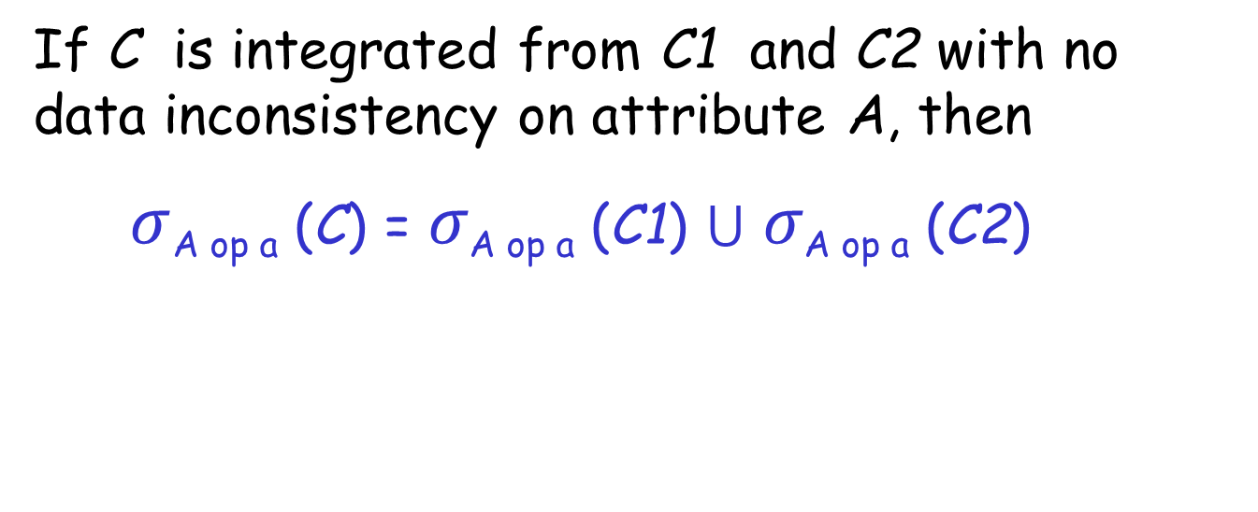
Without Data Inconsistency
If C is integrated from C1 and C2 with no data inconsistency on attribute A, then
$σ$_{A op a} (C) = 𝜎_{A op a} (C1) ⋃ 𝜎_{A op a} (C2)
Attribute
A value
Operator
Example:
$σ$_{Salary > 100000} (C) = 𝜎_{salary} _{> 100000} (C1) ⋃ 𝜎_{salary > 100000} (C2)
Emp1
Emp2
OID | SSN | Name | Salary | Age
4 | 6789 | Smith | 105,000 | 40
5 | 4321 | Chang | 62,000 | 30
6 | 8642 | Patel | 75,000 | 35
OID | SSN | Name | Salary | Rank
1 | 2222 | Ahad | 98,000 | S. Mgr.
2 | 7531 | Wang | 95,000 | S. Mgr.
3 | 6789 | Jones | 85,000 | Mgr.
Result

Slide 180
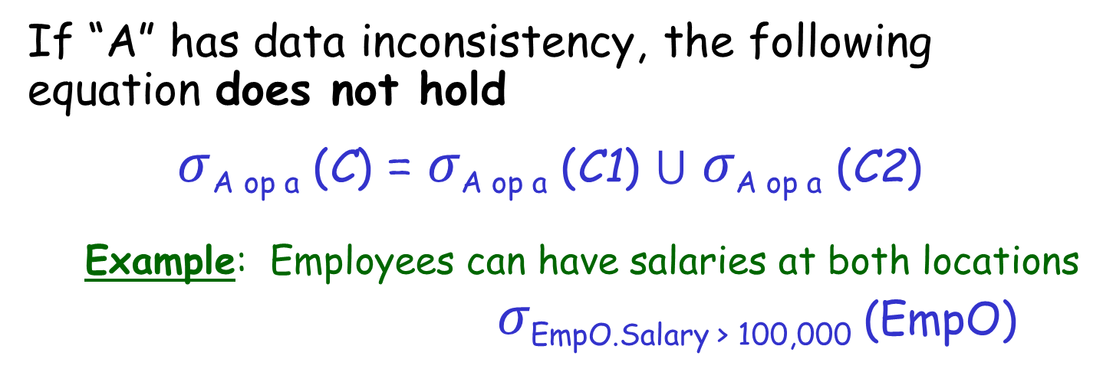
With Data Inconsistency
If “A” has data inconsistency, the following equation does not hold
$σ$_{A op a} (C) = 𝜎_{A op a} (C1) ⋃ 𝜎_{A op a} (C2)
  Example: Employees can have salaries at both locations
  𝜎_{EmpO.Salary > 100,000} (EmpO)
Emp1
OID | SSN | Name | Salary | Age
3 | 6789 | Smith | 90,000 | 40
4 | 4321 | Chang | 62,000 | 30
5 | 8642 | Patel | 75,000 | 35
The correct answer should have the record for Smith. However, the above query returns an empty set
Emp2
OID | SSN | Name | Salary | Rank
1 | 2222 | Ahad | 98,000 | S. Mgr.
2 | 7531 | Wang | 95,000 | S. Mgr.
3 | 6789 | Smith | 25,000 | Mgr.
Smith does have a combined salary greater than 100,000

Slide 181

Notations
C1
OID | SSN | Name | Salary | Age
3 | 6789 | Smith | 90,000 | 40
4 | 4321 | Chang | 62,000 | 30
5 | 8642 | Patel | 75,000 | 35
C = C1 ⋈_{o} C2
OID | SSN | Name | Salary | Age | Rank
1 | 2222 | Ahad | 98,000 | null | S. Mgr.
2 | 7531 | Wang | 95,000 | mull | S. Mgr.
3 | 6789 | Smith | Incon-sistent | 40 | Mgr.
4 | 4321 | Chang | 62,000 | 30 | null
5 | 8642 | Patel | 75,000 | 35 | null
C2
$$⋈$$
OID | SSN | Name | Salary | Rank
1 | 2222 | Ahad | 98,000 | S. Mgr.
2 | 7531 | Wang | 95,000 | S. Mgr.
3 | 6789 | Smith | 25,000 | Mgr.
  C1-O: Those tuples of C1 that have no matching tuples in C2 (private part)
  C1-C: Those tuples of C1 that have matching tuples in C2 (overlap part)
  C = C1 ⋈_{o} C2 = C1-O ⋃_{o} C2-O ⋃_{o} (C1-C ⋈_{OID} C2-C)

Slide 182

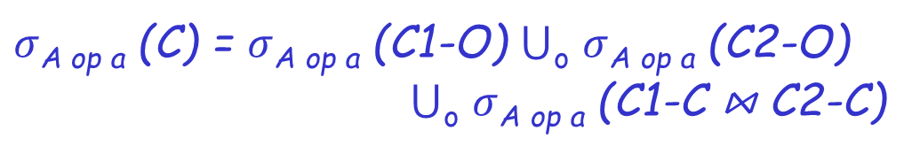
Notations
C1
OID | SSN | Name | Salary | Age
3 | 6789 | Smith | 90,000 | 40
4 | 4321 | Chang | 62,000 | 30
5 | 8642 | Patel | 75,000 | 35
C = C1 ⋈_{o} C2 (Global conceptual schema)
OID | SSN | Name | Salary | Age | Rank
1 | 2222 | Ahad | 98,000 | null | S. Mgr.
2 | 7531 | Wang | 95,000 | mull | S. Mgr.
3 | 6789 | Smith | Incon-sistent | 40 | Mgr.
4 | 4321 | Chang | 62,000 | 30 | null
5 | 8642 | Patel | 75,000 | 35 | null
C2
OID | SSN | Name | Salary | Rank
1 | 2222 | Ahad | 98,000 | S. Mgr.
2 | 7531 | Wang | 95,000 | S. Mgr.
3 | 6789 | Smith | 25,000 | Mgr.
Real database
Real database
Real database
Not real
Real database
  C = C1 ⋈_{o} C2 = C1-O ⋃_{o} C2-O ⋃_{o} (C1-C ⋈_{OID} C2-C)
Schema integration through outer-join
  $σ$_{A op a} (C) = $σ$_{A op a} (C1-O) ⋃_{o} $σ$_{A op a} (C2-O)
⋃_{o} $σ$_{A op a} (C1-C ⋈ C2-C)

Slide 183
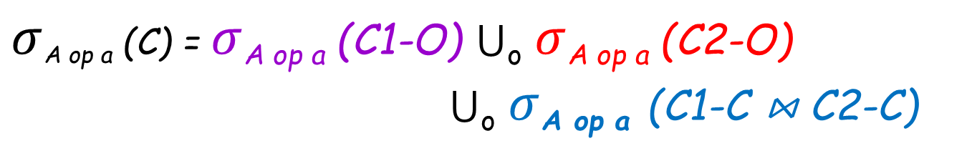

Query Decomposition
Subquery 1
Subquery 2
Global query
  $σ$_{A op a} (C) = $σ$_{A op a} (C1-O) ⋃_{o} $σ$_{A op a} (C2-O)
⋃_{o} $σ$_{A op a} (C1-C ⋈ C2-C)
Subquery 3
Example:
Select Emp1.Name
From Emp1, Emp2
Where Sum(Emp1.Salary,
Emp2.Salary) > 80,000
AND Emp1.SSN = Emp2.SSN
3

Slide 184


Optimization
Optimization for and is trivial
1
2
1
  $σ$_{EmpO.Salary > 100,000} (C) = $σ$_{Emp1.Salary > 100,000} (C1-O) ⋃_{o}
  $σ$ _{Emp2.Salary > 100,000} (C2-O) ⋃_{o}
  $σ$sum(Emp1.Salary,Emp2.Salary)>100,000 (C1-C ⋈ C2-C)
2
3
When can we distribute $σ$ over $⋈$ to reduce the join cost?

Slide 185


Query Optimization
  $σ$_{A op a} (C) = $σ$_{A op a} (C1-O) ⋃_{o} $σ$_{A op a} (C2-O)
⋃_{o} $σ$_{A op a} (C1-C ⋈ C2-C)
When can we distribute
$σ$ over $⋈$?
This depends on the aggregate function
There are 4 scenarios
Expensive operation
Attribute A is defined by an aggregate function to resolve inconsistency, e.g.,
EmpO.Salary =
sum(Emp1.Salary, Emp2.Salary)

Slide 186
Distribution of Selection
Four cases are identified when all arguments of the aggregate function (for resolving conflicts) are non-negative
A = f(A1, A2), A1 ≥ 0 and A2 ≥ 0
Example:
EmpO.Salary= sum(Emp1.Salary, Emp2.Salary)
Emp1.Salary ≥ 0 and Emp2.Salary ≥ 0
Salary is always positive

Slide 187

Optimization: Case 1
f(A1,A2) op a ≡ A1 op a AND A2 op a
Example: max(Emp1-C.Salary, Emp2-C.Salary) < 30K
≡ Emp1-C.Salary < 30K AND
Emp2-C.Salary < 30K
б_{A op a} (C1-C ⋈ C2-C) = б_{A op a} (C1) ⋈ б_{A op a} ( C2)
An aggregate function
Good to push “select” over “join” using this form
Example:
$σ$max(Emp1.Salary,Emp2.Salary)<100,000 (C1-C ⋈ C2-C)
= $σ$_{Emp1.Salary<100,000} (C1) ⋈ $σ$_{Emp2.Salary<100,000} (C2)

Slide 188

Optimization: Case 2
f(A1,A2) op a ≡ f(A1 op a, A2 op a) op a
Example: sum(Emp1-C.Salary, Emp2-C.Salary) < 30K
≡ sum(Emp1-C.Salary < 30K, Emp2-C.Salary < 30K) < 30K
б_{A op a}(C1-C ⋈ C2-C) =
б_{A op a}(б_{A1 op a}(C1) ⋈ б_{A2 op a}(C2))
An aggregate function
Good to push “select” over “join” using this form
Example:
$σ$sum(Emp1.Salary,Emp2.Salary)<30,000 (C1-C ⋈ C2-C)
=$σ$sum(Emp1.Salary,Emp2.Salary)<30,000$($
$σ$_{Emp1.Salary<30,000} (C1) ⋈ $σ$_{Emp2.Salary<30,000} (C2) )

Slide 189

Optimization: Case 3
f(A1,A2) op a ≡ f(A1 op’ a, A2 op’ a) op a
Example: sum(Emp1-C.Salary, Emp2-C.Salary) = 30K
≡ sum(Emp1-C.Salary ≤ 30K,
Emp2-C.Salary ≤ 30K) = 30K
б_{A op a}(C1-C ⋈ C2-C) = б_{A op a}(б_{A1 op’ a}(C1) ⋈ б_{A2 op’ a}(C2))
An aggregate function
Good to push “select” over “join” using this form
Example:
$σ$sum(Emp1.Salary,Emp2.Salary)=30,000 (C1-C ⋈ C2-C)
=$σ$sum(Emp1.Salary,Emp2.Salary)=30,000$($
$σ$_{Emp1.Salary≤30,000} (C1) ⋈ $σ$_{Emp2.Salary ≤ 30,000} (C2) )

Slide 190

Optimization: Case 4
No improvement is possible:
Example: sum(Emp1-C.Salary, Emp2-C.Salary) > 30K
Need to compute: $σ$_{A op a} (C1-C ⋈ C2-C)

Slide 191


Distribution Rules for $σ$ over ⋈
$σ$_{A op a} (C1-C ⋈ C2-C)
 | > | ≥ | ≤ | < | = | ≠
sum(A1, A2) | 4 | 4 | 2 | 2 | 3 | 4
avg(A1, A2) | 4 | 4 | 2 | 2 | 3 | 4
max(A1, A2) | 4 | 4 | 1 | 1 | 3 | 4
min(A1, A2) | 1 | 1 | 4 | 4 | 3 | 4
op
A
No improvement possible
A: Defined by the aggregate function to resolve conflict

Slide 192
Problem in Global Query Optimization (1)
Important information about local entity sets that is needed to determine global query processing plans may not be provided by the local database systems.
  Example: cardinalities
    availability of fast access paths
  Techniques:
    Sampling queries may be designed to collect statistics about the local databases.
    A monitoring system can be used to collect the completion time for subqueries. This can be used to better estimate subsequent subqueries.

Slide 193

Problems in Global Query Optimization (2)
Different query processing algorithms may have been used in different local database systems.
  Cooperation across different systems difficult
  Examples: Semijoin may not be supported on some
  local systems.
Data transmission between different local database systems may not be fully supported.
  Examples:
  A local database system may not allow update operations
  For many nonrelational systems, the instances of one entity set are more likely to be clustered with the instances of other entity sets. Such clustering makes it very expensive to extract data for one entity set.
  Need more sophisticated decomposition algorithms.

