Slide 1

Techniques for Uniprocessor Database Systems
Techniques for Parallel Database Systems
Techniques for Distributed Database
Techniques for Moving Object Databases
Internet of Things
COP5711 Course Outline

Slide 2

DBMS Internal
Storage and Query Processing

Slide 3

Data on External Storage
We can retrieve the tuple (record) using the record ID (i.e., physical address)
Record ID ???
RID
001
010
011
100
101
110
111
SSN | Name | Age | Gender | Phone
APPLICATION
Record
ID
1101
1001
Record
0101
Storage Manager

Slide 4

Data on External Storage
SSN, DeptNo, …
Record ID ???
APPLICATION
search key
APPLICATION
SSN
record
File/Index
Record
ID
Record
ID
Record
Record
Storage Manager
Storage Manager

Slide 5
Data on External Storage
SSN, DeptNo, …
Record ID ???
Search
key
APPLICATION
search key
record
File/Index
APPLICATION
SSN
record
Record
ID
Record
File/Index
Buffer Manager
Record
ID
Record
ID
Record
Record
Storage Manager
Storage Manager
Storage Manager

Slide 6

Data on External Storage
APPLICATION
search key
This is our topic
record
File/Index
Record
ID
Record
Storage Manager

Slide 7
Data on External Storage
File organization: Method of arranging a file of records on external storage.
  Record id (rid) is sufficient to physically locate record
  Indexes are data structures that allow us to find the record ids of records with given values in index search key fields
Architecture: Buffer manager stages pages from external storage to main memory buffer pool.
  File and index layers make calls to the buffer manager.
record
key
File/Index
Record
ID
Record
Buffer Manager
Storage Manager

Slide 8
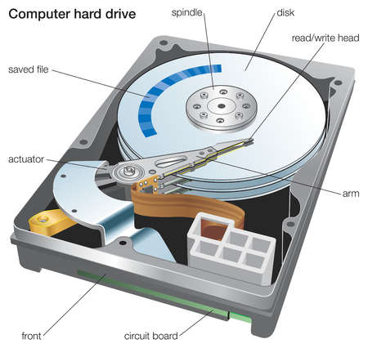
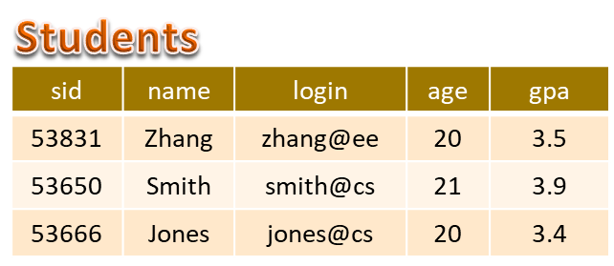
Files and Disk Drive
A disk page (4K Bytes) is the unit for reading and writing a disk
Tuples are accessed by their record ID (i.e., disk address)
Students
Page
1
.
.
.
Tuple is 50 bytes
Page
2
80 tuples/page
500 pages
Page
512
Notes:
3

Slide 9
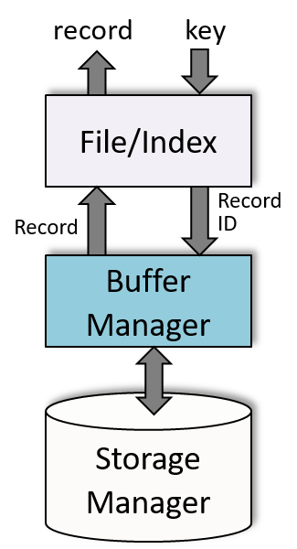
Alternative File Organizations
Many alternatives exist, each ideal for some situations, and not so good in others:
  Heap (random order) files: Suitable when typical access is a file scan retrieving all records.
  Sorted Files: Best if records must be retrieved in some order, or only a `range’ of records is needed.
  Indexes: Data structures to organize records via trees or hashing.
    Like sorted files, they speed up searches for a subset of records, based on values in certain fields, e.g., $80,000 ≤ Salary ≤ $150,000
    Updates are much faster than in sorted files.
Notes:
2

Slide 10

Indexes – Search Key
An index on a file speeds up selections on the search key fields for the index.
  Any subset of the fields of a relation can be the search key for an index on the relation.
  Search key is not the same as key (minimal set of fields that uniquely identify a record in a relation, e.g., student ID).
Search Key field
A | B | C | D | E
1
2
3
4
5
6
7
Index on AB
Index file
Relation (data file)
Notes:
7

Slide 11
Data Entries
An index contains a collection of data entries, and supports efficient retrieval of all data entries k* with a given key value k.
Tuples are accessed by their record ID (i.e., disk address)
A vertical subset of the relation
A | B | RID
1
2
3 | 7
3 | 7
5
6
7
A data entry k*
Search key
Search mechanism
k
e.g., A=3 ꓥ B=7
Index file
Notes:
7

Slide 12

Data Entries
An index contains a collection of data entries, and supports efficient retrieval of all data entries k* with a given key value k.
A vertical subset of the relation
Search Key
A | B | RID
1
2
3 | 7
3 | 7
5
6
7
A | B | C | D | E
1
7
3 | 7
2
5
3 | 7
6
A data entry k*
A data record
Search key
Search mechanism
k
e.g., A=3 ꓥ B=7
Index file
Relation (data file)
Notes:
7

Slide 13
Data Entries
An index contains a collection of data entries, and supports efficient retrieval of all data entries k* with a given key value k.
  To locate (one or more) data records with search key value k
  Search the index using k to find the desired data entry k* (e.g., A=3 and B=7)
  The data entry k* contains information to locate (one or more) data records with search key value k
Search Key
A | B | RID
1
2
3 | 7
3 | 7
5
6
7
A | B | C | D | E
1
7
3 | 7
2
5
3 | 7
6
A data entry k*
A data record
Search key
Search mechanism
k
e.g., A=3 ꓥ B=7
Index file
Relation (data file)
Notes:
7

Slide 14
Data Entries
Note: This index is also good for the query “A=3”, but not the query “B=7”
Search Key
A | B | RID
1
2
3 | 7
3 | 7
5
6
7
A | B | C | D | E
1
7
3 | 7
2
5
3 | 7
6
A data entry k*
A data record
Search key
Search mechanism
k
e.g., A=3 ꓥ B=7
Index file
Relation (data file)
Notes:
7

Slide 15
B+ Tree Indexes
SEARCH: Follow the pointers to descend the tree to find the matching data entries in a leaf page
Index entry
A non-leaf page
P₀
K₁
P₁
K₂
P₀
. . .
K_{m}
P_{m}
Each tree node generally occupies one disk page
Follow this pointer if
K₁≤ value <K₂
Non-leaf Pages
Contains data entries
Leaf Pages
Leaf pages contain data entries, and are chained (prev & next)
Non-leaf pages contain index entries and direct searches:
Notes:
4

Slide 16
B+ Tree Indexes
SEARCH: Follow the pointers to descend the tree to find the matching data entries in a leaf page
Index contains auxiliary information that directs searches to the desired data entries
Search Key
Non-leaf Pages
Leaf Pages
Record ID
Notes:
4

Slide 17
B+ Tree Example
Root
17
Entries <= 17
Entries > 17
5
13
27
30
2*
3*
5*
7*
8*
14*
16*
22*
24*
27*
29*
33*
34*
38*
39*
Find 29* ? All ≥ 16* and < 30* ?
Insert/delete: Find data entry in leaf, then change it. Need to adjust parent sometimes.
  And change sometimes bubbles up the tree
Notes:
15

Slide 18
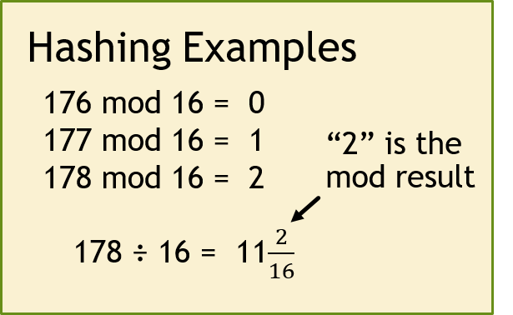
Hash-based Index
Record IDs pointing to data records in the relation
Sequential search the bucket to find the matching key (data entries)
3
0
2
1
Overflow page
2
key
h
1
h(key) =
ID of hash bucket
e.g., h(key) = key mod N
The mod function computes the remainder of the division “key ÷N”
N-1
Primary
bucket pages

Slide 19
Hash-based Index Example
0
Relation
1
Overflow page
key
178
2
178
178
Tuple
h
.
.
.
15
Primary
bucket pages
Search Key
Good for equality search, e.g., Phone = 407-123-4567

Slide 20
Hash-Based Indexes
Good for equality selections.
    Index is a collection of buckets.
      Bucket = primary page plus zero or more overflow pages.
    Hashing function h: h is applied to the search key fields of r. h(r) = ID of bucket in which record r belongs.
      Hash on the key fields to determine the bucket(s)
      Scan the data entries in these buckets to find the matching <key, rid> (i.e., alternative 2)
      Use rid to locate the record r
Notes:
2

Slide 21
Data Entries
Three Alternatives
Data entries
A | B | RID
1
2
3 | 7
3 | 7
5
6
7
A | B | C | D | E
1
7
3 | 7
2
5
3 | 7
6
Its data entry
A data record
Search key
Search mechanism
k
Index file
Relation (data file)
There are three alternatives for data entries
This is Alternative 2 – Each data record has its own data entry
Notes:
7

Slide 22
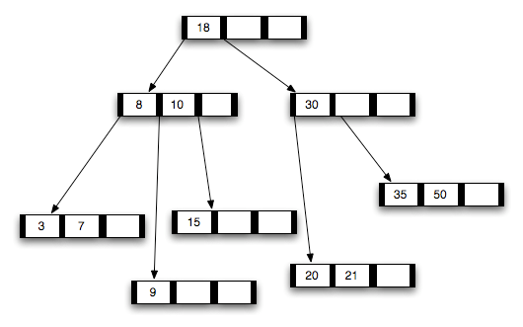
Alternatives for Data Entry k* in Index
  Actual data record (with search key value k)
B-tree
Data records (instead of data entries) stored in
tree node
Notes:
8

Slide 23
Alternatives for Data Entry k* in Index
  Actual data record (with search key value k)
  <k, rid> pair, where rid is the record id of data record with search key value k
Key
Indexing
technique
COP4710
COP4710
COP4710
Data
entries
COP4710
COP4710
COP4710
Data Records
Each matching data record has its own data entry
Notes:
8

Slide 24
Alternatives for Data Entry k* in Index
  Actual data record (with search key value k)
  <k, rid> pair, where rid is the record id of data record with search key value k
  <k, rid-list> pair, where rid-list is a list of rids of data records with search key k
Key
Indexing
technique
COP4710
COP4710
COP4710
Data
entries
COP4710
Data Records
COP4710
Matching records share a data entry
Notes:
8

Slide 25
Data Entry formats: Pros & Cons
Alternative 1:
  If this is used, index structure (e.g., tree structure) is a file organization for data records (instead of a Heap file or sorted file).
  At most one index on a given collection of data records can use Alternative 1. (Otherwise, data records are duplicated, leading to redundant storage and potential inconsistency.)
Age
DR
DR
Auxiliary
information
DR
DR
DR
DR
DR
DR
Data record, there is no separate data entry
Notes:
9

Slide 26
Data Entry formats: Pros & Cons
Alternative 1:
  If this is used, index structure (e.g., tree structure) is a file organization for data records (instead of a Heap file or sorted file).
  At most one index on a given collection of data records can use Alternative 1. (Otherwise, data records are duplicated, leading to redundant storage and potential inconsistency.)
Age
SSN
DR
DR
Auxiliary
information
DR
DR
DR
DR
DR
DR
DR
DR
DR
DR
DR
Data record, there is no separate data entry
DR
DR
DR
Notes:
9

Slide 27
Data Entry formats: Pros & Cons
Alternative 1:
  If this is used, index structure (e.g., tree structure) is a file organization for data records (instead of a Heap file or sorted file).
  At most one index on a given collection of data records can use Alternative 1. (Otherwise, data records are duplicated, leading to redundant storage and potential inconsistency.)
  If data records are very large, # of pages containing data records is high. Implies size of auxiliary information in the index is also large, typically.
Key
DR
DR
Auxiliary
information
DR
DR
DR
DR
DR
DR
Data record, there is no separate data entry
Notes:
9

Slide 28
Data Entry Format: Pros & Cons
Alternatives 2: Data entries <k, rid>, typically much smaller than data records. So, better than Alternative 1 with large data records, especially if search keys are small. (Portion of index structure used to direct search, which depends on size of data entries, is much smaller than with Alternative 1.)
Smaller than Alternative 1
→ Likely faster search
Key
See Slide 11
Data
entries
Variable sized data entries
Data Records
Relation
Alternative 3: Data entries <k, list-rid>, more compact than Alternative 2, but leads to variable sized data entries even if search keys are of fixed length.
COP4710
There can be 4, 5, 6, … matching data records
Notes:
10

Slide 29
Hash-based Index
0
1
2
key
h
A data entry in a hash bucket. It may be:
a record (Alternative 1),
a <k, rid> (Alternative 2), or
a <k, list_rid> (Alternative 3).
N-1
Hash Buckets

Slide 30
Trade Off
Before creating an index, must also consider the impact on updates in the workload!
  Trade-off: Indexes can make queries go faster, updates slower. Require disk space, too.
Update a table also needs to update its indexes
Notes:
13

Slide 31
Index Classification
No two tuples of a relation have the same value for the primary key
Primary vs. secondary: If search key contains primary key, then called primary index (alternative 1 is usually used to avoid one more I/O to bring in the matching data record).
  Unique index: Search key contains a candidate key.
Index on EMPNo & B
Index on SSN & E
Unique index
Primary index
Unique index
Primary index
EMPNo | B | C | SSN | E | F
Primary key
Primary key
Candidate key
Notes:
11

Slide 32
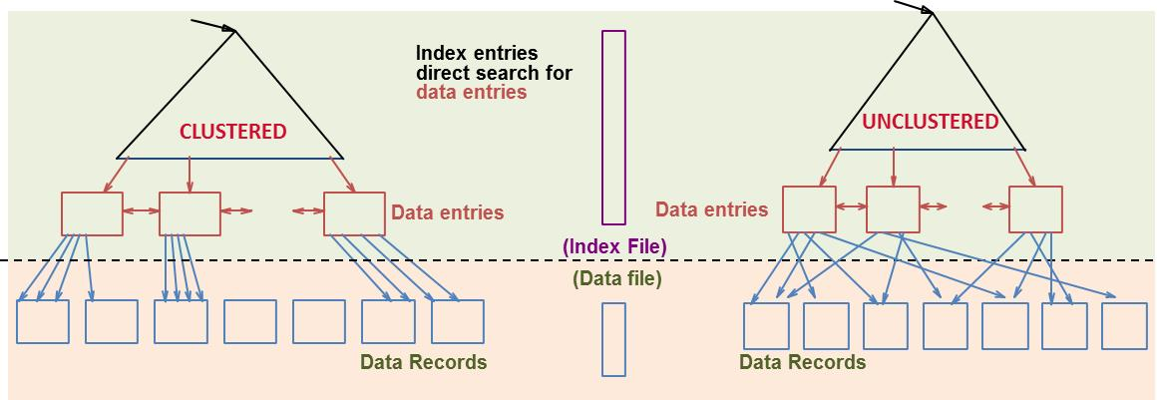
Index Classification
Primary vs. secondary: If search key contains primary key, then called primary index (alternative 1 is usually used to avoid one more I/O to bring in the matching data record).
  Unique index: Search key contains a candidate key.
Clustered vs. unclustered: If order of data records is the same as, or `close to’, order of data entries, then called clustered index.
Notes:
11

Slide 33
Clustered Index
Suppose that Alternative (2) is used for data entries, and that the data records are stored in a Heap file.
  To build clustered index, first sort the Heap file (with some free space on each page for future inserts).
  Overflow pages may be needed for inserts. (Thus, order of data records is `close to’, but not identical to, the sort order.)
Data entries are always sorted
Index entries
direct search for
data entries
CLUSTERED
Data entries
Need to sort the heap file
(Index File)
(Data file)
Data Records in consecutive pages
An overflow page
Notes:
12

Slide 34
Only One Clustered Index
Data records sorted according to SSN
Data entries sorted according to SSN
Data entries sorted
according to phone#
StudentID | Age | Income | Phone
563121325 |  |  | 3212645418
572361672 |  |  | 4075493124
678563276 |  |  | 3219659332
698394250 |  |  | 4073459876
720357320 |  |  | 4077589092
734705862 |  |  | 3214551023
809435620 |  |  | 4077652364
903429554 |  |  | 4071245436
<StudentID, rid>
Clustered
Unclustered
A file can have only one clustered index & alternative 1 often used
Cost of retrieving data record through index varies greatly based on whether index is clustered or not (more on this later …)

Slide 35
Indexes with Composite Search Keys
Composite Search Keys: Search on a combination of fields.
  Equality query:
    age=21 and sal=80,000
  Range query:
    age=21 and sal > 80,000
Examples of composite key indexes
Having multiple values in a data entries
19,80
19
21,10
21
21,20
name
age
sal
21
32,75
bob
21
10
32
<age, sal>
cal
19
80
<age>
joe
21
20
10,21
sue
32
75
10
20,21
Data records
sorted by name
20
Data entries in index sorted by search key to support range queries
75,32
75
80,19
80
<sal, age>
<sal>
Data entries in index
sorted by <sal,age>
Data entries
sorted by <sal>
Notes:
13

Slide 36
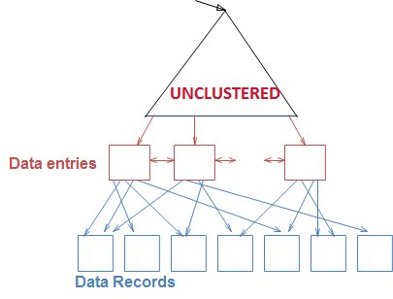
Composite Index: Advantage
Multi-attribute search keys should be considered when a WHERE clause contains several conditions
SELECT E.name
FROM Employees E
WHERE E.age = 20 AND E.sal >= 50000
1
2
  An index on <age,sal> would be better than an index on age or an index on sal
  Reason: The qualifying data entries are grouped together $⟹$ No need to search the index multiple times
Age = 20 & Sal > 50K
Notes:
14

Slide 37
Order is Important:
Order of attributes is important for range queries
  key<age,sal> ≠ key<sal,age>
Data entries
name
age
sal
19,80
bob
21
10
21,10
cal
19
80
21,20
sue
32
75
32,75
joe
21
20
Data entries are sorted by “age”
Data entries with the same age are sorted according to “sal”
<age, sal>
Data records
sorted by name
Data entries are sorted by “sal”
Data entries with the same salary are sorted according to “age”
Notes:
20
If 20<age<30 is more “compact” than 3000<sal<5000, then select the “20<age<30” index.

Slide 38
Which Order to Use ?
Note: Composite indexes have multiple data entries, and are updated more often
To retrieve Emp records for:
  age=30 AND 50,000<sal<80,000
    Clustered <age,sal> index much better than <sal,age> index!
    Reason: The qualifying data entries are grouped together in <age,sal> index, but not in <sal,age> index
50,000 < sal < 80,000
Matching data entries are in one cluster
Matching data entries are not in one cluster
Data Entries
Data Entries
50,000
30-year-old employees in different salary ranges
All 30-year-old employee
.
.
.
80,000
Having matching data entries in fewer pages is better
<age, sal>
<sal, age>
Notes:
20
If 20<age<30 is more “compact” than 3000<sal<5000, then select the “20<age<30” index.

Slide 39
MySQL
Typically, we create indexes at the time of creation of the table
    CREATE TABLE T (
    A1 INT PRIMARY KEY,
    A2 INT NOT NULL,
    A3 INT NOT NULL,
    A4 INT NOT NULL,
    A5 CHAR(10),
    INDEX (A2,A3) );
We use CREAT INDEX to add indexes to existing tables
    CREATE INDEX index_name ON T(A4);
    CREAT UNIQUE INDEX index_name ON T(A5)
CREAT INDEX cannot be used to create primary (use ALTER TABLE when needed)
This is the clustered index

Slide 40

MS SQL Server
Clustered index is automatically created for PRIMARY KEY
You do not have to just accept the default. For many cases, a heap-based table would actually be better
    CREATE TABLE table_name {
    PK_attribute INT PRIMARY KEY NONCLUSTERED
    other attributes …
    }
You can have a clustered index that is different from the primary key
    CREATE TABLE table_name {
    PK_attribute INT PRIMARY KEY,
    clustered_key INT NOT NULL CLUSTERED
    other attributes …
    };

Slide 41
Create Index
Earlier versions of SQL had commands for creating indexes, but they were removed from the language because they were not at the conceptual schema level
Many SQL systems still have the CREATE INDEX commands (check the syntax for your DBMS)
CREATE INDEX index_name
ON table_name (column1, column2, …);
UNIQUE: Duplicate values are not allowed
CREATE UNIQUE INDEX index_name
ON table_name (column1, column2, …);

Slide 42
Cost Model for Our Analysis
Relation
It takes D time units to read/write a disk page
D
For our analysis, D is “1 disk I/O” or just “1 I/O”.
R
Each page holds R records
B
The relation is stored in B data pages
A disk page is the unit for reading and writing a disk (D time units)
Notes:
3

Slide 43
Cost Model for Our Analysis
We ignore CPU costs, for simplicity:
  Measuring number of page I/O’s ignores gains of pre-fetching a sequence of pages; thus, even I/O cost is only approximated.
  Average-case analysis; based on several simplistic assumptions.
Average time to read/write disk page
D
  Good enough to compare different execution plans
R
B
Number of records per page
Number of data pages
Notes:
3

Slide 44

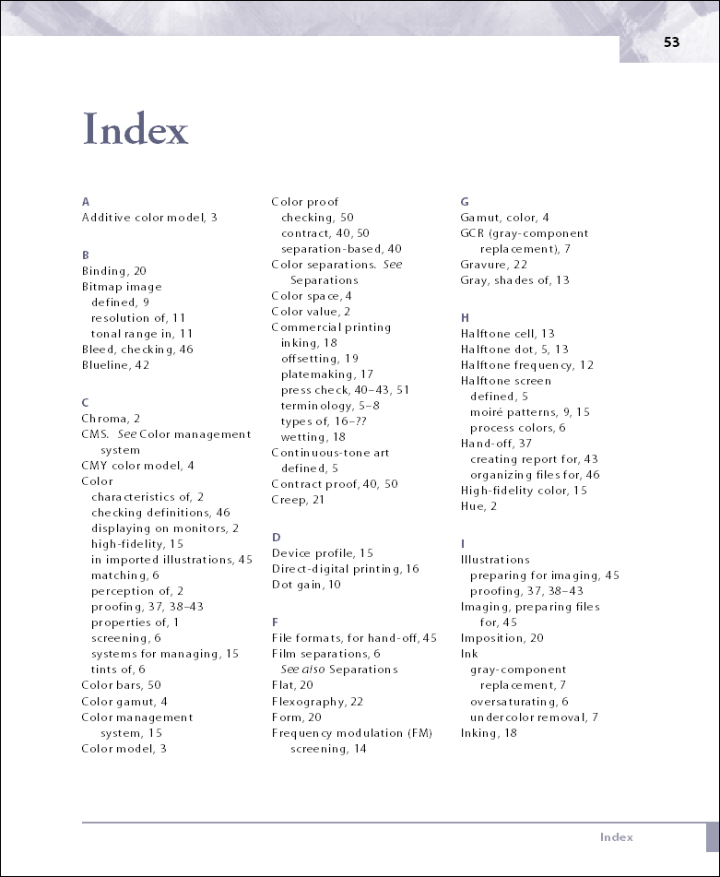
An analogy
Find the page that contains the matching data entries
Search for a paragraph
Use the index to find the page that contain the index term (cost 1)
Scan the page to find the paragraph that contains the index term (cost 2)
Scan the matching page to find the matching data record
Search cost = cost 1 + cost 2

Slide 45

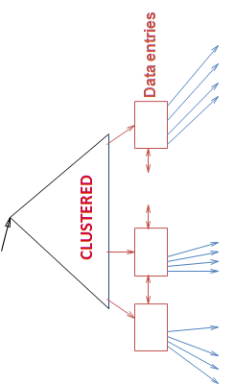
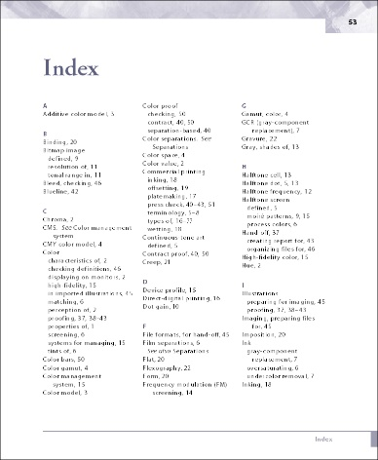
Retrieval Cost
Typically small
Cost depends on #qualifying tuples, and clustering.
  Cost = Cost(finding qualifying data entries)
  + Cost(retrieving records)
1
2
Could be large w/o clustering
Emp
eid | sal | dno | age | phone
Finding qualifying data entries
Retrieving matching data records
1
2
Notes:
12

Slide 46

Height of a Tree
2⁰
Fanout F
Height of the tree is
log₂4
2¹
2²
1
2
3
4
N leaf nodes with fanout F → log_{F}N levels, e.g., log₂4=2.

Slide 47
Height of a Tree
2⁰
Fanout F
Height of the tree is
log₂4
2¹
2²
1
2
3
4
Need to know the number of leaf nodes to compute the tree height

Slide 48
Cost Computation
Fanout is F
αB because data entry size is smaller than data record size (more on this later)
Index page
Height is
log_{F}αB
Data entries
1
F
αB
B data (record) pages
The I/O cost for finding a particular range of 10 matching records:
  Clustered Index: D⋅(log_{F}αB + 1) /* 10 records fit in one page
D is time to read or write a disk page
Number of index pages retrieved
1 more I/O to read the 10 matching data records
Notes:
4

Slide 49

Cost Computation
1
3
2
1
3
4
2
The I/O cost for finding a particular range of 4 matching records:
  Clustered Index: D⋅(log_{F}αB + 1) /* 4 records fit in one page
  Unclustered Index: D⋅(log_{F}αB + 4) /* 4 records scattered over different pages
Fetch 4 data pages
Cost of retrieving data records through index varies greatly based on whether index is clustered or not!
Notes:
11

Slide 50
Another Factor Affecting Tree Width: β
  Hash: No overflow buckets.
    80% page occupancy → File size = 1.25 data size
  Tree: 67% occupancy (this is typical).
    Implies file size = 1.5 data size
Data size
400 records
File size
100 records
100 records
100 records
100 records
100% occupancy → use four pages
Free space
Larger File size
80 records
80 records
80 records
80 records
80 records
80% occupancy
→ use 25% more pages
→ File size = 1.25 data size
A disk page
Notes:
4

Slide 51
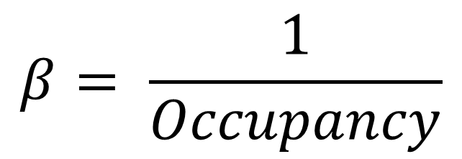
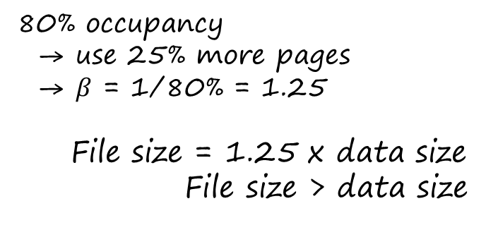
Computing β
$$β= \frac{1}{Occupancy}$$
80% occupancy
→ use 25% more pages
→ $β$ = 1/80% = 1.25
File size = 1.25 x data size
File size > data size
Notes:
4

Slide 52
Cost Computation
Fanout is F
αB because data entry size is smaller than data record size (more on this later)
Index page
Height is
log_{F}αB
Data entries
1
F
F+1
αβB
β ≥ 1 → Size is expanding
Only the indexed attributes αB pages
α ≤ 1 → Size is shrinking
Relation: All attributes, B data (record) pages
Notes:
4

Slide 53
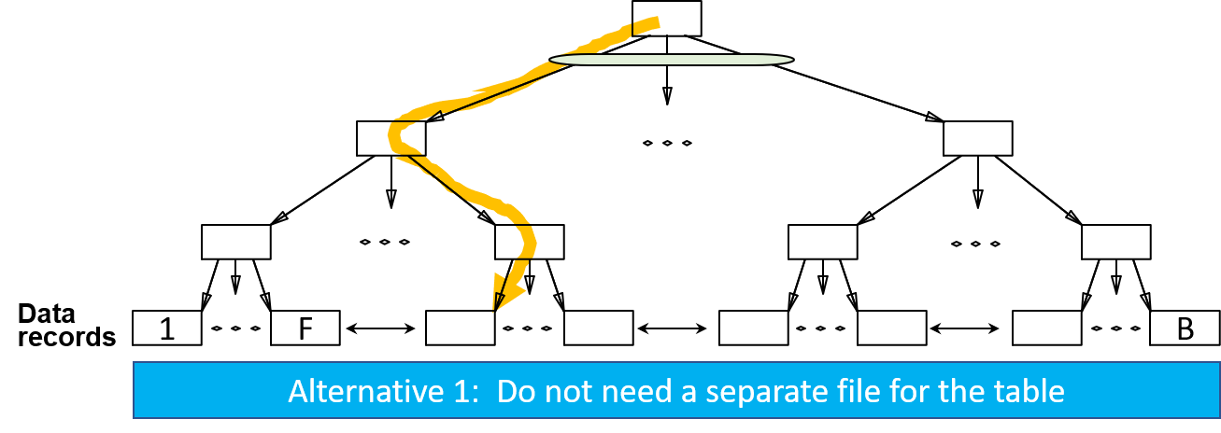
Comparing File Organizations
25 Exercises
Heap files (random order; insert at eof)
Sorted files, sorted on <age, sal>
Clustered B⁺ tree file, Alternative (1), search key <age, sal>

Slide 54
Computing Tree Height
Fanout is F
αB because data entry size is smaller than data record size (more on this later)
Index page
Height is
log_{F}αβB
4
3
Data entries
1
F
αβB
Steps
1: Determine table size
2. Determine α and β
3. Determine total data-entry size
4. Compute tree height
2
α<1: The data entry is smaller than the data record
β>1: Page occupancy is less than 100%
1
B data (record) pages
Notes:
4

Slide 55
Comparing File Organizations
Heap files (random order; insert at eof)
Sorted files, sorted on <age, sal>
Clustered B⁺ tree file, Alternative (1), search key <age, sal>
Heap file with unclustered B⁺ tree index on search key <age, sal>
Heap file with unclustered hash index on search key <age, sal>

Slide 56
Operations to Compare
Scan: Fetch all records from disk
Equality search
Range selection
Insert a record
Delete a record
Scan
Selection
Insert
Search
Delete

Slide 57
25 Excercises
 | Scan | Equality | Range | Insert | Delete
Heap
Sorted
Clustered
Unclustered Tree Index
Unclustered Hash Index
Practice this row at home
Notes:
5

Slide 58
Assumptions in Our Analysis
Heap Files:
  Equality selection on key; exactly one match.
Sorted Files:
  Files compacted after deletions.
Indexes:
  Alt (2), (3): data entry size = 10% size of record
  Hash: No overflow buckets.
    80% page occupancy → File size = 1.25 data size (more on next page)
  Tree: 67% occupancy (this is typical).
    Implies file size = 1.5 data size (more on next page)
Notes:
4

Slide 59
Insert a Tuple
MEMORY
1st I/O

Slide 60
Insert a Tuple
MEMORY
TOTAL COST = 2 I/O’s
= 2D
2nd I/O

Slide 61
Cost of Operations
D
Several assumptions underlie these (rough) estimates!
R
B
 | Scan | Equality | Range | Insert | Delete
Heap | BD | 0.5BD | BD | 2D | Search + D
Sorted
Clustered
Unclustered Tree Index
Unclustered Hash Index
Time to read or write disk page
D
1·D to write the page back after the update
Number of records per page
R
Heap files (not sorted; insert at eof)
B
Number of data pages
Notes:
5

Slide 62
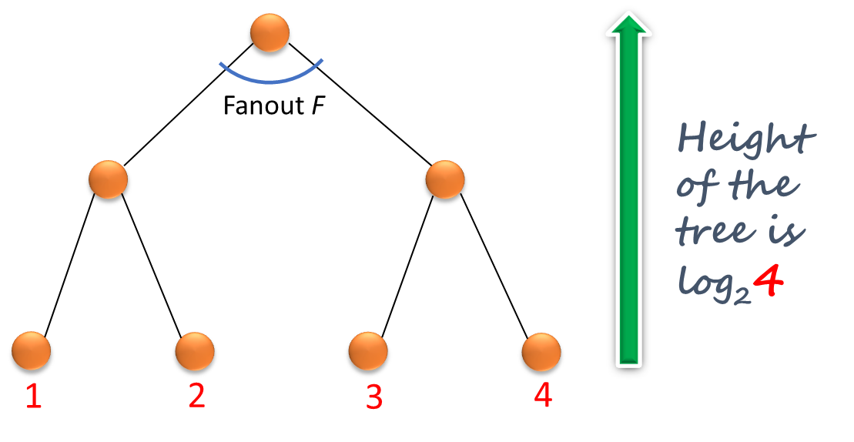
Cost of Operations
Several assumptions underlie these (rough) estimates!
 | Scan | Equality | Range | Insert | Delete
Heap | BD | 0.5BD | BD | 2D | Search + D
Sorted | BD | D⋅log₂B | D(log₂B + # matching pages) | Search + BD | Search + BD
Clustered
Unclustered Tree Index
Unclustered Hash Index
Fetch & rewrite the second half of the file after adding the new record
Sorted files, sorted on <age, sal>
Matching page: A page that contains at least one matching tuple
Notes:
5

Slide 63
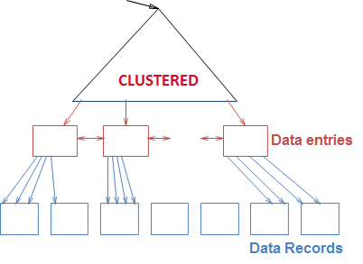
Cost of Operations
Several assumptions underlie these (rough) estimates!
D
R
B
 | Scan | Equality | Range | Insert | Delete
Heap | BD | 0.5BD | BD | 2D | Search + D
Sorted | BD | D⋅log₂B | D⋅(log₂B + # matching pages) | Search + BD | Search + BD
Clustered
Unclustered Tree Index
Unclustered Hash Index
Clustered B⁺ tree file, Alternative (1), search key <age,sal>
Notes:
5

Slide 64
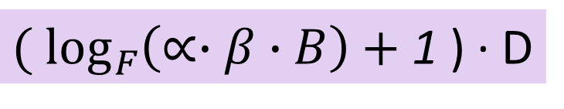
Cost of Equality Search using tree index
${( log}_{F}\left(∝∙β∙B\right)+$1 ) ∙ D
The ratio of the size of data entries with empty space over their size without the empty space (i.e., 100% occupancy)
β≥1
Ratio of the size of the data entries over the size of the relation (i.e., B)
α≤1
When is α=1?
Answer: Alternative 1
When is β=1?
Answer: Occupation is 100%
Notes:
5

Slide 65
Cost of Operations
Several assumptions underlie these (rough) estimates!
D
R
B
 | Scan | Equality | Range | Insert | Delete
Heap | BD | 0.5BD | BD | 2D | Search + D
Sorted | BD | D⋅log₂B | D⋅(log₂B + # matching pages) | Search + BD | Search + BD
Clustered | 1.5BD | D⋅log_{F}(1.5B) | D⋅(log_{F}(1.5B) + # matching pages) | Search + D | Search + D
Unclustered Tree Index
Unclustered Hash Index
α=1. 67% page occupancy, 50% more pages to scan.
Height of the tree
Number of pages at leaf nodes
Clustered B⁺ tree file, Alternative (1), i.e., α=1, and search key is <age,sal>
1 write to insert the new record
Notes:
5

Slide 66
Cost of Operations
D
Several assumptions underlie these (rough) estimates!
R
B
 | Scan | Equality | Range | Insert | Delete
Heap | BD | 0.5BD | BD | 2D | Search + D
Sorted | BD | D⋅log₂B | D⋅(log₂B + # matches) | Search + BD | Search + BD
Clustered | 1.5BD | D⋅log_{F}1.5B | D⋅(log_{F}1.5B + # matching pages) | Search + D | Search + D
Unclustered Tree Index
Unclustered Hash Index
Heap file with unclustered B⁺ tree index on search key <age,sal>
Practice this row at home
Notes:
5

Slide 67
Cost of Operations
D
Several assumptions underlie these (rough) estimates!
R
B
 | Scan | Equality | Range | Insert | Delete
Heap | BD | 0.5BD | BD | 2D | Search + D
Sorted | BD | D⋅log₂B | D(log₂B + # matches) | Search + BD | Search + BD
Clustered | 1.5BD | D⋅log_{F}1.5B | D⋅log_{F}1.5B + # matching pages | Search + D | Search + D
Unclustered Tree Index
Unclustered Hash Index | (BR+0.125B)∙D
Heap file with unclustered hash index
Cost of scanning data entries is 1.25(0.1B)⋅D
Scanning the records in the hashing order
B∙R arrows: Do B∙R IOs to retrieve B∙R records
Notes:
5

Slide 68
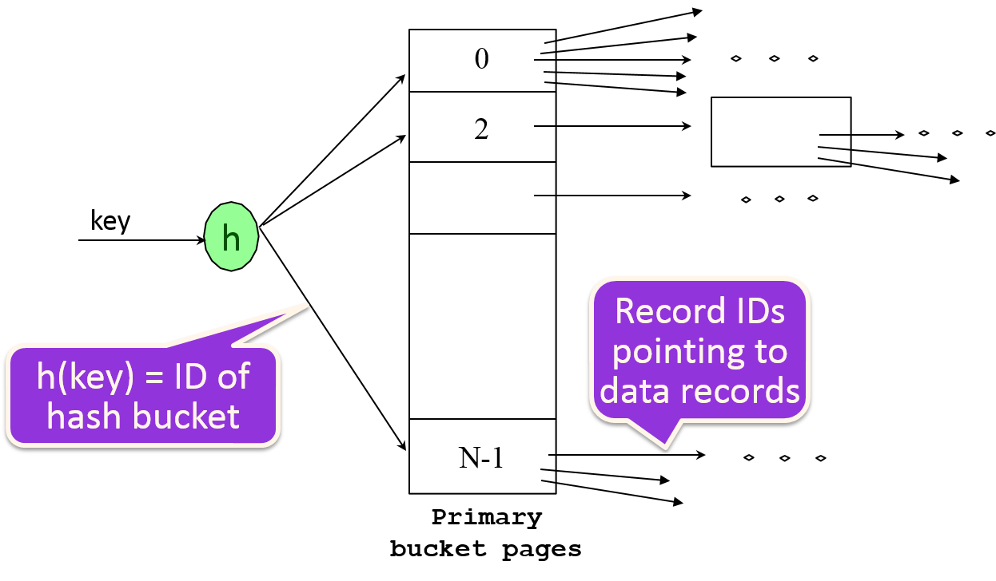
Cost of Operations on
Heap File /w Unclustered Hash Index (1)
SCAN (to obtain data records in “hash” order)
Fetch the hash buckets
For each data entry in a hash bucket, fetch the corresponding data record from the heap file
1
2
1
2

Slide 69
Cost of Operations on
Heap File /w Unclustered Hash Index (2)
SCAN (obtain data records in “hash” order, i.e., based on their “remainder”)
Fetch the hash buckets
For each data entry in a hash bucket, fetch the corresponding data record from the heap file
SCAN COST:
Cost of scanning the hash buckets
  Each page is 80% occupied ⇒ # data pages is 1.25B
  Data entry is only 10% the size of data record ⇒ # index pages (i.e., # hash buckets) is 0.1(1.25B) = 0.125B
  Cost of scanning the data entry is 0.125B⋅D
Cost of fetching the data records
  Since number of data record is B⋅R, cost of retrieving all data records is BR⋅D (i.e., 1 I/O per record)
0.125BD + BRD = BD(R+0.125)

Slide 70
Cost of Operations
D
Several assumptions underlie these (rough) estimates!
R
B
 | Scan | Equality | Range | Insert | Delete
Heap | BD | 0.5BD | BD | 2D | Search + D
Sorted | BD | D⋅log₂B | D(log₂B + # matches) | Search + BD | Search + BD
Clustered | 1.5BD | D⋅log_{F}1.5B | D⋅log_{F}1.5B + # matching pages | Search + D | Search + D
Unclustered Tree Index
Unclustered Hash Index | BD(R+0.125) | 2D
Heap file with unclustered hash index
Cost of reading the hash bucket and the matching data page
Notes:
5

Slide 71
Cost of Operations
D
Several assumptions underlie these (rough) estimates!
R
B
 | Scan | Equality | Range | Insert | Delete
Heap | BD | 0.5BD | BD | 2D | Search + D
Sorted | BD | D⋅log₂B | D(log₂B + # matches) | Search + BD | Search + BD
Clustered | 1.5BD | D⋅log_{F}1.5B | D⋅log_{F}1.5B + # matching pages | Search + D | Search + D
Unclustered Tree Index
Unclustered Hash Index | BD(R+0.125) | 2D | D(0.125B + # matches)
Heap file with unclustered hash index
Scan the data entries and pick up the matching data records
Notes:
5

Slide 72
Cost of Operations (2)
Heap File /w Unclustered Hash Index
Range Selection (Hash structure cannot help)
Scan the hash buckets
For each hash bucket, fetch the data record from the heap file if the corresponding data entry is within the range

Slide 73
Cost of Operations (2)
Heap File /w Unclustered Hash Index
Range Selection (Hash structure cannot help)
Scan the hash buckets
For each hash bucket, fetch the data record from the heap file if the corresponding data entry is within the range
TOTAL COST:
Cost of scanning the hash buckets
  Each page is 80% occupied ⇒ # data pages is 1.25B
  Data entry is only 10% the size of data record ⇒ # index pages (i.e., # hash buckets) is 0.1(1.25B) = 0.125B
  Cost of scanning the data entry is 0.125B⋅D
Cost of fetching the data records:
  (# matches)⋅D
0.125BD + (# matches) D = D∙(0.125B + #matches)

Slide 74
Cost of Operations
D
Several assumptions underlie these (rough) estimates!
R
B
 | Scan | Equality | Range | Insert | Delete
Heap | BD | 0.5BD | BD | 2D | Search + D
Sorted | BD | D⋅log₂B | D(log₂B + # matches) | Search + BD | Search + BD
Clustered | 1.5BD | D⋅log_{F}1.5B | D⋅log_{F}1.5B + # matching pages | Search + D | Search + D
Unclustered Tree Index
Unclustered Hash Index | BD(R+0.125) | 2D | D(0.125B + # matches) | 4D | 4D
2D to update the index file + 2D to update the data file
2D to update the index file + 2D to update the data file
Heap file with unclustered hash index
Notes:
5

Slide 75
Cost of Operations
D
Several assumptions underlie these (rough) estimates!
R
B
 | Scan | Equality | Range | Insert | Delete
Heap | BD | 0.5BD | BD | 2D | Search + D
Sorted | BD | D⋅log₂B | D(log₂B + # matching pages) | Search + BD | Search + BD
Clustered | 1.5BD | D⋅log_{F}1.5B | D⋅log_{F}1.5B + # matching pages | Search + D | Search + D
Unclustered Tree Index
Unclustered Hash Index | BD(R+0.125) | 2D | D(0.125B + # matches) | 4D | 4D
Practice this row at home
Notes:
5

Slide 76
Check Your Answers
D
Several assumptions underlie these (rough) estimates!
R
B
 | Scan | Equality | Range | Insert | Delete
Heap | BD | 0.5BD | BD | 2D | Search + D
Sorted | BD | D⋅log₂B | D(log₂B + # matching pages) | Search + BD | Search + BD
Clustered | 1.5BD | D⋅log_{F}1.5B | D⋅log_{F}1.5B + # matching pages | Search + D | Search + D
Unclustered Tree Index | BD(R+0.15) | D(1 + log_{F}0.15B) | D⋅(log_{F}0.15B + # matches) | D(3 + log_{F}0.15B) | Search + 2D
Unclustered Hash Index | BD(R+0.125) | 2D | D(0.125B + # matches) | 4D | 4D
Scan 0.15B pages of data entries. For each of the BR data entries, fetch the data record
1 I/O to insert the data entry + 2 I/O’s to insert the data record
1 I/O’s to write back the updated data-entry page and 2 I/O to write back the updated data-record page
Cost of descending the tree
Notes:
5

Slide 77
Indexes are only used to improve search ?

Slide 78

Index can be used to support index-only evaluation

Slide 79
Index-Only Evaluation
These data entries can be used as the two columns of the table Emp
Emp
eid | sal | dno | age | phone
age | sal
Index on age and sal
Notes:
14

Slide 80


Index-Only Evaluation
    Example: Use leaf pages of index on age and sal to compute the average salary for each age group
Computing the group averages using only the data entries
Emp
eid | sal | dno | age | phone
age | sal
Index on age and sal
Notes:
14

Slide 81
Index-Only Evaluation
    Example: Use leaf pages of index on age and sal to compute the average salary for each age group
Computing the group averages using only the data entries
Emp
Computing the average for the 27-year-old group
eid | sal | dno | age | phone
age | sal
27
27
27
27
50000
70000
65000
45000
Index on age and sal
Notes:
14

Slide 82

Index-Only Evaluation
    Example: Use leaf pages of index on age and sal to compute the average salary for each age group
Computing the group averages using only the data entries
Advantages
Scanning the data entries is less expensive
The data entries are sorted according to age
Emp
eid | sal | dno | age | phone
age | sal
Index on age and sal
Notes:
14

Slide 83

Index-Only Evaluation
    Example: Use leaf pages of index on age and sal to compute the average salary for each age group
1
Computing the group averages using the data entries
Option 1 is better !!
Emp
eid | sal | dno | age | phone
age | sal
2
Computing the group average using the table
Index on age and sal
Notes:
14

Slide 84
Compute Average Salary
Emp
  The average salary can be computed using either <E.age,E.sal> or <E.sal,E.age> tree index
  Which one is better ? (next slide)
eid | sal | dno | age | phone
Data Entries
Compute the average salary of
25-year-old with a high salary
age | sal
SELECT AVG(E.sal)
FROM Emp E
WHERE E.age=30 AND
E.sal BETWEEN 300000 AND 500000
Qualified entries
Notes:
21

Slide 85

<age, sal> Is Better
    The qualifying data entries are grouped together in <age,sal> index, but not in <sal,age> index
SELECT AVG(E.sal)
FROM Emp E
WHERE E.age=30 AND
E.sal BETWEEN 300000 AND 500000
Matching data entries are not in one cluster
300,000 < sal < 500,000
Matching data entries are in one cluster
Data Entries
Data Entries
300,000
30-year-old employees in different salary ranges
All 30-year-old employees
.
.
.
500,000
Having matching data entries in fewer pages is better
<age, sal>
<sal, age>
Notes:
20
If 20<age<30 is more “compact” than 3000<sal<5000, then select the “20<age<30” index.

Slide 86


Composite Index
To retrieve Emp records for:
  age=30 AND 50,000<sal<80,000
    Clustered <age,sal> index much better than <sal,age> index!
    Reason: The qualifying data entries are grouped together in <age,sal> index, but not in <sal,age> index
To retrieve Emp records for:
  18<age<30 AND 50,000<sal<80,000
    <age,sal> index or <sal,age> index ?
    Less obvious !
Choose an index with matching data entries clustered in fewer pages
Notes:
20
If 20<age<30 is more “compact” than 3000<sal<5000, then select the “20<age<30” index.

Slide 87
Index can be used to support index-only evaluation
Good to know DBMS internal

Slide 88
Trade Off
Before creating an index, must also consider the impact on updates in the workload!
  Trade-off: Indexes can make queries go faster, updates slower. Require disk space, too.
Update a table also needs to update its indexes
Notes:
13

Slide 89
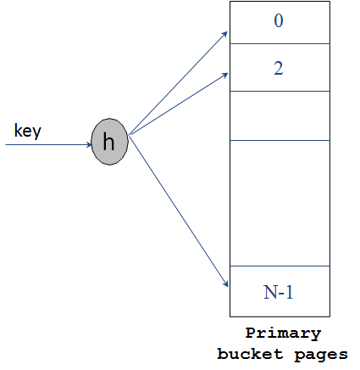
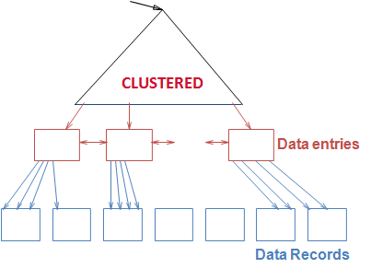
Index Selection
Attributes in WHERE clause are candidates for index keys.
  Exact match condition suggests hash index.
  SELECT E.dno
  FROM Employees E
  WHERE E.num = 568429543
  Range query suggests tree index.
    Clustering is especially useful for range queries, also help equality queries if there are many matching data entries.
SELECT E.name
FROM Employees E
WHERE E.age > 40
SELECT E.name
FROM Employees E
WHERE E.dno=123
Dept. 123 has many employees
Employees older than 40
Clustered hash index is also useful in this case
Notes:
14

Slide 90

Is Index always helpful ?
B⁺ tree index on E.age can be used to get qualifying tuples
SELECT E.dno
FROM Emp E
WHERE E.age>30
Always Helpful ?
Employees older than 30
Note: Many qualified tuples !!
If most employees are older than 30, a sequential scan of the relation would do almost as well, if not better
Notes:
18

Slide 91

Is Index always helpful ?
B⁺ tree index on E.age can be used to get qualifying tuples
SELECT E.dno
FROM Emp E
WHERE E.age>30
Always Helpful ?
What if only 10% are older than 30?
  Unclustered index: Performing one I/O per qualifying tuple could be more expensive than a sequential scan
Older than 30:
Only 10% qualify
Notes:
18

Slide 92
Is Index always helpful ?
B⁺ tree index on E.age can be used to get qualifying tuples
SELECT E.dno
FROM Emp E
WHERE E.age>30
Always Helpful ?
What if only 10% are older than 30?
  Unclustered index: Performing one I/O per qualifying tuple could be more expensive than a sequential scan
  Clustered index: This is a good option
Older than 30:
Only 10% qualify
Notes:
18

Slide 93

Clustered vs Unclustered
1
2
SELECT E.dno
FROM Emp E
WHERE E.hobby=Stamps
SELECT E.dno
FROM Emp E
WHERE E.eid=328169455
If many employees collect stamps, a clustered index on E.hobby is helpful
  If this query is important, we should consider this index
An unclustered index on E.eid is good enough for this query since no two employees have the same E.eid.
Primary key
Notes:
18

Slide 94
Unclustered Index Does not Help
  Using unclustered index on E.age may be costly
  Retrieving tuples with E.age > 25 is expensive
SELECT E.dno, COUNT (*)
FROM Emp E
WHERE E.age>25
GROUP BY E.dno
Index on age
Data entries for age>25
Essentially all these data pages are relevant
Too many tuples qualified !!
Notes:
18

Slide 95

This Clustered Index Helps
Index on dno
dno’s are sorted here
SELECT E.dno, COUNT (*)
FROM Emp E
WHERE E.age>25
GROUP BY E.dno
Employees of dept. 123
For each dno, count the tuple E.age > 25
What to do if a clustered index on dno is not possible ?
Notes:
18

Slide 96
Summary
Many alternative file organizations exist, each appropriate in some situation.
If selection queries are frequent, sorting the file or building an index is important.
  Hash-based indexes only good for equality search.
  Sorted files and tree-based indexes best for range search; also good for equality search. (Files rarely kept sorted in practice; B+ tree index is better.)
Index is:
  a collection of data entries (<key, rid> pairs or <key, rid-list> pairs), plus
  a way to quickly find entries (using hashing or a search tree) with given key values.
Notes:
14

Slide 97
Summary (Contd.)
Data entries can be (1) actual data records, (2) <key, rid> pairs, or (3) <key, rid-list> pairs.
  Choice orthogonal to indexing technique used to locate data entries with a given key value.
Can have several indexes on a given file of data records, each with a different search key.
Indexes can be classified as clustered vs. unclustered. Differences have important consequences for utility/performance.
Notes:
15

Slide 98
Summary (Contd.)
Understanding the nature of the workload for the application, and the performance goals, is essential to developing a good design.
  What are the important queries and updates? What attributes/relations are involved?
Indexes must be chosen to speed up important queries (and perhaps some updates!).
  Index maintenance overhead on updates to key fields.
  Choose indexes that can help many queries, if possible.
  Build indexes to support index-only strategies.
  Clustering is an important decision; only one index on a given relation can be clustered!
  Order of fields in composite index key can be important.

Slide 99

Relational Algebra
SQL
Algebra
DBMS
Notes:
1

Slide 100
Algebra
Operators
  +: Addition
  -: Subtraction
  x: Multiplication
  ∕ : Division
Expression
  (X + Y) / Z
It is a procedure for computation !

Slide 101
Relational Algebra
Basic operations:
  Selection ( ) Selects a subset of rows from relation.
  Projection ( ) Deletes unwanted columns from relation.
  Cross-product ( ) Allows us to combine two relations.
  Set-difference ( ) Tuples in relation 1, but not in relation 2.
  Union ( ) Tuples in relation 1 and in relation 2.
Additional operations:
  Intersection, join, division, renaming: Not essential, but (very!) useful.
Since each operation returns a relation, operations can be composed! (Algebra is “closed”.)
Notes:
6

Slide 102
Projection
Notes:
7

Slide 103
Projection
Notes:
7

Slide 104
Selection
Notes:
8

Slide 105
Operator
Composition
S2
Result relation can be the input for another relational algebra operation !
Notes:
8

Slide 106
Union
S1
S2
Notes:
9

Slide 107
Cross-Product
S1
R1
R1 × S1
Each row of R1 is paired with each row of S1.
Expensive Computation
Notes:
10

Slide 108
Primary Key and Foreign Key
Pairing each sailor with everyone’s reservations
Most of these pairs do not make sense
Expensive Computation
Primary Key
Foreign Key
S1
R1
Notes:
10

Slide 109
Joins
All combinations
Condition Join:
Example:
Selecting some combinations
Selecting combinations with primary key matching foreign key
Notes:
11

Slide 110




Joins
$$S1 ⋈_{S1.sid=R1.sid} R1$$
R1 × S1
Not in join results
Notes:
11

Slide 111
Joins
Sometimes called a theta-join
Condition Join:
S1
R1
Notes:
11

Slide 112
Equi-Join
Foreign key
S1
R1
Equi-Join: A special case of condition join where the condition c contains only equalities.
Notes:
10
A theta join allows for arbitrary comparison relationships (such as ≥)

Slide 113
Joins
Expensive computation !
More efficient algorithms possible !!
Result schema same as that of cross-product.
Fewer tuples than cross-product - can be computed more efficiently
Notes:
11

Slide 114
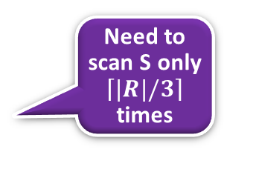
Block Nested-Loops Join
If we have 5 pages available
Memory
Memory
Bring in R 3 pages at a time
JOIN
JOIN the two pages
1
Need to scan S only $\left\lceil \left.|R|/3\right\rceil \right.$ times
Need to scan S M time
2
S
R
S
4
R
3
Simple Nested-Loop Join
Block Nested-Loop Join

Slide 115

Find names of sailors who’ve reserved boat #103
(3) Find out the names of those sailors
(1) Find all reservations for boat 103
(2) Follow the foreign-key pointer to identify sailors who made these reservations
Sailors
Foreign key
Reserves
3
2
1
Notes:
16

Slide 116
Find names of sailors who’ve reserved boat #103
Solution 3:
(3) Find out the names of sailors who made those sailors
(1) Find reservations for every sailor
(2) Retain only reservations for boat 103
Sailors
Foreign key
Reserves
Notes:
16

Slide 117
Which one is better ?
1
2
Need optimization before query execution

Slide 118

Find names of sailors who’ve reserved a red boat
Shorter is not necessarily better
Compare only bid
Compare only sid
A more efficient solution:
These select and project operators make Join operations less expensive
A query optimizer can find this, given the first solution!
Notes:
17

Slide 119






Execution Tree
Query result
Query result
$$π_{sname}$$
Pushing a less expensive operator down the execution tree is usually a good idea
$$π_{sname}$$
$$⋈_{sid}$$
$$σ_{bid=103}$$
$$⋈_{sid}$$
$$σ_{bid=103}$$
Sailors
Reserve
Sailors
Reserve

Slide 120

Summary
SQL
The relational model has rigorously defined query languages that are simple and powerful.
Relational algebra is more operational; useful as internal representation for query evaluation plans.
Several ways of expressing a given query; a query optimizer should choose the most efficient version.
Algebra
DBMS

Slide 121
Query Evaluation
Notes:
1

Slide 122





Simplify Algebraic Expression
A computation proceddure
Optimization
$$5\left(2+x\right)+3\left(5x+4\right)−{\left(x^{2}\right)}^{2}$$
$$=10+5x+15x+12 −{\left(x^{2}\right)}^{2}$$
$$=10+5x+15x+12 − x^{4}$$
$$=10+20x+12 − x^{4}$$
$$=22+20x − x^{4}$$
A simpler procedure that compute the same thing
An SQL query is optimized by optimizing its relational algebraic expressions

Slide 123
Execution Plan
Plan: Tree of R.A. operators, with choice of algorithm for each operator
sname
Use Block Nested-Loop Join algorithm
bid=100
rating > 5
sid=sid
Reserves
Sailors
Notes:
2

Slide 124
Plan Generation – Relational Algebra
SELECT S.sname
FROM Reserves R, Sailors S
WHERE R.sid=S.sid AND
R.bid=100 AND S.rating>5
SELECT clause
WHERE clause
FROM clause
∏_{sname}( σ_{sid=sid ∧ bid=100} _{∧ rating>5} (R×S))
Notes:
4

Slide 125
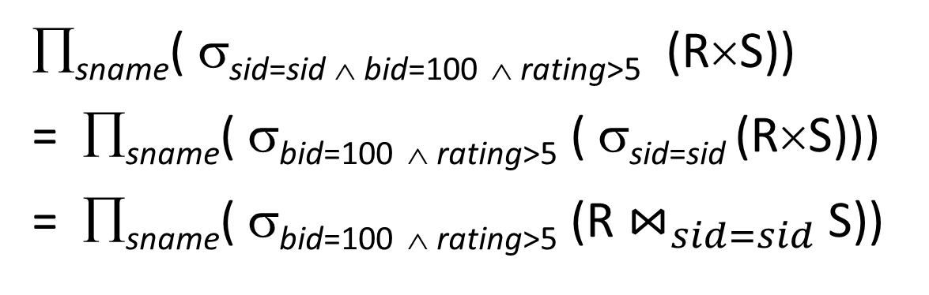
Plan Generation – Relational Algebra
SELECT S.sname
FROM Reserves R, Sailors S
WHERE R.sid=S.sid AND
R.bid=100 AND S.rating>5
SELECT clause
WHERE clause
FROM clause
∏_{sname}( σ_{sid=sid ∧ bid=100} _{∧ rating>5} (R×S))
= ∏_{sname}( σ_{bid=100} _{∧ rating>5} ( σ_{sid=sid} (R×S)))
= ∏_{sname}( σ_{bid=100} _{∧ rating>5} (R $⋈_{sid=sid}$ S))
Notes:
4

Slide 126
On-the-fly Processing
Operator 2
Operator 2
M
Intermediate result
(M pages)
RAM
M
Operator 1
Operator 1
N
N
Database
(N pages)
Database
(N pages)
COST = (N + M + M) I/Os
COST = N I/Os
Notes:
4

Slide 127



On-the-fly Processing
∏_{sname}( σ_{bid=100} _{∧ rating>5} (R$⋈$ S))
$$⇒More I/O$$
Read intermediate result
sname
sname
Save
intermediate result
(On-the-fly)
bid=100
rating > 5
bid=100
rating > 5
$$⇒Save I/O$$
Temp
sid=sid
sid=sid
Reserves
Sailors
Reserves
Sailors
Notes:
4

Slide 128
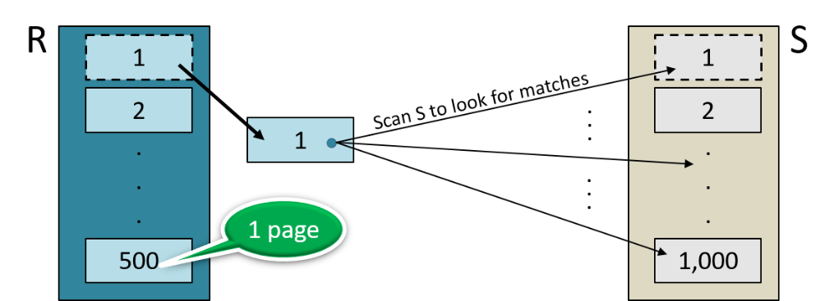



Plan Generation -
Execution Plan
sname
RA Tree
bid=100
rating > 5
∏_{sname}( σ_{bid=100} _{∧ rating>5} (R$⋈$ S))
sid=sid
SELECT S.sname
FROM Reserves R, Sailors S
WHERE R.sid=S.sid AND
R.bid=100 AND S.rating>5
Reserves
Sailors
sname
(On-the-fly)
$$⇒Save I/O$$
(On-the-fly)
bid=100
rating > 5
$$⇒Save I/O$$
(Simple Nested Loops)
sid=sid
Plan
Reserves
Sailors
Notes:
4

Slide 129
Plan Generation -
Execution Plan
sname
RA Tree
bid=100
rating > 5
∏_{sname}( σ_{bid=100} _{∧ rating>5} (R$⋈$ S))
sid=sid
Reserves
Sailors
Cost: 500 + 500×1000 I/Os
By no means the worst plan!
sname
(On-the-fly)
$$⇒Save I/O$$
(On-the-fly)
bid=100
rating > 5
$$⇒Save I/O$$
(Simple Nested Loops)
sid=sid
Plan
Reserves
Sailors
Notes:
4

Slide 130
Plan Generation -
Execution Plan
sname
RA Tree
bid=100
rating > 5
∏_{sname}( σ_{bid=100} _{∧ rating>5} (R$⋈$ S))
sid=sid
Reserves
Sailors
Cost: 500 + 500×1000 I/Os
By no means the worst plan!
sname
(On-the-fly)
Misses several opportunities: selections could have been `pushed’ earlier, no use is made of any available indexes, etc.
Goal of optimization: To find more efficient plans that compute the same answer.
$$⇒Save I/O$$
(On-the-fly)
bid=100
rating > 5
$$⇒Save I/O$$
(Simple Nested Loops)
sid=sid
Plan
Reserves
Sailors
Notes:
4

Slide 131
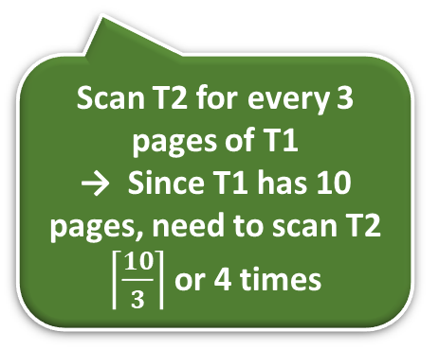
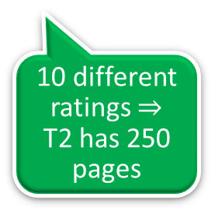
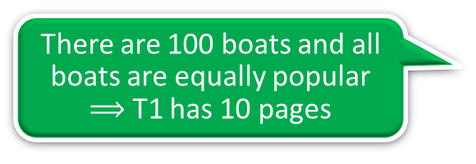
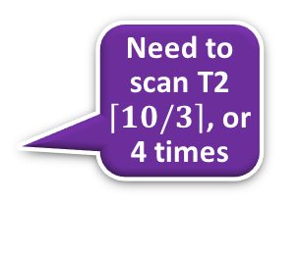
Alternative Plan 1
(No Indexes)
(On-the-fly)
sname
(Block Nested Loop Join)
sid=sid
There are 100 boats and all boats are equally popular
$⟹$ T1 has 10 pages
(Scan;
(Scan;
write to
bid=100
rating > 5
write to
temp T1)
temp T2)
Reserves
Sailors
10 different ratings $⇒$ T2 has 250 pages
join cost = 10+(4×250),
(1,000 pages)
(500 pages)
T1 has 10 pages
Scan T2 for every 3 pages of T1
→ Since T1 has 10 pages, need to scan T2 $\left\lceil \frac{10}{3}\right\rceil$ or 4 times
Memory
5 pages available
Bring in T1 3 pages at a time
JOIN
1
Need to scan T2 $\left\lceil \left.10/3\right\rceil \right.$, or 4 times
Total cost = (1000+10) + (500+250) +
[10+(4X250)]
= 2770 I/Os.
2
T2
4
T1
3
Notes:
5

Slide 132
Push Projections
(On-the-fly)
sname
(Block Nested Loop Join)
sid=sid
(On-the-fly)
(Scan;
(Scan;
sname
write to
bid=100
rating > 5
write to
temp T1)
temp T2)
(Block Nested Loop Join)
sid=sid
Reserves
Sailors
(Scan;
(Scan;
write to
write to
temp T1)
sid
Sid, sname
temp T2)
bid=100
rating > 5
If we `push’ projections, T1 has only sid, T2 only sid and sname:
Reserves
Sailors
Notes:
5

Slide 133
Push Projections
Memory
(On-the-fly)
T1 fits in 3 pages
sname
JOIN
T1
Need to scan the smaller T2 only once
(Block Nested Loop Join)
sid=sid
(Scan;
(Scan;
T1
T2
write to
write to
temp T1)
sid
Sid, sname
temp T2)
bid=100
rating > 5
If we `push’ projections, T1 has only sid, T2 only sid and sname:
  If T1 fits in 3 pages, need to scan T2 only once
  cost of BNL drops to under 250 pages, total cost < 2000.
Reserves
Sailors
Notes:
5

Slide 134
Index Nested-Loop Join
Block Nested-Loop Join: For each page of the outer relation, scan the inner relation
Index Nested Loop Join: For each tuple of the outer relation, use the index to look up the matching records in the inner relation
Memory
JOIN the two pages
Need to scan S M time
R
S
Notes:
19

Slide 135
Summary
There are several alternative evaluation algorithms for each relational operator.
A query is evaluated by converting it to a tree of operators and evaluating the operators in the tree.
Must understand query optimization in order to fully understand the performance impact of a given database design (relations, indexes) on a workload (set of queries).
Two parts to optimizing a query:
  Consider a set of alternative plans.
  Must estimate cost of each plan that is considered.
Notes:
19

Slide 136
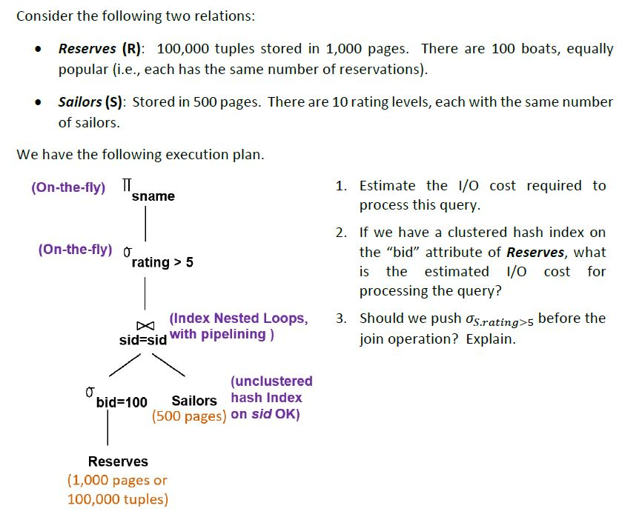
Old Exam
Some of these hash buckets are overflow. The average size of each hash bucket is 1.2 pages.

Slide 137
Homework #1 (old homework)
1000 x 1.2 I/Os to look up the matching data entries in the hash buckets
1)
Pipeline processing:
No additional I/O cost
(On-the-fly)
sname
(On-the-fly)
2
rating > 5
1000 tuples in 10 pages. They are not stored to disk
(Index Nested Loops,
sid=sid
with pipelining )
(unclustered
hash Index on sid OK)
bid=100
Sailors
1
1,000 I/Os
Reserves
1000 I/Os to retrieve the matching Sailor data records
(1,000 pages or
100,000 tuples)
3
1
2
3
Total Cost = 1000 + (1000x1.2 + 1000)
= 3200 I/Os
Notes:
6
Since 100 boats are equally popular, no hash bucket overflows. As a result, retrieving the Reserve tuples takes 10 I/Os, not (10x1.2) I/Os.

Slide 138
Homework #1
2)
(On-the-fly)
1000 x 1.2 I/Os to look up the matching data entries in the hash buckets
1000 tuples in 10 pages. They are not stored to disk
sname
(On-the-fly)
rating > 5
1 I/O to find the matching data entry, and 10 I/Os to retrieve the 1000 matching records
(Index Nested Loops,
sid=sid
with pipelining )
Use clustered
hash index; do not write result to disk
(unclustered
hash Index on sid OK)
bid=100
Sailors
(1+10) I/Os
Reserves
1000 I/Os to retrieve the matching Sailor data records
Assuming bucket overflow does not change the result by much
(1,000 pages or
100,000 tuples)
Total Cost = (1+10) + (1000 x 1.2 + 1000)
= 2211 I/Os
Notes:
6

Slide 139
Homework #1
3)
(On-the-fly)
sname
(On-the-fly)
rating > 5
Should we push this “select” before the “join” ?
(Index Nested Loops,
with pipelining )
sid=sid
Use clustered
hash index; do not write result to disk
(unclustered
hash Index on sid OK)
bid=100
Sailors
Reserves
(1,000 pages or
100,000 tuples)
We do not want to push the “select” before the “join” because we want to benefit from the clustered hash index on Sailors
Notes:
6

