Slide 1





Kien A. Hua
Data Systems Lab
Division of Computer Science
University of Central Florida

Slide 2



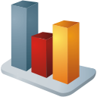



Data Systems Lab
Data
Management
Data Privacy
& Security
Data Systems Lab
Data
Understanding
Data
Communications

Slide 3







Traditional Internet Users - Human
This is changing

Slide 4





Internet of Things
Emerging new users of Internet - “things” !
“Things” can be cameras, sensors, etc.
Transmitting data
Sensing environment

Slide 5
Internet of Things
Emerging new users of Internet - “things” !
“Things” can be cameras, sensors, etc.
Transmitting data
Sensing environment

Slide 6
Internet of Things (IoT)
There will be 28 billions “things” by 2020
Merging physical and online worlds opening up a host of new opportunities
Je parle digital
“Things” are good helpers
My feeling is analog

Slide 7
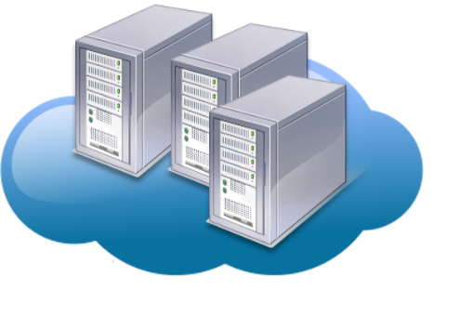

Cloud Computing for IoT ?
28 billions continuous streams by 2020
→ Likely the biggest ‘big data’
Not compatible with cloud computing
→ New Challenges
Continuous live video streaming
Internet

Slide 8
EQL as Thing’s Interface
I speak Event Query Language (EQL)
0
1
1
1
Event query
0
.
.
Internet
S1
.
S1
S1
0
0
1
0
I speak Binary
Talk to “Things” in EQL → Binary streams are much less expensive than video streams

Slide 9
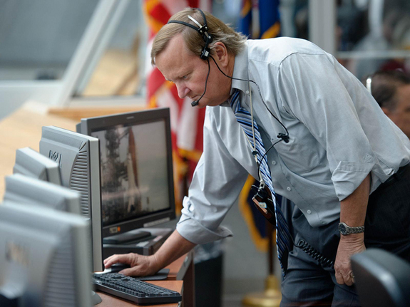
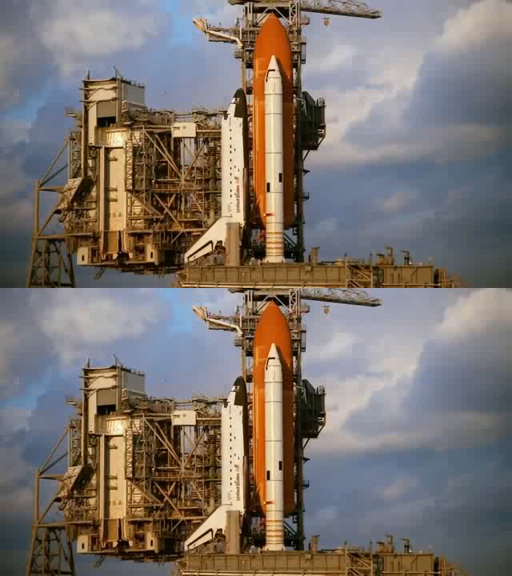
Smart service example
End users
A smart service example
Original video
Event notification
EQL query
Smart detection
(color coded)
S1
S1
S1
S1
S1
S2

Slide 10
EQL - Event Query Language
I speak Event Query Language (EQL)
0
1
1
1
Computer program
Event query
0
.
.
Internet
S1
.
S1
S1
  SELECT event-handler
  FROM Thing1 T1
  WHEN Before(T1.S3, T1.S1)
  WITHIN 30 seconds
  UNTIL 5 minutes
0
0
1
0
Thing1
Event specification

Slide 11

Analogy
Traditional Database Application Development
EQL Application Development
App 1
App 2
App 3
App 1
App 2
App 3
DBMS
(Keyword-based Query Processing)
Event Query Processing
Open
Close
Read
Write
4 smart services
S4
S3
S2
S1
Four I/O services
Storage
devices
Thing

Slide 12



ThingStore
ThingStore
IoT Market Place
S1
S1
S1
S1
S1
S2
Network
Thing Server
S1
S1
S1
S1
S1
S2
Deploy “things” with smart services
Thing Provider

Slide 13

ThingStore
ThingStore
IoT Market Place
S1
S1
S1
S1
S1
S2
app
End Users
app
app
app
Download
App Server
Subscription
Develop apps as online services
Network
EQL
Event Query Language
app
app
app
IoT App Developer
Thing Server
S1
S1
Conventional app store is a market place
ThingStore is both a market place and a platform for IoT application development and deployment
S1
S1
S1
S2
Deploy “things” with smart services
Thing Provider

Slide 14
A High-Performance “Green” Internet
Observation:
  80% of Internet traffic is video
  10% of videos account for 90% of video accessed at YouTube → a lot of “redundant” transmission
  Internet accounts for 2% of worldwide energy consumption
Opportunity:
  Redundancy control conserves Internet bandwidth for emerging applications such as IoT, and saves significant energy

Slide 15





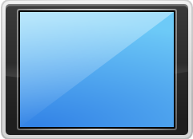





Video-on-Demand (VoD) Challenge
Multicast: Wait for multicast time.
This is not VoD
This is what we want: Do not
need to wait; but how ?

Slide 16
Video Streaming Tree
Source connected to destinations as in conventional routing
Smart router

Slide 17
Video Streaming Tree
Smart router reuses data from an older stream for a newer stream - controlling redundancy !
Smart router
Merge

Slide 18
Video Streaming Tree
Merging taking place independently throughout the network incrementally constructs a video streaming tree

Slide 19
Video Streaming Tree
Merging taking place independently throughout the network incrementally constructs a video streaming tree

Slide 20
Video Streaming Tree
Merging taking place independently throughout the network incrementally constructs a video streaming tree

Slide 21
Video Streaming Tree
Controlling redundancy prevents bottlenecks and reduces network traffic
Bottleneck
Without video streaming tree
More traffic

Slide 22
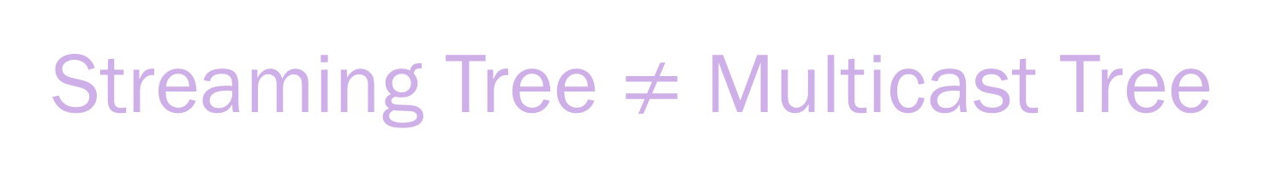
Streaming Tree $≠$ Multicast Tree
Multicast: Wait for multicast time.
Limited Application
Streaming Tree: Video on demand,
many more applications

Slide 23

Deployment
Replace the Internet with the smart routers tomorrow
Not going to happen !
Smart Routers

Slide 24
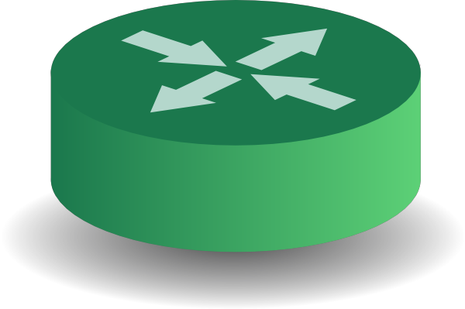
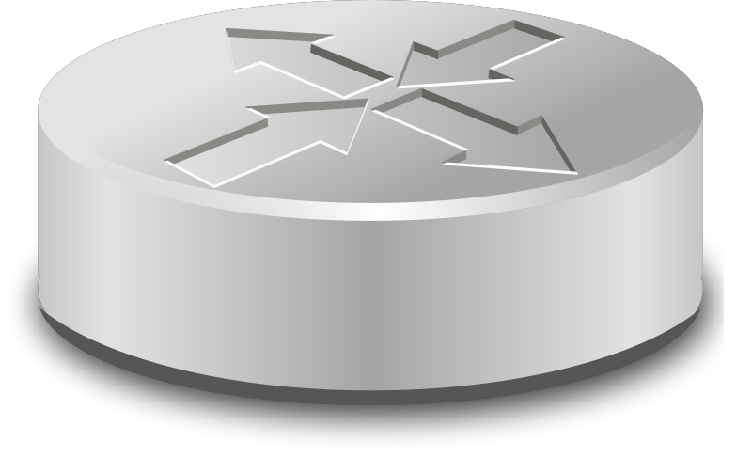
Smart Overlay Network
Smart overlay network consists of smart routers capable of merging redundant streams
The underlying Internet is abstracted and presented as streaming-tree service to video applications
Smart overlay
Logical link
Smart router
Internet
Logical link

Slide 25
Incremental Deployment
Smart routers can be gradually added as the old routers are deprovisioned from Internet
Physical network
Traditional router

Slide 26

Database Courses at UCF
COP4710: Fundamental of Database Systems
COP5711: Parallel and Distributed Database Systems
COP6730: Transaction Processing Systems
COP6731: Advanced Database Systems
COP4710
COP5711
COP6730
COP6731
Databases

