Slide 1

Chapter 8
Storage & Indexing

Slide 2


Data on External Storage
We can retrieve the tuple (record) using the record ID (i.e., physical address)
Record ID ???
RID
001
010
011
100
101
110
111
SSN | Name | Age | Gender | Phone
APPLICATION
Record
ID
1101
1001
Record
0101
Storage Manager

Slide 3

Data on External Storage
SSN, DeptNo, …
Record ID ???
APPLICATION
search key
APPLICATION
SSN
record
File/Index
Record
ID
Record
ID
Record
Record
Storage Manager
Storage Manager

Slide 4
Data on External Storage
SSN, DeptNo, …
Record ID ???
Search
key
APPLICATION
search key
record
File/Index
APPLICATION
SSN
record
Record
ID
Record
File/Index
Buffer Manager
Record
ID
Record
ID
Record
Record
Storage Manager
Storage Manager
Storage Manager

Slide 5

Data on External Storage
APPLICATION
search key
This is our topic
record
File/Index
Record
ID
Record
Storage Manager

Slide 6
Data on External Storage
File organization: Method of arranging a file of records on external storage.
  Record id (rid) is sufficient to physically locate record
  Indexes are data structures that allow us to find the record ids of records with given values in index search key fields
Architecture: Buffer manager stages pages from external storage to main memory buffer pool.
  File and index layers make calls to the buffer manager.
record
key
File/Index
Record
ID
Record
Buffer Manager
Storage Manager

Slide 7
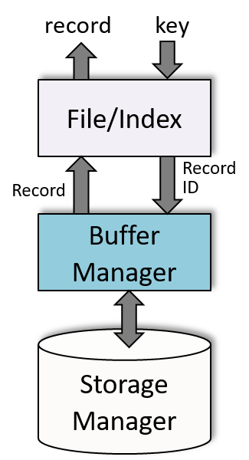
Alternative File Organizations
Many alternatives exist, each ideal for some situations, and not so good in others:
  Heap (random order) files: Suitable when typical access is a file scan retrieving all records.
  Sorted Files: Best if records must be retrieved in some order, or only a `range’ of records is needed.
  Indexes: Data structures to organize records via trees or hashing.
    Like sorted files, they speed up searches for a subset of records, based on values in certain fields, e.g., $80,000 ≤ Salary ≤ $150,000
    Updates are much faster than in sorted files.
Notes:
2

Slide 8

Indexes – Search Key
An index on a file speeds up selections on the search key fields for the index.
  Any subset of the fields of a relation can be the search key for an index on the relation.
  Search key is not the same as key (minimal set of fields that uniquely identify a record in a relation, e.g., student ID).
Search Key field
A | B | C | D | E
1
2
3
4
5
6
7
Index on AB
Index file
Relation (data file)
Notes:
7

Slide 9

Data Entries
An index contains a collection of data entries, and supports efficient retrieval of all data entries k* with a given key value k.
A vertical subset of the relation
Search Key
A | B | RID
1
2
3 | 7
3 | 7
5
6
7
A | B | C | D | E
1
7
3 | 7
2
5
3 | 7
6
A data entry k*
A data record
Search key
Search mechanism
k
e.g., A=3 ꓥ B=7
Index file
Relation (data file)
Notes:
7

Slide 10
Data Entries
An index contains a collection of data entries, and supports efficient retrieval of all data entries k* with a given key value k.
  To locate (one or more) data records with search key value k
  Search the index using k to find the desired data entry k* (e.g., A=3 and B=7)
  The data entry k* contains information to locate (one or more) data records with search key value k
Search Key
A | B | RID
1
2
3 | 7
3 | 7
5
6
7
A | B | C | D | E
1
7
3 | 7
2
5
3 | 7
6
A data entry k*
A data record
Search key
Search mechanism
k
e.g., A=3 ꓥ B=7
Index file
Relation (data file)
Notes:
7

Slide 11
B+ Tree Indexes
SEARCH: Follow the pointers to descend the tree to find the matching data entries in a leaf page
Index entry
A non-leaf page
P₀
K₁
P₁
K₂
P₀
. . .
K_{m}
P_{m}
Each tree node generally occupies one disk page
Follow this pointer if
K₁≤ value <K₂
Non-leaf Pages
Contains data entries
Leaf Pages
Leaf pages contain data entries, and are chained (prev & next)
Non-leaf pages contain index entries and direct searches:
Notes:
4

Slide 12
B+ Tree Indexes
SEARCH: Follow the pointers to descend the tree to find the matching data entries in a leaf page
Index contains auxiliary information that directs searches to the desired data entries
Search Key
Non-leaf Pages
Leaf Pages
Record ID
Notes:
4

Slide 13
B+ Tree Example
Root
17
Entries <= 17
Entries > 17
5
13
27
30
2*
3*
5*
7*
8*
14*
16*
22*
24*
27*
29*
33*
34*
38*
39*
Find 29* ? All ≥ 16* and < 30* ?
Insert/delete: Find data entry in leaf, then change it. Need to adjust parent sometimes.
  And change sometimes bubbles up the tree
Notes:
15

Slide 14
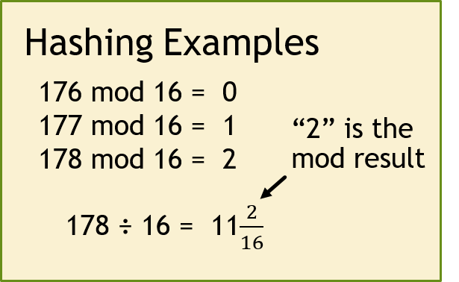
Hash-based Index
Record IDs pointing to data records in the relation
Sequential search the bucket to find the matching key (data entries)
3
0
2
1
Overflow page
2
key
h
1
h(key) =
ID of hash bucket
e.g., h(key) = key mod N
The mod function computes the remainder of the division “key ÷N”
N-1
Primary
bucket pages

Slide 15
Hash-based Index Example
0
Relation
1
Overflow page
key
178
2
178
178
Tuple
h
.
.
.
15
Primary
bucket pages
Search Key
Good for equality search, e.g., Phone = 407-123-4567

Slide 16
Hash-Based Indexes
Good for equality selections.
    Index is a collection of buckets.
      Bucket = primary page plus zero or more overflow pages.
    Hashing function h: h is applied to the search key fields of r. h(r) = ID of bucket in which record r belongs.
      Hash on the key fields to determine the bucket(s)
      Scan the data entries in these buckets to find the matching <key, rid> (i.e., alternative 2)
      Use rid to locate the record r
Notes:
2

Slide 17
Data Entries
Data entries
A | B | RID
1
2
3 | 7
3 | 7
5
6
7
A | B | C | D | E
1
7
3 | 7
2
5
3 | 7
6
Its data entry
A data record
Search key
Search mechanism
k
Index file
Relation (data file)
There are three alternatives for data entries
This is Alternative 2 – Each data record has its own data entry
Notes:
7

Slide 18
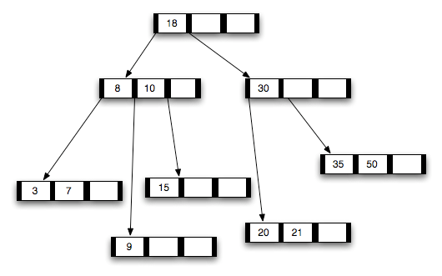
Alternatives for Data Entry k* in Index
  Actual data record (with search key value k)
B-tree
Data records (instead of data entries) stored in
tree node
Notes:
8

Slide 19
Alternatives for Data Entry k* in Index
  Actual data record (with search key value k)
  <k, rid> pair, where rid is the record id of data record with search key value k
Key
Indexing
technique
COP4710
COP4710
COP4710
Data
entries
COP4710
COP4710
COP4710
Data Records
Each matching data record has its own data entry
Notes:
8

Slide 20
Alternatives for Data Entry k* in Index
  Actual data record (with search key value k)
  <k, rid> pair, where rid is the record id of data record with search key value k
  <k, rid-list> pair, where rid-list is a list of rids of data records with search key k
Key
Indexing
technique
COP4710
COP4710
COP4710
Data
entries
COP4710
Data Records
COP4710
Matching records share a data entry
Notes:
8

Slide 21
Data Entry formats: Pros & Cons
Alternative 1:
  If this is used, index structure (e.g., tree structure) is a file organization for data records (instead of a Heap file or sorted file).
  At most one index on a given collection of data records can use Alternative 1. (Otherwise, data records are duplicated, leading to redundant storage and potential inconsistency.)
Age
DR
DR
Auxiliary
information
DR
DR
DR
DR
DR
DR
Data record, there is no separate data entry
Notes:
9

Slide 22
Data Entry formats: Pros & Cons
Alternative 1:
  If this is used, index structure (e.g., tree structure) is a file organization for data records (instead of a Heap file or sorted file).
  At most one index on a given collection of data records can use Alternative 1. (Otherwise, data records are duplicated, leading to redundant storage and potential inconsistency.)
Age
SSN
DR
DR
Auxiliary
information
DR
DR
DR
DR
DR
DR
DR
DR
DR
DR
DR
Data record, there is no separate data entry
DR
DR
DR
Notes:
9

Slide 23
Data Entry formats: Pros & Cons
Alternative 1:
  If this is used, index structure (e.g., tree structure) is a file organization for data records (instead of a Heap file or sorted file).
  At most one index on a given collection of data records can use Alternative 1. (Otherwise, data records are duplicated, leading to redundant storage and potential inconsistency.)
  If data records are very large, # of pages containing data records is high. Implies size of auxiliary information in the index is also large, typically.
Key
DR
DR
Auxiliary
information
DR
DR
DR
DR
DR
DR
Data record, there is no separate data entry
Notes:
9

Slide 24
Data Entry Format: Pros & Cons
Alternatives 2: Data entries <k, rid>, typically much smaller than data records. So, better than Alternative 1 with large data records, especially if search keys are small. (Portion of index structure used to direct search, which depends on size of data entries, is much smaller than with Alternative 1.)
Smaller than Alternative 1
Key
See Slide 11
Data
entries
Variable sized data entries
Data Records
Relation
Alternative 3: Data entries <k, list-rid>, more compact than Alternative 2, but leads to variable sized data entries even if search keys are of fixed length.
COP4710
Notes:
10

Slide 25
Hash-based Index
0
1
2
key
h
A data entry in a hash bucket. It may be:
a record (Alternative 1),
a <k, rid> (Alternative 2), or
a <k, list_rid> (Alternative 3).
N-1
Hash Buckets

Slide 26
Index Classification
No two tuples of a relation have the same value for the primary key
Primary vs. secondary: If search key contains primary key, then called primary index (alternative 1 is usually used to avoid one more I/O to bring in the matching data record).
  Unique index: Search key contains a candidate key.
Index on EMPNo & B
Index on SSN & E
Unique index
Primary index
Unique index
Primary index
EMPNo | B | C | SSN | E | F
Primary key
Primary key
Candidate key
Notes:
11

Slide 27
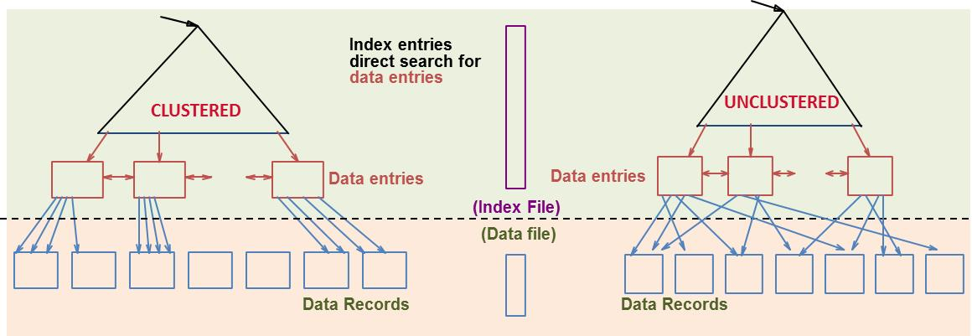
Index Classification
Primary vs. secondary: If search key contains primary key, then called primary index (alternative 1 is usually used to avoid one more I/O to bring in the matching data record).
  Unique index: Search key contains a candidate key.
Clustered vs. unclustered: If order of data records is the same as, or `close to’, order of data entries, then called clustered index.
Notes:
11

Slide 28
Clustered Index
Suppose that Alternative (2) is used for data entries, and that the data records are stored in a Heap file.
  To build clustered index, first sort the Heap file (with some free space on each page for future inserts).
  Overflow pages may be needed for inserts. (Thus, order of data records is `close to’, but not identical to, the sort order.)
Data entries are always sorted
Index entries
direct search for
data entries
CLUSTERED
Data entries
Need to sort the heap file
(Index File)
(Data file)
Data Records in consecutive pages
An overflow page
Notes:
12

Slide 29
Only One Clustered Index
Data records sorted according to SSN
Data entries sorted according to SSN
Data entries sorted
according to phone#
StudentID | Age | Income | Phone
563121325 |  |  | 3212645418
572361672 |  |  | 4075493124
678563276 |  |  | 3219659332
698394250 |  |  | 4073459876
720357320 |  |  | 4077589092
734705862 |  |  | 3214551023
809435620 |  |  | 4077652364
903429554 |  |  | 4071245436
<StudentID, rid>
Clustered
Unclustered
A file can have only one clustered index & alternative 1 often used
Cost of retrieving data record through index varies greatly based on whether index is clustered or not (more on this later …)

Slide 30
Indexes with Composite Search Keys
Composite Search Keys: Search on a combination of fields.
  Equality query:
    age=11 and sal=80
  Range query:
    age=12 and sal > 10
Examples of composite key indexes
Having multiple Data entries
11,80
11
12,10
12
12,20
name
age
sal
12
13,75
bob
12
10
13
<age, sal>
cal
11
80
<age>
joe
12
20
10,12
sue
13
75
10
20,12
Data records
sorted by name
20
Data entries in index sorted by search key to support range queries
75,13
75
80,11
80
<sal, age>
<sal>
Data entries in index
sorted by <sal,age>
Data entries
sorted by <sal>
Notes:
13

Slide 31
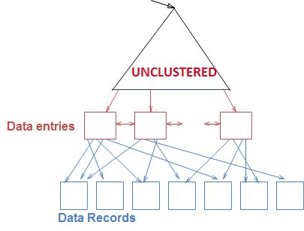
Composite Index: Advantage
Multi-attribute search keys should be considered when a WHERE clause contains several conditions
SELECT E.name
FROM Employees E
WHERE E.age = 20 AND E.sal >= 50000
1
2
  An index on <age,sal> would be better than an index on age or an index on sal
  Reason: The qualifying data entries are grouped together $⟹$ No need to search the index multiple times
Age = 20 & Sal > 50K
Notes:
14

Slide 32
Order is Important:
Order of attributes is important for range queries
  key<age,sal> ≠ key<sal,age>
Data entries
name
age
sal
11,80
bob
12
10
12,10
cal
11
80
12,20
joe
12
20
13,75
sue
13
75
Data entries are sorted by “age”
Data entries with the same age are sorted according to “sal”
<age, sal>
Data records
sorted by name
Data entries are sorted by “sal”
Data entries with the same salary are sorted according to “age”
Notes:
20
If 20<age<30 is more “compact” than 3000<sal<5000, then select the “20<age<30” index.

Slide 33
Which Order to Use ?
Note: Composite indexes have multiple data entries, and are updated more often
To retrieve Emp records for:
  age=30 AND 50,000<sal<80,000
    Clustered <age,sal> index much better than <sal,age> index!
    Reason: The qualifying data entries are grouped together in <age,sal> index, but not in <sal,age> index
50,000 < sal < 80,000
Matching data entries are in one cluster
Matching data entries are not in one cluster
Data Entries
Data Entries
50,000
30-year-old employees in different salary ranges
All 30-year-old employee
.
.
.
80,000
Having matching data entries in fewer pages is better
<age, sal>
<sal, age>
Notes:
20
If 20<age<30 is more “compact” than 3000<sal<5000, then select the “20<age<30” index.

Slide 34
MySQL
Typically, we create indexes at the time of creation of the table
    CREATE TABLE T (
    A1 INT PRIMARY KEY,
    A2 INT NOT NULL,
    A3 INT NOT NULL,
    A4 INT NOT NULL,
    A5 CHAR(10),
    INDEX (A2,A3) );
We use CREAT INDEX to add indexes to existing tables
    CREATE INDEX index_name ON T(A4);
    CREAT UNIQUE INDEX index_name ON T(A4)
CREAT INDEX cannot be used to create primary (use ALTER TABLE when needed)
This is the clustered index

Slide 35

MS SQL Server
Clustered index is automatically created for PRIMARY KEY
You do not have to just accept the default. For many cases, a heap-based table would actually be better
    CREATE TABLE table_name {
    PK_attribute INT PRIMARY KEY NONCLUSTERED
    other attributes …
    }
You can have a clustered index that is different from the primary key
    CREATE TABLE table_name {
    PK_attribute INT PRIMARY KEY,
    clustered_key INT NOT NULL CLUSTERED
    other attributes …
    };

Slide 36
Create Index
Earlier versions of SQL had commands for creating indexes, but they were removed from the language because they were not at the conceptual schema level
Many SQL systems still have the CREATE INDEX commands (check the syntax for your DBMS)
CREATE INDEX index_name
ON table_name (column1, column2, …);
UNIQUE: Duplicate values are not allowed
CREATE UNIQUE INDEX index_name
ON table_name (column1, column2, …);

Slide 37
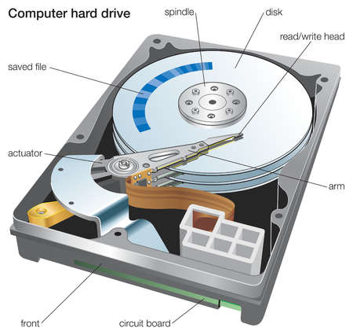
Files and Disk Drive
A disk page (4K Bytes) is the unit for reading and writing a disk
Tuples are accessed by their record ID (i.e., disk address)
Students
.
.
.
Tuple is 50 bytes
80 tuples/page
500 pages
Notes:
3

Slide 38
Cost Model for Our Analysis
Relation
It takes D time units to read/write a disk page
D
For our analysis, D is “1 disk I/O” or just “1 I/O”.
R
Each page holds R records
B
The relation is stored in B data pages
A disk page is the unit for reading and writing a disk (D time units)
Notes:
3

Slide 39
Cost Model for Our Analysis
We ignore CPU costs, for simplicity:
  Measuring number of page I/O’s ignores gains of pre-fetching a sequence of pages; thus, even I/O cost is only approximated.
  Average-case analysis; based on several simplistic assumptions.
Average time to read/write disk page
D
  Good enough to compare different execution plans
R
B
Number of records per page
Number of data pages
Notes:
3

Slide 40

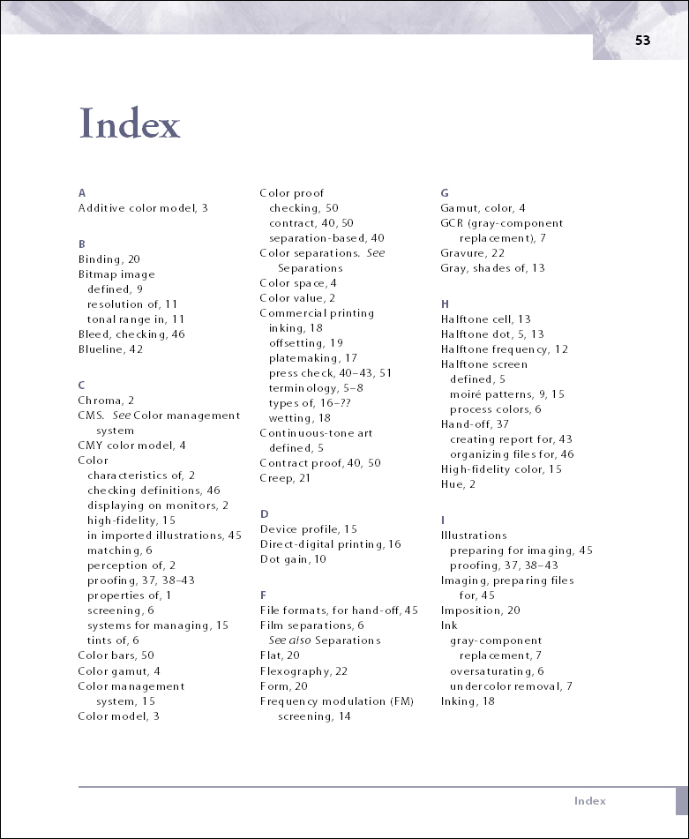
An analogy
Find the page that contains the matching data entries
Search for a paragraph
Use the index to find the pages that contain the index term (cost 1)
Read the paragraphs with the index term in the matching pages (cost 2)
Scan the matching page to find the matching data entries
Search cost = cost 1 + cost 2

Slide 41

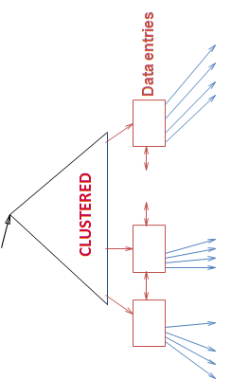
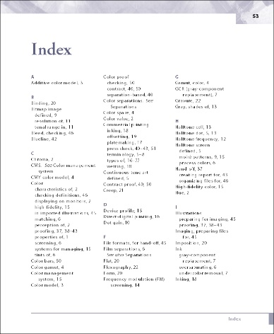
Retrieval Cost
Typically small
Cost depends on #qualifying tuples, and clustering.
  Cost = Cost(finding qualifying data entries)
  + Cost(retrieving records)
Could be large w/o clustering
Emp
eid | sal | dno | age | phone
Finding qualifying data entries
Retrieving matching data records
Notes:
12

Slide 42

Height of a Tree
2⁰
Fanout F
Height of the tree is
log₂4
2¹
2²
1
2
3
4
N leaf nodes with fanout F → log_{F}N levels, e.g., log₂4=2.

Slide 43
Cost Computation
Fanout is F
αB because data entry size is smaller than data record size (more on this later)
Index page
Height is
log_{F}αB
Data entries
1
F
αB
B data (record) pages
The I/O cost for finding a particular range of 10 matching records:
  Clustered Index: D⋅(log_{F}αB + 1) /* 10 records fit in one page
D is time to read or write a disk page
Number of index pages retrieved
1 more I/O to read the 10 matching data records
Notes:
4

Slide 44
Cost Computation
1
3
4
2
The I/O cost for finding a particular range of 10 matching records:
  Clustered Index: D⋅(log_{F}αB + 1) /* 10 records fit in one page
  Unclustered Index: D⋅(log_{F}αB + 10) /* 10 records scattered over different pages
Fetch 10 data pages
Cost of retrieving data records through index varies greatly based on whether index is clustered or not!
Notes:
11

Slide 45
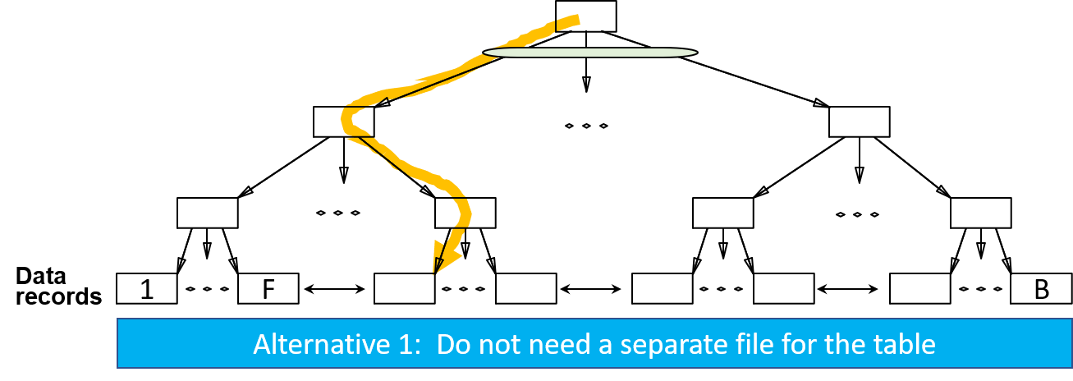
Comparing File Organizations
Heap files (random order; insert at eof)
Sorted files, sorted on <age, sal>
Clustered B⁺ tree file, Alternative (1), search key <age, sal>

Slide 46
Comparing File Organizations
Heap files (random order; insert at eof)
Sorted files, sorted on <age, sal>
Clustered B⁺ tree file, Alternative (1), search key <age, sal>
Heap file with unclustered B⁺ tree index on search key <age, sal>
Heap file with unclustered hash index on search key <age, sal>

Slide 47
Operations to Compare
Scan: Fetch all records from disk
Equality search
Range selection
Insert a record
Delete a record
Scan
Selection
Insert
Search
Delete

Slide 48
Cost of Operations
We have 25 exercises to practice the analysis
 | Scan | Equality | Range | Insert | Delete
Heap | 1 | 2 | 3 | 4 | 5
Sorted | 6 | 7 | 8 | 9 | 10
Clustered | 11 | 12 | 13 | 14 | 15
Unclustered Tree Index | 16 | 17 | 18 | 19 | 20
Unclustered Hash Index | 21 | 22 | 23 | 24 | 25
Notes:
5

Slide 49
Assumptions in Our Analysis
Heap Files:
  Equality selection on key; exactly one match.
Sorted Files:
  Files compacted after deletions.
Indexes:
  Alt (2), (3): data entry size = 10% size of record
  Hash: No overflow buckets.
    80% page occupancy → File size = 1.25 data size* (next page)
  Tree: 67% occupancy (this is typical).
    Implies file size = 1.5 data size (next page)
*Data size is the size of the data set in terms of number of pages.
Notes:
4

Slide 50
Assumptions in Our Analysis
  Hash: No overflow buckets.
    80% page occupancy → File size = 1.25 data size
  Tree: 67% occupancy (this is typical).
    Implies file size = 1.5 data size
Data size
400 records
File size
100 records
100 records
100 records
100 records
100% occupancy → use four pages
Free space
Larger File size
80 records
80 records
80 records
80 records
80 records
80% occupancy
→ use 25% more pages
→ File size = 1.25 data size
A disk page
Notes:
4

Slide 51
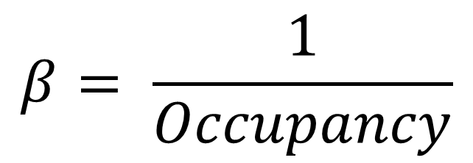
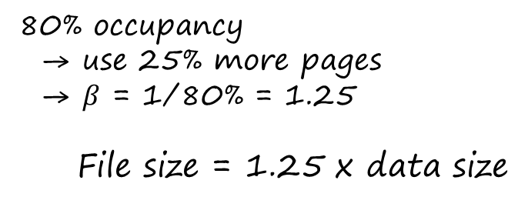
Computing β
$$β= \frac{1}{Occupancy}$$
80% occupancy
→ use 25% more pages
→ $β$ = 1/80% = 1.25
File size = 1.25 x data size
Notes:
4

Slide 52
Computing Tree Height
Fanout is F
αB because data entry size is smaller than data record size (more on this later)
Index page
Height is
log_{F}αβB
4
3
Data entries
1
F
αβB
Steps
1: Determine table size
2. Determine α and β
3. Determine total data-entry size
4. Compute tree height
2
α<1: The data entry is smaller than the data record
β>1: Page occupancy is less than 100%
1
B data (record) pages
Notes:
4

Slide 53
Insert a Tuple
MEMORY
1st I/O

Slide 54
Insert a Tuple
MEMORY
TOTAL COST = 2 I/O’s
= 2D
2nd I/O

Slide 55
Operations on Heap
D
R
B
 | Scan | Equality | Range | Insert | Delete
Heap | BD | 0.5BD | BD | 2D | Search + D
Sorted
Clustered
Unclustered Tree Index
Unclustered Hash Index
Time to read or write disk page
D
1·D to write the page back after the update
Number of records per page
R
Heap files (not sorted; insert at eof)
B
Number of data pages
Notes:
5

Slide 56
Cost of Operations
D
Several assumptions underlie these (rough) estimates!
R
B
 | Scan | Equality | Range | Insert | Delete
Heap | BD | 0.5BD | BD | 2D | Search + D
Sorted | BD | D⋅log₂B | D(log₂B + # matching pages) | Search + BD | Search + BD
Clustered
Unclustered Tree Index
Unclustered Hash Index
Fetch & rewrite the latter half of the file after adding the new record
Sorted files, sorted on <age, sal>
Notes:
5

Slide 57
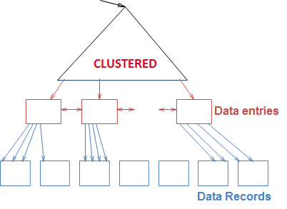
Cost of Operations
Several assumptions underlie these (rough) estimates!
D
R
B
 | Scan | Equality | Range | Insert | Delete
Heap | BD | 0.5BD | BD | 2D | Search + D
Sorted | BD | D⋅log₂B | D⋅(log₂B + # matching pages) | Search + BD | Search + BD
Clustered
Unclustered Tree Index
Unclustered Hash Index
Clustered B⁺ tree file, Alternative (1), search key <age,sal>
Notes:
5

Slide 58
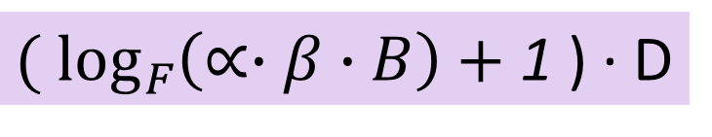
Cost of Equality Search using tree index
${( log}_{F}\left(∝∙β∙B\right)+$1 ) ∙ D
The ratio of the size of data entries with empty space over their size without the empty space (i.e., 100% occupancy)
β≥1
Ratio of the size of the data entries over the size of the relation (i.e., B)
α≤1
When is α=1?
When is β=1?
Notes:
5

Slide 59
Cost of Operations
Several assumptions underlie these (rough) estimates!
D
R
B
 | Scan | Equality | Range | Insert | Delete
Heap | BD | 0.5BD | BD | 2D | Search + D
Sorted | BD | D⋅log₂B | D⋅(log₂B + # matching pages) | Search + BD | Search + BD
Clustered | 1.5BD | D⋅log_{F}(1.5B) | D⋅(log_{F}(1.5B) + # matching pages) | Search + D | Search + D
Unclustered Tree Index
Unclustered Hash Index
67% page occupancy, 50% more pages to scan
Height of the tree
Number of pages as leaf nodes
Clustered B⁺ tree file, Alternative (1), search key <age,sal>
1 write to insert the new record
Notes:
5

Slide 60
Cost of Operations on
Heap File /w Unclustered B⁺ tree
SCAN (to obtain data records in sorting order)
Scan the leaf level of the index
For each data entry in a leaf node, fetch the corresponding data record from the heap file
SCAN COST:
Cost of scanning the leaf nodes (data entries)
  Each page is 67% occupied ⇒ # data pages is 1.5B
  Data entry is only 10% the size of data record ⇒ # leaf pages is 0.1(1.5B)
  Cost of scanning the leaf pages is 0.1(1.5B)⋅D
Cost of fetching the data records
  Number of data record is B⋅R Cost of retrieving all data records is BR⋅D
1
D
2
0.1(1.5B)D + BRD = BD(R+0.15)
R
B
Data size
1
0.1(1.5) B pages
2
B pages

Slide 61
Cost of Operations
D
Several assumptions underlie these (rough) estimates!
R
B
 | Scan | Equality | Range | Insert | Delete
Heap | BD | 0.5BD | BD | 2D | Search + D
Sorted | BD | D⋅log₂B | D⋅(log₂B + # matches) | Search + BD | Search + BD
Clustered | 1.5BD | D⋅log_{F}1.5B | D⋅(log_{F}1.5B + # matching pages) | Search + D | Search + D
Unclustered Tree Index | BD(R+0.15)
Unclustered Hash Index
Heap file with alternative-2 unclustered B⁺ tree index on search key <age,sal>
Size of data entries
Size of data records
Notes:
5

Slide 62
Cost of Operations
D
Several assumptions underlie these (rough) estimates!
R
B
 | Scan | Equality | Range | Insert | Delete
Heap | BD | 0.5BD | BD | 2D | Search + D
Sorted | BD | D⋅log₂B | D⋅(log₂B + # matches) | Search + BD | Search + BD
Clustered | 1.5BD | D⋅log_{F}1.5B | D⋅(log_{F}1.5B + # matching pages) | Search + D | Search + D
Unclustered Tree Index | BD(R+0.15) | D(1 + log_{F}0.15B)
Unclustered Hash Index
Heap file with unclustered B⁺ tree index on search key <age,sal>
One more I/O to retrieve the data record
Cost of descending the tree of height 0.1(1.5B)
Notes:
5

Slide 63
Cost of Operations
D
Several assumptions underlie these (rough) estimates!
R
B
 | Scan | Equality | Range | Insert | Delete
Heap | BD | 0.5BD | BD | 2D | Search + D
Sorted | BD | D⋅log₂B | D⋅(log₂B + # matches) | Search + BD | Search + BD
Clustered | 1.5BD | D⋅log_{F}1.5B | D⋅(log_{F}1.5B + # matching pages) | Search + D | Search + D
Unclustered Tree Index | BD(R+0.15) | D(1 + log_{F}0.15B) | D⋅(log_{F}0.15B + # matches)
Unclustered Hash Index
Heap file with unclustered B⁺ tree index on search key <age,sal>
Each match requires an I/O
Notes:
5

Slide 64
Cost of Operations
D
Several assumptions underlie these (rough) estimates!
R
B
 | Scan | Equality | Range | Insert | Delete
Heap | BD | 0.5BD | BD | 2D | Search + D
Sorted | BD | D⋅log₂B | D⋅(log₂B + # matches) | Search + BD | Search + BD
Clustered | 1.5BD | D⋅log_{F}1.5B | D⋅(log_{F}1.5B + # matching pages) | Search + D | Search + D
Unclustered Tree Index | BD(R+0.15) | D(1 + log_{F}0.15B) | D⋅(log_{F}0.15B + # matches) | D(3 + log_{F}0.15B)
Unclustered Hash Index
Heap file with unclustered B⁺ tree index on search key <age,sal>
1 I/O to insert the data entry + 2 I/O’s to insert the data record
Cost of descending the index tree
Notes:
5

Slide 65
Cost of Operations
D
Several assumptions underlie these (rough) estimates!
R
B
 | Scan | Equality | Range | Insert | Delete
Heap | BD | 0.5BD | BD | 2D | Search + D
Sorted | BD | D⋅log₂B | D⋅(log₂B + # matches) | Search + BD | Search + BD
Clustered | 1.5BD | D⋅log_{F}1.5B | D⋅(log_{F}1.5B + # matching pages) | Search + D | Search + D
Unclustered Tree Index | BD(R+0.15) | D(1 + log_{F}0.15B) | D⋅(log_{F}0.15B + # matches) | D(3 + log_{F}0.15B) | Search + 2D
Unclustered Hash Index
Heap file with unclustered B⁺ tree index on search key <age,sal>
1 I/O’s to write back the updated data-entry page and 1 I/O to write back the updated data-record page
Notes:
5

Slide 66
Cost of Operations on
Heap File /w Unclustered B⁺ tree
EQUALITY SEACH
Search for the matching data entry in the index
Fetch the corresponding data record from the data file
SEARCH COST:
Cost of searching the index (descending the tree)
  # leaf pages is 0.1(1.5B) ⇒ tree height is log_{F}(0.15B)
  Descending the index tree visits log_{F}(0.15B) pages
  Cost of finding the matching data entry is D⋅log_{F}(0.15B)
Cost of fetching the matching data records
  Fetching the corresponding data records incurs one more I/O, or 1⋅D
Total search cost:
D⋅log_{F}(0.15B) + 1D = D(1+ log_{F}(0.15B))

Slide 67
Cost of Operations on
Heap File /w Unclustered B⁺ tree
Equality Search (from last slide)
Range Selection
D(1+ log_{F}(0.15B))
Fetching the matching record
Search the B⁺ tree
D(# matches + log_{F}(0.15B))
Fetching each match in the range incurs one I/O
Search the B⁺ tree

Slide 68
Cost of Operations
Heap File /w Unclustered B⁺ tree
INSERT
Insert the new record in the heap file
Insert the corresponding data entry in the B⁺ tree
INSERT COST:
Cost of inserting the new record
  Inserting the new record incurs two I/O’s: 2⋅D
Cost of inserting the data entry in the B⁺ tree
  # leaf pages is 0.1(1.5B) ⇒ tree height is log_{F}(0.15B)
  Descending the index tree visits log_{F}(0.15B) pages
  Cost of finding the target leaf page is D⋅log_{F}(0.15B)
  Updating target leaf page incurs one more I/O: 1D + D⋅log_{F}(0.15B)
Total insert cost:
D+D⋅log_{F}(0.15B) + 2D = D(3 + log_{F}(0.15B))

Slide 69
Cost of Operations
Heap File /w Unclustered B⁺ tree
Insert
(from last slide)
Delete
D(3 + log_{F}(0.15B))
Search the B⁺ tree
1 I/O to insert the data entry + 2 I/O’s to insert the new record
D(3 + log_{F}(0.15B)) = 2D + Search
1 I/O to delete the data entry + 2 I/O’s to delete the data record
1 I/O to write back the updated data-entry page and another I/O to write back the updated data-record page
Search the B⁺ tree

Slide 70
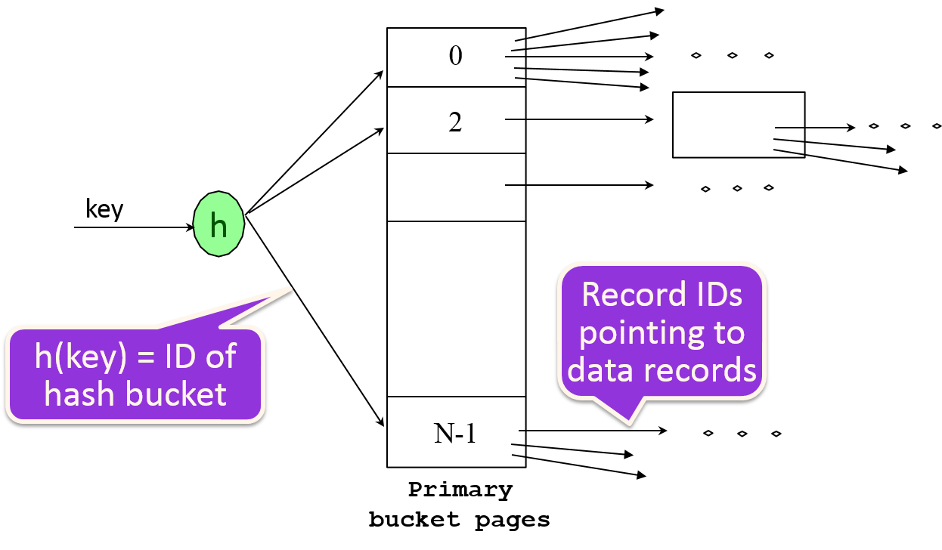
Cost of Operations on
Heap File /w Unclustered Hash Index (1)
SCAN (to obtain data records in “hash” order)
Fetch the hash buckets
For each data entry in a hash bucket, fetch the corresponding data record from the heap file
1
2
1
2

Slide 71
Cost of Operations on
Heap File /w Unclustered Hash Index (2)
SCAN (to obtain data records in “hash” order)
Fetch the hash buckets
For each data entry in a hash bucket, fetch the corresponding data record from the heap file
SCAN COST:
Cost of scanning the hash buckets
  Each page is 80% occupied ⇒ # data pages is 1.25B
  Data entry is only 10% the size of data record ⇒ # index pages (i.e., # hash buckets) is 0.1(1.25B) = 0.125B
  Cost of scanning the data entry is 0.125B⋅D
Cost of fetching the data records
  Since number of data record is B⋅R, cost of retrieving all data records is BR⋅D (i.e., 1 I/O per record)
0.125BD + BRD = BD(R+0.125)

Slide 72

Cost of Operations
D
Several assumptions underlie these (rough) estimates!
R
B
 | Scan | Equality | Range | Insert | Delete
Heap | BD | 0.5BD | BD | 2D | Search + D
Sorted | BD | D⋅log₂B | D(log₂B + # matches) | Search + BD | Search + BD
Clustered | 1.5BD | D⋅log_{F}1.5B | D⋅log_{F}1.5B + # matching pages | Search + D | Search + D
Unclustered Tree Index | BD(R+0.15) | D(1 + log_{F}0.15B) | D⋅(log_{F}0.15B + # matches) | D(3 + log_{F}0.15B) | Search + 2D
Unclustered Hash Index | BD(R+0.125)
Heap file with unclustered hash index
Cost of scanning data entries is 1.25(0.1B)⋅D
Cost of scanning tuples in the hash order
Notes:
5

Slide 73


Homework
We have 25 exercises to practice the analysis
 | Scan | Equality | Range | Insert | Delete
Heap
Sorted
Clustered
Unclustered Tree Index
Unclustered Hash Index
Homework
Notes:
5

Slide 74
Cost of Operations
D
Several assumptions underlie these (rough) estimates!
R
B
 | Scan | Equality | Range | Insert | Delete
Heap | BD | 0.5BD | BD | 2D | Search + D
Sorted | BD | D⋅log₂B | D(log₂B + # matching pages) | Search + BD | Search + BD
Clustered | 1.5BD | D⋅log_{F}1.5B | D⋅log_{F}1.5B + # matching pages | Search + D | Search + D
Unclustered Tree Index | BD(R+0.15) | D(1 + log_{F}0.15B) | D⋅(log_{F}0.15B + # matches) | D(3 + log_{F}0.15B) | Search + 2D
Unclustered Hash Index | BD(R+0.125) | 2D | D(0.125B + # matches) | 4D | 4D
Scan 0.15B pages of data entries. For each of the BR data entries, fetch the data record
1 I/O to insert the data entry + 2 I/O’s to insert the data record
1 I/O’s to write back the updated data-entry page and 2 I/O to write back the updated data-record page
Cost of descending the tree
Notes:
5

Slide 75
Trade Off
Before creating an index, must also consider the impact on updates in the workload!
  Trade-off: Indexes can make queries go faster, updates slower. Require disk space, too.
Update a table also needs to update its indexes
Notes:
13

Slide 76
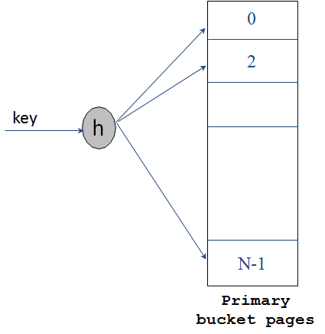

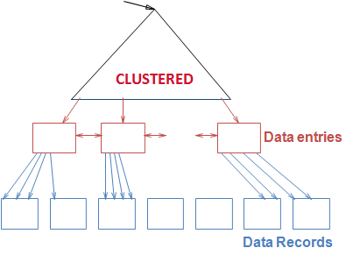
Index Selection
Attributes in WHERE clause are candidates for index keys.
  Exact match condition suggests hash index.
  SELECT E.dno
  FROM Employees E
  WHERE E.num = 568429543
  Range query suggests tree index.
    Clustering is especially useful for range queries
    can also help on equality queries if there are many matching data entries.
SELECT E.name
FROM Employees E
WHERE E.age > 40
SELECT E.name
FROM Employees E
WHERE E.dno=123
Dept. 123 has many employees
Employees older than 40
Notes:
14

Slide 77

Is Index always helpful ?
B⁺ tree index on E.age can be used to get qualifying tuples
SELECT E.dno
FROM Emp E
WHERE E.age>30
Always Helpful ?
Employees older than 30
Note: Many qualified tuples !!
If most employees are older than 30, a sequential scan of the relation would do almost as well, if not better
Notes:
18

Slide 78
Is Index always helpful ?
B⁺ tree index on E.age can be used to get qualifying tuples
SELECT E.dno
FROM Emp E
WHERE E.age>30
Always Helpful ?
What if only 10% are older than 30?
  Unclustered index: Performing one I/O per qualifying tuple could be more expensive than a sequential scan
Older than 30:
Only 10% qualify
Notes:
18

Slide 79
Is Index always helpful ?
B⁺ tree index on E.age can be used to get qualifying tuples
SELECT E.dno
FROM Emp E
WHERE E.age>30
Always Helpful ?
What if only 10% are older than 30?
  Unclustered index: Performing one I/O per qualifying tuple could be more expensive than a sequential scan
  Clustered index: This is a good option
Older than 30:
Only 10% qualify
Notes:
18

Slide 80

Clustered vs Unclustered
1
2
SELECT E.dno
FROM Emp E
WHERE E.hobby=Stamps
SELECT E.dno
FROM Emp E
WHERE E.eid=328169455
If many employees collect stamps, a clustered index on E.hobby is helpful
  If this query is important, we should consider this index
An unclustered index on E.eid is good enough for this query since no two employees have the same E.eid.
Primary key
Notes:
18

Slide 81
Unclustered Index Does not Help
  Using unclustered index on E.age may be costly
  Retrieving tuples with E.age > 25 is expensive
SELECT E.dno, COUNT (*)
FROM Emp E
WHERE E.age>25
GROUP BY E.dno
Index on age
Data entries for age>25
Essentially all these data pages are relevant
Too many tuples qualified !!
Notes:
18

Slide 82

This Clustered Index Helps
Index on dno
dno’s are sorted here
SELECT E.dno, COUNT (*)
FROM Emp E
WHERE E.age>25
GROUP BY E.dno
Employees of dept. 123
For each dno, count the tuple E.age > 25
Notes:
18

Slide 83

Composite Index
To retrieve Emp records for:
  age=30 AND 50,000<sal<80,000
    Clustered <age,sal> index much better than <sal,age> index!
    Reason: The qualifying data entries are grouped together in <age,sal> index, but not in <sal,age> index
50,000 < sal < 80,000
Matching data entries are in one cluster
Matching data entries are not in one cluster
Data Entries
Data Entries
50,000
30-year-old employees in different salary ranges
All 30-year-old employees
.
.
.
80,000
Having matching data entries in fewer pages is better
<age, sal>
<sal, age>
Notes:
20
If 20<age<30 is more “compact” than 3000<sal<5000, then select the “20<age<30” index.

Slide 84
Composite Index - Less Obvious
To retrieve Emp records for:
  18<age<30 AND 50,000<sal<80,000
    <age,sal> index or <sal,age> index ?
    Less obvious
Choose an index with matching data entries clustered in fewer pages
Notes:
20
If 20<age<30 is more “compact” than 3000<sal<5000, then select the “20<age<30” index.

Slide 85
Indexes are only used to improve search ?

Slide 86

Index can be used to support index-only evaluation

Slide 87
Index-Only Evaluation
    Example: Use leaf pages of index on age and sal to compute the average salary for each age group
These data entries can be used as the two columns of the table Emp
Emp
eid | sal | dno | age | phone
age | sal
Index on age and sal
Notes:
14

Slide 88
Index-Only Evaluation
    Example: Use leaf pages of index on age and sal to compute the average salary for each age group
Computing the group averages using only the data entries
Emp
eid | sal | dno | age | phone
age | sal
Index on age and sal
Notes:
14

Slide 89
Index-Only Evaluation
    Example: Use leaf pages of index on age and sal to compute the average salary for each age group
Computing the group averages using only the data entries
Emp
Computing the average for the 27-year-old group
eid | sal | dno | age | phone
age | sal
27
27
27
27
50000
70000
65000
45000
Index on age and sal
Notes:
14

Slide 90

Index-Only Evaluation
    Example: Use leaf pages of index on age and sal to compute the average salary for each age group
Computing the group averages using only the data entries
Advantages
Scanning the data entries is less expensive
The data entries are sorted according to age
Emp
eid | sal | dno | age | phone
age | sal
Index on age and sal
Notes:
14

Slide 91

Index-Only Evaluation
    Example: Use leaf pages of index on age and sal to compute the average salary for each age group
1
Computing the group averages using the data entries
Emp
eid | sal | dno | age | phone
age | sal
2
Computing the group average using the table
Index on age and sal
Notes:
14

Slide 92
Index can be used to support index-only evaluation
Good to know DBMS internal

Slide 93

Database Example
We use this database for the following query examples
My manager
Emp
Dept
dno | mgr | budget
eid | sal | dno | age | phone
Foreign key
Notes:
20

Slide 94
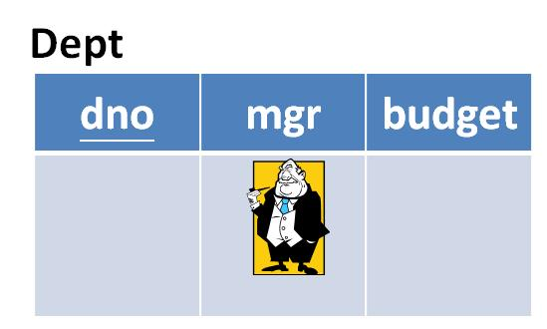
Without Index
Find mangers of departments with at least one employee
SELECT D.mgr
FROM Dept D, Emp E
WHERE D.dno=E.dno
Need to join the two tables:
Dept ${ ⋈}_{dno }$ Emp
Expensive !!
Emp
eid | sal | dno | age | phone
Find matches
Notes:
21

Slide 95

With Index
A number of queries can be answered without retrieving any tuples from one or more of the relations involved if a suitable index is available.
Find mangers of departments with at least one employee
SELECT D.mgr
FROM Dept D, Emp E
WHERE D.dno=E.dno
  Scan the E.dno data entries and pick up the corresponding Dept tuples
No need to perform join operation
Index on dno
Emp
eid | sal | dno | age | phone
This table is not needed
Notes:
21

Slide 96
Compute Average Salary
Emp
  The average salary can be computed using either <E.age,E.sal> or <E.sal,E.age> tree index
  <E.age, E.sal> is better (next slide)
eid | sal | dno | age | phone
Data Entries
Compute the average salary of
25-year-old with a high salary
age | sal
SELECT AVG(E.sal)
FROM Emp E
WHERE E.age=25 AND
E.sal BETWEEN 300000 AND 500000
Qualified entries
Notes:
21

Slide 97
<age, sal> Is Better
    The qualifying data entries are grouped together in <age,sal> index, but not in <sal,age> index
SELECT AVG(E.sal)
FROM Emp E
WHERE E.age=25 AND
E.sal BETWEEN 300000 AND 500000
300,000 < sal < 500,000
Matching data entries are in one cluster
Matching data entries are not in one cluster
Data Entries
Data Entries
300,000
30-year-old employees in different salary ranges
All 30-year-old employees
.
.
.
500,000
Having matching data entries in fewer pages is better
<age, sal>
<sal, age>
Notes:
20
If 20<age<30 is more “compact” than 3000<sal<5000, then select the “20<age<30” index.

Slide 98


How Many 30-Year-Olds in Each Department?
Index-only plans are possible if the key is <dno,age> or we have a tree index with key <age,dno>
  Using <dno,age> index
    Scan all data entries (hash index is OK too)
    For each dno, count number of tuples with age=30
SELECT E.dno, COUNT (*)
FROM Emp E
WHERE E.age=30
GROUP BY E.dno
No need to scan all data entries !
  Using <age,dno> index
    Use index find first data entry /w age = 30
    Scan data entries with age = 30, and count number of tuples for each dno (the departments are arranged continuously for age=30)

Slide 99
How Many age>30 in Each Department?
Index only plans are possible
SELECT E.dno, COUNT (*)
FROM Emp E
WHERE E.age>30
GROUP BY E.dno
  Using the <age,dno> index
    Use one counter for each department
    Scan data entries and count the number of “age>30” for each dno
  Using <dno,age> index
    Scan data entries
    For each dno, count the number of data entries with age > 30

Slide 100
Summary
Many alternative file organizations exist, each appropriate in some situation.
If selection queries are frequent, sorting the file or building an index is important.
  Hash-based indexes only good for equality search.
  Sorted files and tree-based indexes best for range search; also good for equality search. (Files rarely kept sorted in practice; B+ tree index is better.)
Index is:
  a collection of data entries (<key, rid> pairs or <key, rid-list> pairs), plus
  a way to quickly find entries (using hashing or a search tree) with given key values.
Notes:
14

Slide 101
Summary (Contd.)
Data entries can be (1) actual data records, (2) <key, rid> pairs, or (3) <key, rid-list> pairs.
  Choice orthogonal to indexing technique used to locate data entries with a given key value.
Can have several indexes on a given file of data records, each with a different search key.
Indexes can be classified as clustered vs. unclustered. Differences have important consequences for utility/performance.
Notes:
15

Slide 102
Summary (Contd.)
Understanding the nature of the workload for the application, and the performance goals, is essential to developing a good design.
  What are the important queries and updates? What attributes/relations are involved?
Indexes must be chosen to speed up important queries (and perhaps some updates!).
  Index maintenance overhead on updates to key fields.
  Choose indexes that can help many queries, if possible.
  Build indexes to support index-only strategies.
  Clustering is an important decision; only one index on a given relation can be clustered!
  Order of fields in composite index key can be important.

