Slide 1

Internet Computing

Slide 2
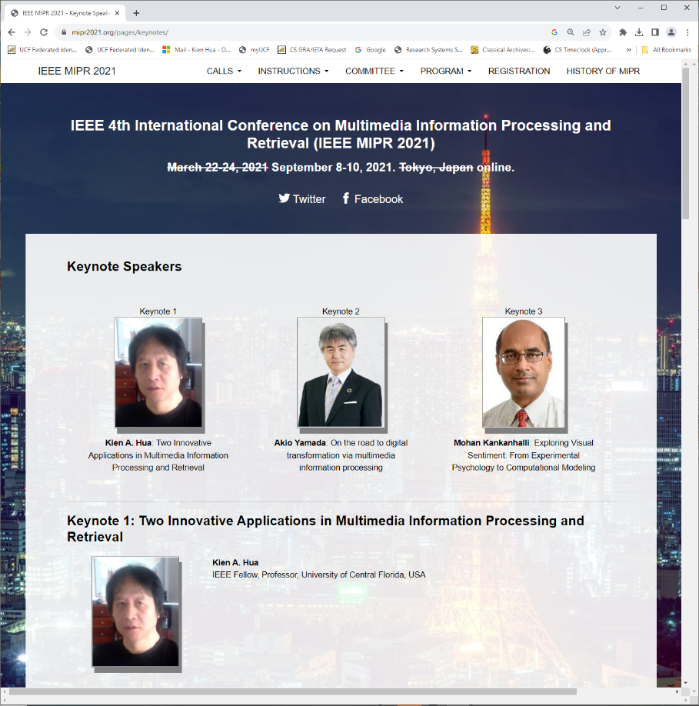
HTML: Review
HTML is the presentation language for the Internet

Slide 3
HTML: Basic Contructs
<html>
</html>
START
An HTML document is enclosed by these two tags
Commands in HTML consist of
a start tag and an end tag
END

Slide 4
HTML: Basic Contructs
<html>
<head>
…
</head>
</html>
The head section contains information about the page including the title, author, etc.

Slide 5
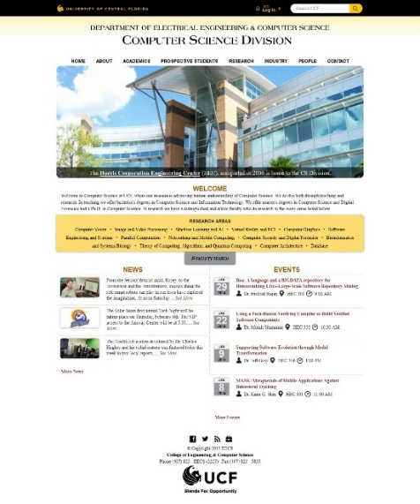
HTML: Basic Contructs
<html>
<head>
…
</head>
<body>
</body>
</html>
The body section contains the parts of the web page the browser will display: text, images, links, etc.

Slide 6
HTML: Basic Contructs
<html>
<head>
…
</head>
<body>
<h1>Section 1</h1>
</body>
</html>
There are six levels of section headers: h1 through h6

Slide 7
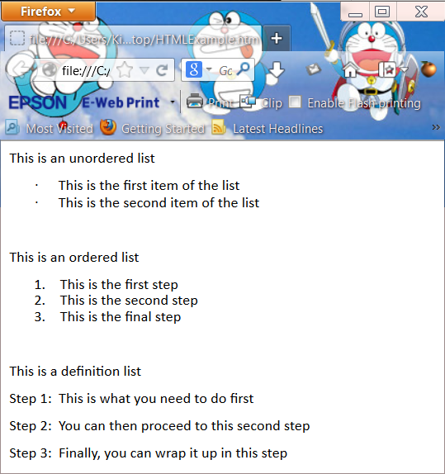
HTML: Basic Contructs
<html>
<head>
…
</head>
<body>
<h1>Section 1</h1>
<ul>
<li>This is the first item</li>
</ul>
</body>
</html>
This is an unordered list

Slide 8
HTML: Basic Contructs
<html>
<head>
…
</head>
<body>
<h1>Section 1</h1>
  <ol>
  <li>Coffee</li>
  <li>Tee</li>
  </ol>
</body>
</html>
This is an ordered list

Slide 9
HTML: Basic Contructs
<html>
<head>
…
</head>
<body>
<h1>Section 1</h1>
  <dl>
  <dt>Step 1:</dt>
  <dd> … </dd>
  <dt>Step 2:</dt>
  <dd> … </dd>
  <dt>Step 3:</dt>
  <dd> … </dd>
  </dl>
</body>
</html>
This is a definition list

Slide 10
HTML: Basic Contructs
<html>
<head>
…
</head>
<body>
<h1>Section 1</h1>
<ul>
<li> This is the <b>first</b> item <\li>
</ul>
</body>
</html>
Display “first” in boldface

Slide 11
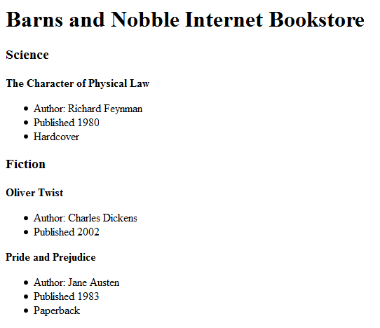
HTML: An Example
h1
<html>
<head></head>
<body>
<h1>Barns and Nobble Internet Bookstore</h1>
<h3>Science</h3>
<b>The Character of Physical Law</b>
<ul>
<li>Author: Richard Feynman</li>
<li>Published 1980</li>
<li>Hardcover</li>
</ul>
<h3>Fiction</h3>
<b>Oliver Twist</b>
<ul>
<li>Author: Charles Dickens</li>
<li>Published 2002</li>
</ul>
h3
b
ul
h3
<b>Pride and Prejudice</b>
<ul>
<li>Author: Jane Austen</li>
<li>Published 1983</li>
<li>Paperback</li>
</ul>
</body>
</html>

Slide 12
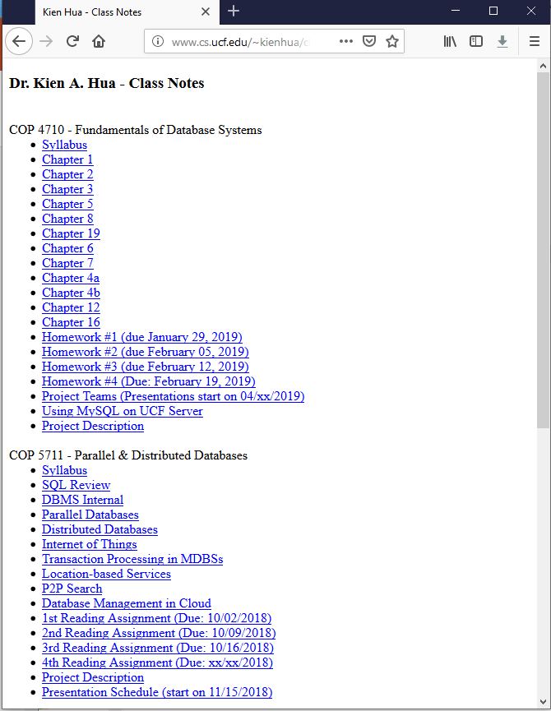
HTML: Summary
HTML is a markup language
Commands are tags:
  Start tag and end tag
  Examples:
    <HTML> … </HTML>
    <UL> … </UL>
Many editors automatically generate HTML directly from your document (e.g., Microsoft Word has an “Save as Web Page” facility)

Slide 13

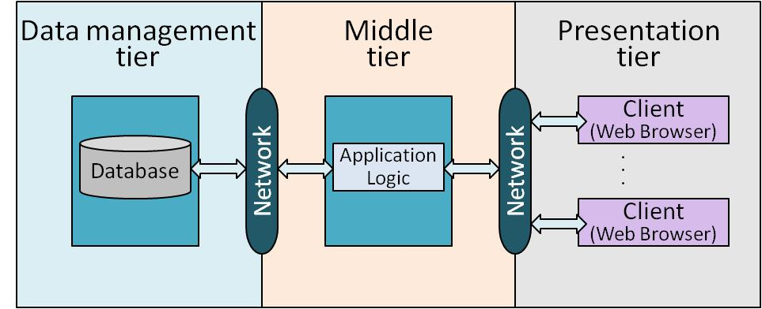
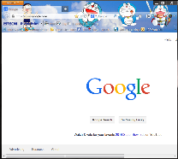
This chapter
Chapter 6 – How to use DBMS from applications
Chapter 5

Slide 14
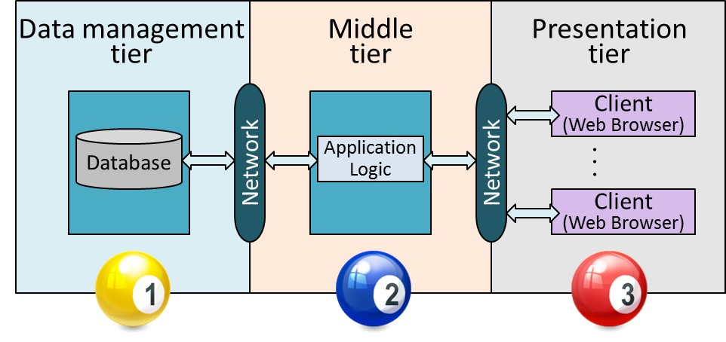
Overview
This chapter
Web Application Development
Internet Concepts
Three-tier architectures
The presentation layer
  HTML forms; HTTP Get and POST, URL encoding; Javascript; Stylesheets. XSLT
The middle tier
  CGI, application servers, Servlets, JavaServerPages, passing arguments, maintaining state (cookies)

Slide 15

Uniform Resource Identifier (URI)
Uniform naming scheme
to identify resources on
the Internet
A resource can be anything:
  Index.html
  mysong.mp3
  picture.jpg
Example URIs:
http://www.acmmm.org/2014/organizing_cmte.html

Slide 16
Structure of URIs
1
2
http://www.cs.ucf.edu/~kienhua/classes/COP4710_internetapp.ppt
3
URI has three parts:
  Name of the protocol used to access the resource (http)
  Name of the host computer (www.cs.ucf.edu)
  Name of the resource (~kienhua/classes/COP4710/Ch7_internetapp.ppt)
URLs are a subset of URIs
  URL (Universal Resource Locator)
  The distinction is not important for our purposes

Slide 17
Hypertext Transfer Protocol (HTTP)
What is a communication protocol?
  Set of standards that defines the structure of messages
  Examples: TCP, IP, JDBC, HTTP
What happens if we click on the following link ?
www.cs.ucf.edu/~kienhua/classes/
  Client (web browser) sends HTTP request to server
  Server replies with an HTTP response

Slide 18
HTTP Requests
HTTP Requests consists of several lines of ASCII text, with an empty line at the end.
HTTP
Method
URI field
HTTP
version
The type of the client (e.g., Mozilla, Version 4.0)
GET ~/index.html HTTP/1.1
User-agent: Mozilla/4.0
Accept: text/html, image/gif, image/jpeg
The type of files the client is willing to accept (e.g., this client cannot accept an mpg video)

Slide 19


HTTP Responses
The server retrieves the page index.html and uses it to assemble the HTTP response message
GET ~/index.html HTTP/1.1
User-agent: Mozilla/4.0
Accept: text/html, image/gif, image/jpeg
HTTP Request
~/index.html
index.html

Slide 20
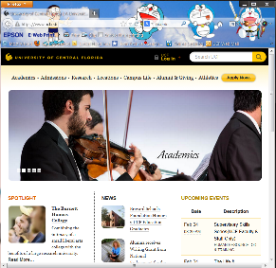
HTTP Responses
The server retrieves the page index.html and uses it to assemble the HTTP response message
The HTTP response message has three parts:
  status line
  several header lines
  body of the message (contains the requested object)
HTTP Request
~/index.html
index.html
HTTP Response

Slide 21
HTTP Response: Status Line
1
HTTP
version
Status code
Associated server message
HTTP/1.1 200 OK
Common status codes and associated messages:
200 OK: The request succeeded and the object is in the body of the message
400 Bad Request: The request could not be fulfilled
404 Not Found: The requested object does not exist
505 HTTP Version Not Supported: The protocol version used by the client is not supported by the server

Slide 22
HTTP Responses: Header Lines
2
Server time
Date: Mon, 04 Mar 2002 12:00:00 GMT
Server: Apache/1.3.0 (Linux)
Last-Modified: Mon, 01 Mar 2002 09:23:24 GMT
Content-Length: 1024
Content-Type: text/html
Server type
Number of bytes being sent
Date when the object was created
Type of object being sent

Slide 23
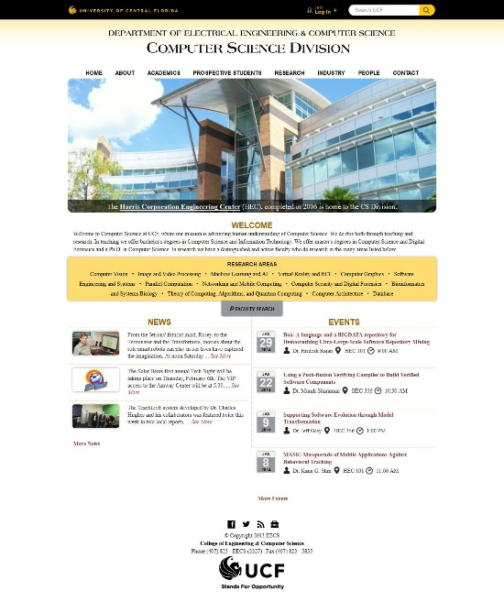
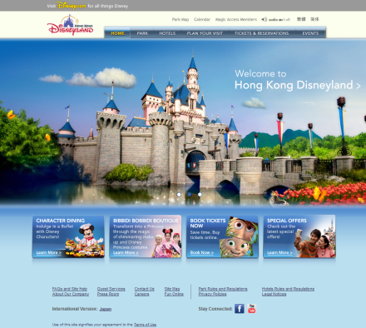
HTTP Response: Body
3
<HTML> <HEAD></HEAD>
<BODY>
<h1>Barns and Noble Internet Bookstore</h1>
Our inventory:
<h3>Science</h3>
<b>The Character of Physical Law</b>
...
Requested object
Display

Slide 24
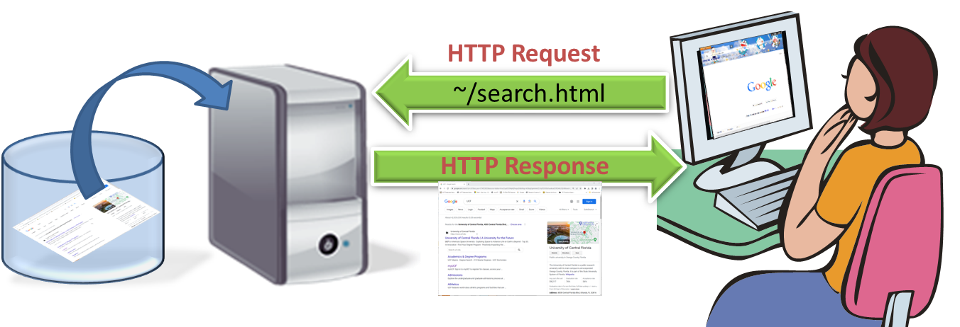
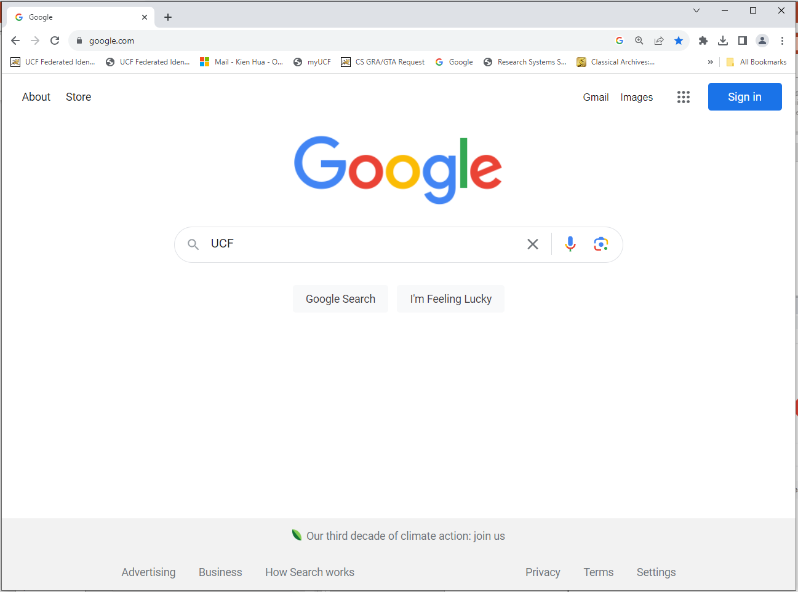
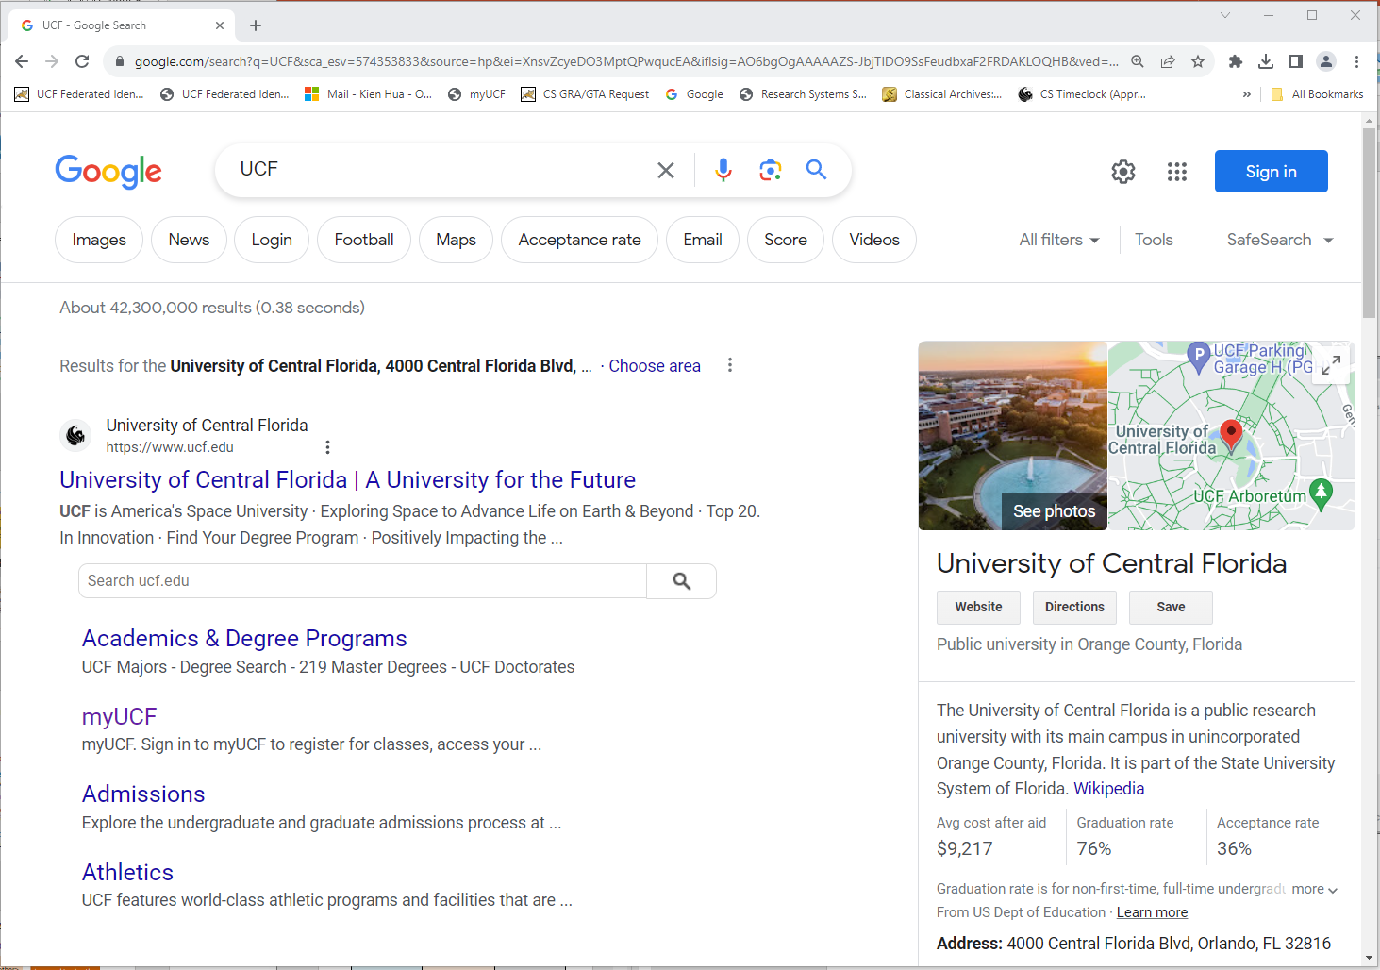
Brower as a User Interface
This page can be dynamically created

Slide 25
Overview
Internet Concepts
Three-tier architectures
The presentation layer
  HTML forms; HTTP Get and POST, URL encoding; Javascript; Stylesheets. XSLT
The middle tier
  CGI, application servers, Servlets, JavaServerPages, passing arguments, maintaining state (cookies)

Slide 26



Three-Tier Architecture
  Implements business logic (implements complex actions, maintains state between different steps of a workflow
  Accesses different data management systems
  Primary interface to the user
  Needs to adapt to different display devices (PC, PDA, cell phone, voice access?)
  One or more standard database management systems
Data management
tier
Business Logics
tier
Presentation
tier
Client
(Web Browser)
Database
Application Logic
.
.
.
Network
Network
Client
(Web Browser)

Slide 27
Technologies
HTML
Javascript
XSLT
Client Program
(Web Browser)
JSP
Servlets
Cookies
CGI
php
Web server + Application Server
(e.g., Tomcat, Apache)
Database Management System
(e.g., mySQL, DB2)
XML
Stored Procedures

Slide 28
Lecture Overview
Internet Concepts
Three-tier architectures
The presentation layer
  HTML forms; HTTP Get and POST, URL encoding; Javascript; Stylesheets.
The middle tier
  CGI, application servers, Servlets, JavaServerPages, passing arguments, php, maintaining state (cookies)

Slide 29
Overview of the Presentation Tier
Functionality of the presentation tier
  Primary interface to the user
  Needs to adapt to different display devices (PC, PDA, cell phone, voice access?)
  Simple functionality, such as field validity checking
We will cover:
  HTML Forms: How to pass data to the middle tier (i.e., the application)
  JavaScript: Simple functionality at the presentation tier (e.g., simple animations)
  Style sheets: Present the same webpage with different formatting for clients with different capabilities.

Slide 30
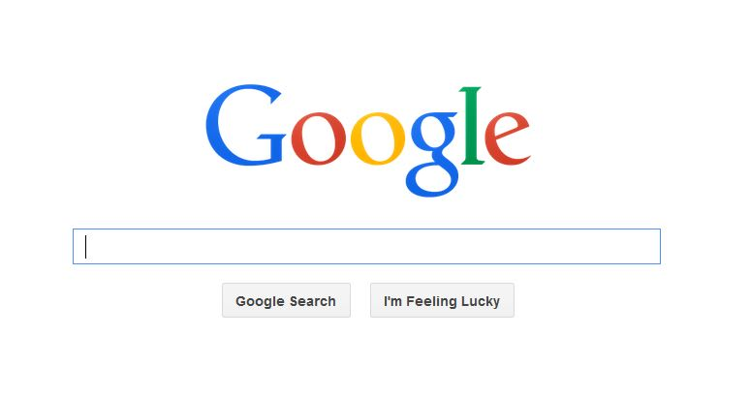
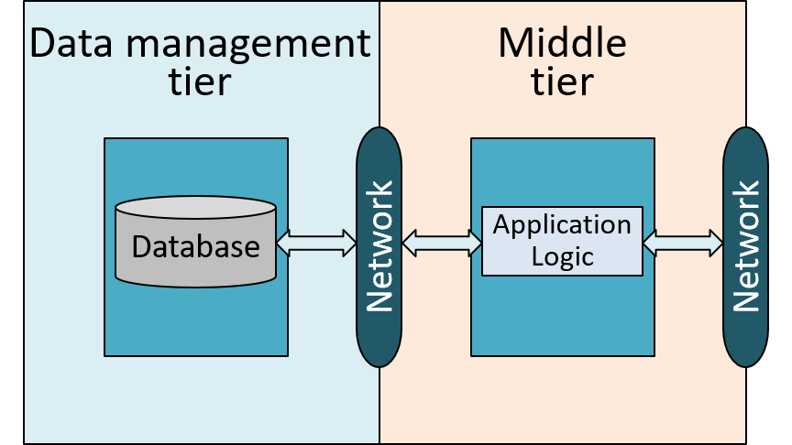
HTML Forms
Common way to communicate data from client to middle tier
Inside an HTML form,
  We can use any HTML tags
  We can have form elements that allow the user to enter information in a form
Form element
This is a form

Slide 31
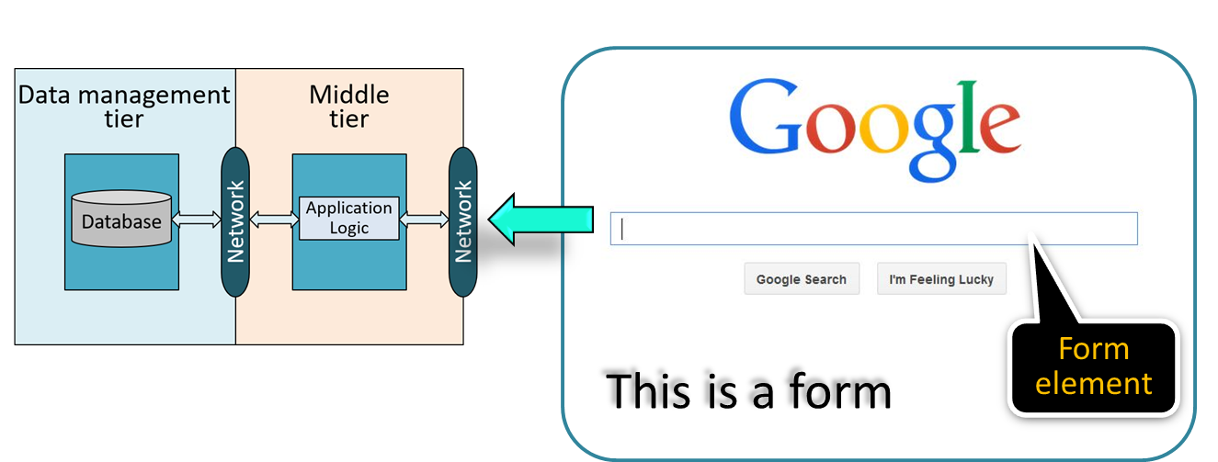
HTML Form - General Format
  <FORM ACTION=“page.jsp” METHOD=“GET”
  NAME=“LoginForm”>
  …
  </FORM>
Name of the form
GET or POST
Program to generate the response page

Slide 32
HTML Form - General Format
  <FORM ACTION=“page.jsp” METHOD=“GET”
  NAME=“LoginForm”>
  …
  </FORM>
NAME: Name of the form; can be used in client-side scripts to refer to the form (more on this later)
METHOD: Specifies HTTP GET or POST method for form submission (more on this later)
ACTION: Specifies URI of the page to which the form contents are submitted (if absent, URI of current page is used)
  → the page provides logic for processing input from the form (more on this later)

Slide 33
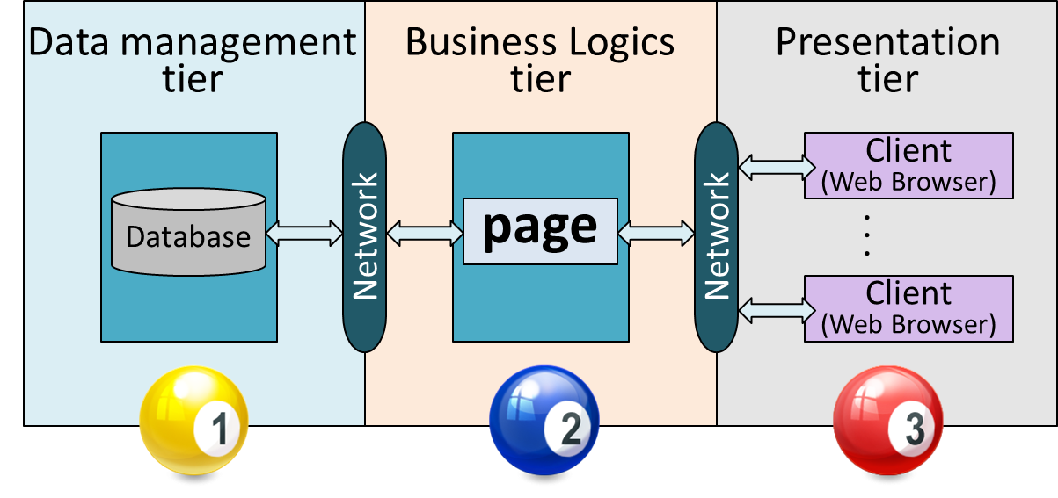
HTML Form - Passing Paramters
  <FORM ACTION=“page.jsp” METHOD=“GET”
  NAME=“LoginForm”>
  …
  </FORM>
Passing parameters

Slide 34
Form Element - Text Type
INPUT is the most used form tag:
  <FORM>
  First name:
  <INPUT TYPE=“text” NAME=“firstname”>
Display in a browser:
First name:
Firstname = “value”
20 characters by default
Martim
firstname = ‘Martim’

Slide 35
Limit the Number of Characters
  <INPUT TYPE=“text”
  MAXLENGTH=40 MINLENGTH=8 NAME=“firstname”>
Maximum is 40 characters
Minimum is 8 characters

Slide 36
Form Element - Text Type
INPUT is the most used form tag:
  <FORM>
  First name:
  <INPUT TYPE=“text” NAME=“firstname”>
  <br>
  Last name:
  <INPUT TYPE=“text” NAME=“lastname”>
  </FORM>
Display in a browser:
First name:
Last name:
An “HTML” page that can take input from the user

Slide 37
Form Element - Radio Type
Using radio buttons:
  <FORM>
  <INPUT TYPE=“radio” NAME=“under”> Undergraduate
  <br>
  Last name:
  <INPUT TYPE=“radio” NAME=“grad”> Graduate
  </FORM>
Display in a browser:
Undergraduate
Graduate
under = “Undergraduate”
grad = “Graduate”

Slide 38
Form Element - Submit Type
Using Submit botton:
  <FORM ACTION=“phone.jsp” METHOD=“GET” NAME=“Phone”>
  Phone number:
  <INPUT TYPE=“text” NAME=“phonenum”>
  <INPUT TYPE=“submit” VALUE=“Submit”>
  </FORM>
Display in a browser:
Phone number:
The page named action needs to be a program, script, or page that will process the user input
4
1
2
3
4
When clicked, content of the form is sent to the page called phone.jsp on the server
1
Submit
2
3

Slide 39
INPUT - General Format
<INPUT TYPE=“text” NAME=“username” VALUE=“Joe”>
text: a text input field
Specifies the symbolic name for this field
Used to identify the input field when it is sent to the middle tier
Specifies default value for text or password fields
For submit or reset buttons, it determines the label of the button
username =
“Joe”

Slide 40
INPUT - General Format
<INPUT TYPE=“text” NAME=“username” VALUE=“Joe”>
text: a text input field
password: a text field where the entered characters are displayed as stars
reset: a button that resets all input fields
submit: a button that sends the values in the form to the server
number: a number input field
Login:
Password:
LoginName
********
Reset
Submit
Two decimal places.
Default is “1”
<input type="number" name=“number” step="0.01" min="0" max="10">
Notes:
Default is 1 digit

Slide 41
INPUT - <label> tag
<form action="/action_page.php">
Favorite Book:
<input type=“text” name=“Book”><br>
<input type="submit" value="Submit Title">
</form>
Favorite Book:
Label created outside the input element
Submit Title
The label for an input field can also be created inside the input element (next slide)
Notes:
The text “Favorite Book” is only for display purposes. See next page for a functional text display to highlight the window field for text input. Make the text a label for accessibility.

Slide 42

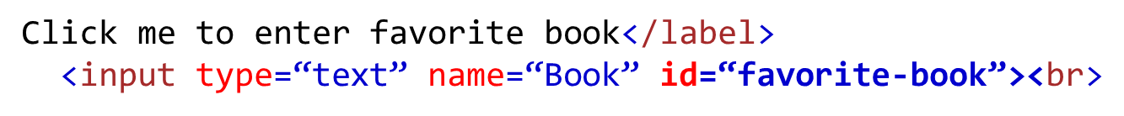

INPUT - <label> tag
Common to add a <label> tag for best accessibility practice.
Add <label> inside the iput element
<form action="/action_page.php”>
<label for=“favorite-book”>
<input type="submit" value="Submit Title">
</form>
Click me to enter favorite book
Submit Title
This window is highlighted when “Click me to enter favorite book” is click

Slide 43
INPUT - <label> tag
<form action="/action_page.php”>
<label for=“favorite-book”>Favorite Book</label>
<input type=“text” name=“Book” id=“favorite-book”><br>
<input type="submit" value="Submit Title">
</form>
Favorite Book
Submit Title
The for attribute’s value should match the id (e.g., favorite-book), not the name (e.g., Book) of the input
Form submission relies on name, and label pairing relies on id
Often see the same value in both id and name attributes

Slide 44
Case Sensitive ?
<INPUT TYPE=“text” NAME=“username” VALUE=“Joe”>
HTML is not case sensitive
Using uppercase to make them stand out from the content, or all lowercase to save holding the shift key

Slide 45

Three Ways of Specifying User Input
INPUT tag (last page)
TEXTAREA tag
<textarea name=“comments” cols=“45” row=“10”>
Please give your input here – as many words as you like.
</textarea>
SELECT tag
Please give your input here – as many words as you like
    Allows the user to choose from a fixed set of values; one or several at once.
10 lines
45 characters
Notes:
TEXTARE tag can hold an unlimited number of characters.

Slide 46

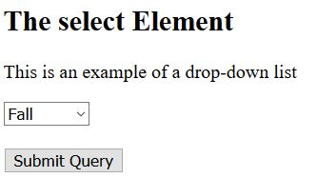
SELECT Tag - Drop-down List
<!DOCTYPE html>
<html>
<body>
<h2>The Select Element</h2>
<p> This is an example of a drop-down list</p>
<form action=“/action_page.php”>
<select name=“semester">
<option value=“fallsem">Fall</option>
<option value=“springsem">Spring</option>
<option value=“summerses">Summer</option>
</select>
<br><br>
<input type=“submit” value=“Submit Query”>
</form>
</body>
</html>
Standard HTML
Display
A form
Value
For display
An <option> element defines an option that can be selected
Example:
Semester = “fallsem”

Slide 47
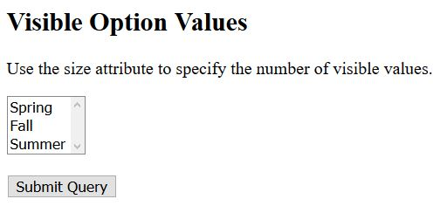
SELECT Tag - Drop-down List
<!DOCTYPE html>
<html>
<body>
<h2>Visible Option Values</h2>
<p> Use the size attribute to specify the number of visible values</p>
<form action=“/action_page.php”>
<select name=“semester“ size=“3” >
<option value=“fallsem">Fall</option>
<option value=“springsem">Spring</option>
<option value=“summerses">Summer</option>
</select>
<br><br>
<input type=“submit”>
</form>
</body>
</html>
Scrolling if the option list is longer than the window size
Display
Display size is 3

Slide 48
Passing Arguments
Two methods for submitting HTML Form data to the Web server:
GET
POST
<FORM ACTION=“page.jsp” METHOD=“GET” NAME=“LoginForm”>
…
</FORM>

Slide 49
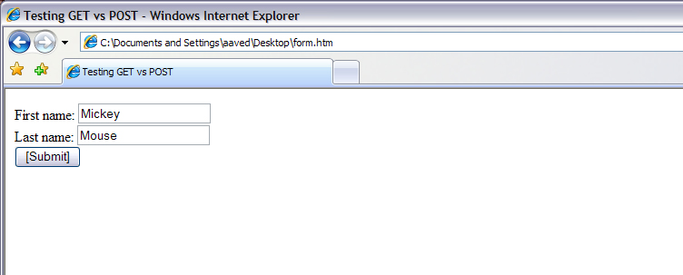
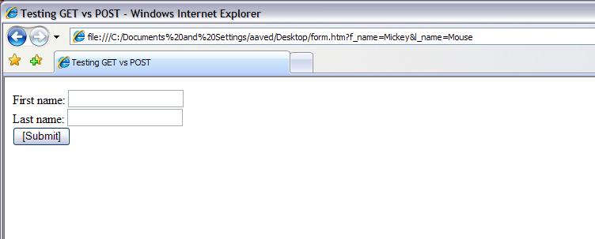
GET Method
Before clinking on “Submit”
  The form contents are directly visible to the user as the constructed URI
  The users can bookmark the page with the constructed URI
After clinking on “Submit”
Constructed URI - Contents of the form are assembled into the query URI (i.e., Middle tier receives header that actually contains data from the form)

Slide 50
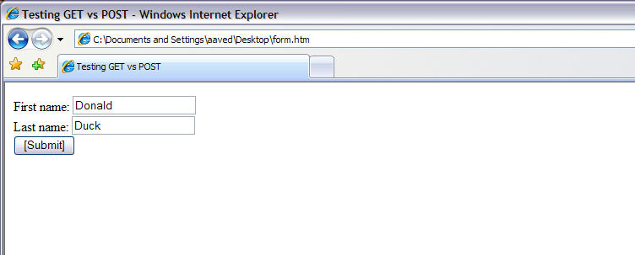
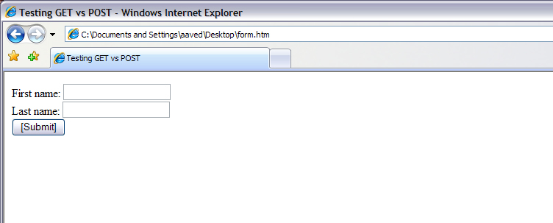
POST Method
Before clinking on “Submit”
  The contents of the form are encoded as in the GET method, but they are sent in the HTTP request body, a separate data block not visible to the user
After clinking on “Submit”
Contents of the form not included
Use POST if form data contain sensitive information, or when a great deal of data would need to be specified in the URI

Slide 51
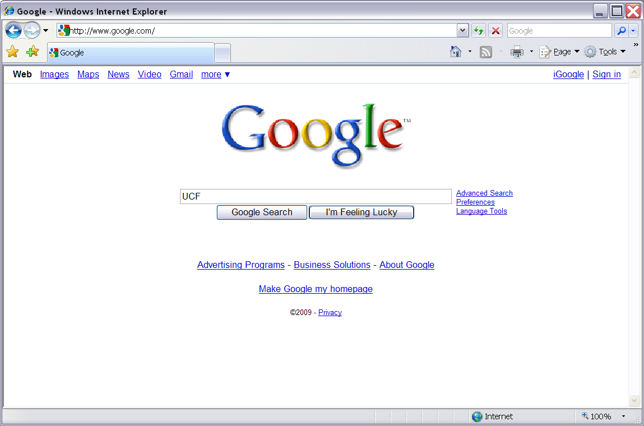
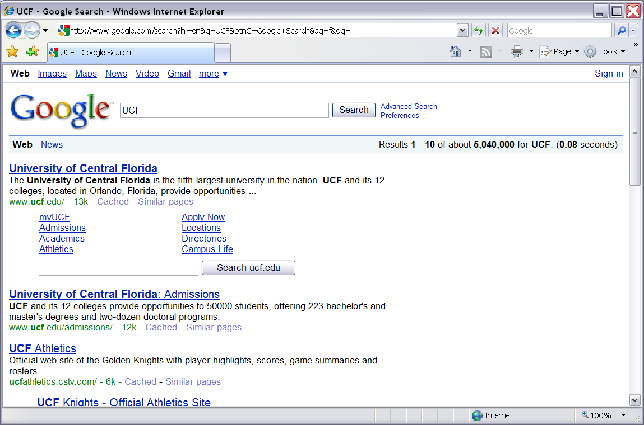
Google Search
Using GET

Slide 52


Encoded URI
action?name1=value1&name2=value2&name3=value3
The action is the URI specified in the ACTION attribute of the FORM tag
  <FORM ACTION=“page.jsp” METHOD=“GET” NAME=“loggin”>
  Login:
  <INPUT TYPE=“text” NAME=“username”> <br>
  <INPUT TYPE=“password” NAME=“password”> <br>
  <INPUTTYPE=“submit” VALUE=“Login”>
  </FORM>
Example:
page.jsp?username=John+Doe&password=secret
Passing two parameters to page.jsp in the middle teir
Notes:
With “password,” use post to protect sensitive information.

Slide 53
Encoded URI
Only shown for GET method
action?name1=value1&name2=value2&name3=value3
‘name=value’ pairs are the user inputs from the INPUT fields in the form
  <FORM ACTION=“page.jsp” METHOD=“GET” NAME=“loggin”>
  Login:
  <INPUT TYPE=“text” NAME=“username”> <br>
  <INPUT TYPE=“password” NAME=“password”> <br>
  <INPUTTYPE=“submit” VALUE=“Login”>
  </FORM>
Example:
page.jsp?username=John+Doe&password=secret
Use the POST method to protect sensitive information
‘+’ represents a space character

Slide 54
Encoded URI
action?name1=value1&name2=value2&name3=value3
  <FORM ACTION=“page.jsp” METHOD=“GET” NAME=“loggin”>
  Login:
  <INPUT TYPE=“text” NAME=“username”> <br>
  <INPUT TYPE=“password” NAME=“password”> <br>
  <INPUTTYPE=“submit” VALUE=“Login”>
  </FORM>
Example:
page.jsp?username=John+Doe&password=secret
This is submitted to the Web Server

Slide 55
HTTP GET: Encoding Form Fields
Form fields can contain general ASCII characters that cannot appear in an URI (e.g., space character)
Name: Jane Doe
Space is allowed here, but not in the URI
A special encoding convention converts such field values into “URI-compatible” characters

Slide 56
HTTP GET: Encoding Form Fields
  Convert all spaces to the “+” character
  Glue (name,value)-pairs from the form INPUT tags together with “&” to form the URI
  Convert all reserved characters to %xyz, where xyz is the ASCII code of the character. Special characters include ? + & = % ( ) @, etc.
1
2
page.jsp?coursename=Database+Systems&CourseID=COP4710
First INPUT
Reserved character
Second INPUT

Slide 57
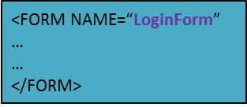
JavaScript
JavaScript is an interpreted scripting language
  A JavaScript is a program added to a Web page.
  It runs at the client tier to add functionality to the presentation
A program running at client
<HTML>
<SCRIPT>
A Web page
</SCRIPT>
</HTML>
Notes:
A browser has an embedded engine sometimes called a “JavaScript virtual machine.” A JavaScript program runs automatically as the page loads.
There can be many <SCRIPT>…</SCRIPT> tags in a document

Slide 58
JavaScript
JavaScript is an interpreted scripting language
  A JavaScript is a program added to a Web page.
  It runs at the client tier to add functionality to the presentation
Sample applications:
  Browser Detection: Detect browser type and load browser-specific page.
  Form validation: Validate form input fields (e.g., an email address contains ‘@’), or if all required fields have input data.
  Browser control: Open new windows (e.g., pop-up ads)

Slide 59
JavaScript: SCRIPT Tags
A JavaScript is usually embedded inside the HTML with the <SCRIPT> … </SCRIPT> tags.
<SCRIPT> tag has several attributes:
<SCRIPT Type=“text/javascript” SRC=“validate.js”>
</SCRIPT>
  SRC: Specifies the external file with the script code. It is in this html file if SRC is not specified.
Type: indicates language of the script (such as JavaScript)

Slide 60
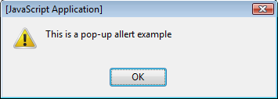
JavaScript without SRC Attribute
SRC field is not included
Example: Create a pop-up box with a message
<SCRIPT Type=“text/javascript” >
alert(“This is a pop-up alert example”)
</SCRIPT>
SRC=“validate.js”>
<HTML>
<SCRIPT>
Display:
</SCRIPT>
</HTML>

Slide 61
Two Different Commenting Styles
“//…” is used for single-line comments
// <code to be commented out>
“/* … */ ” is used for multi-line comments
/*
<code to be commented out>
<other code to be commented out>
<some more code to be commented out>
*/

Slide 62
JavaScript
  Variables:
    numbers, Boolean values, strings, …
    Variables do not have a fixed type, but implicitly have the type of the data to which they have been assigned
  Assignments: =, +=, …
  Comparison operators: <,>,…
  Boolean operators: && for logical AND, || for logical OR, ! for negation
  Statements
    if (condition) {statements;} else {statements;}
    Loops: for-loop, do-while, and while-loop
  Functions with return values
    function funcname(arg1, …, argk) {statements;}
Notes:
While loop, the condition tested at the beginning of the loop, and if the condition is True, statements inside the loop will execute. It means the While loop executes the code block only if the condition is True.
At the end of the loop, the Do While loop tests the condition. So, Do While executes the statements in the code block at least once even if the condition Fails.

Slide 63
Event Handler
Submit
Call event handler when this button is clicked.
An event handler is a function that is called if an event happens on an object (e.g., submit button) in a webpage
onSubmit is an event handler, which is called if the submit button is pressed
If the event handler returns true, then the form contents are submitted to the server

Slide 64
Event Handler
<FORM NAME = “LoginForm” METHOD=“POST”
ACTION=“TableOfContents.jsp”
onSubmit=“return testLoginEmpty()”>
Event handler
An event handler is a function that is called if an event happens on an object (e.g., submit button) in a webpage
onSubmit is an event handler, which is called if the submit button is pressed
If the event handler returns true, then the form contents are submitted to the server
Submit form if even handler returns true
<FORM … onSubmit=“return …>
…
<INPUT TYPE=“SUBMIT” … >
…
</FORM>
EVEN
HANDLER
EVENT

Slide 65
A Complete Example
<SCRIPT TYPE=“text/javascript”>
<!--
function testLoginEmpty()
{
loginForm = document.LoginForm
if ((loginForm.userid.value == “”) ||
(loginForm.password.value == “”)) {
alert(‘Please enter userid and password.’);
return false;
}
else
return true;
}
//-->
</SCRIPT>
“document” is an implicitly defined variable referring to the current HTML page
i.e., the “LoginForm” form in this page
HTML Page
function testLoginEmpty
…
… = document.LoginForm
…
This slide:
An event handler
Next slide:
The form
<FORM NAME=“LoginForm” …
…
</FORM>
onSubmit = “return testLoginEmpty()”

Slide 66
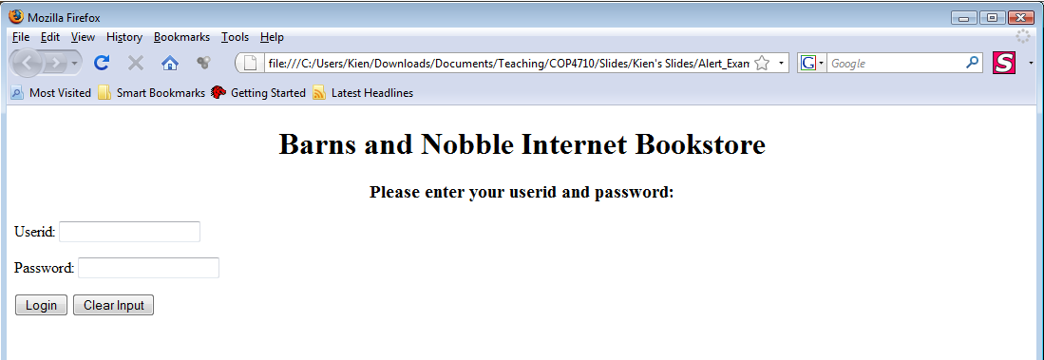
A Complete Example – Cont’d
<H1 ALIGN = “CENTER”>Barns and Nobble Internet Bookstore</H1>
<H3 ALIGN = “CENTER”>Please enter your userid and password:</H3>
<FORM NAME=“LoginForm” METHOD=“POST”
ACTION=“TableOfContents.jsp”
onSubmit=“return testLoginEmpty()”>
Userid: <INPUT TYPE=“TEXT” NAME=“userid”><P>
Password: <INPUT TYPE=“PASSWORD” NAME=“password”><P>
<INPUT TYPE=“SUBMIT” VALUE=“Login” NAME=“SUBMIT”>
<INPUT TYPE=“RESET” VALUE=“Clear Input” NAME=“RESET”>
</FORM>
The form contents are submitted to server if this function returns true
1
2
3
4
On SUBMIT, call the function testLoginEmpty
1
2
4
3
Notes:
Usually, a submit button works fine without a name attribute. However, there are occasions where there's a need to have two submit buttons for the same form, hence making use of the name attribute to identify which button was clicked on the server side.
TableOfContents program in the middle tier will receive the data in the form for server-side processing
Use addEventListener() to add many events on the same button. https://www.w3schools.com/js/tryit.asp?filename=tryjs_addeventlistener_add_many2)

Slide 67
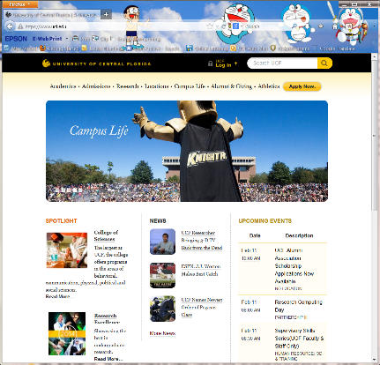
Style Sheets
We need different ways of displaying the same information to clients with different displays
  Using different font sizes or colors to provide better contrast
  Rearranging objects on the page to accommodate small screens
  Highlighting different information to focus on some important part of the page
I have a small screen

Slide 68
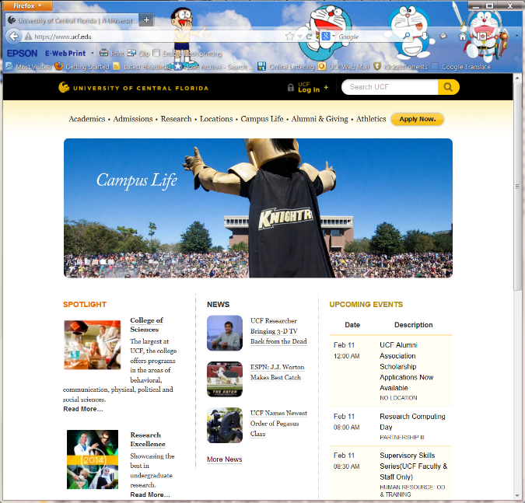
Style Sheets
A style sheet is a method to adapt the same document contents to different presentation formats
It tells a Web browser how to translate the document contents into a presentation that is suitable for the client’s display
How to present
Style
sheet
Different presentations
Same contents

Slide 69
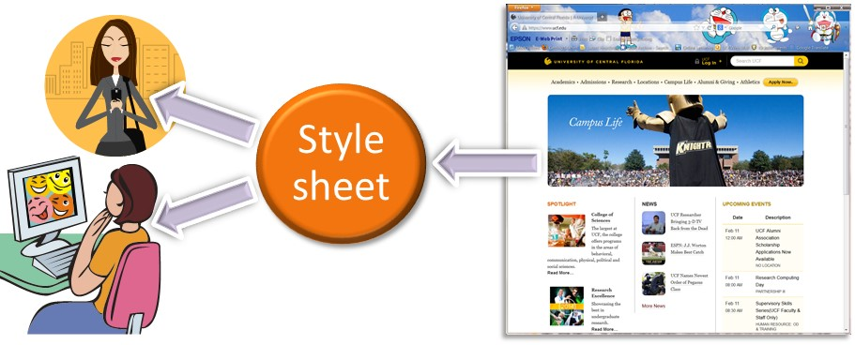
Stylesheets
Idea: (1) Separate display from contents, and (2) adapt display to different presentation formats
Two aspects:
  Document transformations to decide what parts of the document to display in what order
  Document rendering to decide how each part of the document is displayed

Slide 70
Stylesheet Languages
Cascading style sheets (CSS): For HTML documents
Extensible stylesheet language (XSL): For XML documents

Slide 71

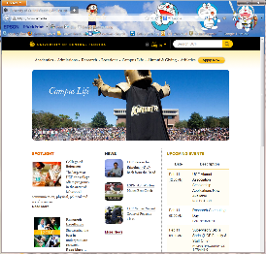
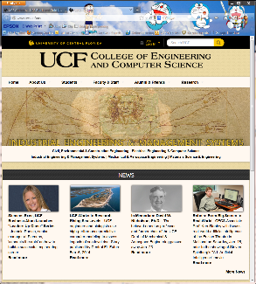
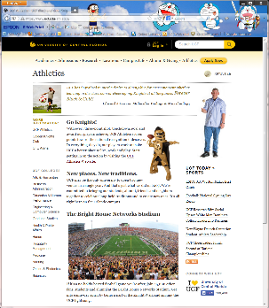
CSS: Cascading Style Sheets
Styles are normally stored in style sheets, which are files that contain style definitions. They define how to display HTML documents.
Many HTML documents (e.g., all in a website) can refer to the same CSS
Can change format of a website by changing a single file (i.e., separation of content from presentation)
Style sheet
Style definitions

Slide 72
CSS: Cascading Style Sheets
Include the following line into an HTML file to link to the external CSS style sheet.
<LINK REL=“style sheet” TYPE=“text/css” HREF=“books.css” />
Relationship between current document and linked document
The type of the linked document
Location of the linked document

Slide 73
CSS: Example
<LINK REL=“style sheet” TYPE=“text/css” HREF=“books.css”/>
The books.css file:
BODY {BACKGROUND-COLOR: black}
H1 {FONT-SIZE: 36pt}
H3 {COLOR: yellow}
P {MARGIN-LEFT: 50px; COLOR: yellow}
Each line consists of three parts: selector {property: value}
Selector: Tag whose format is defined
Property: Tag’s attribute whose value is set
Value: value of the attribute
Same effect as:
<BODY BACKGROUND-COLOR=“BLACK”>
in HTML
Properties separated by semicolons
Notes:
A CSS pixel (“px”) is not necessarily exactly the same size as a single pixel on your display.

Slide 74
CSS vs XSL
Use CSS when you can. It is easier to learn. There are WYSIWYG editors
Use XSL (Extensible Stylesheet Language) when you need transformation:
  Display a list in lexicographical order
  Replace words by other words
  Replace empty elements with text
  See http://www.w3.org/Style/XSL/

Slide 75
Lecture Overview
Internet Concepts
Three-tier architectures
The presentation layer
  HTML forms; HTTP Get and POST, URL encoding; Javascript; Stylesheets. XSLT
The middle tier
  CGI, application servers, Servlets, JavaServerPages, passing arguments, php, maintaining state (cookies)

Slide 76

Overview of the Middle Tier
Encodes business logic
1st tier
2nd tier
FORM
Database
CONNECTION
OUTPUT
3rd tier
Receive data and generate dynamic HTML
We will cover
  CGI: Protocol for passing arguments to programs running at the middle tier
  Application servers: Runtime environment at the middle tier
  Servlets: Java programs at the middle tier
  JavaServerPages: Java scripts at the middle tier
  php: HTML-embedded scripting language
  Cookies: Used to maintain state at the middle tier.

Slide 77
CGI: Common Gateway Interface
Goal: Transmit arguments from HTML forms to application programs running at the middle tier

Slide 78
CGI Illustration: Request the Page
Internet
Web Server
Request the page (HTTP)
<FORM> …
<FORM> …

Slide 79
CGI Illustration: Send Back the page
Internet
Web Server
<FORM> …
Fill the <FORM> and send back the page
<FORM> …

Slide 80


CGI Illustration: Process <FORM>
This is called a CGI script since many such programs are written in a scripting language, e.g., Perl
XYZ.cgi
(child process)
Internet
Result
HTTP protocol
Web Server
parameters
<FORM> …
<FORM> …
CGI protocol
<FORM> …
Extracts parameters from Webpage
Generates a Webpage to return the results

Slide 81


CGI: Example
Type an author name:
HTML form:
  <form action=“findbooks.cgi” method=POST>
  Type an author name:
  <input type=“text” name=“authorName”>
  <input type=“submit” value=“Send it”>
  <input type=“reset” value=“Clear form”>
  </form>
Send it
Clear form
When the user submits this page, the input values in the form are passed to the program findbooks.cgi in the middle tier
Perl code:
  use CGI;
  $dataIn=new CGI;
  $dataIn->header();
  $authorName=$dataIn->param(‘authorName’);
  print(“<HTML><TITLE>Argument passing test</TITLE>”);
  print(“The author name is “, $authorName);
  print(“</HTML>”);
  exit;
CGI script
Findbooks.cgi
in middle tier

Slide 82
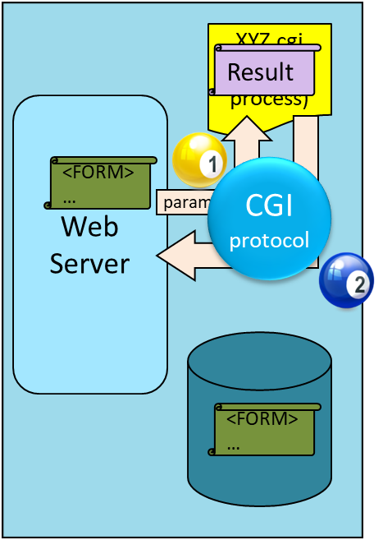

CGI: Example
Type an author name:
HTML form:
  <form action=“findbooks.cgi” method=POST>
  Type an author name:
  <input type=“text” name=“authorName”> <br>
  <input type=“submit” value=“Send it”>
  <input type=“reset” value=“Clear form”>
  </form>
Send it
Clear form
Include the standard library CGI.pm – no need to deal with CGI protocol
Perl code:
  use CGI;
  $dataIn=new CGI;
  $dataIn->header();
  $authorName=$dataIn->param(‘authorName’);
  print(“<HTML><TITLE>Argument passing test</TITLE>”);
  print(“The author name is “, $authorName);
  print(“</HTML>”);
  exit;
Perl is often used for CGI scripting

Slide 83
CGI: Example
Type an author name:
HTML form:
  <form action=“findbooks.cgi” method=POST>
  Type an author name:
  <input type=“text” name=“authorName”> <br>
  <input type=“submit” value=“Send it”>
  <input type=“reset” value=“Clear form”>
  </form>
Send it
Clear form
The header() function prints out the
“Content-Type: text/html” statement.
Note: The output of the program must be returned in an HTML page
Include the standard library CGI.pm – no need to deal with CGI protocol
Perl code:
  use CGI;
  $dataIn=new CGI;
  $dataIn->header();
  $authorName=$dataIn->param(‘authorName’);
  print(“<HTML><TITLE>Argument passing test</TITLE>”);
  print(“The author name is “, $authorName);
  print(“</HTML>”);
  exit;
param() returns the value of the parameter, i.e., authorName
Instantiate a CGI object $dataIn
Extract the argument of the HTML form – High level interface for CGI protocol
Dynamically construct the Webpage, i.e., result of user request

Slide 84


CGI - Does Not Scale Well
The application program is invoked using the CGI protocol. Each page request results in the creation of a new process → Do not scale well to many simultaneous requests.
Checking out a customer
Hiring the next cashier for the next customer

Slide 85
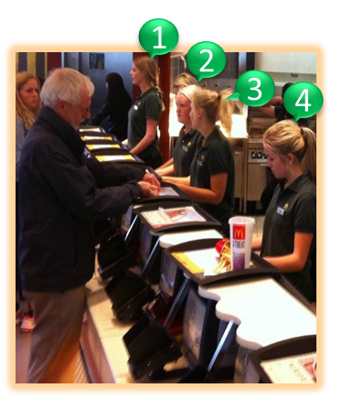
Application Servers
Multiple Persistent Processes
Avoid the process creation overhead:
  Application server maintains
  a pool of threads or processes
  and uses them to execute requests
  Application server also provides
  other functionality
    Enable access to heterogeneous data sources (e.g., by providing JDBC drivers)
    Provide APIs for session management

Slide 86
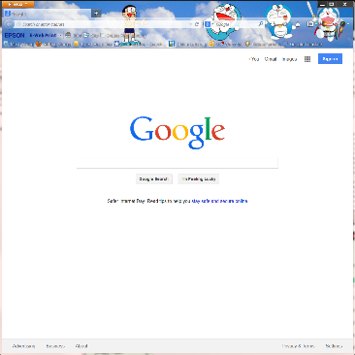
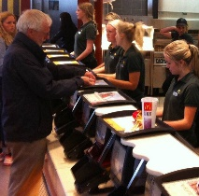
Application Server: Process Structure
The client sends an HTTP request to the server
The server directs the request to be processed by appropriate servlets
Web Server
(e.g., Apache)
HTTP
Web Browser
C++ Application
JavaBeans
Application Server
JDBC
DBMS 1
ODBC
DBMS 2
The servlets do their processing, then return results to the client normally in the form of HTML documents
Pool of Servlets
Pool of persistent processes

Slide 87
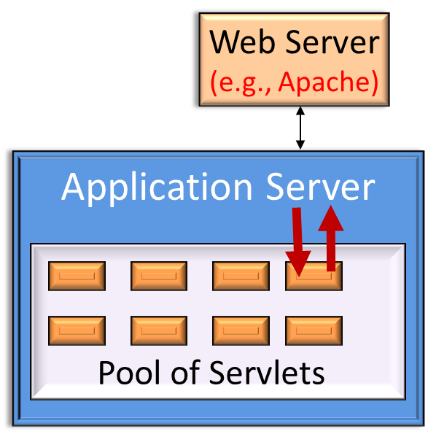
What is a Servlet ?
Servlets are Java’s answer to CGI programming
Servlet is a Java class used to extend the capabilities of servers that host applications
Web Browser
Servlet extends the capability of the Application Server

Slide 88
What is a Servlet ?
Servlets are Java’s answer to CGI programming
Servlet is a Java class used to extend the capabilities of servers that host applications
Web Browser
If you have a Java application with JSP* and Servlet to generate dynamic content, then you need also web containers
A web server is sufficient if you are serving static web pages

Slide 89
What is a Servlet ?
In most cases, servlets extend the specific HttpServlet class for Web servers that communicate with clients via HTTP
  doGet (for HTTP GET) and doPost (for HTTP POST) to receive arguments from HTML forms, and
  sending output back to the client via HTTP
Web Browser
HttpServlet takes care of “I/O”
HTTP
Output
GET
HttpServlet
doGet
doPost
…
Servlet
Web server

Slide 90

Servlet Review
Use request object to read the form
Server
Servlet
Use response object to compose the Web page

Slide 91
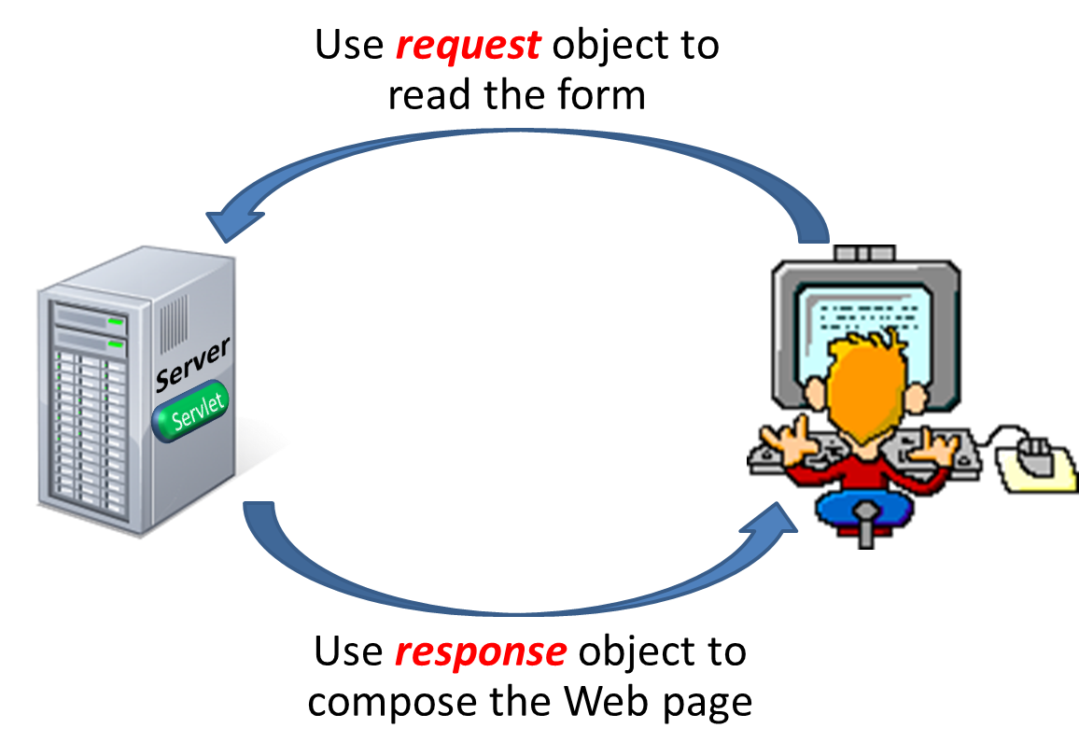
Review: HTTP Responses
The HTTP response message has three parts:
  status line, e.g., “HTTP/1.1 200 OK” (The request succeeded and the object is in the body of the message.)
  several header lines
Date: Mon, 04 Mar 2002 12:00:00 GMT
Server: Apache/1.3.0 (Linux)
Last-Modified: Mon, 01 Mar 2002 09:23:24 GMT
Content-Length: 1024
Content-Type: text/html
  body of the message (which contains the requested object)
Dynamically generated by Servlet in response to an HTTP request

Slide 92
Servlet Generating Web Page as Output
Use request object to read form data
public class ServletTemplate extends HttpServlet {
public void doGet(HTTPServletRequest request,
HTTPServletResponse response)
.
.
.
}
}
Use response object to construct the output page
Servlet-Generated
Webpage
Status line
Header lines
Body
Three parts of a Webpage

Slide 93
Servlet Generating Web Page as Output
Use request object to read form data
public class ServletTemplate extends HttpServlet {
public void doGet(HTTPServletRequest request,
HTTPServletResponse response)
.
.
.
}
}
Use response object to create status code and the headers of the http response
Use response object to construct the output page
Servlet-Generated
Webpage
Status line
Create a PrintWriter object to compose the body (next page)
Header lines
Body
Three parts of a Webpage

Slide 94
Template of a Generic Servlet Structure
This simple servlet just outputs two words “Hello World”
import java.io.*;
import java.servlet.*;
import java.servlet.http.*;
public class ServletTemplate extends HttpServlet {
public void doGet(HTTPServletRequest request,
HTTPServletResponse response)
throws ServletException, IOException {
PrintWriter out=response.getWriter();
out.println(“Hello World”); //Use ‘out’ to compose the Webpage
}
}
request object is used to read HTML form data.
e.g., request.getParameter(“username”) returns value of the variable username
This example has no form to read
response object is used to print “Hello World”
Use ‘out’ to compose content that is returned to the client
Returns a PrintWriter object that can send character text to the client

Slide 95
Servlets: A Complete Example
public class ReadUserName extends HttpServlet {
public void doGet( HttpServletRequest request,
HttpSevletResponse response)
throws ServletException, IOException {
reponse.setContentType(“text/html”);
PrintWriter out = response.getWriter();
out.println(“<HTML><BODY>\n <UL> \n” +
“<LI>” + request.getParameter(“userid”) + “\n” +
“<LI>” + request.getParameter(“password”) + “\n” +
“<UL>\n<BODY></HTML>”);
}
public void doPost( HttpServletRequest request,
HttpSevletResponse response)
throws ServletException, IOException {
doGet(request,response);
}
}
Prepare
“Content-Type: text/html” statement in the header of the Web page
request object is used to read HTML form data.
We extend the servlet to dynamically generate HTML (by writing to the PrintWriter object)
Notes:
When a servlet container calls a servlet because of a requested page, it starts with the service() method, whose default behavior is to call one of the following methods based on the HTTP transfer method: Service() calls doGet() for a HTTP GET request, and it calls doPost() for a HTTP POST request. This automatic dispatching allows the servlet to perform different tasks on the request data depending on the HTTP transfer method.

Slide 96
Web Server and Servlet Container
A Web server (e.g., Apache) handles HTTP requests and responses
Servlet container (e.g., Tomcat) is the intermediary between the Web server and the servlets in the container
If you have a Java application with JSP* and Servlet to generate dynamic content, then you need also web containers.
You need a web server if you are serving static web pages
Servlet container (Tomcat)
Web Server
(e.g., Apache)
HTTP
Web Browser
Pool of Servlets
* Discussed later

Slide 97
Servlet Container
The servlet container (also known as web container) is a compiled and executable program. It loads, initializes, and executes the servlets
When a request arrives from the Web server:
  The container maps the request to a servlet, and then passes the request to the servlet.
  The servlet processes the request and produces a response
  The container translates the response into the network format, then sends the response back to the Web server

Slide 98
Application Server
APPLICATION SERVER
(WebSphere, WebLogic, Jboss)
WEB CONTAINER
APPLICATION CLIENT CONTAINER
EJB⁺ CONTAINER
SERVLETS
JSP
…
SECURITY
TRANSACTION PROCESSING
Logical division
Web container is part of the application server. However, Tomcat is a standalone software.
⁺Enterprise JavaBeans
Notes:
Web container is part of the application server. However, Tomcat is a standalone software. EJB = “Enterprise JavaBeans”

Slide 99
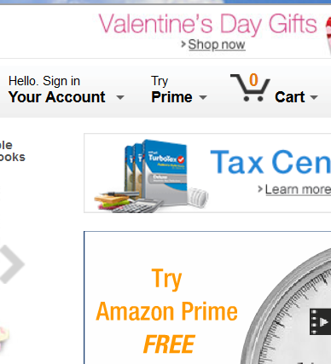

HTTP is Stateless
HTTP is stateless
  No “sessions”
  Every message is completely self-contained
  No previous interaction is “remembered” by the protocol
  Tradeoff between ease of implementation and ease of application development: Other functionality has to be built on top
Implications for applications:
  Any state information (shopping carts, user login-information) need to be encoded in every HTTP request and response!
  Popular methods on how to maintain state:
    Cookies (more later)
    Dynamically generate unique URL’s at the server level (more later)

Slide 100

Application State
Server-side state
  Information is stored in a database, or in the application layer’s local memory
Client-side state
  Information is stored on the client’s computer in the form of a cookie
Hidden state
  Information is hidden within dynamically created web pages
Hidden state
Cookies
Server-side state

Slide 101
Server-Side State
Many types of Server side state:
Store information in a database
  Data will be safe in the database
  BUT: requires a database access to query or update the information
Use application layer’s local memory
  Can map the user’s IP address to some state without disk access
  BUT: this information is volatile and takes up lots of server main memory

Slide 102
When to Use Server-Side State
Should use Server-side state maintenance for information that needs to persist, e.g.,
  Old customer orders
  “Click trails” of a user’s movement through a site
  Permanent choices a user makes

Slide 103




Client-side State: Cookies
Storing text (cookies) on the client which will be passed to the application with every HTTP request.
A cookie is a collection of (Name, Value) pairs
Issues
  Can be disabled by client
  Wrongfully perceived as "dangerous," and therefore will scare away potential site visitors if asked to enable cookies
Web server
Send cookies to Web server
HTTP request

Slide 104
Client State: Cookies
Advantages
  Easy to use in Java Servlets/JSP
  Provide a simple way to persist non-essential data on the client (in the browser cache) even after the browser is closed
Disadvantages
  Limit of 4 KB of information (not bad for most applications)
  Users can (and often will) disable them
Should use cookies to store interactive state
  The current user’s login information
  The current shopping basket
  Any non-permanent choices the user has made

Slide 105
Passing and Receiving Cookie
Use request object to read the form
1
Server

Slide 106
Passing and Receiving Cookie
Use request object to read the form
The cookie is appended to all HTTP requests
Cookie is added to the response object
3
Browser cache
Servlet
Cookie
Servlet
Servlet
2
Use response object to compose the Web page

Slide 107




Cookie - How it works in A Servlet
We create a cookie through the Java Cookie class in the middle tier application code
The cookie is added to the response object (within the java servlet) to be sent to the client (and stored in browser’s cache)
Once a cookie is received, the client’s Web browser appends it to all HTTP requests it sends to this site, until the cookie expires
2
Middle tier
Note: Server does not get anything it does not already know
1

Slide 108
Creating A Cookie in Servlet
Create new cookie object with the specified (name, value) pair
Cookie myCookie =
new Cookie(“username", “jeffd");
response.addCookie(myCookie);
You can create a cookie at any time
response object in Servlet
Add the cookie to the header of the page

Slide 109
Cookie Attributes
Cookie myCookie = new Cookie(“username”, “jeffd”);
Cookie.setDomain(www.bookstore.com);
// Web site that receives this cookie
Cookie.setSecure(false): // no SSL required
Cookie.setMaxAge(60*60*24*31) // one month lifetime
response.addCookie(myCookie);
Three attributes of the cookie
SSL - Secured version of HTTP protocol
Use Cookie.setSecure(true) for HTTPs servers

Slide 110
Accessing A Cookie
Call request.getCookies() to obtain the cookie array
Scan the array to find a particular “Name” cookie
getName
getValue
Cookie[0]
Cookie[2]
Cookie[3]
Cookie[4]
(Name, Value)
(Name, Value)
(Name, Value)
(Name, Value)
(Name, Value)
Notes:
getName().equals

Slide 111
Accessing A Cookie
Look for the cookie with name ‘username’
Cookie[] cookies = request.getCookies(); // returns an array of cookies
String theUser;
for(int i=0; i < cookies.length; i++) {
Cookie cookie = cookies[i];
if(cookie.getName().equals(“username”)) theUser = cookie.getValue();
}
// at this point theUser == “username”
Scan the array to find the “username” cookie
Read the value of the cookie
getName
getValue
Cookie[0]
Cookie[2]
Cookie[3]
Cookie[4]
(Name, Value)
(Name, Value)
(Name, Value)
(Name, Value)
(Name, Value)
Notes:
getName().equals

Slide 112

Servlet’s Input/Output
Your Name:
John
submit
Request.getCookies
Request.getParameter
Servlet
Application Server
Response.getWriter
DBMS
con.prepareStatement
(JDBC)

Slide 113
Hidden State
Often users will disable cookies
We can “hide” data in two places:
  Hidden fields within a form
  Using the path information
State information is passed inside each web page.
No storage required

Slide 114

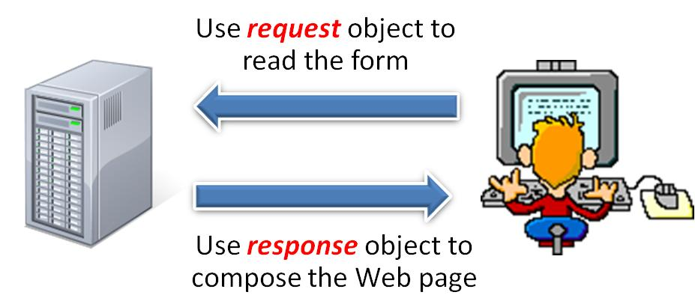
Hidden Fields within a Form
Declare hidden fields within a form:
  <input type=‘hidden’ name=‘user’ value=‘username’/>
Basically, a cookie
Users will not see this information in the form (unless they view the HTML source)
Retrieve Hidden state
2
1
Send hidden state in a form

Slide 115
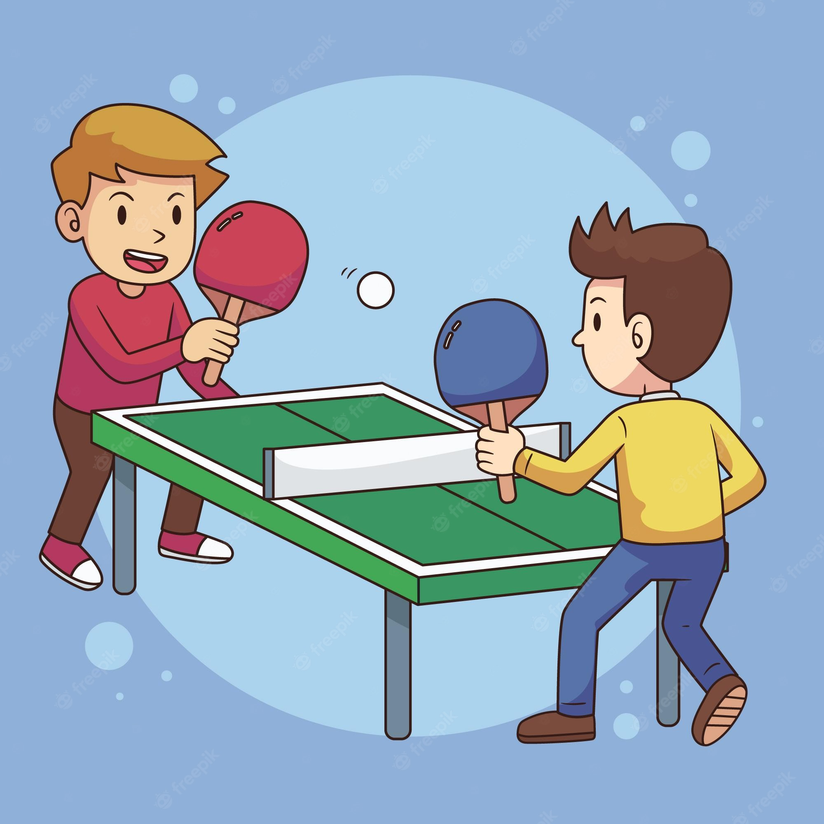


Using Hidden Fields
Typically used when we want to pass variables from one form to another without making the user to re-type the information repeatedly
  We can use this feature to maintain state, e.g., remember the user in order to update the shopping cart
USER:
Emily
Hidden field
Item1:
FORM 1 to request name
Item2:
Emily
FORM 2 to request more information
USER:
Emily
Item1:
Item2:
Hidden field
<input type=‘hidden’ name=‘user’ value=‘Emily’/>

Slide 116
Hidden State: Using Extra Path Information
Path information is stored in the URL reques
Append a session identifier to the URL as a parameter (in Java)
String url = "https://ucf.edu/page?userid=" + request.getSession().getId();
URL + (Jeff)
Extra information

Slide 117
Hidden State: Using Extra Path Information
Path information is stored in the URL request:
http://ucf.edu/index.htm?user=jeffd
Extra information
HTML page
URL + (Jeff)
There are mechanisms to parse this field in Java. Check out the javax.servlet.http.HttpUtils parserQueryString() method.
Notes:
There are mechanisms to parse this field in Java. Check out the
javax.servlet.http.HttpUtils parserQueryString() method.

Slide 118

Using Extra Path Information
The middle tier can embed an identifier, as extra path information, within a document’s URL
As a user traverses through the site, the dynamically generated html pages can pass the identifier from document to document
Thus, we can track the documents requested by the user
From Kay
From Kay
HTML 1
HTML 2
HTML 3
Servlet 2
Servlet
3
URL1 + (Kay)
URL2 + (Kay)
URL3 + (Kay)
This chain of stateful interactions can start with the login page that identify the user.
Notes:
This chain of stateful interactions can start with the login page that identify the user.

Slide 119
Java Server Pages (JSP)
public class ReadUserName extends HttpServlet {
public void doGet(HttpServletRequest request,
HttpSevletResponse response)
throws ServletException, IOException {
reponse.setContentType(“text/html”);
PrintWriter out = response.getWriter();
out.println(“<HTML><BODY>\n <UL> \n” +
“<LI>” + request.getParameter(“userid”) + “\n” +
“<LI>” + request.getParameter(“password”) + “\n” +
<UL>\n<BODY></HTML>”);
}
public void doPost(HttpServletRequest request,
HttpSevletResponse response)
throws ServletException, IOException {
doGet(request,response);
}
}
JSP page
<html>
<%
…
Java code
…
%>
Code
</html>
JavaServer Pages
  Written in HTML, Servlet-like code embedded in the HTML
  Webpage first, code second
  They are usually compiled into a Servlet
Servlets
  Generate HTML by writing it to the “PrintWriter” object
  Code first, webpage second
Notes:
Note: Both scriplet and applet are small Java programs embedded in HTML. However, an applet is executed on the client side; whereas a JSP page with scriplets is often compiled into a servlet and is executed on the server side.

Slide 120
JavaServer Pages
Change the file extensions to “.jsp” instead of “.html”
Embed Java expressions in JSP pages by putting them between <%= and %>
  Example: The time is now <%= date %>
Embed block of Java code (called scriplet) between <% and %>
HTML page
JSP page
<html>
<html>
scriplet
Webpage first !
<%
…
Java code
…
%>
Code second !
</html>
</html>

Slide 121
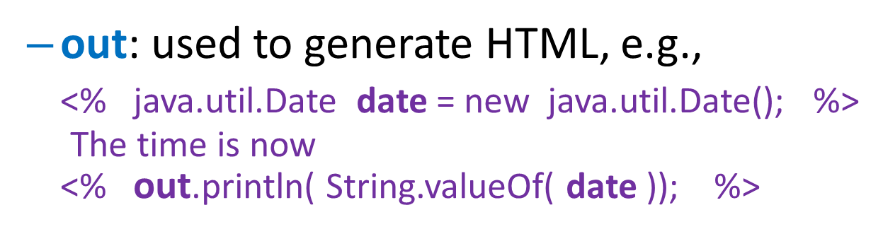
Predefined Objects for Scriplet
A number of useful predefined objects for scriplet:
  request: returns value of the requested parameter
  Example: request.getParameter(“username”) returns value of the variable username
Returns the string representation
Notes:
Java.util Package contains the collections framework, legacy collection classes, event model, date and time facilities, internationalization, and miscellaneous utility classes (a string tokenizer, a random-number generator, and a bit array).
Date: The class Date represents a specific instant in time, with millisecond precision.

Slide 122
Predefined Objects for Scriplet
A number of useful predefined objects for scriplet:
  request: returns value of the requested parameter, e.g.,
  request.getParameter(“username”) returns value of the variable username
Returns the string representation
Notes:
Java.util Package contains the collections framework, legacy collection classes, event model, date and time facilities, internationalization, and miscellaneous utility classes (a string tokenizer, a random-number generator, and a bit array).
Date: The class Date represents a specific instant in time, with millisecond precision.

Slide 123
JavaServer Pages: Example
<html>
<head><title>Welcome to B&N</title></head>
<body>
<h1>Welcome back!</h1>
<% String name=“NewUser”;
if (request.getParameter(“username”) != null) {
name=request.getParameter(“username”);
}
%>
You are logged on as user <%=name%>
<p>
</body>
</html>
If username not entered, log on as “NewUser”
This page responds to a login page
Scriptlet makes it possible to generate dynamic HTML pages

Slide 124
PHP
php is an HTML-embedded scripting language
php syntax is borrowed from C, Java, and Perl with a couple of unique PHP-specific feature thrown in
Goal: Allow Web developers to write dynamically generated pages quickly

Slide 125
A Simple php Page
<html>
<head>
<title>A Simple PHP Page</title>
</head>
<body>
<?php
Echo “Hello World!”;
Echo “Hello World!!”;
Echo “Hello World!!!”;
?>
</body>
</html>
Semicolon signifies end of PHP statement
Start tag
Embedded PHP code
End tag

Slide 126
php Variable
Simply echo the variable to display
Define variable using the form
  $variable_name=Value
Variable names are case sensitive
Must start with a letter or “_”
Variable with more than one word should be separated with underscores
Need “$”
<html>
<head>
<title>A Simple PHP Page</title>
</head>
<body>
<?php
$hello = “Hello World”;
Echo “$hello ! <br/>”;
?>
</body>
</html>
Variables do not have a fixed type, but implicitly have the type of the data to which they have been assigned
Data type determined by assigned value
Embedded PHP code
Use the value in string
DISPLAY: Hello World!

Slide 127
PHP: Input Form Data
<html>
<body>
<form action=“hello.php” method=“post”>
Your Name:
<input type=“text” name=“name”><br>
<input type=“submit”>
</form>
</body>
</html>
Your Name:
John
submit
Input the data field “name” from the form
<html>
<body>
Hello <?php
echo $_POST[“name“]; ?>
</body>
</html>
HTML page with FORM
Note: Functions and class methods are case insensitive for both user defined and PHP defined
Display:
“Hello John”

Slide 128
PHP: Input Form Data
The same result could also be achieved using the HTTP GET method
<html>
<body>
<form action=“hello.php” method=“get”>
Your Name:
<input type=“text” name=“name”><br>
<input type=“submit”>
</form>
</body>
</html>
Your Name:
John
submit
<html>
<body>
Hello <?php
echo $_GET[“name“]; ?>
</body>
</html>
Hello John

Slide 129

PHP Operators
Writing program to generate HTML code
$addition = 2 + 4;
$subtraction = 4 – 2;
Echo “2 + 4 =”.$addition.“<br/>”;
Echo “4 - 2 =”.$subtraction.“<br/>”;
Concatenation operator
Concatenating two character strings and a variable
Display
2 + 4 = 6
4 – 2 = 2

Slide 130
Some PHP Constructs
Basic arithmetic operators: +, -, *, /, % (modulus)
Comparison operators: ==, !=, <, >, <=, >=
Assignment operators: +=, -=, *=, /=, %=, =
Numerically indexed array: $arrayname[index] = value;
If statement: if (…) { … } else { … }
if (…) { … } elseif (…) { … } else { …}
Case statement:
    Switch ($city){
    case “Orlando”: echo “Orlando”; break;
    case “Tampa”: echo “Tampa”; break;
    default: echo “Miami”; break
    }
While loop: while ( conditional statement is true) { do this code; }
For loop: for {initialize a counter; conditional statement; increment a counter) { do this code; }
html forms: php can be used with html forms
Function: function myfunction(){ … }
Notes:
Array elements in PHP can hold values of any type, such as numbers, strings and objects. They can also hold other arrays, which means you can create multidimensional , or nested , arrays.

Slide 131
PHP Hypertext Processor
When a php webpage is visited, the Web server processes the php code
  Determines which parts to show
  Hides the file operations and math calculation, etc.
  Translates the php into HTML
  Sends the Web page to the visitor’s browser

Slide 132
php - Connecting to MySQL
<?php
/*** mysql hostname ***/
$hostname = ‘myhost';
/*** mysql username ***/
$username = ‘myusername';
/*** mysql password ***/
$password = ‘mypassword';
try {
$dbh = new PDO("mysql:host=$hostname;dbname=mysql", $username, $password);
/*** echo a message saying we have connected ***/
echo 'Connected to database';
}
catch(PDOException $e)
{
echo $e->getMessage();
}
?>
PDO (PHP Data Object) is a consistent way to access databases
JAVA uses JDBC
Perl uses Perl DBI
php uses PDO
Connect to the mySQL
Notes:
mysql:host may take an IP address. See PHP manual.

Slide 133
Prepared statement in PHP using PDO
$dbh is the database handle, see last slide
Create a prepared statement
$name = “Steven”;
$stmt = $dbh->prepare("SELECT * FROM
table WHERE NAME = ? ");
$stmt->execute($name);
Execute the query
“?” is set to the value of the variable $name

Slide 134
PHP cookies
Use setcookie() to create a cookie.
Setcookie() function must appear before <html> tag
Use setcookie again to modify a cookie
<?php
$cookie_name = "user";
$cookie_value = "John Smith";
setcookie($cookie_name, $cookie_value, time() + (86400 * 30), "/"); // 86400 = 1 day
?>
<html>
<body>
<?php
if(!isset($_COOKIE[$cookie_name])) {
echo "Cookie named '" . $cookie_name . "' is not set!";
} else {
echo "Cookie '" . $cookie_name . "' is set!<br>";
echo "Value is: " . $_COOKIE[$cookie_name];
}
?>
</body>
</html>
“/” indicates that cookie is available in entire website. Alternatively, a subdomain can be specified
To delete a cookie, set the expiration date in the past, e.g.,
setcookie(“user”, “”, time() – 3600);

Slide 135
PHP cookies
<?php
$cookie_name = "user";
$cookie_value = "John Smith";
setcookie($cookie_name, $cookie_value, time() + (86400 * 30), "/"); // 86400 = 1 day
?>
<html>
<body>
<?php
if(!isset($_COOKIE[$cookie_name])) {
echo "Cookie named '" . $cookie_name . "' is not set!";
} else {
echo "Cookie '" . $cookie_name . "' is set!<br>";
echo "Value is: " . $_COOKIE[$cookie_name];
}
?>
</body>
</html>
Find out if the cookie is not set
Display:
Cookie ‘user’ is set !
Value is: John Smith
Get value for “user” cookie
Notes:
“!” is the “NOT” logical operator that negates the expression

Slide 136
PHP Session
Start a session using: session_start();
Close a session using: session_destroy();
Name-value pairs are stored in an array called $_SESSION on server side
  To register a name-value pair:
    $_SESSION[“some_name”] = some_value;
  To extract value of a session variable
    $value = $_SESSION[“SOME_NAME”];
Notes:
By default sessions are stored on the disk your server. PHP Sessions are destroyed automatically when you close your browser; but if you want to erase the session data before without closing the browser, you can use session_destroy().
Completely destroy session in PHP:
//remove PHPSESSID from browser
if ( isset( $_COOKIE[session_name()] ) )
setcookie( session_name(), “”, time()-3600, “/” );
//clear session from globals
$_SESSION = array();
//clear session from disk
session_destroy();

Slide 137


PHP Session
A session stores name-value pairs to be used across multiple pages until the user closes the browser (e.g., It can be used to implement shopping cart)
Notes:
Sessions are a simple way to store data for individual users against a unique session ID. This can be used to persist state information between page requests. Session IDs are normally sent to the browser via session cookies and the ID is used to retrieve existing session data.

Slide 138
PHP Session - Example 1
<?php
// Start the session
session_start();
?>
<!DOCTYPE html>
<html>
<body>
<?php
// Set session variables
$_SESSION["favsport"] = “tennis";
$_SESSION["favfood"] = “Italian";
echo "Session variables are set.";
?>
</body>
</html>
Session_start() function must be the very first thing, before any HTML tags, in the document
They can be retrieved and used in subsequent pages
Display:
Session variables are set.

Slide 139
PHP Session - Example 2
<?php
session_start();
?>
<!DOCTYPE html>
<html>
<body>
<?php
// Echo session variables that were set on previous page
echo "Favorite sport is " . $_SESSION["favsport"] . ".<br>";
echo "Favorite food is " . $_SESSION["favfood"] . ".";
?>
</body>
</html>
Display:
Favorite sport is tennis.
Favorite food is Italian.
Session variables are not automatically passed to the next page
They must be retrieved from the session
Notes:
session_start() creates a session or resumes the current one based on a session identifier passed via a GET or POST request, or passed via a cookie.
Unlike cookies, session variables are not passed individually to each new page, instead they are retrieved from the session.

Slide 140
Multiple state methods
Typically all methods of state maintenance are used:
  User logs in and this information is stored in a cookie
  User issues a query which is stored in the path information
  User places an item in a shopping cart cookie
  User purchases items and credit-card information is stored/retrieved from a database
  User leaves a click-stream which is kept in a log on the web server (which can later be analyzed)
Notes:
When a Web page is requested via the HTTP protocol, the server locates a file in its file system based on the requested URL. This file may be a regular file or a program. In the latter case, the server may (depending on its configuration) run the program, sending its output as the required page. The query string is a part of the URL which is passed to the program. Its use permits data to be passed from the HTTP client (often a Web browser) to the program which generates the web page.

Slide 141
Summary
Internet Concepts (URIs, HTTP)
Web data formats
  HTML, XML, DTDs
Three-tier architectures
The presentation layer
  HTML forms, Javascript, Stylesheets.
The middle tier
  CGI, application servers, Servlets, JavaServer Pages (JSP), php, maintaining state (cookies)
Add functionality to Web page
Support different devices
HTML with embedded Java code
Get input from user
Java code to generate dynamic content
Generate dynamic content
HTML with embedded scripting language

Slide 142

Options
Webpage First?
YES
Option for the project
NO
Java code to generate dynamic content
Servlets
(Application Server)
YES
JAVA?
NO
JDBC
DBMS
JSP
(Java Server Pages)
PHP
(Hypertext Processor)
HTML with embedded scripting language
HTML with embedded Java code
JDBC
PDO
DBMS
DBMS

Slide 143

Option for Class Project
HTML
FORM
JavaScript
PHP
MySQL
<FORM>
<input type=“number”
name=var>
…
<\FORM>
<html>
<body>
<?php
$_GET[‘var’];
?>
…
</body>
</html>
SQL
MySQL
Prepared statement
<SCRIPT>
<\SCRIPT>
JavaScript
ResultSet
Get input from user
Provide service

Slide 144

Project: Teamwork
Teamwork: Design the Web pages for the application together (hand drawing)
Each team member sets up MySQL (with the relational tables) and the software development environment
Implementation of the Web pages is divided evenly among the team members
Teamwork: Test the system and prepare the demo. Each member demo his/her Web pages
Teamwork: Prepare the design document

