Slide 1


Chapter 4, Part B
Relational Calculus

Slide 2
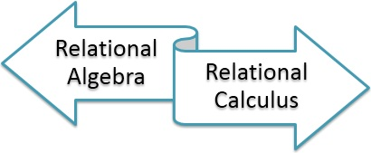
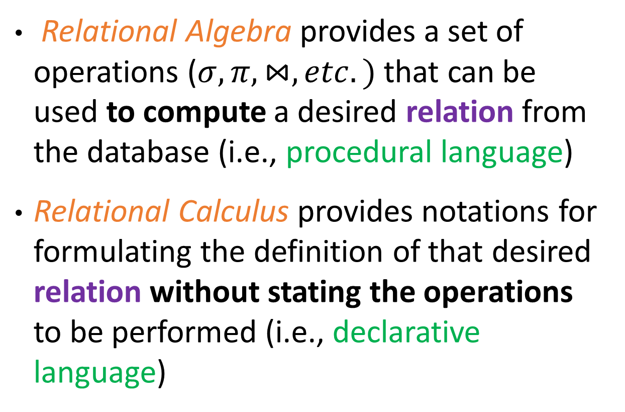
Relational Calculus
Relational Algebra provides a set of operations ($σ, π, ⋈, etc.)$that can be used to compute a desired relation from the database (i.e., procedural language)
Relational Calculus provides notations for formulating the definition of that desired relation without stating the operations to be performed (i.e., declarative language)
SQL is based on the relational calculus

Slide 3
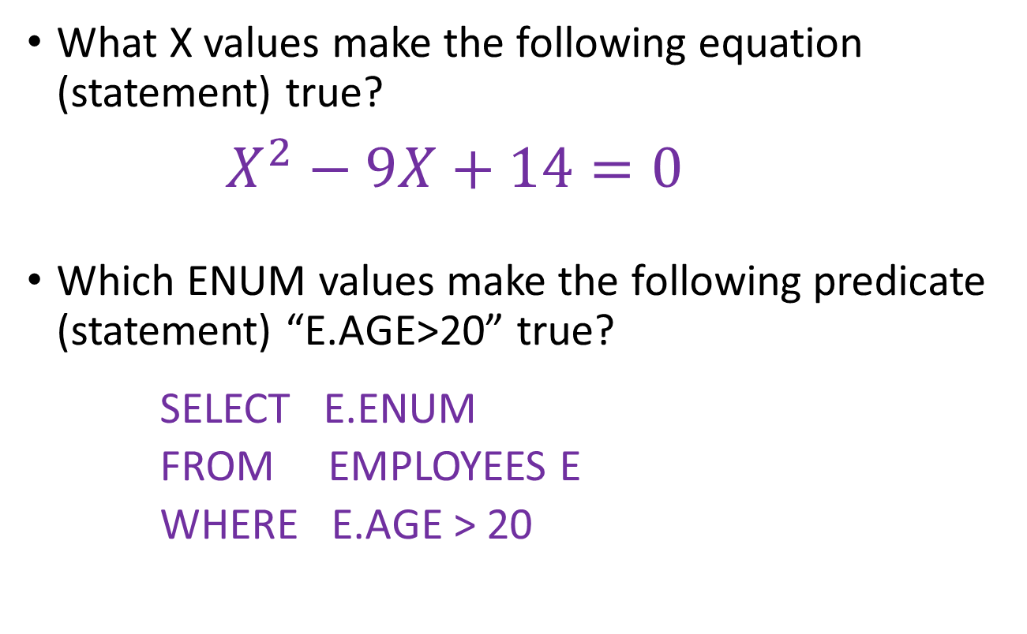
Relational Calculus
What X values make the following equation (statement) true?
    $$X^{2}−9X+14=0$$
Which ENUM values make the following predicate (statement) “E.AGE>20” true?
  SELECT E.ENUM
  FROM EMPLOYEES E
  WHERE E.AGE > 20

Slide 4
Relational Calculus
Calculus has variables, constants, comparison ops, logical connectives, and quantifiers.
Comes in two flavors: Tuple relational calculus (TRC) and Domain relational calculus (DRC)
  TRC: Variables range over (i.e., get bound to) tuples.
  DRC: Variables range over domain elements (= field values).
We discuss only DRC

Slide 5
Domain Relational Calculus
Calculus has variables, constants, comparison ops, logical connectives, and quantifiers.
Comes in two flavors: Tuple relational calculus (TRC) and Domain relational calculus (DRC)
  TRC: Variables range over (i.e., get bound to) tuples.
  DRC: Variables range over domain elements (= field values).
Expressions in the calculus are called formulas. An answer tuple is essentially an assignment of constants to variables that make the formula evaluate to true.
  SELECT E.ENUM
  FROM EMPLOYEES E
  WHERE E.AGE > 20

Slide 6

Formula as Query
Query:
  2X + Y = 10
Answers:
  [1, 8], [3, 4], [4, 2]
X | Y
1 | 8
2 | 5
3 | 4
3 | 7
4 | 2
5 | 2

Slide 7
Domain Relational Calculus
Query has the form:
{ <x1, x2, …, xn> | p(<x1, x2, …, xn>) }
tuple
formula
Answer includes all tuples <x1, x2, …, xn> that
make the formula p(<x1, x2, …, xn>) true.
Name
Training
Example:
ID
Age

Slide 8
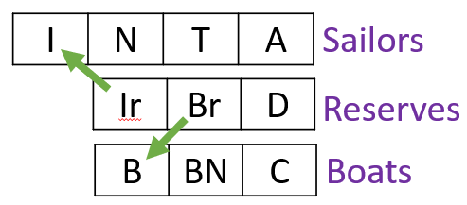
Our Relations

Slide 9
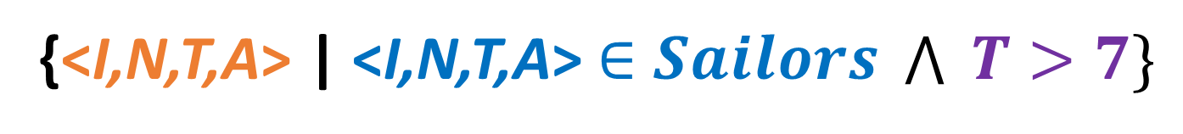
DRC and SQL
SELECT *
FROM Sailors S
WHERE S.T > 7
{<I,N,T,A> | <I,N,T,A>$∈Sailors \bigwedge{ T>7\}}$
Output schema
Input relation
Predicate

Slide 10
DRC and SQL
‘|’ should be read as ‘such that’
It says that every tuple <I,N,T,A> of Sailors that satisfies T > 7 is in the answer.
{<I,N,T,A> | <I,N,T,A>$∈Sailors \bigwedge{ T>7\}}$
Output schema
Input relation
Predicate

Slide 11
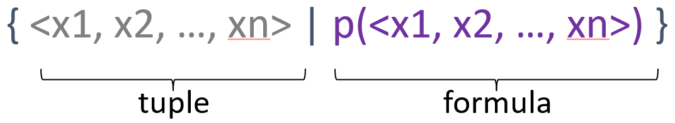
Formula
Formula is recursively defined,
  starting with simple atomic formulas, and
  building bigger and better formulas using the logical connectives.
A formula
Atomic ꓥ Atomic ꓦ Atomic

Slide 12



DRC Formulas
Atomic formula:
  getting tuples from relations:
  or making comparisons of values
  X op Y, or X op constant
  where op is one of ˂, ˃, =, ≤, ≥, ≠.
Formula: recursively defined starting with atomic formulas
  an atomic formula, or
  If p and q are formulae, so are ¬p, pΛq, and pVq.
  If p is a formula with domain variable X, then
  and are also formulae.

Slide 13
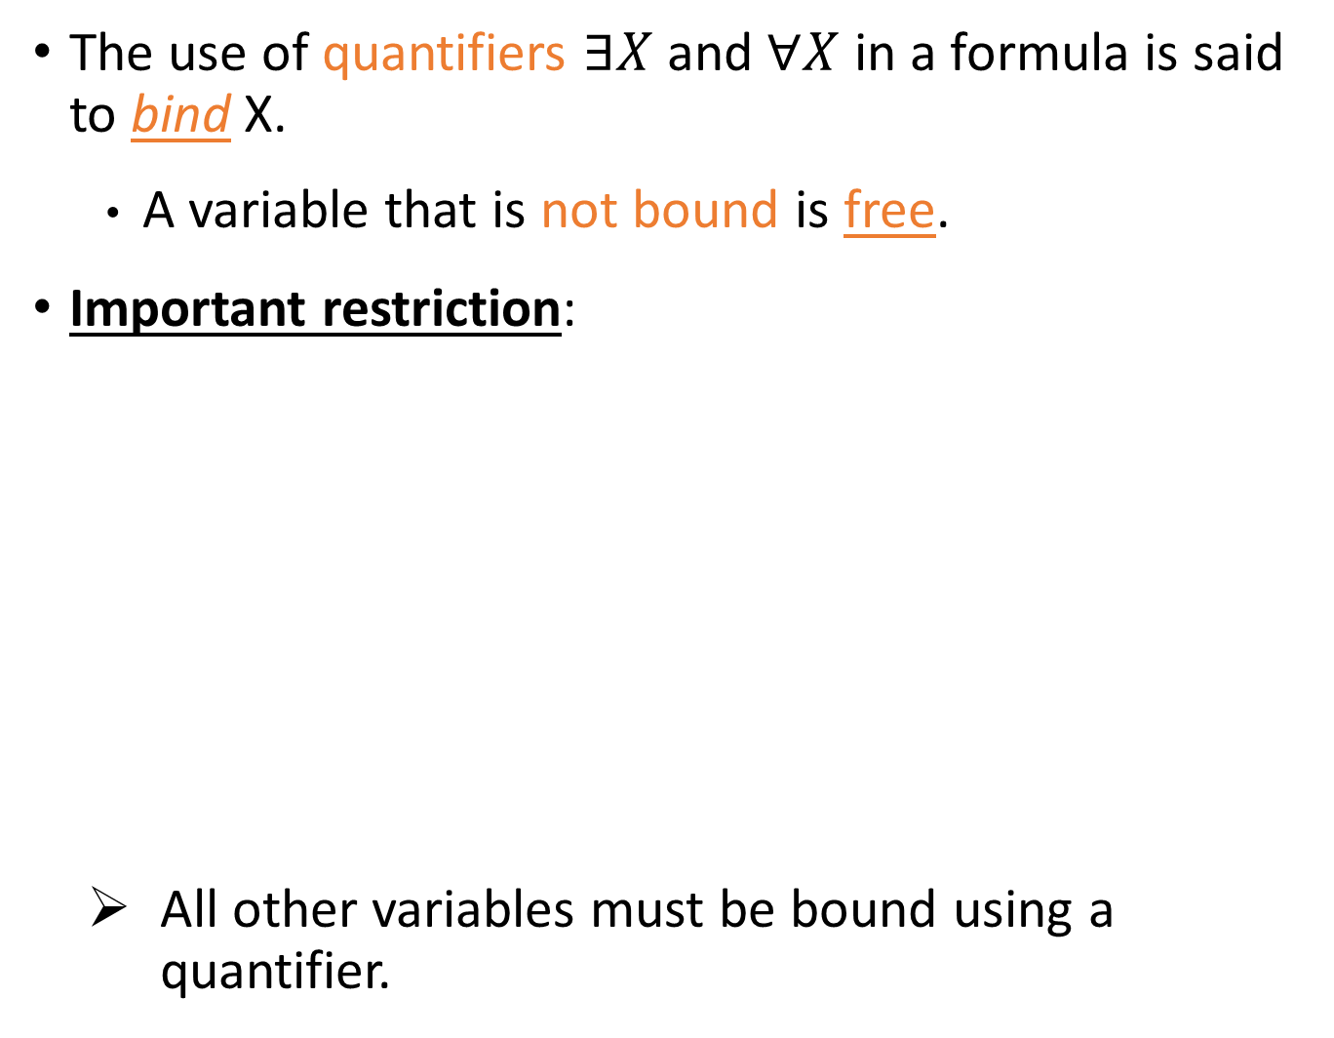
Free and Bound Variables
The use of quantifiers $∃X$ and $∀X$ in a formula is said to bind X.
  A variable that is not bound is free.
Important restriction:
  All other variables must be bound using a quantifier.
These are the only free variable in the formula
Other variables must be bound using a quantifier

Slide 14

Find sailors whose rating is better than 7
$$\left\{\left\langle I,N,T,A\right\rangle | \left\langle I,N,T,A\right\rangle ∈Sailors ∧T>7\right\}$$
Find Sailors
All variables are free
Find names of sailors whose rating is better than 7
$$\left\{\left\langle N\right\rangle | ∃I, T, A (\left\langle I,N,T,A\right\rangle ∈Sailors ∧T>7)\right\}$$
Find Names of Sailors
The variables appearing to the left of “│” must be the only free variables
Notes:
The variables that appear to the left of “|” must be the only free variables in the formula p(…),

Slide 15
Find sailors rated > 7 who have reserved boat #103
Find all sailor I such that his/her rating is better than 7, and
… for boat 103
there exist a reservation …
… and the reservation is for sailor I …

Slide 16
Find sailors rated > 7 who have reserved boat #103
Variables that appear to the left of “|” must be the only free variables in the formula - Do not quantify them
Ir, Br, and D are bound

Slide 17
Find sailors rated > 7 who have reserved boat #103
Use “Ǝ Ir, Br, D (…)” as a short hand for: “Ǝ Ir ( Ǝ Br ( Ǝ D (…)))”
The use of Ǝ is to find a tuple in Reserves that match (`joins with’) the Sailors tuple under consideration.
The declarative “language” implies a join operation without specifying the operator (nonprocedural !)

Slide 18
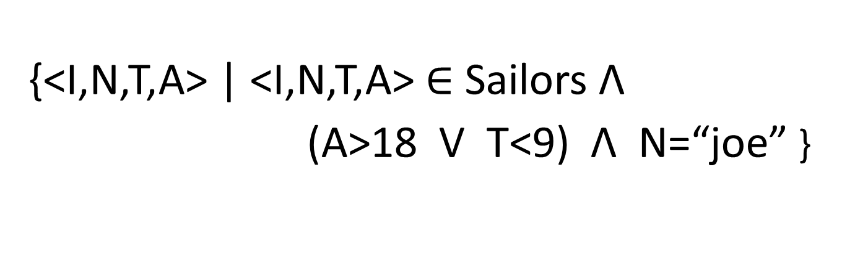
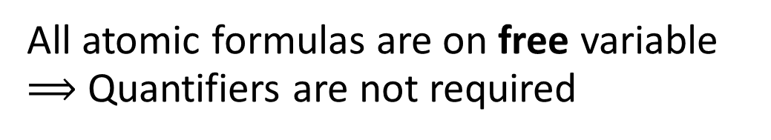
Find sailors who are older than 18 or have a rating under 9, and are called ‘joe’
Find any sailors
{<I,N,T,A> | <I,N,T,A> $∈$ Sailors Λ
(A>18 V T<9) Λ N=“joe” }
Who are older than 18 or have a rating under 9
are called ‘joe’
All atomic formulas are on free variable $⟹$Quantifiers are not required

Slide 19
Find sailors rated > 7 who’ve reserved a red boat
Find a sailor I rated better than 7
There exists a reservation of Br for I
Br is a boat and its color is read
( A … (B … (C … ) ) )
BLUE ZONE
GREEN ZONE
BLACK ZONE

Slide 20
Find sailors rated > 7 who’ve reserved a red boat
A can be referenced in all three zones
Free variables can be referenced anywhere
( A … ( B … (C … ) ) )
BLUE ZONE
RED ZONE
BLACK ZONE

Slide 21
Find sailors rated > 7 who’ve reserved a red boat
B can be referenced in only two zones
( A … ( B … (C … ) ) )
BLUE ZONE
RED ZONE
BLACK ZONE

Slide 22
Find sailors rated > 7 who’ve reserved a red boat
1st join
2nd join
A declarative query !!

Slide 23
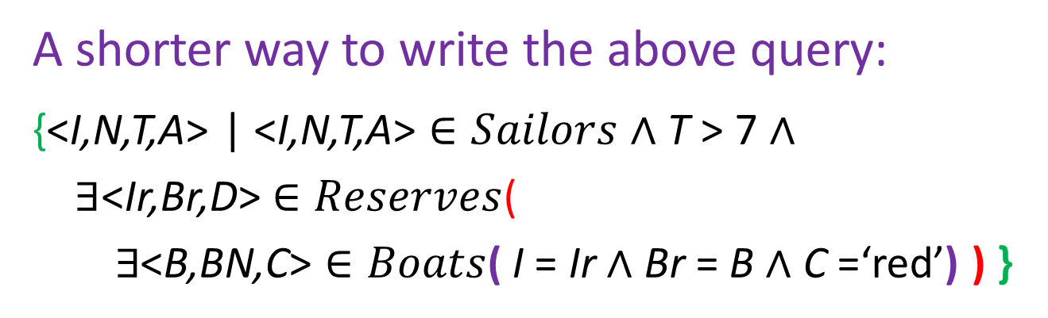
Find sailors rated > 7 who’ve reserved a red boat
Short hand
A shorter way to write the above query:
{<I,N,T,A> | <I,N,T,A> $∈Sailors$ $∧$ T > 7 $∧$
$∃$<Ir,Br,D> $∈Reserves$(
$∃$<B,BN,C> $∈Boats$( I = Ir $∧$ Br = B $∧$ C =‘red’) ) }

Slide 24



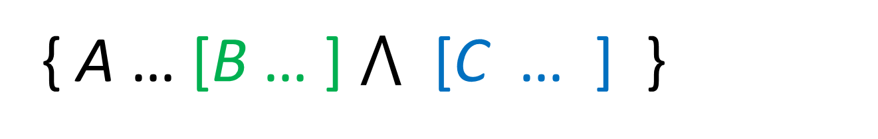
Find sailors rated > 7 who’ve reserved a red boat
$\left\{<I,N,T,A> \right|<I,N,T,A> ∈Sailors ⋀$ $T>7 ∧$
$∃ Ir, Br, D [<Ir,Br,D> ∈Reserves ⋀$ $Ir=I] ∧$
$∃ B, BN,C [<B,BN,C> ∈Boats ⋀$ B$=Br ∧$ $C=^{′}red′]\}$
Br is not defined in this scope
{ A … [B … ] $⋀$ [C … ] }
( A … ( B … (C … ) ) )
What we had in a previous slide

Slide 25
Find sailors rated > 7 who’ve reserved a red boat
$\left\{<I,N,T,A> \right|<I,N,T,A> ∈Sailors ⋀$ $T>7 ∧$
$∃ Ir, Br, D [<Ir,Br,D> ∈Reserves ⋀$ $Ir=I] ∧$
$∃ B, BN,C [<B,BN,C> ∈Boats ⋀$ B$=Br ∧$ $C=^{′}red′]\}$
Br is not defined in this scope
{ A … [B … ] $⋀$ [C … ] }
The parentheses control the scope of each quantifier’s binding.
This may look cumbersome, but with a good user interface, it is very intuitive (e.g., MS Access, QBE)

Slide 26
Find sailors who’ve reserved all boats
Find all sailors I such that
for each <B,BN,C> tuple, either it is not a tuple in Boats, or
Output
there is a tuple in Reserves showing that sailor I has reserved it.
I | N | T | A
Sailors
Ir | Br | D
Reserves
B | BN | C
Boats

Slide 27
Find sailors who’ve reserved all boats
A
B
Not(A) V B
is equivalent to
A → B
If ˂B,BN,C> is a boat, then there is a reservation of this boat B for sailor I

Slide 28
Find sailors who’ve reserved all boats (simpler formula)
There exists a reservation for sailor I
This condition is true for all boats
Simpler notation, same query.
To find sailors who’ve reserved all red boats:
.....
Unless the boat is not red, or sailor I has reserved it
If the boat is red then sailor I has reserved it

Slide 29


Unsafe Queries, Expressive Power
It is possible to write syntactically correct calculus queries that have an infinite number of answers! Such queries are called unsafe.
  e.g.,
It is known that every query that can be expressed in relational algebra can be expressed as a safe query in DRC / TRC; the converse is also true.
Relational Completeness: Query language (e.g., SQL) can express every query that is expressible in relational algebra/calculus (and more).

Slide 30
Summary
Relational calculus is non-operational, and users define queries in terms of what they want, not in terms of how to compute it. (Declarativeness.)
Algebra and safe calculus have same expressive power, leading to the notion of relational completeness.

