Slide 1

Relational Algebra
SQL
Chapter 4, Part A
Algebra
DBMS
Notes:
1

Slide 2
Relational Query Languages
Query languages: Allow manipulation and retrieval of data from a database.
Relational model supports simple, powerful QLs:
  Strong formal foundation based on logic.
  Allows for much optimization.
Query Languages ≠ programming languages!
  QLs not expected to be “Turing complete”.
  QLs not intended to be used for complex calculations.
  QLs support easy, efficient access to large data sets.
Notes:
2
Turing complete is a term used in computability theory to describe abstract machines, usually called automata. Such an automaton is Turing complete, if it can be used to emulate a Turing machine. It is also called computationally universal. Most modern programming languages are Turing-complete.

Slide 3
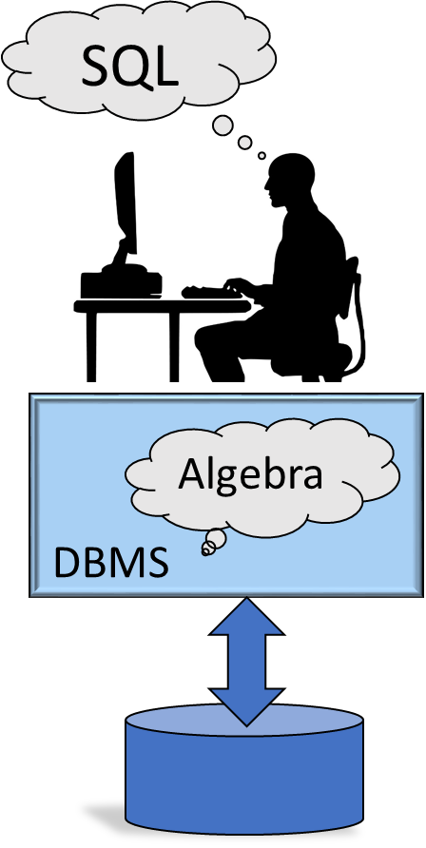
Formal Relational Query Languages
Two mathematical Query Languages form the basis for “real” languages (e.g. SQL), and for implementation:
  Relational Algebra: More operational, very useful for representing execution plans.
  Relational Calculus: Lets users describe what they want, rather than how to compute it. (Non-operational, declarative.)

Slide 4
Preliminaries
A query is applied to relation instances, and the result of a query is also a relation instance.
  Schemas of input relations for a query are fixed (but query will run regardless of instance!)
  The schema for the result of a given query is also fixed! Determined by definition of query language constructs.
SELECT S.name, E.grade
FROM Students S, Enrolled E
WHERE S.sid = E.sid and S.age<20
Schema of input: Students(SSN: CHAR(9), Name: CHAR(40), Age: INTEGER)
Enrolled(stuid CHAR(20), cid CHAR(20), grade CHAR(10))
Schema for the result
Input
Schema is fixed
Notes:
4

Slide 5
Notation
3rd position in relation
Field name is “rating”
SQL uses both positional and named-field notations
  Positional notation: referring to fields by their positions. Easier for formal definitions,
  Named-field notation: using field names to refer to fields. Make query more readable.
Notes:
4

Slide 6
Example Instances
R1
“Sailors” and “Reserves” relations for our examples.
We’ll use positional or named field notation, assume that names of fields in query results are `inherited’ from names of fields in query input relations.
S1
S2
Notes:
5

Slide 7

Algebra
Their operators are different
Mathematical algebra
(X + Y) / Z
Relational algebra

Slide 8
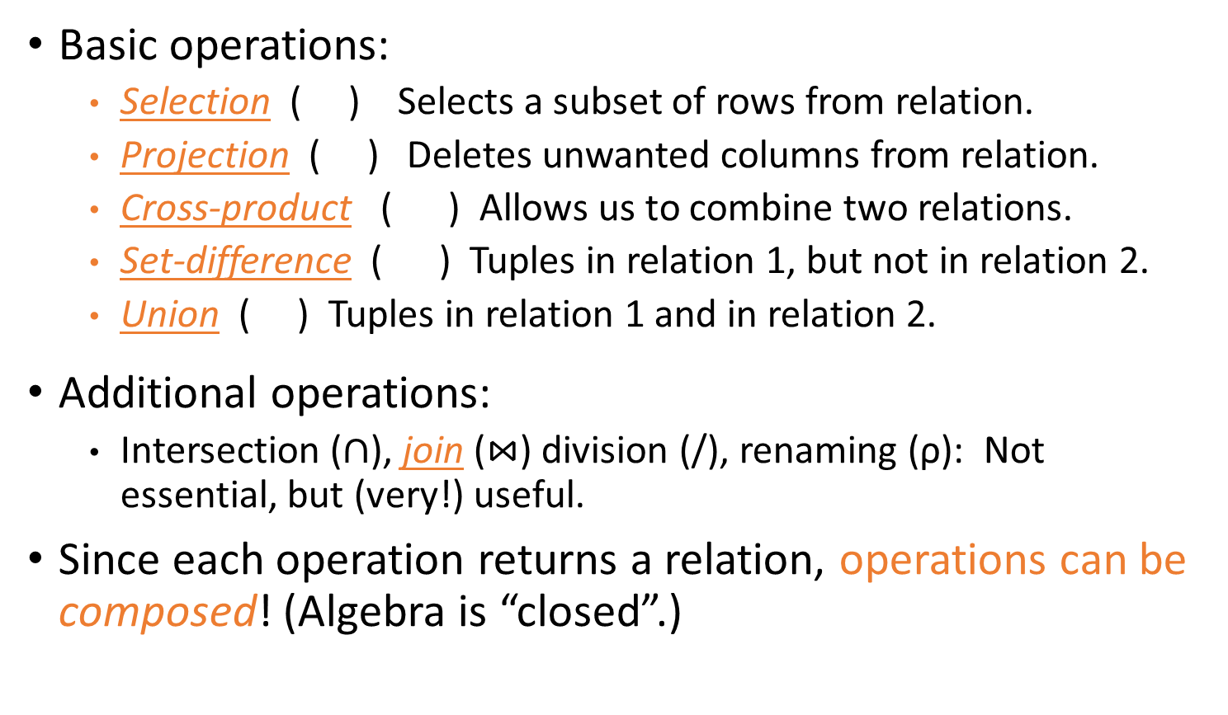
Relational Algebra
Basic operations:
  Selection ( ) Selects a subset of rows from relation.
  Projection ( ) Deletes unwanted columns from relation.
  Cross-product ( ) Allows us to combine two relations.
  Set-difference ( ) Tuples in relation 1, but not in relation 2.
  Union ( ) Tuples in relation 1 and in relation 2.
Additional operations:
  Intersection ($∩$), join ($⋈$) division (/), renaming (ρ): Not essential, but (very!) useful.
Since each operation returns a relation, operations can be composed! (Algebra is “closed”.)
Notes:
6

Slide 9
Projection
S2
A vertical filter
Notes:
7

Slide 10
Projection: Duplicate Elimination
Deletes attributes that are not in projection list.
Schema of result contains exactly the fields in the projection list, with the same names that they had in the (only) input relation.
Projection operator has to eliminate duplicates.
  Note: real systems typically don’t do duplicate elimination unless the user explicitly asks for it.
After duplicate elimination
Notes:
7

Slide 11
Selection
A horizontal filter
Selects rows that satisfy selection condition.
Schema of result identical to schema of (only) input relation
No duplicates in result! (Why?)
Notes:
8

Slide 12
Operator
Composition
S2
Result relation can be the input for another relational algebra operation !
Notes:
8

Slide 13
Union
S1
S2
Union Compatible:
The two operand relations must have the same schema
Notes:
9

Slide 14
Intersection
S1
Does not go to the output
S2
Notes:
9

Slide 15

Set-Difference
S1
S2
No “22”
Notes:
9

Slide 16
Union, Intersection, Set-Difference
All of these operations take two input relations, which must be union-compatible:
  Same number of fields.
  `Corresponding’ fields have the same type.
Notes:
9

Slide 17

Cross-Product
S1
R1
R1 × S1
Each row of R1 is paired with each row of S1.
Notes:
10

Slide 18
Cross-Product
Pairing each sailor with everyone’s reservations
Most of the pairs do not make sense
Expensive Computation
R1 × S1
This pairing is not meaningful
Notes:
10

Slide 19
Cross-Product
Pairing each sailor with everyone’s reservations
Most of the pairs do not make sense
Expensive Computation
R1 × S1
Want to compute only the meaningful pairs → JOIN
Notes:
10

Slide 20
Primary Key and Foreign Key
Pairing each sailor with everyone’s reservations
Most of the pairs do not make sense
Expensive Computation
Primary Key
Foreign Key
S1
R1
Notes:
10

Slide 21
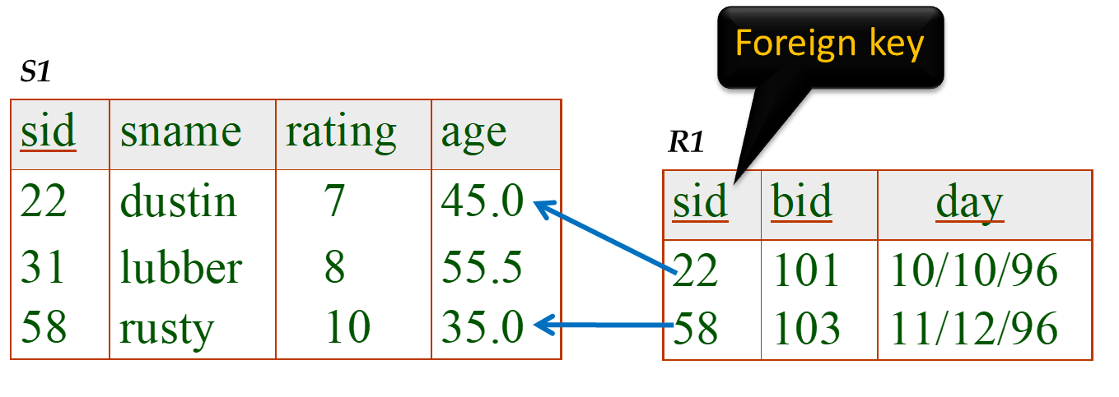
Joins
All possible pairs
Condition Join:
Example:
Select some of the pairs
Select only the meaningful pairs
Notes:
11

Slide 22
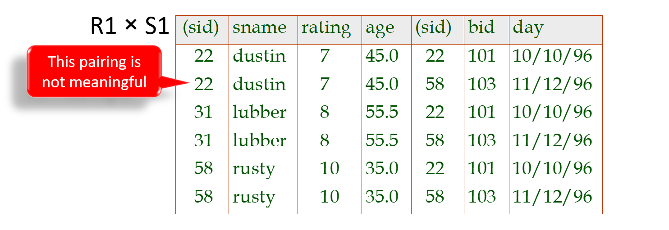
Joins
Join can be significantly less expensive to compute
Notes:
11

Slide 23
Joins
Expensive computation !
More efficient algorithms possible !!
Result schema same as that of cross-product.
Fewer tuples than cross-product - can be computed more efficiently
Notes:
11

Slide 24


R $⋈$ S
Outer relation
Inner relation
foreach tuple r in R do
foreach tuple s in S where r_{i} == s_{j} do
add <r, s> to result
R
S
1
Load page
For each page of R,
Scan S to look for matches
1
2
.
.
.
2
1
1 page
.
.
.
.
.
.
.
.
.
M
Scan S M times
Still a lot of work !
N

Slide 25

Block Nested-Loops Join
If we have 5 pages available
Memory
Memory
Bring in R 3 pages at a time
JOIN
JOIN the two pages
1
Need to scan S only $\left\lceil \left.|R|/3\right\rceil \right.$ times
Need to scan S M time
2
S
R
S
4
R
3
Simple Nested-Loop Join
Block Nested-Loop Join

Slide 26
Joins
Sometimes called a theta-join
c: join condition
S1
R1
Notes:
11

Slide 27
Foreign Key
Foreign key
S1
R1
sid | bid | day
22 | 101 | 10/10/23
22 | 105 | 8/23/24
31 | 101 | 11/11/23
58 | 103 | 9/1/24
sid | sname | rating | age | bid | day
22 | dustin | 7 | 45.5 | 101 | 10/10/23
22 | dustin | 7 | 45.5 | 105 | 8/23/24
31 | lubber | 8 | 55.5 | 101 | 11/11/23
58 | rusty | 10 | 35.0 | 103 | 9/1/24
Redundant data !
Notes:
10
A theta join allows for arbitrary comparison relationships (such as ≥)

Slide 28
Equi-Join
Foreign key
S1
R1
Equi-Join: A special case of condition join where the condition c contains only equalities.
Notes:
10
A theta join allows for arbitrary comparison relationships (such as ≥)

Slide 29
Equi-Joins & Natural Join
Equi-Join: A special case of condition join where the condition c contains only equalities.
Result schema similar to cross-product, but only one copy of fields for which equality is specified.
Natural Join: Equijoin on all common fields.
Notes:
12

Slide 30

Division
Not supported as a primitive operator
A/B
X
A
X
Y
B
Y
It covers all the Y values
No yellow nor green
No red nor green
Notes:
13

Slide 31

Division
Not supported as a primitive operator
Useful for expressing queries like:
Find sailors who have reserved all boats
Division
R/B
sid
R
sid
bid
B
bid
It covers all the Y values
No yellow boat
No red boat
Notes:
13

Slide 32
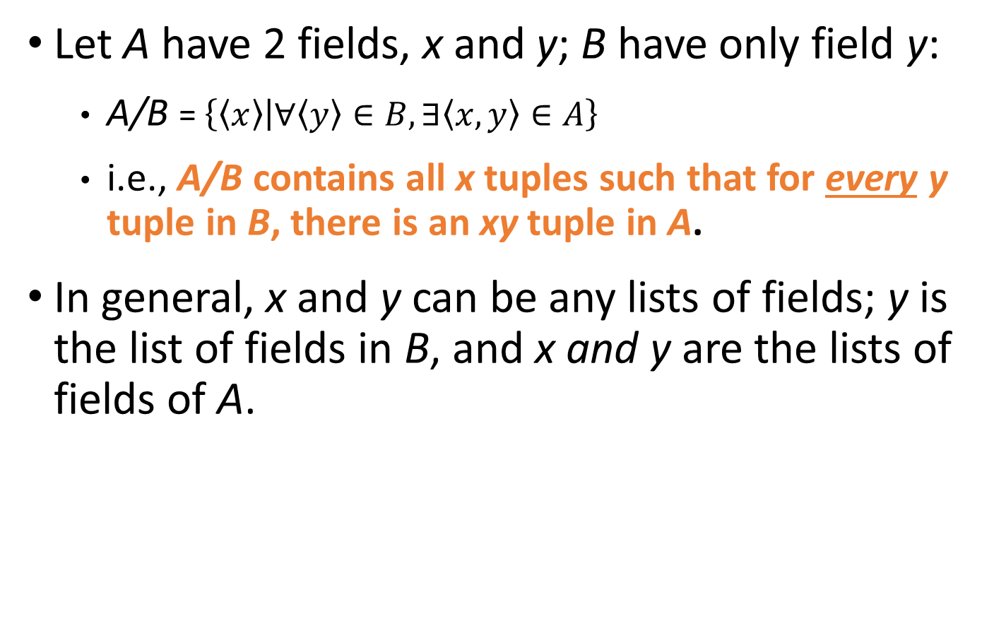
Division
Let A have 2 fields, x and y; B have only field y:
  A/B = $\left\{\left\langle x\right\rangle | ∀\left\langle y\right\rangle ∈B, ∃\left\langle x,y\right\rangle ∈A\right\}$
  i.e., A/B contains all x tuples such that for every y tuple in B, there is an xy tuple in A.
In general, x and y can be any lists of fields; y is the list of fields in B, and x and y are the lists of fields of A.
Notes:
13

Slide 33
Examples of Division A/B
B1
B2
B3
A
A/B1
A/B2
A/B3
Notes:
14

Slide 34
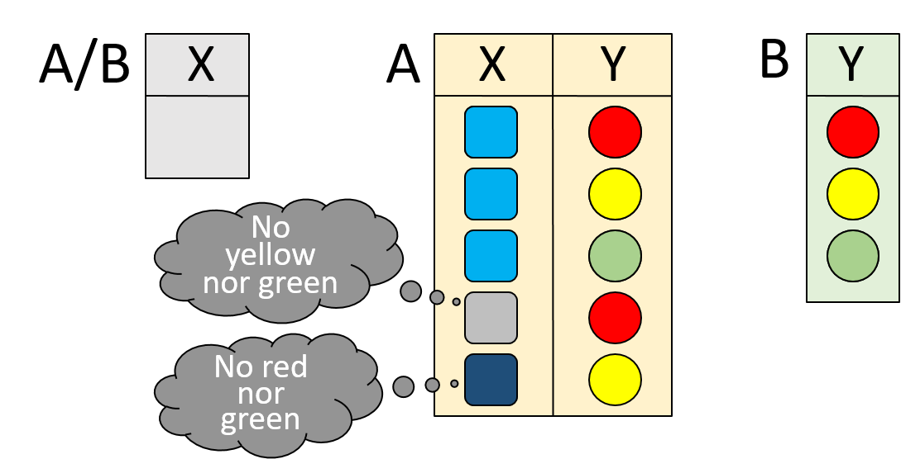
Expressing A/B Using Basic Operators
Division is not essential op; just a useful shorthand.
  (Also true of joins, but joins are so common that systems implement joins specially.)
Idea: For A/B, compute all x values in A that are not `disqualified’ by some y value in B.
  x value is disqualified if by attaching y value from B, we obtain an xy tuple that is not in A.
Notes:
15

Slide 35
Expressing A/B Using Basic Operators
Division is not essential op; just a useful shorthand.
  (Also true of joins, but joins are so common that systems implement joins specially.)
xy
combinations in A
All possible xy
combinations
  Disqualified x values:
xy combinations not in A
Disqualified x values
Notes:
15

Slide 36
Expressing A/B Using Basic Operators
Division is not essential op; just a useful shorthand.
  (Also true of joins, but joins are so common that systems implement joins specially.)
xy
combinations in A
All possible xy
combinations
  Disqualified x values:
xy combinations not in A
Disqualified x values
A/B:
all disqualified x values
All x values in A that are not disqualified by some y value in B
Notes:
15

Slide 37
Expressing A/B Using Basic Operators
Division is not essential op; just a useful shorthand.
  (Also true of joins, but joins are so common that systems implement joins specially.)
xy
combinations in A
All possible xy
combinations
  Disqualified x values:
xy combinations not in A
Disqualified x values
A/B:
All x values in A that are not disqualified by some y value in B
Notes:
15

Slide 38
Renaming
Result schema has one field per field of S1 and R1, with field names `inherited’ if possible.
  Conflict: Both S1 and R1 have a field called sid.
sid1
sid2
Renaming operator:
Notes:
10

Slide 39

Find names of sailors who’ve reserved boat #103
(3) Find out the names of those sailors
(1) Find all reservations for boat 103
(2) Follow the foreign-key pointer to identify sailors who made these reservations
Sailors
Foreign key
Reserves
3
2
1
Notes:
16

Slide 40
Find names of sailors who’ve reserved boat #103
Solution 2: Using renaming operators
(1) Find all reservations for boat 103
(2) Follow the foreign-key pointer to identify sailors who made these reservations
(3) Find out the names of those sailors
Sailors
Foreign key
Reserves
Notes:
16

Slide 41
Find names of sailors who’ve reserved boat #103
Solution 3:
(3) Find out the names of sailors who made those reservation
(1) Find reservations for every sailor
(2) Retain only reservations for boat 103
Sailors
Foreign key
Reserves
Notes:
16

Slide 42
Which one is better ?
1
2
Need optimization before query execution

Slide 43
Find names of sailors who’ve reserved a red boat
Start with “boat” because we have a predicate about boat
1
2
Sailors(sid, sname, rating, age)
Reserves(sid, bid, day)
Boats(bid, bname, color)
Foreign key
2nd join
Find sailors who made those reservations
Foreign key
1st join
Find all reservations of red boats
Notes:
17

Slide 44

Find names of sailors who’ve reserved a red boat
Shorter is not necessarily better
Compare with only bid, the foreign key
A more efficient solution:
Primary key
Make Join operations less expensive
A query optimizer can find this, given the first solution!
Notes:
17

Slide 45

Find sailors who’ve reserved a red or a green boat
Can identify all red or green boats, then find sailors who’ve reserved one of these boats:
Can also define Tempboats using union
Notes:
18

Slide 46


Find sailors who’ve reserved a red and a green boat
This won’t work!
ρ(Tempboats, (Ϭ _{color=‘red’} _{color=‘green’} Boats))
_{sname} (Tempboats Reserves Sailors)
Empty Relation
$$⋀$$
Notes:
19

Slide 47
Find sailors who’ve reserved a red and a green boat
Identify sailors who’ve reserved red boats
Identify sailors who’ve reserved green boats
Find the intersection and look up the names
Notes:
19

Slide 48
Find the names of sailors who’ve reserved all boats
Uses division; schemas of the input relations to division must be carefully chosen:
sid of sailors who have reserved all boats
All boats
Look up their names
To find sailors who’ve reserved all ‘Interlake’ boats:
.....
‘Interlake’ boats
Notes:
20

Slide 49

Summary
SQL
The relational model has rigorously defined query languages that are simple and powerful.
Relational algebra is more operational; useful as internal representation for query evaluation plans.
Several ways of expressing a given query; a query optimizer should choose the most efficient version.
Algebra
DBMS

