Slide 1

The Relational Model
Chapter 3
Students
sid | name | login | age | gpa
53831 | Zhang | zhang@ee | 20 | 3.5
53650 | Smith | smith@cs | 21 | 3.9
53666 | Jones | jones@cs | 20 | 3.4
Notes:
1

Slide 2
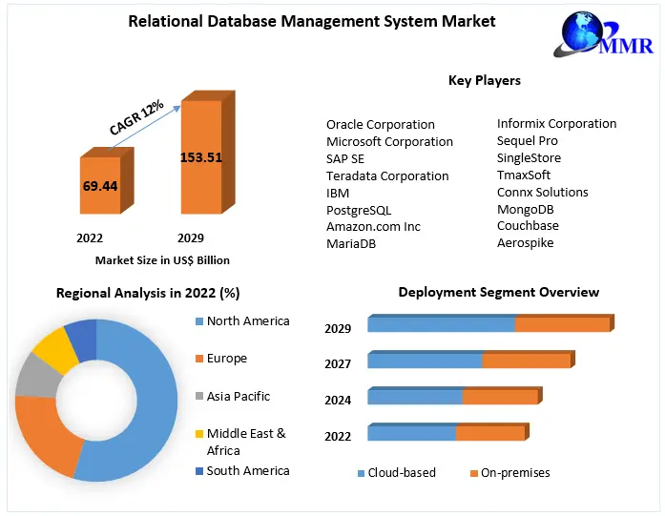
Why Study the Relational Model?
Most widely used model
Notes:
2
CAGR = Compound annual growth rate

Slide 3
Relational Database: Definitions
Relational database: a set of relations
Relation: made up of 2 parts:
  Schema: specifies name of relation, plus name and type of each column.
    Example: Students(sid: string, name: string, login: string, age: integer, gpa: real).
  Instance: a table, with rows and columns.
  #Rows = cardinality, #fields = degree/arity.
Can think of a relation as a set of rows or tuples (i.e., all rows are distinct).
Notes:
3

Slide 4
Example Instance of “Students” Relation
Schema
Students
Cardinality = 3, degree = 5, all rows distinct*
*In practice, commercial systems allows duplicate rows
Notes:
4

Slide 5
Relational Query Languages
A major strength of the relational model: supporting simple and powerful querying of data.
Queries can be written intuitively, and the DBMS is responsible for efficient evaluation.
  Precise semantics for relational queries.
  Allows the optimizer to extensively re-order operations, and still ensure that the answer does not change.
Notes:
9

Slide 6
The SQL Query Language
To find all 18 year old students, we can
To find just names and logins, replace the first line:
Students
SELECT *
FROM Students S
WHERE S.age=18
name | login
Jones | jones@cs
Smith | smith@ee
SELECT S.name, S.login
FROM Students S
WHERE S.age=18

Slide 7
The SQL Query Language
Vertical filtering Selecting columns
SELECT S.name, S.login
FROM Students S
WHERE S.age=18
Data sets
Horizontal filtering Selecting rows

Slide 8
Querying Relations (1)
What does the following query compute?
Range variable
Enrolled
SELECT S.name, E.cid
FROM Students S, Enrolled E
WHERE S.sid=E.sid AND E.grade=“A”
A student with “sid” has an entry in Enrolled
The Enrolled entry has “A” for the grade attribute
Students
sid | name | login | age | gpa
53831 | Zhang | zhang@ee | 19 | 3.2
53650 | Smith | smith@cs | 21 | 3.9
53666 | Jones | jones@cs | 20 | 3.5
Retrieve names of students and the courses they received an “A” grade

Slide 9

Querying Relations (2)
Enrolled
Students
sid | name | login | age | gpa
53831 | Zhang | zhang@ee | 19 | 3.2
53650 | Smith | smith@cs | 21 | 3.9
53666 | Jones | jones@cs | 20 | 3.5
SELECT S.name, E.cid
FROM Students S, Enrolled E
WHERE S.sid=E.sid AND E.grade=“A”
S.name | E.cid
Smith | Topology112

Slide 10

Creating Relations in SQL
CREATE TABLE Students
(sid: CHAR(20),
name: CHAR(20),
login: CHAR(10),
age: INTEGER,
gpa: REAL)
Relation “Students” has five attributes (data fields)
Students
sid | name | login | age | gpa
53831 | Zhang | zhang@ee | 20 | 3.5
53650 | Smith | smith@cs | 21 | 3.9
53666 | Jones | jones@cs | 20 | 3.4
A data field
Domain (type) of the field – enforced by DBMS
Notes:
15

Slide 11

Creating Relations in SQL
As another example, the Enrolled table holds information about courses that students take.
CREATE TABLE Enrolled
(sid: CHAR(20),
cid: CHAR(20),
grade: CHAR(2))
Enrolled
History105
53666
Notes:
15

Slide 12
Some MySQL Data Types
Char(size) | Fixed length character string. Maximum 255 characters
VARCHAR(size) | Variable length character string. Maximum 255 characters
TEXT | Variable character string. Maximum 65,535 characters
BLOB | Binary Large Object. Maximum 65,535 bytes of data
INT(size) | Integer. Maximum display width may be specified in “size” parameter. A value less than “size” digits is padded with zeros
FLOAT(size,d) | Maximum number of digits specified in “size” parameter, and maximum number of digits to the right of the decimal point in “d” parameter
DATE() | A date. Format: YYYY-MM-DD
DATETIME() | A date and time combination. Format: YYYY-MM-DD HH:MI:SS
TIME() | A time. Format: HH:MI:SS
YEAR() | A year in two-digit YEAR(2) or four digit YEAR(4) format

Slide 13
Destroying and Altering Relations
DROP TABLE Students
Removes the relation Students. The schema information and the tuples are deleted.
ALTER TABLE Students
ADD COLUMN firstyear: integer
The schema of Students is altered by adding a new field firstyear with type integer
Every tuple in the current instance is extended with a null value in the new field.
Notes:
16

Slide 14
Destroying and Altering Relations
DROP TABLE Students
Removes the relation Students. The schema information and the tuples are deleted.
ALTER TABLE Students
ADD COLUMN firstyear: integer
Drop a column:
ALTER TABLE “table _name”
DROP COLUMN “column_name”
The schema of Students is altered by adding a new field firstyear with type integer
Every tuple in the current instance is extended with a null value in the new field.
Notes:
16

Slide 15
Adding and Deleting Tuples
Can insert a single tuple using:
INSERT INTO Students (sid, name, login, age, gpa)
VALUES (53688, ‘Smith’, ‘smith@ee’, 18, 3.2)
Can delete all tuples satisfying some condition (e.g., name = Smith):
DELETE
FROM Students S
WHERE S.name = ‘Smith’
Powerful variants of these commands are available; more later!
Notes:
10

Slide 16
Integrity Constraints (ICs)
IC: condition that must be true for any instance of the database; e.g., domain constraints.
  ICs are specified when schema is defined.
  ICs are checked when relations are modified.
A legal instance of a relation is one that satisfies all specified ICs.
  DBMS should not allow illegal instances.
If the DBMS checks ICs, stored data is more faithful to real-world meaning.
  Avoids data entry errors, too!
Notes:
5

Slide 17
Primary Key Constraints
A set of fields is a key for a relation if :
  No two distinct tuples can have same values in all key fields, and
  This is not true for any subset of the key.
    Part 2 false ? → We have a superkey
    <SSN> is a key → <SSN, NAME> is a superkey
Students
sid | name | login | age | gpa
53831 | Zhang | zhang@ee | 20 | 3.5
53650 | Smith | smith@cs | 21 | 3.9
53666 | Jones | jones@cs | 20 | 3.4
Notes:
6

Slide 18


Primary Key Constraint Example
sid is a key for Students. The set {sid, gpa} is a superkey (i.e., set of fields that contains a key)
CREATE TABLE Students
(sid: CHAR(20),
name: CHAR(20),
login: CHAR(10),
age: INTEGER,
gpa: REAL,
PRIMARY KEY (sid) )
Key
No two students can have the same sid
023
136
Notes:
6

Slide 19
Candidate Keys
If there is more than one key for a relation, one of the keys is chosen (by DBA) to be the primary key.
Notes:
6

Slide 20
Primary and Candidate Keys in SQL
Possibly many candidate keys (specified using UNIQUE), one of which is chosen as the primary key.
CREATE TABLE Enrolled
(sid CHAR(20)
cid CHAR(20),
grade CHAR(2),
PRIMARY KEY (sid,cid) )
CREATE TABLE Enrolled
(sid CHAR(20)
cid CHAR(20),
grade CHAR(2),
PRIMARY KEY (sid),
UNIQUE (cid, grade) )
There is only one candidate key, chosen as the primary key
There are two candidate keys
Notes:
6

Slide 21
Primary and Candidate Keys in SQL
CREATE TABLE Enrolled
(sid CHAR(20)
cid CHAR(20),
grade CHAR(2),
PRIMARY KEY (sid,cid) )
Constraint: For a given student and course, there is a single grade
Constraint 1: Students can take only one course, and receive a single grade for that course
CREATE TABLE Enrolled
(sid CHAR(20)
cid CHAR(20),
grade CHAR(2),
PRIMARY KEY (sid),
UNIQUE (cid, grade) )
Constraint 2: Furthermore, no two students in a course receive the same grade
Notes:
6

Slide 22
Composite Keys
A composite key consists of more than one attribute
CREATE TABLE Enrolled
(sid CHAR(20)
cid CHAR(20),
grade CHAR(2),
PRIMARY KEY (sid),
UNIQUE (cid, grade) )
Composite keys
Notes:
6

Slide 23
Foreign Keys
Foreign key : Set of fields in one relation that is used to `refer’ to a tuple in another relation.
Must correspond to primary key of the second relation
Like a `logical pointer’ (for retrieving additional data)
Foreign key
Enrolled
Student 53650 is identified, but no further information
Notes:
7

Slide 24
Foreign Keys
Foreign key : Set of fields in one relation that is used to `refer’ to a tuple in another relation.
Must correspond to primary key of the second relation
Like a `logical pointer’ (for retrieving additional data)
Primary key
Foreign key
Students
Enrolled
See Students relation for further information
Notes:
7

Slide 25
Foreign Keys in SQL
CREATE TABLE Enrolled
(sid CHAR(20),
cid CHAR(20),
grade CHAR(2),
PRIMARY KEY (sid,cid),
FOREIGN KEY (sid) REFERENCES Students )
Constraint: Only students listed in the Students relation should be allowed to enroll for courses
Enrolled
Students
Notes:
7

Slide 26

DBMS Ensures Referential Integrity
sid is a foreign key in Enrolled referring to Students
Students
Enrolled
Who is “11111”?
Referential Integrity: If all foreign key constraints are enforced, referential integrity is achieved, i.e., no dangling references.

Slide 27
Enforcing Referential Integrity
Consider Students and Enrolled; sid in Enrolled is a foreign key that references Students.
What should be done if an Enrolled tuple with a non-existent student id is inserted?
(Reject it !)
Enrolled
Students
Register for COP4710
12345 COP4710 A
12345
Notes:
13

Slide 28

Enforcing Referential Integrity
What should be done if a Students tuple is deleted?
Option 1:
Students
Also
delete
Enrolled
Notes:
13

Slide 29
Enforcing Referential Integrity
What should be done if a Students tuple is deleted?
Option 2:
Students
Enrolled
Not
allowed
Notes:
13

Slide 30
Enforcing Referential Integrity
What should be done if a Students tuple is deleted?
Option 3:
Students
Default sid
Enrolled
99999
99999
99999
Notes:
13

Slide 31
Enforcing Referential Integrity
What should be done if a Students tuple is deleted?
Option 4:
Students
Enrolled
null
null
null
Notes:
13

Slide 32
Enforcing Referential Integrity
Consider Students and Enrolled; sid in Enrolled is a foreign key that references Students.
What should be done if an Enrolled tuple with a non-existent student id is inserted? (Reject it!)
What should be done if a Students tuple is deleted?
  Also delete all Enrolled tuples that refer to it.
  Disallow deletion of a Students tuple that is referred to.
  Set sid in Enrolled tuples that refer to it to a default sid.
  (In SQL, also: Set sid in Enrolled tuples that refer to it to a special value null, denoting `unknown’ or `inapplicable’.)
Similarly, if primary key of Students tuple is updated.
NOTE: Update is a delete followed by an insert
Notes:
13

Slide 33
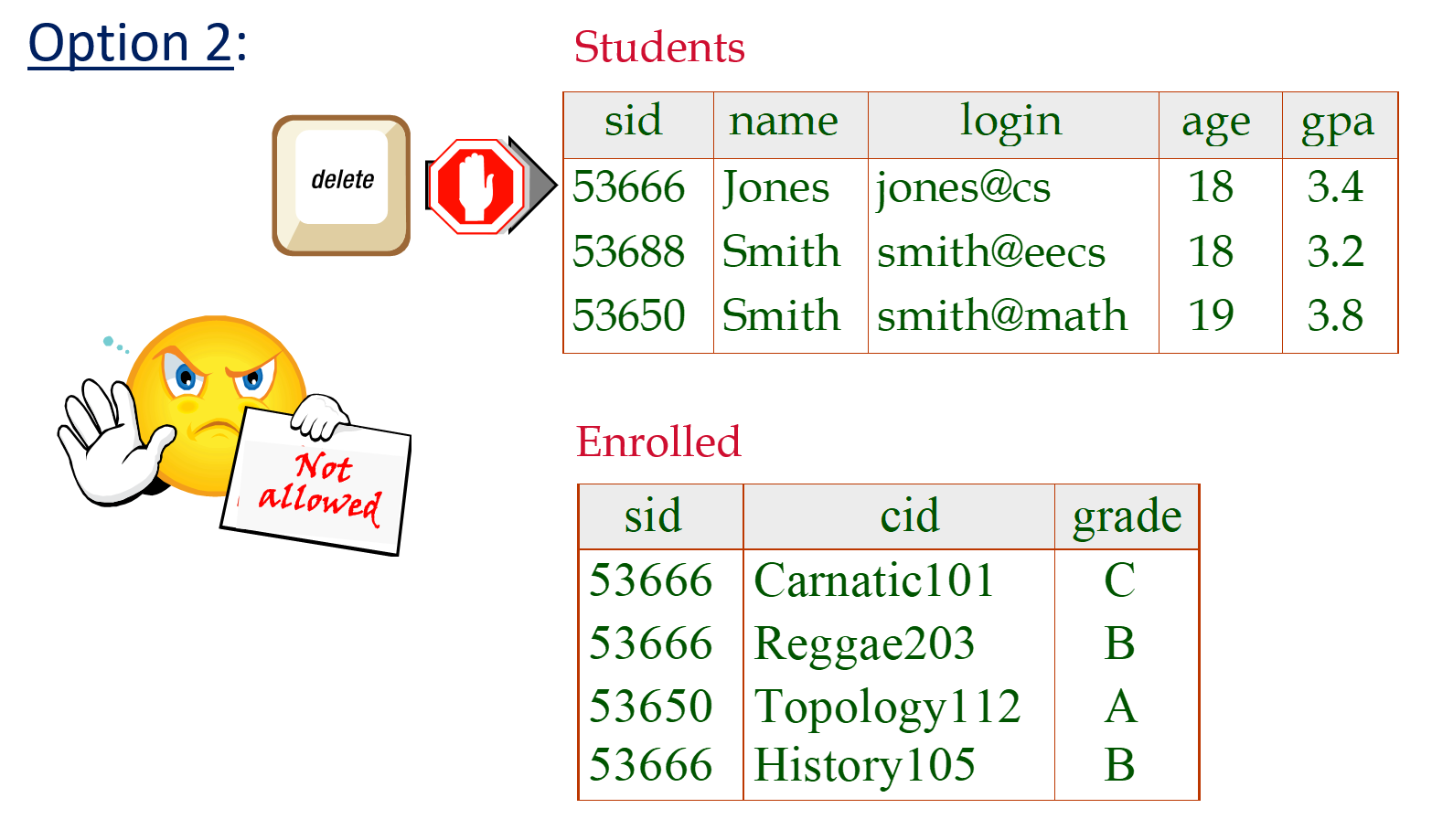
Referential Integrity in SQL
  Default is NO ACTION (delete/update is rejected)
  CASCADE (also delete all tuples that refer to deleted tuple)
  SET NULL / SET DEFAULT (sets foreign key value of referencing tuple)
Notes:
14

Slide 34
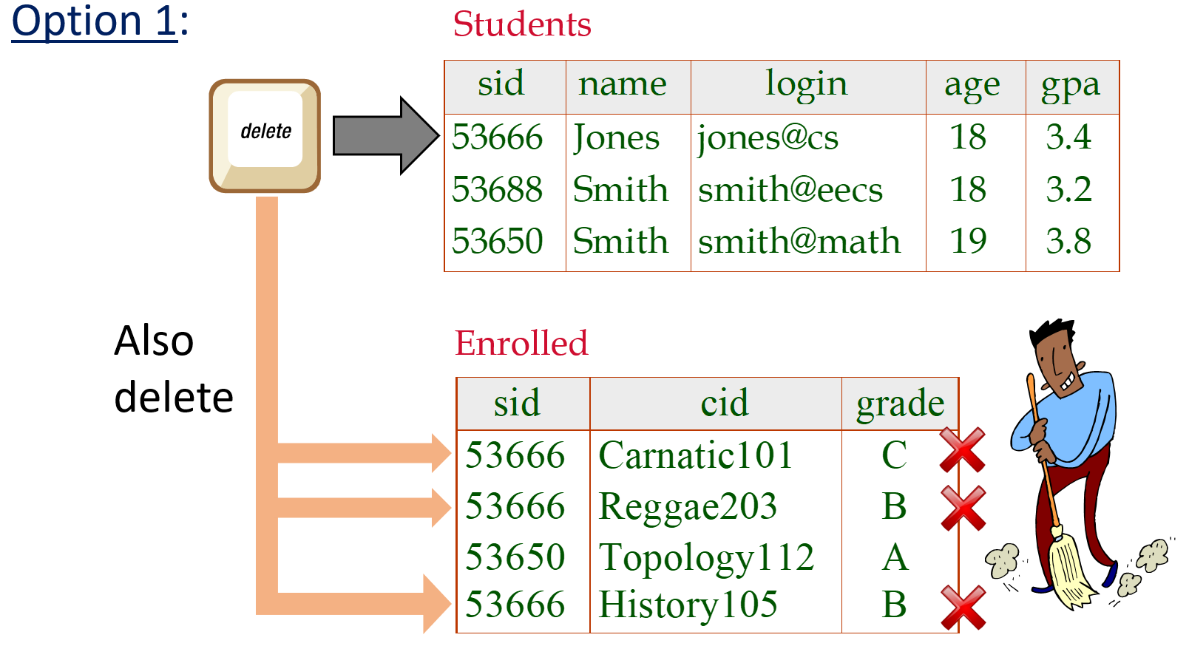
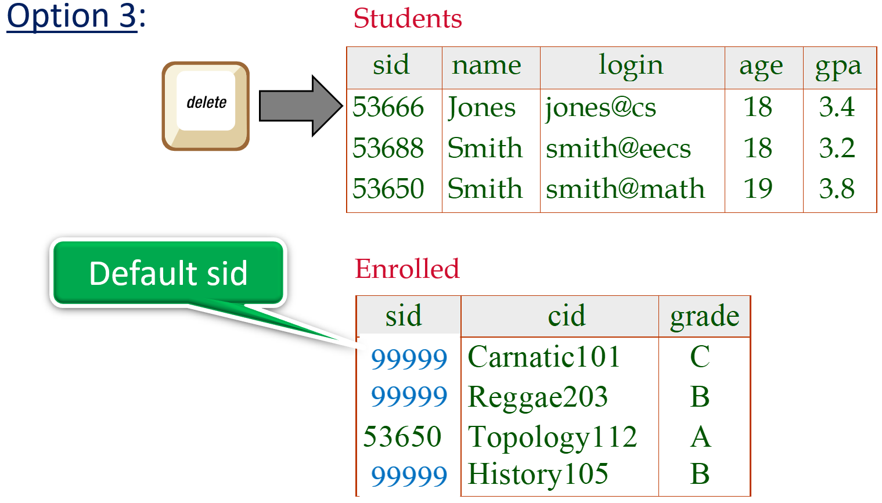
Referential Integrity in SQL
CREATE TABLE Enrolled
(sid CHAR(20),
cid CHAR(20),
grade CHAR(2),
PRIMARY KEY (sid,cid),
FOREIGN KEY (sid)
REFERENCES Students
ON DELETE CASCADE
ON UPDATE SET DEFAULT )
Update is a delete followed by an insert
Notes:
14

Slide 35
Referential Integrity in SQL
CREATE TABLE Enrolled
(sid CHAR(20),
cid CHAR(20),
grade CHAR(2),
PRIMARY KEY (sid,cid),
FOREIGN KEY (sid)
REFERENCES Students
ON DELETE CASCADE
ON UPDATE SET DEFAULT )
If a student is deleted from Students table, all his enrolled courses are also deleted
If an sid is updated in Students table, set the corresponding sid in enrolled table to ‘99999’
Notes:
14

Slide 36
Where do ICs Come From?
ICs are based upon the semantics of the real-world enterprise that is being described in the database relations.
We can check a database instance to see if an IC is violated, but we can NEVER infer that an IC is true by looking at an instance.
An IC is a statement about all possible instances !!
Name is
a key ?

Slide 37
Logical DB Design: ER to Relational
Entity sets to tables:
CREATE TABLE Employees
(ssn CHAR(11),
name CHAR(20),
lot INTEGER,
PRIMARY KEY (ssn))
name
ssn
lot
Employees
Employees
ssn | name | lot
Notes:
3
The slides for this text are organized into several modules. Each lecture contains about enough material for a 1.25 hour class period. (The time estimate is very approximate--it will vary with the instructor, and lectures also differ in length; so use this as a rough guideline.) This covers Lectures 1 and 2 (of 6) in Module (5).
Module (1): Introduction (DBMS, Relational Model)
Module (2): Storage and File Organizations (Disks, Buffering, Indexes)
Module (3): Database Concepts (Relational Queries, DDL/ICs, Views and Security)
Module (4): Relational Implementation (Query Evaluation, Optimization)
Module (5): Database Design (ER Model, Normalization, Physical Design, Tuning)
Module (6): Transaction Processing (Concurrency Control, Recovery)
Module (7): Advanced Topics

Slide 38
Relationship Sets to Tables (1)
In translating a relationship set to a relation, attributes of the relation must include:
  Keys for each participating entity set (as foreign keys).
    This set of attributes forms a superkey for the relation.
  All descriptive attributes.
since
name
since
dname
ssn
ssn
did
lot
did
budget
Descriptive attribute
Employees
Works_In
Departments
Works_In
Notes:
5

Slide 39
Relationship Sets to Tables (2)
name
since
dname
ssn
lot
did
budget
Employees
Works_In
Departments
Works_In
CREATE TABLE Works_In(
ssn CHAR(11),
did INTEGER,
since DATE,
PRIMARY KEY (ssn, did),
FOREIGN KEY (ssn) REFERENCES Employees,
FOREIGN KEY (did) REFERENCES Departments)
ssn | did | since
Notes:
5

Slide 40
Review: Key Constraints
Each dept has at most one manager, according to the key constraint on Manages.
Employees
Departments
since
name
dname
ssn
lot
did
budget
Employees
Manages
Departments
1-to Many
Notes:
6

Slide 41
Key Constraint Mapping
Option 1: Map relationship to a table:
  Separate tables for Employees and Departments.
Note that did is the key now – Each department can have only one manager
since
name
since
dname
ssn
ssn
did
lot
did
budget
Employees
Manages
Departments
Manages
1-to-many
Notes:
5

Slide 42
Constraint Mapping in SQL
CREATE TABLE Manages(
ssn CHAR(11),
did INTEGER,
since DATE,
PRIMARY KEY (did),
FOREIGN KEY (ssn) REFERENCES Employees,
FOREIGN KEY (did) REFERENCES Departments)
since
name
since
dname
ssn
ssn
did
lot
did
budget
Employees
Manages
Departments
Manages
ssn
did
since
Notes:
5

Slide 43
Translating ER Diagrams with Key Constraints
Option 2: Since each department has a unique manager, we could instead combine Manages and Departments.
Manager information
Dept_Mgr
did | dname | budget | ssn | since
did
dname
budget
Department
did
ssn
since
Combine the relations
Manages
Notes:
7

Slide 44
Translating ER Diagrams with Key Constraints
Option 2: Since each department has a unique manager, we could instead combine Manages and Departments.
Manager information
Dept_Mgr
did | dname | budget | ssn | since
CREATE TABLE Dept_Mgr(
did INTEGER,
dname CHAR(20),
budget REAL,
ssn CHAR(11),
since DATE,
PRIMARY KEY (did),
FOREIGN KEY (ssn) REFERENCES Employees)
Manager information
Notes:
7

Slide 45
Translating ER Diagrams with Key Constraints
Option 2: Since each department has a unique manager, we could instead combine Manages and Departments.
Dept_Mgr
did | dname | budget | ssn | since
Can also use one table for both “Manages” and “Departments”
Folding them into one table
name
since
dname
ssn
lot
did
budget
Employees
Manages
Departments
Notes:
7

Slide 46
Review: Participation Constraints
Does every department have a manager?
  If so, this is a participation constraint: the participation of Departments in Manages is said to be total (vs. partial).
  Every did value in Departments table must appear in a row of the Manages table (with a non-null ssn value!)
name
since
dname
ssn
did
lot
did
budget
Employees
Manages
Departments
Notes:
8

Slide 47

Participation Constraints in SQL
name
since
dname
ssn
did
lot
did
budget
Employees
Manages
Departments
CREATE TABLE Dept_Mgr(
did INTEGER,
dname CHAR(20),
budget REAL,
ssn CHAR(11) NOT NULL,
since DATE,
PRIMARY KEY (did),
FOREIGN KEY (ssn) REFERENCES Employees,
ON DELETE NO ACTION)
Total participation
i.e., Every department must have a manager
Cannot be “null”
Notes:
9

Slide 48
Participation Constraints in SQL
We can capture participation constraints involving one entity set in a binary relationship, but little else (without resorting to CHECK constraints – discussed later).
name
since
dname
ssn
did
lot
did
budget
Employees
Manages
Departments
Notes:
9

Slide 49
Review: Weak Entities
A weak entity can be identified uniquely only by considering the primary key of another (owner) entity.
  Owner entity set and weak entity set must participate in a one-to-many relationship set (1 owner, many weak entities).
  Weak entity set must have total participation in this identifying relationship set.
name
ssn
cost
pname
age
lot
Employees
Policy
Dependents
Notes:
10

Slide 50


Translating Weak Entity Sets
name
ssn
lot
cost
pname
age
Employees
Policy
Dependents
ssn is part of a primary key
→ Implicit NOT NULL
CREATE TABLE Dep_Policy (
pname CHAR(20),
age INTEGER,
cost REAL,
ssn CHAR(11) NOT NULL,
PRIMARY KEY (pname, ssn),
FOREIGN KEY (ssn) REFERENCES Employees,
ON DELETE CASCADE)
Map into
one table
Weak entity set
When the owner entity is deleted, all owned weak entities must also be deleted
Notes:
11

Slide 51
Review: ISA Hierarchies
As in C++, or other PLs, attributes are inherited.
If we declare A ISA B, every A entity is also considered to be a B entity.
name
ssn
lot
Employees
hours_worked
hourly_wages
ISA
contractid
Hourly_Emps
Contract_Emps
Overlap constraints: Can Joe be an Hourly_Emps as well as a Contract_Emps entity? (Allowed/disallowed)
Covering constraints: Does every Employees entity also have to be an Hourly_Emps or a Contract_Emps entity? (Yes/no)
Notes:
12

Slide 52
Mapping ISA to Relations
Two approaches:
Using three tables
Using two tables
name
ssn
lot
Employees
hourly_wages
hours_worked
ISA
contractid
Hourly_Emps
Contract_Emps
Notes:
12

Slide 53
ISA: Mapping Using Three Relations
Employees
Every employee is recorded in Employees
ssn | name | lot
ssn
name
lot
Employees
Contract_Emps
ssn | contractid
hours_worked
ISA
hourly_wages
contractid
Hourly_Emps
ssn | Hourly_wages | Hours_worked
Hourly_Emps
Contract_Emps
For hourly employees, extra information (i.e., Hourly_Wages and Hours_worked) recorded in Hourly_Emps
      must delete Hourly_Emps tuple if referenced Employees tuple is deleted.
Notes:
12

Slide 54
ISA: Mapping Using Three Relations
Employees
ssn | name | lot
ssn
name
lot
Employees
Contract_Emps
ssn | contractid
hours_worked
ISA
hourly_wages
contractid
Hourly_Emps
ssn | Hourly_wages | Hours_worked
Hourly_Emps
Contract_Emps
More detail on “join” later
    Queries involving all employees easy,
      e.g., Find SSN of all Smiths
    those involving just Hourly_Emps require a join to get some attributes (e.g., name)
    e.g., Find Hourly_wages of all Smiths
Notes:
12

Slide 55
ISA: Mapping Using Two Relations
ssn
name
lot
Each employee must be in one of these two relations, i.e., covering = ‘yes’
Employees
hours_worked
ISA
hourly_wages
contractid
Hourly_Emps
Contract_Emps
Hourly_Emps
ssn | name | lot | hourly_wages | hours_worked
Contract_Emps
ssn | name | lot | Contractid
Notes:
13

Slide 56
Mapping ISA Constraints
Overlap and covering constraints in ISA relationships can be expressed in SQL using assertions
We will discuss assertions later

Slide 57
Mapping Two Binary Relationships (1)
The key constraints allow us to combine Purchaser with Policies, and Beneficiary and Dependents.
name
pname
ssn
lot
age
CREATE TABLE Policies (
policyid INTEGER,
cost REAL,
ssn CHAR(11) NOT NULL,
PRIMARY KEY (policyid).
FOREIGN KEY (ssn) REFERENCES Employees,
ON DELETE CASCADE)
Employees
Dependents
Purchaser
Beneficiary
Policies
policyid
cost
CREATE TABLE Dependents (
pname CHAR(20),
age INTEGER,
policyid INTEGER,
PRIMARY KEY (pname, policyid),
FOREIGN KEY (policyid) REFERENCES Policies, ON DELETE CASCADE)
Notes:
7

Slide 58
Chain of Weak Entity Sets
What if Policies is also a weak entity set ?
Primary key:
(pname, policyid, ssn)
name
pname
ssn
lot
age
Employees
Dependents
Purchaser
Beneficiary
Add ssn to
primary key
Policies
Include both ssn and policyid
in primary key
policyid
cost
Notes:
7

Slide 59
Chain of Identifying Relationships for Weak Entity Sets
pname
age
name
ssn
lot
Dependents
CREATE TABLE Dependents (
pname CHAR(20),
age INTEGER,
policyid INTEGER,
PRIMARY KEY (pname, policyid),
FOREIGN KEY (policyid) REFERENCES Policies,
ON DELETE CASCADE)
Employees
from Policies
Purchaser
Beneficiary
Policies
(From Slide 58)
policyid
cost
CREATE TABLE Dependents (
pname CHAR(20),
age INTEGER,
policyid INTEGER,
ssn INTEGER,
PRIMARY KEY (pname, policyid, ssn),
FOREIGN KEY (policyid, ssn) REFERENCES Policies,
ON DELETE CASCADE)
Must include also SSN from Employees
Becomes
Notes:
8

Slide 60

Views
A view is just a relation, but we store a definition, rather than a set of tuples.
A relation
View 2
View 1
Notes:
18

Slide 61


Views
A view is just a relation, but we store a definition, rather than a set of tuples.
Students
YoungStudents
CREATE VIEW YoungStudents (name, grade)
AS SELECT S.name, E.grade
FROM Students S, Enrolled E
WHERE S.sid = E.sid and S.age<18
View definition is a “query”
Notes:
18

Slide 62


Drop A View
Views can be dropped using the DROP VIEW command.
  How to handle DROP TABLE if there’s a view on the table?
  DROP TABLE command has options to let the user specify this.
    “DROP TABLE Students RESTRICT” - Removes Students unless there are related views
    “DROP TABLE Students CASCADE” - Also removes any referencing views
Students
DROP
TABLE
View
Notes:
18

Slide 63
Views and Security
Views can be used to
present necessary information (or a summary),
while hiding details in underlying relation(s).
  Example: Given YoungStudents but not Students or Enrolled, we can find young students who have enrolled but not the cid’s of the courses they are enrolled in.
CREATE VIEW YoungStudents (name, grade)
AS SELECT S.name, E.grade
FROM Students S, Enrolled E
WHERE S.sid = E.sid and S.age<18
Need both Students & Enrolled to find out the courses the students are enrolled in
Notes:
22

Slide 64
Summary: ER to Relational Mapping

Slide 65
ER to Relational Mapping (1)
KEY
KEY
KEY
KEY
KEY
KEY
Key constraint
KEY
Foreign Key
KEY
KEY
Merge
Notes:
18

Slide 66
ER to Relational Mapping (2)
Key constraint
KEY
Foreign Key
KEY
KEY
Merge
KEY
Foreign Key
KEY
KEY
NOT NULL
Total participation
Merge
PKEY
KEY
KEY
PKEY
NOT NULL
PKEY becomes part of the composite key (PKEY, KEY)
PKEY: Partial key
Merge
Notes:
18

Slide 67
ER to Relational Mapping (3)
Using Three Tables
Some might not belong to either subcategory
KEY
KEY
ISA
KEY
KEY
Notes:
18

Slide 68
ER to Relational Mapping (4)
Using Two Tables
Not stored
KEY
KEY
ISA
KEY
They must include all employees
Notes:
18

Slide 69
ER to Relational Mapping (5)
KEY
PKEY
Primary key:
KEY
PKEY
KEY
Primary key:
PKEY
Primary key:
KEY
PKEY
PKEY
KEY
PKEY
KEY
PKEY
Notes:
18

Slide 70
ER to Relational Mapping (6)
KEY
KEY
KEY
KEY
KEY
KEY
Notes:
18

Slide 71
Mapping Example – ER Design
address
phone
Place
Home
Telephone
albumID
speed
name
Lives
ssn
copyrightDate
title
Musicians
Producer
Album
Plays
Appears
Perform
Instrument
Songs
instrID
key
songID
author
dname
title

Slide 72
Mapping Example
address
phone
Place
Home
Telephone
albumID
Total participation
name
speed
ssn
Lives
copyrightDate
CREAT TABLE Home_Telephone
( phone CHAR(11) ,
address CHAR(30) NOT NULL,
PRIMARY KEY (phone),
FOREIGN KEY address REFERENCES Place
)
title
Musicians
Producer
Album
Key constraint
Plays
Appears
Perform
Instrument
Songs
instrID
key
songID
author
dname
title

Slide 73
Mapping Example
address
address
phone
Phone_no
Place
Home
Telephone
Home_Telephone
albumID
speed
name
Lives
ssn
copyrightDate
title
Many-to-many
Musicians
Producer
Album
CREAT TABLE Lives (
ssn CHAR(10),
phone CHAR(11),
PRIMARY KEY (ssn, phone),
FOREIGN KEY phone
REFERENCES Home_Telephone,
FOREIGN KEY ssn
REFERENCES Musicians )
Plays
Appears
Perform
Instrument
Songs
instrID
key
songID
author
dname
title

Slide 74
Mapping Example
address
phone
Place
Home
Telephone
albumID
speed
name
Lives
ssn
copyrightDate
title
CREAT TABLE Plays (
ssn CHAR(10),
instrID INTEGER
PRIMARY KEY (ssn, instrID),
FOREIGN KEY (ssn)
REFERENCES Musicians,
FOREIGN KEY (instrID)
REFERENCES Instruments )
Musicians
Producer
Album
Plays
Appears
Perform
Instrument
Songs
instrID
key
songID
author
dname
title

Slide 75
Mapping Example
address
phone
Place
Home
Telephone
albumID
speed
name
Lives
ssn
copyrightDate
title
Musicians
Producer
Album
Total participation
CREAT TABLE Album_Producer (
albumID INTEGER,
ssn CHAR(10) NOT NULL,
copyrightDate DATE,
speed INTEGER,
title CHAR(30)
PRIMARY KEY (albumID),
FOREIGN KEY (ssn) REFERENCES Musicians )
Plays
Appears
Perform
Instrument
Songs
Key constraint
instrID
key
songID
author
dname
title

Slide 76
Mapping Example
address
phone
CREAT TABLE Perform (
songID INTEGER,
ssn CHAR(10),
PRIMARY KEY (ssn, songID),
FOREIGN KEY (ssn)
REFERENCES Musicians,
FOREIGN KEY (songID)
REFERENCES Songs )
Place
Home
Telephone
albumID
speed
name
Lives
ssn
copyrightDate
title
Musicians
Producer
Album
Plays
Appears
Perform
Instrument
Songs
instrID
key
songID
author
dname
title

Slide 77
Mapping Example
address
phone
Place
Home
Telephone
albumID
speed
name
Lives
ssn
copyrightDate
title
Musicians
Producer
Album
CREAT TABLE Songs_Appears (
songID INTEGER,
author CHAR(30),
title CHAR(30),
albumID INTEGER NOT NULL,
PRIMARY KEY (songID),
FOREIGN KEY (albumID)
REFERENCES Album_Producer )
Plays
Appears
Perform
Instrument
Songs
instrID
key
songID
author
dname
title

Slide 78
Relational Model: Summary
A tabular representation of data.
Simple and intuitive, currently the most widely used.
Integrity constraints can be specified by the DBA, based on application semantics. DBMS checks for violations.
  Two important ICs: primary and foreign keys
  In addition, we always have domain constraints.
Powerful and natural query languages exist.
Rules to translate ER to relational model
Notes:
15

