Slide 1
Important
Attend all the lectures
The slides do not have all the details and explanation
The three exams are based on the lecture materials.

Slide 2
COP4710: Three parts
Database Development
Application Development
DBMS Internal

Slide 3
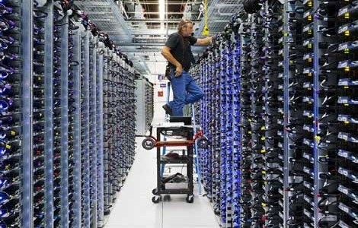
Chapter 1
Introduction to Database Systems
Notes:
The slides for this text are organized into chapters. This lecture covers Chapter 1.
Chapter 1: Introduction to Database Systems
Chapter 2: The Entity-Relationship Model
Chapter 3: The Relational Model
Chapter 4 (Part A): Relational Algebra
Chapter 4 (Part B): Relational Calculus
Chapter 5: SQL: Queries, Programming, Triggers
Chapter 6: Query-by-Example (QBE)
Chapter 7: Storing Data: Disks and Files
Chapter 8: File Organizations and Indexing
Chapter 9: Tree-Structured Indexing
Chapter 10: Hash-Based Indexing
Chapter 11: External Sorting
Chapter 12 (Part A): Evaluation of Relational Operators
Chapter 12 (Part B): Evaluation of Relational Operators: Other Techniques
Chapter 13: Introduction to Query Optimization
Chapter 14: A Typical Relational Optimizer
Chapter 15: Schema Refinement and Normal Forms
Chapter 16 (Part A): Physical Database Design
Chapter 16 (Part B): Database Tuning
Chapter 17: Security
Chapter 18: Transaction Management Overview
Chapter 19: Concurrency Control
Chapter 20: Crash Recovery
Chapter 21: Parallel and Distributed Databases
Chapter 22: Internet Databases
Chapter 23: Decision Support
Chapter 24: Data Mining
Chapter 25: Object-Database Systems
Chapter 26: Spatial Data Management
Chapter 27: Deductive Databases
Chapter 28: Additional Topics

Slide 4

What Is a DBMS?
A database is a very large, integrated collection of data. It models real-world enterprise.
  Entities (e.g., students, courses)
  Relationships (e.g., Patrick Bauer is taking COP4710)
A Database Management System (DBMS) is a software package designed to store and manage databases.

Slide 5
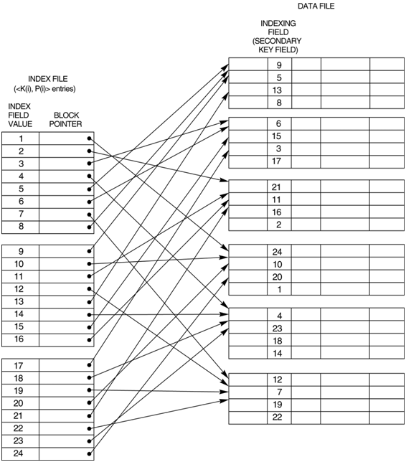
Why Use a DBMS?
Data independence
  Applications are insulated from changes in the way the data are structured and stored
Efficient data access
  Sophisticated techniques to store and retrieve data efficiently
Reduced application development time
  Supports functions common to many applications
Notes:
3

Slide 6
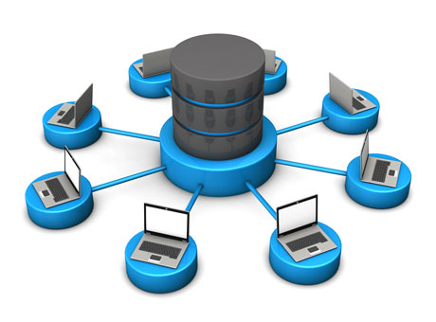
Why Use a DBMS?
Data integrity and security
  Enforces integrity constraints (e.g., the department budget is not exceeded when a new salary is inserted)
  Enforces access controls for different classes of users
Uniform data administration
  Database administrators have the knowledge to minimize data redundancy and fine tune the database to make retrieval efficient
Notes:
3

Slide 7
Why Use a DBMS?
Concurrent access
  Multiple users can access the database concurrently
Recovery from crashes
  Protect the users from the effects of system failures
Notes:
3

Slide 8
Data Models
A data model is a collection of concepts for describing data
  Example: Relational model uses tables with rows and columns
A schema is a description of a particular collection of data, using a given data model
  Example: Description for a student table
Notes:
5

Slide 9
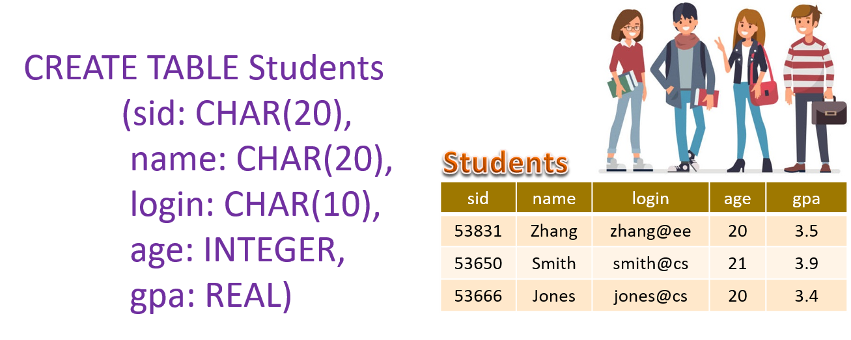
Relational Data Model
The most widely used model today.
  Main concept: relation, basically a table with rows and columns.
  Every relation has a schema, which describes the columns, or fields.
Notes:
5

Slide 10

Levels of Abstraction
Describes how the users see the data
View 1
View 2
View 3
Defines the logical structure
Conceptual Schema
Physical Schema
Describes the files and indexes used
Database
Schemas are defined using DDL (Data Definition Language)
Data is modified/queried using DML (Data Manipulation Language)
Notes:
6

Slide 11

Example: University Database
Conceptual schema:
  Students(sid: string, name: string, login: string,
  age: integer, gpa:real)
  Courses(cid: string, cname:string, credits:integer)
  Enrolled(sid:string, cid:string, grade:string)
Physical schema:
  Example:
  Relations stored as unordered files (i.e., data records not sorted)
  Index on first column of Students (i.e., sid)
External Schema (View):
  Course_info(cid:string, enrollment:integer)
Implicit data – computed as needed
Notes:
7

Slide 12
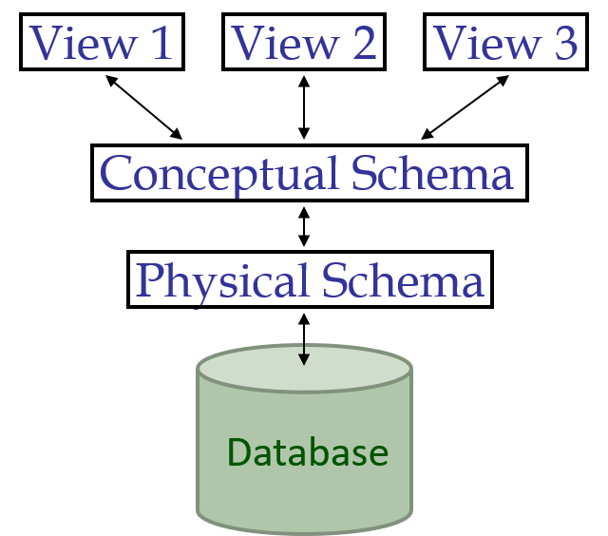

Data Independence
Application 1
Application 1
Application 1
Applications insulated from how data are structured and stored.
Physical data independence: Protection from changes in physical structure of data.
Logical data independence: Protection from changes in logical structure of data (more on next slide).
These are some of the most important benefits of using a DBMS!

Slide 13
Logical Data Independence
Application
View: Courseinfo( cid: String, fname: string, enrollment: integer)
Faculty( fid: string, fname: string, sal: real)
Courses( cid: string, cname: string, credits: integer)
Enrolled( sid: string, cid: string, grade: string)
Teaches( fid: string, cid: string)
Faculty_public( fid: string, fname: string, office: integer)
Faculty_private( fid: string, sal: real)
.
.
.
Changes in the conceptual schema do not affect the application
Reorganize
data

Slide 14
Concurrency Control
Concurrent execution of user programs is essential for good DBMS performance.
  Since disk accesses are frequent and relatively slow, it is important to keep the cpu humming by working on several user programs concurrently.
Interleaving actions of different user programs can lead to inconsistency: e.g., check is cleared while account balance is being computed.
DBMS ensures such problems don’t arise: users can pretend they are using a single-user system.

Slide 15
Transaction: An Execution of a DB Program
Transaction is an atomic sequence of database actions (reads/writes).
Each transaction, executed completely, must leave the DB in a consistent state if DB is consistent when the transaction begins.
  Users can specify some simple integrity constraints on the data, and the DBMS will enforce these constraints.
  Beyond this, the DBMS does not really understand the semantics of the data. (e.g., it does not understand how the interest on a bank account is computed).
  Thus, ensuring that a transaction (run alone) preserves consistency is ultimately the user’s responsibility!

Slide 16
Scheduling Concurrent Transactions
Concurrent execution of a set of transactions {T1, ... , Tn} is equivalent to some serial execution T1, ... , Tn.
  Before reading/writing an object, a transaction requests a lock on the object, and waits till the DBMS gives it the lock.
  All locks are released at the end of the transaction. (Strict 2-Phase Locking protocol.)
I wait
I have the lock
I can lock now
I am done
T₂
X
T₁
T₂
X
T₁
W
R
W

Slide 17
2-Phase Locking (2PL) Protocol
2PL Locking Protocol is sufficient and more efficient
2PL offers more concurrency; but it is difficult to implement
What if I need another lock before commit ?
Strict 2PL
2PL
Number of locks acquired
Time
Notes:
2PL is needed - If a transaction T releases the lock of a data item X, other transactions might update X. If T locks and uses X again, T might see a different data value.

Slide 18
Deadlock
Deadlock
I wait for X
I have the lock on X
X
W₃
R₂
T₂
T₁
I have the lock on Y
W₁
W₄
I wait for Y
Y
A solution: T₁ or T₂ is aborted and restarted

Slide 19
Ensuring Atomicity
DBMS ensures atomicity (all-or-nothing property) even if system crashes in the middle of a Xact.
Idea: Keep a log (history) of all actions carried out by the DBMS while executing a set of Xacts:
  Before a change is made to the database, the corresponding log entry is forced to a safe location - Write-Ahead Log (WAL) protocol
  After a crash, the effects of partially executed transactions are undone using the log. (Thanks to WAL, if log entry wasn’t saved before the crash, corresponding change was not applied to database!)

Slide 20

DBMS simplifies application development
All log related activities (and in fact, all CC related activities such as lock/unlock, dealing with deadlocks etc.) are handled transparently by the DBMS.
Notes:
20

Slide 21
Summary
DBMS is used to maintain and query large datasets.
Levels of abstraction give data independence.
Benefits include recovery from system crashes, concurrent access, quick application development, data integrity and security.
A DBMS typically has a layered architecture.
DBMS R&D is one of the broadest and most exciting areas in CS. (More on this later)

Slide 22



DBMS Is a Very Advanced System
It simplifies software development !!
I can design and implement data structures
I can generate code
Easy
DBMS

Slide 23
Multimedia Databases
. . . not just about text and number

Slide 24


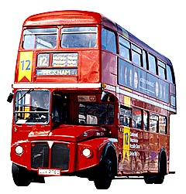
Matching Images
Image features: Shape, Color, Texture, Size, etc.
Images are represented by their feature vector, i.e., a point in the feature space
Two images are similar if they are near each other in the feature space
Similar
Less similar

Slide 25
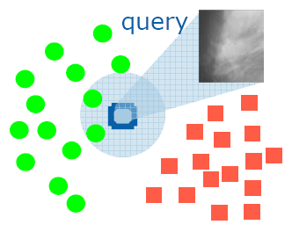
Database Approach to
Computer-Aided Diagnosis
Content-based image retrieval techniques can be applied to implement computer-aided diagnosis systems
The database consists of a large number of images with verified pathology results
Diagnosis is done by submitting the suspected image as a query to retrieve similar cases from the database

Slide 26
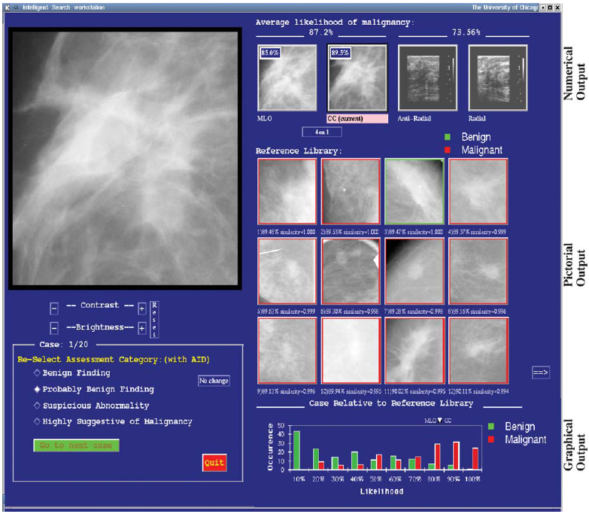
A Mammography CAD System
[Giger et al.]
Probability of
malignancy
Similar images of known diagnosis

Slide 27





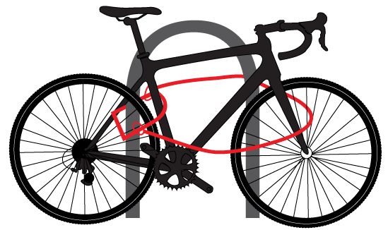
ThingStore
A database approach to the Internet of Things
ThingStore

Slide 28


System Overview
3
2
1
Applications
0
0
1
0
1
1
0
0
1
0
1
1
0
0
0
0
0
1
0
1
1
Complex events
EQL Processor
(Boolean Query Processing)
1
1
0
0
0
0
0
1
1
1
0
0
0
0
0
0
0
1
1
1
1
1
0
0
0
0
1
0
Atomic events
3 smart services
S6
S5
S4
S4
S3
S2
S1
4 smart services
Thing
Thing
Any kind of Camera
Any kind of sensor

Slide 29
Addressing Challenges
3
2
1
Applications
0
0
1
0
1
1
0
0
1
0
1
1
0
0
0
0
0
1
0
1
1
A programming interface for sharing IoT Infrastructure
EQL Processor
(Boolean Query Processing)
Challenge
3
App Developers only focus on the application logic
1
1
0
0
0
0
0
1
1
1
0
0
0
0
0
0
0
1
1
1
1
1
0
0
0
0
1
0
Boolean abstraction hides complexity due to device heterogeneity
Challenge
2
Thing servers at the “edge” of network
S6
S5
Edge computing → No need to stream raw data
S4
S4
S3
S2
S1
Thing
Thing
1
Challenge
This runs counter to the theme of consolidation and massive data centers that has dominated the discourse on cloud computing.

Slide 30



ThingStore
ThingStore
IoT Market Place
S1
S1
An Ecosystem for IoT Collaboration
S1
S1
S1
S2
Network
Thing Server
S1
S1
S1
S1
S1
S2
Deploy “things” with smart services
Thing Provider

Slide 31


ThingStore
ThingStore
IoT Market Place
S1
S1
An Ecosystem for IoT Collaboration
S1
S1
S1
app
S2
app
app
Download
app
End Users
Query Processor
EQL queries
App Server
Develop apps as online services
Network
app
Subscription
app
app
IoT App Developer
Thing Server
S1
S1
S1
S1
S1
S2
Deploy “things” with smart services
Thing Provider

Slide 32


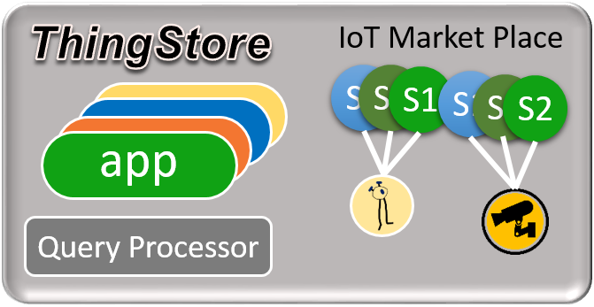
ThingStore
Thing Developer
IoT App Developer
An Ecosystem for IoT Collaboration
IoT Users
Collaboration platform for IoT development and deployment

Slide 33


Tabletop

Slide 34
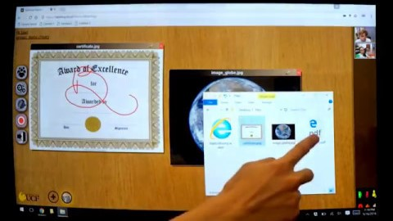
Tabletop

Slide 35
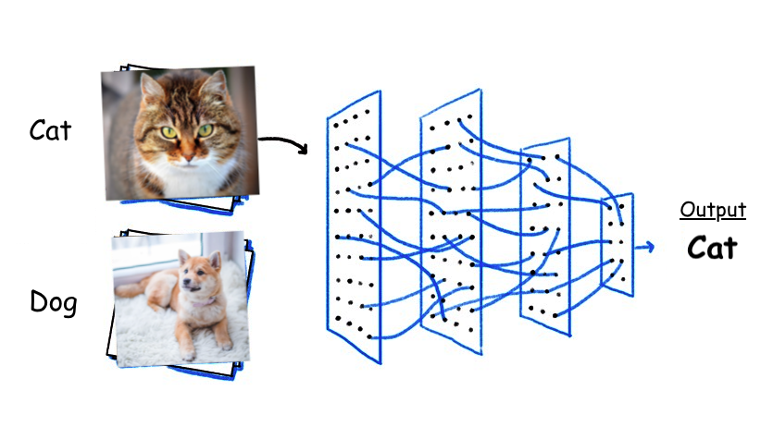
Pattern Recognition

Slide 36

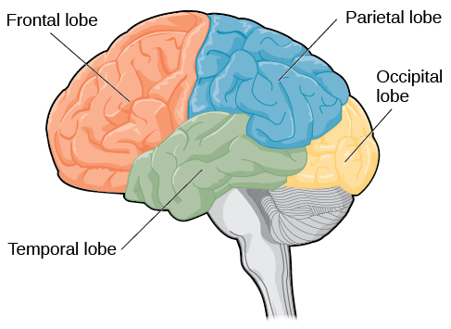
Pattern Recognition vs. Reasoning & Invention
Reasoning
Creativity
Invention
Processing information from body’s senses
Processing visual information
Hearing
Memory
Language

Slide 37
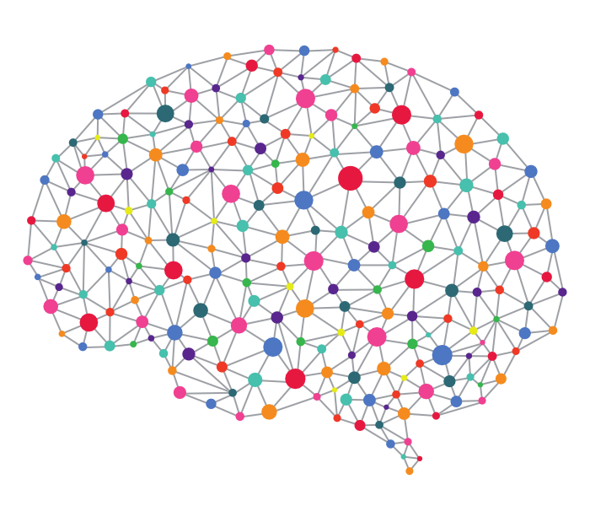
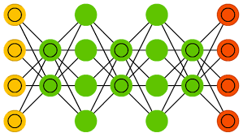
Reasoning and Invention
Facts
(Raw Data)
Reasoning
Mind Builder
Knowledge Base
Invention
The knowledge base must have a structure that facilitates the reasoning

Slide 38
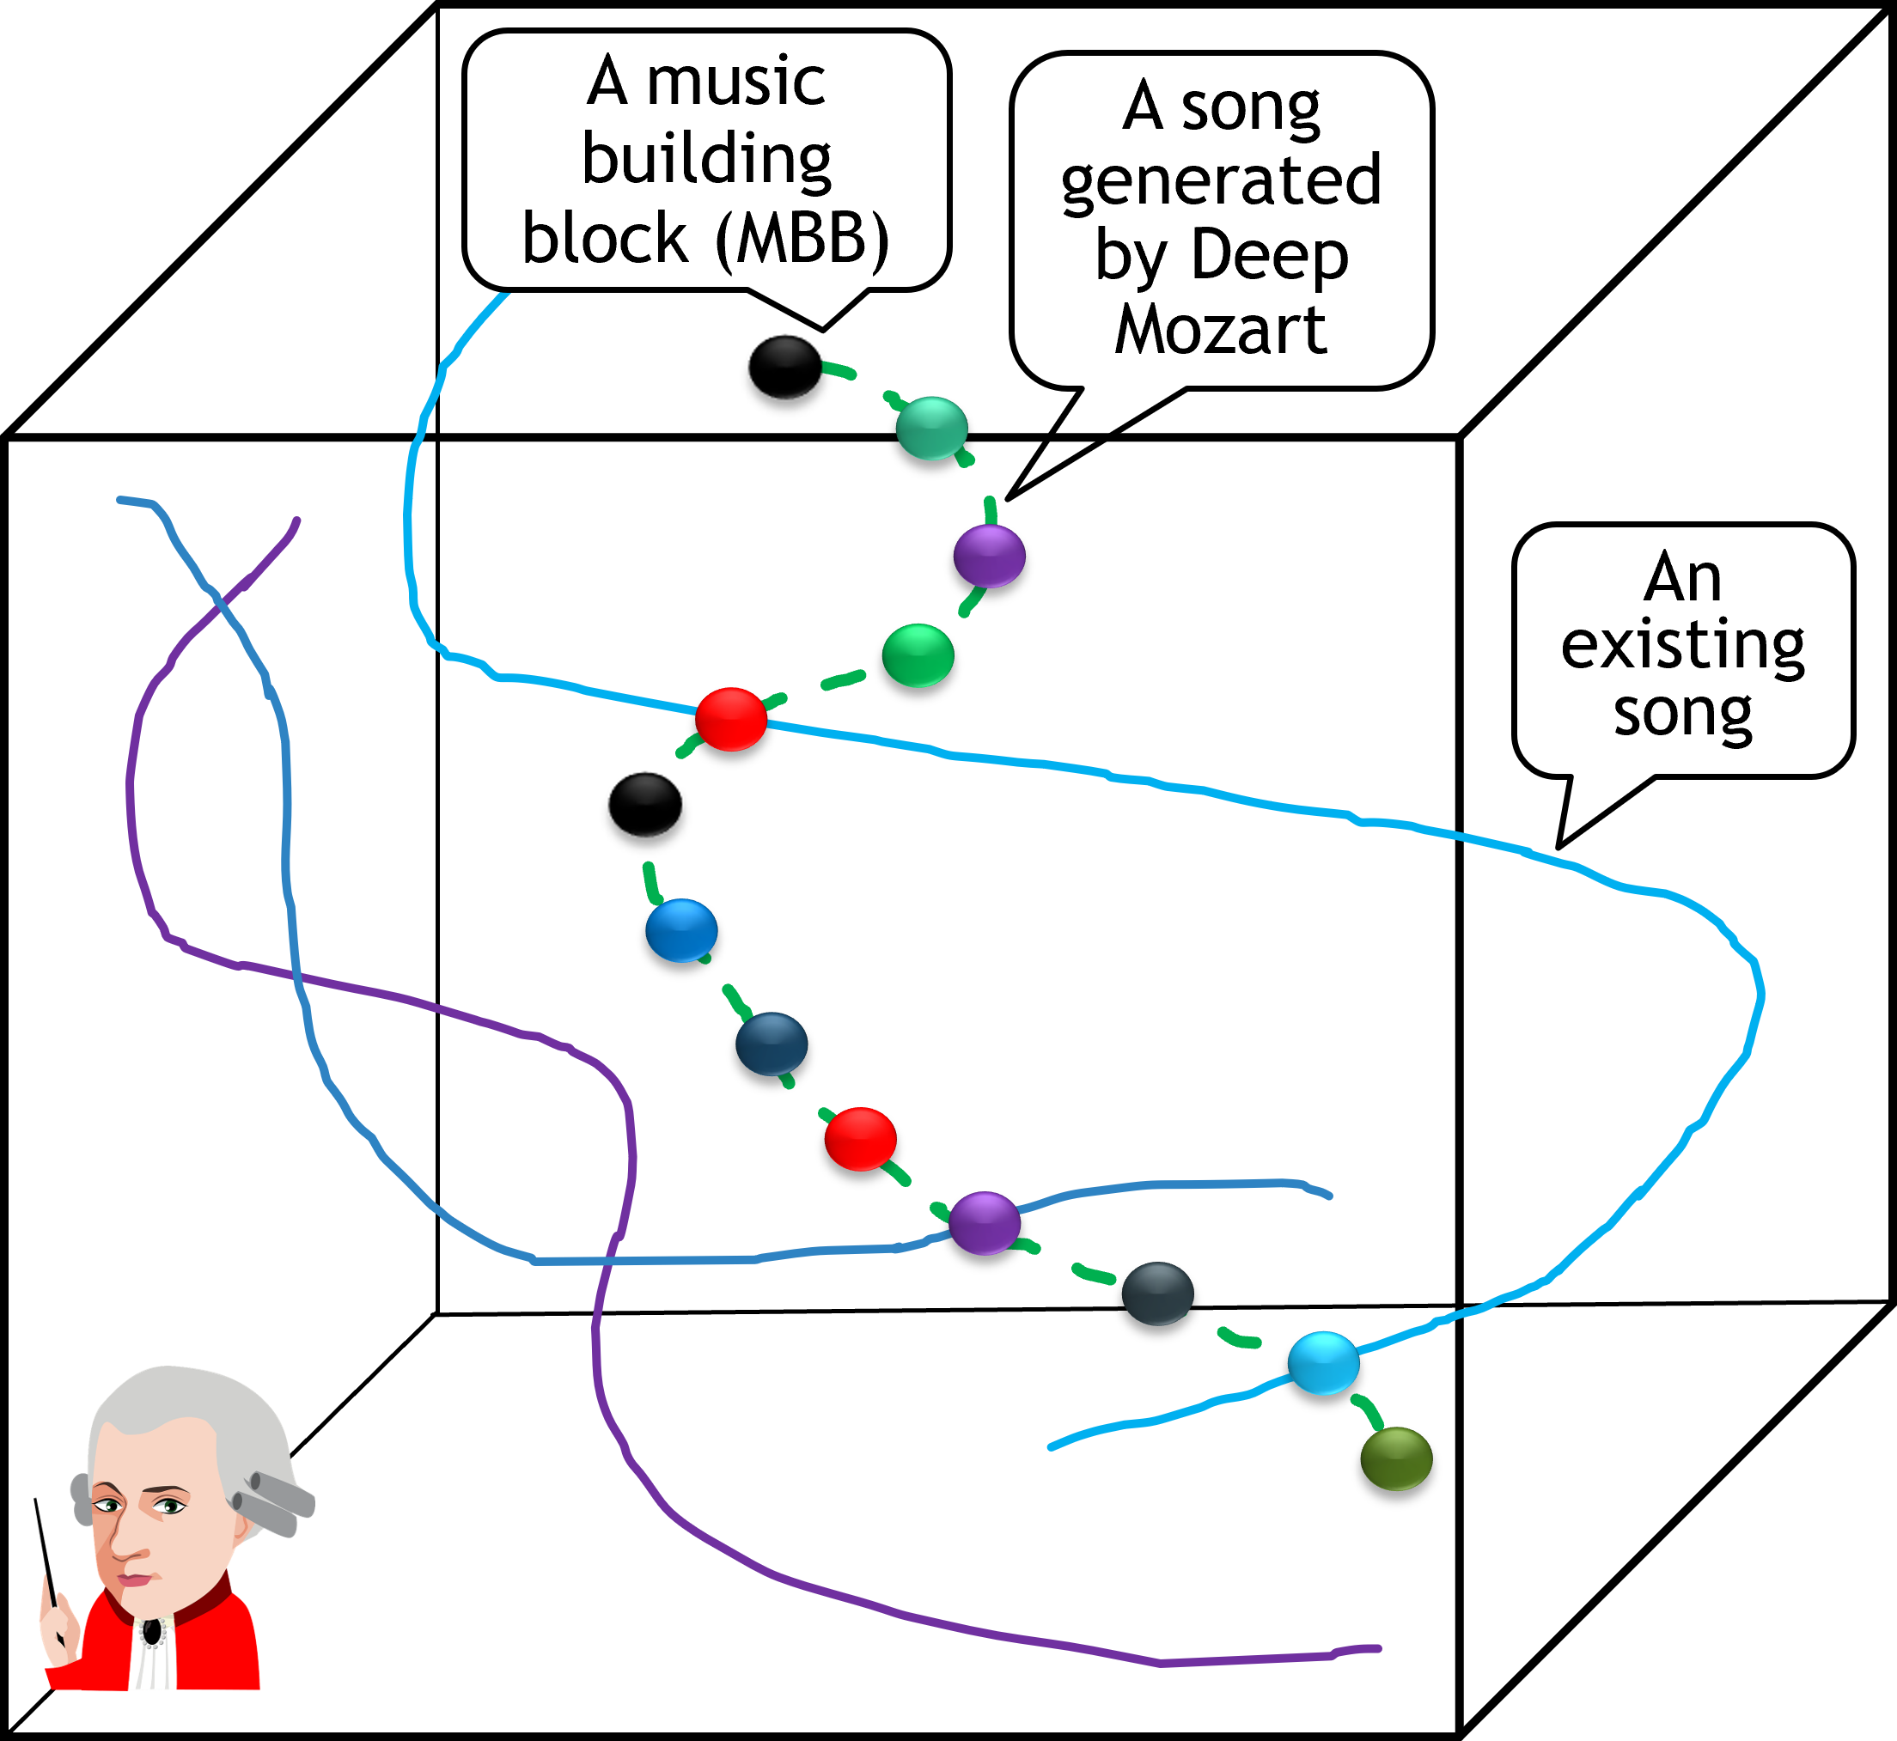
Reasoning & Invention
Music Composition
Facts
(Raw Data)
Reasoning
Information
Retrieval
Mind Builder
New Original Music
Knowledge Base

Slide 39
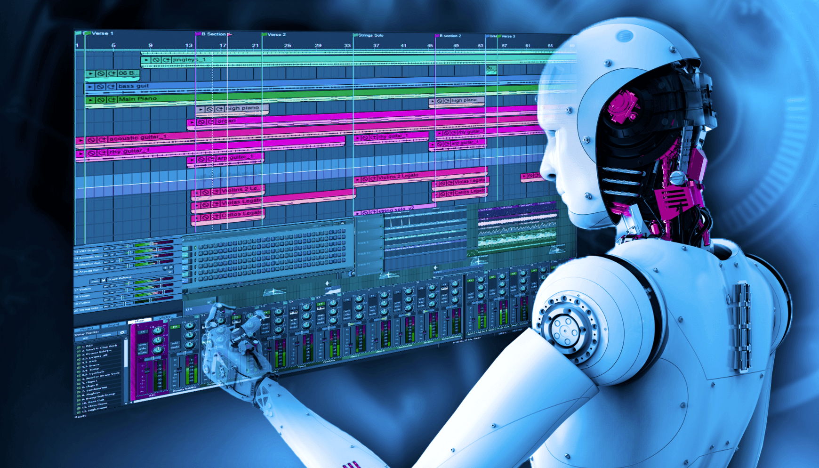
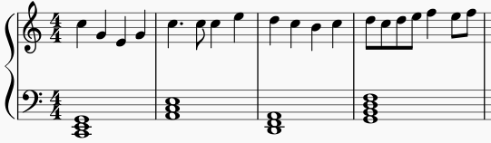
Intelligence Duplication
Deep Composer
Database of
tiny music segments
Query
Retrieve
Query
Retrieve

Slide 40
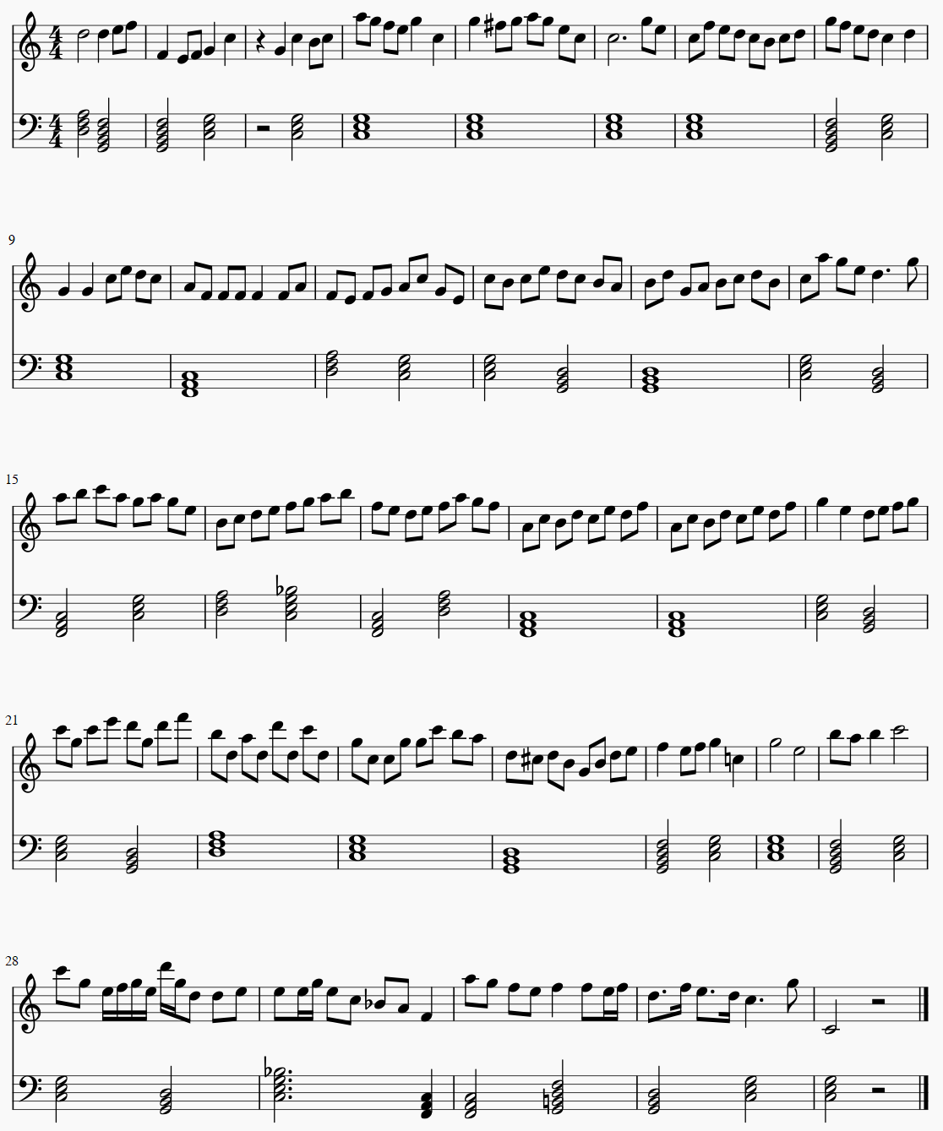

A Sample Generated Song

Slide 41
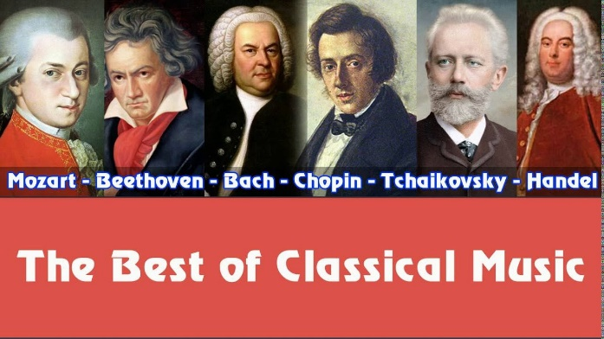



Bring Back Great Composers
A music building block
A new “green” song generated by Deep Mozart
An existing “blue” song composed by Mozart
Mozart music mind

Slide 42
Advanced Database Courses at UCF (COP5711, COP6731)
Parallel and Distributed Database Systems
Computer Aided Diagnosis of Medical Images
A Database Approach to the Internet of Things
Music Generation

