Slide 1


Schema Refinement and
Normal Forms
Chapter 19
Notes:
1

Slide 2
The Evils of Redundancy
Redundancy is at the root of several problems associated with relational schemas:
  redundant storage, insert/delete/update anomalies (more on this later)
Integrity constraints, in particular functional dependencies, can be used to identify schemas with such problems and to suggest refinements.
Main refinement technique: decomposition - replacing Table(ABCD) with, say, T1(AB) and T2(BCD), or T1(ACD) and T2(ABD).
Decomposition should be used judiciously:
  Is there reason to decompose a relation?
  What problems (if any) does the decomposition cause?
Notes:
14

Slide 3

Functional Dependencies (FDs)
A functional dependency X → Y (read “X determines Y”) holds over relation R if, for every allowable instance r of R:
    t1 ∈ r, t2 ∈ r, ∏_{X}(t1) = ∏_{X}(t2) $⇒$ ∏_{Y}(t1) = ∏_{Y}(t2)
Given two tuples in r
then their Y values must also agree
if their X values agree
X and Y values are stored redundantly
X and Y are sets of attributes
∏: Relational projection operator
Notes:
15

Slide 4
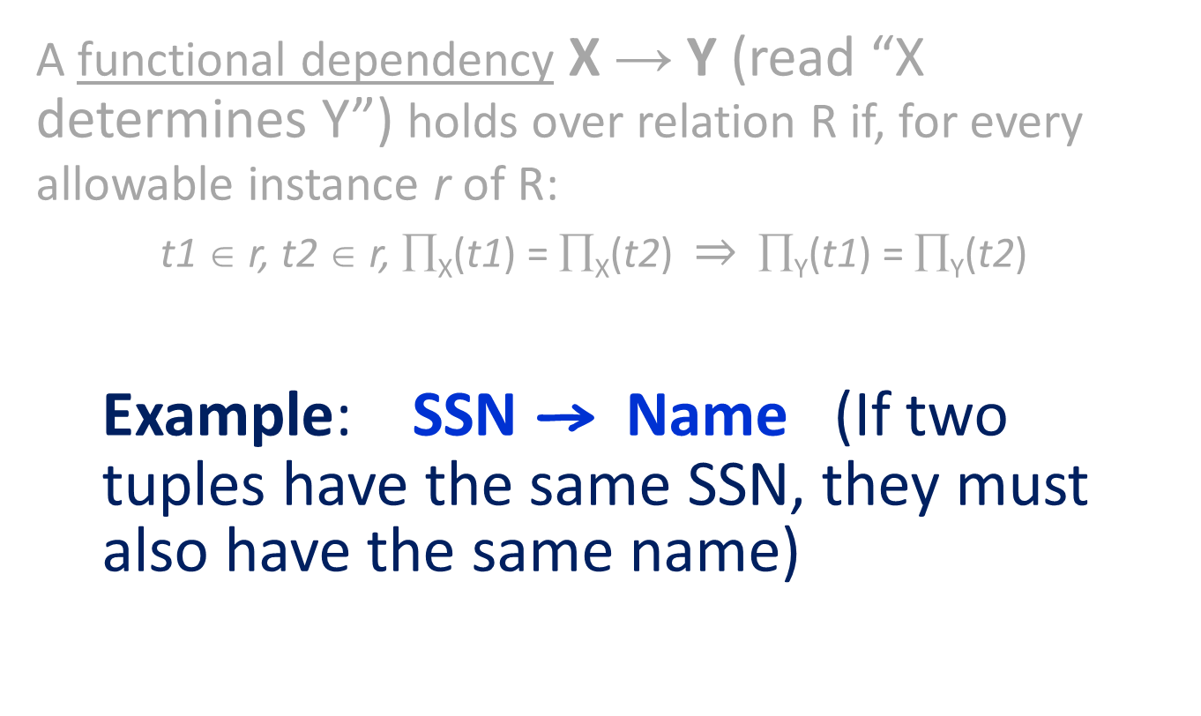
Functional Dependencies Example
A functional dependency X → Y (read “X determines Y”) holds over relation R if, for every allowable instance r of R:
    t1 ∈ r, t2 ∈ r, ∏_{X}(t1) = ∏_{X}(t2) $⇒$ ∏_{Y}(t1) = ∏_{Y}(t2)
Example: SSN → Name (If two tuples have the same SSN, they must also have the same name)
Notes:
15

Slide 5
Notations
Consider relation obtained from Hourly_Emps:
  Hourly_Emps (ssn, name, lot, rating, hrly_wages, hrs_worked)
Notation: We will denote this relation schema by listing the attributes: SNLRWH
  This is really the set of attributes {S,N,L,R,W,H}.
  Sometimes, we will refer to all attributes of a relation by using the relation name. (e.g., Hourly_Emps for SNLRWH)
Some FDs on Hourly_Emps:
  ssn determines the tuple: S → SNLRWH /* S is a key
  rating determines hrly_wages: R → W
S N L R W H
Notes:
16

Slide 6
Functional Dependencies (FDs)
An FD “X→Y” is a statement about all allowable instances of a relation.
  Must be identified based on semantics of application.
  Given some allowable instance of R, we can check if it violates some FD f, but we cannot tell if f holds over R!
“K is a candidate key for relation R” means that K → R (i.e., The K value determines a tuple in R)
  However, K → R does not require K to be minimal! (If A → R, we also have AB → R; but AB is not a candidate key)
Notes:
15

Slide 7
Anomalies
Problems due to R → W :
  Update anomaly: Can we change W in just the 1st tuple of SNLRWH?
  Insertion anomaly: What if we want to insert an employee and don’t know the hourly wage for his rating?
  Deletion anomaly: If we delete all employees with rating 5, we lose the information about the wage for rating 5!
Hourly_Emps2
Wages
SOLUTION
Using two smaller tables solve the problems
Notes:
17

Slide 8
Anomalies
Problems due to R → W :
  Update anomaly: Can we change W in just the 1st tuple of SNLRWH?
  Insertion anomaly: What if we want to insert an employee and don’t know the hourly wage for his rating?
  Deletion anomaly: If we delete all employees with rating 5, we lose the information about the wage for rating 5!
This is the topic of this chapter
Hourly_Emps2
Wages
Using two smaller tables solve the problems
Notes:
17

Slide 9
Armstrong’s Axiom
Armstrong’s Axioms (X, Y, Z are sets of attributes):
  Reflexivity: If X ⊆ Y, then Y → X
  Augmentation: If X → Y, then XZ → YZ for any Z
  Transitivity: If X → Y and Y → Z, then X → Z
These are sound and complete inference rules for FDs!
Couple of additional rules (that follow from AA):
  Union: If X → Y and X → Z, then X → YZ
  Decomposition: If X → YZ, then X → Y and X → Z
Notes:
19

Slide 10
Armstrong’s Axiom
Armstrong’s Axioms (X, Y, Z are sets of attributes):
  Reflexivity: If X ⊆ Y, then Y → X
  Augmentation: If X → Y, then XZ → YZ for any Z
  Transitivity: If X → Y and Y → Z, then X → Z
These are sound and complete inference rules for FDs!
Couple of additional rules (that follow from AA):
  Union: If X → Y and X → Z, then X → YZ
  Decomposition: If X → YZ, then X → Y and X → Z
Notes:
19

Slide 11
Reasoning About FDs - Example
Project ID
Department ID
Supplier ID
Part ID
Contract ID
Quantity
Example: Contracts(cid,sid,jid,did,pid,qty,value)
Shorthand: Contracts(CSJDPQV)
Notes:
20

Slide 12
Reasoning About FDs - Example
Project ID
Department ID
Supplier ID
Part ID
Contract ID
Quantity
Explicit Set
Example: Contracts(CSJDPQV), and:
  C is the key: C → CSJDPQV (C is a candidate key)
  Project purchases each part using single contract: JP → C
  Dept purchases at most one part from a supplier: SD → P
JP → C, C → CSJDPQV imply JP → CSJDPQV
SD → P implies SDJ → JP
SDJ → JP, JP → CSJDPQV imply SDJ → CSJDPQV
Implicitly, these are also candidate keys
Notes:
20

Slide 13
Reasoning About FDs
Given some FDs, we can usually infer additional FDs:
  { ssn → did, did → lot } implies ssn → lot
An FD f is implied by a set of FDs F if f holds whenever all FDs in F hold.
  F⁺ = closure of F is the set of all FDs that are implied by F.
Implicit Set
Closure of F
Explicit Set
F⁺
Implies
f
F
f₁
f
Implies
f’
An additional FD
f₃
f₂
Implies
f”
Notes:
19

Slide 14
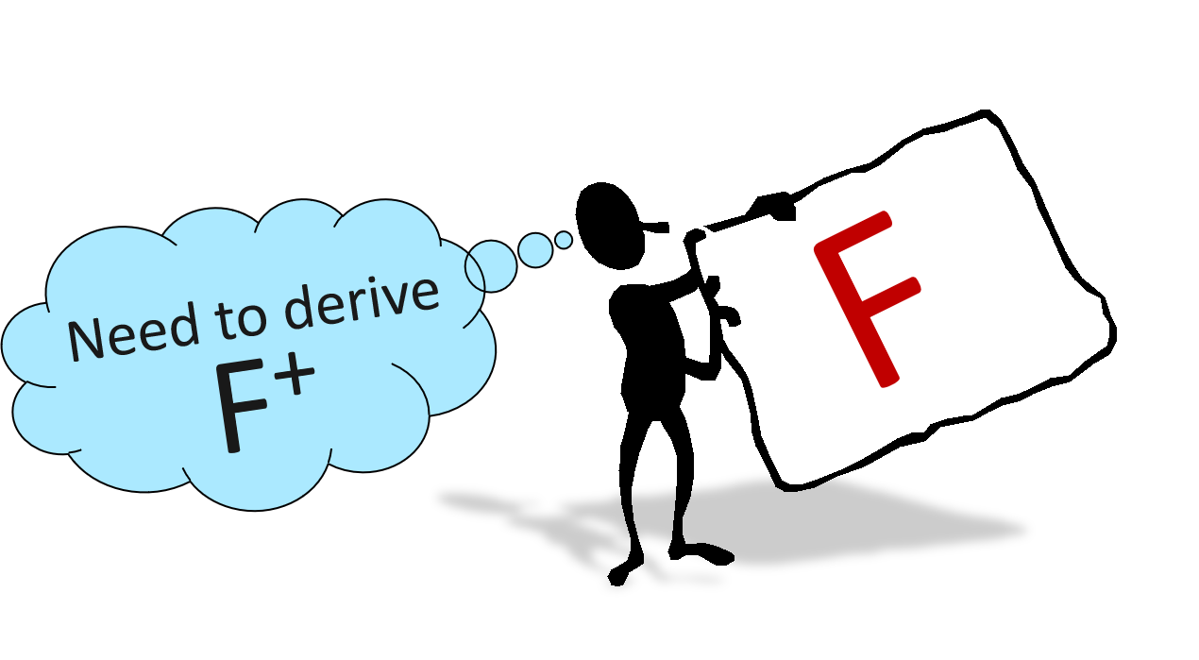
Closure of a FD set
F
F⁺ = closure of F is the set of all FDs that are implied by F
X→AB
…
Explicit set
Analysis is based on F⁺
Notes:
21

Slide 15
Attribute Closure (≠ closure of a FD set)
R
X
X→AB
…
X→C
F
F⁺
X→AB
…
X⁺ = {A,B,C, …}
Attribute closure of X is the set of attributes whose value can be determined from the value of X (according to F⁺ )
X
X⁺
X can be a set of attributes
  X⁺ = the set of all attributes A such that X → A is in F⁺
Notes:
21

Slide 16
Computing Attribute Closure
  Closure = X;
  Repeat until there is no change {
  if there is an FD U→V in F⁺ such that U ⊆ closure,
  then set closure = closure ∪ V }
F⁺
U→V
…
U
X⁺
V
If left side is in the closure, add the right side to the closure
Notes:
21

Slide 17
Attribute Closure - Example
Relation ABCDEF with F⁺= {AB→C, BC→AD, D→E, CF→B}
What is {A, B}⁺ ?
1
2
3
4
C
Initially, {A, B}⁺ = {A, B}
AB→C ⇒ {A, B}⁺ = {A, B, C}
BC→AD ⇒ {A, B}⁺ = {A, B, C, D}
D→E ⇒ {A, B}⁺ = {A, B, C, D, E}
CF→B ⇒ F is on the left-hand side, we cannot include F
{A,B}⁺
1
2
A
B
3
4
Make sure to consider the closure of the FD set
F
F⁺

Slide 18
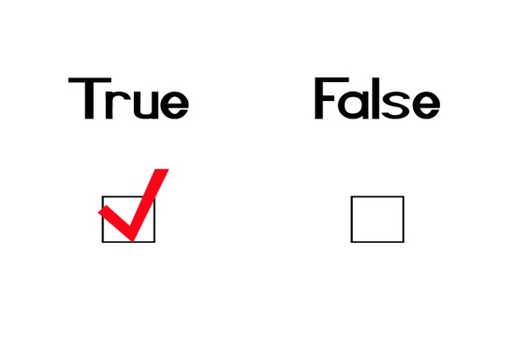

Reasoning About FDs (Contd.)
Check if X → Y is true:
Compute X⁺ wrt F⁺
Check if Y is in X⁺ (i.e., Do we have X → Y ?)
X → Y ?
X⁺
F
If Yes
X
Y
F⁺
Notes:
21

Slide 19
Normal Forms
Role of FDs in detecting redundancy:
  Consider a relation R with 3 attributes, ABC.
    Given A → B: Several tuples could have the same A value, and if so, they’ll all have the same B value - redundancy !
Example:
R → W
Notes:
22

Slide 20
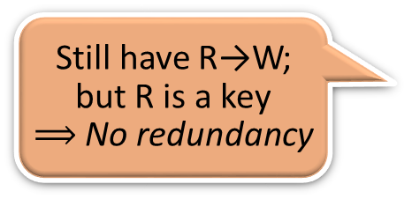
Normal Forms
Role of FDs in detecting redundancy:
  Consider a relation R with 3 attributes, ABC.
    Given A → B: Several tuples could have the same A value, and if so, they’ll all have the same B value - redundancy !
    No FDs hold: There is no redundancy here
No FD, no redundancy
Still have R→W;
but R is a key
$⟹$ No redundancy
Notes:
22

Slide 21
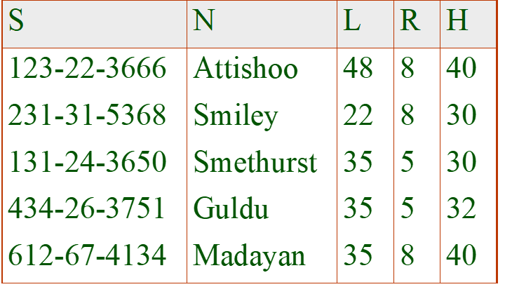
Normal Forms
    A → B potentially causes problems. However, if we know that no two tuples share the same value for A, then such problems cannot occur (a normal form)
S → NLRH
No redundancy because no two tuples have the same value for S
Notes:
22

Slide 22

Redundancy
Redundancy
R → W
No redundancy
S → NLRH
Notes:
22

Slide 23
Normal Forms
If a relation is in a certain normal form (BCNF, 3NF, etc.), it is known that certain kinds of problems are avoided/minimized. This can be used to help us decide whether decomposing the relation will help.
Notes:
22

Slide 24
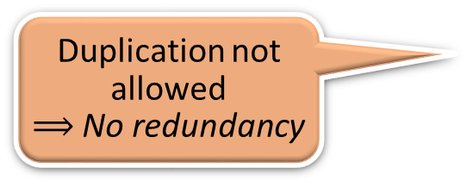
Boyce-Codd Normal Form (BCNF)
Relation R is in BCNF if, for all X → A in F,
  A ∈ X (called a trivial FD), or
  X is a superkey (i.e., contains a key of R)
R | A relation
F | The set of FD hold over R
X | A subset of the attributes of R
A | An attribute of R
R
X1 | . . . | X6 | A | X7 | C
X
Trivial FD
In other words, R is in BCNF if the only non-trivial FDs that hold over R are key constraints (i.e., X must be a superkey!)
R
X1 | . . . | X7 | A | B | C
Duplication not allowed
$⟹$ No redundancy
X
X1 ∙∙∙ X7 → ABC
a superkey
Notes:
23

Slide 25

Not BCNF Example
Given R → W: Several tuples could have the same A value, and if so, they’ll all have the same B value - redundancy !
R → W
R is not a super key
Wage information is stored redundantly for each rating level
Notes:
22

Slide 26
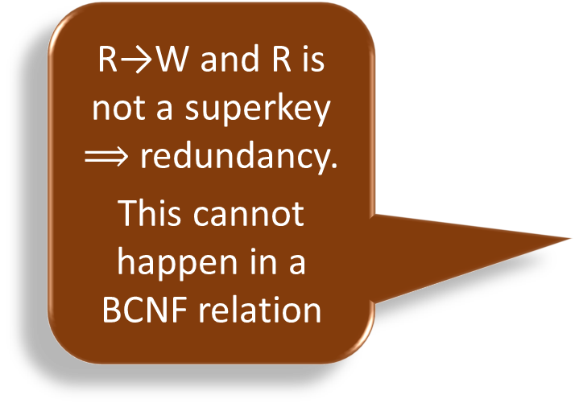
Not BCNF Example
Given R → W: Several tuples could have the same A value, and if so, they’ll all have the same B value - redundancy !
R→W and R is not a superkey $⟹$ redundancy.
This cannot happen in a BCNF relation
R → W
Notes:
22

Slide 27

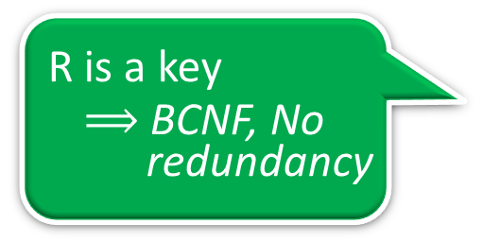
BCNF Example
Given R → W: Although the value of R determines the values of W, we cannot infer their values from other tuples because no two tuples in R have the same value for R
  ⇒ no redundancy ! (BCNF)
No FD, no redundancy
R is a key
  $⟹$ BCNF, No redundancy
Notes:
22

Slide 28

BCNF Example
This is a good design
Notes:
22

Slide 29



BCNF Example
No FD, no redundancy
R is a key
  $⟹$ BCNF, No redundancy
Key constraint is the only form of FDs allowed in BCNF
Notes:
22

Slide 30

Third Normal Form (3NF)
R | A relation
F | The set of FD hold over R
X | A subset of the attributes of R
A | An attribute of R
Relation R is in 3NF if, for all X → A in F
  A ∈ X (called a trivial FD), or
  X is a superkey (containing some key), or
  A is part of some key for R.
Example: Relation Reserves(SBDC) with the FD C → S
Same as in BCNF
Boat
Date
Sailor
Credit Card
Notes:
24

Slide 31

Third Normal Form (3NF)
R | A relation
F | The set of FD hold over R
X | A subset of the attributes of R
A | An attribute of R
Relation R is in 3NF if, for all X → A in F
  A ∈ X (called a trivial FD), or
  X is a superkey (containing some key), or
  A is part of some key for R.
Same as in BCNF
  If A is part of some superkey, then this condition would be true for any relation (because we can add any additional attribute to the superkey to make a bigger superkey).
Minimality of a key is crucial here
Notes:
24

Slide 32
Third Normal Form (3NF)
R | A relation
F | The set of FD hold over R
X | A subset of the attributes of R
A | An attribute of R
Relation R is in 3NF if, for all X → A in F
  A ∈ X (called a trivial FD), or
  X is a superkey (containing some key), or
  A is part of some key for R.
Same as in BCNF
Observation:
If R is in BCNF, obviously in 3NF.
If R is in 3NF, some redundancy is possible. It is a compromise, used when BCNF not achievable (e.g., no ``good’’ decomp, or performance considerations).
Discussed in next few pages
Notes:
24

Slide 33
Compromise - Two Cases
Suppose X→A causes a violation of 3NF
X is not a superkey (not in BCNF), and
A is not part of a key (not in 3NF)
3RD Normal Form: A must be part of some key for R unless X is a superkey.
X is not a key
A is not part of a key
Partial dependency
1
KEY
X
A
Transitive dependency
2
KEY
X
A

Slide 34
Compromise – Case 1 Example
CASE 1: X is a proper subset of some key K (partial dependency)
In this case we store (X,A) pairs redundantly
EXAMPLE: Relation Reserves(SBDC) with FD S → C
We store the credit card number for a sailor as many times as there are reservations for that sailor.
KEY
X
A
Boat
Date
Sailor
Credit Card

Slide 35
Compromise - Case 2 Example
CASE 2: X is not a proper subset of any key (transitive dependency)
EXAMPLE: Hourly_Emps(SNLRWH) with FD R →W (i.e., rating determines wage)
We have S → R → W (transitive dependency)
We cannot record a rating without knowing the hourly wage for that rating
This condition leads to insertion, deletion, and update anomalies (see page 6)
KEY (i.e., S)
W
R

Slide 36

Redundancy in 3NF
EXAMPLE: Relation Reserves(SBDC) with the FD’s
C → S and S → C
S is part of the key ⇒ “C → S” does
not violate 3NF
C → S (i.e., Credit card uniquely
identifies the sailor)
CBD → SBD (Augmentation axiom)
CBD → SBD → SBDC (SBD is a key)
CBD is also a key of Reserves
(Transitivity axiom)
“S → C” does not violate 3NF
because C is part of the key
    Reserves relation is in 3NF. Nonetheless, we store the credit card number for a sailor as many times as there are reservations for that sailor.
3NF is indeed a compromise relative to BCNF

Slide 37
Motivation for 3NF
3NF weakens the BCNF requirements just enough to ensure that Lossless-join & dependency-preserving decomposition of a relation into a collection of 3NF relations always possible.
This is not guaranteed for BCNF (more later)
Notes:
24
We also have multi8valued dependencies (MVDs) that lead to 4th Normal Form - See text

Slide 38
Decomposition of a Relation Scheme
Suppose that relation R contains attributes A1 ... An. A decomposition of R consists of replacing R by two or more relations such that:
  Each new relation scheme contains a subset of the attributes of R (and no attributes that do not appear in R), and
  Every attribute of R appears as an attribute in at least one of the new relations.
Decomposition
A B C D E
A | B | C
C | D | E
A B C
C D E
Notes:
26

Slide 39
Decomposition of a Relation Scheme
T
S | N | L | R | W | H
Example: We can decompose SNLRWH into
SNLRH and RW
Relation R is now stored as two relations
S | N | L | R | H
R | W
Notes:
26

Slide 40
Decomposition Example
Decompositions should be used only when needed.
  SNLRWH has FDs S → SNLRWH and R → W
  R → W causes violation of 3NF; W values repeatedly associated with R values.
    Solution: Decompose SNLRWH into SNLRH and RW
If we just store the projections of SNLRWH tuples onto SNLRH and RW, we might have duplicates in RW
Notes:
27

Slide 41

Lossless Join Decompositions
Decomposition of R into X and Y is lossless-join w.r.t. a set of FDs F if, for every instance r that satisfies F, we have π_{X}(r) π_{Y}(r) = r
We can reconstruct r
NOT
LOSSLESS JOIN
R
X
Y
Join two
tables on
B
Notes:
29

Slide 42
Lossless Join Decompositions
Decomposition of R into X and Y is lossless-join w.r.t. a set of FDs F if, for every instance r that satisfies F, we have π_{X}(r) π_{Y}(r) = r
It is always true that
r ⊆ π_{X}(r) π_{Y}(r)
  However, the other direction might not hold! If it does, the decomposition is lossless-join.
We can reconstruct r
NOT
LOSSLESS JOIN
Join two
tables on
B
Notes:
29

Slide 43
Lossless Join Decompositions
Definition extended to decomposition into 3 or more relations in a straightforward way.
It is essential that all decompositions used to deal with redundancy be lossless! (Avoids Problem in the last page)
Notes:
29

Slide 44


Dependency Preserving Decomposition
A | B | C | D | E | F
Need to reconstruct the original relation to verify D → F
A | B | C | D | E
E | F
Notes:
26

Slide 45
Problems with Decompositions
decompose SNLRWH into SNLRH and RW
There are three potential problems to consider:
  Some queries become more expensive.
    e.g., How much did sailor Joe earn? (salary = W∙H)
  Given instances of the decomposed relations, we may not be able to reconstruct the corresponding instance of the original relation!
    Fortunately, not in the SNLRWH example.
  Checking some dependencies may require joining the instances of the decomposed relations.
    Fortunately, not in the SNLRWH example.
Tradeoff: Must consider these issues vs. redundancy.
Lossless Join
Dependency Preserving
Notes:
28

Slide 46
Problems with Decompositions
decompose SNLRWH into SNLRH and RW
There are three potential problems to consider:
  Some queries become more expensive.
    e.g., How much did sailor Joe earn? (salary = W∙H)
  Given instances of the decomposed relations, we may not be able to reconstruct the corresponding instance of the original relation!
    Fortunately, not in the SNLRWH example.
  Checking some dependencies may require joining the instances of the decomposed relations.
    Fortunately, not in the SNLRWH example.
Third Normal Form is desirable!
Lossless Join
Dependency Preserving
Notes:
28

Slide 47
More on Lossless Join
The decomposition of R into X and Y is lossless-join wrt F if and only if the closure of F contains:
  X ∩ Y → X, or
  X ∩ Y → Y
Example:
Decompose SNLRWH into SNLRH and RW
The intersection must be the primary key of X or Y
Foreign key
The intersection “R” is the primary key of the 2nd relation
Notes:
30

Slide 48
Loss-Less Join Decomposition
the decomposition of R into UV and R-V is lossless-join if U→V holds over R.
Given U→V, we create the first table as UV
Remove V from the original table (i.e., R-V) to create the second table
U
V
Primary key
Foreign key
T
U
V
1
T
U
2

Slide 49

Dependency Preserving Decomposition
Consider CSJDPQV, C is key, JP → C and SD →P.
  BCNF decomposition: CSJDQV and SDP
  Problem: Checking JP → C requires a join!
Need dependency preserving decomposition
C | S | J | D | P | Q | V
BCNF decomposition
C | S | J | D | Q | V
S | D | P
Checking JP→C requires a join
Notes:
3

Slide 50



Dependency Preserving Decomposition
  If R is decomposed into X, Y and Z, and we enforce the FDs that hold on X, on Y and on Z, then all FDs that were given to hold on R must also hold.
→ Avoids Problem in the last slide
F
F1
F2
F3
R
X
Y
Z
Notes:
3

Slide 51
Projection of a Set of FDs
If R is decomposed into relations X, Y, ... projection of F onto X (denoted F_{X} ) is the set of FDs U → V in F⁺ such that U, V are in X
F_{X} is a subset of F⁺, that involves only attributes in X.
Projection of F onto the relation X
X
F⁺
F_{X}
F_{Y}
F_{Z}
R
X
Y
Z
Notes:
3

Slide 52
Projection of a Set of FDs
If R is decomposed into relations X, Y, ... projection of F onto X (denoted F_{X} ) is the set of FDs U → V in F⁺ such that U, V are in X
F⁺
R (A, B, C, D, E)
F: Set of FD’s
A→B
B→D
B→CD
F
B→C
F_{BCD}
B | C | D
Projection of F onto the relation BCD
Notes:
3

Slide 53
Projection of a Set of FDs
If R is decomposed into relations X, Y, ... projection of F onto X (denoted F_{X} ) is the set of FDs U → V in F⁺ such that U, V are in X
F⁺
R (A, B, C, D, E)
F: Set of FD’s
A→B
B→D
B→CD
F
B→C
F_{BCD}
  i.e., F_{X} is the set of FDs in F⁺, that involve only attributes in X
  Important to consider F ⁺, not F, in this definition (e.g., B→CD is also in F_{BCD})
Projection of F onto the relation BCD
Notes:
3

Slide 54

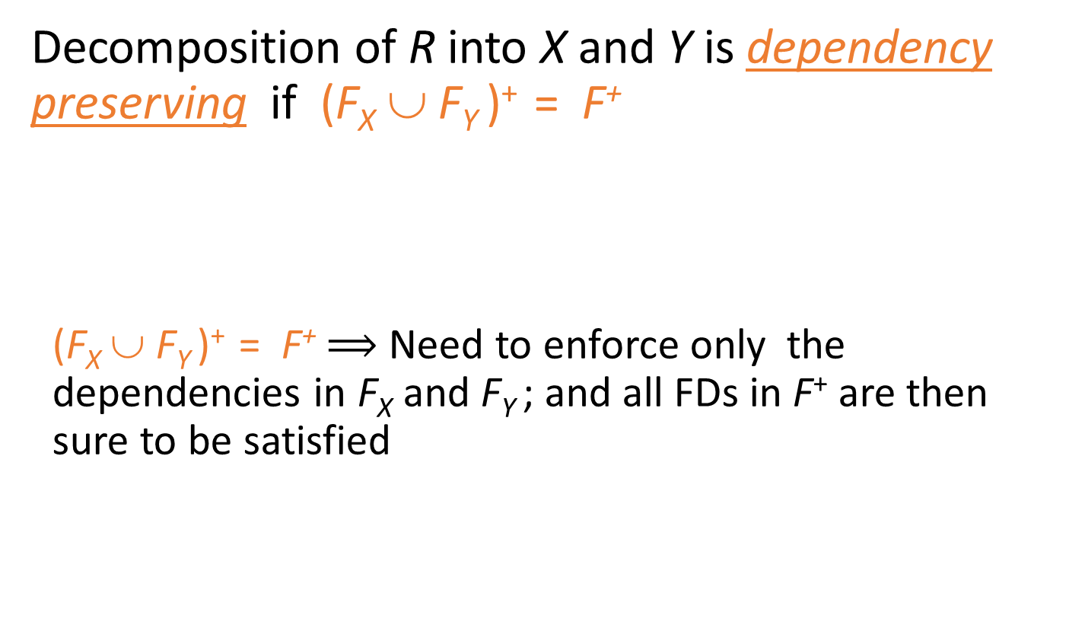
Dependency Preserving Decompositions
(Contd.)
Decomposition of R into X and Y is dependency preserving if (F_{X} ∪ F_{Y} )⁺ = F⁺
  (F_{X} ∪ F_{Y} )⁺ = F⁺ $⟹$ Need to enforce only the dependencies in F_{X} and F_{Y} ; and all FDs in F⁺ are then sure to be satisfied
F_{X}
Projection of F⁺ on X
X
F⁺
R
Projection of F⁺ on Y
F_{Y}
Y
A JOIN is not needed !!
F⁺
F_{X}
F_{Y}
R
X
Y
Notes:
4

Slide 55

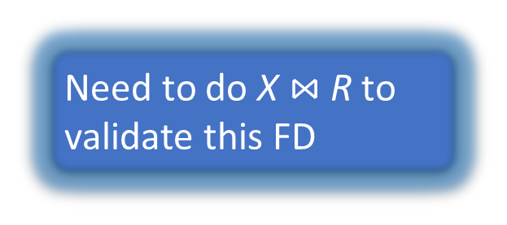
Not Dependency Preserving
Decomposition of R into X and Y is dependency preserving if (F_{X} ∪ F_{Y} )⁺ = F⁺
Need to do X $⋈$ R to validate this FD
X
F⁺
F_{X}
F_{Y}
F_{Z}
R
X
Y
Z
Do not want this
Notes:
3

Slide 56
Dependency Preserving Decompositions
(Contd.)
Decomposition of R into X and Y is dependency preserving if (F_{X} ∪ F_{Y} )⁺ = F⁺
  (F_{X} ∪ F_{Y} )⁺ = F⁺ $⟹$ Need to enforce only the dependencies in F_{X} and F_{Y} ; and all FDs in F⁺ are then sure to be satisfied
F_{X}
Projection of F⁺ on X
X
F⁺
R
Projection of F⁺ on Y
F_{Y}
Y
A JOIN is not needed !!
F⁺
F_{X}
F_{Y}
R
X
Y
Notes:
4

Slide 57
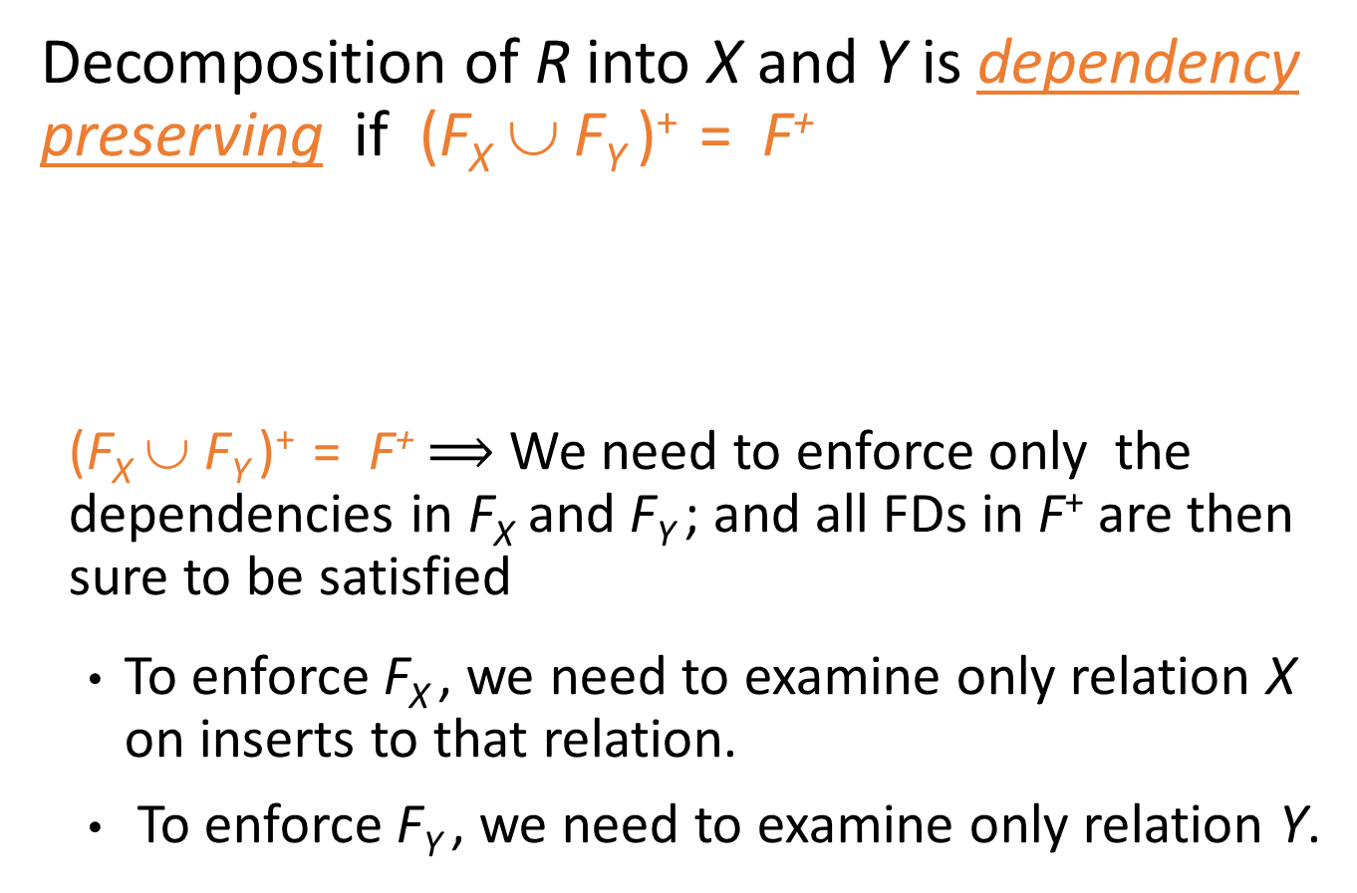
Dependency Preserving Decompositions
(Contd.)
Decomposition of R into X and Y is dependency preserving if (F_{X} ∪ F_{Y} )⁺ = F⁺
  (F_{X} ∪ F_{Y} )⁺ = F⁺ $⟹$ We need to enforce only the dependencies in F_{X} and F_{Y} ; and all FDs in F⁺ are then sure to be satisfied
  To enforce F_{X} , we need to examine only relation X on inserts to that relation.
  To enforce F_{Y} , we need to examine only relation Y.
F_{X}
Projection of F⁺ on X
X
F⁺
R
F_{Y}
Projection of F⁺ on Y
Y
Notes:
4

Slide 58
Dependency Preserving Decomposition vs. Lossless Join Decomposition
Dependency preserving does not imply lossless join:
  ABC, with F = {A→B}, decomposed into AB and BC.
  F_{AB} = {A→B} and F_{BC} = φ
  (F_{AB} ∪ F_{BC} )⁺ = {A→B} = F⁺
  The decomposition is dependency preserving. Nonetheless, it is not a lossless-join decomposition ! (A does not appear as a foreign key in the relation BC)
And vice-versa!
The intersection “B” is not a key of either relation
Consider CSJDPQV, C is key, SD →P , and JP → C.
BCNF decomposition: CSJDQV and SDP
  Problem: Checking JP → C requires a join!
Lossless Join decomposition
Not dependency preserving !
Notes:
4

Slide 59
Dependency Preserving Decompositions:
Example
Decomposition of R into X and Y is dependency preserving if (F_{X} ∪ F_{Y} )⁺ = F ⁺
  ABC, A→B, B →C, C→A is decomposed into AB and BC.
  ⇒ F_{AB} = {A→B} and F_{BC} = {B→C}
  (F_{AB} ∪ F_{BC} )⁺ = {A→B, B→C, A→C} ≠ F⁺
  not dependency preserving ??
  We need to examine F⁺ (not F) when computing F_{AB} & F_{BC}
  F⁺ = F ∪ { A→C, B→A, C→B }
  F_{AB} = {A→B, B→A} and F_{BC} = {B→C, C→B}
  F_{AB} ∪ F_{BC} = {A→B, B→A, B→C, C→B}
  (F_{AB} ∪ F_{BC} )⁺ = {A→B, B→A, B→C, C→B, A→C, C→A} = F⁺
  The decomposition preserves the dependencies !!
Notes:
4

Slide 60
Decomposition into BCNF
Consider relation R with FDs F. If X →Y violates BCNF, decompose R into R-Y and XY.
Repeated application of this idea will give us a collection of relations that are in BCNF; lossless join decomposition, and guaranteed to terminate.
  Example: CSJDPQV, key C, JP →C, SD →P, J →S
Keep SD as a foreign key to facilitate JOIN
CJDQV
CSJDQV
J →S
CSJDPQV
SD →P
JS
SDP
Notes:
5

Slide 61
Decomposition into BCNF
In general, several dependencies may cause violation of BCNF. The order in which we ``deal with’’ them could lead to very different sets of relations!
CJDQV
CSJDQV
J →S
CSJDPQV
SD →P
JS
SDP
Notes:
5

Slide 62

BCNF & Dependency Preservation
In general, there may not be a dependency preserving decomposition into BCNF
Example 2: Decomposition of CSJDQV into SDP, JS, and CJDQV is not dependency preserving (w.r.t. the FDs JP → C, SD → P, and J → S).
This is a lossless join decomposition. However, JP → C is not preserved
Adding JPC to the collection of relations gives us a dependency preserving decomposition.
    JPC tuples stored only for checking FD! (Redundancy!)
CJDQV
JP→C ?
CSJDQV
J →S
CSJDPQV
SD →P
JS
SDP
Notes:
6

Slide 63
Decomposition into 3NF
To ensure dependency preservation, one idea:
  If X → Y is not preserved, add relation XY
  Problem is that XY may violate 3NF!
  Example: In the following decomposition, adding JPC to preserve JP→C does not work if we also have J→ C.
Refinement: Instead of the given set of FDs F, use a minimal cover for F (another form of F).
CJDQV
CSJDQV
J →S
Does not work if we also have J→C
CSJDPQV
SD →P
JS
SDP
JP→C
JPC
Notes:
7

Slide 64
Minimal Cover for a Set of FDs
Minimal cover G for a set of FDs F is a set of FDs such that
  Cover Form: Right hand side of each FD in G is a single attribute (e.g., ACD → E).
  Equivalence: G⁺ = F⁺, i.e., closure of G = closure of F.
  Minimality: G is minimal. If we delete an FD or remove an attribute from an FD in G, the closure changes.
Intuitively, every FD in G is needed, and ``as small as possible’’ in order to get the same closure as F.
Notes:
8

Slide 65
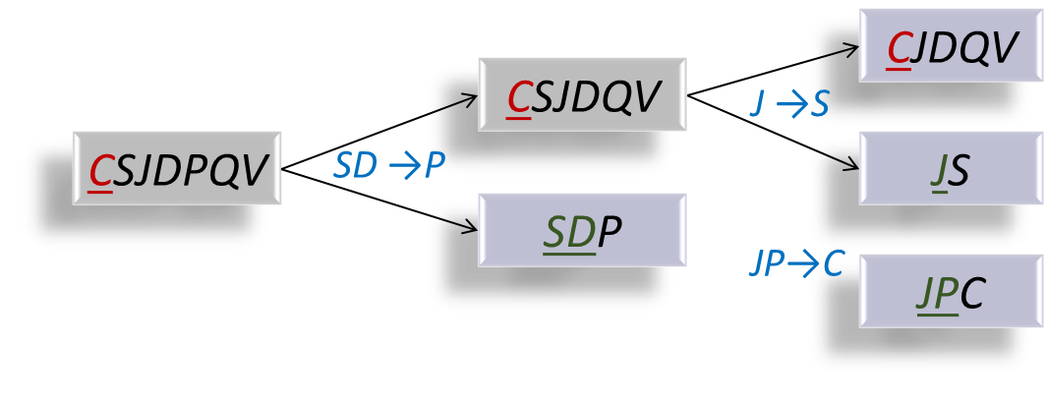

Using Minimal Cover
If we do the decomposition based on the minimal cover, JP → C implies we cannot also have J → C in the minimal cover
CJDQV
CSJDQV
Does not work if we also have J→C
J →S
CSJDPQV
SD →P
JS
SDP
JP→C
JPC
This can’t happen!
A lossless-join and dependency-preserving 3NF decomposition
Notes:
7

Slide 66

Minimal Cover: Example
A→ B, EF→GH, ABCD → E, ACDF→EG Compute minimal cover
Initial Set = {A→ B, EF→G, EF→H, ABCD → E, ACDF→E, ACDF→G}
We keep A→ B, EF→G, and EF→H because they are minimal and cannot be inferred from the other FDs in the initial set
Notes:
8

Slide 67

Minimal Cover: Example
A→ B, EF→GH, ABCD → E, ACDF→EG Compute minimal cover
Initial Set = {A→ B, EF→G, EF→H, ABCD → E, ACDF→E, ACDF→G}
We keep A→ B, EF→G, and EF→H because they are minimal and cannot be inferred from the other FDs in the initial set
We can remove B from ABCD → E because
  A→ B ⇒ AACD → BACD → E ⇒ ACD → E
  ⇒ B can be removed from ABCD → E
  We use
  ACD → E
  instead of
  ABCD → E
⇒
Notes:
8

Slide 68
Minimal Cover: Example
A→ B, EF→GH, ABCD → E, ACDF→EG Compute minimal cover
Initial Set = {A→ B, EF→G, EF→H, ABCD → E, ACDF→E, ACDF→G}
We keep A→ B, EF→G, and EF→H because they are minimal and cannot be inferred from the other FDs in the initial set
We can remove B from ABCD → E because
  A→ B ⇒ AACD → BACD → E ⇒ ACD → E
  ⇒ B can be removed from ABCD → E
We do not keep ACDF→E because we already keep ACD → E (i.e., F can be removed)
  We use
  ACD → E
  instead of
  ABCD → E
⇒
Notes:
8

Slide 69
Minimal Cover: Example
A→ B, EF→GH, ABCD → E, ACDF→EG Compute minimal cover
Initial Set = {A→ B, EF→G, EF→H, ABCD → E, ACDF→E, ACDF→G}
We keep A→ B, EF→G, and EF→H because they are minimal and cannot be inferred from the other FDs in the initial set
We can remove B from ABCD → E because
  A→ B ⇒ AACD → BACD → E ⇒ ACD → E
  ⇒ B can be removed from ABCD → E
We do not keep ACDF→E because we already keep ACD → E (i.e., F can be removed)
We do not keep ACDF→G because we already keep ACD → E
ACD → E ⇒ ACDF → EF → G ⇒ ACDF → G
A minimal Cover is {A→ B, EF→G, EF→H, ACD→E}
  We use
  ACD → E
  instead of
  ABCD → E
⇒
Notes:
8

Slide 70
Minimal Cover: Algorithm
Put FDs in the standard form: Obtain a collection G of equivalent FDs with a single attribute on the right side (i.e., the initial set)
  A→ B, EF→G, EF→H, ABCD → E, ACDF→E, ACDF→G
Minimize the left side of each FD: For each FD in G, check each attribute in the left side to determine if it can be deleted while preserving equivalence to F⁺
  A→ B, EF→G, EF→H, ABCD → E, ACDF→E, ACDF→G
Delete redundant FDs: Check each remaining FD in G to determine if it can be deleted while preserving equivalence to F⁺
  A→ B, EF→G, EF→H, ABCD → E, ACDF→E, ACDF→G

Slide 71
Lossless-Join Dependency-Preserving Decomposition into 3NF (Summary)
Compute a minimal cover G of the original set of FDs
Obtain a lossless-join decomposition: R₁, R₂, … R_{n}
Identify the set N of FDs in G that were not used in the above decomposition
For each FD X→A in N, create a relation schema XA and add it to the result set /* Since X is the key, this relation is in 3rd normal form
Optimization: If N contains {X→A₁, X → A₂, … X → A_{k}}, replace them with X → A₁A₂…A_{k} to produce only one relation

Slide 72
Lossless-Join Dependency-Preserving Decomposition into 3NF (Detailed)
Compute a minimal cover G of the original set of FDs
Obtain a lossless-join decomposition: R₁, R₂, … R_{n} such that each one is in 3NF /* BCNF is also a 3NF
Determine the projection of G onto each R_{i} , i.e., G_{i}
Identify the set N of FDs in G that is not preserved, i.e., not included in (G₁∪G₂ ∪ … ∪ G_{n})⁺ /* They were not used in
the decomposition */
For each FD X→A in N, create a relation schema XA and add it to the result set
Optimization: If N contains {X→A₁, X → A₂, … X → A_{k}}, replace them with X → A₁A₂…A_{k} to produce only one relation

Slide 73
Lossless-Join & Dependency-Preserving 3NF Example
CJDQV
CSJDQV
J →S
J →S
CSJDPQV
SD →P
JS
SDP
JP→C
JPC
A minimal cover: F = {SD →P, J →S, JP→C}
F_{SDP} = {SD →P}, F_{JS} = {J →S}, F_{CJDQV} = φ
⇒ (F_{SDP} ∪ F_{JS} ∪ F_{CJDQV} )⁺ = {SD →P, J →S}
JP→C is not in (F_{SDP} ∪ F_{JS} ∪ F_{CJDQV} )⁺ ⇒ add relation JPC
(SDP, CJDQV, JS, and JPC) is a lossless-join dependency preserving 3NF decomposition
Note: JP is the key for the relation

Slide 74
Good News !
A decomposition into 3NF relations that is lossless-join and dependency-preserving is always possible
Notes:
7

Slide 75

Refining an ER Diagram
Before:
1st diagram translated: Workers(S,N,L,D,Si) Departments(D,M,B)
  Lots associated with workers.
Suppose all workers in a dept are assigned the same lot: D→L
Redundancy; fixed by: Workers2(S,N,D,Si) Dept_Lots(D,L)
Can fine-tune this: Workers2(S,N,D,Si) Departments(D,M,B,L)
since
name
mname
ssn
lot
did
budget
Employees
Works_In
Departments
Refining
After:
since
budget
Combined
name
mname
ssn
Better ER design
did
lot
Employees
Works_In
Departments
Notes:
18

Slide 76
Better ER Diagram for Documentation
Before:
Conceptual Design
ER Diagram
Table design
Redundancy Analysis
ER Refinement
Final ER Design for
Documentation
since
name
mname
ssn
lot
did
budget
Employees
Works_In
Departments
Refining
After:
since
budget
name
mname
ssn
Better ER design
did
lot
Employees
Works_In
Departments
Notes:
18

Slide 77
Schema Refinement
Should a good ER design not lead to a collection of relations free of redundancy problems ?
ER design is a complex and subjective process
Some FDs as constraints are not expressible in terms of ER diagrams
Decomposition of relations produced through ER design might be necessary
This chapter is important!

Slide 78
Summary of Schema Refinement
If a relation is in BCNF, it is free of redundancies that can be detected using FDs. Thus, trying to ensure that all relations are in BCNF is a good heuristic.
If a relation is not in BCNF, we can try to decompose it into a collection of BCNF relations.
  Must consider whether all FDs are preserved.
  If a lossless-join, dependency preserving decomposition into BCNF is not possible (or unsuitable, given typical queries), should consider decomposition into 3NF.
  Decompositions should be carried out and/or re-examined while keeping performance requirements in mind.
Notes:
9

