Slide 1

Chapter 12
Query Optimization
Query Processing

Slide 2
Plan Generation – Relational Algebra
SELECT S.sname
FROM Reserves R, Sailors S
WHERE R.sid=S.sid AND
R.bid=100
SELECT clause
WHERE clause
FROM clause
∏_{sname}( σ_{sid=sid ∧ bid=100} (R×S))
Notes:
4

Slide 3
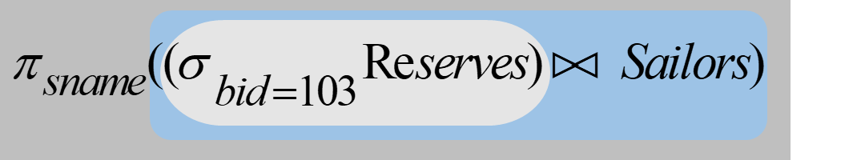
Join Techniques
SELECT S.sname
FROM Reserves R, Sailors S
WHERE R.sid=S.sid AND R.bid=100
Need to do this efficiently
Notes:
1

Slide 4
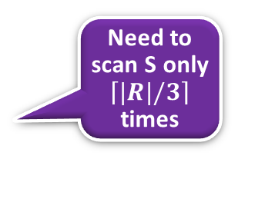
Block Nested-Loops Join
If we have 5 pages available
Memory
Memory
Bring in R 3 pages at a time
JOIN
JOIN the two pages
1
Need to scan S only $\left\lceil \left.|R|/3\right\rceil \right.$ times
Need to scan S M time
2
S
R
S
4
R
3
Simple Nested-Loop Join
Block Nested-Loop Join

Slide 5
Index Nested-Loops Join
Block Nested-Loop Join: For each page of the outer relation, scan the inner relation
Index Nested Loop Join: For each tuple of the outer relation, use the index to look up the matching records in the inner relation
Memory
Memory
JOIN the two pages
JOIN the tuples
No need to scan S
Need to scan S M time
1 page
Index
R
S
R
S
Simple Nested-Loop Join
Index Nested-Loop Join

Slide 6
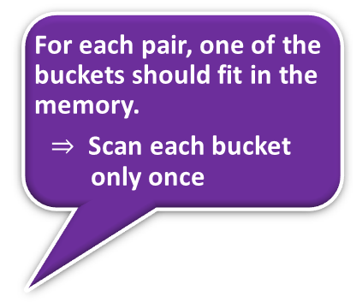

Hash Join
J1
For each pair, one of the buckets should fit in the memory.
$⇒$ Scan each bucket only once
Join one pair at a time
$$⋈$$
Hash-bucket pairs from the two operand relations
H
Cost: Scan each relation to build the buckets. Scan the relations again (i.e., bucket pairs) to do the join.
T
T

Slide 7

Find names of sailors who’ve reserved boat #103
(3) Find out the names of those sailors
(1) Find all reservations for boat 103
(2) Follow the foreign-key pointer to identify sailors who made these reservations
Sailors
Foreign key
Reserves
3
2
1
Notes:
16

Slide 8
Find names of sailors who’ve reserved boat #103
Solution 3:
(3) Find out the names of sailors who made those sailors
(1) Find reservations for every sailor
(2) Retain only reservations for boat 103
Sailors
Foreign key
Reserves
Notes:
16

Slide 9
Which one is better ?
1
2
Need optimization before query execution

Slide 10

Find names of sailors who’ve reserved a red boat
Shorter is not necessarily better
Compare only bid
Compare only sid
A more efficient solution:
These select and project operators make Join operations less expensive
A query optimizer can find this, given the first solution!
Notes:
17

Slide 11






Execution Tree
Query result
Query result
$$π_{sname}$$
Pushing a less expensive operator down the execution tree is usually a good idea
$$π_{sname}$$
$$⋈_{sid}$$
$$σ_{bid=103}$$
$$⋈_{sid}$$
$$σ_{bid=103}$$
Sailors
Reserve
Sailors
Reserve

Slide 12
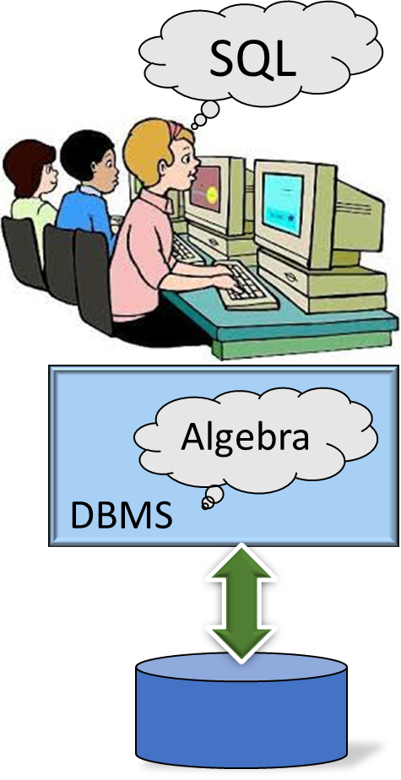
Query Evaluation
The relational model has rigorously defined query languages that are simple and powerful.
Relational algebra is more operational; useful as internal representation for query evaluation plans.
Several ways of expressing a given query; a query optimizer should choose the most efficient version.
Notes:
1

Slide 13
Query Optimization
Cost Estimation

Slide 14





Simplify Algebraic Expression
A computation proceddure
Optimization
$$5\left(2+x\right)+3\left(5x+4\right)−{\left(x^{2}\right)}^{2}$$
$$=10+5x+15x+12 −{\left(x^{2}\right)}^{2}$$
$$=10+5x+15x+12 − x^{4}$$
$$=10+20x+12 − x^{4}$$
$$=22+20x − x^{4}$$
A simpler procedure that compute the same thing
An SQL query is optimized by optimizing its relational algebraic expressions

Slide 15
Execution Plan
Plan: Tree of R.A. operators, with choice of algorithm for each operator
sname
Use Block Nested-Loop Join algorithm
bid=100
rating > 5
sid=sid
Reserves
Sailors
Notes:
2

Slide 16
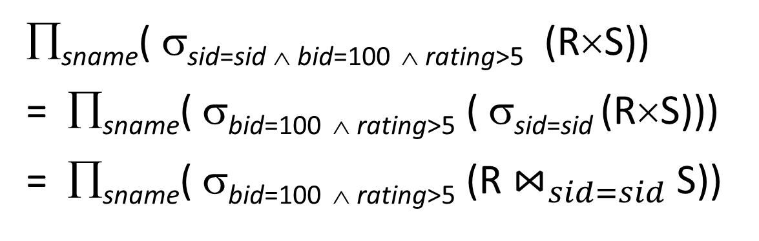
Plan Generation – Relational Algebra
SELECT S.sname
FROM Reserves R, Sailors S
WHERE R.sid=S.sid AND
R.bid=100 AND S.rating>5
SELECT clause
WHERE clause
FROM clause
∏_{sname}( σ_{sid=sid ∧ bid=100} _{∧ rating>5} (R×S))
= ∏_{sname}( σ_{bid=100} _{∧ rating>5} ( σ_{sid=sid} (R×S)))
= ∏_{sname}( σ_{bid=100} _{∧ rating>5} (R $⋈_{sid=sid}$ S))
Notes:
4

Slide 17
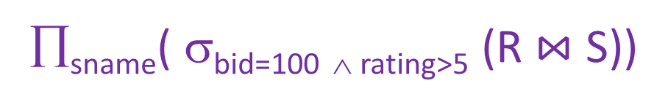


On-the-fly Processing
∏_{sname}( σ_{bid=100} _{∧ rating>5} (R$⋈$ S))
$$⇒More I/O$$
Read intermediate result
sname
sname
Save
intermediate result
(On-the-fly)
bid=100
rating > 5
bid=100
rating > 5
$$⇒Save I/O$$
Temp
sid=sid
sid=sid
Reserves
Sailors
Reserves
Sailors
Notes:
4

Slide 18
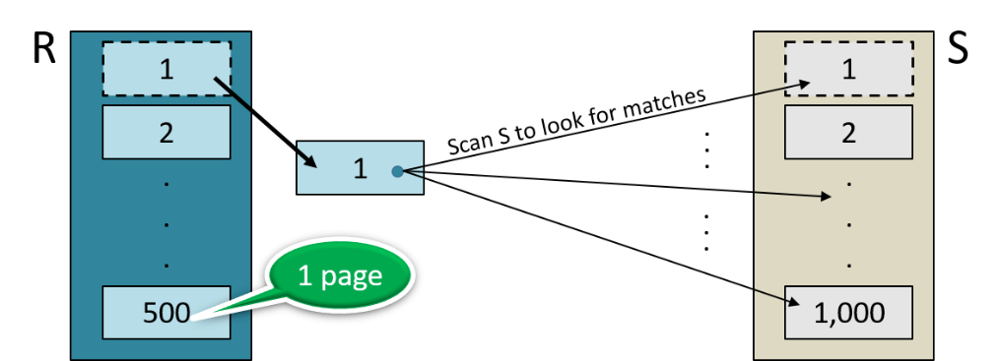
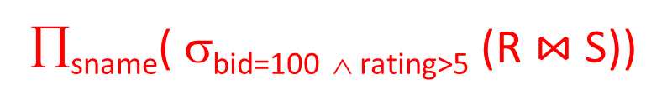


Plan Generation -
Execution Plan
sname
RA Tree
bid=100
rating > 5
∏_{sname}( σ_{bid=100} _{∧ rating>5} (R$⋈$ S))
sid=sid
SELECT S.sname
FROM Reserves R, Sailors S
WHERE R.sid=S.sid AND
R.bid=100 AND S.rating>5
Reserves
Sailors
sname
(On-the-fly)
$$⇒Save I/O$$
(On-the-fly)
bid=100
rating > 5
$$⇒Save I/O$$
(Simple Nested Loops)
sid=sid
Plan
Reserves
Sailors
Notes:
4

Slide 19
Plan Generation -
Execution Plan
sname
RA Tree
bid=100
rating > 5
∏_{sname}( σ_{bid=100} _{∧ rating>5} (R$⋈$ S))
sid=sid
Reserves
Sailors
Cost: 500 + 500×1000 I/Os
By no means the worst plan!
sname
(On-the-fly)
$$⇒Save I/O$$
(On-the-fly)
bid=100
rating > 5
$$⇒Save I/O$$
(Simple Nested Loops)
sid=sid
Plan
Reserves
Sailors
Notes:
4

Slide 20
Plan Generation -
Execution Plan
sname
RA Tree
bid=100
rating > 5
∏_{sname}( σ_{bid=100} _{∧ rating>5} (R$⋈$ S))
sid=sid
Reserves
Sailors
Cost: 500 + 500×1000 I/Os
By no means the worst plan!
sname
(On-the-fly)
Misses several opportunities: selections could have been `pushed’ earlier, no use is made of any available indexes, etc.
Goal of optimization: To find more efficient plans that compute the same answer.
$$⇒Save I/O$$
(On-the-fly)
bid=100
rating > 5
$$⇒Save I/O$$
(Simple Nested Loops)
sid=sid
Plan
Reserves
Sailors
Notes:
4

Slide 21
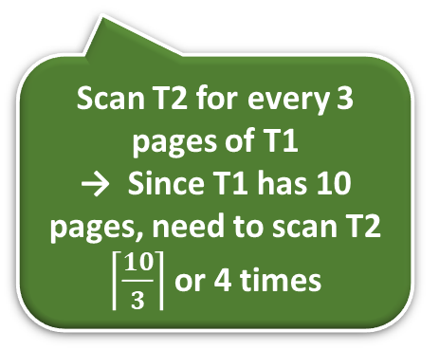
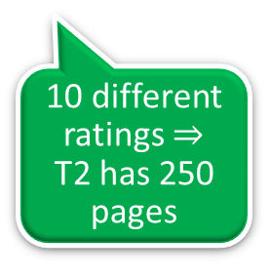
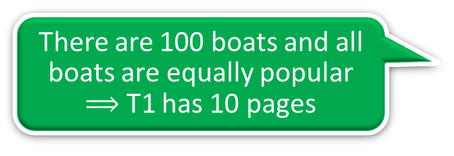
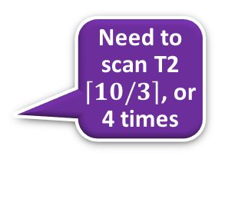
Alternative Plan 1
(No Indexes)
(On-the-fly)
sname
(Block Nested Loop Join)
sid=sid
There are 100 boats and all boats are equally popular
$⟹$ T1 has 10 pages
(Scan;
(Scan;
write to
bid=100
rating > 5
write to
temp T1)
temp T2)
Reserves
Sailors
10 different ratings $⇒$ T2 has 250 pages
join cost = 10+(4×250),
(1,000 pages)
(500 pages)
T1 has 10 pages
Scan T2 for every 3 pages of T1
→ Since T1 has 10 pages, need to scan T2 $\left\lceil \frac{10}{3}\right\rceil$ or 4 times
Memory
5 pages available
Bring in T1 3 pages at a time
JOIN
1
Need to scan T2 $\left\lceil \left.10/3\right\rceil \right.$, or 4 times
Total cost = (1000+10) + (500+250) +
[10+(4X250)]
= 2770 I/Os.
2
T2
4
T1
3
Notes:
5

Slide 22
Push Projections
(On-the-fly)
sname
(Block Nested Loop Join)
sid=sid
(On-the-fly)
(Scan;
(Scan;
sname
write to
bid=100
rating > 5
write to
temp T1)
temp T2)
(Block Nested Loop Join)
sid=sid
Reserves
Sailors
(Scan;
(Scan;
write to
write to
temp T1)
sid
Sid, sname
temp T2)
bid=100
rating > 5
If we `push’ projections, T1 has only sid, T2 only sid and sname:
Reserves
Sailors
Notes:
5

Slide 23
Push Projections
Memory
(On-the-fly)
T1 fits in 3 pages
sname
JOIN
T1
Need to scan the smaller T2 only once
(Block Nested Loop Join)
(No need to
write to
3 pages
sid=sid
temp T1)
T1
T2
(Scan;
sid
Sid, sname
write to
10 pages
temp T2)
bid=100
rating > 5
If we `push’ projections, T1 has only sid, T2 only sid and sname:
  If T1 fits in 3 pages, need to scan T2 only once
  cost of BNL drops:
  1000 + (500 + 250) + 250 = 2000 I/Os
Reserves
Sailors
(1,000 pages)
(500 pages)
Notes:
5

Slide 24
Push Projections
(On-the-fly)
sname
In fact, we do not need to write to T2 either
(Block Nested Loop Join)
(No need to
write to
3 pages
sid=sid
temp T1)
(Scan;
sid
Sid, sname
write to
10 pages
temp T2)
bid=100
rating > 5
  Total cost drops to:
  1000 + 500 = 1500 I/Os
Reserves
Sailors
(1,000 pages)
(500 pages)
Notes:
5

Slide 25
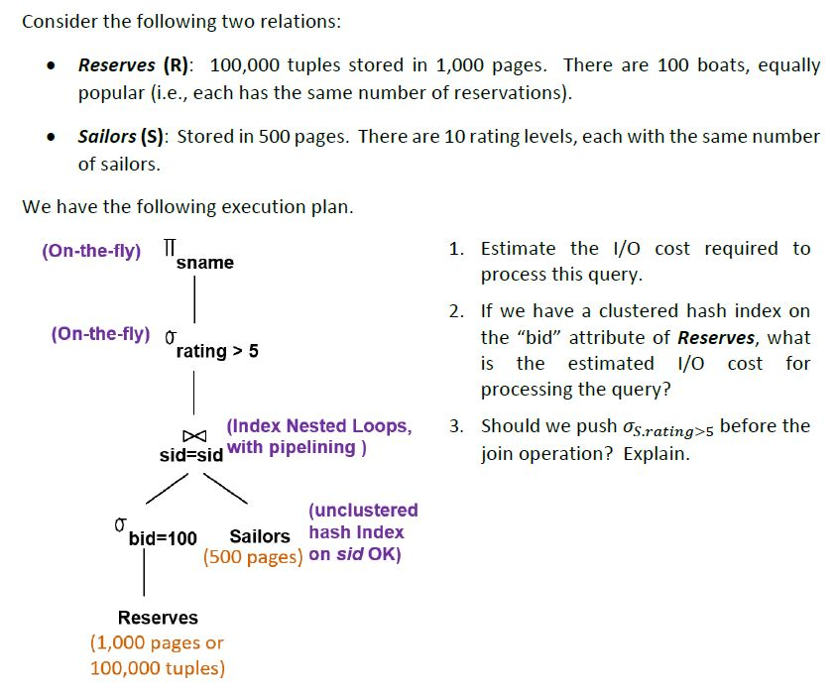
Old Test
Some of these hash buckets are overflow. The average size of each hash bucket is 1.2 pages.

Slide 26
Old Test: Estimate the IO Cost
1
1000 x 1.2 I/Os to look up the 1000 matching data entries in the hash buckets
1)
Pipeline processing:
No additional I/O cost
(On-the-fly)
sname
(On-the-fly)
rating > 5
1000 tuples in 10 pages. They are not stored to disk
(Index Nested Loops,
sid=sid
with pipelining )
(unclustered
hash Index on sid OK)
bid=100
Sailors
1,000 I/Os
2
Reserves
1000 I/Os to retrieve the matching Sailor data records
(1,000 pages or
100,000 tuples)
Total Cost = 1000 + (1000x1.2 + 1000)
= 3200 I/Os
Notes:
6
Since 100 boats are equally popular, no hash bucket overflows. As a result, retrieving the Reserve tuples takes 10 I/Os, not (10x1.2) I/Os.

Slide 27
Old Test: Having Hash Index on bid
2)
(On-the-fly)
sname
1000 tuples in 10 pages. They are not stored to disk
(On-the-fly)
rating > 5
Hash
buckets
(Index Nested Loops,
sid=sid
with pipelining )
1
2
3
4
5
6
7
8
9
10
Use clustered
hash index; do not write result to disk
(unclustered
hash Index on sid OK)
Search
bid = 100
100
bid=100
Sailors
100
Reserves
(1,000 pages or
100,000 tuples)
Total Cost = (1+10) + ∙∙∙
Notes:
6

Slide 28
Old Test: Having Hash Index on bid
2)
(On-the-fly)
1000 x 1.2 I/Os to look up the matching data entries in the hash buckets
1000 tuples in 10 pages. They are not stored to disk
sname
(On-the-fly)
rating > 5
1 I/O to find the matching data entry, and 10 I/Os to retrieve the 1000 matching records
(Index Nested Loops,
sid=sid
with pipelining )
Use clustered
hash index; do not write result to disk
(unclustered
hash Index on sid OK)
bid=100
Sailors
(1+10) I/Os
Reserves
1000 I/Os to retrieve the matching Sailor data records
Assuming no bucket overflow
(1,000 pages or
100,000 tuples)
Total Cost = (1+10) + (1000 x 1.2 + 1000)
= 2211 I/Os
Notes:
6

Slide 29

Old Test: Push Down Select Operator?
We want to benefit from the clustered hash index on Sailors
3)
(On-the-fly)
sname
(On-the-fly)
rating > 5
(Index Nested Loops,
Should we push this “select” before the “join” ?
with pipelining )
sid=sid
Use clustered
hash index; do not write result to disk
(unclustered
hash Index on sid OK)
bid=100
Sailors
Reserves
(1,000 pages or
100,000 tuples)
Notes:
6

Slide 30
Summary
There are several alternative evaluation algorithms for each relational operator.
A query is evaluated by converting it to a tree of operators and evaluating the operators in the tree.
Must understand query optimization in order to fully understand the performance impact of a given database design (relations, indexes) on a workload (set of queries).
Two parts to optimizing a query:
  Consider a set of alternative plans.
  Must estimate cost of each plan that is considered.
Notes:
19

