Slide 1
Computer Vision

Slide 2
DARPA Challenge Seeks Robots To Drive Into Disasters.
DARPA's Robotics Challenge offers a $2 million prize if you can build a robot capable of driving and using human tools.
DARPA Wants to build rescue robots for the military?
The new challenge; to develop robots that can navigate disaster-response scenarios.
Robots will be required to complete a number of discrete tasks, including traveling across rubble, removing debris from a blocked entryway, climbing a ladder, and entering and driving a car.

Slide 3
Current capabilities show that robot
physical forms are quite advanced.
Bigdog
Petman
Robot Swag
Aquatic synthetic life

Slide 4
Why robots?
They can go places humans can’t or shouldn’t go!
Natural disasters areas too dangerous for people
Uninhabitable environments
Nuclear, chemical or biological disasters

Slide 5
Why, then, if my robot is so useful is my android paranoid?

Slide 6
As mobile and dexterous as my robot is it needs a way to know where it is and how to get to a desired location or to know the location of objects in the surrounding environment.

Slide 7
This task is referred to as localization.
Where am I? How did I get here? How do I get out of here, or go to the next place?
Localization also refers to knowledge of the position or location of important objects in the environment.

Slide 8
Our robot could use GPS, except after a natural disasters like hurricanes or earthquakes nothing is where it is supposed to be. Major features of a city or locale may no longer exist.

Slide 9
After the Tsunami in Japan all GPS references to buildings and streets was useless

Slide 10
The same was true after this earthquake in China

Slide 11
Our robot may be in an area where GPS is unavailable – under the sea, in a building, a geographical location with no reference points.

Slide 12
This building could collapse at any time. Perfect for an android.

Slide 13
But, the android would need a method of creating navigational information for these new situations.

Slide 14
In general, important objects within the environment may be destroyed, moved from their original location, temporarily positioned or too insignificant to have GPS reference data.

Slide 15
The Goal for our robot is to autonomously develop an independent and real time understanding of its location and position vis-à-vis existing locations and objects using visual information.

Slide 16
The problem is to develop the machine’s capability to visually recognize objects within the immediate environment.
However:
Humans see and immediately recognize specific objects; trees, faces, buildings, etc. We automatically know where we are in relation to these objects.
This is the result of many complex neurological and cognitive processes.

Slide 17
Computers don’t see things the way humans do.
Computers see light and dark, color intensity.
Computers store numbers and analyze (think) in equations.

Slide 18
We need a way for computers to identify objects in the environment as reference points for locating themselves and other objects in the environment.
They will not see objects as we do. Though, they will be able to consistently recognize an object as having been “seen” before and associate the object with a specific location and position.

Slide 19
Robots see using digital cameras. Images are stored as digital information.
We need our robot to recognized objects within the digital images of that object taken a different times and at different angles.
Regardless of ambient conditions of light, weather, time of day, rotation of image and angle at which the picture was taken

Slide 20
As mentioned, images are stored as digital information.
This information can be stored as an array of numbers that represent individual dots of the image called pixels.
For grayscale images similar to “black and white” photographs the intensity of blackness is stored as a number from 0(black) to 255(white)

Slide 21
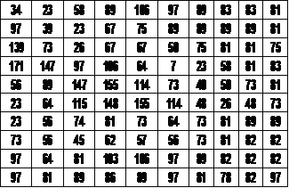
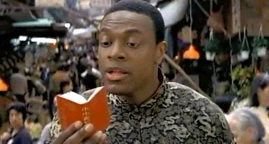

Slide 22
For color images the image information can be stored as an array of numbers that represent individual pixels as well.
Instead of storing information on the intensity of blackness, information is stored about the levels of red, green and blue colors for each pixel (RGB).
The intensity for these colors is stored as a number from 0(maximum) to 255(minimum)

Slide 23
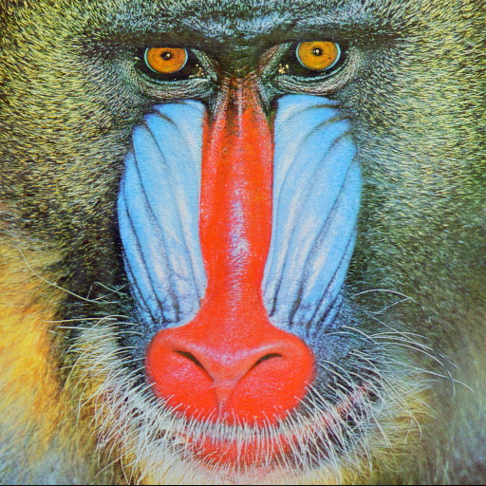

Slide 24
Color images can be easily converted to Grayscale by weighting the values for Red, Green, and Blue and summing the resulting values.
Often color will no provide useful information for our process, but increase the processing burden. We will work in grayscale.

Slide 25
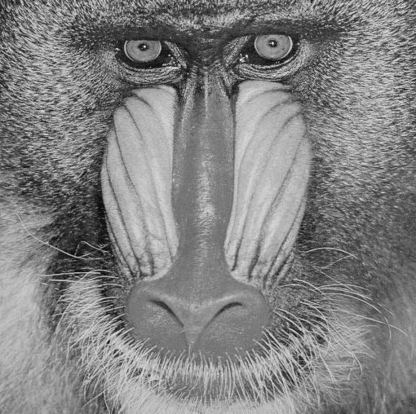

Slide 26
We need our robot to recognized an object within the digital images of that object taken a different times and different angles.
Matching an object’s features across different images is a common problem in computer vision.
When you have different images with different scales and rotations, you need to use an program called Scale Invariant Feature Transform or SIFT.

Slide 27
The SIFT algorithm analyses sections of a digital image and identifies regions of significant change in grayscale referred to as SIFT points.
These SIFT points are then described by the size and intensity of the region’s changes and the general direction (orientation) of these changes.
The region’s location and its relative position to other SIFT points is recorded.

Slide 28
Through this process SIFT creates a unique “fingerprint” for an object that is independent of many ambient features of a photograph or image.

Slide 29
Photograph of rooftops in [Italy?]

Slide 30
Converted to grayscale and SIFT process applied
The SIFT point are detected

Slide 31
This slide displays information about each SIFT point.

Slide 32
Two photos which share objects

Slide 33
We have found SIFT points that match
from the two photos!!!

Slide 34
Using SIFT our robot can identify a geographic or architectural feature and associate the image with a position either by GPS or another positioning technology.

Slide 35
Even though our goal is for our robot to employ an autonomous locating ability separate from GPS technology, we can use GPS technology in the development of our system.

Slide 36
Current research employees geolocalization using GPS and Google street view images.
I can take a photograph on any street in downtown Orlando and using SIFT and other technologies determine my location by comparing SIFT points in my photograph and SIFT points in images found in Google street view for Orlando.

Slide 37
The success rate in obtaining a good location is quite high.
Ultimately my paranoid android may be calmed by the certain knowledge of his location in the world.

Slide 38
Frankly, the mathematics involved in these tasks is far beyond the scope of any of your current classes.
Calculus, Statistic and probability theory as well as finite mathematics are employed.
People who are able to develop Artificial intelligence and robotic capabilities are and will be some of the most sought after employees in the modern work force.
All These technologies are still developing technologies and creative fundamental work still needs to be done.

Slide 39
If this type of work interests you, please contact:
Dr. Mubarak Shah or Dr. Neils Lobo for more information.
Questions

