Slide 1
Geolocalization
Focus on Orlando
Based on the research from the UCF Computer Vision Lab
RET 2012
Stephanie Aaron, Cassidy Fuller,
Christle Kiely, and Judy Klein

Slide 2
Where in the world was I?

Slide 3
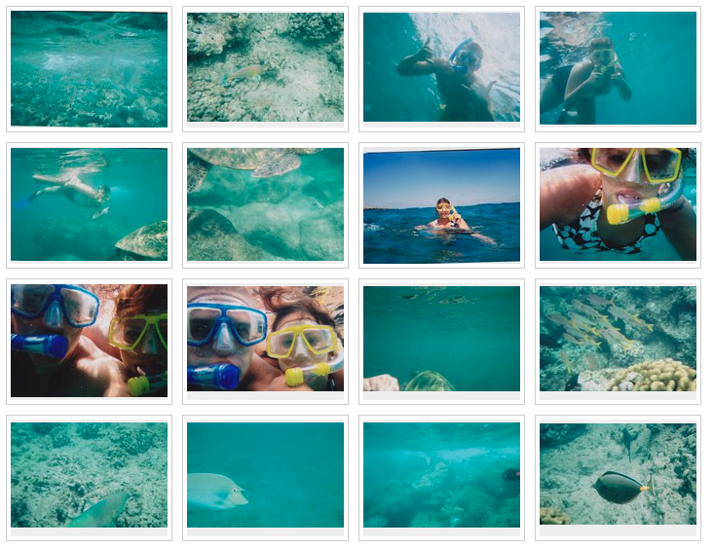
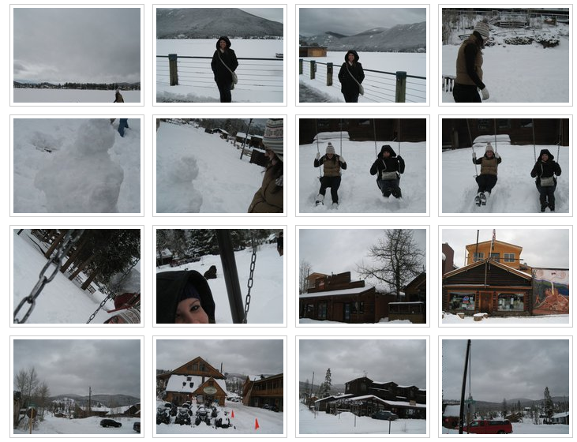
Picture This...
Notes:
Its senior year and you’re about to graduate. You and some friends are looking through old pictures on Facebook, remembering all of the good times you’ve spent together. You stumble upon some pictures which no one can seem to remember where or when they were taken. Wouldn’t it be nice to have a program that can tell you exactly where you were standing?

Slide 4
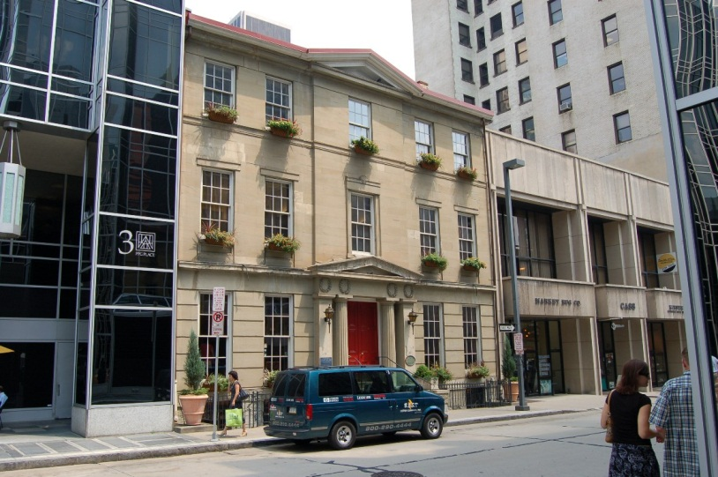
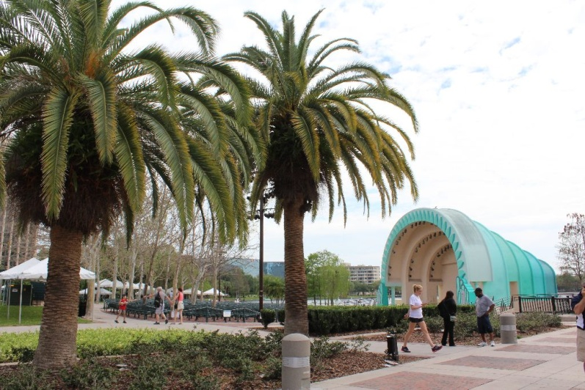
Problem: Your memory sucks!
Question: Is there something that could tell me the location of where my pictures were taken?
Input
Mere Visual Information(Images)
Output
Location in Terms of
λ (Longitude.) and φ (Latitude.)
Notes:
Changed to Orlando Picture but need to fix animation.

Slide 5
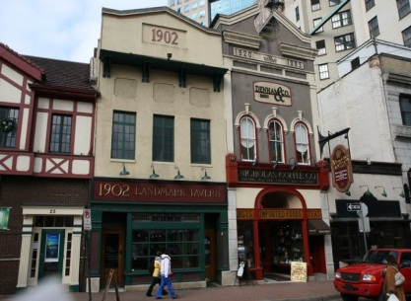
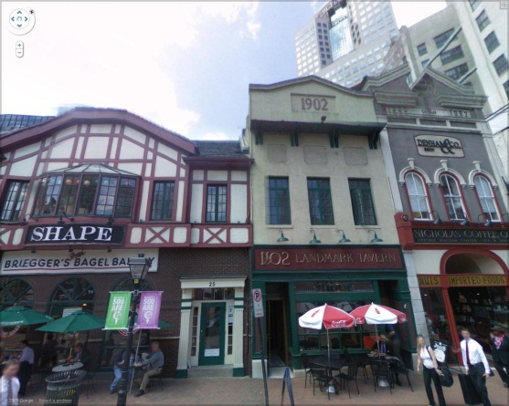
Solution: Geolocalization. A program that has a database of images that we can input our images into and find a matching location.
Input
Output
Notes:
Input one of our Orlando pictures if we get them working.

Slide 6
The Dataset
Google Street View
360° Spherical views about every 10 meters
Currently available in 9 countries
To be available in 22 more countries in near future
332 6th Ave, Pittsburgh, PA $φ$=40.4418, $λ$=-79.9987
Notes:
Figure out timing. Disappears right away.

Slide 7
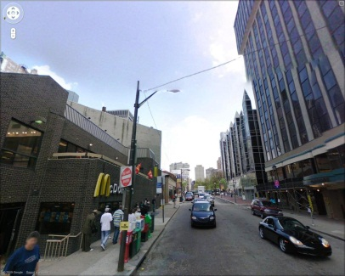
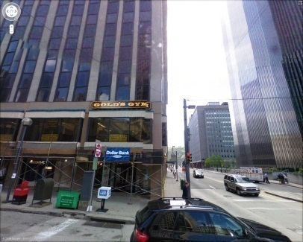
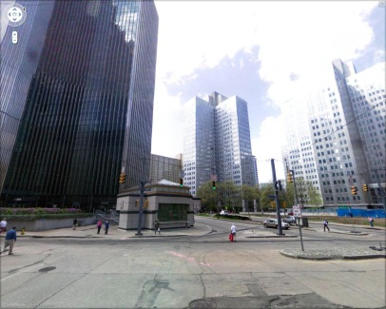
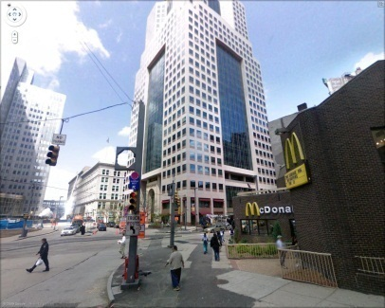
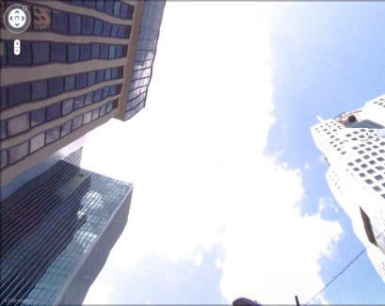
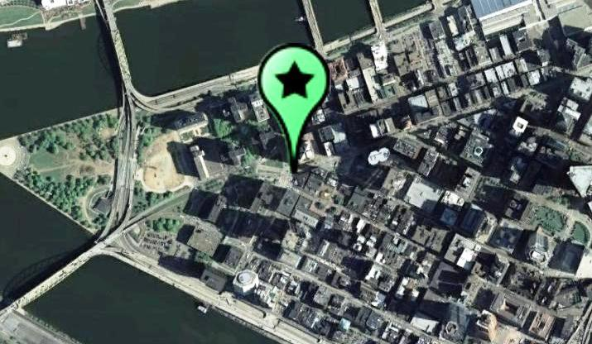
Google Maps Street View Dataset
Side Views
Top View
Pittsburgh, PA $φ$= 40.44146°, $λ=$-80.0037°
Notes:
The RET program had two data sets. Set A was in Pittsburg and Set B was focused in Orlando. These compile to make our DATA SET and are called REFERENCE IMAGES.

Slide 8
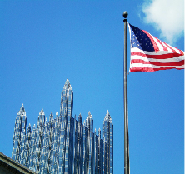
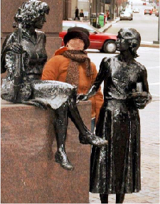
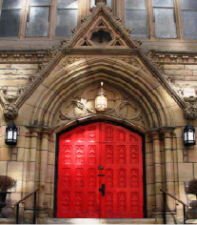
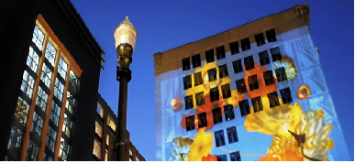
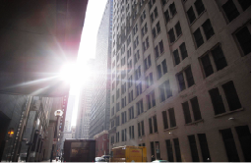
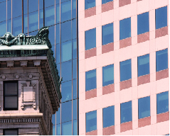
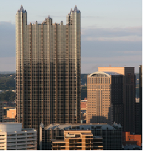
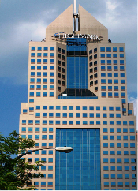
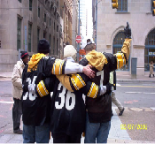
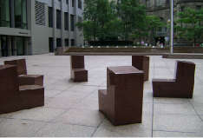
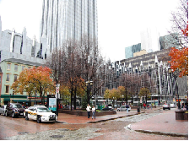
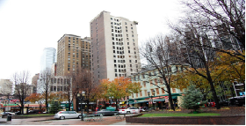
Testing it out!
Their test set:
521 GPS- Tagged User Uploaded Images
Pittsburgh, PA and Orlando, FL
Downloaded From Flickr, Panoramio, Picasa, etc.
picasa.google.com
Panoramio.com
Flickr.com
Notes:
Change to Orlando

Slide 9
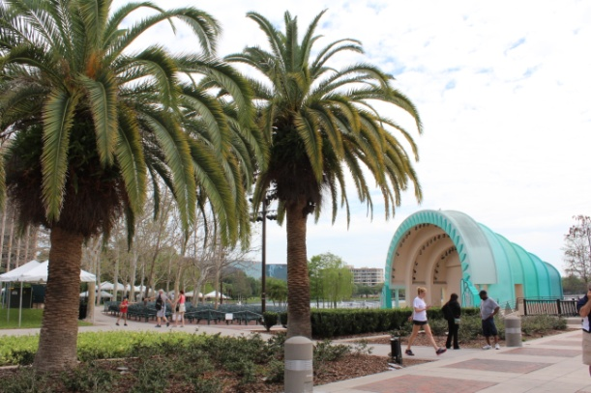
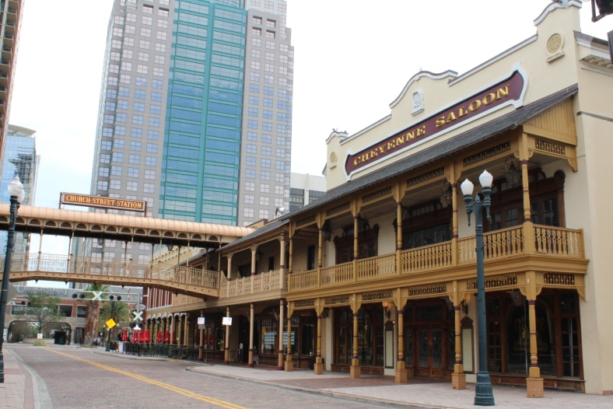
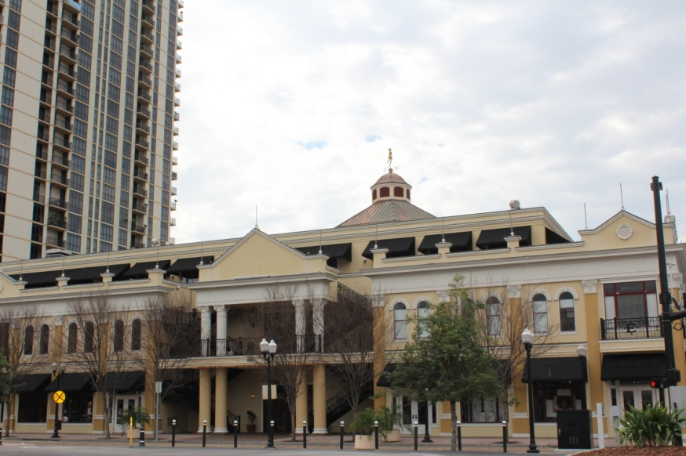
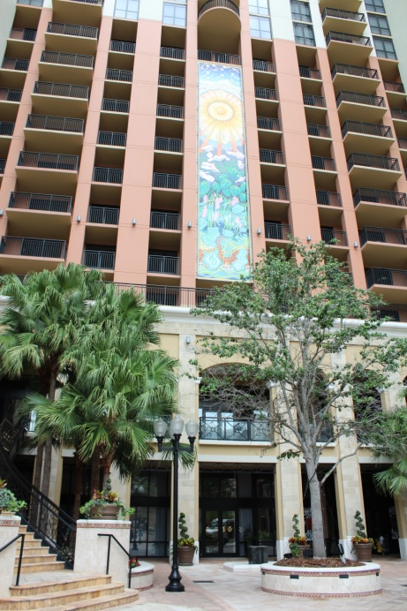
OUR turn!
Our test set:
4 teachers, one camera, on the streets of downtown Orlando taking random pictures.
Notes:
Each picture we took is called a QUERTY IMAGE. These pictures together are called the TEST SET.

Slide 10
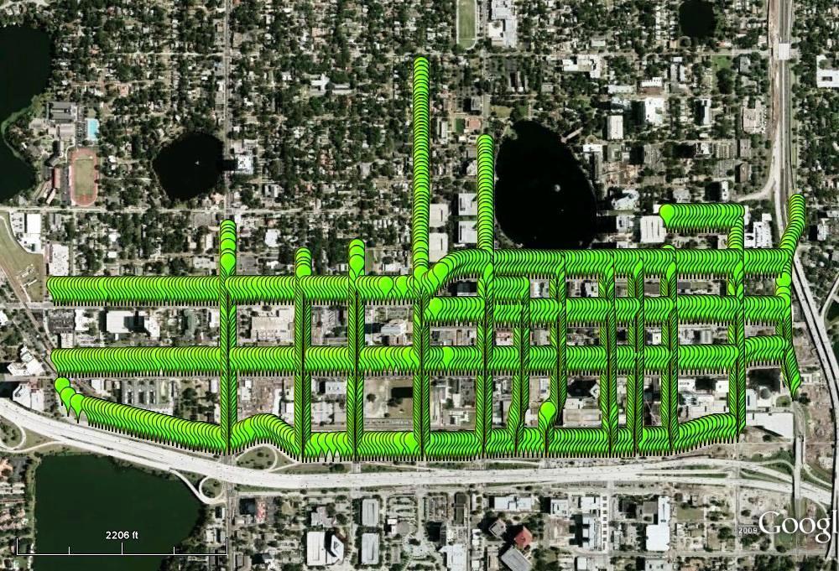
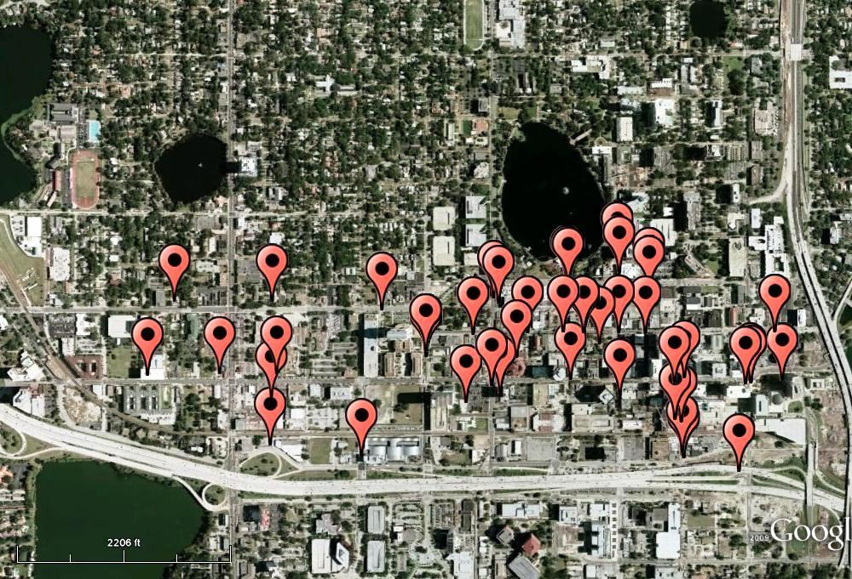
Compare and Contrast
Reference Images
Query Images
Downtown Orlando, FL
Notes:
Reference Images = Data Set and Query Images = Test Set

Slide 11
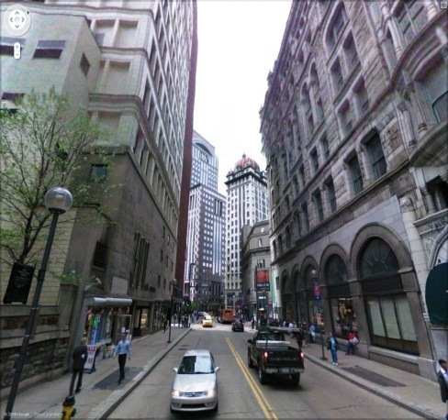
Before we start…
Google maps image dataset
Notes:
Create data set from the google maps images as explained before (front, left, back, right, up)

Slide 12
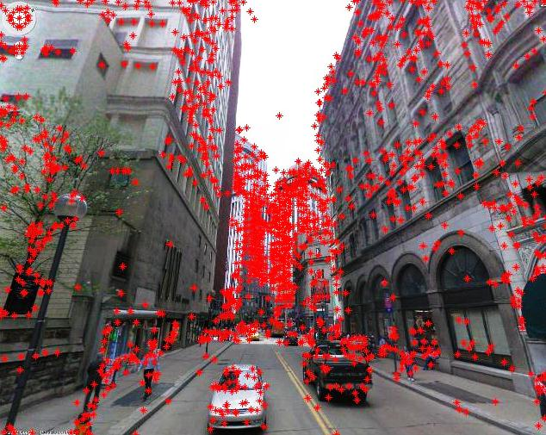
Before we start…
Google maps image dataset
Find the SIFT points in the dataset
Notes:
SIFT points explained on NEXT SLIDE

Slide 13
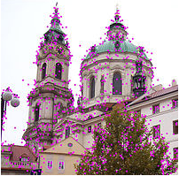
SIFT points, WHAT?!
Interesting points (corners, edges, etc...)
Nothing to do with color.
Fingerprint of ONE location (location is in vector form)
Notes:
SIFT points: explain. So “points of interest”. Ignoring color, points that are right on the edge of things.

Slide 14
Before we start…
Google maps image dataset
Find the SIFT points in the dataset
Build a “tree” that organizes the distances between SIFT points.
Data Structure Tree
Notes:
Building the tree: The computer does all the work for us! Calculates the distance between SIFT points using something very similar to the distance formula we use in class. Then, it organizes our SIFT points by the distances between the points. (Could possibly add something about the 128 dimensions if they tell us we need to)

Slide 15
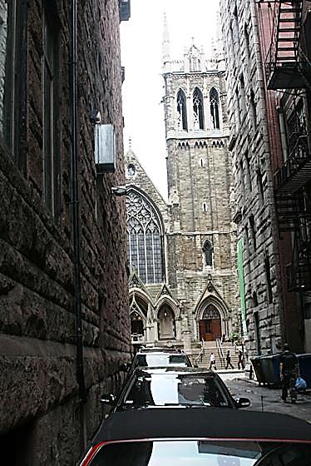
Here comes the fun part…
Processing the data
Input Query Image
Compute SIFT Vectors for Detected Interest Points
Remove Weak Votes
Accumulate Votes for Matching Locations
Select Image with Highest Number of Votes
Notes:
This is a very quick process.

Slide 16
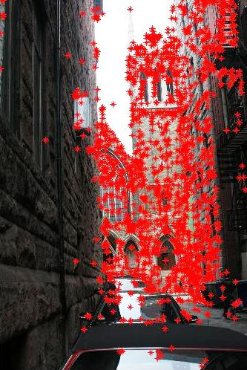
Here comes the fun part…
Processing the data
Input Query Image
Compute SIFT points
Remove Weak Votes
Accumulate Votes for Matching Locations
Select Image with Highest Number of Votes
Notes:
More explanation of what SIFT points are. Interest points…different gradients. Edges.

Slide 17
Processing the data
Input Query Image
Compute SIFT points
Remove Weak Votes
Search the tree and assign votes to nearest neighbors
Select Image with Highest Number of Votes
Data Structure Tree
Notes:
Search the tree that has been built to find the nearest neighbors in the data set and give that SIFT point a “vote” for being a likely position of OUR SIFT points. NEAREST NEIGHBOR EXPLAINED IN FOLLOWING 2 SLIDES.

Slide 18
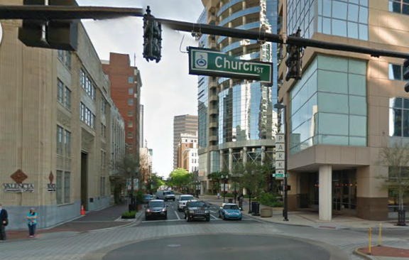
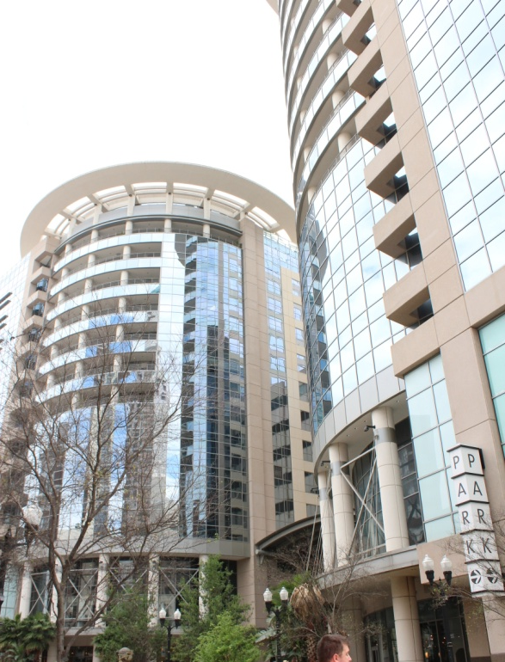
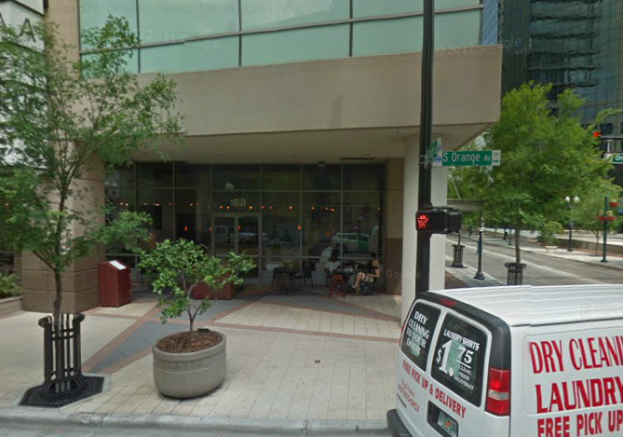
Query Image
Dataset Images
Notes:
SHOWING WHAT THE SYMBOLS MEAN WHICH WE WILL USE ON NEXT SLIDE: Blue squares→sift from query
Green circles→SIFT from dataset image 1
Red triangles→SIFT from dataset image 2

Slide 19
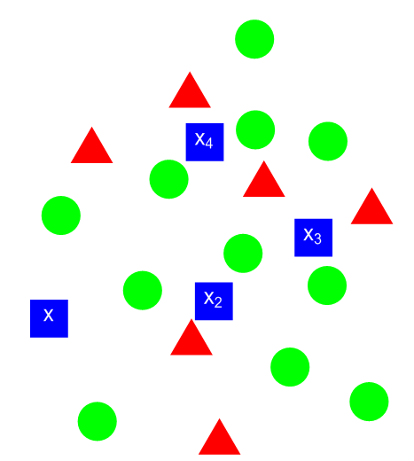
Using nearest neighbor and assigning votes
Dataset SIFT POINTS | Votes
 | IIIII III
 | III
Notes:
Explain the process of votes awarded to three closest SIFT points to our Query Image. Mark votes on as we go through explaining (on a WHITE BOARD?)

Slide 20
Processing the data
Input Query Image
Compute SIFT points
Remove Weak Votes
Search the tree and assign votes to nearest neighbors
Select Image with Highest Number of Votes
Vertical Axis: Number of Votes
Matching
Horizontal Axes: Location Coordinates (x,y)
Notes:
Organize the “votes” using their longitude and latitude to find high peaks. Similar to a HISTOGRAM?? The more “Votes” a SIFT point receives, the higher the peak will be.

Slide 21
Processing the data
Input Query Image
Compute SIFT points
Remove unlikely locations.
Search the tree and assign votes to nearest neighbors
Select Image with Highest Number of Votes
Notes:
Take away SIFT points that do not have a lot of votes and are UNLIKELY locations. Remove unlikely locations by calculating the nearest neighbor and honing in on likely locations. Low number of votes.

Slide 22
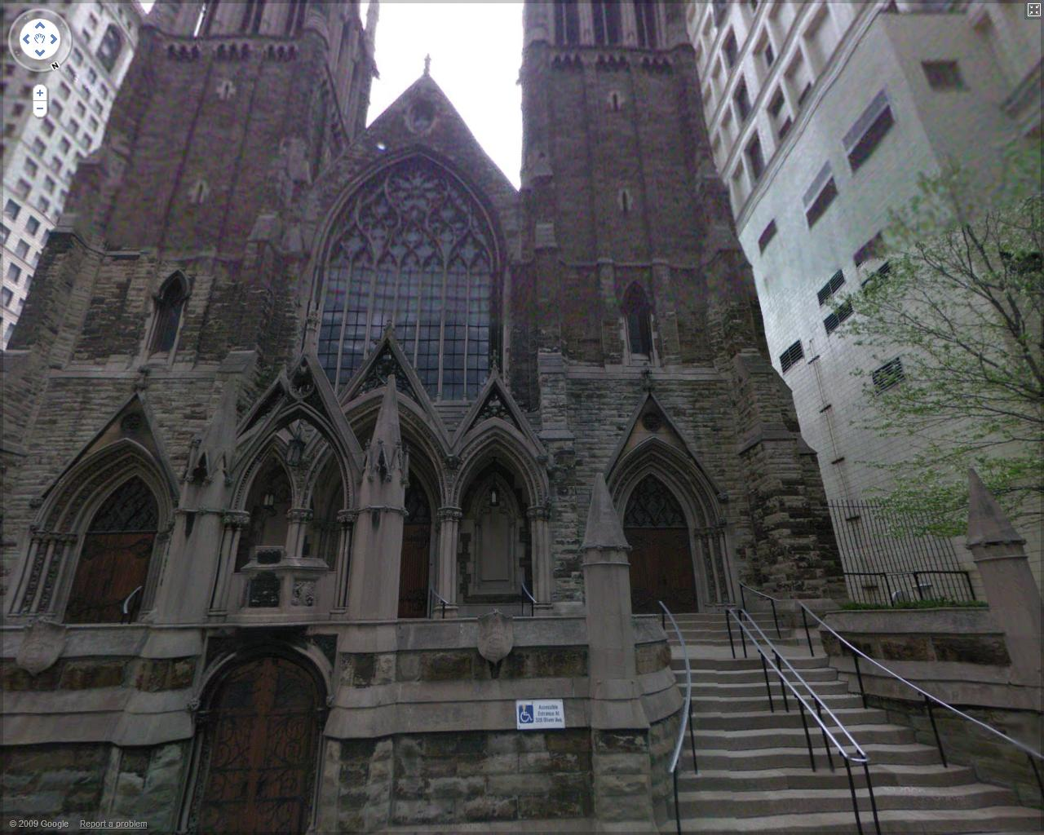
Processing the data
Input Query Image
Compute SIFT points
Remove unlikely locations.
Search the tree and assign votes to nearest neighbors
Select Image with Highest Number of Votes
Notes:
Highest peak provides us with the most likely location the query image was taken. (Most likely match to the data set)

Slide 23
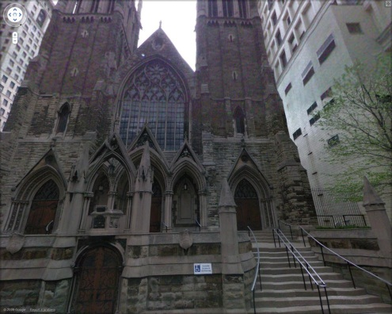
Processing the data
Input Query Image
Compute SIFT points
Remove unlikely locations.
Find the longitude and latitude of the SIFT points
Select Image with Highest Number of Votes
Query
17.8 m
Match
Notes:
Like every experiment, there is some ERROR. In this case, 17.8m (insignificant for our purposes)

Slide 24
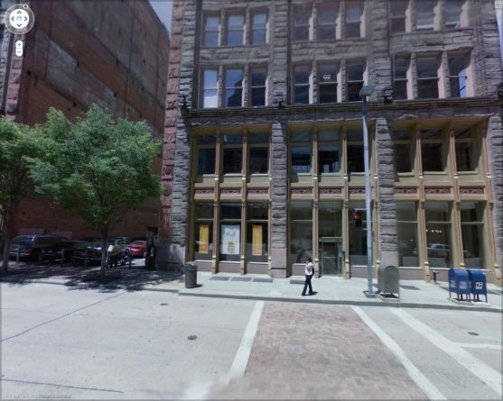
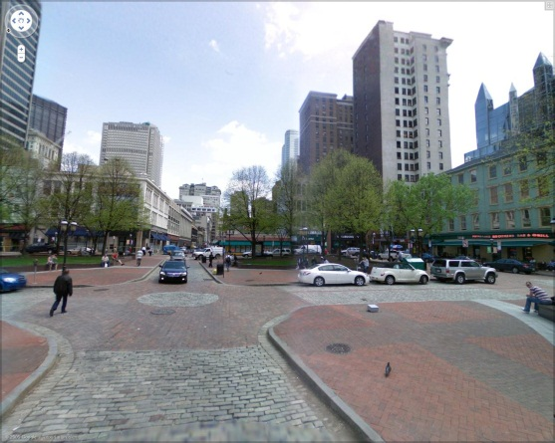
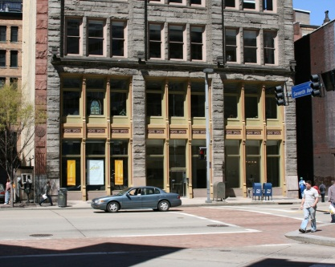
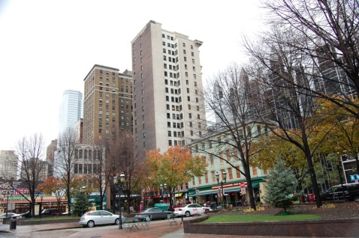
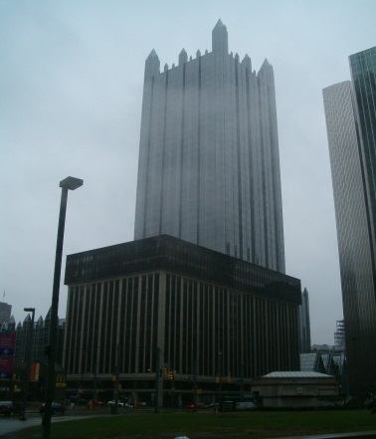
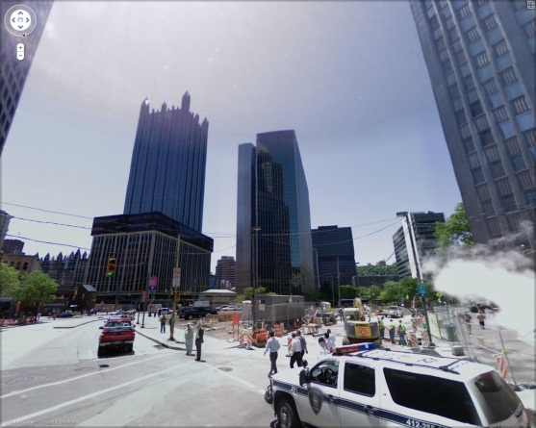
Their Results:
18.5%: localization failed
13.2%: A correct match found, but not the best one
68.3%: The best match found:
Query
Query
Match – Error: 9.01 m
Match – Error: 6.4 m
Query
Match – Error: 7.5 m
Query
Match – Error: 62.7 m
Notes:
For localization failed→extraneous solution!! We got an image but it really didn’t work when we check our answer.
A correct match BUT NOT THE BEST ONE→a negative value due to quadratic that DOES work…but could not be used due to the value representing a length or distance (for example)

Slide 25
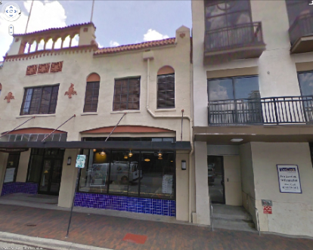
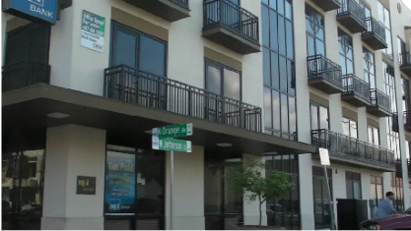
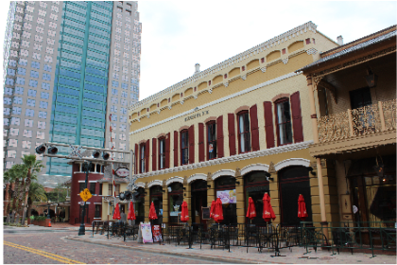
Our Results:
Query
Match – Error: 42.27 m
Query
Match – Error: 7.42 m
Notes:
Yes there will be errors but this is much more accurate than other programs out there that are doing something similar. Their methods have decreased the error when locating the images.

Slide 26
Your Favorite Question: “When could this be used?”
Personal – social activities.
Law enforcement – finding missing persons.
Military – identifying targets/needed locations
Notes:
What do they think?

Slide 27
Why am I learning about this in math class?
Guess what? ALL of this is math based!
Nearest neighbor – distance between two points.
Longitude and Latitude – coordinate grid
Functions – inputs → outputs
Matlab is all VECTORS and MATRICES!
(a way organizing data)
Notes:
Matlab: the program that is used to run the data and code.
Vectors: gives a magnitude (length) and direction.
Lots of different types of data can be organized into vectors and matrices.

Slide 28
What you should take away from this:
TECHNOLOGY AND MATHEMATICS GO HAND IN HAND.
Math is continually building on itself.
If you think this topic is
interesting maybe
there is an engineer in you!
Notes:
We broke it down into basics for you…but this math is INTENSE! Years of studying higher level math and engineering concepts build on the foundation you are receiving NOW!

