Slide 1
Welcome Students
Research Experience for Teachers (R.E.T.)
Teachers seek out promising students from high school to connect to the engineering program at the University of Central Florida

Slide 2
R.E.T. at UCF
The R.E.T. at UCF is in Computer Vision
Computer Vision – image processing through numerical data
Computer Vision requires higher mathematical skills and programming skills
So the goal is to excite students with the importance of studying math in High School
Then students can pursue advanced math later, which engineering needs
High school students can also be motivated to learn computer studies
Notes:
Computer vision = image processing

Slide 3
MATLAB
MATLAB (Matrix laboratory)
Used for coding and computing in a research environment
Ideal for numerical computation
Easy to learn and run
Quick processing of images
Helpful tools and tricks for engineers/researchers

Slide 4
MATLAB Layout

Slide 5
Things We Can Do in MATLAB
Basic math operations
Solving systems of linear equations
Matrices
Vectors

Slide 6
Processing Images in MATLAB

Slide 7
Defining Images
Gray images: levels 0 (black) to 255 (white)
Color images: three 2-D arrays of numbers
Red
Green
Blue

Slide 8
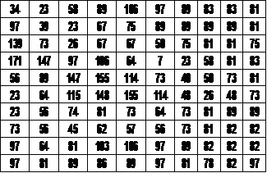
Numerical Data of an Image

Slide 9
MATLAB is able to produce numerical data from given images.
We can achieve this by using various applications.
One application is SIFT.

Slide 10
What is SIFT?
Scale Invariant Feature Transform
An application used in MATLAB
A step by step procedure for calculations used to detect and describe unique features in given images
Computes points of interest (descriptors) and writes them to a file
Converts the picture into a series of numbers

Slide 11
What are Points of Interest?
Detection of contrast of color
Includes brightness and intensity
Detects edges based on x and y axis variations
There are several SIFT program variations that each have different determining factors

Slide 12
AIR JORDAN 13 FLINTS Query Image

Slide 13
AIR JORDAN13 FLINTS with SIFT Points

Slide 14
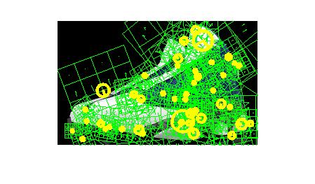
AIR JORDAN 13 FLINTS with Descriptor Points

Slide 15
TAYLOR LAUTNER Query Image

Slide 16
TAYLOR LAUTNER with SIFT Points

Slide 17
TAYLOR LAUTNER with Descriptor Points

Slide 18
CHS TRACK TEAM Query Image

Slide 19
CHS TRACK TEAM with SIFT Points

Slide 20
CHS TRACK TEAM with Descriptor Points

Slide 21
Geolocation
Geolocation = Geographic Location
SIFT is the first step in finding the Geolocation of an image using position and orientation by taking the numerical data using mode
Uses frames of reference to match the Interest Points

Slide 22
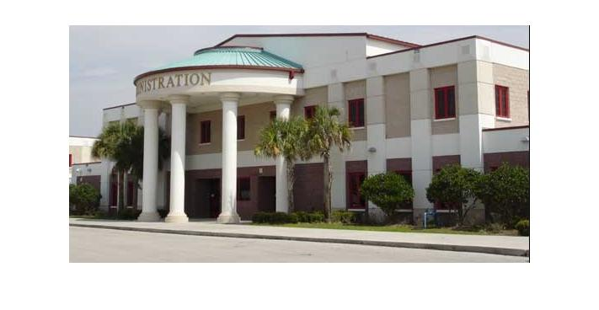
COLONIAL HIGH SCHOOL Query Image
% SHOW ORIGINAL PICTURE
figure(1)
OriginalImg=imread([picturefolder '\' picture]);
imshow(OriginalImg);
img1=rgb2gray(OriginalImg);

Slide 23
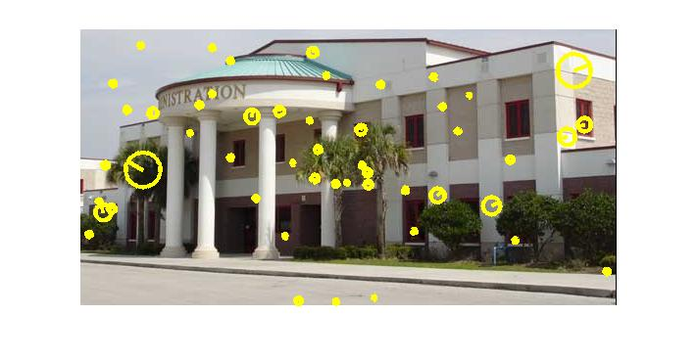
COLONIAL HIGH SCHOOL with SIFT Points
% PERFORM SIFT AND PLOT POINTS OF INTEREST
I=single(img1);
[f,d]=vl_sift(I);
perm=randperm(size(f,2));
sel=perm(1:50);
% Random selection of 50 features
figure(2); imshow(OriginalImg);
h1=vl_plotframe(f(:,sel));
h2=vl_plotframe(f(:,sel));
set(h1,'color','k','linewidth',3);
set(h2,'color','y','linewidth',3);

Slide 24
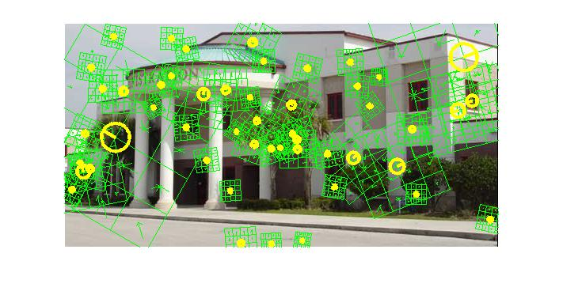
Colonial High School with Descriptor Points
% SHOW OVERLAY OF DESCRIPTORS
figure(3);
imshow(OriginalImg);
h3=vl_plotsiftdescriptor(d(:,sel),f(:,sel));
set(h3,'color','g');
Notes:
By matching up the numerical data, we can

Slide 25
Aerial View
By using the numerical data, we can find the geolocation of the building anywhere in the world.

Slide 26
Aerial View

Slide 27
Street View

Slide 28
What can geolocation be used for?
Locating the address of a location in an image anywhere in the world
E-retail, banking, media, education, travel, hospitality, entertainment, health care, online gaming, law enforcement and for preventing online fraud

Slide 29
Your Path
Math & Science
ENGINEERING
IMAGE PROCESSING
Geolocation

Slide 30
Contact Info
For information for scholarship info at UCF go to:
http://server.cs.ucf.edu/statess/form/index.php
Or contact Dr. Lobo at: niels@eecs.ucf.edu

Slide 31
CREDITS
Slides
UCF Computer Vision Engineering Department
Pictures
Chris Tucker in “Rush Hour”
Nike Air Jordan
Taylor Lautner
Colonial High School
Videos
Google Maps
Resident Genius
Karen Oliver
THANK YOU!

Slide 32
THANK
YOU !

