Slide 1

Where in the world am I?

Slide 2
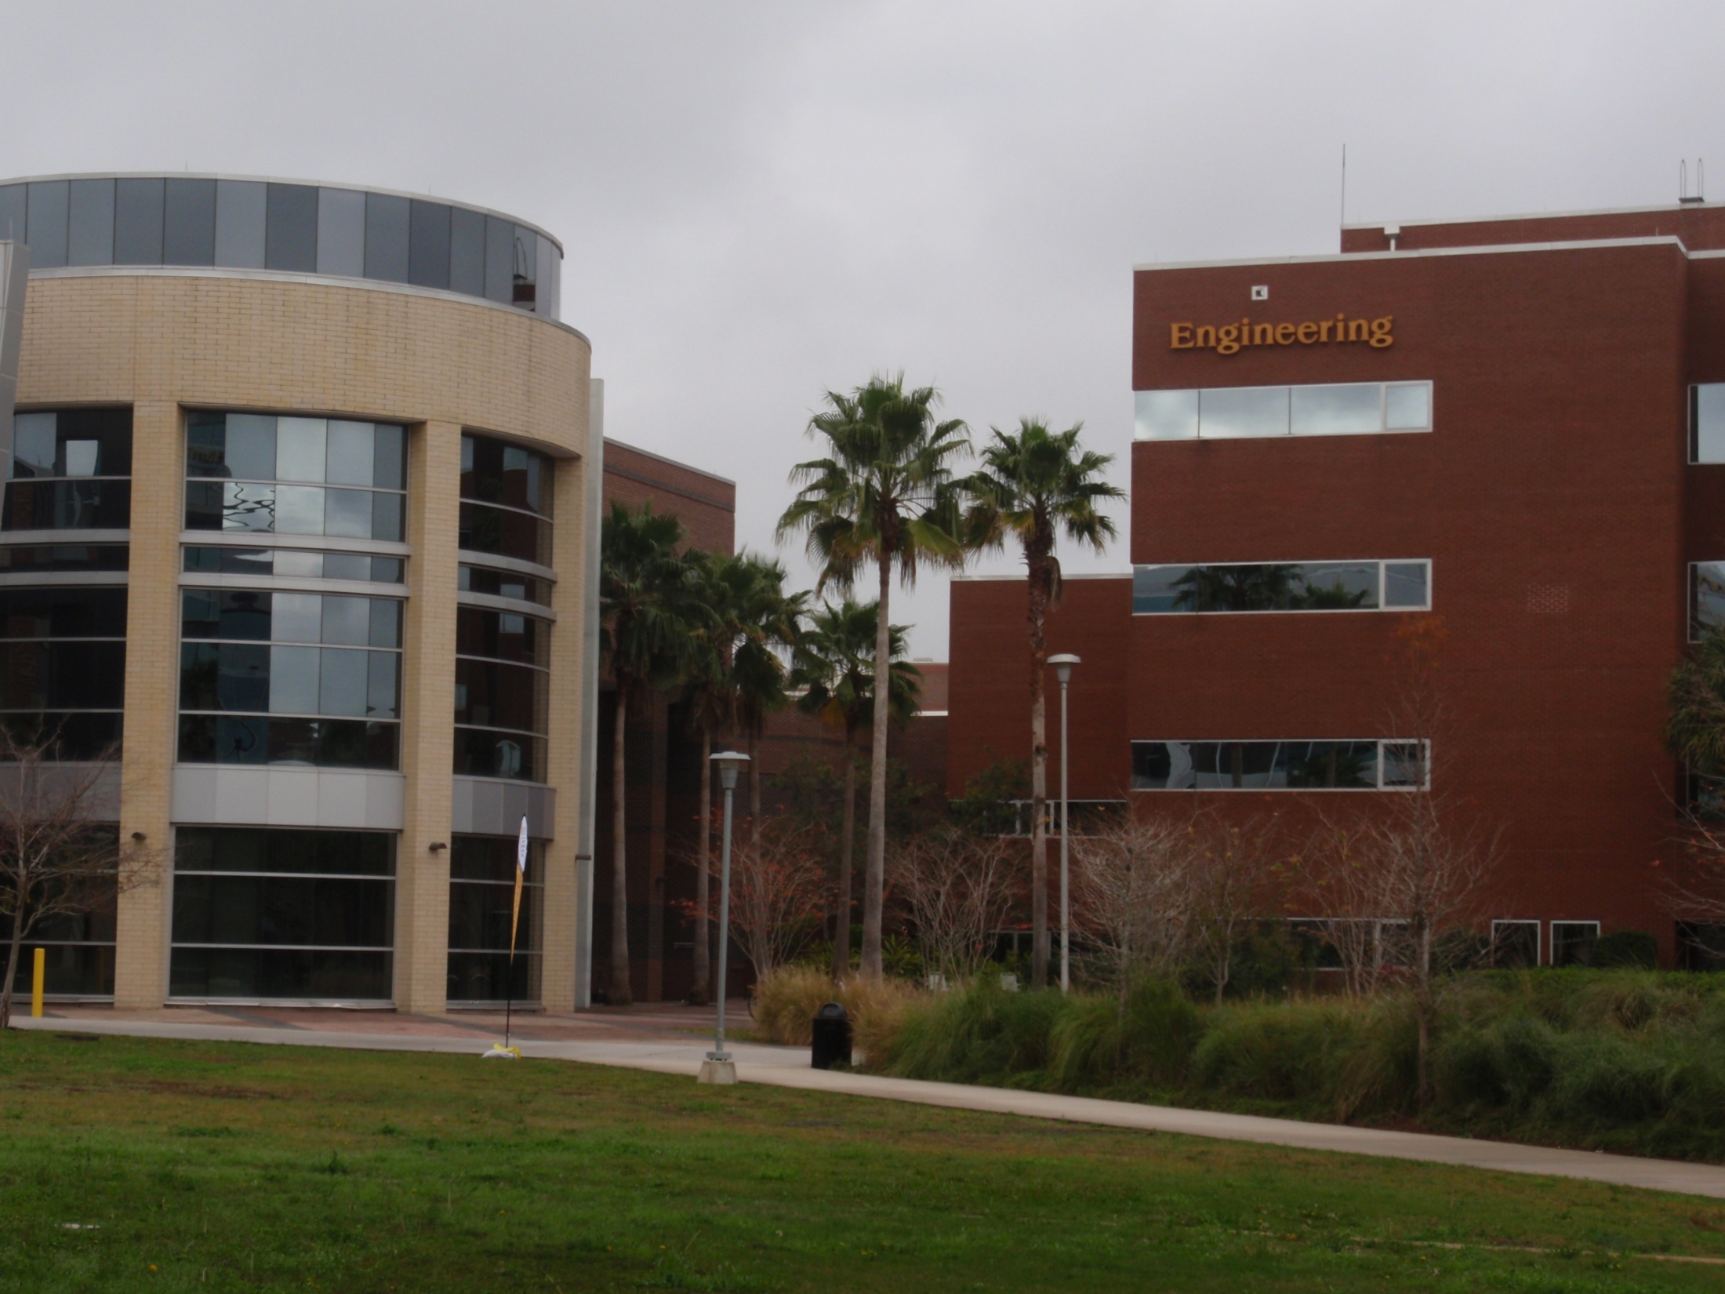
What is R.E.T.?
Research Experience for Teachers
UCF is searching for high school students who have an interest in math and science to help them connect to
STEM programs…
Any idea why? …..

Slide 3




engineering mathematics
STEM
science technology

Slide 4

A direct quote from AEGIS,
a partnership program between UCF and FIT says
“America faces a critical talent gap in science,
technology, engineering and mathematics (STEM),
and is not keeping pace with foreign competition.
In the past five years alone, the percentage of U.S.
college students receiving STEM degrees has dropped by over 25%. “

Slide 5
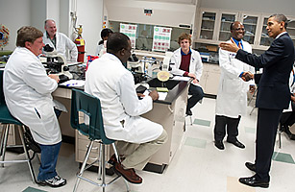
“President Obama tours a biotech classroom at Forsyth Technical Community College in Winston-Salem, North Carolina, on December 6, 2010. PHOTO taken from TIME magazine article The Next Great Resource Shortage: U.S. Scientists by ANDREW J. ROTHERHAM Thursday, May 26, 2011

Slide 6
Research Experience for Teachers
The Projects
Motion patterns
Geo-localization
Seeing through water
Detections from aerial camera

Slide 7
Research Experience for Teachers
Projects
Motion patterns : given a set of traffic scenes, find events like left turns, right turns, and possible anomalies.
Geo-localization: given a set of images with GPS locations, be able to match the right position.
Seeing through water: given a video of an image under the water, find an undistorted image.
Detections from aerial camera: given a video filmed from an aircraft, find the moving objects on ground.

Slide 8
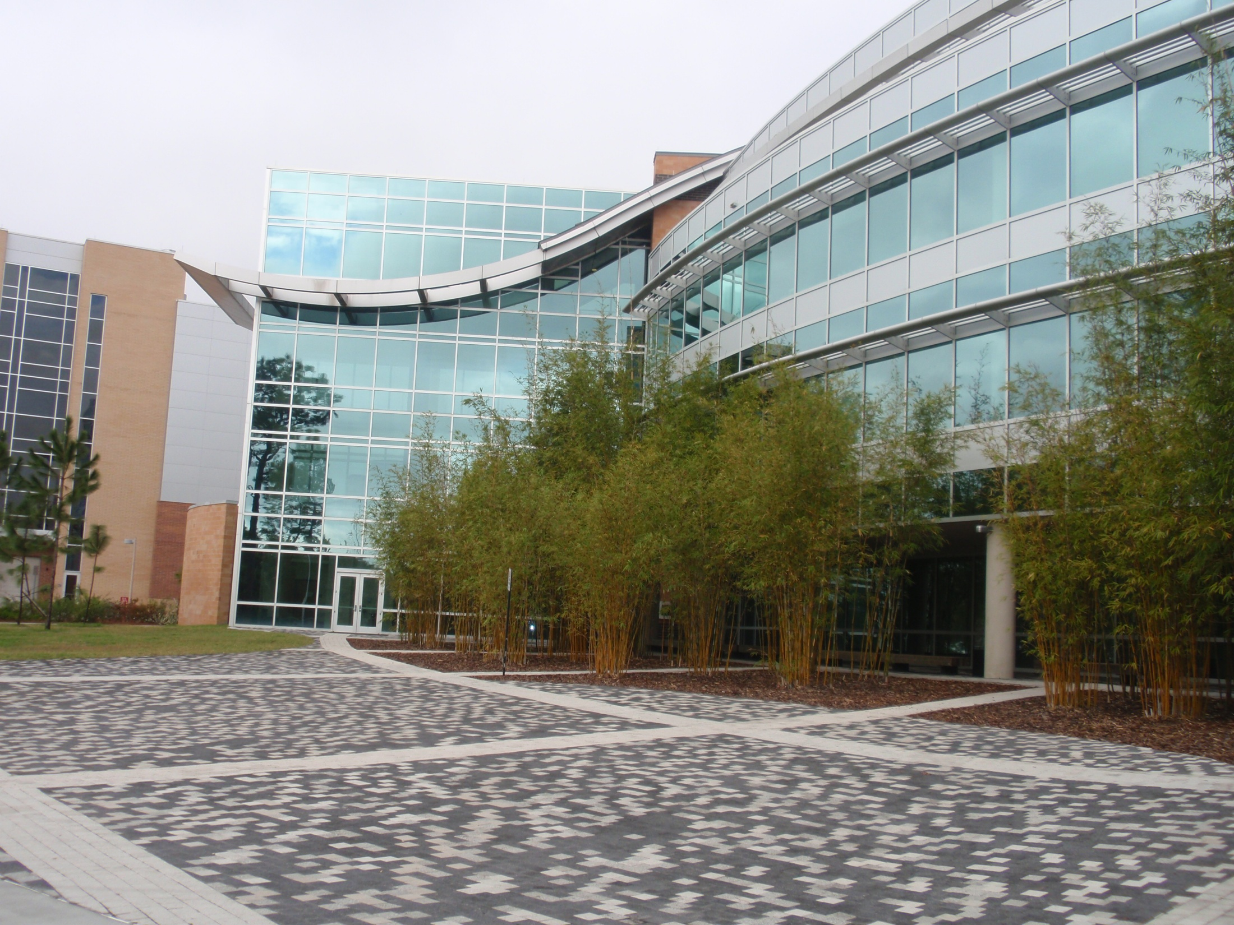
Geo-Localization
Accurate Image Localization
Based on
Google Maps Street View
ECCV 2010
Amir Roshan Zamir, Mubarak Shah

Slide 9
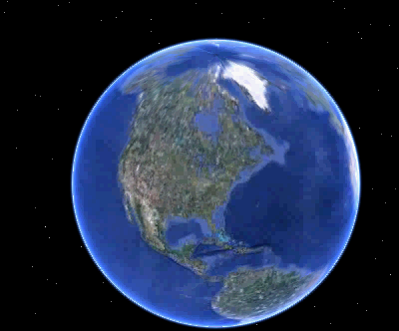
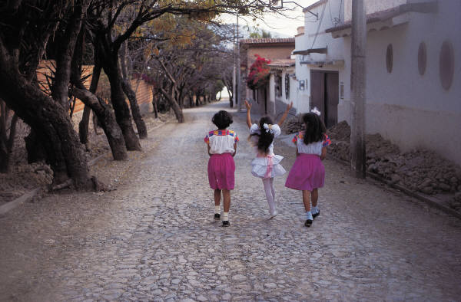

Possible Problems/Scenarios:
I forgot the location where I took this picture? ☺
I need to locate a missing person ☹
Input
Output
    Location in Terms of λ (Lon.) and φ (Lat.)
$φ$=40.4419, $λ$=-79.9986

Slide 10
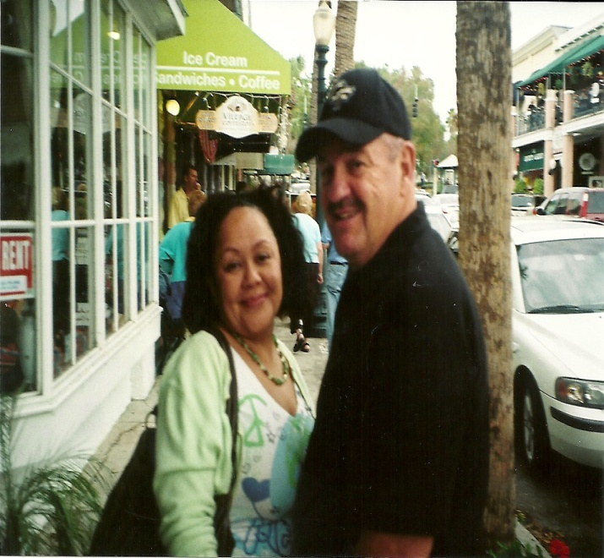
“Where in the world am I?”
Problem:I forgot the location where I took this picture?
Solution: use “Accurate Image Localization”
Input
Output: ?????
    Location in Terms of λ (Lon.) and φ (Lat.)
$φ$=40.4419, $λ$=-79.9986

Slide 11
Accurate Image Localization
a new system for Image localization and location recognition is proposed
based in terms of Longitude () and Latitude ()
accuracy is comparable to hand held GPS-devices
based on Google Maps Street view.

Slide 12
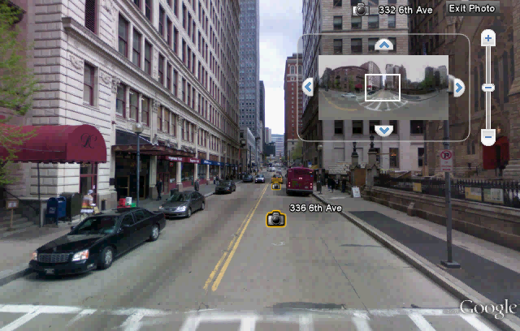
    Google Maps Street View Dataset. 360° Spherical views about every 10 meters
    Dataset A and B: each has 50,000 Images captured in Downtown Pittsburg, PA and Orlando FL,
    5 Images per Place Mark: 4 Side views, 1 Top View

Slide 13
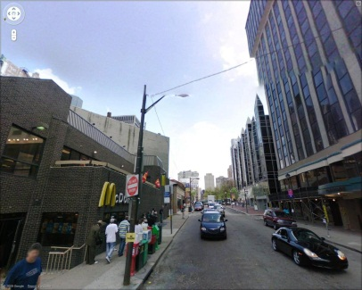
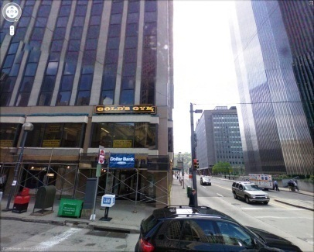
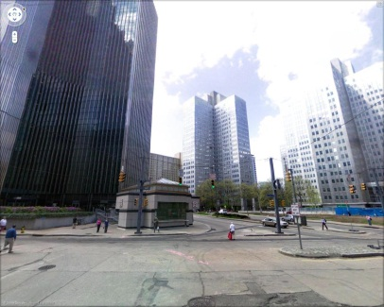
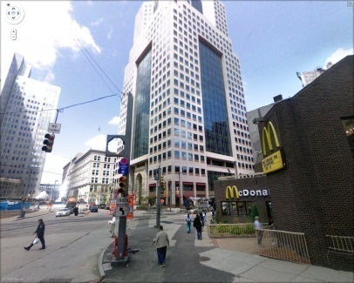
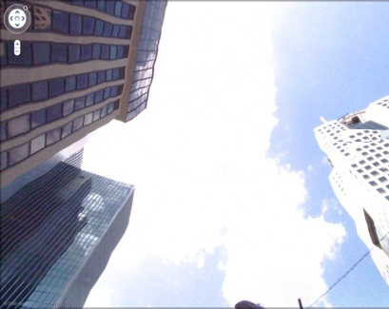
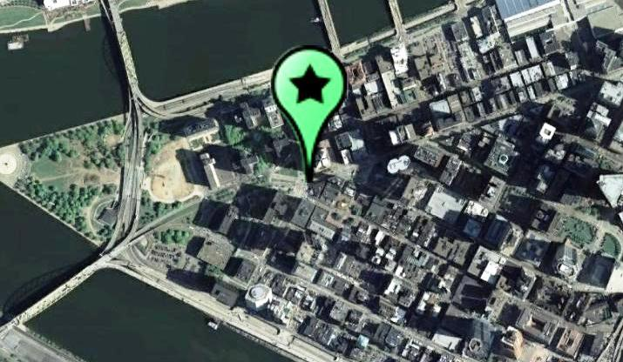
Google Maps Street View Dataset
Side Views
Top View
Pittsburgh, PA $φ$= 40.44146°, $λ=$-80.0037°

Slide 14
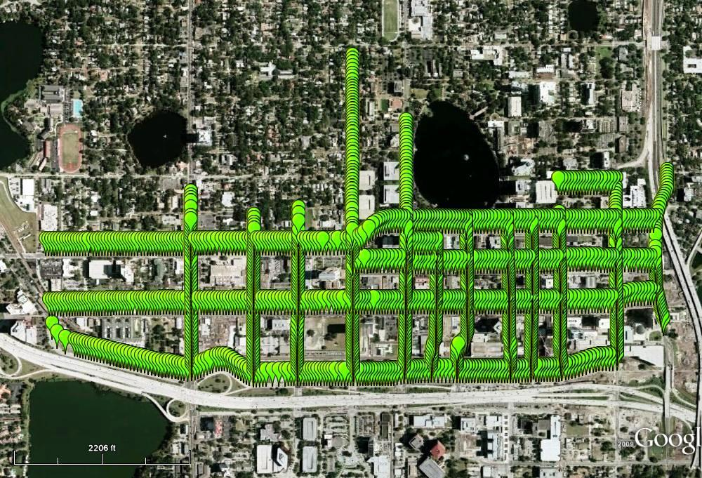
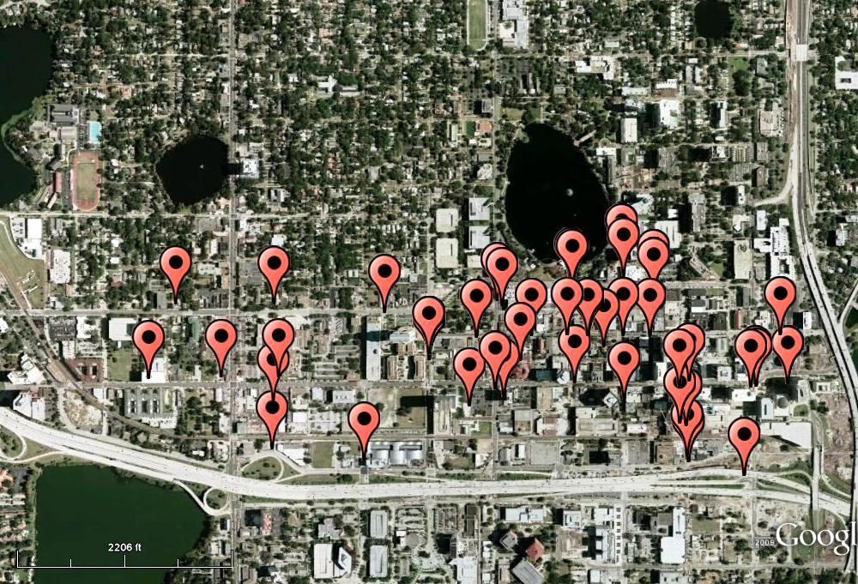
Google Maps Street View Dataset
Reference Images Place Marks
Query Images
Orlando, FL

Slide 15
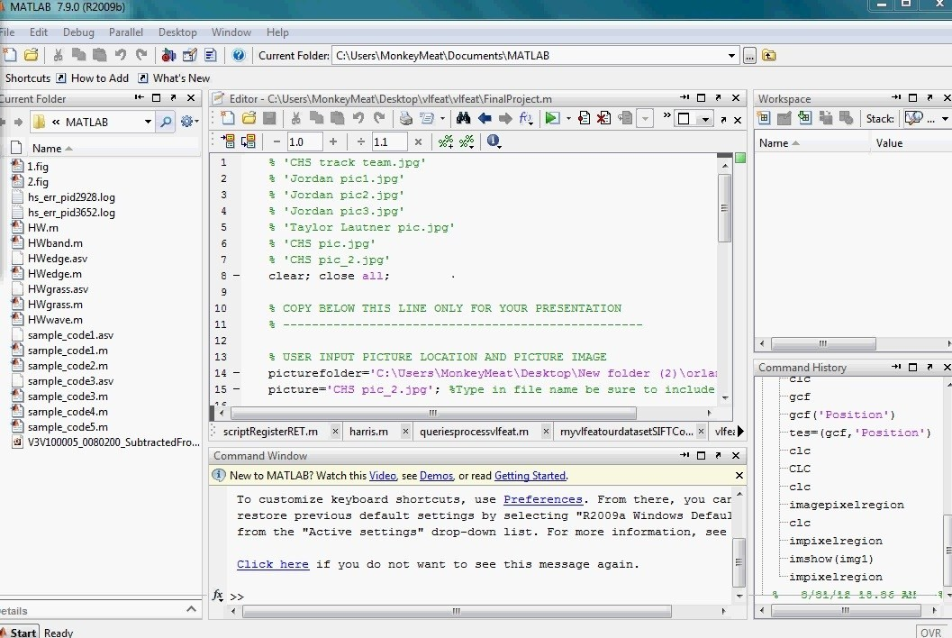
MATLAB program used for quick processing of images

Slide 16
I know you WONDER? how to connect our picture to
Google Map Street view?
Earn some extra credit, thumbs up when you hear me say a “vocabulary word”
Interesting points called SIFT points,
DISTANCE BETWEEN these points will be important
Photos will be transformed to black and white
Think: Each location in the world has their own thumbprint…………. a coordinate (x,y)
Notes:
SIFT points: explain. So “points of interest”. Ignoring color, points that are right on the edge of things.

Slide 17
SIFT POINTS
allows us to detect and describe local features in images
Query Image (or input image)

Slide 18
Points of interest are denoted with a yellow symbol
SIFT then stores the information about the photo and distances between the points.

Slide 19
Query Image with Descriptor Points

Slide 20
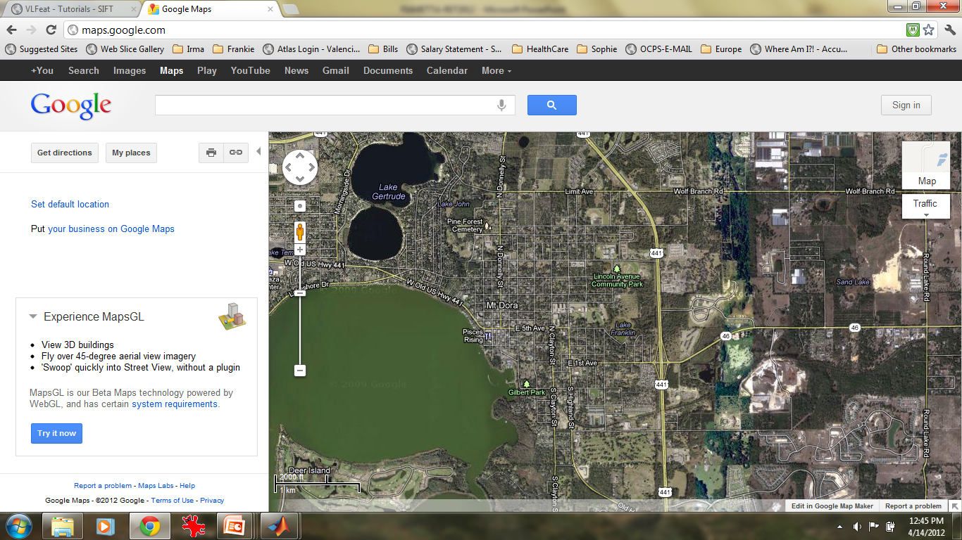
(I climbed) Mount Dora, Florida

Slide 21
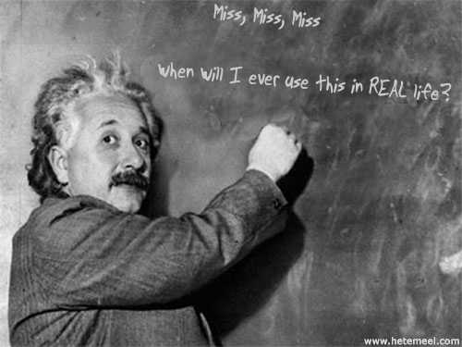
FIRST OF ALL :
High School Math is just a …..
STEPPING STONE to a bigger and better life….

Slide 22
GEOLOCALIZATION possible uses
Social Media
Finding missing persons…
FBI Most Wanted
Ideas…?

Slide 23
Geo-Localization
Is just one of the projects that UCF students are involved with…..
There is more….So much more…

Slide 24

So…..WHO YOU GONNA call….?
For information for scholarship info at UCF
http://server.cs.ucf.edu/statess/form/index.php
Or contact Dr. Lobo at: niels@eecs.ucf.edu
Computer Science Club at ERHS
Fall 2012 – Mrs Fiametta

