Slide 1
Adaboost for faces. Material
Gonzalo Vaca-Castano

Slide 2
Adaboost for faces paper
David G. Lowe, "Distinctive image features from scale-invariant keypoints," International Journal of Computer Vision, 60, 2 (2004), pp. 91-110

Slide 3
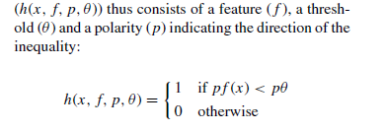
Algorithm
Train
Test

Slide 4
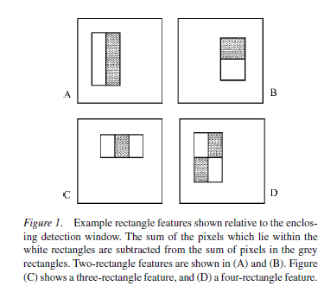
Weak Classifiers
4 types of rectangular filters (24x24 picture)

Slide 5
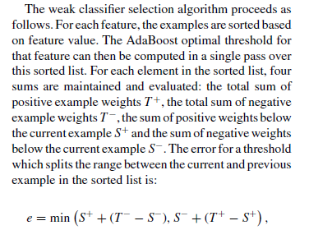
Step 2

Slide 6
Step 2
Threshold level
- - - - - + + + + +
Sorted Filter Output
- + - + - + + - + +

Slide 7
Step 2
Threshold level
- - - - - + + + + +
Sorted Filter Output
- + - + - + + - + +
S+
S-

Slide 8
Step 2
Threshold level
- - - - - + + + + +
Sorted Filter Output
- + - + - + + - + +
T-

Slide 9
Step 2
Threshold level
- - - - - + + + + +
Sorted Filter Output
- + - + - + + - + +
T+

Slide 10
Step 2
Threshold level
- - - - - + + + + +
Sorted Filter Output
- + - + - + + - + +
Errors

Slide 11
Step 2
Threshold level
- - - - - + + + + +
Sorted Filter Output
- + - + - + + - + +
Errors

Slide 12
Step 2
Threshold level
+ + + + + - - - - -
Sorted Filter Output
- + - + - + + - + +
Errors

