Slide 1
Matlab Tutorial.
Session 1
Basics, Filters, Color Space, Derivatives, Pyramids, Optical Flow
Gonzalo Vaca-Castano

Slide 2
BASICS
Matlab Tutorial. Session 1

Slide 3
Introduction to mathematical programming
Commonly used coding/computing environment in research: MATLAB (Matrix laboratory)
  Ideal for numerical computation
  Easy to learn
  No compiling hassles
  Quick testing of ideas!
  Helpful tools and tricks for engineers/researchers
  Execution of tasks on command prompt

Slide 4
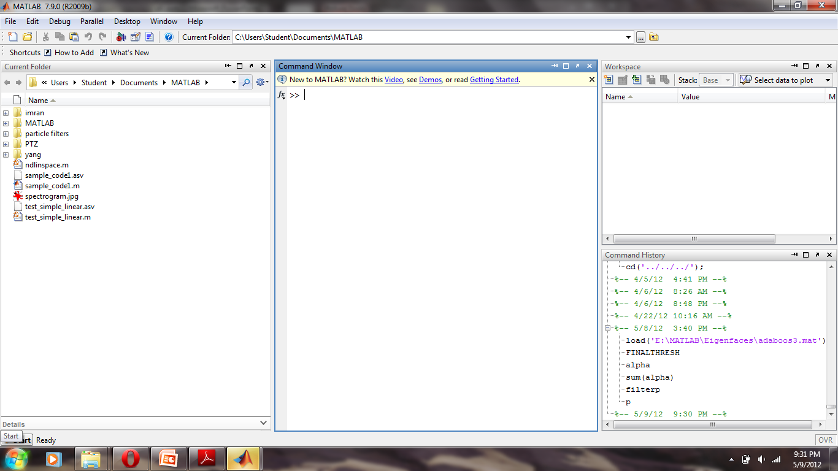
Matlab Layout
Current directory

Slide 5
Basic math operations
DMAS : ‘/’ ‘*’ ‘+’ ‘-’
Exponents: ‘^’
Trigonometric operations
  sin, asin
  cos, acos
  tan, atan

Slide 6
Matrices
Creating a matrix:
  Example: >> [1 1; 0 1]
Matrix operations
  Addition, multiplication, inverse, transpose
  ‘+’ , ‘*’ , inv() , ‘

Slide 7
Vectors
Creating vectors:
  example: >> [1 2 3 4 5]
Vector operations:
  Dot product: ‘.’
  Sum all elements: sum()
  Sort elements: sort()
  Find histogram of elements: hist()
  Find average of elements: mean()

Slide 8
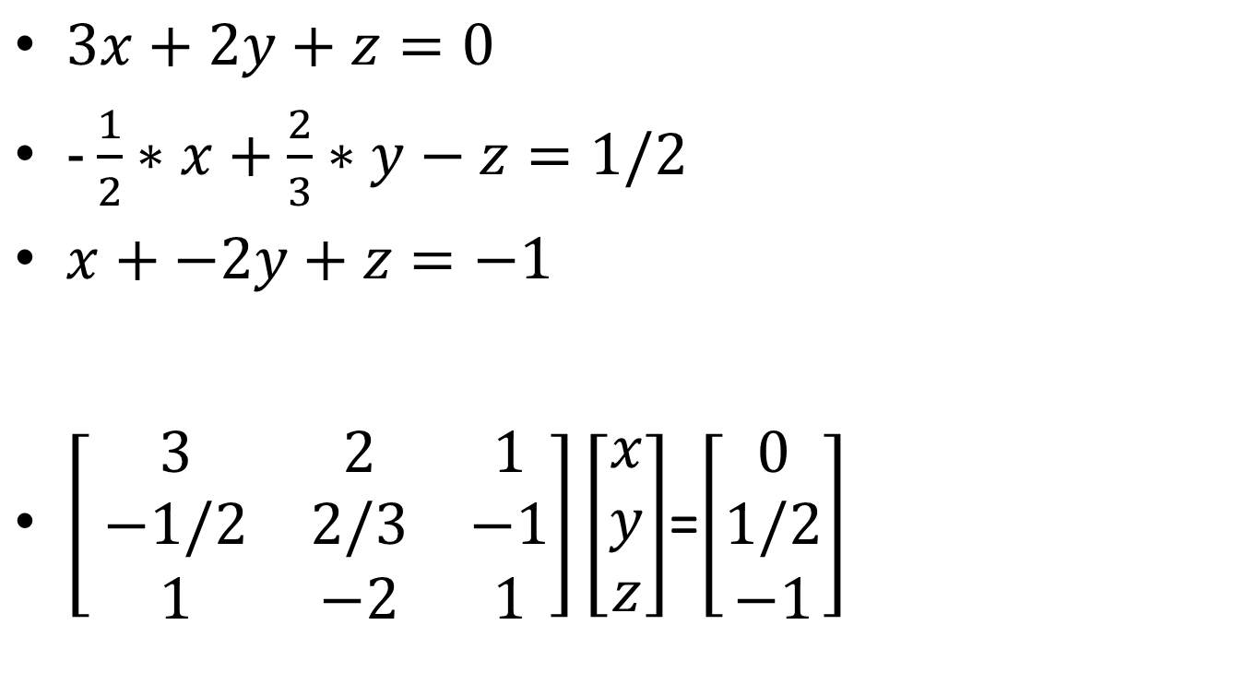
Solving a system of linear equations
$3x+2y+z=0$
$-\frac{1}{2}∗x+\frac{2}{3}∗y−z=1/2$
$x+−2y+z=−1$
$\left[ \begin{matrix}3 & 2 & 1 \\ −1/2 & 2/3 & −1 \\ 1 & −2 & 1\end{matrix}\right]\left[\begin{matrix}x \\ y \\ z\end{matrix}\right]$=$\left[\begin{matrix}0 \\ 1/2 \\ −1\end{matrix}\right]$

Slide 9
Solving a system of linear equations
a=[3 2 1; -1/2 2/3 -1; 1 -2 1]
b=[0;1/2;-1]
c=inv(a)*b;
Output: c= [-0.1429; 0.3214; -0.2143]

Slide 10
Processing images in Matlab

Slide 11
Image
2-D array of numbers (intensity values, gray levels)
Gray levels 0 (black) to 255 (white)
Color image is 3 2-D arrays of numbers
  Red
  Green
  Blue

Slide 12
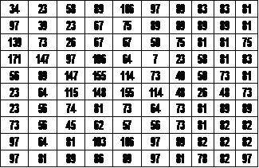

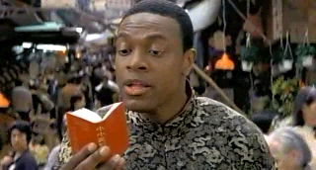

Slide 13
Example: Removing noise
% Create a noisy image
I = imread('eight.tif');
imshow(I)
J = imnoise(I,'salt & pepper',0.02);
figure, imshow(J)
% Mean filter
K = filter2(fspecial('average',3),J)/255;
figure, imshow(K)
%Median filter
L = medfilt2(J,[3 3]);
figure, imshow(L)

Slide 14
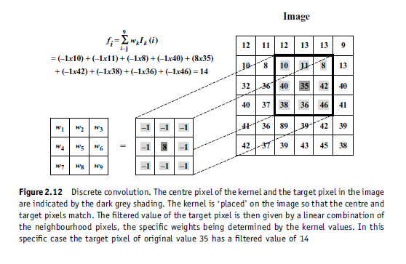
Convolution

Slide 15
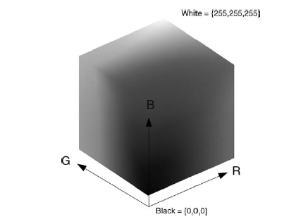
Color spaces: Rgb,HSV, etc
Matlab Tutorial. Session 1

Slide 16
Image Architecture
Raster Images (RGB, Gray Scale, Logical)
(8-bit representation of gray scale)
Single depth
Row 3
Row 2
Row
Row 1
3 depths
Gray Scale
(0 – 255)
Col
(1-bit
representation of black or white saturation)
B
(0 – 255)
G
(0 – 255)
(8-bit representation of colors)
R
(0 – 255)
Logical (0 0r 1)

Slide 17
RGB space
>> I = imread('board.tif')
Displaying image:
  >> imshow(I)
Check image size
  >> size(I)
Convert color image to black and white image:
  >> rgb2gray(I)
  % Gray= 0.2989 * R + 0.5870 * G + 0.1140 * B

Slide 18
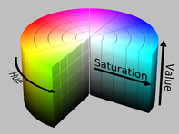
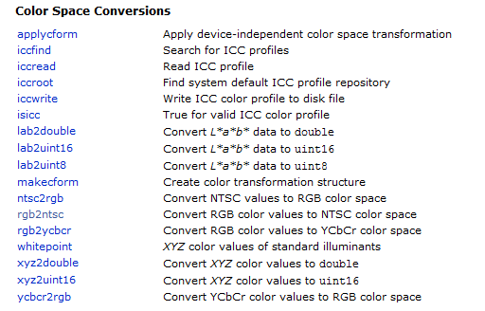
Other Color spaces
http://en.wikipedia.org/wiki/HSL_and_HSV
rgb2hsv(I)
rgb2ycbcr(I)
rgb2ntsc (I)
CIELAB or CIECAM02

Slide 19
Derivatives

Slide 20

Derivatives (Filters)
In a continuos 1d Signal, derivative is:
  lim dx->0 f(x+dx)-f(x)/dx
In a discrete 1d signal, derivative is:
  f(x+1)-f(x)
  It is a convolution with the filter:
  Other popular filter is:
Sobel Filter

Slide 21
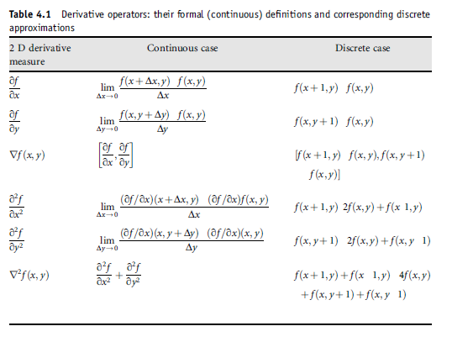
Derivatives in 2D
KERNEL
-
-
[1 -1]
-
-
-
-
-
-
-
-
[1 -2 1]
-
-
-
[1 -2 1]’
-
-
0 1 0
1 -4 1
0 1 0
-

Slide 22
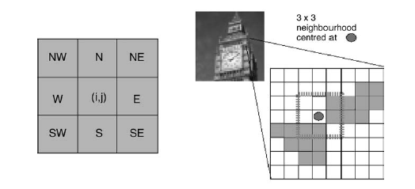
Filtering in 2D Arrays (Convolution)

Slide 23
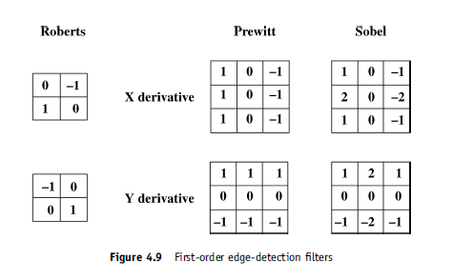
Alternative derivatives in 2D

Slide 24
Derivatives in Matlab
I = imread('trees.tif');
imshow(I)
k1=[ 1 0 -1;2 0 -2; 1 0 -1]
o=imfilter(double(I),k1,'same');
figure; imagesc(o)
colormap gray
QUESTION:Why imagesc instead of imshow ?

Slide 25
Pyramids

Slide 26
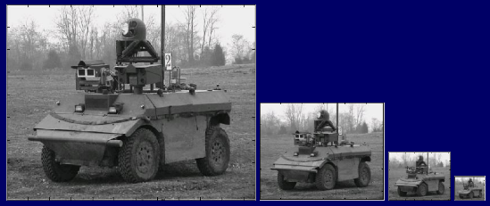
Pyramid
Definition:
  is a type of multi-scale signal representation in which a signal or an image is subject to repeated smoothing and subsampling

Slide 27

Smoothing
L is a blurred image
- G is the Gaussian Blur operator
- I is an image
- x,y are the location coordinates
- σ is the “scale” parameter. Think of it as the amount of blur. Greater the value, greater the blur.
- The * is the convolution operation in x and y. It “applies” gaussian blur G onto the image I

Slide 28
Smoothing function
% gauss_filter: Obtains a smoothed gaussian filter image
% - Output:
% smooth: image filter by a gaussian filter
% - Input:
% image: Matrix containing single band image.
% sigma: Value of the sigma for the Gaussian filter
% kernel_size: Size of the gaussian kernel (default: 6*sigma)
function [smooth]= gauss_filter(image,sigma,kernel_size)
if nargin < 2
sigma=1;
end
if nargin < 3
kernel_size=6*sigma;
end
gaussian_radio=floor(kernel_size/2); %radio of the gaussian
x=[-gaussian_radio : gaussian_radio]; % x values (gaussian kernel size)
gaussiano= exp(-x.^2/(2*sigma^2))/(sigma*sqrt(2*pi) ); %calculate the unidimensional gaussian
temp=conv2(double(image),double(gaussiano),'same');
smooth=conv2(double(temp),double(gaussiano'),'same');
end

Slide 29
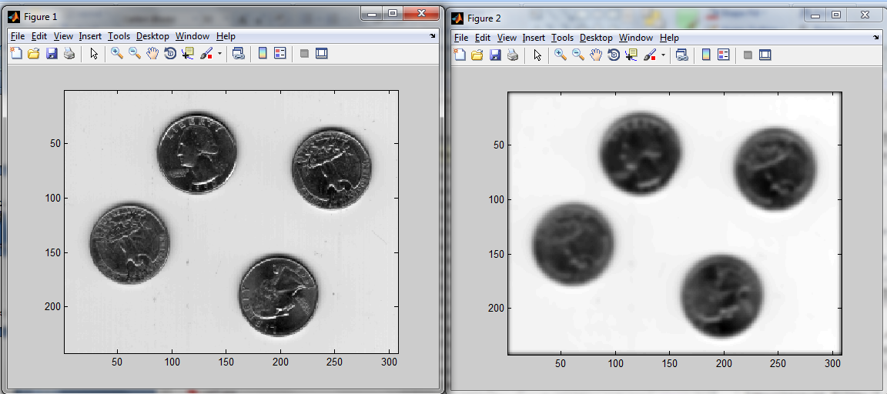
Example smoothing
I = imread('eight.tif'); imagesc(I); colormap gray;
antialiassigma=2;
Ismooth=gauss_filter(I,antialiassigma,11);
figure; imagesc(Ismooth); colormap gray;

Slide 30
Subsampling
I0 = imread('cameraman.tif');
I1 = impyramid(I0, 'reduce');
I2 = impyramid(I1, 'reduce');
I3 = impyramid(I2, 'reduce');
imshow(I0)
figure, imshow(I1)
figure, imshow(I2)
figure, imshow(I3)
See also: imresize

Slide 31
Optical Flow

Slide 32
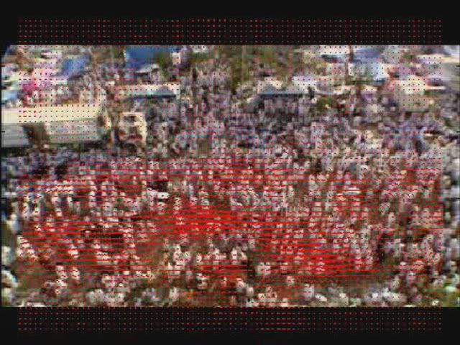
Optical flow
Definition
  Optical flow or optic flow is the pattern of apparent motion of objects, surfaces, and edges in a visual scene caused by the relative motion between an observer (an eye or a camera) and the scene

Slide 33
Optical Flow code
(Download it from webpage)
i1=imread('view1.png');
i2=imread('view5.png');
[u,v,cert] =HierarchicalLK(rgb2gray(i1),rgb2gray(i2),3,2,2,1)
flowtocolor(u,v)

Slide 34
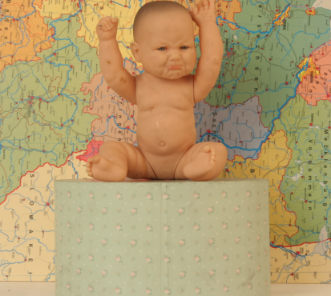
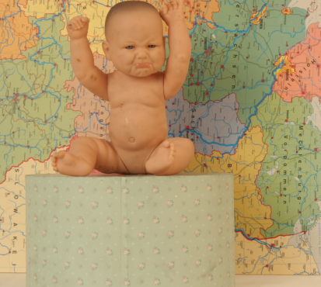
Optical Flow Results

