Slide 1
2014 FHSPS Playoff Problem Set Analysis
Arup Guha (UCF Prog. Team Coach)
March 15, 2014
dmarino@cs.ucf.edu

Slide 2

Tests/ Contests Shape How Students Study
SAT makes exam changes in the hopes that high school students emphasize certain aspects of learning.

Slide 3
My goals in shaping future Programming Contest Studying
Continue rewarding basic problem solving
Movie Trip (trip)
Building Olaf (frozen)
Encourage problem analysis to discover when greedy solutions work
Wolf of Wall Steet (wolf)
Dallas Buyers’ Club (dallas)
Encourage thinking about storing data
Great Gatsby (gatsby)
Encourage best students to go to the next level
Seating Arrangement
Hunger Games
Twelve Years a Slave

Slide 4

Basic Problem Solving
Movie Trip
Process multiple cases.
Reading in data.
Printing to specific # of decimals
Basic problem most solve frequently.
Building Olaf
Manipulating given mathematics formula to solve for a variable.
Use of math library (sqrt).

Slide 5
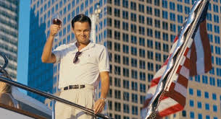
Greedy Solutions
Dallas Buyers’ Club
Key: In matching a subsequence, the greedy choice of matching a letter as soon as possible is best, because it maximizes future options.
The Wolf of Wall Street
Key: We want to bet more on the games we’re more likely to win. This tends to go along with peoples’ intuition.

Slide 6

Data Representation
The Great Gatsby
Input is condensed
Solving problem with input in this form requires careful consideration of corner cases.
Expanding input to granular minute by minute view allows for a very simple solution
Key: 1440 minutes in a day is easy to store.

Slide 7
Seating Arrangement
Recursion – taught in high school, but at a basic level.
This problem requires a slightly more sophisticated view of recursion.
Key: Determining what recursive function should take in and return.
Input: subset of seats already used.
Output: number of ways we can place the remaining couples.

Slide 8
Seating Arrangement Con’t
Recursive Solution
Base case: if all seats are used, return 1.
Recursive case
Find the first unused seat. Place one person here.
Loop through the rest of the unused seats not adjacent to this one.
Place this person’s mate in this second seat and recursively call the function with these two seats used.
Add up all of these totals for each placement of this next comple.

Slide 9
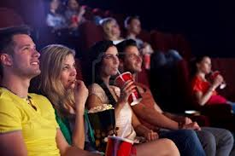
Seating Arrangement Code
public static int solve(boolean[] used) {
if (allUsed(used)) return 1;
int sum = 0;
for (int i=0; i<used.length; i++) {
if (!used[i]) {
used[i] = true;
for (int j=i+2; j<used.length; j++) {
if (!used[j]) {
used[j] = true;
sum += solve(used);
used[j] = false;
}
}
used[i] = false;
break;
}
}
return sum;
}

Slide 10
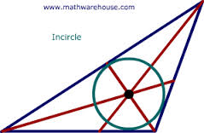
Hunger Games
Hardest Problem in Set
Geometry
Goal: To encourage students to learn about geometry techniques for programming contest questions, such as vectors, which have many practical uses.
This problem requires finding the incenter of a triangle!

Slide 11
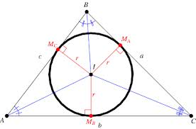
Hunger Games: My Solution
Find reference angles emanating from one vertex to the other two, via atan2.
Use area and perimeter to calculate legs of right triangle with vertex and incenter.
Use definition of sin, cos to “move” from vertex to incenter.

Slide 12
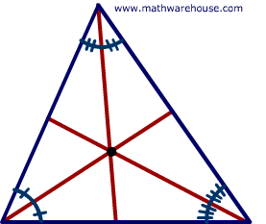

Hunger Games: Galletti’s Solution
Find two lines that are angle bisectors
Find their intersection.

Slide 13
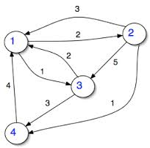
Twelve Years a Slave
Need shortest distances in a graph between any set of points
Floyd-Warshall’s Algorithm
Very easy to implement
Run time O(V³), okay if V ~ 400 or less.
Problem Solution
Count number of movie theaters for which d[start][theater]+d[theater][end] ≤ time allotted

Slide 14
Thank You!!!
First and foremost: Kyle Dencker, for starting and running this wonderful series
To all the teachers, for working with the students and getting them excited about contests
To all the students, without whom, we wouldn’t have contests
Judges: Glenn Martin and Chris Gouge, UCF Coaches, who actually hand judged today’s contest
Alternate Solutions: Michael Galletti, UCF Team Member, helped me double check my solutions and data

