Slide 1
Programming Competition Training: Women’s Team
Arup Guha – dmarino@cs.ucf.edu
2015 CLIS Presentation
5/17/2015

Slide 2
My Two Favorite MIT courses
US History, up to 1865
US Women’s History
One female in class
Routinely, Nicole came up with ideas and viewpoints that the guys in the class would have never thought of. She made the class better.
Four males in class, three were terribly shy.
I was the fourth.
The professor personally told me that I added a diversity of viewpoints to the course that improved it.
Moral: Software needs BOTH men and women

Slide 3
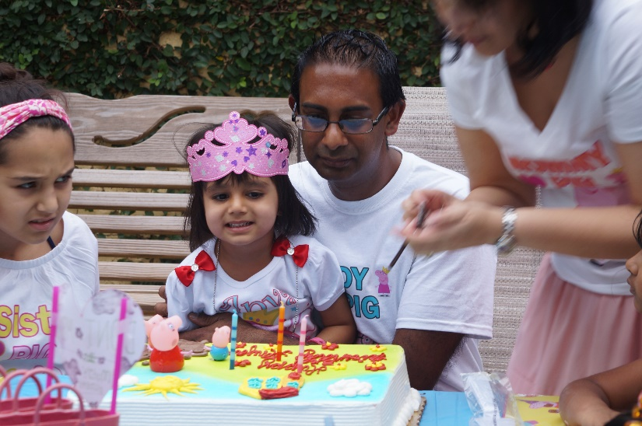
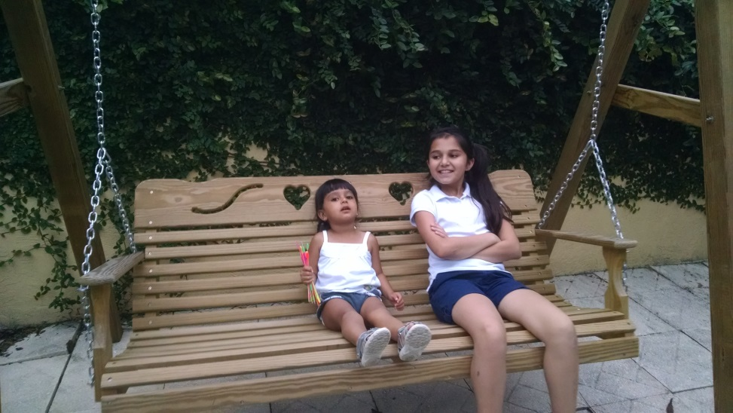
My daughters should have the same opportunities as boys, in reality, not just theory.
Anya, Simi on Swing
Anya’s 3rd Birthday

Slide 4
The Facts (2003-2011)
Team Training Correlated with Professional Success
Over ½ of our team members got jobs with top companies.
Even some of those who didn’t could have, but preferred to stay in the Orlando area.
Team Composition
Over 100 males benefitted from team training.
Only ONE female benefitted from team training.

Slide 5
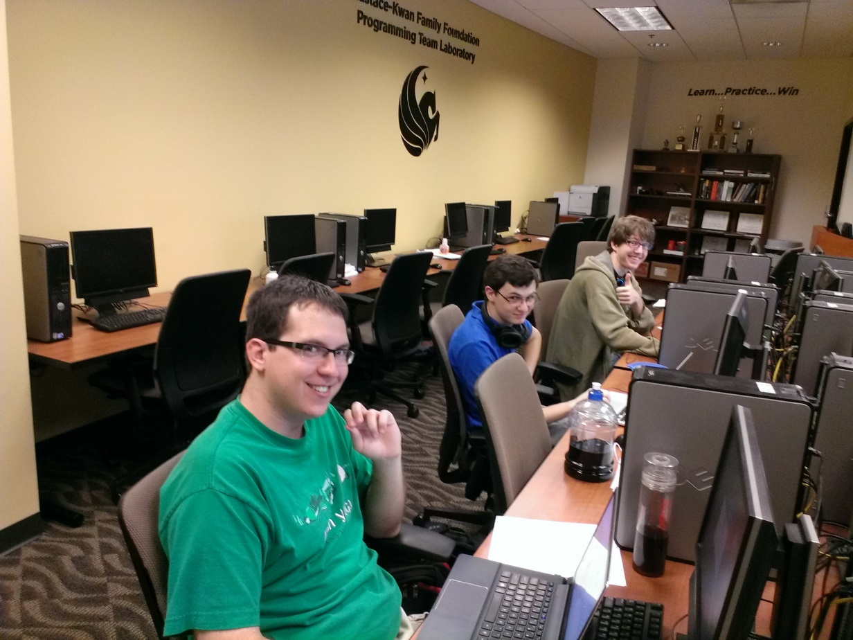
Private Donor Funds Team - 2008
Built dedicated Programming Team Lab(PTL)
Designed for collaboration
Team Members have 24 hour access.
Gave Students Scholarships
Allowed students not to seek outside work.

Slide 6
Difference Between Theory and Practice
Theory
Practice
Tryouts open to all students.
Practices and Lectures open to all students.
Funding provides a great incentive for students to practice.
The percentage of women trying out was less than the percentage of CS students that were women.
Funding didn’t alter this key fact.
Males disproportionately benefitted from training AND funding.

Slide 7
My Pitch for 2012
I requested some funding of scholarship money from our head coach, Dr. Ali Orooji to work with several women as part of a women’s team.
He agreed to allow me to allocate 35 hours/week worth of scholarship money. (10.4% of all scholarship hours)
I allocated the funds amongst 5 women, and 2 others joined the team without funding, for a total of 7.

Slide 8
Women’s Team Routine 2012
Saturdays
No lecture
Five hour mock contests – could be done on Saturdays, or during the week. (Usually individual)
Goal – to attempt to include students who had other Saturday commitments.
During the Week
Required lecture on algorithms/data structures.
Problem set based on lecture material
Saturday Problem Set Open Online
Some team meetings

Slide 9
2012 Women’s Team Outcomes
South East Regional
Took one all female team.
First year with D1/D2 designation.
No banger questions.
Team didn’t solve any problems.
Mercer Programming Contest
Took two all female teams.
Appropriate set based on ability.
Teams finished 15th and 16th, respectively. (out of 33 teams)

Slide 10
2012 Women’s Team Feedback
Other Coaches
Everyone needs to come to Saturday practices.
Women never hung out in the lab (PTL)
Progress seems slow.
Team Members
Didn’t become friends with other team members.
Felt other team members didn’t take them seriously.
Several members didn’t like the label “WPT”
Enjoyed Mercer Contest

Slide 11
Changes for 2013
Renamed “Developmental Team”
Included males as well (freshmen)
Required Saturday Practices
Paid all members for 10 hours/week. (Thus, pay allocated for women doubled since 7 women made the team for 70 hours/week, which was 16.7% of the scholarship hours.)

Slide 12
Results 2013
South East Regional – took two Dev Teams, both solved one problem. (Placed 16th and 35th out of 60+ teams.)
Mercer – Took three Dev teams, finished 3rd, 4th and 5th. None of the teams were all women, but a majority of the students who competed were women.
Women on team encouraged other women to take Programming Competition Class (COP 4516)

Slide 13
Feedback 2013
A few students were upset that Dev Team didn’t represent top finishers subsequent to the top five teams(Varsity).
Team members interacted with varsity members more, but the interaction was limited to a few individuals.
Some team members didn’t like being placed on particular teams.
Some team members were upset that they didn’t get to be official participants in either South East Regional or Mercer Contest

Slide 14
2014 Prospects and Tryout
Out of the eight best women, only two tried out!!!
Several cited a busy class schedules.
Others chose to pursue work opportunities.
A woman made the varsity team.
Four new women joined the Developmental Team.
Women received 95 hours/week worth of funding, for 21.1% of the total hours.

Slide 15
2014 Results
Mercer contest finish: 2nd, 4th and 5th.
South East Regional teams finished 1 and 0 problems, respectively. (16th place out of 60+ teams)
Much better integration of developmental team and varsity team than past two years.
More weekly homework being done.
Although the five women on the team this year started with much less expertise and background, they finished the year as strong as the 2013 group.

Slide 16
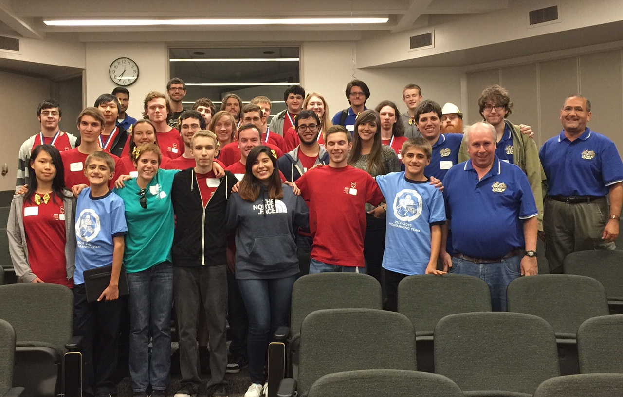
UCF Team at 2014 S. E. Regional

Slide 17
The Positives, So Far
Internships and Full-Time Job Offers
Microsoft
Google
Facebook
Intuit
Motorola
Goldman-Sachs
SalesForce
Snapchat
First female from Dev Team on our Varsity team.

Slide 18
Top Company X – Female Hiring

Slide 19
Lessons Learned – So Far
Any methods to enhance interaction between the Developmental Team and Varsity Team is good.
There is a strong correlation between getting one year of programming team training and being able to get a job with a top company.
As long as you get women who work hard and enjoy programming, it doesn’t matter what their background is. They can get to a level where they are competing at a moderate regional level in just a year.
Women tend to care about their courses more, so you must be willing to adapt to this fact.

Slide 20
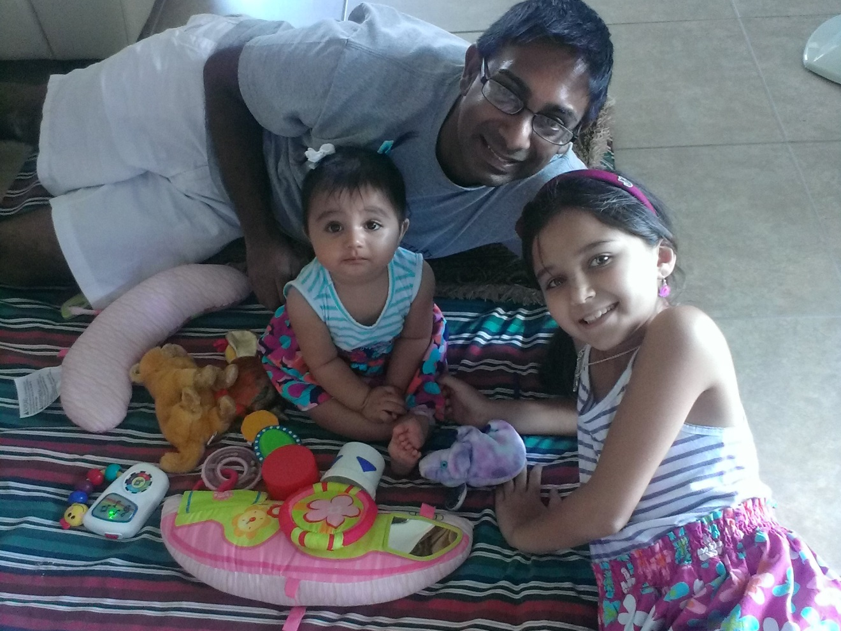
Any Questions or Comments?
Mr. Arup Guha, dmarino@cs.ucf.edu

