Slide 1

Cyber Security Education at UCF
Dr. Cliff Zou
Program Coordinator, Cyber Security and Privacy MS
Program Coordinator, Digital Forensics MS
Professor, Dept. Computer Science
changchun.zou@ucf.edu

Slide 2
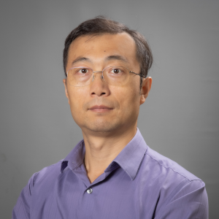
About Myself
Joined UCF Dept. Computer Science since 2005
PhD from UMass in 2005
Research: Cybersecurity, computer networking, cyber education
Program Coordinator:
Digital Forensic MS
Cyber Security and Privacy MS
Point-of-Contact of UCF CAE-CD and CAE-R accreditation
PI for UCF’s NSF CyberCorps Scholarship-for-Service (SFS) and DoD Cyber Service Academy (CSA) Scholarship programs
PI for UCF’s DoD Cyber Service Academy (CSA) Scholarship program

Slide 3
National Cybersecurity Accreditation
UCF Department of Computer Science obtained:
National Centers of Academic Excellence in Cyber Defense (CAE-CD) in 2016
Renewed CAE-CD in 2022, valid through 2027
National Centers of Academic Excellence in Cyber Research (CAE-R) in 2017
Renewed CAE-R in Fall 2024, valid through 2029
UCF Cybersecurity official website: https://www.ucf.edu/cybersecurity/

Slide 4
UCF Cybersecurity Educational Programs
Undergraduate:
Secure Computing and Networks (SCAN) Minor
Base for our CAE-CD accreditation since 2016
total 18 credit hours
4 required courses (below), plus 2 elective courses on cybersecurity
CIS3360 - Security in Computing (3)
CIS3362 - Cryptography and Information Security (3)
CNT4403 - Network Security and Privacy (3)
CIS4361 - Secure Operating Systems and Administration (3)
Cyber Operations Undergraduate Certificate

Slide 5
UCF Cybersecurity Educational Programs
Graduate:
Cyber Security and Privacy MS (since 2021)
Has both Technical Track and Interdisciplinary Track, 83 graduated after Spring’25
In Spring’23, we have 77 active students
In Spring’24, we have 116 active students
In Spring’25, we have 165 active students
Digital Forensics MS (since 2008)
566 graduated from the program after Spring’25
Has 110 active students in Spring’25 (99 are in the full online MS program)
In Feb. 2025, the online Master's degree in Digital Forensics program is ranked by U.S. News as No. 17 for “best online graduate computer information technology programs".
Modeling and Simulation of Behavioral Cybersecurity Certificate (since 2016, by SMST)
Cyber Risk Management Graduate Certificate (by Dept. Management)

Slide 6
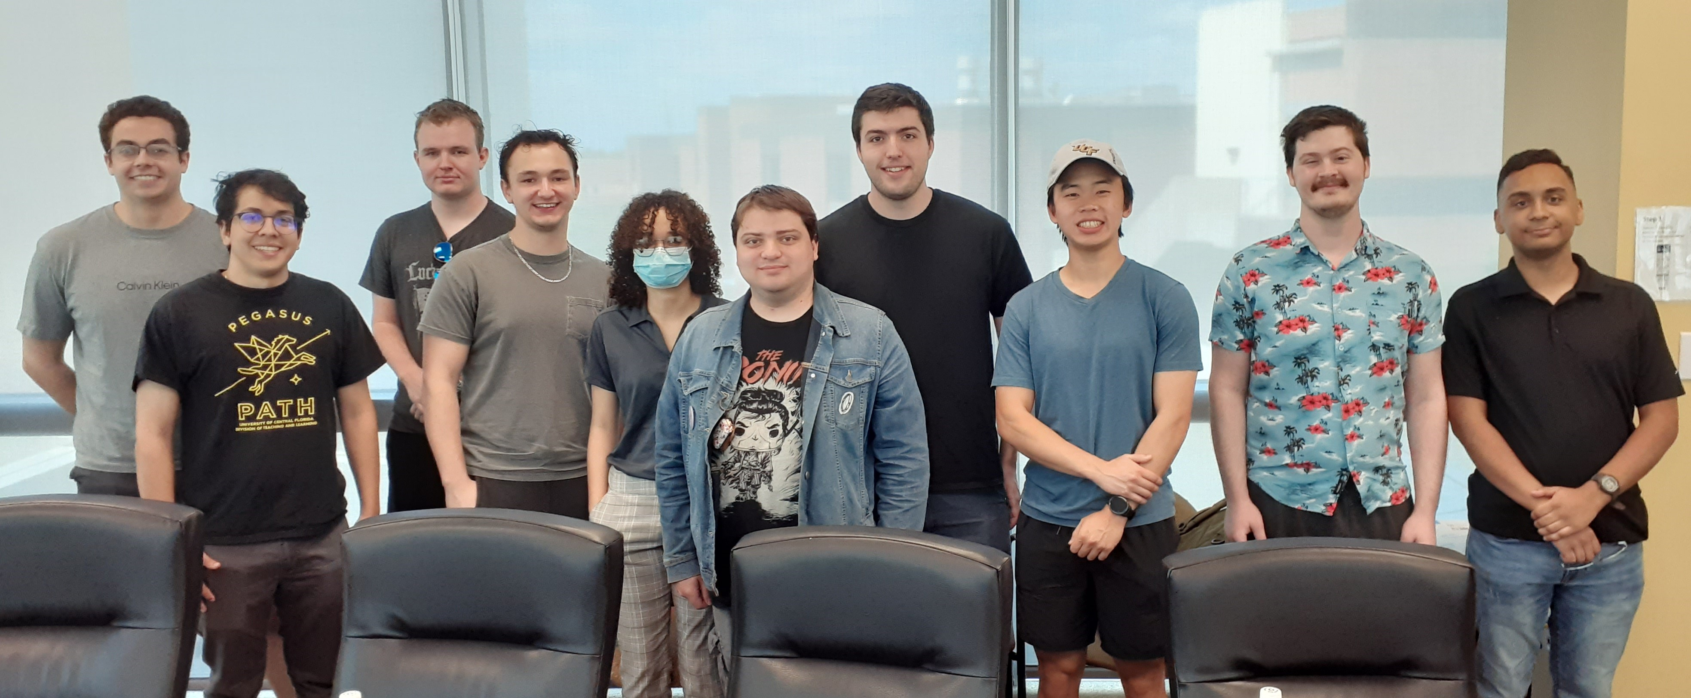
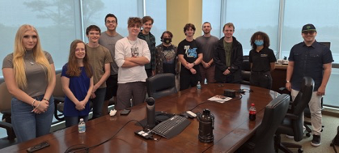
Cybersecurity Workforce Development and Activities
NSF SFS Scholarship: UCF was awarded with 3.5M Scholarship-for-Service (SFS) grant in 2021
6 scholars in 2021 cohort (selected from 30 applicants)
6 in 2022 cohort (selected from 30 applicants)
9 scholars in 2023 cohort (selected from 70 applicants)
9 scholars in 2024 cohort (selected from 57 applicants)
Graduated SFS scholars work in government agencies
2 in FDIC, 2 in Air Force, 2 in NSA
4 in Sandia National Lab
1 in Sheriff’s Office, 1 in CA Dept. Conservation
DoD Cyber Service Academy (CSA) Scholarship
UCF has one MS in Cyber student awarded for 2025-26

Slide 7
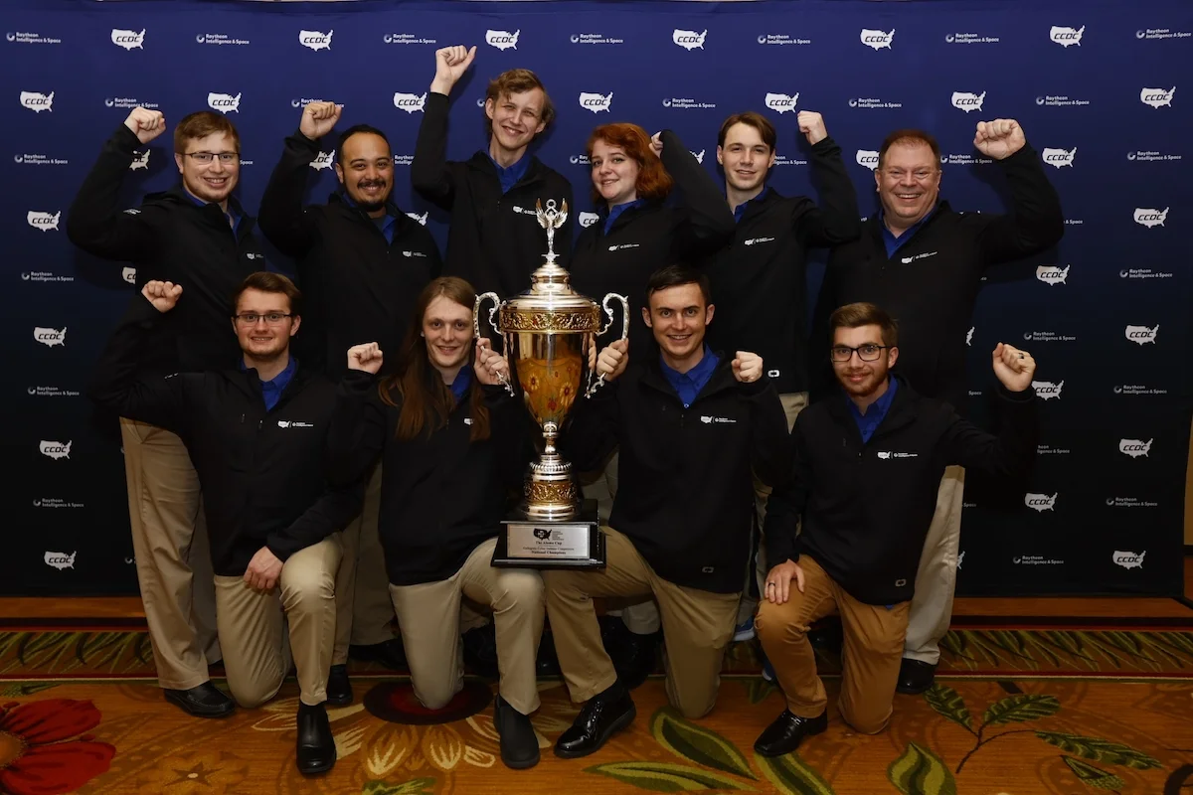
Cybersecurity Workforce Development and Activities
UCF has a well-known Collegiate Cyber Defense Student Club and achieved extraordinary cyber competition achievements
https://www.hackucf.org/
400+ student members
CCDC national championship: 2014, 2015, 2016, 2021, 2022, 2024
Won second-place on 2018, 219, 2020
DoE CyberForce championship: 2018, 2019, 2021, 2022, 2025
2022 NSA CAE-NCX (National Cybersecurity Exercise) Champions
And more: https://www.ucf.edu/cybersecurity/competitions/

Slide 8
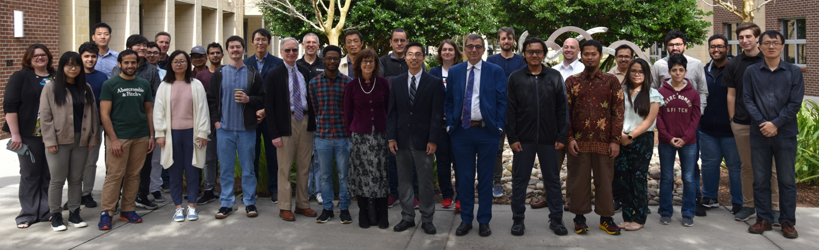
Cyber Security and Privacy Faculty Cluster
UCF established Cyber Security & Privacy Faculty Cluster in 2017
https://www.ucf.edu/research/cyber-security-privacy/
14 faculty members from CS, ECE, Model & Simulation, Politics, Health Informatics

Slide 9
