Slide 1
Penetration Testing− Reconnaissance 2
CIS 6395, Incident Response Technologies
Fall 2016, Dr. Cliff Zou
czou@cs.ucf.edu

Slide 2
Acknowledgement
Content from the book:
“The Basics of Hacking and Penetration Testing: Ethical Hacking and Penetration Testing Made Easy”, Second Edition

Slide 3
Attack Reconnaissance
Httrack: Website copier
Harvester: find email addresses in website
Netcraft.com: find target website information
Fierce: find all sub web domains belonging to target
Metagoofil: Find documents from target and download them, extract useful metadata

Slide 4
HTtrack
Included in Kali Linux
Usage: Clone a target website
Command line based website copier
GUI place: Applications → Web Application Analysis→httrack, will give you help manual
Run ‘httrack’ in command line, it asks settings step-by-step
Mostly use default options
Input target website URL
It maybe slow to download an entire URL

Slide 5
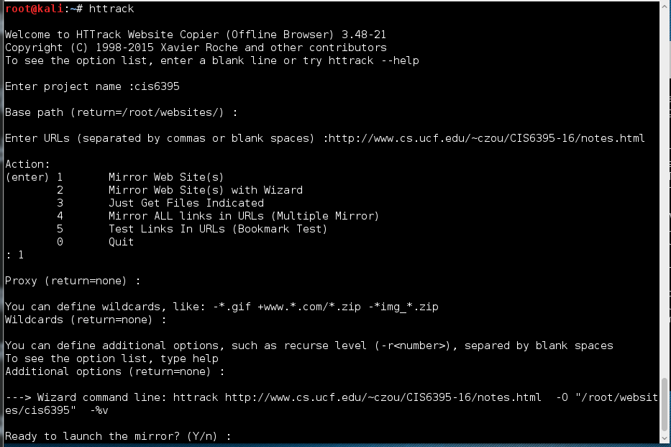
HTtrack

Slide 6
Harvester
Included in Kali Linux
Gather E-mail Accounts, Subdomains, Hosts, Employee Names – Information Gathering Tool
Command line:
theharvester –d cs.ucf.edu –l 100 –b google
-d: define target domain name
Search all possible websites inside that domain
Pro: Can be used to find out all possible websites in the target place
Useful for further reconnaissance
Con: Only websites, not other online machines

Slide 7
Harvester
It searches search engines, not the target website
Means that it will not generate noisy traffic to the target!
theharvester –d cs.ucf.edu –l 100 –b google
-d: define target domain name
-l: limit the number of results returned
-b: define which search engine to use
-b all: use all search engines
A youtube video: https://www.youtube.com/watch?v=0-OyZGbpSJk

Slide 8
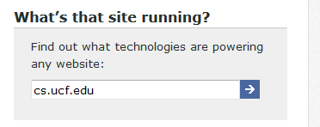
Netcraft.com
Type target website URL into the box
“what’s that site running?”
Provide results of:
Organization
Webserver OS, webserver software version
Webserver technologies
Pro: scans generated from netcraft.com, not your machine
Con: very basic information of the target, only about target web server

Slide 9
Fierce
Available in Kali Linux
Find out all possible domain names under a target domain
By conducting DNS enumeration queries
Example:
fierce –dns example.com
It will find out possible domain names end with “example.com”
Careful: Fierce will use brute force DNS queries to try many different names ending with the target domain
The above example tries 2280 possible names!
So be careful

Slide 10
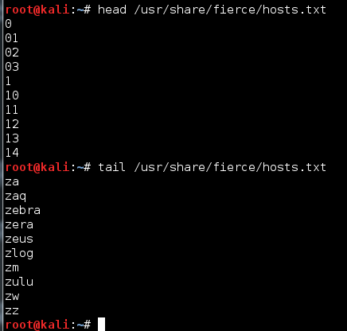
Fierce
Some online tutorials:
http://tools.kali.org/information-gathering/fierce
http://www.behindthefirewalls.com/2013/06/dns-enumeration-with-fierce-in.html
fierce –dns example.com
Will use a default name list (2280 entries) to search possible domain names end with ‘example.com’
You can edit the enumeration name list:
Con: Too much DNS noise!
Con: may not be complete

Slide 11
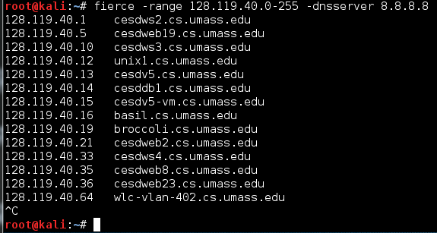
Fierce
Make reverse DNS lookup for a subnet space
You must provide option –dnsserver to specify which DNS server to send the queries to
Google provides high-speed public DNS servers that anyone can use: 8.8.8.8 and 8.8.4.4
Pro: Reverse lookup is better to find all domain names in an IP space without much DNS noise
So first find out the IP space of a target, then do reverse Fierce to a public DNS server (no alert traffic to the target)

Slide 12
Metagoofil
Available in Kali Linux
Not in our current version, but you can install it by typing in terminal:
root@kali:~# apt-get install metagoofil
Find documents, download them, and extract useful metadata from target.

Slide 13
Metagoofil
Usage: metagoofil options -d: domain to search -t: filetype to download (pdf,doc,xls,ppt,odp,ods,docx,xlsx,pptx) -l: limit of results to search (default 200) -h: work with documents in directory (use "yes" for local analysis) -n: limit of files to download (important to limit running time) -o: working directory (location to save downloaded files) -f: output file
metagoofil -d cs.ucf.edu -t pdf -l 100 -n 5 -o cspdf -f cspdf.html

Slide 14
Metagoofil
Besides files downloaded, metadata extracted are useful for reconnaissance
User name
windows or unix or mac?
Account name

Slide 15
Ethnical Attention
Some of today’s tools could be invasive and could generate a large amount of traffic (especially the Metagoofil)
Try target with care
Try small amount of downloads
Try small target first
Do not try on sensitive targets

Slide 16
Indepth Question: Fierce probing mechanism?
fierce –dns cs.ucf.edu
It will find out all domain names end with “cs.ucf.edu”
The above example tries 2280 possible names!
Please modify the Fierece ‘hosts.txt’ file before you try to reduce DNS queries!
How does it try those many DNS queries?
Investigation: Using Wireshark for monitoring
Kali Linux has preinstalled wireshark
Setup capturing option to only capture UDP or DNS traffic
Again, make sure you greatly shorten the ‘hosts.txt’ to reduce generated traffic

Slide 17
Understanding Fierce DNS Query Traffic
Reverse DNS lookup
Find domain name by query IP address
DNS type PTR record:
An opposite of the type A record
Dig -x IPaddress
Example: dig -x 209.132.183.81
;; QUESTION SECTION:
;81.183.132.209.in-addr.arpa. IN PTR
;; ANSWER SECTION:
81.183.132.209.in-addr.arpa. 600 IN PTR www.redhat.com.

Slide 18
A Few More Words on DNS Query
Dig any cs.ucf.edu:
find all records for target
Specify DNS server for query:
Nslookup searchName DNS-server-IP
Dig @DNS-server-IP searchName
But most DNS reject outside query!
We can use google’s public DNS server
https://developers.google.com/speed/public-dns/
IP: 8.8.8.8 or 8.8.4.4

