Slide 1
TaintScope: A Checksum-Aware Directed Fuzzing Tool for Automatic Software Vulnerability Detection
Tielei Wang1;2, Tao Wei1;2, Guofei Gu3, Wei Zou1;2
1Key Laboratory of Network and Software Security Assurance (Peking University),
Ministry of Education, Beijing 100871, China
2Institute of Computer Science and Technology, Peking University
3 Department of Computer Science & Engineering, Texas A&M University
{wangtielei, weitao, zouwei}@icst.pku.edu.cn, guofei@cse.tamu.edu
31st IEEE Symposium on Security & Privacy
Presented by - Swati Tripathi
CAP 6135 – SPRING 2013
University of Central Florida

Slide 2
Acknowledgement
This presentation has some content from
James Clause, Wanchun Li, and Alessandro Orso. Dytan: A Generic Dynamic Taint Analysis Framework. In ISSTA’07, July 9–12, 2007, London, England, United Kingdom
Lecture Slides -http://www.seas.harvard.edu/courses/cs252/2011sp/slides/Lec13-SymExec.pdf
Presentation : TaintScope

Slide 3
Checksum
A common way to check the integrity of data
Widely used in network protocols and many file formats
Checksum algorithms –Alder-32, CRC, MD5.
data
Checksum function
data
Checksum field
Notes:
the basic pattern to check the integrity of an input instance at receiving end is to recompute a new checksum of the input instance and compare it with the checksum attached in the input instance. A mismatch indicates a corrupted input instance.

Slide 4
Fuzzing
Software testing technique
Generate malformed inputs (invalid, unexpected, or random test cases) and feed them to an application
In the best case, malformed inputs will explore different program paths, and trigger security vulnerabilities

Slide 5
Dynamic Taint Analysis
Tracks the information ﬂow within a program by
associating one or more markings with some data values in the program
propagating these markings as data values ﬂow through the program during execution

Slide 6
Example code - Explicit information ﬂow
1 i n t a , b , w, x , y , z ;
2 a = 1 1 ;
3 b = 5 ; Taint variable a, b with marking ta and tb
4 w = a ∗ 2 ;
5 x = b + 1 ;
6 y = w + 1 ;
7 z = x + y ;
At the end of execution taint marking are
w-> {ta}
x -> {tb}
y -> {ta}
z -> {ta , tb}
Notes:
explicit information ﬂow, that is, direct involvement of a tainted variable in the computation of another variable’s value.

Slide 7
Example code - Implicit information ﬂow
1 void foo ( i n t a ) {
2 i n t x , y ; Taint variable a with marking ta
3 i f ( a > 10) {
4 x = 1 ; ta affects x’s value through a control dependence
5 }
6 e l s e {
7 x = 2 ;
8 }
9 y = 1 0 ;
10 p r i n t ( x ) ;
11 p r i n t ( y ) ;
12 }
At the end of execution taint marking are
x-> {ta}
y -> none
Notes:
implicit information ﬂow, which refers to situations in which a tainted data value affects the value of another variable indirectly.(due to control dependences2
in the code)

Slide 8
Symbolic Execution
Analysis of programs by tracking symbolic rather than actual values
Used to reason about all the inputs that take the same path through a program

Slide 9
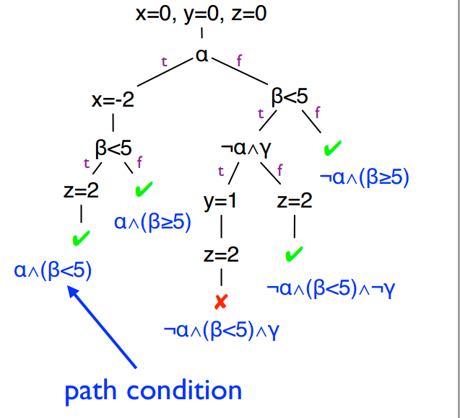
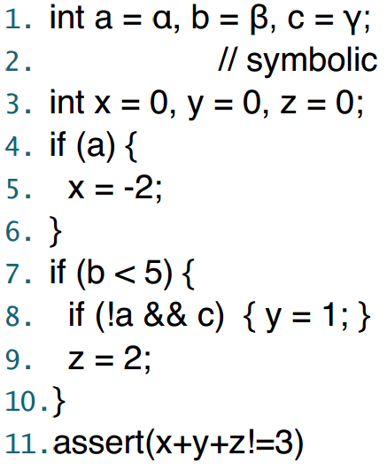
Symbolic Execution Example
Code:
Symbolic execution tree:
- “Simulate” the code using symbolic values instead of program numeric data
(PC=“path constraints”)
Notes:
During symbolic execution, we are trying to determine if certain formulas are satisﬁable
•E.g., is a particular program point reachable? •Figure out if the path condition is satisﬁable •E.g., is array access a[i] out of bounds?
•Figure out if conjunction of path condition and i<0 ∨ i > a.length is satisﬁable •E.g., generate concrete inputs that execute the same paths
This is enabled by powerful SMT/SAT solvers
By negating some of the conditions in the Path Constraint, and by using a constraint solver to obtain satisfying assignments to the modified Path Constraint it is possible to generate inputs that explore new parts of the program.
Can substitute all program inputs with symbolic values, gather input constraints on a program trace and generate new inputs that can drive program executions along different traces.
These systems are able to provide good code coverage and have proven to highly improve the effectiveness of traditional fuzzing tools.

Slide 10
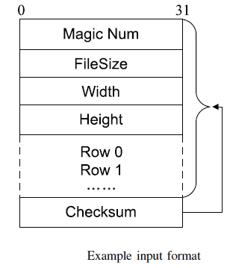
The Problem
The input mutation space is enormous .
Most malformed inputs dropped at an early stage, if the program employs a checksum mechanism. File Format
Real size of input
Image Data

Slide 11
Example Code
re-compute a new checksum
1 void decode_image(FILE* fd){
2 ...
3 int length = get_length(fd);
4 int recomputed_chksum = checksum(fd, length);
5 int chksum_in_file = get_checksum(fd);
//line 6 is used to check the integrity of inputs
6 if(chksum_in_file != recomputed_chksum)
7 error();
8 int Width = get_width(input_file);
9 int Height = get_height(input_file);
10 int size = Width*Height*sizeof(int); //integer overflow
11 int* p = malloc(size);
12 ...
13 for(i=0; i<Height;i++){// read ith row to p
14 read_row(p + Width*i, i, fd); //heap overflow
If the two values mismatch, the code raises an error and exits immediately.
Read the attached checksum
compare two values
Notes:
Finally, the code reads image data row by row into the allocated buffer.
However, a specially crafted image containing large width and height values can cause an integer overflow in the above
expression (line 10) and further lead to an insufficient memory allocation at line 11. A heap overflow will eventually
occur when the code reads image data into memory, leading to a potential attack.

Slide 12
The Key Idea
To infer whether/where a program checks the integrity of input instances
Identify which input bytes can flow into security-sensitive points
Taint analysis at byte level – monitors how application uses the input data.
Create malformed input focusing the “hot bytes”
Repair checksum fields in input, to expose vulnerability
Notes:
can perform checksum-aware fuzzing
(e.g., memory allocation function malloc(), string manipulation function strcpy())

Slide 13
TaintScope
An automatic fuzzing system using dynamic taint analysis and symbolic execution techniques
Identify checksum fields in input instances, accurately locate checksum-based integrity checks in target code
Directed fuzzing tool working at X86 binary level, based on fine-grained dynamic taint tracing
Fully automatic from detecting checksum, directed fuzzing, to repairing crashed samples
Notes:
TaintScope identifies which bytes in a well-formed input are used in security-sensitive operations (e.g.invoking system/library calls) and then focuses on modifying such bytes.

Slide 14
TaintScope – Four Phases of Execution
Dynamic Taint Tracing
Hot Byte Information
Checksum Information
Detecting Checksum Check Points
Directed Fuzzing
Based on hot bytes information generate malformed test cases
Bypass Checksum check points to allow malformed input to propagate
4.Repair Crashed Samples
Fixing checksum field in test cases
Notes:
TaintScope neither depends on the source code nor on the input format specification.
1) which input bytes pollute the arguments of specified API functions; and
2) which input bytes each conditional jump instruction (e.g.,JZ, JE, JB) depend on. [monitor which input bytes can influence the execution context of any program point]

Slide 15
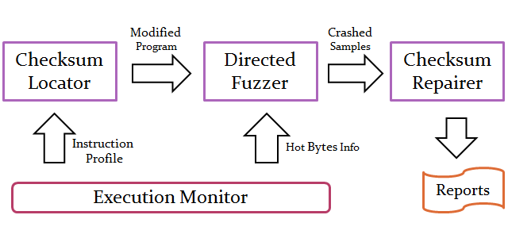
TaintScope System Overview
Notes:
execution monitor to dynamically instrument the program P and monitor how the program P processes the input data I.
TaintScope uses a checksum detector to locate potential checksum check points in the program P.
The output of this phase is the test cases that could cause the program to crash or consume 100% CPU.

Slide 16
Dynamic Taint Tracing
First runs program with well formed inputs
Execution monitor records :
Hot Bytes Information– Input bytes that pollutes the arguments of specified API function (e.g. malloc, strcpy)
Checksum Information– Input bytes each constructional jump instruction depends on
Considers only data flow dependencies (no control flow)

Slide 17
Dynamic Taint Tracing
Instruments instructions - data movement (e.g.,MOV, PUSH), arithmetic (e.g., SUB, ADD), and logic (e.g., AND, XOR).
Taints all values written by an instruction with the union of all taint labels associated with values used by that instruction
The eflags register is also considered.
eax {0x6, 0x7}, ebx {0x8, 0x9}
add eax, ebx
eax {0x6, 0x7, 0x8, 0x9}, eflags {0x6, 0x7, 0x8, 0x9}

Slide 18
Dynamic Taint Tracing - Example
Size of Input File is 1024 bytes
Analysts are interested in the size argument of memory allocation function malloc()
Hot bytes report will include entry:
0x8048d5b: invoking malloc: [0x8,0xf]
Explanation - Instruction at 0x8048d5b calls function malloc and the size argument depends on input bytes in the range from 0x8 to 0xf
Analyst are interested in input bytes on which JZ conditional jump instruction depends
Checksum information report will include entry
0x8048d4f: JZ: 1024: [0x0, 0x3ff]
Explanation - the conditional jump instruction JZ at 0x8048d4f depends on 1024 input bytes in the range from 0x0 to 0x3ff.

Slide 19
Detecting Checksum
A checksum detector is used to locate potential checksum check points in the program
Instruments all conditional jump instructions
Before the execution , checks whether the number of marks associated with the eflags register exceeds a predefined threshold value
If so, the conditional jump instruction is considered to be a potential checksum check point.

Slide 20
Detecting Checksum
Refinement:
Well-formed inputs can pass the checksum test,
but most malformed inputs cannot

Slide 21
Detecting Checksum
Refinement:
Well-formed inputs can pass the checksum test,
but most malformed inputs cannot
Run well-formed inputs, identify the always-taken and always-not-taken instructions.

Slide 22
Detecting Checksum
Refinement:
Well-formed inputs can pass the checksum test,
but most malformed inputs cannot
Run well-formed inputs, identify the always-taken and always-not-taken instructions.
Run malformed inputs, also identify the always-taken and always-not-taken instructions.

Slide 23
Detecting Checksum
Refinement:
Well-formed inputs can pass the checksum test,
but most malformed inputs cannot
Run well-formed inputs, identify the always-taken and always-not-taken instructions.
Run malformed inputs, also identify the always-taken and always-not-taken instructions.
Identify the conditional jump instructions
that behaves completely different when
processing well-formed and malformed inputs
Notes:
This is checksum check point.

Slide 24
Detecting Checksum - Example
The checksum detector identifies the conditional jump instruction JZ at 0x8048d4f as an integrity check
The checksum detector generates a bypass rule
0x8048d4f: JZ: always-taken
Explanation - the branch instruction JZ at 0x8048d4f needs to be always taken.

Slide 25
Detecting Checksum
Checksum field identification
6 if(chksum_in_file != recomputed_chksum)
7 error();
recomputed_chksum is a value depending on a considerable number of input bytes
chksum_in_file is a value only derived from a few input bytes
input bytes that can affect chksum_in_file are considered as the checksum field

Slide 26
Directed Fuzzing
A fuzzer module is responsible for generating malformed test cases and feeding them back to the target program
If the checksum detector does not generate bypass rules, the fuzzer directly feeds malformed test cases to the original program
If bypass rules is generated the fuzzer feeds malformed test cases to an instrumented program
According to the bypass rules, the fuzzer alters the execution traces at checksum check points - sets the eflag registers

Slide 27
Directed Fuzzing
All malformed test cases are constructed based on the hot bytes information obtained during dynamic taint analysis
Bytes that can influence memory allocation functions are set to small, large or negative integer values
Bytes that flow into string functions are replaced by malformed characters, such as %n, %p
Output - test cases that could cause the program to crash or consume 100% CPU.

Slide 28
Directed Fuzzing - Example
6 if(chksum_in_file != recomputed_chksum)
7 error();
8 int Width = get_width(input_file);
9 int Height = get_height(input_file);
10 int size = Width*Height*sizeof(int);
11 int* p = malloc(size);
Checksum report “hot bytes” report
… …
0x8048d4f: JZ: 1024: [0x0,0x3ff] 0x8048d5b: invoking malloc: [0x8,0xf]
… …
Bypass info
0x8048d4f: JZ: always-taken
Before executing 0x8048d4f, the fuzzer sets the flag ZF in eflags to an opposite value

Slide 29
Repairing Crashed Samples
Needs to fix checksum fields in the malformed test cases that cannot pass checksum checks in the original program but cause the instrumented program to crash
The classical solution is using combined concrete and symbolic execution techniques

Slide 30
Repairing Crashed Samples
Cr – row data in the checksum field
T – transformation
D – input data protected by checksum field
Checksum() – the complete checksum algorithm
Using symbolic execution to solve:
Collect the constraints by symbolic execution and solve the constraints
It is hard or impossible, if both input data and checksum field are symbolic values
Checksum(D) == T(Cr)

Slide 31
Repairing Crashed Samples
We want to pass the constraint:
Checksum(D) is a runtime determinable constant:
Only Cr is a symbolic value.
Simplified constraint does not depend on checksum algorithm
Common transformations (e.g. converting from hex/oct to decimal), can be solved by existing solvers (STP)
If the new test case cause the original program to crash, a potential vulnerability is detected.
Checksum(D) == T(Cr)
c== T(Cr)
Notes:
This contrasts with prior symbolic execution methods which would require ALL of the bytes involved in the checksum computation to be handled symbolically
Data bytes that are dependencies to the checksum become concrete values, simplifying the constraint solving for the checksum field
This allows for many current constraint solvers to be adequate to solve this simple checksum constraint

Slide 32
Evaluation
Applied on large number of real world applications.
Incomplete list of applications used in experiment are -

Slide 33
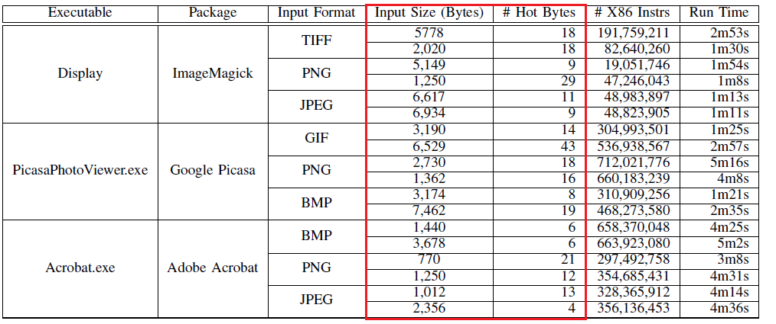
Evaluation-Hot Byte Identification
Evaluated the performance of the execution monitor and measured the portion of hot bytes in well-formed inputs
Notes:
Input bytes that can flow into memory allocation functions are considered as hot bytes.
The size of well-formed inputs is roughly in the range from 1,000 to 7,000 bytes, but the number of hot bytes is less than 50.The reason is that memory allocations during displaying an image usually depend on only a few fields in the image, such as the width, length and color depth fields.
We also measured the trace length and performance overhead, as shown in the two rightmost columns. The performance overhead is acceptable.

Slide 34
Evaluation-Checksum Check Points Identification
Six file format chosen which employ different checksum algorithm –
PNG
Divided into chunks and each chunk has an associated CRC stored with it
Compressed data stream stored in zlib format, that uses Alder-32 checksum
PCAP – Contains checksum in TCP/UDP packets in PCAP file
CVD (ClamAV Virus Database) – MD5 Checksum
VCDIFF(Generic Differencing and Compression Data Format) - Alder32 checksum
Tar – Checksum calculated on 512 byte header
Intel HEX – Checksum value calculated on the data
Notes:
PNG, a popular image format
PCAP, a widely used format for dumping network packet traces
VCDIFF (Generic Differencing and Compression Data Format) [46] is a general, efficient and portable data format suitable for delta encoding.
Tar archive format is widely used on Unix-like systems.
Intel HEX [7] is a text format

Slide 35
Evaluation-Checksum Check Points Identification
Input well-formed test cases to target applications and execution monitor identified potential checksum check points in target applications
Input malformed test cases to target application and employed branch profiling techniques to refine the set A
Notes:
1-2 column - applications
A – potential checksum point
if a conditional jump instruction depends on more than 16 input bytes, it is considered as a potential checksum check, the threshold 16 is chosen empirically.
j(P1 \ P′0) [ (P0 \ P′1)j - Real checksum check points
several wellformed test cases and slightly more than ten malformed test cases are enough to locate the checksum check points in target programs.

Slide 36
Evaluation – Checksum Field Identification and Repair
Accurately identified the number and the size of checksum fields in each well-formed instance
Automatically generate valid checksum fields for given test cases

Slide 37
Evaluation – Fuzzing Result
TaintScope has detected 27 severe vulnerabilities in widely used applications and libraries
Most vulnerability identified were buffer overflow, integer overflow, double free, null pointer dereference, and infinite loop
Secunia and oCERT have confirmed and published security advisories for most of these vulnerabilities
Vendors have also released corresponding patches

Slide 38
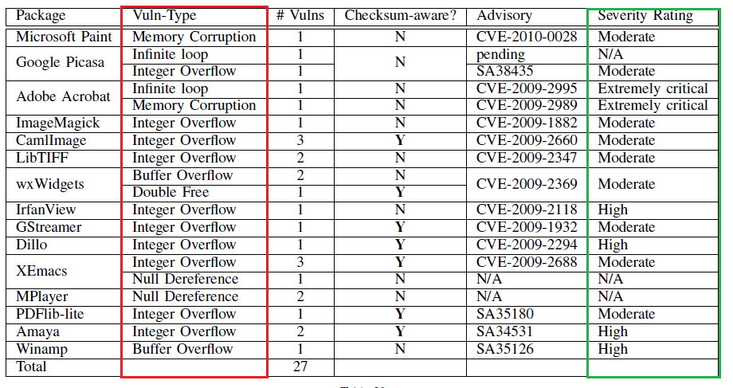
Evaluation – Fuzzing Result
High – Remotely exploitable vulnerabilities
Moderate - vulnerabilities that require user interaction

Slide 39
Contributions
Taintscope is the first “checksum aware” fuzzing tool
Neither depends on the source code nor on the input format specification.
Directed Fuzzing used to dramatically reduce mutation space
Accurately locate checksum check points and checksum field in input format
Automatically fix checksum field in malformed test cases using concrete and symbolic execution techniques
Detected a number of serious real world problems
Notes:
TaintScope directly works on binary executables and can monitor the execution of all libraries.
TaintScope directly leaves all bytes concrete except those in the checksum fields, which significantly reduces the complexity of the trace constraints.

Slide 40
Weaknesses
TaintScope cannot deal with secure integrity check schemes (e.g. keyed cryptographic hash algorithms or digital signature) – impossible to generate test cases with valid digital signature
Limited effectiveness when all data input are encrypted – difficulty in processing decrypted data
Control flow dependencies are not considered
Execution monitor does not instrument all kinds of x86 instruction
Notes:
which are designed to protect against intentional data alteration
After data decryption, the complex data dependency relationships will heavily influence hot bytes detection and checksum identification
Due to the complexity of the x86 instruction set, the current execution monitor in TaintScope system does not instrument all kinds of x86 instructions.

Slide 41
Improvements
Control flow dependencies should be also considered during taint propagation
Protection against intentional data alterations should be implemented
Code coverage based input selection and mutation can also be used during fuzzing

Slide 42
QUESTIONS ?

