Slide 1
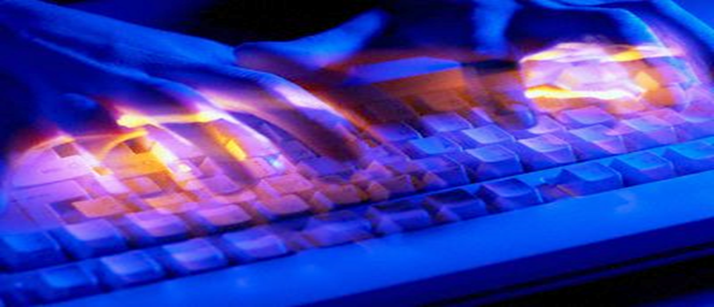
I can be You: Questioning the use of Keystroke Dynamics as Biometrics
—Paper by Tey Chee Meng, Payas Gupta, Debin Gao
Presented by:
Kai Li
Department of Computer Science
University of Central Florida
Orlando FL 32816

Slide 2
Outline
Introduction
Approaches of keystroke biometric system
  Keystroke features
  Anomaly detection and accuracy measures
Experimental Design
Experimental Results
Conclusion
My Comments
  Contributions
  Weaknesses

Slide 3
Biometrics
Physiological biometric: biometric based on the physical trait of an individual
  Facial features
  Fingerprints
  DNA
Behavioral biometric: biometric based on the behavioral trait of an individual
  Signatures
  Handwriting
  Typing patterns (i.e. key stroke dynamics)

Slide 4
Keystroke biometrics
Using keystroke dynamics is based on the assumption that each person has a unique keystroke rhythm
Question the uniqueness property:
  Is imitation possible ?
  What information is needed to imitate?
  How to effectively imitate ?

Slide 5











Keystroke features
Pressing and releasing a keystroke pair $(k_{a},k_{b}),$results in 4 timings:
  Key-down time: ${t_{k_{a}}}^{↓}$
  Key-up time: ${t_{k_{a}}}^{↑}$
  Key-down time: ${t_{k_{b}}}^{↓}$
  Key-up time: ${t_{k_{b}}}^{↓}$
Four features are derived
  Inter-stroke timing: $I_{k_{a},k_{b}}={t_{k_{b}}}^{↓}−{t_{k_{a}}}^{↓}$
  Holding time of $k_{a}$: $H_{k_{a}}={t_{k_{a}}}^{↑}−{t_{k_{a}}}^{↓}$
  Holding time of $k_{b}$: $H_{k_{b}}={t_{k_{b}}}^{↑}−{t_{k_{b}}}^{↓}$
  Up-down timing: $U_{k_{a}}={t_{k_{b}}}^{↓}−{t_{k_{a}}}^{↑}$
$$I_{k_{a},k_{b}}$$
$${t_{k_{a}}}^{↓}$$
$${t_{k_{a}}}^{↑}$$
$${t_{k_{b}}}^{↓}$$
$${t_{k_{b}}}^{↑}$$
$$H_{k_{a}}$$
$$U_{k_{a}}$$
$$H_{k_{b}}$$
$$K_{a}$$
$$K_{b}$$

Slide 6


Keystroke features
The feature for a password of length $l$ can be represented as a $(2l−1)$-dimensional vector
x = $(I_{k_{1},k_{2}},…,I_{k_{l−1},k_{l}},H_{k_{1} },…,H_{k_{l} })$
Inter-keystroke time
Hold time
For each user, n sample of the above feature vectors will be collected, for which the mean and absolute deviation will be calculated
$$\overline{x}= \frac{1}{n}\sum_{i=1}^{n}{x_{i}}, d=\frac{1}{n−1}\sum_{i=1}^{n}{\left|x_{i}−\overline{\text{x}}\right|}$$

Slide 7

Anomaly Detection
Given a test vector $ts$, two kinds of anomaly scores can be computed:
  Euclidean distance based anomaly score
$$a_{e}=\sqrt{\sum_{j=1}^{2l−1}{{({ts}_{j}−\overline{x_{j}})}^{2}}}$$
  Manhattan distance based anomaly score
$$a_{s}=\sum_{j=1}^{2l−1}{\frac{\left|{ts}_{j}−\overline{x_{j}}\right|}{d_{j}}}$$

Slide 8

Anomaly Detection
Keystroke biometric classification
  Anomaly detectors take a test vector as input and output one bit indicating positive or negative
  A threshold $a_{T}$ is chosen to map the anomaly score to positive or negative
  $$Classify[a\left(ts\right)]=\left\{\begin{matrix}postive, a>a_{T} \\ negative, a ≤a_{T}\end{matrix}\right.$$

Slide 9
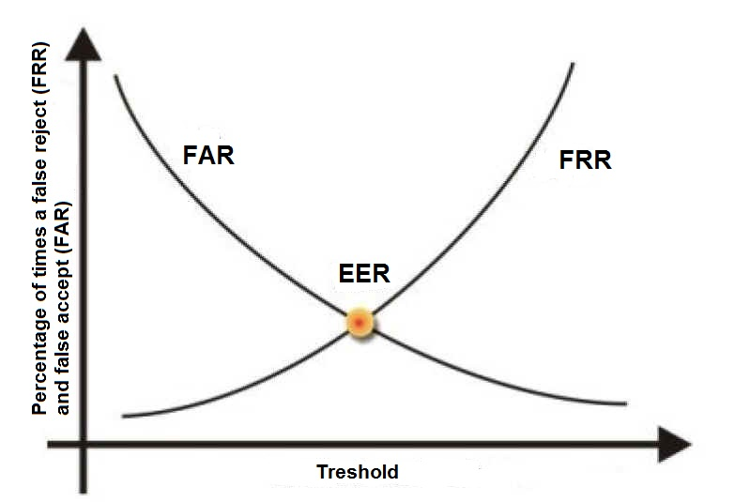

Anomaly Detection
Classification accuracy measures
  FRR – false rejection rate
    FRR decreases with higher threshold
  FAR – false acceptance rate
    FAR increases with higher threshold
  EER – equal error rate FRR = FAR
    $a_{T}$ can be chosen based on EER
FRR
FAR

Slide 10
Experiment Design
Attack scenarios
  The attacker is able to acquire the victim patterns from a compromised biometrics database
  The attacker is able to capture samples of the victim’s keystroke (e.g. by installing a key-logger)
Choice of password
  Weak password: ‘serndele’
  Strong password: ‘ths.ouR2’

Slide 11
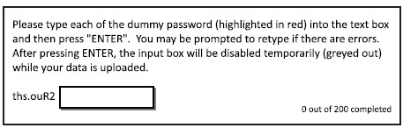
Experiment Design
Four sets of experiments are designed
  Experiment 1 (e1)
    Goal: User Data Collection
    Details: 88 users were asked to submit 200 samples for each of the two passwords using an existing keystroke dynamics based authentication system.

Slide 12
Experiment Design
Four sets of experiments are designed
  Experiment 2 (e2):
    Goal: Evaluate imitation results given partial user data as feedback
    Details: 84 participants played the role of attackers. 10 victims were randomly chosen from e1. Each attacker was randomly assigned one of the 10 victims, and was given the victim’s mean vector for 30 minutes imitation task. Attackers gets real-time feedback based on Euclidean distance based anomaly score.

Slide 13
Experiment Design
Four sets of experiments are designed
  Experiment 3 (e3a):
    Goal: Investigate the effect an additional session has on the imitation performance
    Details: 14 best attackers were chosen from e2 to perform the same imitation task in e2 for only 20 minutes.
  Experiment 4 (e3b):
    Goal: Investigate the imitation performance of highly motivated attackers in optimal environment (e.g. full victim parameters, extended time)
    Details:14 attackers are the same as in e3a. Feedback is based on full victim typing pattern information (Manhattan distance and absolute deviation)

Slide 14
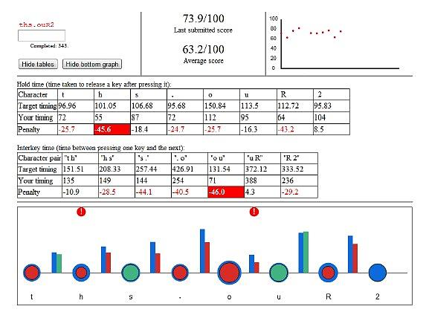
Experiment Design
Feedback interface: Mimesis

Slide 15
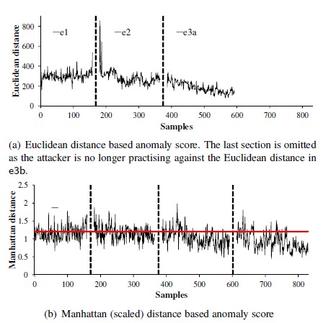
Experiment Results
Typing profile of an attacker

Slide 16
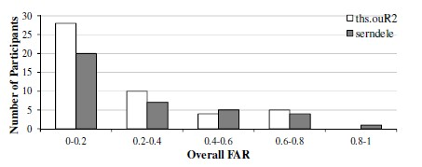
Experiment Results
Results from e1: collision attack
  Given a target organization with 10 high value targets, if a team of 84 attackers were to be assembled, we expect to find on average, one attacker with the same typing pattern as one of the high value targets.

Slide 17
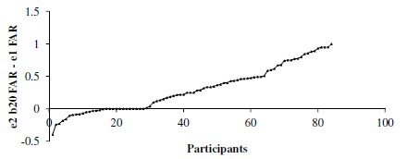
Experiment Results
Imitation outcome of e2
  b20 data set: an attacker’s best 20 consecutive tries in an experiment
Attackers with degraded performance
Attackers with improved performance

Slide 18
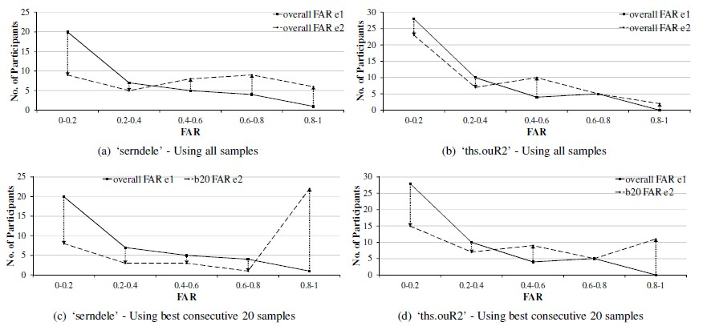
Experiment Results
Results from e2: effect of password difficulty
The effectiveness of keystroke biometrics in mitigating weak passwords is lesser than assumed

Slide 19
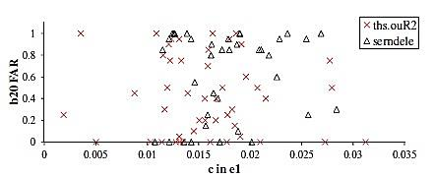

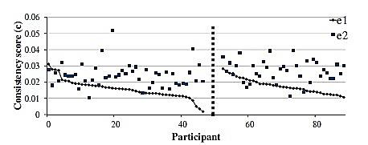
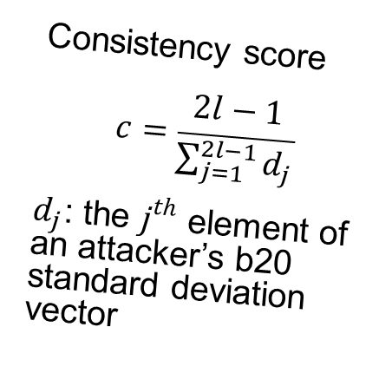
Experiment Results
Results from e2: effect of attacker consistency
Consistency score
$$c=\frac{2l−1}{\sum_{j=1}^{2l−1}{d_{j}}}$$
$d_{j}$: the $j^{th}$ element of an attacker’s b20 standard deviation vector
Imitation performance based on consistency in e1
Consistency scores in e1 and e2

Slide 20
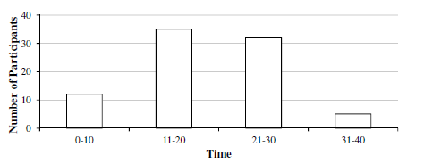
Experiment Results
Results from e2: effect of training duration
  56% attackers took no more than 20 minutes to reach their b20 performance.
Time required to reach b20 performance

Slide 21
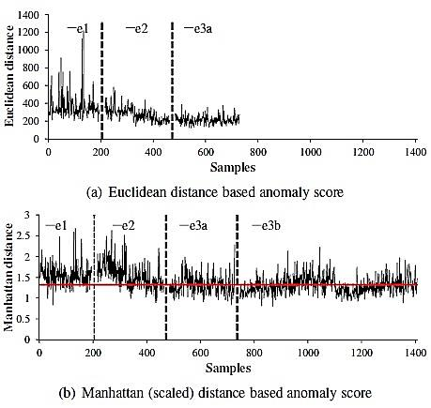
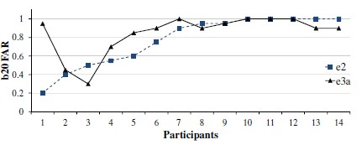
Experiment Results
Imitation outcome of e3a
  6 attackers improved their b20 FAR
  4 attackers unchanged
  4 attackers worsened

Slide 22
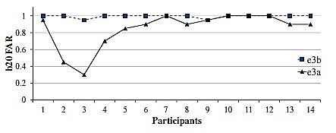
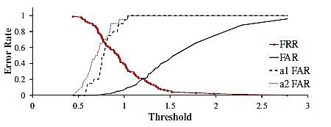
Experiment Results
Imitation outcome of e3b
Almost all attackers were able to achieve near perfect imitation of their victims
The original FRR and FAR of a victim, and the FAR of his two assigned attackers

Slide 23
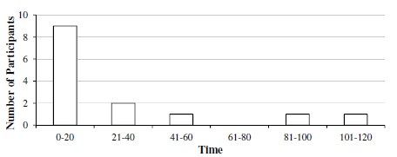
Experiment Results
Results from e3b: training time to achieve b20 FAR
  64% attackers peak their performance in 20 minutes or less
  Two highly motivated participants took nearly 2 hours

Slide 24
Experiment Results
Factors affecting imitation outcome
  Gender: male performs significantly better than females
  Initial typing similarity with the victim: weak correlation
  Typing speed, keyboard, Number of trials per minute are not affecting factors

Slide 25
Conclusion
A user’s typing pattern can be imitated
  Trained with incomplete model of the victim’s typing pattern, an attacker’s success rate is around 0.52
  The best attacker increases FAR to 1 after training
  When the number of attackers and victims are sizeable, chance of natural collision is significant
Factors that affect the imitation performance
  Easier passwords are easily imitated
  Males are better imitators

Slide 26
Comments
Contributions
  Extensive experiments are designed to study different keystroke dynamic imitation scenarios
  Show by concrete results that keystroke dynamics biometric system can be compromised by attackers after imitation training
  Design a friendly user interface for imitation training
Weakness
  Deliberately exclude the key up-down timing, which might have an negative on the imitation
  b20 performance do not actually represent real attacking performance
  Too many experiments, some are not important. Technical contribution is limited.

Slide 27
Questions?

