Slide 1
A Presentation Of
TaintDroid & Related Topics
Based on the OSDI’10 paper “TaintDroid: An Information-Flow Tracking System for Realtime Privacy Monitoring on Smartphones”
Presented by Toby Tobkin
for CAP6135 Spring 2013
Notes:
This paper came from the 9th USENIX Symposium on Operating Systems Design and Implementation
By related topics, I mean additional general information that will help you understand this paper.

Slide 2
Paper Information
TaintDroid: An Information-Flow Tracking System for Realtime Privacy Monitoring on Smartphones
9th USENIX Symposium on Operating Systems Design and Implementation
Authors:
  William Enck The Pennsylvania State University
  Peter Gilbert Duke University
  Byung-Gon Chun Intel Labs
  Landon P. Cox Duke University
  Jaeyeon Jung Intel Labs
  Patrick McDaniel The Pennsylvania State University
  Anmol N. Sheth Intel Labs

Slide 3
Presentation Overview
Introduction 15 slides
TaintDroid 5 slides
Experiment 5 slides
Concluding Remarks 4 slides
Notes:
In case you get bored with my presentation, knowing when it will end will probably make you less anxious.
Unless otherwise indicated somehow, much of this presentation will be told from the viewpoints of Enck et al. The implementation of the software described in the paper is very complex, and as such, I will only be giving a high-level description of what was done.

Slide 4
Introduction
Motivation, Taint Analysis

Slide 5
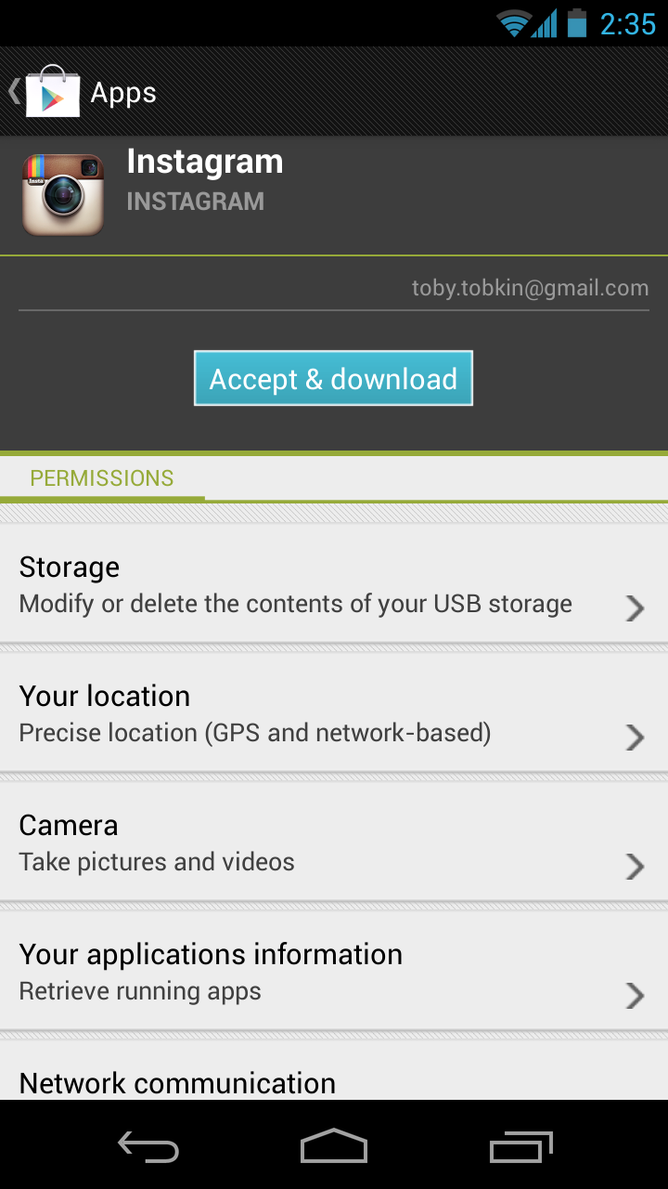
Motivation
Historical problem with computer software: privacy violations
  Unwitting users
Problem exacerbated by smartphones
  Almost ubiquitously store private information
  Large array of sensors
  Monetization pressures to detriment of user privacy
  Cited by paper: [12, 19, 35]
Android’s coarse-grained privacy control
Notes:
Almost ubiquitously store: I’m sure you’re all aware, but cellular phones tend to contain data such as contacts, account information, and lascivious images.
Large array: GPS, accelerometers, cameras, microphones
Monetization: Security is, intrinsically, a secondary concern in most situations, and mobile application distribution is certainly such a situation. The foremost goal of the App Store or the Play Store is to sell applications, and placing more cumbersome security requirements on their distribution is obviously at odds with this.
Incidents of problems exacerbated by smartphones: [35, 12] & [19]

Slide 6
Motivation
Current privacy control methods arguably inadequate
Idea:
  Can’t change the current system without repercussions
  Instead, create a method to audit untrusted applications
Execution:
  Must be able to detect potential misuses of private information, and
  be fast enough to be usable
Android’s coarse-grained privacy control
Notes:
Idea: Since the phrase goes, “Money talks” and not “security talks,” obviously a smart solution is to have some workaround method of determining whether user privacy is being respected or not.

Slide 7
Dynamic Taint Analysis
The mechanism by which TaintDroid operates
Basic idea: keep track of what some input does
Considered a type of data flow analysis
Done on concrete executions
Notes:
This could have been included in the section about TaintDroid’s design. I am going to explain taint analysis in general with an example so that the basis upon which TaintDroid operates, and why it lends itself as a good tool for privacy analysis, can be understood.

Slide 8
Dynamic Taint Analysis
i = get_input();
two = 2;
if(i%2 == 0){
  j = i+two;
  l = j;
} else {
  k = two*two;
  l = k;
}
jmp l;
Example sourced from CMU ECE
  Source
Will show the basic approach of dynamic taint analysis
Two concrete executions will be presented
Goal: evaluate whether control can be hijacked by [malicious] user input

Slide 9
Dynamic Taint Analysis
i = get_input();
two = 2;
if(i%2 == 0){
  j = i+two;
  l = j;
} else {
  k = two*two;
  l = k;
}
jmp l;
Variable | Value | Taint Status

Slide 10
Dynamic Taint Analysis
i = get_input();
two = 2;
if(i%2 == 0){
  j = i+two;
  l = j;
} else {
  k = two*two;
  l = k;
}
jmp l;
Variable | Value | Taint Status
i | 6 | true

Slide 11
Dynamic Taint Analysis
i = get_input();
two = 2;
if(i%2 == 0){
  j = i+two;
  l = j;
} else {
  k = two*two;
  l = k;
}
jmp l;
Variable | Value | Taint Status
i | 6 | true
two | 2 | false

Slide 12
Dynamic Taint Analysis
i = get_input();
two = 2;
if(i%2 == 0){
  j = i+two;
  l = j;
} else {
  k = two*two;
  l = k;
}
jmp l;
Variable | Value | Taint Status
i | 6 | true
two | 2 | false
j | 8 | true

Slide 13
Dynamic Taint Analysis
i = get_input();
two = 2;
if(i%2 == 0){
  j = i+two;
  l = j;
} else {
  k = two*two;
  l = k;
}
jmp l;
Variable | Value | Taint Status
i | 6 | true
two | 2 | false
j | 8 | true
l | 8 | true
Notes:
In this case, the taint analysis would show that an attack is possible. Notice, however, that we don’t know exactly how variable L is tainted by variable I as we do in a fully symbolic execution—we only know that the two variables are related. However, computing a fully symbolic execution is often intractable, thus giving dynamic taint analysis some merits as a higher-performance technique (in terms of computational efficiency).

Slide 14
Dynamic Taint Analysis
i = get_input();
two = 2;
if(i%2 == 0){
  j = i+two;
  l = j;
} else {
  k = two*two;
  l = k;
}
jmp l;
Variable | Value | Taint Status

Slide 15
Dynamic Taint Analysis
i = get_input();
two = 2;
if(i%2 == 0){
  j = i+two;
  l = j;
} else {
  k = two*two;
  l = k;
}
jmp l;
Variable | Value | Taint Status
i | 7 | true

Slide 16
Dynamic Taint Analysis
i = get_input();
two = 2;
if(i%2 == 0){
  j = i+two;
  l = j;
} else {
  k = two*two;
  l = k;
}
jmp l;
Variable | Value | Taint Status
i | 7 | true
two | 2 | false

Slide 17
Dynamic Taint Analysis
i = get_input();
two = 2;
if(i%2 == 0){
  j = i+two;
  l = j;
} else {
  k = two*two;
  l = k;
}
jmp l;
Variable | Value | Taint Status
i | 7 | true
two | 2 | false
k | 4 | false

Slide 18
Dynamic Taint Analysis
i = get_input();
two = 2;
if(i%2 == 0){
  j = i+two;
  l = j;
} else {
  k = two*two;
  l = k;
}
jmp l;
Variable | Value | Taint Status
i | 7 | true
two | 2 | false
k | 4 | false
l | 4 | false
Notes:
In this case, the taint analysis would show that an attack is not possible.

Slide 19
TaintDroid
TaintDroid Architecture

Slide 20
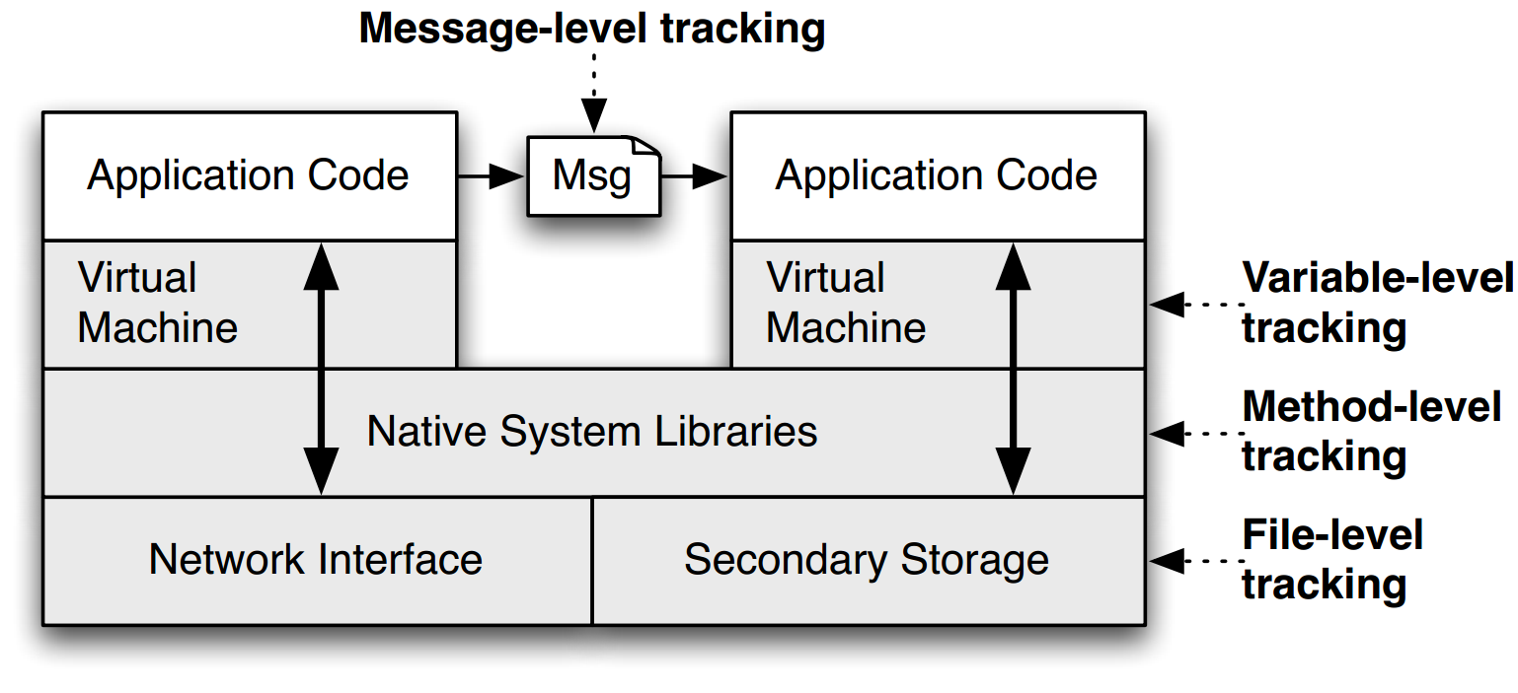
TaintDroid Architecture
Source: TaintDroid Paper
Notes:
This is a figure from the conference paper describing TaintDroid. It shows where, at a high level, the various kinds of taint analysis are done. There are 4 “granularities” of taint analysis used in TaintDroid, including message-level, variable-level, method-level, and file-level.

Slide 21
TaintDroid Architecture
Binder IPC
Source: TaintDroid Paper
Notes:
All Android inter-process-communication occurs through binder. Message-level tracking is done here because certain core system applications exist for the purpose of disseminating privacy sensitive information.

Slide 22
TaintDroid Architecture
Dalvik VM Interpreter
Source: TaintDroid Paper
Notes:
All variables that are operated on must be operated on using the Dalvik VM’s virtual registers.

Slide 23
TaintDroid Architecture
Android Middleware
Source: TaintDroid Paper

Slide 24
Experiment
Experimental Setup, Experimental Results

Slide 25
Experimental Setup
Sample set of popular Android applications: 1100 applications
358 of 1100 required Internet permissions plus one or more of the following data access permissions:
  location
  camera
  camera
Of these 358, 30 applications randomly selected for examination

Slide 26
Experimental Setup
Each application manually exercised and monitored using TaintDroid
Results verified by comparing TaintDroid logs to network packet capture
Also noted whether applications asked user consent for information used

Slide 27
Experimental Results
Observed Behavior (# of apps) | Details
Phone Information to Content Servers (2) | 2 apps sent out the phone number IMSI, and ICC-ID along with geo-coordinates to the app’s content server
Device ID to Content Servers (7)* | 2 social, 1 shopping, 1 reference and 3 other apps transmitted the IMEI number to the app’s content server
Location to Advertisement Servers (15) | 5 apps sent geo-coordinates to ad.qwapi.com, 5 apps to admob.com, 2 apps to ads.mobclix.com (1 sent location both to admob.com and ads.mobclix.com) and 4 apps sent locationy to data.ﬂurry.com
Notes:
Enck et al. found that 20 out of 30 applications had potential privacy violations. 3 applications had multiple violations. *9 applications were flagged by TaintDroid in this category, but 2 of them actually mentioned their data usage in their EULAs.

Slide 28
Experimental Results
TaintDroid produced no false positives on the application set tested
1/2 of applications shared location data with advertising servers
~1/3 expose device ID
Authors claim no perceived latency in using interactive applications
TaintDroid shown to be qualitatively useful
Notes:
Author’s claim: Their claim is probably legitimate. They made the case that (1) most applications are primarily in a “wait” state and (2) heavyweight operations such as screen updates are not monitored by TaintDroid

Slide 29
Concluding Remarks

Slide 30
Contributions
TaintDroid produced useful results for every application tested
A useful privacy analysis tool was implemented
  produced no false positives in experiments completed
  high performance in design
  also, released to public

Slide 31
Weaknesses
Mentioned by Enck et al.:
  TaintDroid can be circumvented by implicit information flow
  TaintDroid cannot tell if tainted information re-enters the phone after leaving
Interactive application latency was reported anecdotally, but could have been measured more formally
  perhaps like this: “Project Butter”
Notes:
TaintDroid can: Detecting this requires static code analysis, which is not necessarily an option for closed-source Play Store applications

Slide 32
Improvements
Mentioned on last slide: certain performance metrics could have been reported more formally

