Slide 1
Social Networking with Frientegrity:
Privacy and Integrity with an Untrusted Provider
-Ariel J. Feldman, Aaron Blankstein, Michael J. Freedman and Edward W. Felten
Princeton University
Presented by:
Sanketh Beerabbi
University of Central Florida

Slide 2
Outline
Introduction
Problem
Prior Solutions
Concept
Overview
Implementation
Results
Analysis
Conclusion

Slide 3
Introduction
Online social networks enable people to remain connected and share information.
Types:
Personal networks - Facebook, Google+
Status update networks - Twitter
Location networks - Foursquare
Content-sharing networks - Youtube, Flickr
Shared-interest networks - LinkedIn

Slide 4
Privacy
Social networks store information remotely, rather than on a user’s personal computer.
Millions of users are compelled to trust service providers with their personal data.
Centralized nature of these services leads to a greater number of privacy issues.

Slide 5
Problems
Increasing incidences of data leaks and identity thefts by malicious attackers.
Complex and non uniform privacy controls.
Providers introduce new features and repeatedly change default privacy settings.
Providers release information to governments without proper warrants.

Slide 6
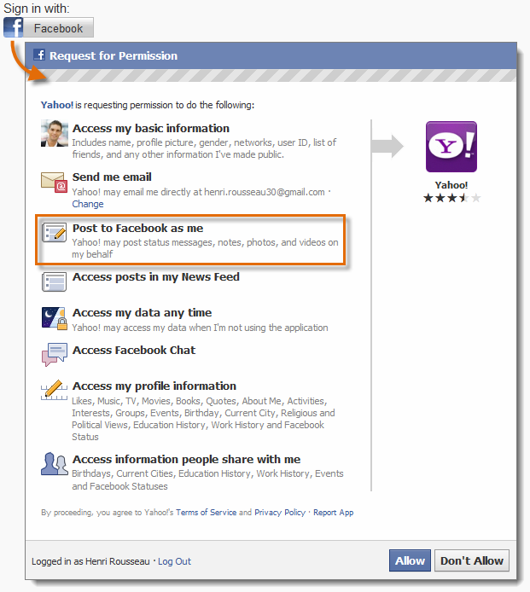
Example:
SSO

Slide 7
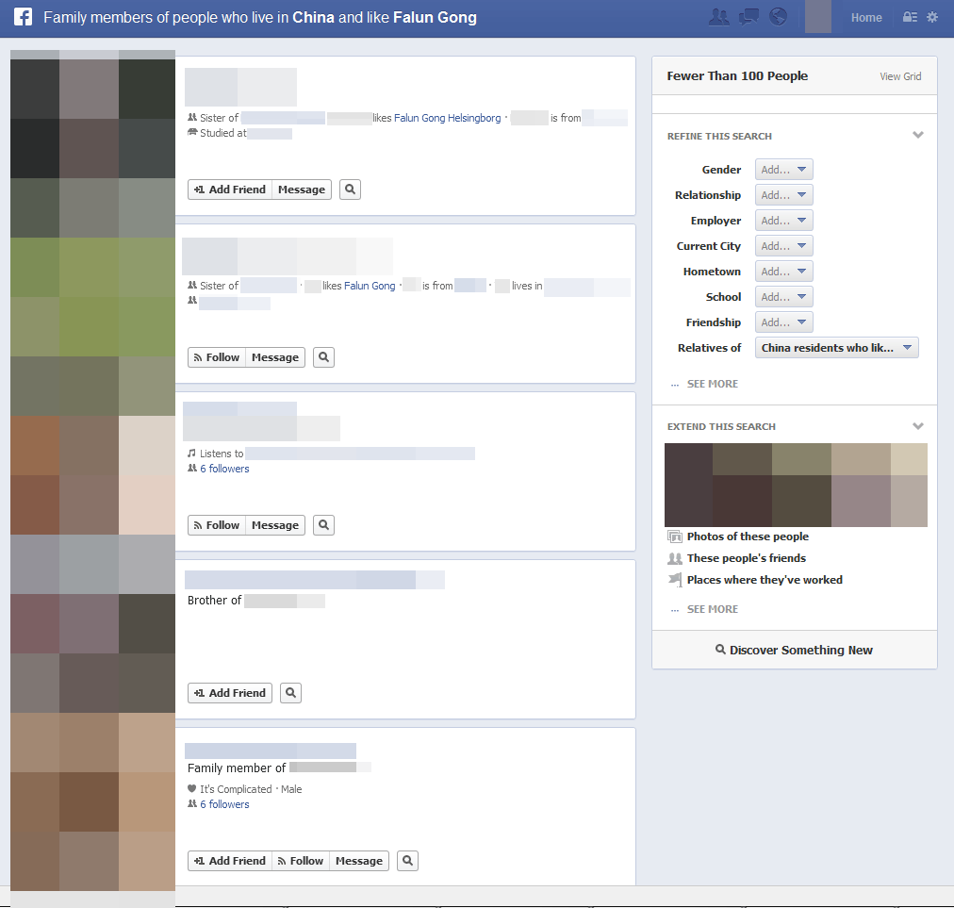
Actual Facebook graph search

Slide 8
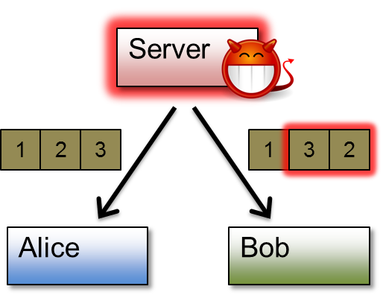
Integrity
Data Corruption:
Tampering with users data
Equivocation:
Malicious service presents diﬀerent clients with divergent views of the system.
Used to disguise censorship by allowing user to see content but hiding from followers.

Slide 9
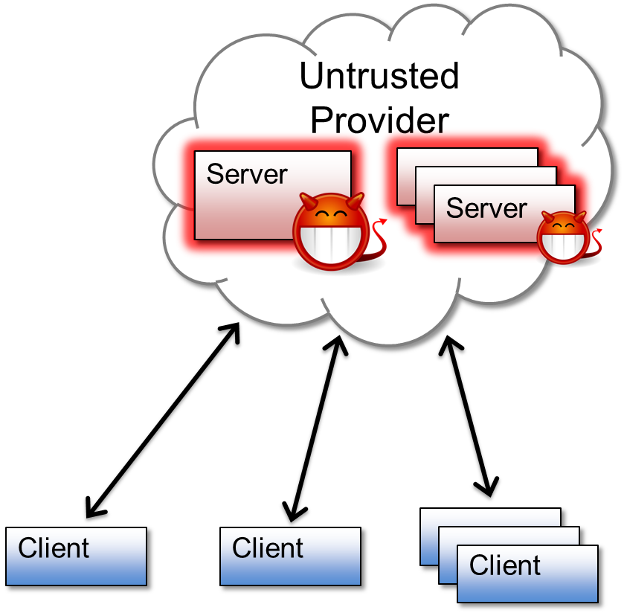
Vulnerability
Client vulnerable to:
Attacks on servers
Privacy policies
Data corruption
Censorship

Slide 10
Prior Solutions
Encryption:
Data integrity still not ensured on remote servers.
Decentralization:
Store data locally
(sacrifice availability, reliability & convenience)
Store data with 3rd party providers
(may not be trust worthy too)

Slide 11
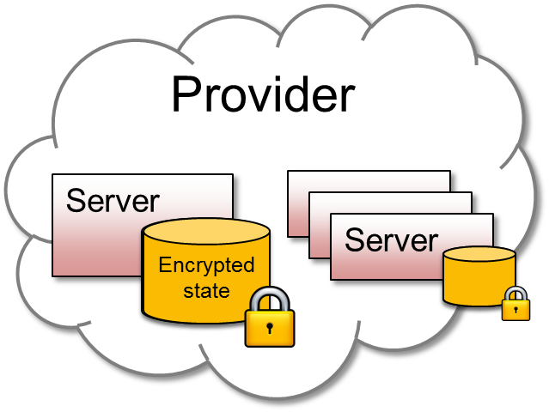
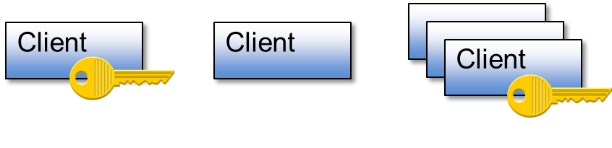
Frientegrity Concept
Provider’s servers only see encrypted data and clients collaborate to detect equivocation.
Access control
Cryptographic Keys

Slide 12
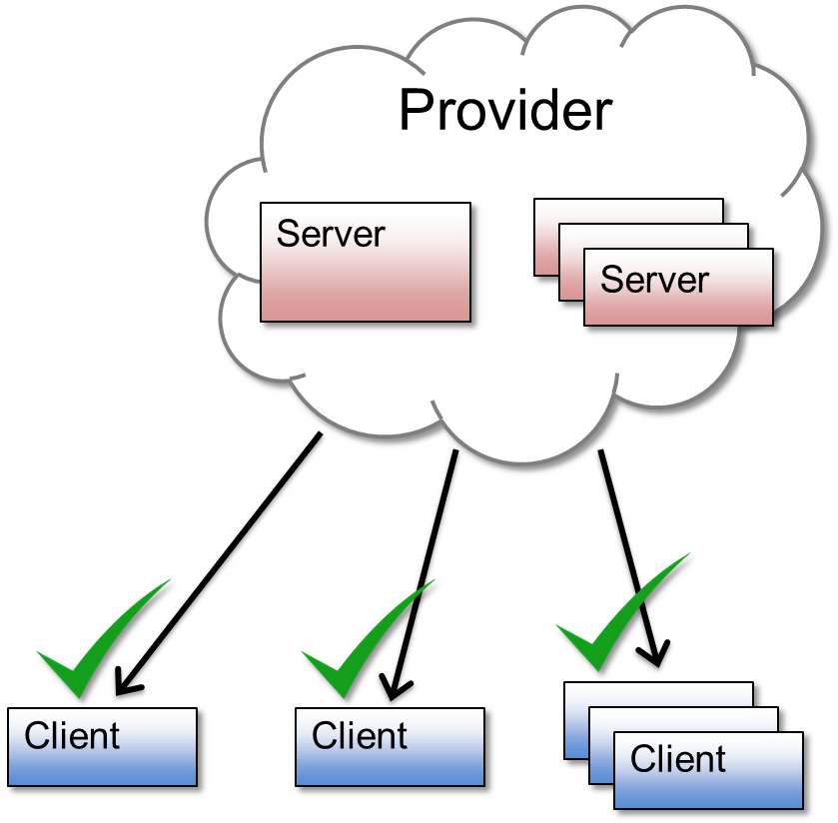
Client side
Clients collaborate to verify
that provider:
Enforces access control on writes
Doesn’t corrupt individual updates
Doesn’t equivocate.

Slide 13
Frientegrity Goals
Broadly applicable – support popular features.
Data integrity – use cryptography
Security - Detect malicious actions
Eﬃcient – Scalable enough

Slide 14
Fork Consistency
All clients see strongly consistent updates to common data (likes wall posts or tweets)
Implemented using network file systems, key value stores and group collaboration systems.
Works when number of users are small and all updates occur in a linear manner.

Slide 15
Scalability (Fork* consistency)
Only most recent updates are verified. Previous history of operations ignored
Single message exchanged instead of two, ensuring crashed client doesn’t stall system.
Objects(user content) are shared across many servers and indexed using directory service or hashing.

Slide 16
Detecting Equivocation
To prevent equivocation, Frientegrity clients digitally sign messages with users’ private keys.
To prevent provider from equivocating previous objects, clients share individual views of histories.
For eﬃciency, Frientegrity only enforces fork* consistency on a per-object basis.

Slide 17
Access Control Lists(ACL)
User’s proﬁle is comprised of multiple objects such as photos and comments.
Frientegrity uses ACL to allow only certain friends to access objects.
ACLs store users’ pseudonyms and every operation is labeled with the pseudonym of its creator.

Slide 18

System Overview
Server 1
Alice’s profile
Server 2
Checked for equivocation
Server n
Alice’s photo album
Alice’s ACL
Comment thread
Alice’s wall
Bob’s profile
Optionally entangled
Read Alice’s wall
Latest updates
Proof of no equivocation
Bob
Proof of ACL enforcement
Decryption keys
Verify & decrypt

Slide 19
Implementation
Simulate basic Facebook features
Server having set of user proﬁles and clients that access them. Implemented using Java.
Each profile has user objects, ACL and history.
Uses 2048-bit RSA signatures.
Reduced cryptographic use for higher throughput

Slide 20
Object read & write latency
Frientegrity
Hash Chain
Method

Slide 21
ACL change latency

Slide 22
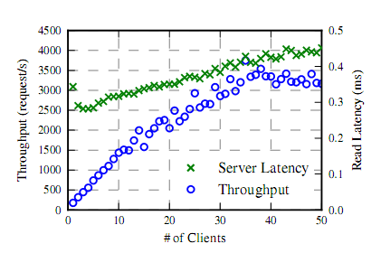
Server performance

Slide 23
Strengths
Frientegrity is a practical solution which is quite reliable, efficient and scalable.
In addition to adequately protecting user privacy and data integrity, also tackles equivocation which many solutions do not.
Provides some form of decentralization while still allowing convenience and redundancy.

Slide 24
Weakness
Encryption and message exchange may lead to large overhead and greater system requirements.
For scalability, since only most recent updates are scrutinized, equivocation may still be possible.
Malicious providers can still know users social relationships based upon public key hashes.

Slide 25
Weakness
Does not provide complete decentralization as envisaged while other solutions offer it.
Still uses untrusted third party infrastructure.
Implementation tones down some of the cryptographic measures.

Slide 26
Conclusion
Frientegrity provides the much needed framework for privacy and integrity in social networking applications.
Achieves main goal of detecting provider equivocation.
Can be further improved upon to achieve complete decentralization of user data.

Slide 27
Questions?

