Slide 1
Protecting Browsers from Extension Vulnerabilities
Paper by:
Adam Barth, Adrienne Porter Felt, Prateek Saxena at University of California, Berkeley({abarth,afelt,prateek}@eecs.berkeley.edu), and Aaron Boodman at Google, Inc. aa@google.com
2010.
Presentation by:
Cody McMahon
CAP 6135 Dr. Zou

Slide 2
Briefing
Are your computers susceptible to attacks through the use of the extensions in your web-browser?
Extension, extend the functionality of your browser providing both personalization and ease of use. How can they hurt you?
Problem: majority of Firefox extensions are running at a critically insecure level.

Slide 3
Introduction
Firefox extensions and their system of implementation
Popular tools that are not developed with security in mind. “Roughly one third of Firefox users have at least one browser extension.”
Firefox extensions born with all rights that the browser and user have.
Notes:
DOM
XMLHTTPREQUEST
NPAPI Interface
Greatest privilege vs. least

Slide 4
Extensions vs. Plug-ins
Extensions: third party software to extend functionality of a browser, very popular one being adblock plus. The webpage does not ask for these
Plug-in: used to interact with a specific MIME type. It is requested by the webpage. Think Flash.

Slide 5
Observations
25 popular Firefox extensions examined(Appendix A)
2 randomly picked from the 13 categories on the recommended page(Appendix A)
88% of the Extensions need less permissions than given.
76% of the Extensions permission issue comes from overpowered APIs

Slide 6
Multi-part System Solution
Least Privilege – lists privileges needed at installation
Privilege Separation – break up extension into three main parts: content script, extension core, and native binary
Strong isolation – each part of the extension is isolated beyond just being separate components.
Notes:
Each Covered in more detail later

Slide 7
Threat Models
Two Threat Models Covered:
Webpage: Attacker can host a malicious webpage. Can have bad JavaScript to try and mix up the pointers of the objects and inject a malicious one.
Network: man-in-the-middle http request response

Slide 8
4 Exploitation Techniques
Cross-Site Scripting(XSS): evaluating webpage info without proper sanitization.
Replacing Native APIs: webpage replace DOM APIs with its own method definitions.
Javascript Capability Leaks: an extension leaks a javascript object and a webpage can use that object to access other ones.
Mixed Content: a network attacker can load a script to be run when an extension makes an http request.

Slide 9
Counter-Measure
XSS: evalInSandox API which does not give extension privileges to script. (not comprehensive)
Replacing Native APIs: XCPNativeWrapper shows the javascript object at its base ignoring webpage modifications. (known to be buggy)
The problem remains that the extensions still have more access than they need.

Slide 10
Examples of Damage
“Greasemonkey exposed a privileged version of XMLHttpRequest to every web page [33], letting attackers circumvent the browser’s same-origin policy by issuing HTTP requests with the user’s cookies to arbitrary web sites and reading back the responses.”
“An extension injects an HTTP script into an HTTPS page. For example, we discovered that an extension [6] injects an HTTP script into the HTTPS version of Gmail.”

Slide 11
Privilege Separation
Content Script: composed of javascript, Interacts directly with the DOM, can send messages to extension core.
Extension Core: does not interact with webpage directly but has access to APIs and is what the user interfaces with
Native Binary: the only part that can execute code but is the farthest removed from the webpage.

Slide 12
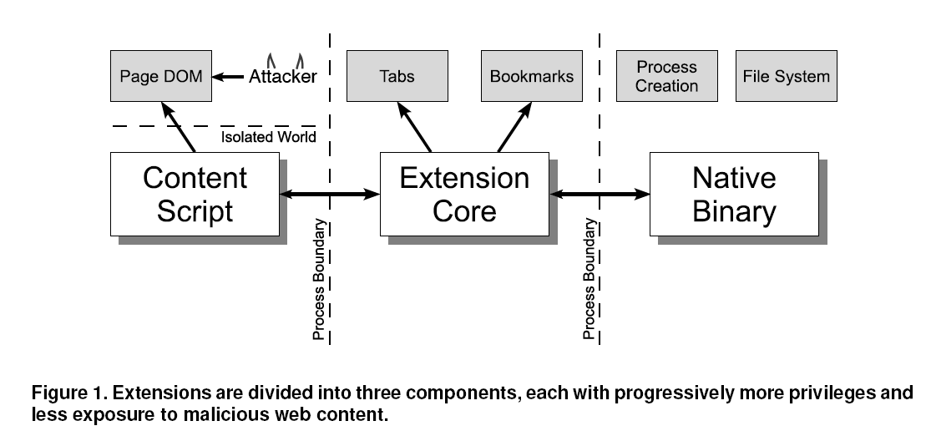

Slide 13
Methodology
Compare:
The most powerful functionality needed
The most powerful functionality received
Manually check interfaces in source code and rate by the Firefox Security Severity Ratings.

Slide 14
Least Privilege System
Ratings are based on the Firefox Security Severity Ratings:
Critical: Can run arbitrary code on the user’s system (e.g., arbitrary file access)
High: Can access site-specific confidential information (e.g., cookies and password) or the Document Object Model (DOM) of all web pages
Medium: Can access private user data (e.g., recent history) or the DOM of specific web pages
Low: Can annoy the user
None: No security privileges (e.g., a string) or privileges limited to the extension itself
Notes:
Low?

Slide 15
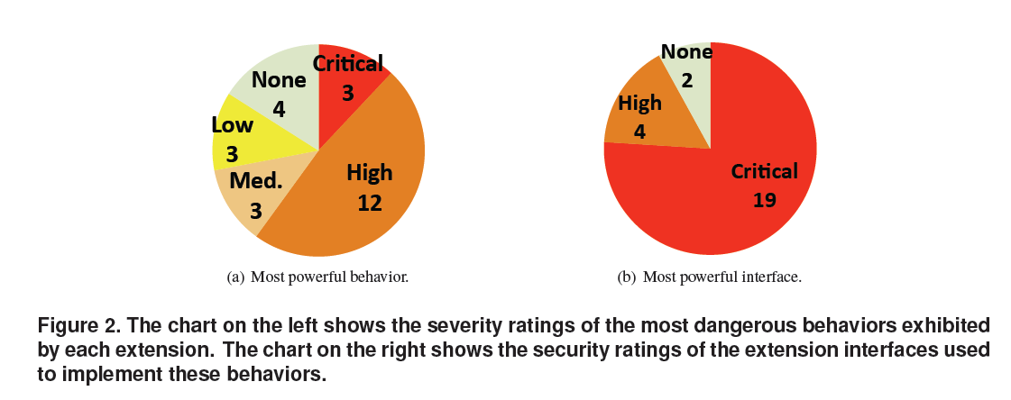
Purpose vs. Privilege

Slide 16
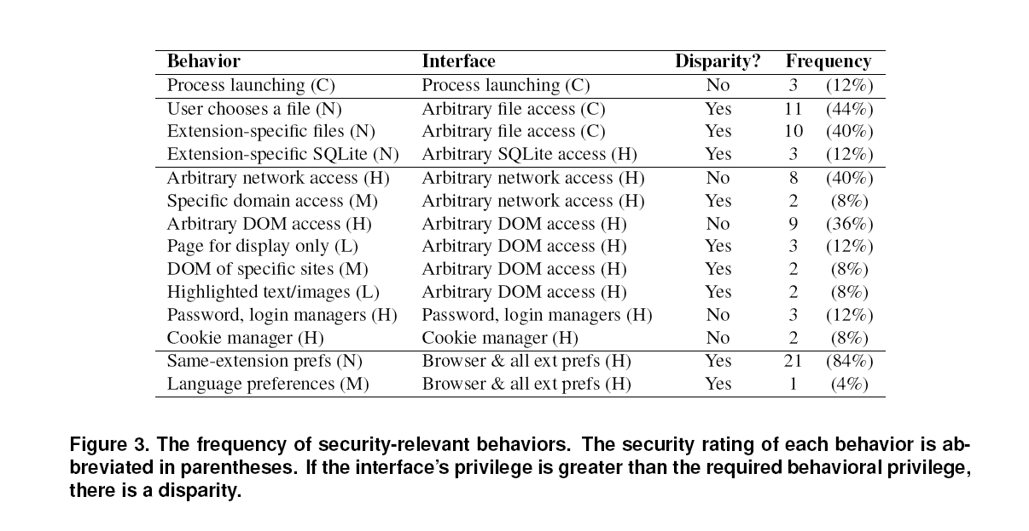
Purpose vs. Privilege
Notes:
Download managers actually need the ability to create new processes
Problem again lies in Firefox APIs

Slide 17
Deductive System
Another issue lies in privilege escalation in XPCOM interfaces.
Example:
“type foo has a method that accepts type bar as a parameter. Type bar has a method getFile that returns a file type. We do not know whether an implementation of foo actually ever calls bar.getFile, but we know it is possible.”

Slide 18
Analysis
613 interfaces out of 1582
Upward edges represented escalation
Fix: add runtime access checks or taming the interface at design time
Not really addressed in detail

Slide 19
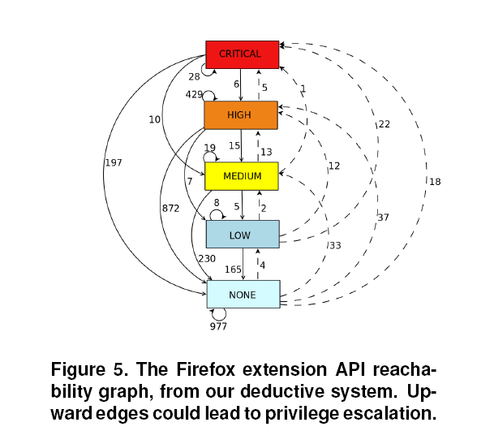

Slide 20
Least Privilege (Manifests)
Executing arbitrary code: The only way to do this is to list a native binary in the manifest.
Web site access: In order to access a website, it must be listed in the manifest under the permissions category.
API access: similar to the web site access, it must be listed in the manifest under the permissions.
Notes:
Manifests provide easy to see descriptions of the extension

Slide 21
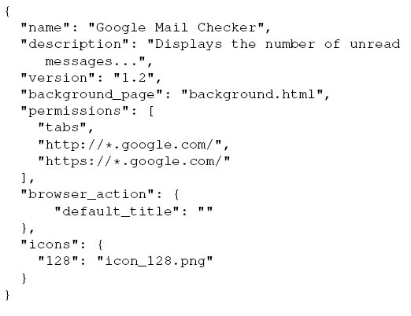
Gmail Checker Extension Manifest [13]

Slide 22
Reward for Security
Why would extension creators bother asking for less?
The user decides which permissions to allow at installation time, possibly preventing use of extension.
The galleries (Chrome and Firefox) need contract for code execution
The user can review the manifest manually.

Slide 23
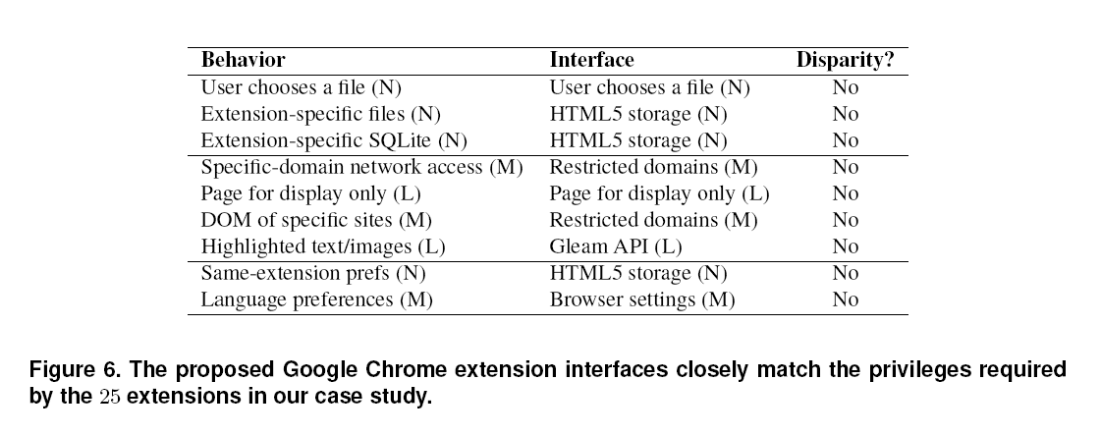
Proposed Least Privilege Model
Chrome:

Slide 24
Isolation Mechanics
Origin: The power of am extension script comes from the location. Public key added to URL.
Ex: chrome-extension:// ilpnegfhimflflifcnmgpeihglhedbnn/
Process Isolation: each component has a separate process. Content script is in webpage process. Protects from simple crashes and hacks.
Isolate Worlds: each content script uses its own Javascript heap instead of the webpages.

Slide 25
Processes

Slide 26
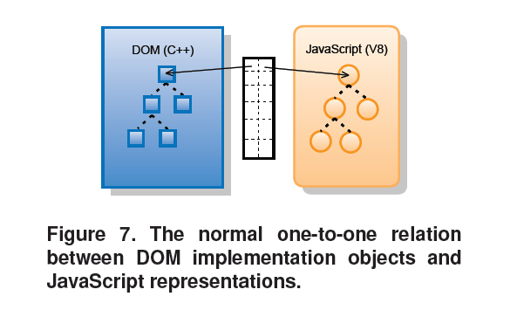
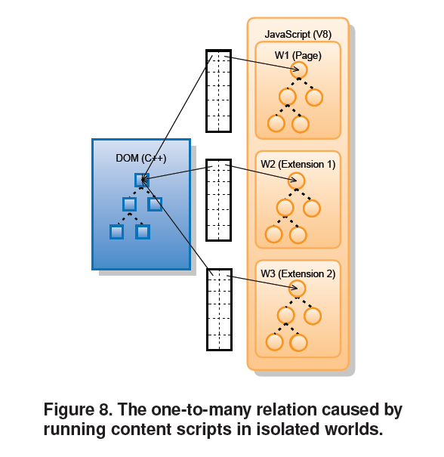
Isolation of Worlds
Notes:
Different tables and worlds

Slide 27
Performance
Initial Concern:
Three parts now communicate with one another.
The difference is trivial, .8ms, for interprocess communication.
Real area for concern:
DOM access in separate world model.
33.3% to access time

Slide 28
Contribution
The system currently used by Chrome as of Chrome 4 for its extensions.
Identifying more secure extensions easier with the reward system
The surface of attack smaller for extension exploitation

Slide 29
Weakness
The user still has to do work during installation determining which privileges to accept
The creator of the extension still has the ability to try to include more privileges than necessary.
Notes:
Redundancy and a little disorganization

Slide 30
Improvement
Testing work with browsers like Opera or Internet Explorer.
Explicitly fixing or creating new tighter interfaces for the extension to use.

Slide 31
Related Work
There is another extension system for Firefox called JetPack which proposes narrow interfaces for browser functionality.
Other papers look into the problem of dealing specifically with running code in the native plug-in.
Pulls from the MashupOs and JAR publickey signing work; Browser is mashup of extension code and webcontent.

Slide 32
Acknowledgements
Nick Baum, Erik Kay, Collin Jackson, Matt Perry, Dawn Song, David Wagner, and the Google Chrome Team.
This work is partially supported by the Air Force Office of Scientific Research under MURI Grant No. 22178970-4170.

Slide 33
Extensions Used(Appendix A)
25 Extensions:
“Our extension survey (Section 3.1) examines extensions
from the Firefox Add-on “recommended” directory.
We selected two from each category in the directory. The thirteen categories are:
Alerts & Updates, Appearance, Bookmarks,
Download Management, Feeds News & Blogging,
Language Support, Photos Music & Videos, Privacy & Security, Search Tools, Social & Communication, Tabs, Toolbars, and Web Development.
The twenty-five extensions in our extension survey are:
Adblock Plus 1.0.2, Answers 2.2.48, AutoPager 0.5.0.1,
Auto Shutdown (InBasic) 3.1.1B, Babel Fish 1.84, Cool-
Previews 2.7.4, Delicious Bookmarks 4.3, docked JSConsole 0.1.1, DownloadHelper 4.3, Download Statusbar 2.1.018, File and Folder Shortcuts 1.3, Firefox Showcase 0.3.2009040901, Fission 1.3, Glue 4.2.18, GoogleEnhancer 1.70, Image Tweak 0.18.1, Lazarus: Form Recovery 1.0.5, Mouseless Browsing 0.5.2.1, Multiple Tab Handler 0.9.5, Quick Locale Switcher 1.6.9, Shareaholic 1.7, Status-bar Scientific Calculator 4.5, TwitterFox 1.7.7.1, WeatherBug 2.0.0.4, and Zemanta 0.5.4.”

Slide 34
Questions?????
Security note:
Pay attention to what you install and all the permissions asked for during installation.

