Slide 1

On Limitations of Designing Leakage Resilient Password Systems: Attacks, Principles and Usability
Presented by
Siddarth Asokan

Slide 2

Citation and acknowledgement
Qiang Yan, Jin Han, Yingjiu Li and Robert H. Deng “On Limitations of Designing Leakage-Resilient Password Systems: Attacks, Principles and Usability”, NDSS 2012.
SeongHan Shin, Kazukuni Kobara, Hideki Imai “A Simple Leakage-Resilient Authenticated Key Establishment Protocol, Its Extensions, and Applications”, 736 IEICE Trans. Fundamentals, VOL.E88–A, NO.3 MARCH 2005.

Slide 3
Presentation Agenda
What is Leakage Resilient Password Systems?
Brute Force Attack
Statistical Attack
Quantitative Analysis
Paper contribution
Paper weakness
Paper improvement
Questions

Slide 4

Leakage Resilient Password system
Conventional Password systems and security threats
Ideal LRPS
Two types of generic attacks:
Brute force attack
Statistical Attack
-Probabilistic decision tree
-Multi dimensional counting

Slide 5
Leakage Resilient Password system
It is a challenge response between user and server
User and server agree on a common root secret (password)
User uses the root secret to generate responses to challenges issued by the server to prove his identity
A response in LRPS is an obfuscated message derived from the root secret, rather than the plaintext of the root secret itself
The common system parameters of the most existing LRPS systems can be described by a tuple (D, k, n, d,w, s)

Slide 6
Threat Model & Experimental Setting
The security strength of an LRPS
The process is summarized as follow:
Generate a random password as the root secret
Generate a challenge for an authentication round
Generate a response based on the password and the underlying system design
Analyze the collected challenge-response pairs after each authentication round assuming that the adversary has full knowledge of the system design except the password
Repeat steps 2, 3, and 4 until the exact password is recovered

Slide 7
Brute Force Attack
It is a pruning-based learning process
Its procedure can be described as follows:
List all possible candidates for the password in the target system
For each independent observation of a challenge-response round, check the validity of each candidate in the current candidate set by running the verification algorithm used by the server, and remove invalid candidates from the candidate set
Repeat the above step until the size of candidate set reaches a small threshold

Slide 8
Power of Brute Force Attack
This can be explained by two statements:
Statement 1:
The verification algorithm used in brute force attack for candidate verification is at least as efficient as the verification algorithm used by server for response verification.
Statement 2:
The average shrinking rate for the size of valid candidate set is the same as one minus the average success rate of guessing attack.

Slide 9
P1: Large Root Secret Space Principle
An LRPS system with secret leakage should have a large candidate set for the root secret.
There are three possible leakage sources in an LRPS system:
The response alone
The challenge-response pair
The challenge alone

Slide 10
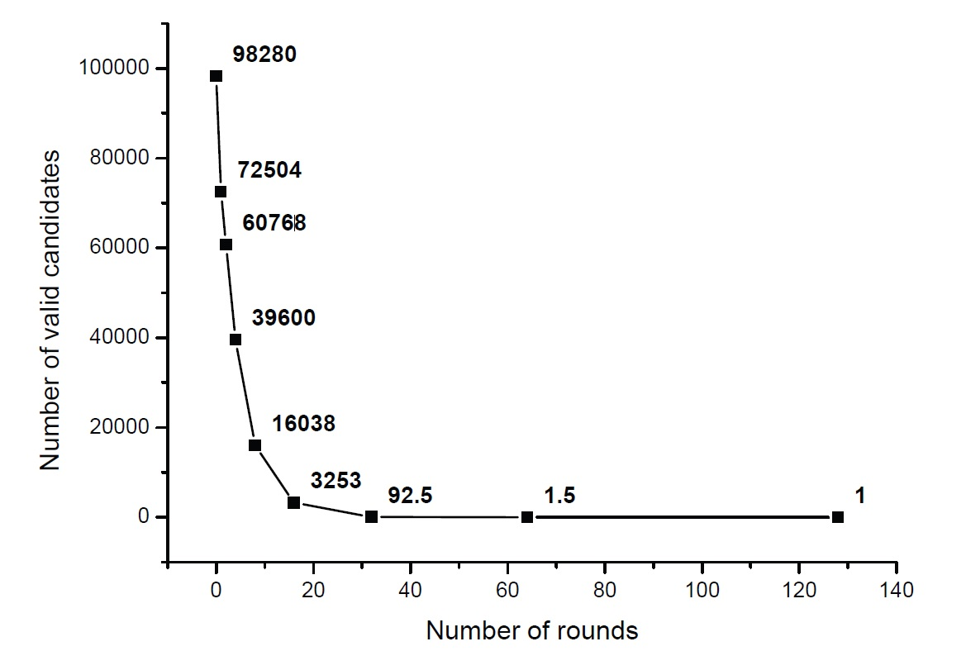
P1: Large Root Secret Space Principle
The average number of valid candidates shrinks
for Undercover

Slide 11
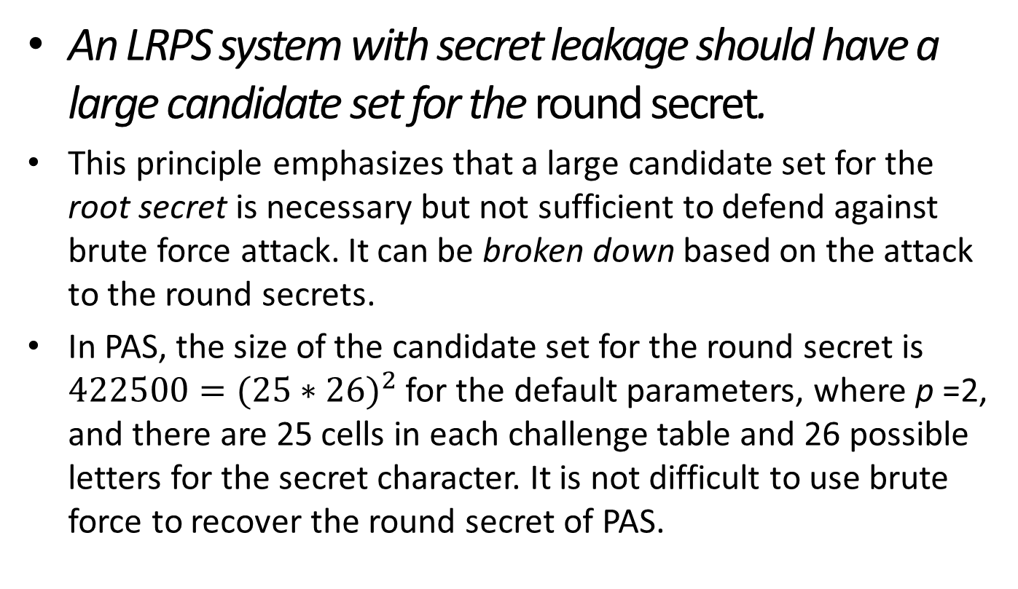
P2: Large Round Secret Space Principle
An LRPS system with secret leakage should have a large candidate set for the round secret.
This principle emphasizes that a large candidate set for the root secret is necessary but not sufficient to defend against brute force attack. It can be broken down based on the attack to the round secrets.
In PAS, the size of the candidate set for the round secret is $422500={(25∗26)}^{2}$ for the default parameters, where p =2, and there are 25 cells in each challenge table and 26 possible letters for the secret character. It is not difficult to use brute force to recover the round secret of PAS.

Slide 12
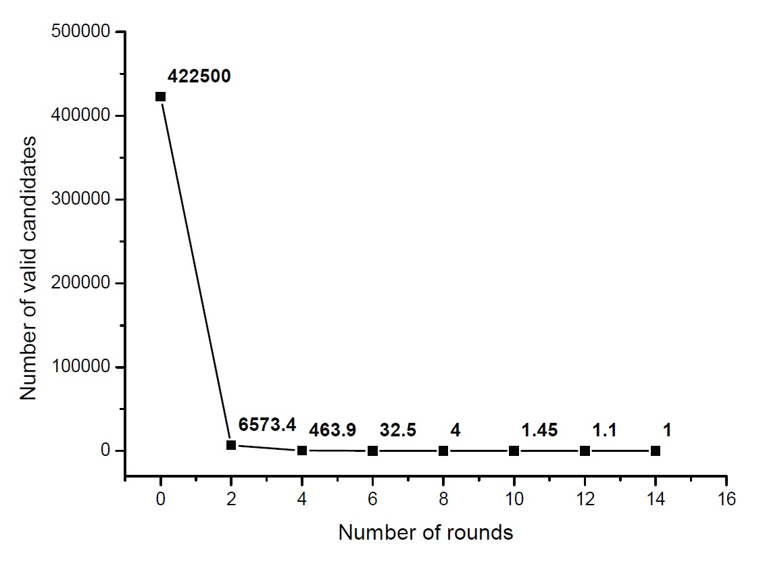
P2: Large Round Secret Space Principle
The average number of valid candidates
shrinks for PAS

Slide 13
Statistical Attack
It is an accumulation-based learning process, where an adversary gradually increases its confidence on relevant targets when more and more cues are available
Compared to brute force attack, statistical attack has fewer limitations as it can be applied to schemes with a large password space
The efficiency of statistical attack is design dependent and varies with different schemes and different analysis techniques

Slide 14
Statistical Attack
Two general statistical analysis techniques that are able to efficiently extract the root secret of most existing schemes are:
Probabilistic decision tree
The process is as follows:
Creation of score table for each individual element
For each independent observation of a challenge response pair, the adversary enumerates every consistent decision path that leads to the current response

Slide 15
Statistical Attack
A decision path is an emulation of the user’s decision process that consists of multiple decision nodes. Each decision node represents a decision event decided by the membership relation of a corresponding entry in the score table, whether or not it belongs to the secret set.
Consider a scheme which has a four element window <S₁:1, S₂:2, S₃:1, D₁:1>, where Sᵢ:x represents a secret element associated with no. x and Dᵢ:y represents a decoy element associated with no. y

Slide 16
Statistical Attack
A decision path is an emulation of the user’s decision process that consists of multiple decision nodes. Each decision node represents a decision event decided by the membership relation of a corresponding entry in the score table, whether or not it belongs to the secret set.
Consider a scheme which has a four element window <S₁:1, S₂:2, S₃:1, D₁:1>, where Sᵢ:x represents a secret element associated with no. x and Dᵢ:y represents a decoy element associated with no. y

Slide 17
Statistical Attack
II. Counting-based statistical analysis
The procedure is as follows:
Create l counting tables for l response groups. The adversary creates a counting table for each possible response if affordable
For each independent observation of a challenge-response pair, the adversary first decides which counting table is updated according to the observed response
Repeat the above step until the number of entries with different score levels reaches a threshold

Slide 18
P3: Uniform Distributed Challenge Principle
An LRPS system with secret leakage should make the distribution of the elements in each challenge as uniformly distributed as possible
This principle requires that an LRPS system should be able to generate the challenges without knowing the secret
Undercover is a typical counterexample to show secret leakage from biased challenges
The consequence of the distribution bias caused by structural requirements in the challenge is subtle to identify and has not been well recognized

Slide 19
P4: Large Decision Space or Indistinguishable Individual Principle
An LRPS system with secret leakage should make each individual element indistinguishable in the probabilistic decision tree if the candidate set for decision paths is enumerable.
This principle is critical to limit the feasibility of probabilistic decision tree attack. The power of probabilistic decision tree stems from its emulation of all possible decision processes leading to the observed response
The emulation creates a tight binding between each challenge and its response, from which the adversary is able to extract the subtle statistical difference during the user’s decision

Slide 20
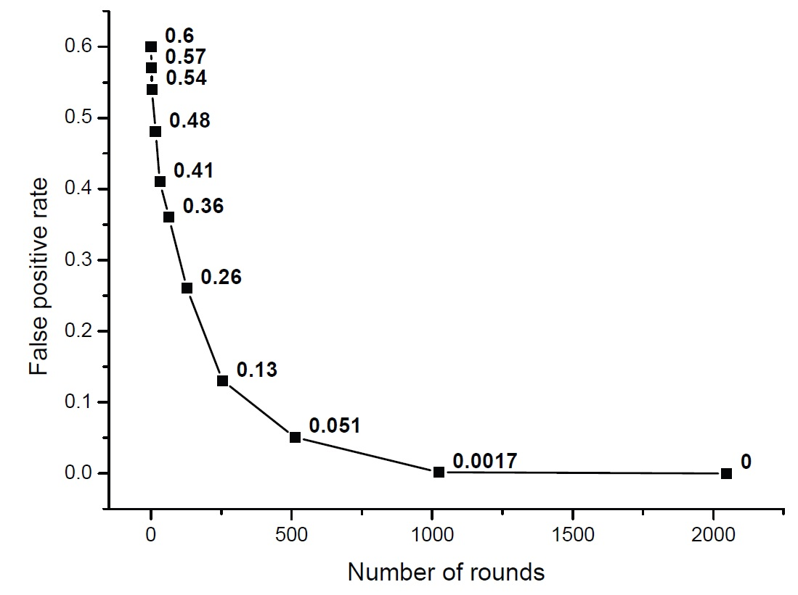
P4: Large Decision Space or Indistinguishable Individual Principle
The average false positive rate decreases for the high complexity CAS scheme

Slide 21
P5: Indistinguishable Correlation Principle
An LRPS system with secret leakage should minimize the statistical difference in low-dimensional correlations among each possible response
This principle is complementary to Principle 4 to limit the efficiency of counting-based statistical analysis.
Though counting-based statistical analysis is straightforward, it cannot be completely prevented without a secure channel, as the user’s response is always statistically biased towards his knowledge of the secret

Slide 22
P5: Indistinguishable Correlation Principle
In the extreme case, the adversary is able to maintain a counting table to hold every candidate for the root secret, and update the table according to every available observation.
The statistical difference caused by the knowledge of the secret is always identifiable even when the user is asked to make intentional mistakes at a predefined probability only known by the server
User has to produce incorrect answers with a fixed error probability to create noises. This further decreases the SecHCI scheme’s usability. Another design limitation on counting based scheme is that the response function cannot be in the form of r = x mod q, where q is an integer larger than 2

Slide 23
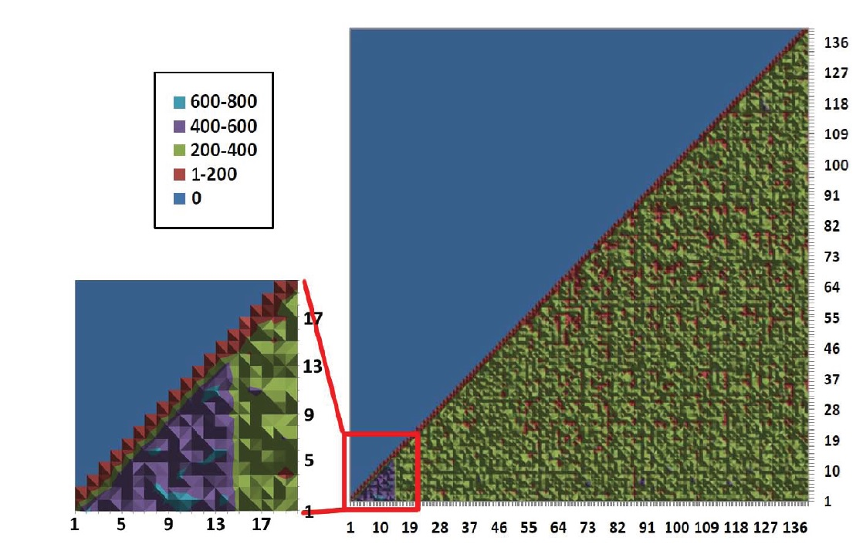
P5: Indistinguishable Correlation Principle
The pairbased score distribution is distorted for SecHCI. The first 14 elements
are the secret icons, whose pairbased scores are distinguishable from the scores of other icons.

Slide 24
Quantitative Analysis
This framework decomposes the process of human-computer authentication into atomic cognitive operations in psychology.
There are four types of atomic cognitive operations commonly used:
Single/parallel recognition
Free/cued recall
Single-target/multi-target visual search
Simple cognitive arithmetic

Slide 25
Quantitative Analysis
There are two components in our quantitative analysis framework:
Cognitive Workload (C)
Memory Demand (M)
Cognitive workload is measured by the total reaction time required by the involved cognitive operations
Memory demand is measured by the number of elements that must be memorized by the subject, which is the prerequisite of any password system

Slide 26

Paper Contribution
Analyzed and demonstrated the effectiveness of two types of generic attacks, brute force and statistical attacks against LRPS systems
Introduced five principles that are necessary to mitigate brute force and statistical attacks
Established the first quantitative analysis framework on usability costs of the existing LRPS systems. This framework utilizes the performance models of atomic cognitive operations in authentication to estimate usability costs

Slide 27
Paper Weakness
Based on the framework and security analysis, the tradeoff between security and usability is strong, which indicates the inherent limitation in the design of LRPS systems
Since the cognitive workload is not totally independent with the memory demand, it is possible to improve the overall score calculation instead of using the product operation (i.e. HP= M×C);
Error rate is currently not included in the analysis framework as it is difficult for experimental psychology to provide the general relation between thinking time and error rate

Slide 28
Paper Improvement
Certain approximation can be added to improve the precision of the framework in the future
The quantitative analysis framework could have been more analyzed since it was still in its preliminary stage

Slide 29


QUESTIONS

