Slide 1
IntScope-Automatically Detecting Integer Overflow Vulnerability in X86 Binary (http://www.utdallas.edu/~zxl111930/file/IntScope_NDSS09.pdf)
Tielei Wang†, TaoWei†, Zhiqiang Lin‡, Wei Zou†.
Purdue University & Peking University
Proceedings of NDSS'09: Network and Distributed System Security Symposium
Jose Sanchez

Slide 2
Acknowledgement
Some materials are taken from:
Authors presentation at NDSS'09
www.isoc.org/isoc/conferences/ndss/09/pdf/17.pdf

Slide 3
Agenda
Problem Description
Integer overflow detection in binary code
Approach
Taint analysis and symbolic execution over an intermediate representation on disassembled code
Contributions
Weaknesses
Improvement

Slide 4
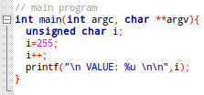
What is Integer Overflow?
An integer overflow occurs when an operation results in a value greater than the maximum one of the integral data type.

Slide 5
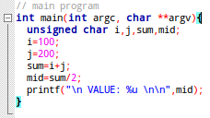
Overflow Example
Expected result?
Actual result?

Slide 6
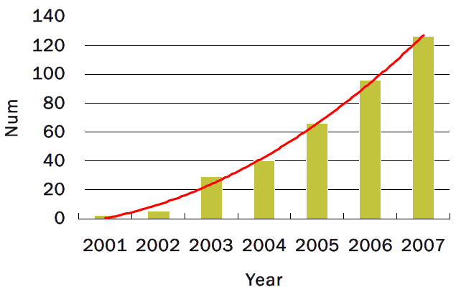
Integer Overflow Vulnerabilities Growth

Slide 7
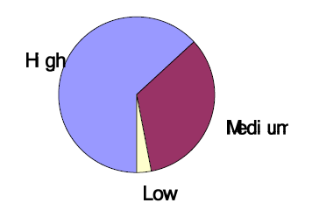
Vulnerabilities are Dangerous
According to Common Vulnerability Scoring System(CVSS), more than 60% of Integer Overflow vulnerabilities have the highest severity score.

Slide 8
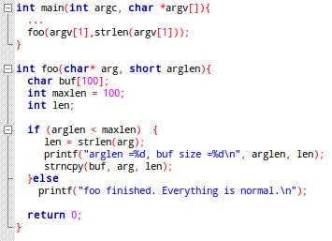
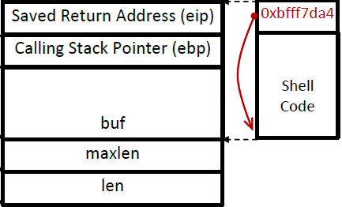
A Known Example: Integer Overflow ➔ Stack Overflow
Untrusted (tainted) source
Integer Overflow
Incomplete validations (sanitization)
Stack Overflow

Slide 9
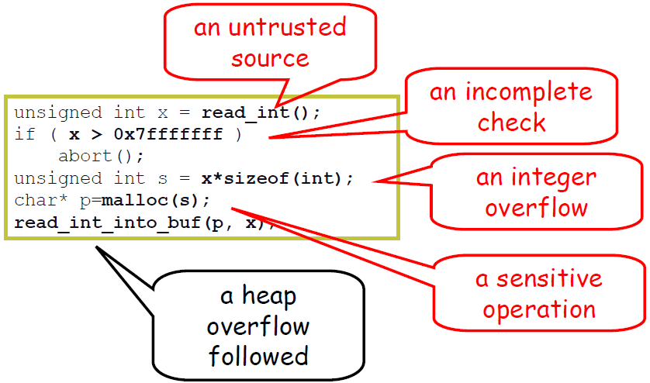
Common Features of Integer Overflow Vulnerabilities

Slide 10
Some Concepts
Untrusted Source:
Input source like network messages, input files, or command line options.
Tainted data:
Data that is derived from untrusted input sources.
Sink Sensitive operations or points in the program that uses tainted data. For example:
Memory allocation
Memory access
Branch statement
main(…){
int i,j,x,y;
i=0;
j=read_int();
x=i+1;
y=x+j;
printf(j);
malloc(y);
}

Slide 11
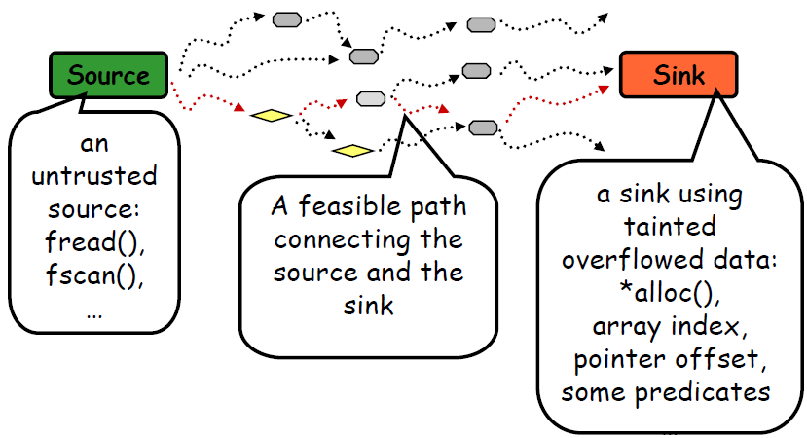
Problem Model
An instance of taint-based problem

Slide 12
Approach-Phase1
Decompiler
Disassemble the binary
Translate it into Intermediate Representation (PANDA)
Construct the control flow graph (G) and call graph (C)
Component Extractor
Extract from C the candidate functions that are common ancestors connecting source to a sink
Profile Constructor
Computes a chop flow graph G’ based on G, that includes only source-sink paths in candidate sub-graphs.

Slide 13
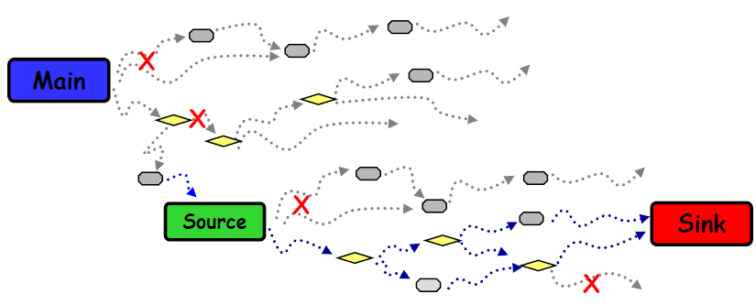
Approach-Phase1
Decompile and create graphs
Tag sources and sinks
Prune irrelevant paths (x)
Only keep source-to-sink paths ( )

Slide 14
Approach-2
Symbolically execute each path in the components
Collect path constraints, and check the feasibility of the path (constraint solver)
Track the propagation of untrusted (tainted) data
Only check whether untrusted data causes integer overflows at sink points

Slide 15
Approach-Phase2
Symbolic execution
Collect path constraints and check the feasibility (x)
Track tainted data propagation
Only check integer overflows at sink points

Slide 16
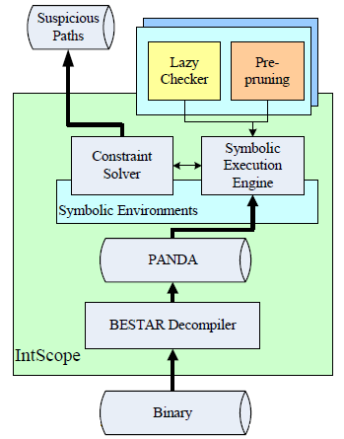
Approach Implementation

Slide 17
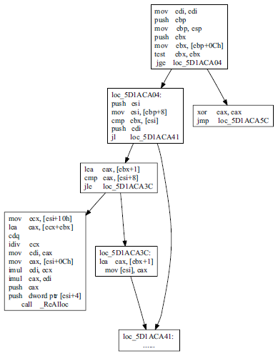
The Control Flow Graph CFG

Slide 18
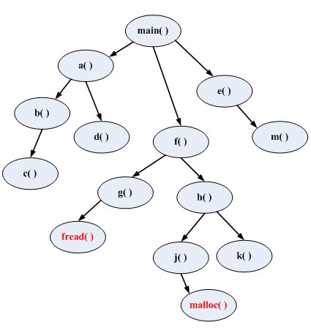
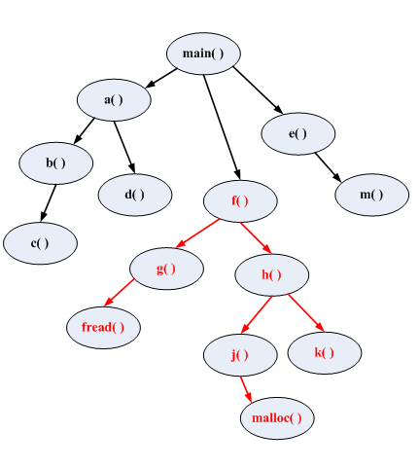
Components in the Call Graph
Tag sources (fread) and sinks (malloc)
Common ancestor (f() ) determines the component

Slide 19
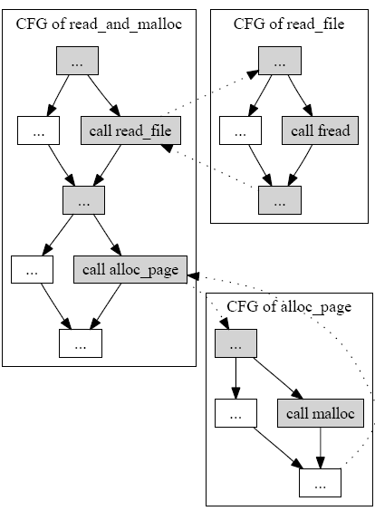
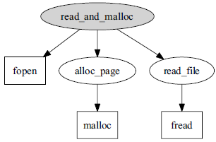
Chopping the CFG G into G'
S_{r}=source, S_{k}=sink, E_{sr}=C_{entry}⇝S_{r,} E_{sk}=C_{entry}⇝S_{k,} S_{e}=S_{r}⇝C_{exit,} G'=E_{sr}∪ (S_{e}∩E_{sk})

Slide 20
Symbolic Execution
Statically “run” the program with symbolic values instead of concrete ones.
int* f(){
int x, y;
x=rand()%5+1;
y=read_int();
if(0<y && y<100){
return (int*) malloc(y*sizeof(int));
}
else if (x>y){
x = x + y;
y = x - y;
x = x - y;
if (x-y > 0){
return (int*) malloc(y*sizeof(int));
}
else {
return (int*) malloc(x*sizeof(int));
}
}
return NULL;
}
// x = x₀, y = y₀
x = x + y; // x = x₀+ y₀
y = x - y; // y = (x₀+ y₀)- y₀ = x₀
x = x - y; // x= (x₀+ y₀)- x₀ = y₀
// x ⇄ y

Slide 21
Symbolic Execution
int* f(){
int x, y;
x=rand()%5+1;
y=read_int();
if(0<y && y<100){
return (int*) malloc(y*sizeof(int));
}
else if (x>y){
x = x + y;
y = x - y;
x = x - y;
if (x-y > 0){
return (int*) malloc(y*sizeof(int));
}
else {
return (int*) malloc(x*sizeof(int));
}
}
return NULL;
}
Keeps track of symbolic values of variables and Path Constraint (PC)
Verify PC and discard unfeasible paths
x=rand()%5+1;
y=read_int();
if(0<y && y<100)
x=x₀:[1,5],
y=y₀:[-limit, +limit],
PC: true
false
true
x=x₀:[1,5], y=y₀:]0,100[,
PC: 0<y₀ && y₀<100
x=x₀:[1,5], y=y₀:[-limit, +limit],
PC: y₀≤0 || 100≤y₀
if (x>y)
return (int*) malloc(y*sizeof(int));
false
true
x=x₀:[1,5], y=y₀:[1, +limit[,
PC: (y₀≤0 || 100≤y₀) && (x₀≤y₀)
x=x₀:[1,5], y=y₀:[-limit, 5[,
PC: (y₀≤0 || 100≤y₀) && (x₀>y₀)
return NULL;
x = x + y;
y = x - y;
x = x - y;
if (x-y > 0)
x=y₀:[-limit, 5[, y=x₀:[1,5],
PC: (y₀≤0 || 100≤y₀) &&
(x₀>y₀) && (y₀-x₀≤0)
true
x=y₀:[-limit, 5[, y=x₀:[1,5],
false
PC: (y₀≤0 || 100≤y₀) &&
(x₀>y₀) && (y₀-x₀>0)
return (int*) malloc(x*sizeof(int));
return (int*) malloc(y*sizeof(int));
not feasible

Slide 22
Static Taint Analysis
Taint the untrusted data, and infer the possible propagation of such untrusted data
int* f(){
int x, y;
x=rand()%5+1;
y=read_int();
if(0<y && y<100){
return (int*) malloc(y*sizeof(int));
}
else if (x>y){
x = x + y;
y = x - y;
x = x - y;
if (x-y > 0){
return (int*) malloc(y*sizeof(int));
}
else {
return (int*) malloc(x*sizeof(int));
}
}
return NULL;
}
tainted
sanitized
no problem
taint propagation from y to x
not feasible
no problem
problem
problem

Slide 23
Taint Type System
Assign taint types ( ) to program elements
Taint binary operator:
Environment , maps variables taint types
Literals are Untainted:
Variable Access: determined by environ:
Expressions uses binary operator:
Command sequence:
Assignment ( ):
Conditional:

Slide 24
Evaluation and Results
Detected integer overflow bugs in Windows DLLs
Detected bugs in several widely used applications
QEMU, Xen
Media playersMplayer
Xine
VLC
FAAD2
MPD
Others
Cximage, Hamsterdb, Goom

Slide 25
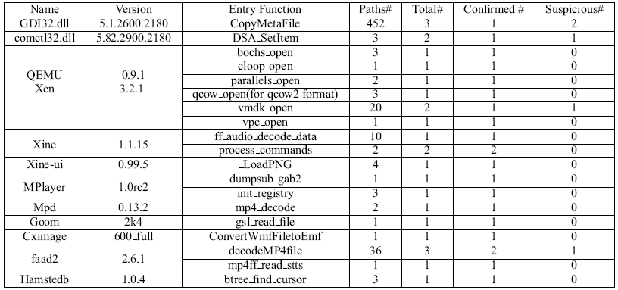
Results
20+ confirmed vulnerabilities
Some suspicious (not confirmed) ones

Slide 26
Tools Used
IDA Pro: A Windows, Linux or Mac OS X hosted multi-processor disassembler and debugger
https://www.hex-rays.com/products/ida/index.shtml
GiNaC: Symbolic Execution Framework (C++)
http://www.ginac.de/
STP: Constraint Solver (automated prover)
https://sites.google.com/site/stpfastprover/

Slide 27
Contributions
A systematic method of combining taint analysis and path-sensitive symbolic execution to detect integer overflow vulnerabilities in executables.
An intermediate instruction representation, based on IDA Pro’s disassembled code, and a symbolic execution engine.
A prototype called IntScope to analyze real-world binaries, which shows the approach is highly effective.

Slide 28
Weaknesses
Incomplete test case generation.
Partial path analysis source⇝sink instead of main⇝sink
Missing of the constraints between inputs.
Lack of information on intrinsic constraints between inputs leads to false positives.
Lack of global information
Lack of information on global variables may lead to false positives.
Imprecise symbolic execution.
Not accurately simulation of block memory functions (memmove, etc.) and string functions (strncmp,etc.) may lead to false negatives.

Slide 29
Improvements
Produce Path Constraints for suspicious cases.
They could be used in a fuzzing tools.
Improve the precision of the symbolic execution of block memory operations.
Open problem
More precise taint propagation

Slide 30
References
[1] WANG, T., WEI, T., LIN, Z., AND ZOU, W. Intscope: Automatically detecting integer overflow vulnerability in x86 binary using symbolic execution. In Network Distributed Security Symposium (NDSS) (2009).
[2] D. Ceara, L. Mounier, and M.-L. Potet, Taint dependency sequences: A characterization of insecure execution paths based on input-sensitive cause sequences, in proceedings of the IEEE Int. workshop MDV'10. IEEE Computer Society, pages 371-380, 2010
[3] D. Ceara. Detecting Software Vulnerabilities Static Taint Analysis. www.tanalysis.googlecode.com/files/DumitruCeara_BSc.pdf.
[4] J. C. King. Symbolic Execution and Program Testing. Communications of the ACM, 19(7):385–394, 1976.

Slide 31
Thanks! IntScope-Automatically Detecting Integer Overflow Vulnerability in X86 Binary (http://www.utdallas.edu/~zxl111930/file/IntScope_NDSS09.pdf)
Jose Sanchez

