Slide 1
Detecting Spammers on Social Networks
Published By:
Gianluca Stringhini
Christopher Kruegel
Giovanni Vigna
University of California, Santa Barbara
Presenter Name: Ahmed Alyammahi

Slide 2
Outline
Introduction
The purpose of the paper
Related work
Social networking
1. DATA COLLECTION
2. ANALYSIS OF COLLECTED DATA
3. SPAM PROFILE DETECTION
Contribution, Weakness, and improvement
Conclusion
References

Slide 3
Introduction
Social networking sites have been targeted by millions of users around the globe
Such sites store and share huge amount of personal data
No strong authentication mechanism to protect users
Cybercriminals have interest on social networking sites for
Exploit the implicit trust relationship between users
Collect personal information for identity theft

Slide 4
The purpose of the paper
To address the impact of spammers on social networking
This can be done by
Creating honey-profiles on three different social networking sites.
Record the received contacts and messages
Analyze the recorded data & identify unusual activates by users
Develop a tool to detect spammers

Slide 5
Related work
A previous study showed that 45% of users on a social networking site readily click on links posted by their “friend” accounts, even if they do not know that person in real life.
Another study conducted by Sophos shows noticeable increase of Spam activities on Social Networking

Slide 6
Social networking
Facebook
The largest
No public profiles
Twitter
Much simpler
No personal info
MySpace
The First
Public by default

Slide 7
1. DATA COLLECTION
Honey-Profiles
900 Honey profiles have been created in three social networking sites (Facebook, Twitter and MySpace ).
300 of those are allocated to each social networking site.
joined 16 geographic networks (Facebook)
N. America | Europe |  | Asia | Africa | S. America
Los Angeles | London | Germany | China | Nigeria | Brazil
New York | France | Russia | Japan | Algeria | Argentina
 | Italy | Spain | India/ KSA

Slide 8
1. DATA COLLECTION
On Facebook, a total of 2,000 were crawled from each network accounts at random, logging names, ages, and gender.
4,000 accounts were crawled in Twitter.
No requests were send, only receive
The scripts ran for a total of 12 months on Facebook starting from June 6, 2009 to June 6, 2010).
On Twitter and MySpace, the scripts ran from June 24, 2009 to June 6, 2010.

Slide 9
2. ANALYSIS OF COLLECTED DATA
Network | Overall | Spammers
Facebook | 3, 831 | 173
MySpace | 22 | 8
Twitter | 387 | 361
Friend Requests
Network | Overall | Spammers
Facebook | 72, 431 | 3, 882
MySpace | 25 | 0
Twitter | 13, 113 | 11, 338
Messages received

Slide 10
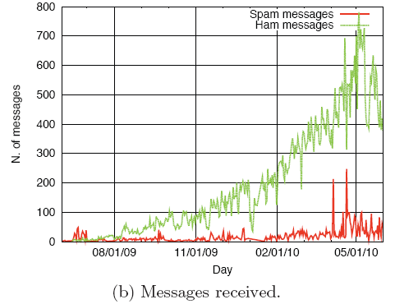
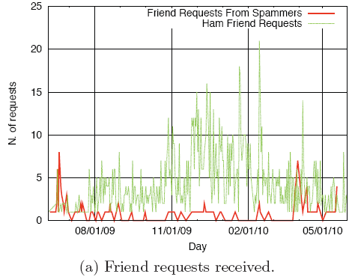
2. ANALYSIS OF COLLECTED DATA: Facebook

Slide 11
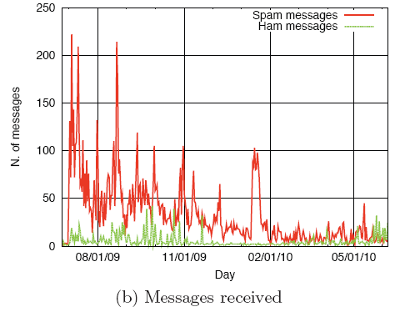
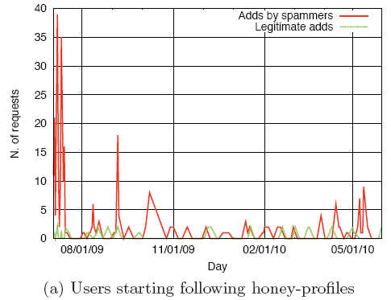
2. ANALYSIS OF COLLECTED DATA: Twitter

Slide 12
Spam Pot Analysis
Level of activities
Displayer
Bragger
Poster
Whisperer
 | Facebook | MySpace | Twitter
Displayer | 2 | 8 | 0
Bragger | 163 | 0 | 341
Poster | 8 | 0 | 0
Whisperer | 0 | 0 | 20

Slide 13
Spam Pot Analysis
The average lifetime for Facebook spam account was four days, while on Twitter, it was 31 days.
During the observation, it was noticeable that some bots showed a higher activity around midnight.
Two kinds of bot behavior were identified
Greedy :416
Stealthy: 98

Slide 14
Spam Pot Analysis
Most observed spam profiles sent less than 20 messages during their life span. (Facebook & Twitter )
Many Facebook spammers did not seem to pick victims randomly, but instead they seem to follow certain criteria
80% of bots we detected on Facebook used the mobile interface to send their spam messages.

Slide 15
3. SPAM PROFILE DETECTION
Detection features
FF ratio (R)
The feature compares the number of friend requests that a user sent to the number of friends they have.
Unfortunately, the number of friend requests sent is not public on Facebook and on MySpace.
R = following / followers (Twitter)
URL ratio (U)
The feature to detect a bot is the presence of URLs in the logged messages.
U = messages containing URLs/ total messages

Slide 16
3. SPAM PROFILE DETECTION
Message Similarity (S)
Friend Choice (F)

Slide 17
3. SPAM PROFILE DETECTION
Messages Sent (M)
Profiles that send out hundreds of messages are less likely to be spammers,
Friend Number (FN)
Profiles with thousands of friends are less likely to be spammers

Slide 18
3. SPAM PROFILE DETECTION
Facebook
1,000 profiles
173 spam bots that contacted our honey-profiles
827 manually checked profiles
790,951 profiles
Detected: 130
False positive: 7
100 profiles
False negative: 0

Slide 19
3. SPAM PROFILE DETECTION
Twitter
500 spam profiles and 500 legitimate profiles were picked
Twitter limited our machine to execute only 20,000 API calls per hour.
we executed Google searches for the most common words in tweets sent by the already detected spammers
From March 06, 2010 to June 06, 2010, we crawled 135,834 profiles, detecting 15,932 of those as spammers.
False positive: 75

Slide 20
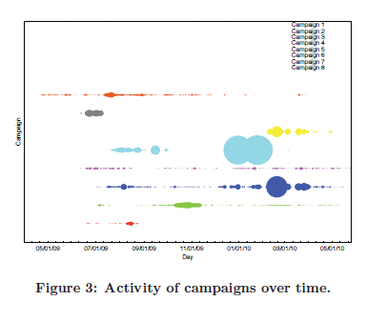
3. SPAM PROFILE DETECTION
Identification of Spam Campaigns

Slide 21
3. SPAM PROFILE DETECTION
Identification of Spam Campaigns
# | SN | Bots | # Mes. | Mes./day | Avg. vic | Avg. lif | Gc | Slite adv
1 | T | 485 | 1,020 | 0.79 | 52 | 25 | 0.28 | Adult Dating
2 | T | 282 | 9,343 | 0.08 | 94 | 135 | 0.60 | Ad Network
3 | T, F | 2,430 | 28, 607 | 0.32 | 36 | 52 | 0.42 | Adult Dating
4 | T | 137 | 3, 213 | 0.15 | 87 | 120 | 0.56 | Making Money
5 | T, F | 5,530 | 83, 550 | 1.88 | 18 | 8 | 0.16 | Adult Site
6 | T, F | 687 | 7, 298 | 1.67 | 23 | 10 | 0.18 | Adult Dating
7 | T | 860 | 4, 929 | 0.05 | 112 | 198 | 0.88 | Making Money
8 | T | 103 | 5, 448 | 0.4 | 43 | 33 | 0.37 | Ad Network

Slide 22
Contribution
The Detection of 15,857 spam profiles on twitter
Provided decent spam campaign activities study
Alert social networking sites for potential spammers

Slide 23
Weakness
No validation methodology was provided
Doesn’t record any script related to the study
Not very accurate results were provided

Slide 24
improvement
Find a way to join legitimate users in the process of identifying spammers.
Add validation methodology in which they provide more accurate results
Provide a script descripting their process of identifying spammers activities

Slide 25
References
http://www.sophos.com/en-us/press-office/press-releases/2011/01/threat-report-2011.aspx
http://www.insidefacebook.com/2010/09/03/prevent-friend-request/ (Facebook Prevents Users From Sending Suspicious Friend Requests To Strangers)
http://cs.ucsb.edu/~RAVENBEN/publications/pdf/fbspam-imc10.pdf (Detecting and Characterizing Social Spam Campaigns)
http://www.cse.ohio-state.edu/hpcs/WWW/HTML/publications/papers/TR-12-2.pdf (Spam Behavior Analysis and Detection in User Generated Content on Social Networks)

Slide 26
?

