Slide 1
CryptDB: Protecting Confidentiality with Encrypted Query Processing
Presented by Chris Zorn
Paper by Popa et al. - MIT CSAIL
23rd ACM Symposium on Operating Systems Principles (SOSP), 2011

Slide 2
Motivation
Unencrypted databases can be very unsecure
Attackers, malicious admins, hosting providers
Snoop on private data: Health records, Financial Statements
Current encrypted systems are either client-side or computationally expensive

Slide 3
CryptDB
Intermediate point between DBMS and application server
Executes queries over encrypted data
Efficiently supports SQL queries
Equality checks, sums, joins, etc
Supports most relational queries
Symmetric & public key encryption
MySQL 5.1 & Postgres 9.0
C++ & Lua

Slide 4
Evalution
Works for 99.5% of columns used by MIT applications
Low overhead
Reduced throughput by only 14.5% for phpBB forum andby 26% for TPC-C
6 applications

Slide 5
Database Management System Proxy
Intercepts all queries
Encrypts & decrypts data
Hides decryption keys from DBMS
Prevents access to logged out users’ data
Can’t prevent deletion of data or maintain integrity of application

Slide 6
Threat 1: DBMS Compromise
Attacker: (Passive) Malicious admin or attacker with access to DBMS
More likely to read or leak data than to alter or delete
Goal: Confidentiality
Approach
CryptDB encrypts queries and inserted data
Hides column information from DBMS
Only exposes necessary columns

Slide 7
Threat 1: DBMS Compromise
Guarantees
Sensitive data is not plaintext readable by DBMS
DBMS can’t read results of queries not requested by CryptDB
Can’t Hide
Table structure, number of rows, column types, column relationships

Slide 8
Queries over Encrypted Data
Proxy intercepts and rewrites query
anonymizes table and cloumn names
Encrypts using a master Secret Key
Passes new query to DBMS
Decrypts query results and returns it to the application

Slide 9
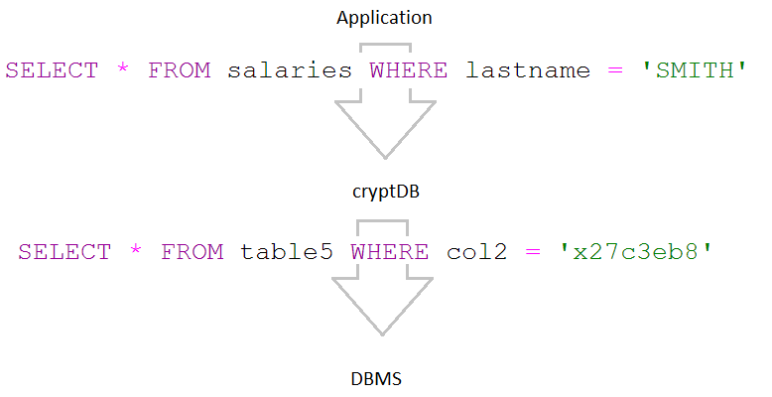
Example

Slide 10
Queries over Encrypted Data
Different Layers of encryption depending on query type

Slide 11
SQL-aware Encryption
Random
Maximum security (AES or Blowfish)
Indistinguishable under an adaptive chosen-plaintext attack
Deterministic
Generates same ciphertext for the same plaintext
Allows server to perform equality checks (equality JOINs, GROUP BY, COUNT, DISTINCT)

Slide 12
SQL-aware Encryption
Order-preserving encryption
If x < y, then OPE(x) < OPE(y)
Allows for ORDER BY, MIN, MAX, SORT
Join
Prevents cross-column correlations exposed by Deterministic encryption
Word Search
Allows for searching over encrypted text (LIKE)
Only full-word, can’t support regex

Slide 13
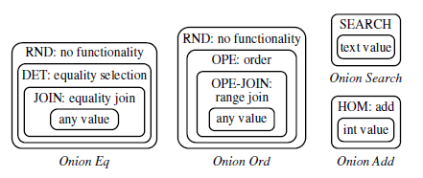
Adjustable Query-based Encryption
Adjust layer of encryption based on query needs

Slide 14
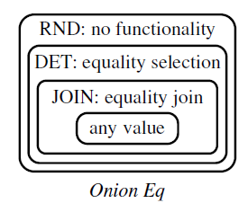
Example
INSERT INTO `users`
VALUES(…, ‘Alice’,…)

Slide 15
Example
Where `name` = ‘Alice’
SELECT * FROM `Table1` WHERE `C2-EQ` = ‘a67b65e5`

Slide 16
Example

Slide 17
Threat 2: Arbitrary Threats
Attacker compromises application server, CryptDB proxy, or DBMS
Solution: Encrypt different data with different keys – e.g. data belonging to different users
Developers annotate DB schema to indicate how each data item should be decrypted
Maintains security from threat 1

Slide 18
Example

Slide 19
Threat 2: Arbitrary Threats
Key chaining & public key encryption allow different groups or users access to the same information
Sub-forum that is hidden to non-group members
Private messages between two users
Only access data for logged in users

Slide 20
Case Studies
phpBB
Opensource forum
Users & groups with varied access permissions to messages, forums, posts
HotCRP
Conference review application
Users restricted from viewing who reviewed papers
Currently, vanilla HotCRP cannot prevent a conference chair from viewing confidential information, so many conferences setup second server

Slide 21
Case Studies
Grad-apply
Graduate admissions system used by MIT EECS
An applicant’s data can only be viewed by applicant and reviewing faculty
Applicant can’t view letters of recommendation

Slide 22
Application Changes

Slide 23
Functional Evaluation

Slide 24
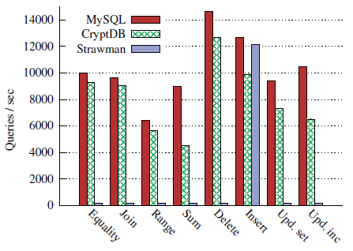
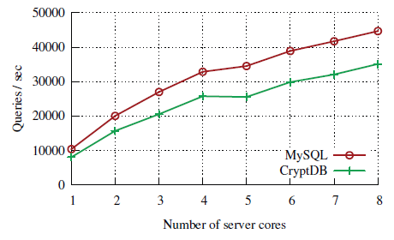
Performance Evaluation (TPC-C)

Slide 25
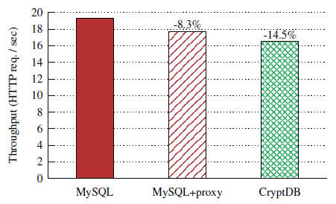
Performance Evaluation (phpBB)
10 parallel clients

Slide 26
Contribution
Layer of security for typical databases that guarantees a certain level of confidentiality for different threats

Slide 27
Weaknesses
Cannot support both computation and comparison on the same column
E.g. WHERE salary > employment_length*1200
In multi-key mode, cannot support server-side computations on encrypted data affecting multiple entities

Slide 28
Improvement
Add features to secure Integrity of data in addition to Confidentiality
Perhaps impractical

Slide 29
Questions?

