Slide 1
Hey, You, get Off of My Cloud: Exploring Information Leakage in Third-Party Compute Clouds
Presented by John Cain
A paper by Thomas Ristenpart, Eran Tromer, Hovav Shacham, and Stefan Savage,
Proceedings of the ACM Conference on Computer and Communications Security, Chicago, IL, November 2009.

Slide 2
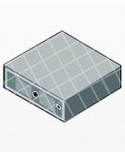
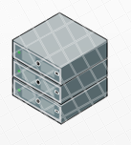
Cloud Computing
De-centralize software and data to scale to hardware availability
12 Operating Systems
6 servers
One OS
One Server

Slide 3
Threat Model – Co-locating
CLOUD SERVER ##
XEN Hypervisor
Network
CPU
Dom 0
HDD
RAM
VM1
VM2
VM3

Slide 4
Amazon EC2
Amazon EC2 cloud to find a target server
Amazon’s EC2 operates with 2 physical regions (US and Europe)
3 availability zones for each region
Before beginning a VM instance you are asked to choose: the region, the availability zone and the instance-type related to hardware requirements.
Hardware choices amount to 5 types
32bit
M1.small (1 ECU 1.0-1.2GHz 2007 Opteron – 1.7GB memory and 160GB storage) $.10/hr
C1.medium
64bit
M1.large (2 virtual cores each with 2 ECU– 7.5GB memory and 850GB storage) $.40/hr
M1.xlarge
C1.xlarge

Slide 5
Mapping the Cloud
NMAP to perform TCP Connect probes
TCP SYN traceroutes – sends TCP SYN packets with increasing TTL until no ACK is received
Map the EC2 cloud via DNS entries
One set - External public IP DNS vs internal queries
Second set – varied EC2 instances and checking IP
4 distinct IP prefixes {/16, /17, /18,/19}
14054 unique internal IPs

Slide 6
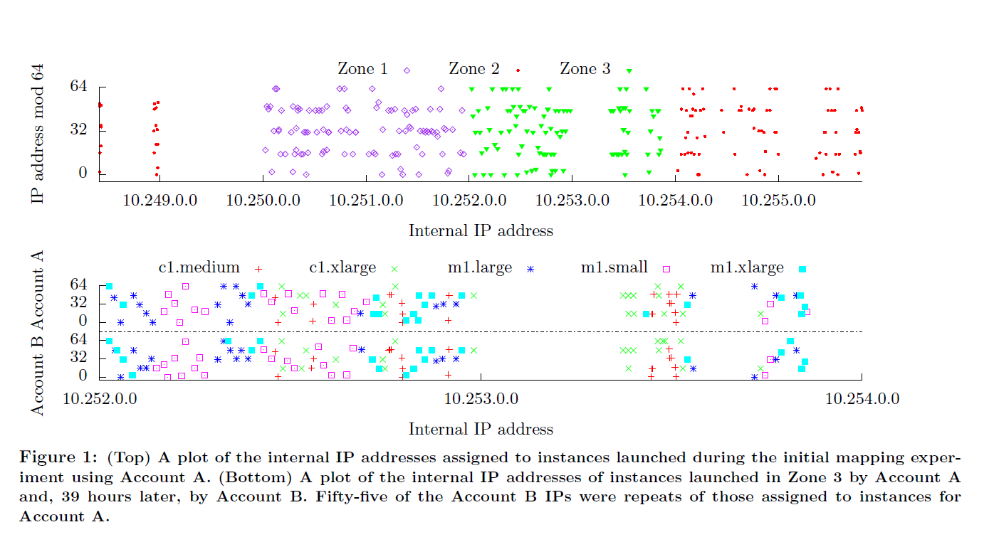
Mapping the Cloud
Account A
20 instances for each availability/instance type
92 had unique /24 prefixes
Account B
100 instances (20 per type) in Zone 3 (39 hours after A)
88 unique /24 prefixes

Slide 7
Achieving Co-Residency
Processing the data – the defining heuristic
All IPs from /16 are from the same availability zone
A /24 inherits any included sampled instance type
A /24 containing a Dom0 IP address only contains Dom0 IP Addresses
All /24s between two consecutive Dom0 inherit the former’s instance type
Dom0 IPs are consistently assigned a prefix that immediately precedes the instance IPs they are associated with –
869 /24s in data
Unique zone and type to 723
23 unique zone with 2 types
123 unlabeled

Slide 8
Assessing Co-Residency
 | Count | Median RTT (ms)
Co-resident Instance | 62 | 0.242
Zone1 Crl A Zone1 Crl B | 62 62 | 1.164 1.027
Zone2 Crl A Zone2 Crl B | 61 62 | 1.113 1.187
Zone3 Crl A Zone3 Crl B | 62 62 | .550 .436
Network based co-residence checks
Exploiting hard disk based covert channel between
EC2 instances
Co-resident if
Matching Dom0 IP address
Small packet round-trip times
Numerically close internal IP addresses (within 7)
Exploiting placement
A single account was never seen to have two instances running on a physical machine
No more than (8) m1.small instances were running on a machine

Slide 9
Instance Placement - Abuse
Brute Force
Run numerous instances over a long period of time - determine amount of instances that were able to form co-residence with
Using the ‘cloud map’ Zone 3 / m1.small (1686 servers)
78 unique Dom0 IPs
1785 instance probes
141 victim servers were hit (8.4% coverage)
Instance Flooding
Abuse scalable infrastructures – when service scales to meet demand determine server and try to join it
Instances tend to restart on the same physical server
New instances started after an instance starts will tend to be placed nearby
A single account will not have more than 1 instance started on a single platform

Slide 10
Side Channel Abuse
Cross VM leakage
Stealing crypto keys through cache-based side channels
Denial of service by attacker instance physical resource usage
Cache-based covert channel
Sender idles to transmit “0” and accesses memory to transmit “1”
Receiver accesses memory block and observes the latencies perceived to be flushing of the cache
Estimating Traffic Rates
Keystroke Timing Attack
Similar to cache-based load measurements
Hope to catch password input via shell and detect the time in between keys to gather length

Slide 11
Contribution
This paper contributes greatly to the understanding of mapping of the EC2 cloud both in practical application and in cloud security
The authors include commentary in each section expressing the validity of each attack attempt and the ease to correct it
Shows the robust nature of the EC2 cloud –
Easiest option for commercial ventures is to pick a M1.xlarge or CL1.xlarge as they fill the entire physical platform and deny co-residence
Xen’s resource exclusion is not perfect but nearly impossible to exploit – improved with software randomization tweaks to cache

Slide 12
Weakness
Mapping was mostly at random, co-residence was extremely low even with techniques applied
Instance placement was time sensitive which is constantly updating and changing
With the exception of one m1.large instance, only m1.smalls are able to co-reside and not really applicable to commercial applications
The side channel analysis was weak and speculative; they didn’t seem to run any hard penetration testing utilities but focused on very low level cpu-cache analysis

Slide 13
Improvement
This idea could be improved with more financial resources to run hundreds of accounts with the maximum 20 instances all at the same time
Taking further the idea of side-channel attacks to combine traditional attacks with having co-located instances. This could make the extremely small bandwidth side channels they were able to exploit more practicable. With resource starvation traditional attacks might be more effective
Poisoning dom0 resource mapping to gain further access

Slide 14
Conclusion
My thoughts –
project was mostly unsuccessful in demonstrating anything actionable
The EC2 cloud is potentially dangerous for how accessible it makes gaining access to vast computational and bandwidth resources for launching attacks on other networks
Thanks

